Slide 1
Summarization Evaluation
By Parth Desai, Anish Dhondi, Harshil Goel, Varun Choudhary
CS 4624: Multimedia, Hypertext, and Information Access
Professor Edward A. Fox
Virginia Tech, Blacksburg, VA 24060
April 13th, 2023
Notes:
Anish

Slide 2
Outline
Ground
Truth Data Set
Project Overview
Team Members
Project Deliverables
Website Walkthrough
Future Facing
Challenges
Notes:
Anish

Slide 3

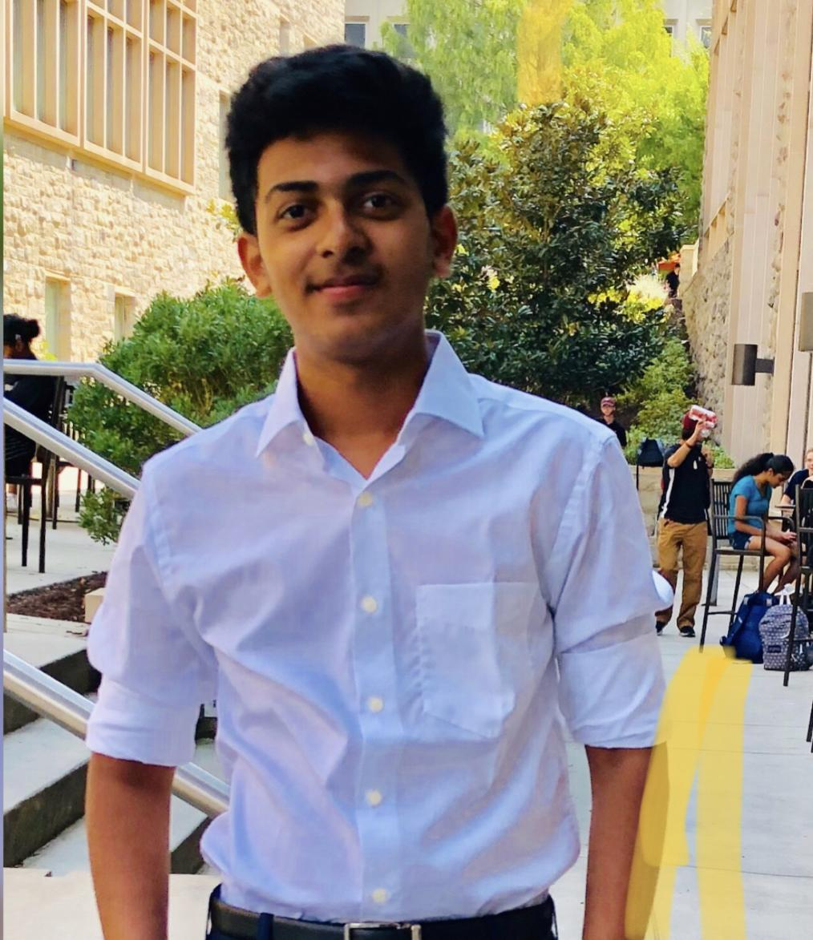


Team Member Responsibilities
Harshil Goel Team Lead
Backend Development
Parth Desai Frontend Development
Varun Choudhary Research & Development
Anish Dhondi Frontend Development
Notes:
Everyone

Slide 4

Project Overview
Problem
Solution
Need a way to evaluate AI-generated summaries on ETDs
AI must understand complex human preferences
Users rank summaries
Assessment factors: accuracy, coherence, contextually relevant
Feedback for AI generating summaries
Notes:
Varun

Slide 5
Project Deliverables
The four primary deliverables for this project:
Web User Interface
Easy to use UI
Populate Data Set
Results from user interaction with webpage
Ranking Summaries
Method to rank summaries based on fluency, usefulness, efficiency
Feedback Stored
System to store feedback on ranking method or UI/UX
Notes:
Varun Create an easy to use UI without needing any prior documentation for it.
The results from user interaction with the web page should populate a data set that contains the name and content of the ranked summaries, as well as their associated chapters.
A method for ranking summaries must be displayed that will provide the best insight for representing the most fluent, useful, efficient summaries provided.
The completed project should provide a system that can store feedback from users either about the rankings or about the WebUI in general, that will be useful for future iterations of the project.

Slide 6

Milestones
Literature Review
Finalize Tech Stacks
Background Reading
UI Wireframes
Connect backend to frontend
End-to-End system ready
Ready for User Tests
Complete user tests
Iterative improvements
Feb 14th
Feb 28th
Mar 14th
Mar 31st
Apr 7th
Apr 13th
Data Cleaning
Barebones UI Implementation (using previous work)
Testing phase
Quality assurance
Notes:
Varun
Studying previous code base
Research on best tech stack
Wireframe diagrams
Data Cleaning and static ui
Connect back end to front end
And have a system ready for user tests
Team testing
User tests for feedback on

Slide 7
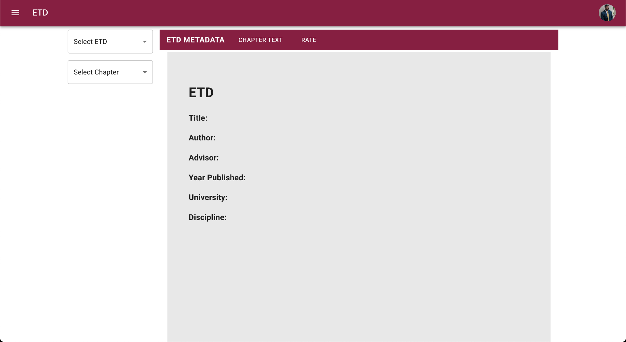
Website Walkthrough
Dropdown to select ETD ID
Dropdown to select chapter based on chosen ETD ID
Notes:
Parth

Slide 8
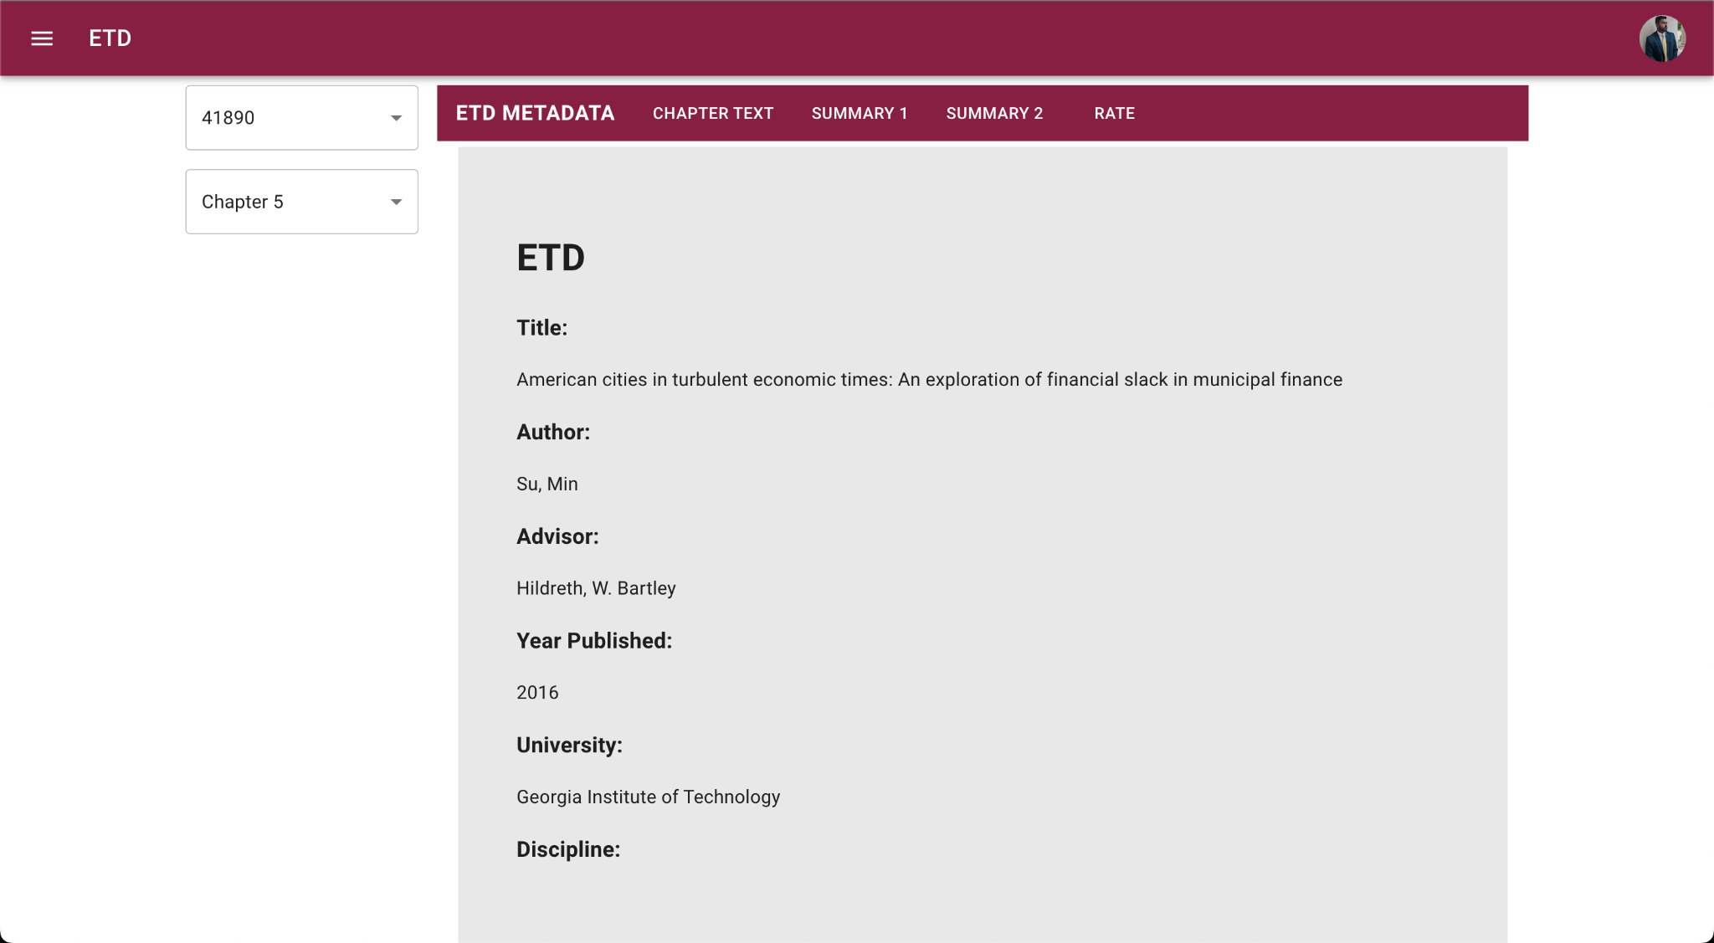
Website Walkthrough
Notes:
Parth

Slide 9
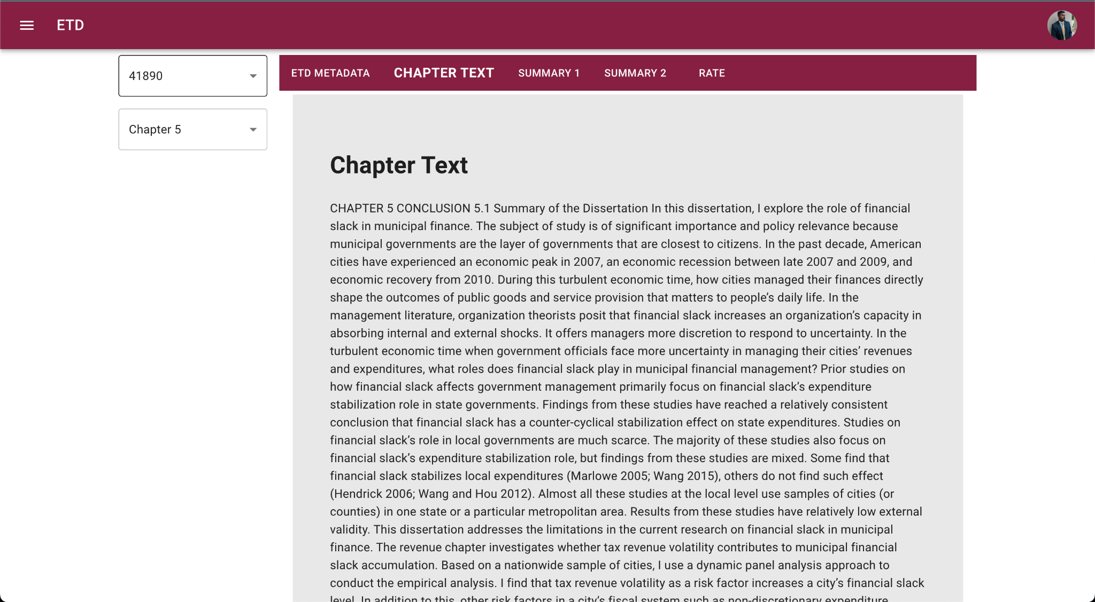
Website Walkthrough
Notes:
Parth

Slide 10
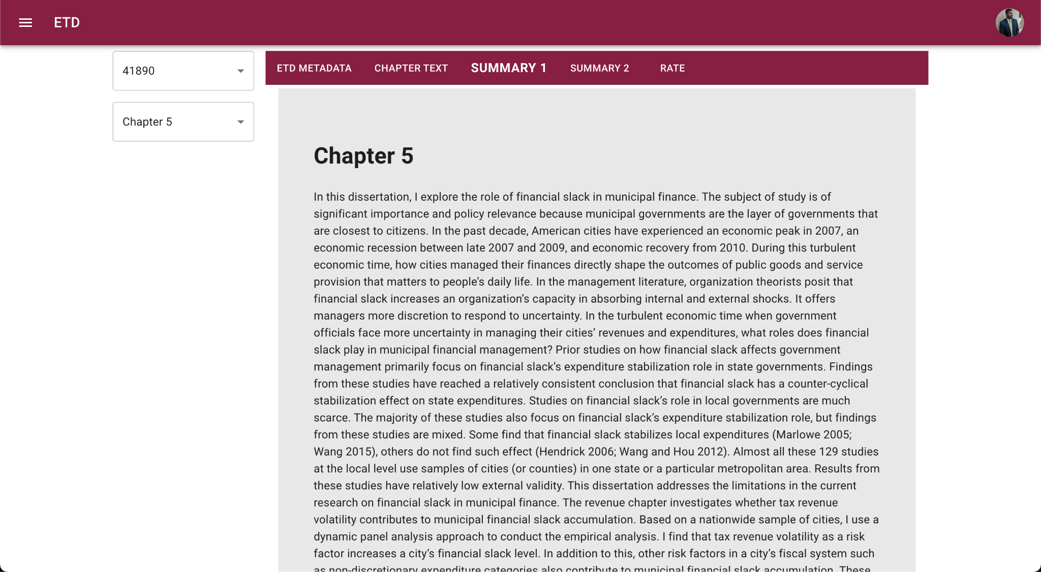
Website Walkthrough
Notes:
Parth

Slide 11
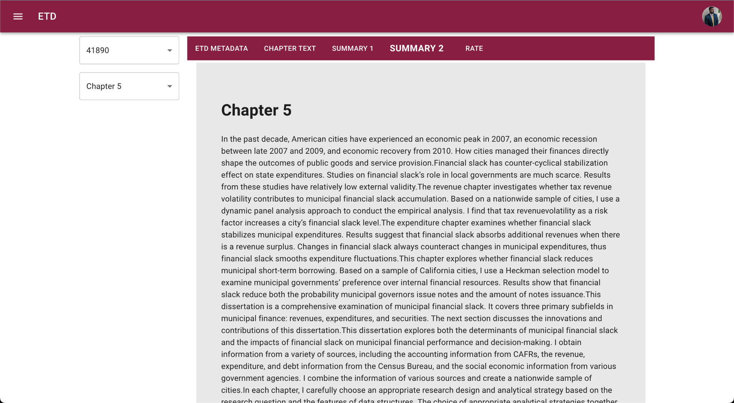
Website Walkthrough
Notes:
Parth

Slide 12
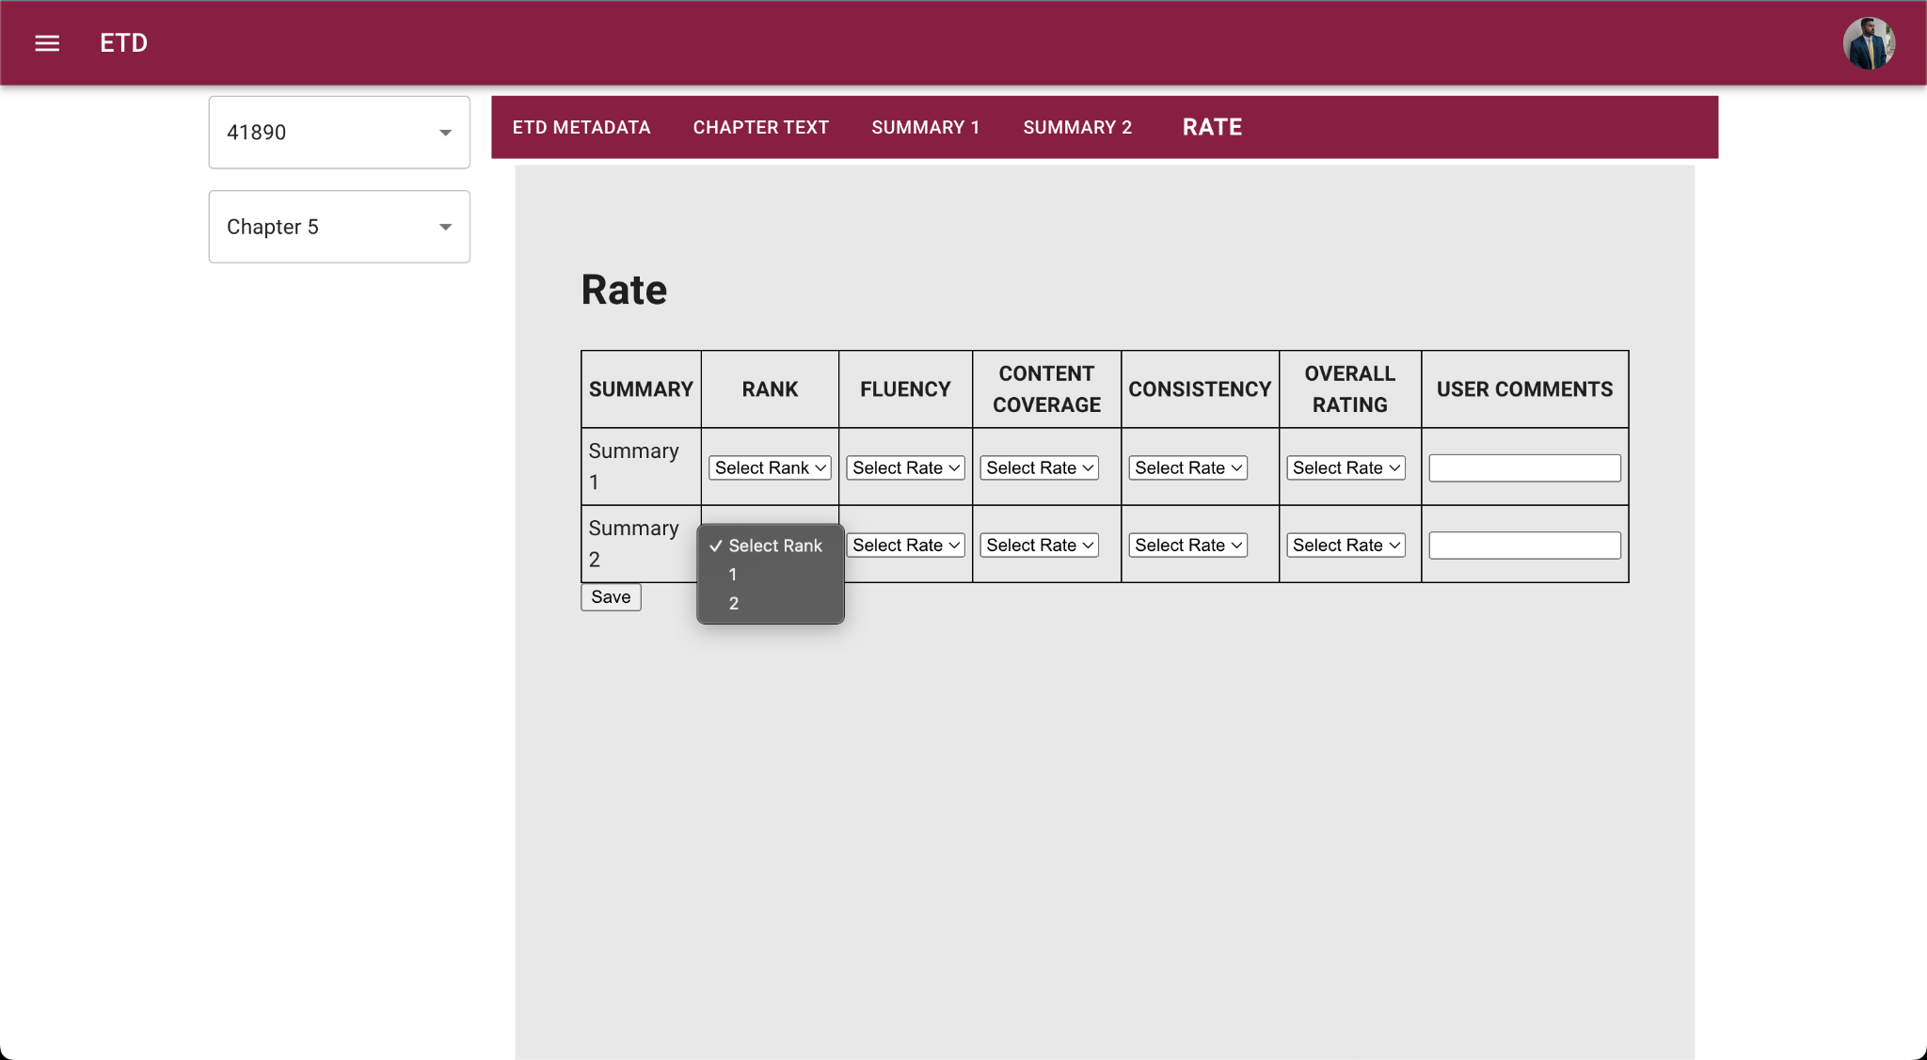
Website Walkthrough
Form supports data validation so that:
users do not provide the same rank for two summaries
each field (except for user comments) is filled out
Rate other values on a scale of 1-5
Optional User comments field
Rank Summaries
Notes:
Parth

Slide 13
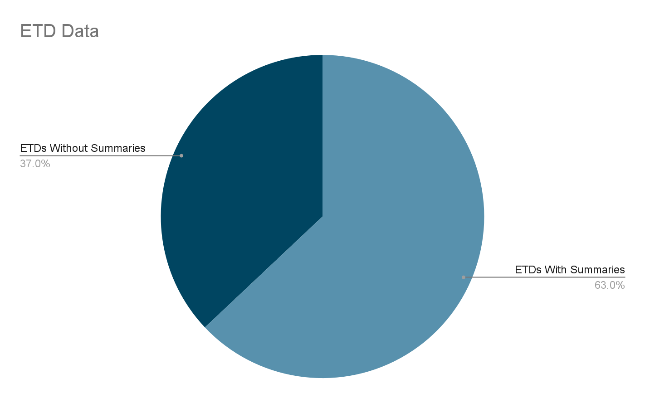
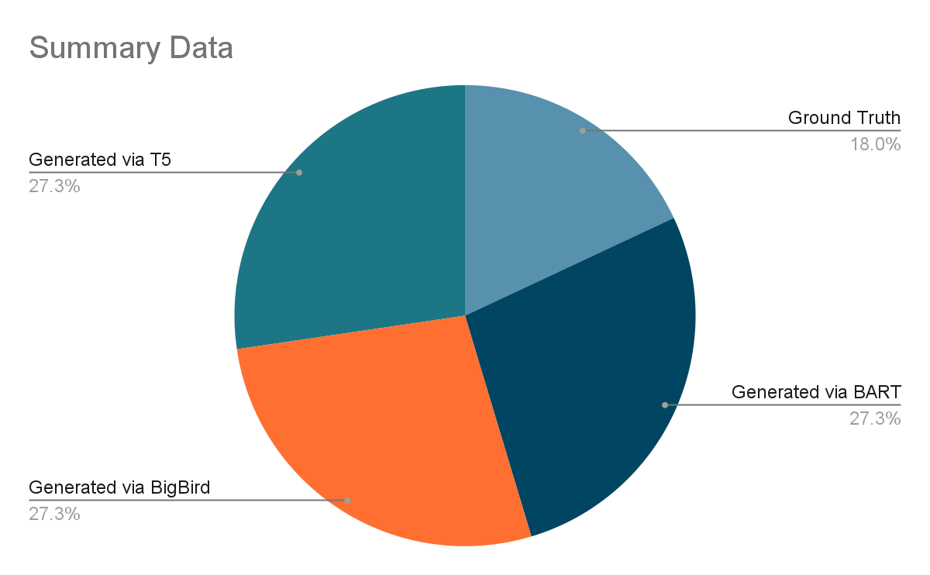
Ground Truth Data Set
Had a dataset of 27 ETDs of which 17 had at least one chapter with a summary
64 Ground Truth summaries (Chapters with written summaries)
355 total summaries when including generated summaries
Notes:
Harshil NOTES
Stat (how many ideas had summary or abstract)
Number of summaries we had
Etds we looked at
Tables for statistics

Slide 14
Challenges
Front End Handover
Front end template came with numerous uninstalled dependencies
Took time to configure developer environment
Backend Data Extraction (Biggest Setback)
Attempted to automate, but inconsistent structure led to having to scrap the idea
Text decoding errors
Decoding errors are still present in some summaries
Unreadable for the user
Insufficient ETD Summary Data
Some ETD chapters and even entire ETDs come without a ground truth
Cannot compare generated to ground truth
Notes:
Harshil

Slide 15

Future Work
User Tests & Iterative Improvements
The team will complete users tests on
10 subject matter experts in Bipasha’s Lab (the intended audience)
Classmates in this Capstone Class for feedback on ux/ui
Notes:
Anish

Slide 16



Acknowledgements & Resources
Thanks to Bipasha, our client, for the guidance through challenges
Other very helpful resources throughout design and development
Youtube for learning basics
GeeksforGeeks walk throughs
ChaptGPT for early development, finding missing dependencies
Notes:
Anish

