Slide 1
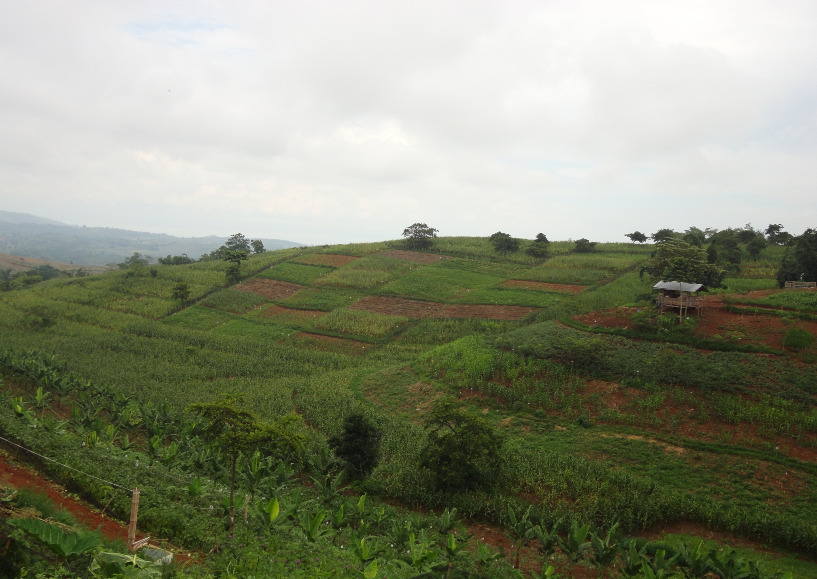

Physiological and agronomic efficiencies of corn under conservation agriculture practice systems (caps) in a sloping oxisol in Southern Philippines
Gonzaga, AB, Mercado, AR, Jr. and Reyes, M.
4th International Conference in Conservation Agriculture in Southeast Asia
December 9-13, 2013, Battambang University, Cambodia

Slide 2
introduction

Slide 3
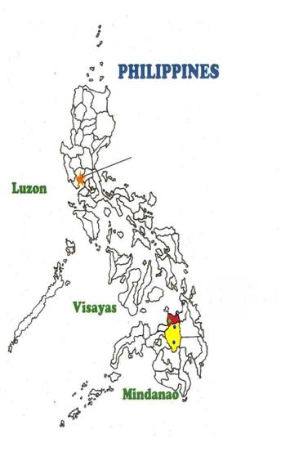
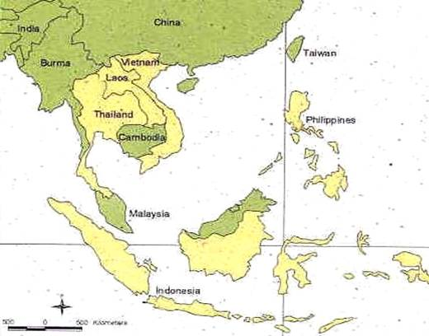
Context: Upland areas and smallholders
Philippines
More than 7,000 islands
Population is 98 M people
Land area is 30 M has.
10 M has sloping acid upland soils
5 M has less productive upland areas due to degradation (Mercado et al., 2011)
Manila
Claveria

Slide 4


Location: The City of Cagayan de Oro is the entry point in going to Claveria ...
46 hours
28 hours
1hr & 30 min.

Slide 5
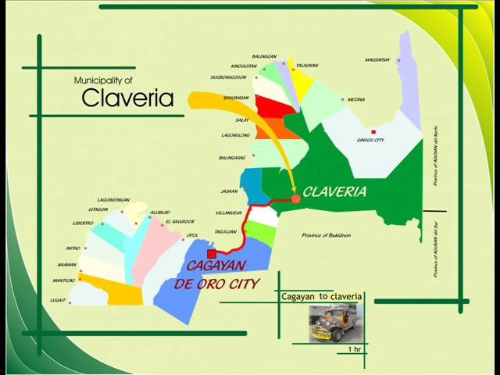
Location of Claveria. . .in the Province
42 km from CDO City
“One Hour Ride”

Slide 6

Topography and Elevation…
The Municipality has rugged and mountainous terrain ...
with elevation ranges from 400 masl to more than 1,000 masl...
Maize, cassava and upland rice - lower elevation (<600masl)
vegetable and maize in rotation dominate the upper elevation.

Slide 7
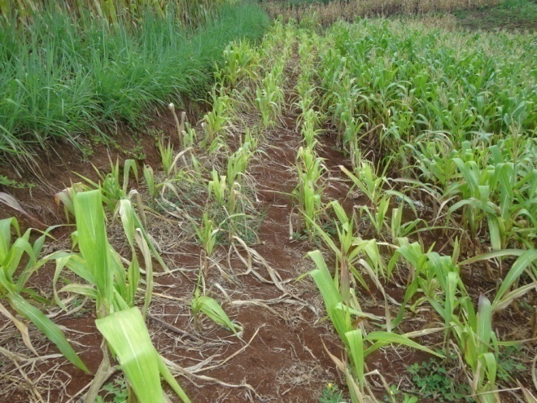
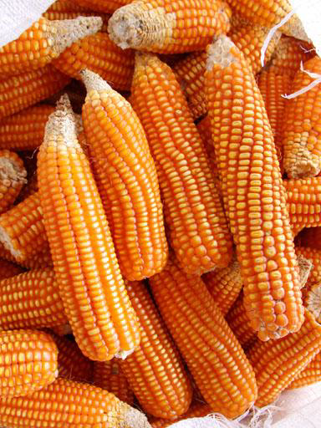
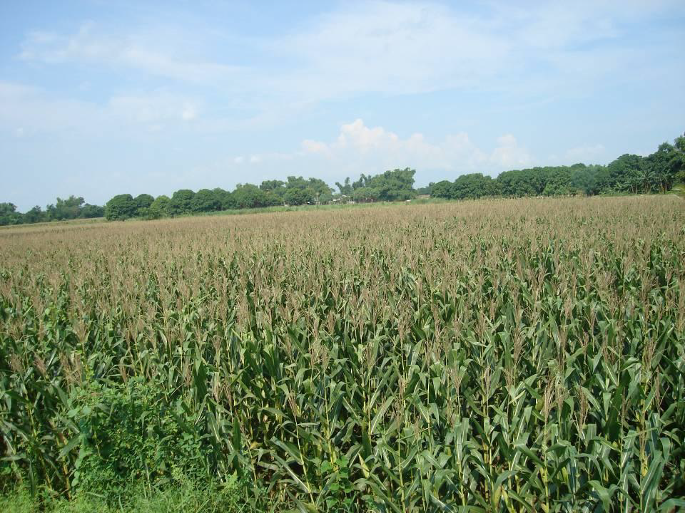
Farming is a major source of income in the municipality (77%), with corn as a major crops grown.
Soils are acidic with pH ranges from 4.2 to 5.2

Slide 8
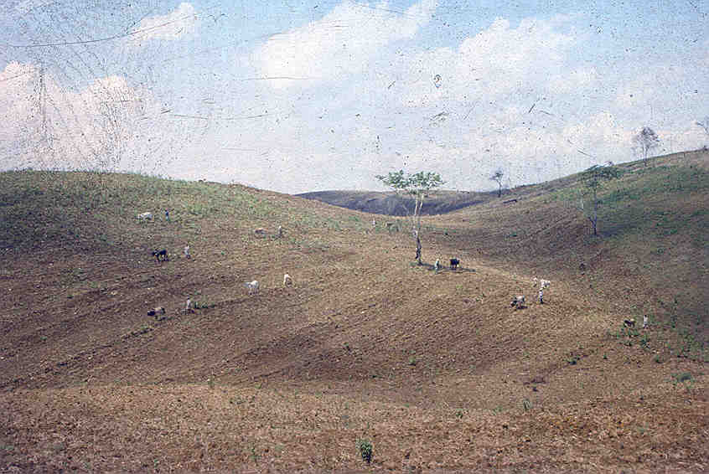
Upland farmers traditionally cultivate their fields up and down the slope…

Slide 9
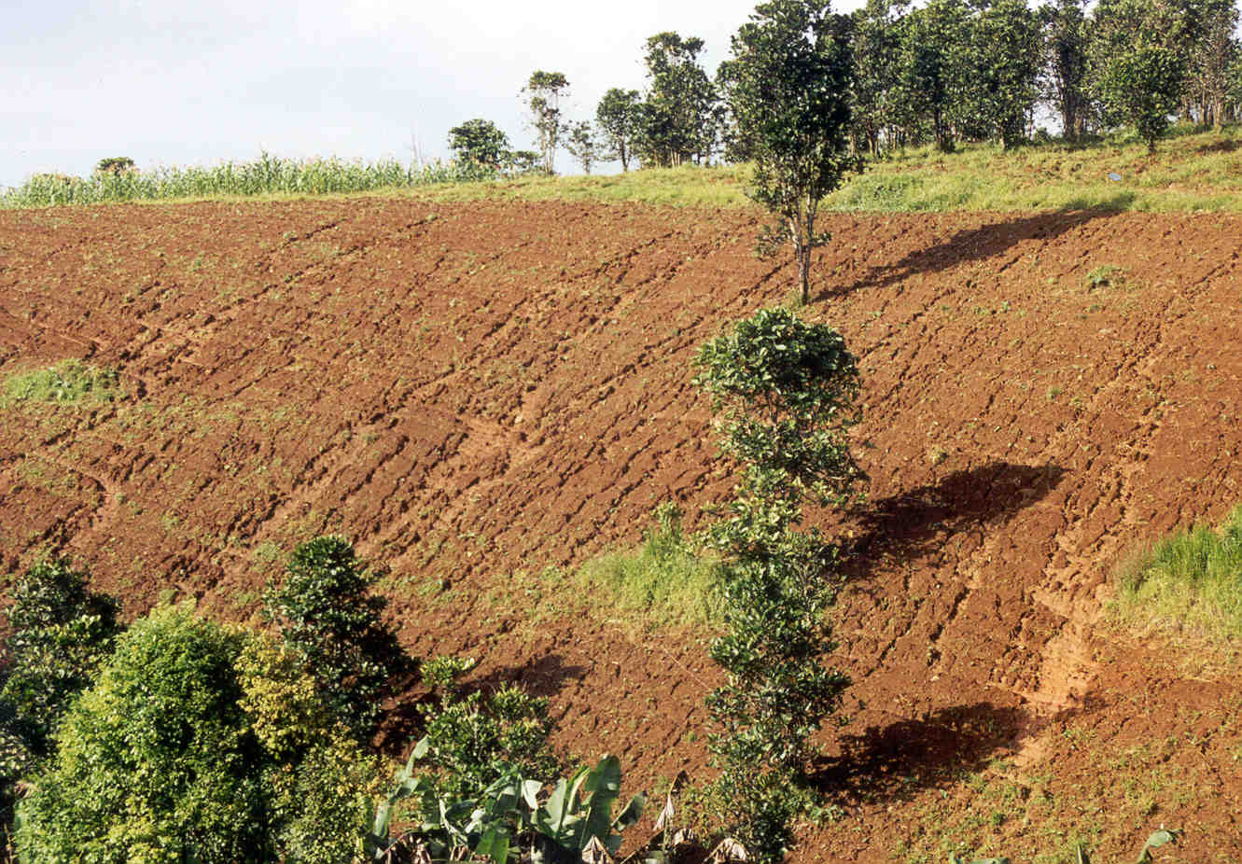
The estimated annual replacement cost of eroded nutrients (Claveria) is P37,000 per hectare per year.

Slide 10
McD
Minimal soil disturbance
Continuous mulch
Diverse species

Slide 11
Conservation Agriculture Practices Systems (CAPS)
Its creation especially in small farming communities in the upland are not yet established.
Thus, CAPS is a tailor-fitted approach for successful adoption and implementation of CA to specific locations.

Slide 12
Objectives
General:
Evaluate the productivity, profitability and soil sustainability of various corn-based cropping systems intercropped with several species of legumes in a sloping upland crop production area.

Slide 13
... Objectives
Specific:
To evaluate the productivity and efficiency of corn-based cropping system with different conservation agriculture production systems in terms of growth and agronomic parameters;
To assess the effect of different cropping systems on soil properties, nutrient uptake and efficiencies, and residual water in the soil;

Slide 14
… Objectives
Determine the Return to Labor Cost (RLC), Return to Material Cost (RMC) and Return to Investment (ROI) of each conservation practice employed; and
Identify the most suitable conservation agriculture practice that will optimize corn yield in an upland sloping ecosystem.

Slide 15
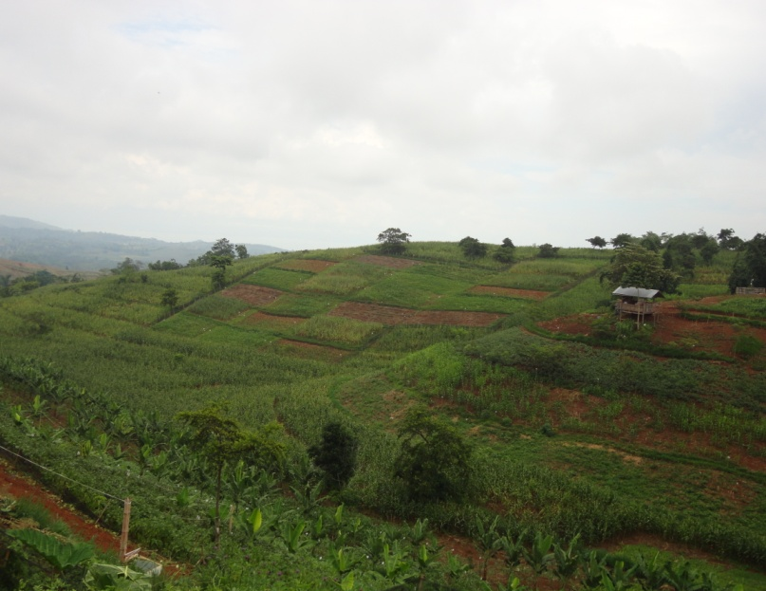
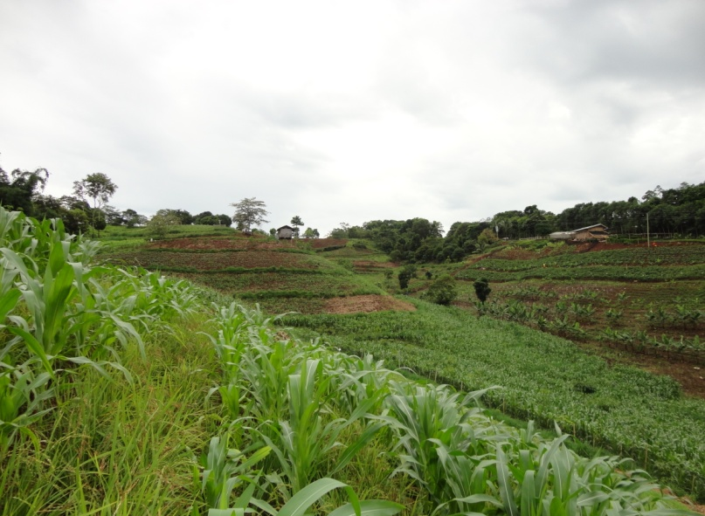
SLOPING UPLAND AREAS
Cropping Systems
Continuous Crop Rotation
Minimal
Tillage
Continuous Ground Cover
Conservation Practice
Components
Improved/Enhanced Agronomic, Physiological and Soil Characteristics
Enhanced Productivity, Nutrient Uptake/Efficiency and Soil Water Holding Capacity
Enhanced Corn-based Production System in Sloping Upland
Figure 1. Conceptual framework of the study.

Slide 16
Methodology

Slide 17
Time and Place of the Study
November 2011 to November 2012 at Bug-ong, Rizal, Claveria in Misamis Oriental, Northern Mindanao
two corn croppings

Slide 18
Experimental Design and Treatments
Randomized Complete Block Design
5 treatments (CS₁ – CS₅)
4 replications
Plot size : 10 m x 10 m,
Space between treatments : 2 m within reps
Space between replications : 3 m

Slide 19
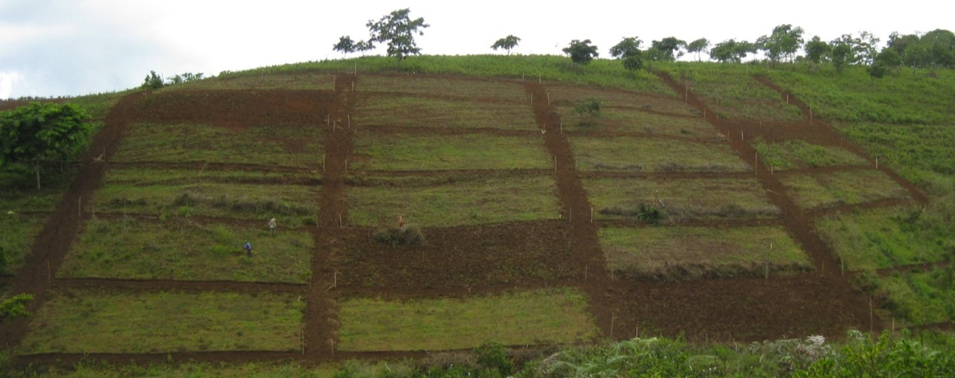
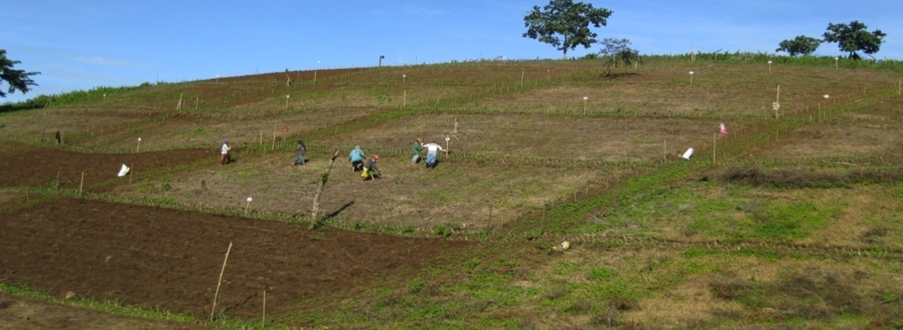
Field Layout

Slide 20
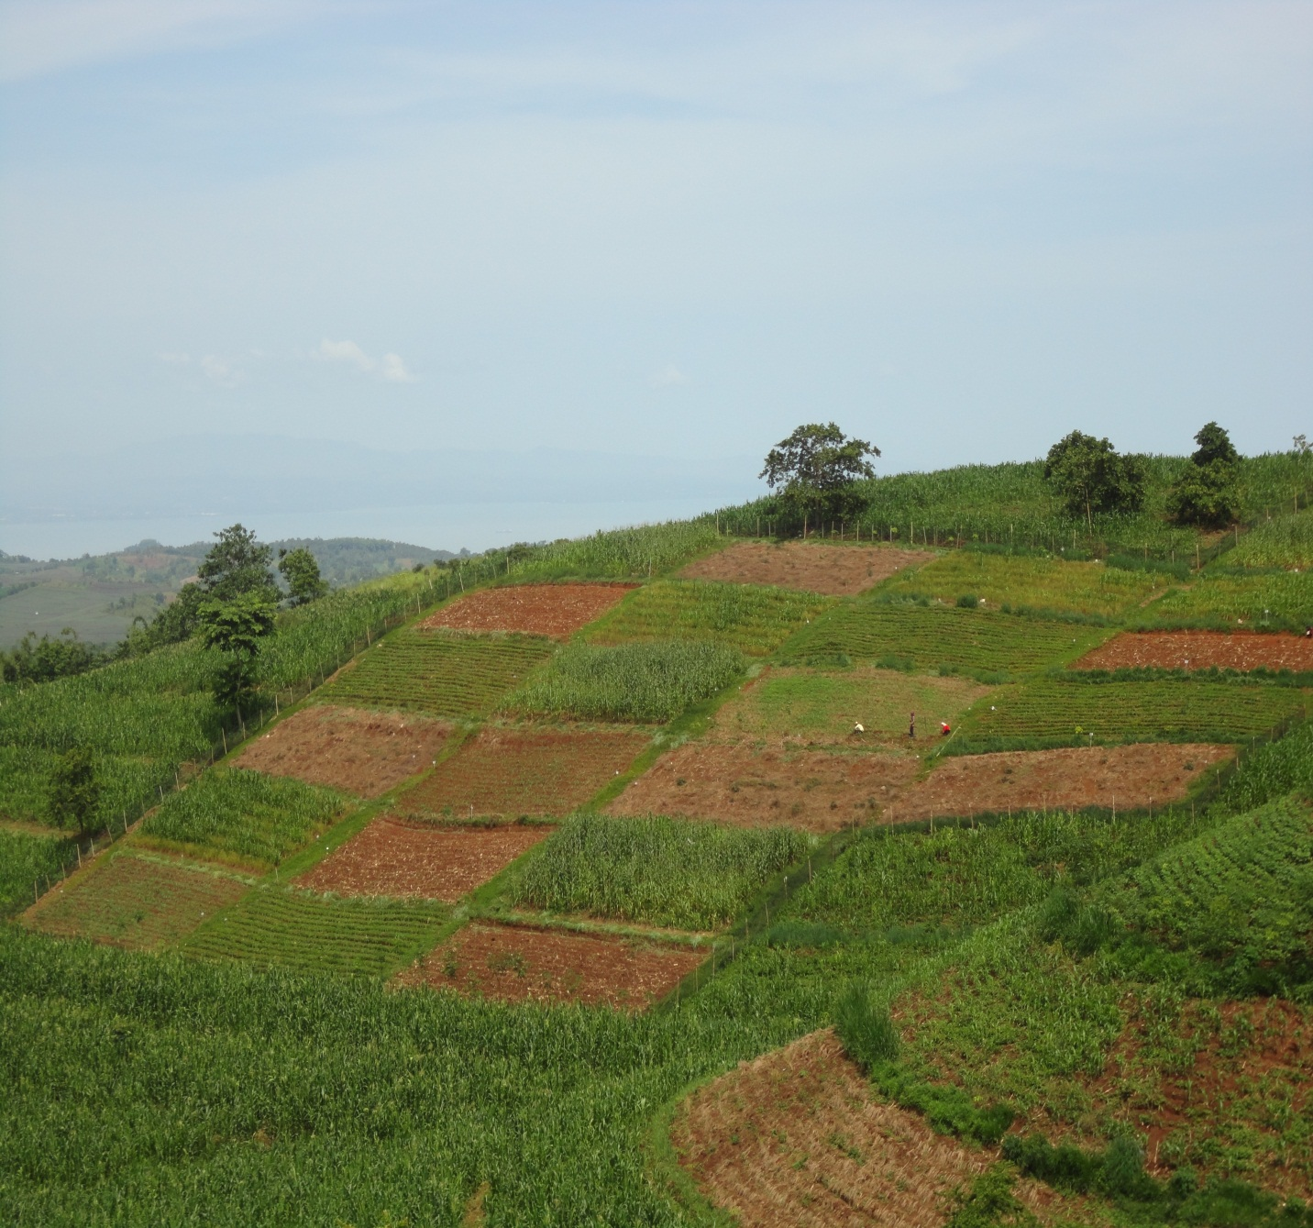
The experimental site.

Slide 21
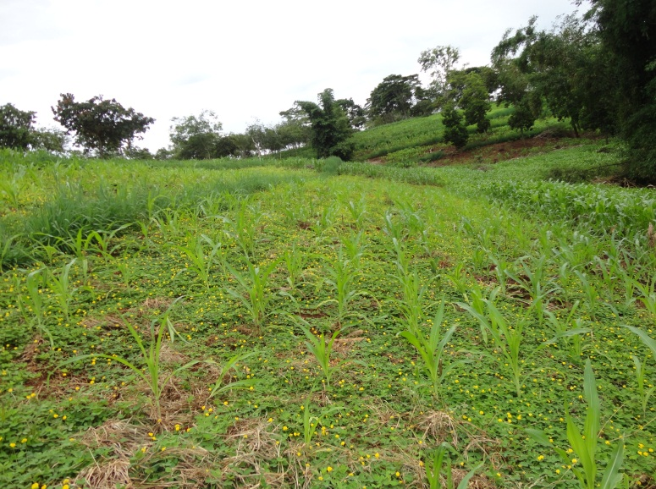
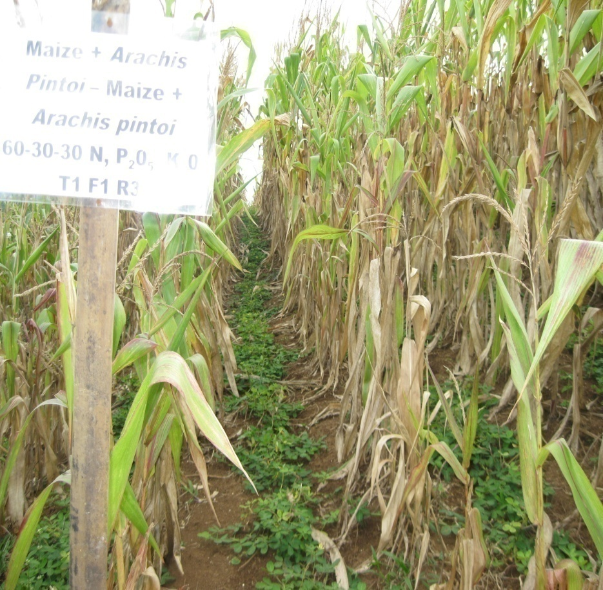
CS1: Corn + Arachis pintoi

Slide 22
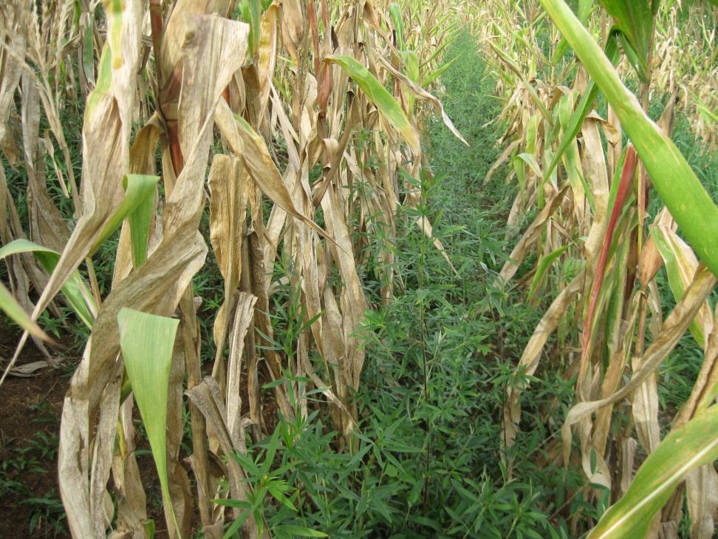
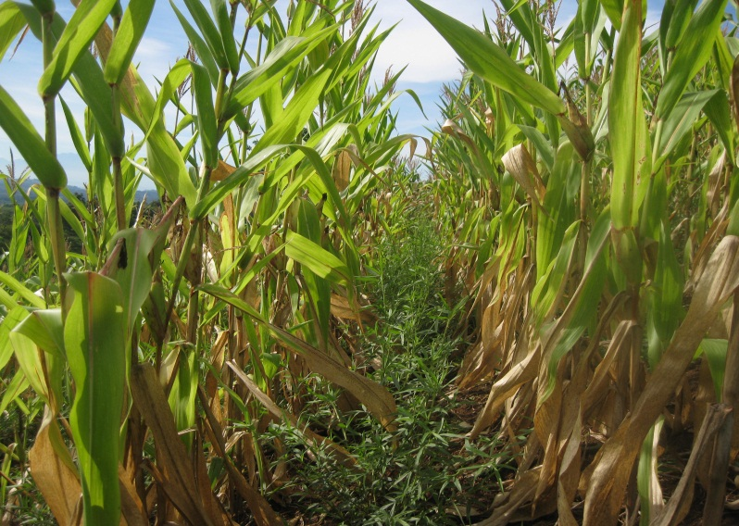
CS2: Corn + Stylosanthes guainensis

Slide 23
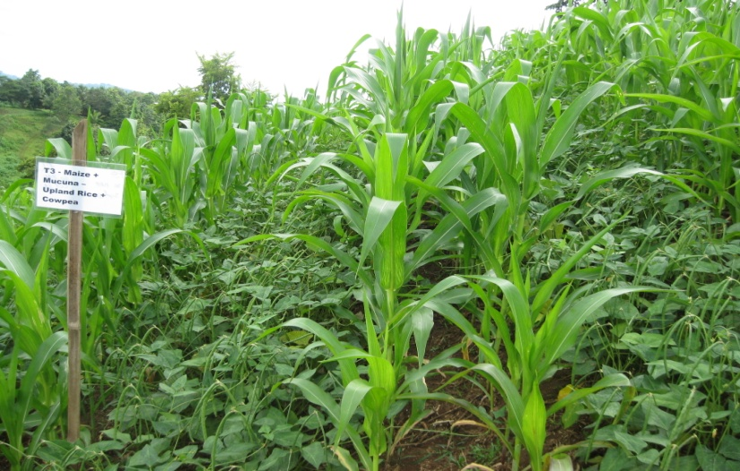
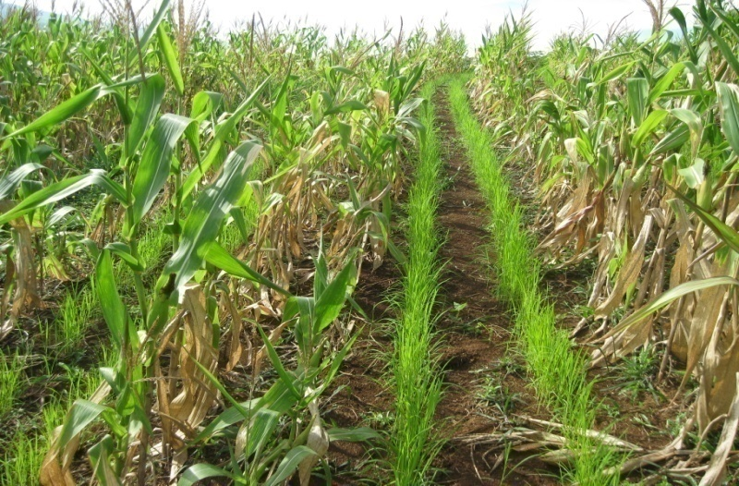
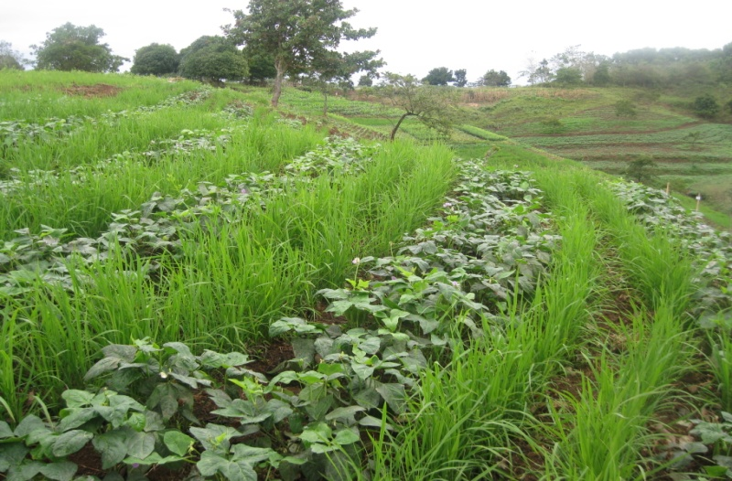
CS3: Corn + Cowpea – Upland Rice + Cowpea

Slide 24
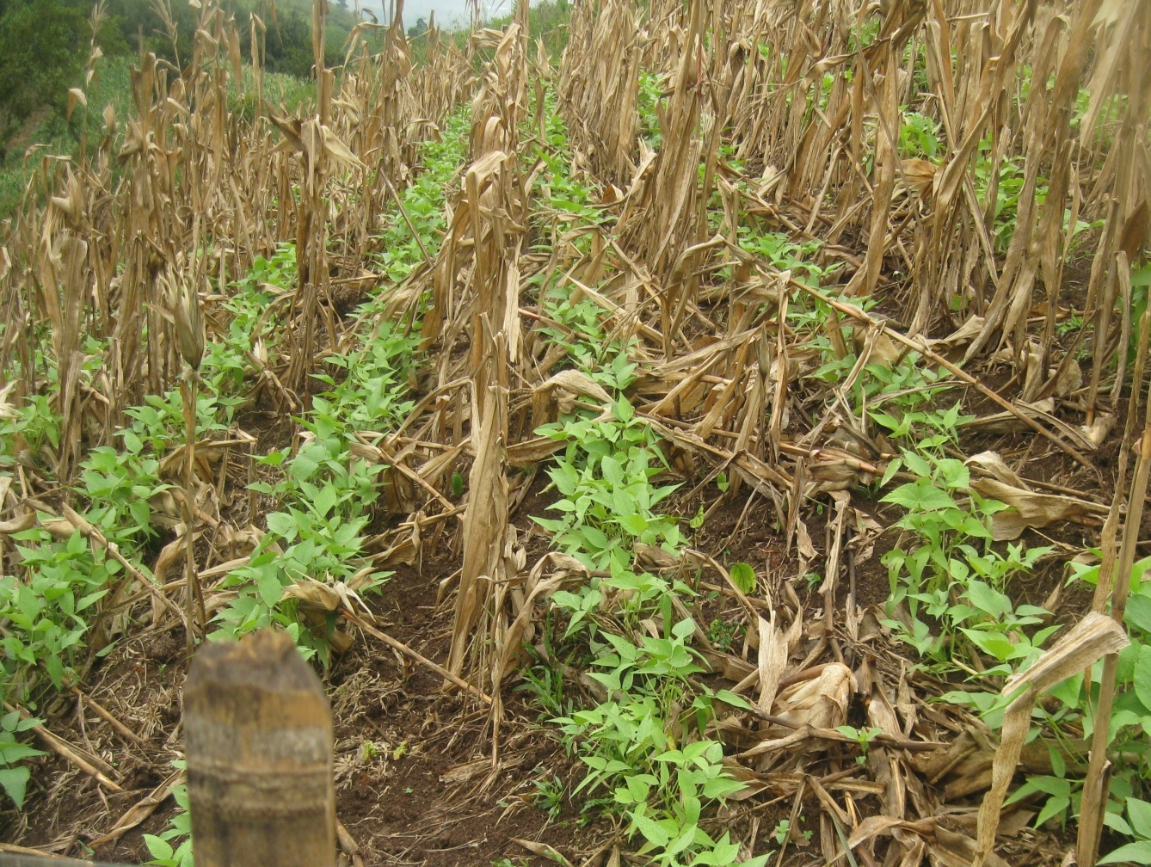
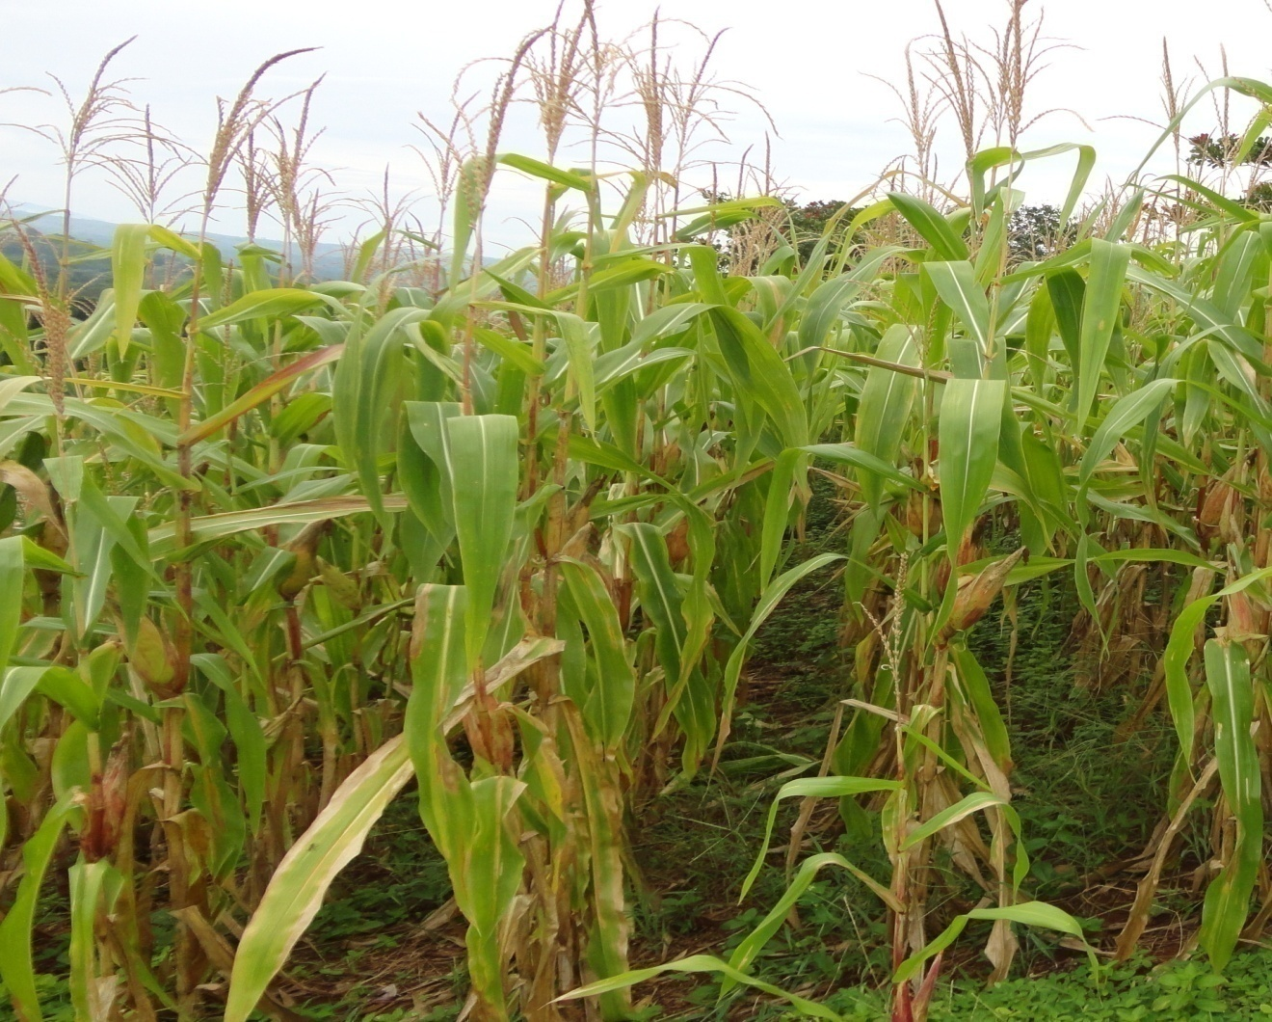
CS4: Corn + Rice Bean

Slide 25
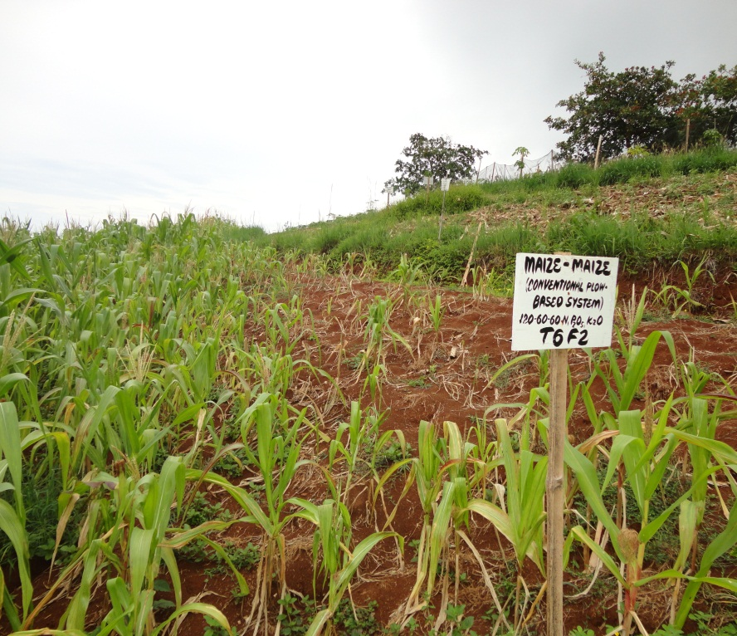
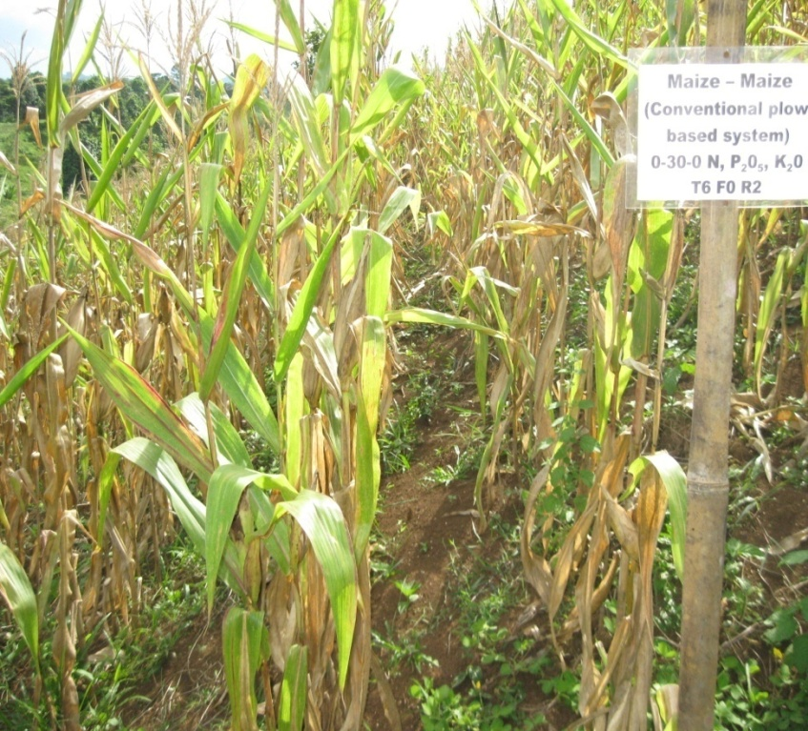
CS5: Corn – Corn (Control, Plow based)

Slide 26
First Cropping
Second Cropping
Figure 2. Cropping systems imposed as treatments of the study on a year cycle.

Slide 27
Data Gathered:
Corn-based Cropping Systems
Growth and Agronomic
Responses of Corn
  Productivity and Efficiency
  of Cropping Systems
LAI - LAR
  NAR - CGR
  DMY - PC
  HI - GY
  Yield Components
  DM Productivity of Corn
  DM Productivity of Legumes
  Carbon Productivity of Corn
  Nutrient Uptake
  Internal Efficiency of N
  Land Equivalent Ratio
Soil Sustainability
Profitability
Soil pH - OM
OC - CEC
Soil NPK - C:N Ratio
Soil Water-holding capacity
Return to Labor Cost (RLC)
Return to Material Cost (RMC)
Return to Investment (ROI))

Slide 28
RESULTS AND DISCUSSION

Slide 29
Table 1. Soil profile description of the experimental site.
Horizon | Depth (cm) | Description
Ap | 0-12 | Dark brown (7.5 YR 3/3) silty clay; weak, fine, sub-angular blocky structure, firm, friable, sticky and plastic; many fine roots; few fine pores; strongly acid; clear smooth boundary.
Bt₁ | 12-39 | Brown (7.5 YR 4/4) clay; moderate, fine, sub-angular blocky structure; sticky, plastic, no mottles; very few medium roots; strongly acid; diffuse irregular boundary.
Bt₂ | 39-69 | Reddish brown (5 YR 4/4) clay; moderate, medium, angular to sub-angular blocky structure; hard, firm, sticky and plastic very few coarse roots; strongly acid; diffuse irregular boundary.
Bt₃ | 69-150 | Dark reddish brown (5 YR 3/4) clay; angular to sub-angular blocky structure; strong, firm, sticky and plastic; few roots; common fine tubular pores; no mottles; strongly acid; smooth boundary.

Slide 30
Figure 3. Representative soil profile of the study site showing its respective horizon.

Slide 31
Figure 4. Monthly rainfall and solar radiation during first and second cropping seasons.
Figure 5. Monthly minimum (Tmin), maximum (Tmax) and mean (Tmean) temperatures during first and second cropping seasons.

Slide 32
Table 2. Growth and agronomic response of corn under varying cropping systems in two cropping seasons.
Growth Parameters | DAP | Cropping Season (A) | Cropping Systems (B) | A x B
LAI | 30 | 1st CS | CS2 | 1st CS: CS4, CS2 2nd CS: CS2
 | 60 | 1st CS | CS4 | 1st CS: CS4, CS2 2nd CS: CS1, CS4
 | 85 | 1st CS | CS1, CS2 | 1st CS: CS2 2nd CS: CS1
LAR | 30 | 1st CS | CS1 | 1st CS: CS1 2nd CS: CS1
 | 60 | 1st CS | CS1 | 1st CS: CS4 2nd CS: CS1
 | 85 | 2nd CS | CS1 | 1st CS: CS1, CS4 2nd CS: CS1
NAR | 30-60 | 1st CS | CS5 | 1st CS: CS5 2nd CS: CS5
 | 60-85 | 2nd CS | CS5 | 2nd CS: CS5
CGR | 30-60 | ns | ns | ns
 | 60-85 | ns | CS2 | ns
ns – not significant DAP – Days After Planting

Slide 33
Table 3. Growth and agronomic response of corn under varying cropping systems in two cropping seasons.
Growth Parameters | DAP | Cropping Season (A) | Cropping Systems (B) | A x B
DMY (corn) | 30 | ns | CS2 | 1st CS: CS2 2nd CS: CS2
 | 60 | ns | CS3 | 1st CS: CS3 2nd CS: CS2, CS3
 | 85 | ns | CS3, CS5 | ns
PC (leaf) | 30 | ns | CS1, CS5 | ns
 | 60 | ns | ns | ns
 | 85 | ns | CS5 | ns
PC (stem) | 30 | ns | CS2, CS3 | ns
 | 60 | ns | ns | ns
 | 85 | ns | ns | ns
PC (ear) | 60 | ns | CS1, CS2 | 1st CS: CS1
 | 85 | ns | CS5 | 1st CS: CS2, CS5 2nd CS: CS2, CS5
ns – not significant DAP – Days After Planting

Slide 34
Table 4. Harvest index, grain yield and yield components of corn under varying cropping systems in two cropping seasons.
Growth Parameters | Cropping Season (A) | Cropping Systems (B) | A x B
Harvest Index | 2nd CS | CS1 | ns
Grain Yield | ns | CS2, CS3, CS4 | ns
Weight of 1000 kernels | ns | ns | ns
# of kernels per ear | ns | CS3, CS4 | 1st CS: CS4 2nd CS: CS2, CS3, CS4
ns – not significant DAP – Days After Planting

Slide 35
Table 5. Harvest index, grain yield and yield components of corn under varying cropping systems in two cropping seasons.
Growth Parameters | Cropping Season (A) | Cropping Systems (B) | A x B
DMY of associated legumes | 2nd CS | CS2 | 1st CS: CS2 2nd CS: CS5
Total DMY (corn + associated crops) | 1st CS | CS1, CS2 | 1st CS: CS1 2nd CS: CS1
Total biological yield |  | CS1
Carbon productivity of corn | 1st CS | CS1 | 1st CS: CS1 2nd CS: CS1
LER | 2nd CS | CS2, CS4 | ns
ns – not significant DAP – Days After Planting

Slide 36
Table 6. Nutrient uptake (kg kg⁻¹) of corn as influenced by cropping systems during two cropping seasons.
CROPPING SYSTEM |  |  | Nutrient Uptake (kg kg⁻¹)
 | C:N ratio |  |  |  |  | Exch. K, ppm
 | T N % | T P% |  | T K % |  | T N % | T P % | T K %
CS1 | 30.07 | 5.74 |  | 28.40 |  | 8.78 | 1.96 | 6.02
CS2 | 19.03 | 4.54 |  | 14.49 |  | 6.36 | 2.09 | 4.23
CS3 | 12.46 | 2.36 |  | 7.78 |  | 6.09 | 1.59 | 3.96
CS4 | 10.69 | 2.17 |  | 13.26 |  | 5.88 | 1.36 | 5.08
CS5 | 17.94 | 4.44 |  | 20.03 |  | 10.12 | 1.89 | 8.66
CS1 = Corn + Arachis pintoi – Arachis pintoi
CS2 = Corn + S. guianensis - S. guianensis - fallow
CS3 = Corn + Cowpea - Upland rice + Cowpea
CS4 = Corn + Rice bean - Corn + Rice bean
CS5 = Corn - Corn

Slide 37
Table 7. Internal efficiency of nitrogen in corn grown under different cropping systems.
CROPPING SYSTEM | INTERNAL EFFICIENCY OF NITROGEN (kg kg-1)
 | First Cropping |  |  | Second Cropping
 | IE N (kg kg⁻¹) | % N Rec |  | IE N (kg kg⁻¹) | % N Rec
CS1 | 51.03 | 0.43 |  | 38.31 | 0.32
CS2 | 68.08 | 0.57 |  | 38.73 | 0.32
CS3 | 65.79 | 0.55 |  | 39.30 | 0.33
CS4 | 57.52 | 0.48 |  | 32.85 | 0.27
CS5 | 56.21 | 0.47 |  | 46.21 | 0.39
CS1 = Corn + Arachis pintoi – Arachis pintoi
CS2 = Corn + S. guianensis - S. guianensis - fallow
CS3 = Corn + Cowpea - Upland rice + Cowpea
CS4 = Corn + Rice bean - Corn + Rice bean
CS5 = Corn - Corn

Slide 38
Table 8. Soil pH, organic matter, organic carbon and cation exchange capacity of soils as influenced by cropping systems during two cropping seasons.
Cropping System | pH |  |  |  | OM (%) |  |  |  | OC (%) |  |  |  | CEC (me/100g)
 | Initial* | Final** | Percent Change |  | Initial | Final | Percent Change |  | Initial | Final | Percent Change |  | Initial | Final | Percent Change
CS1 | 4.01 | 4.14 | 3.24 |  | 5.18 | 4.86 | -6.18 |  | 3.01 | 2.82 | -6.31 |  | 24.59 | 33.98 | 38.19
CS2 | 4.77 | 5.07 | 6.29 |  | 4.22 | 5.75 | 36.26 |  | 2.45 | 3.34 | 36.33 |  | 26.38 | 26.09 | -1.10
CS3 | 4.00 | 4.64 | 16.00 |  | 5.05 | 5.18 | 2.57 |  | 2.93 | 3.01 | 2.73 |  | 21.40 | 29.57 | 38.18
CS4 | 4.01 | 4.41 | 9.98 |  | 4.22 | 4.60 | 9.00 |  | 2.45 | 2.67 | 8.98 |  | 24.78 | 32.48 | 31.07
CS5 | 4.18 | 4.14 | -0.96 |  | 4.66 | 4.47 | -4.08 |  | 2.71 | 2.60 | -4.06 |  | 23.93 | 30.69 | 28.25
*Initial - before first cropping season
** Final - after second cropping season
CS1 = Corn + Arachis pintoi – Arachis pintoi
CS2 = Corn + S. guianensis - S. guianensis - fallow
CS3 = Corn + Cowpea - Upland rice + Cowpea
CS4 = Corn + Rice bean - Corn + Rice bean
CS5 = Corn - Corn

Slide 39
Table 9. Total nitrogen, extractable phosphorus, exchangeable potassium, and C:N ratio of soil as influenced by cropping systems during two cropping seasons.
Cropping System | Total N,% |  |  |  | Extr P,% |  |  |  | Exch. K (ppm) |  |  |  | C:N ratio
 | Initial* | Final** | Percent Change |  | Initial | Final | Percent Change |  | Initial | Final | Percent Change |  | Initial | Final | Percent Change
CS1 | 0.19 | 0.25 | 31.58 |  | 1.29 | 6.02 | 366.67 |  | 45.00 | 33.00 | -26.67 |  | 15.49 | 11.48 | -25.89
CS2 | 0.19 | 0.25 | 31.58 |  | 8.24 | 1.98 | -75.97 |  | 45.00 | 30.00 | -33.33 |  | 12.62 | 13.59 | 7.69
CS3 | 0.17 | 0.22 | 29.41 |  | 4.59 | 13.92 | 203.27 |  | 36.00 | 30.00 | -16.67 |  | 17.44 | 13.67 | -21.62
CS4 | 0.19 | 0.23 | 21.05 |  | 1.83 | 26.40 | 1342.62 |  | 39.00 | 42.00 | 7.69 |  | 12.65 | 11.48 | -9.25
CS5 | 0.14 | 0.21 | 50.00 |  | 2.36 | 3.34 | 41.53 |  | 84.00 | 39.00 | -53.57 |  | 19.04 | 12.55 | -34.09
*Initial - before first cropping season
** Final - after second cropping season
CS1 = Corn + Arachis pintoi – Arachis pintoi
CS2 = Corn + S. guianensis - S. guianensis - fallow
CS3 = Corn + Cowpea - Upland rice + Cowpea
CS4 = Corn + Rice bean - Corn + Rice bean
CS5 = Corn - Corn

Slide 40
Figure 6. Soil water-holding capacity at varying days after rain occurrence as influenced by cropping systems during two cropping seasons.

Slide 41
Table 10. Summary table on the economic analysis of a 1-hectare corn production under different cropping systems for two cropping season.
CROPPING SYSTEM | Total Costs | Net Income | Return/ Total Costs | RLC | RMC | ROI
First Cropping
Corn + Arachis pintoi – Arachis pintoi | 33,070 | 7,880 | 1.24 | 2.97 | 1.40 | 0.24
Corn + S. guianensis – S. guianensis - fallow | 33,070 | 24,000 | 1.73 | 7.00 | 2.22 | 0.73
Corn + Cowpea – Upland rice + Cowpea | 32,160 | 19,840 | 1.62 | 5.67 | 2.07 | 0.62
Corn + Rice bean – Corn + Rice bean | 32,160 | 24,000 | 1.75 | 6.65 | 2.29 | 0.75
Corn- Corn | 35,410 | 14,770 | 1.42 | 2.97 | 1.80 | 0.42
Second Cropping
Corn + Arachis pintoi – Arachis pintoi | 31,510 | 14,255 | 1.45 | 4.56 | 1.78 | 0.45
Corn + S. guianensis – S. guianensis - fallow | 32,010 | 23,610 | 1.74 | 6.90 | 2.27 | 0.74
Corn + Cowpea – Upland rice + Cowpea | 31,160 | 21,895 | 1.70 | 6.15 | 2.25 | 0.70
Corn + Rice bean – Corn + Rice bean | 31,160 | 3,650 | 1.76 | 6.56 | 2.35 | 0.76
Corn- Corn | 35,410 | 5,630 | 1.16 | 1.75 | 1.30 | 0.16
Mean
Corn + Arachis pintoi – Arachis pintoi | 32,290 | 11,068 | 1.35 | 3.77 | 1.59 | 0.35
Corn + S. guianensis – S. guianensis - fallow | 32,540 | 23,805 | 1.74 | 6.95 | 2.25 | 0.74
Corn + Cowpea – Upland rice + Cowpea | 31,660 | 20,868 | 1.66 | 5.91 | 2.16 | 0.66
Corn + Rice bean – Corn + Rice bean | 31,660 | 13,825 | 1.76 | 6.61 | 2.32 | 0.76
Corn- Corn | 35,410 | 10,200 | 1.29 | 2.36 | 1.55 | 0.29
RLC = Return to Labor Costs
RMC = Return to Material Cost
ROI = Return of Investment

Slide 42
conclusion

Slide 43
…conclusion
Cropping season did not showed any significant effects on most growth related parameters except for LAI, LAR, NAR and HI. Except for CGR at 60 DAP, PC to the leaf (65 DAP) and stem at 65 and 85 DAP as well as the weight of 1000 kernels, most growth and agronomic responses of corn were generally significantly influenced by cropping systems as treatments.

Slide 44
…conclusion
Likewise, a significant interaction effect between cropping season and systems was observed in most growth parameters except for CGR, DMY at 85 DAP, PC to the leaf and stem at early vegetative stage (30 DAP), HI, grain yield and weight of 1000 kernels.

Slide 45
…conclusion
Parameters measuring the total productivity and efficiency of the different cropping systems were observed to be influenced significantly by both the cropping seasons and cropping systems as treatments as well as their interaction effects except for LER wherein the interaction of the two factor did not exhibit any significant difference.

Slide 46
…conclusion
Changes in key soil properties due to the various cropping systems imposed were observed especially for percent OM and OC. However, results obtained for this study is very limited owing to the time element involved (2 cropping seasons only). Internal efficiencies of N also differed between cropping systems and seasons.

Slide 47
…conclusion
Economic analysis on the different treatments employed showed that corn-based intercropped with legumes, in two seasons had higher Return of Investment (ROI) as compared with the conventional (corn monocropping). Differences were noted in the cost of early establishment and labor costs.

Slide 48
recommendations

Slide 49
…recommendation
Employment of corn-legume based cropping systems in the sloping uplands (e.g. corn + Stylosanthes guaniensis, corn + rice bean, corn + cowpea,) is highly recommended than using monocropping corn.
In the enhanced implementation of CAPS, other potential researchable avenues should be looked into e.g. crop-weed associations, and the socio-economic aspect of large-scale legumes production as a viable option economically.

Slide 50
…recommendation
A pilot or model farm that will showcase principal components of CAPS can be established within the locality will be very helpful in further understanding the benefits of this system tailored under local condition.

Slide 51
…recommendation
A pilot or model farm that will showcase principal components of CAPS can be established within the locality will be very helpful in further understanding the benefits of this system tailored under local condition.
4. Long term studies on carbon and water balances under CAPS will help further elucidate the benefits of this innovation.

Slide 52


Slide 53
The author is heavily indebted to: drs. M. reyes, ar mercado, v. ella , SANREM STAFF, WAC-ICRAF CLAVERIA OFFICE & MOSCAT ADMINISTRATION
Acknowledgement:

Slide 54
Thank you for listening. . .

