Slide 1
Making Meetings Thrive:
Creating Safe Spaces in 4-H Club Meetings
Chad N. Proudfoot, MA, MPA
4-H Extension Specialist
Virginia Cooperative Extension

Slide 2
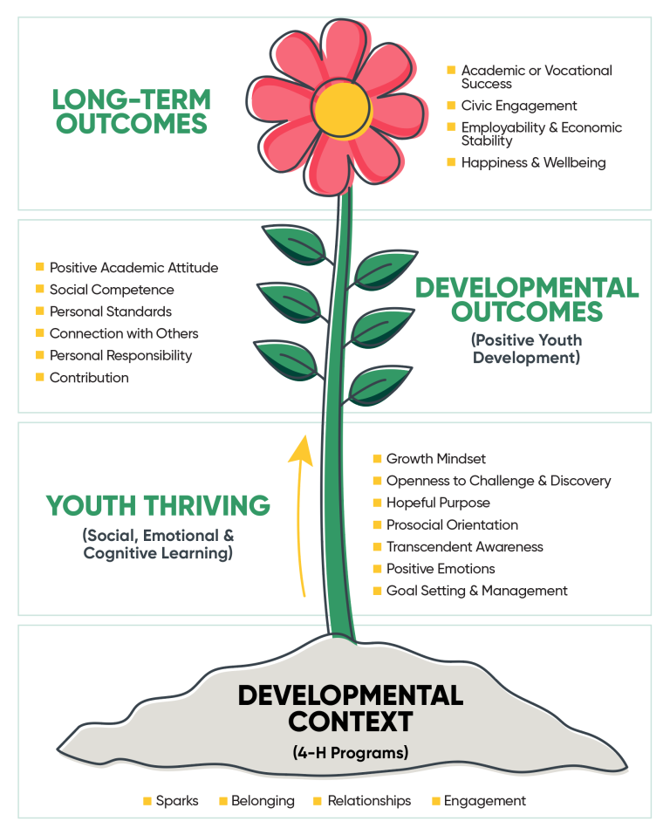
4-H Thriving

Slide 3
What is a traditional 4-H Club meeting?
Business Meeting
  Pledges
  Robert’s Rules of Order
  Structure
  Limitations
Program/Project
Socialization
  Snack
  Game
  Song

Slide 4
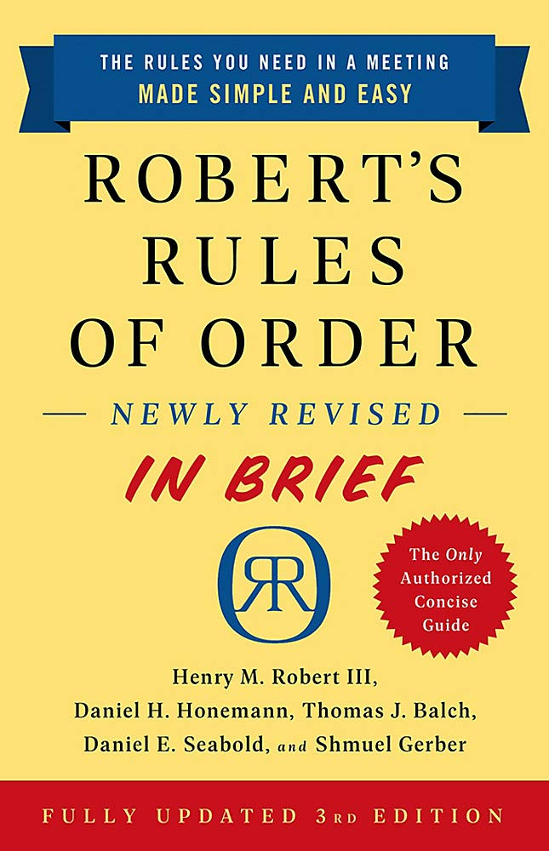
Who is Robert and why does he care about my meeting?
First published in 1876 by Henry M. Robert
  Brigadier General, United States Army; Chief of Engineers
Guide for meetings in non-legislative organizations
How to conduct meetings and run the business of an organization
Most commonly used parliamentary authority in the United States
Currently RONR Newly Revised 12th Edition
Newest revision released September 1, 2020
  RONR In Brief
  eBook (YAY!)

Slide 5
Creating a Safe Space to Speak
Try not to be nervous
Most other people aren’t RONR experts either
It’s alright to say “I don’t know”
It’s fine to put the brakes on things
When in doubt, stop and look it up
When really in doubt, do your best
“They’re you’re rules, you can change them”
When mistakes are made – admit it, correct it, and move on
Other Resources

Slide 6
Using Robert’s Rules of Order to your advantage!
Special Procedure for “Small Boards” (Section 49:21)
Motions need not be seconded
No limit on speaking
Informal discussion
Unanimous consent

Slide 7
What do we do about virtual meetings?
Create a situation electronically that replicates as much of the face-to-face meeting as possible.
Everyone must be able to hear and speak to one another
Quorum requirements (and any other requirements) still count
Must be able to receive reports and make motions
Must be able to conduct votes
Follow standard agenda
Have a program (if applicable)

Slide 8
Making Zoom Work for Meetings
Designate a “Zoom Master” for each meeting
Monitors participants, chat box, etc.
Advises presiding officer
Helps keep things on task
Should not be the presiding officer or secretary
Possible job for vice-president
Don’t forget about someone on the phone!
Remember to slow down

Slide 9
Making Accommodations:
Positive Emotions, Hopeful Purpose, & Awareness
Creating a welcoming environment
Changing the setup without changing the rules
Modifying what can be modified
Knowing our audience
  “Warm up” activities
  Seating/Zoom arrangements
  Taking Breaks
“When procedure stands in the way of the mission, it’s time to alter the procedure.”

Slide 10
Planning for Programs
Prioritizing diversity in programming and projects
Striving for:
  Openness for challenge and discovery
  Growth mindset
Using technology to our advantage
Letting youth guide us
Recognizing potential
  Opportunities for cultural diversity
  Inclusion as a springboard for outreach and recruitment

Slide 11
Resources
Robert’s Rules of Order official website
  www.robertsrules.com
Parliamentary Procedure Charts / Handouts
  https://www.jimslaughter.com/charts-handouts
  https://www.parliamentarians.org/

Slide 12
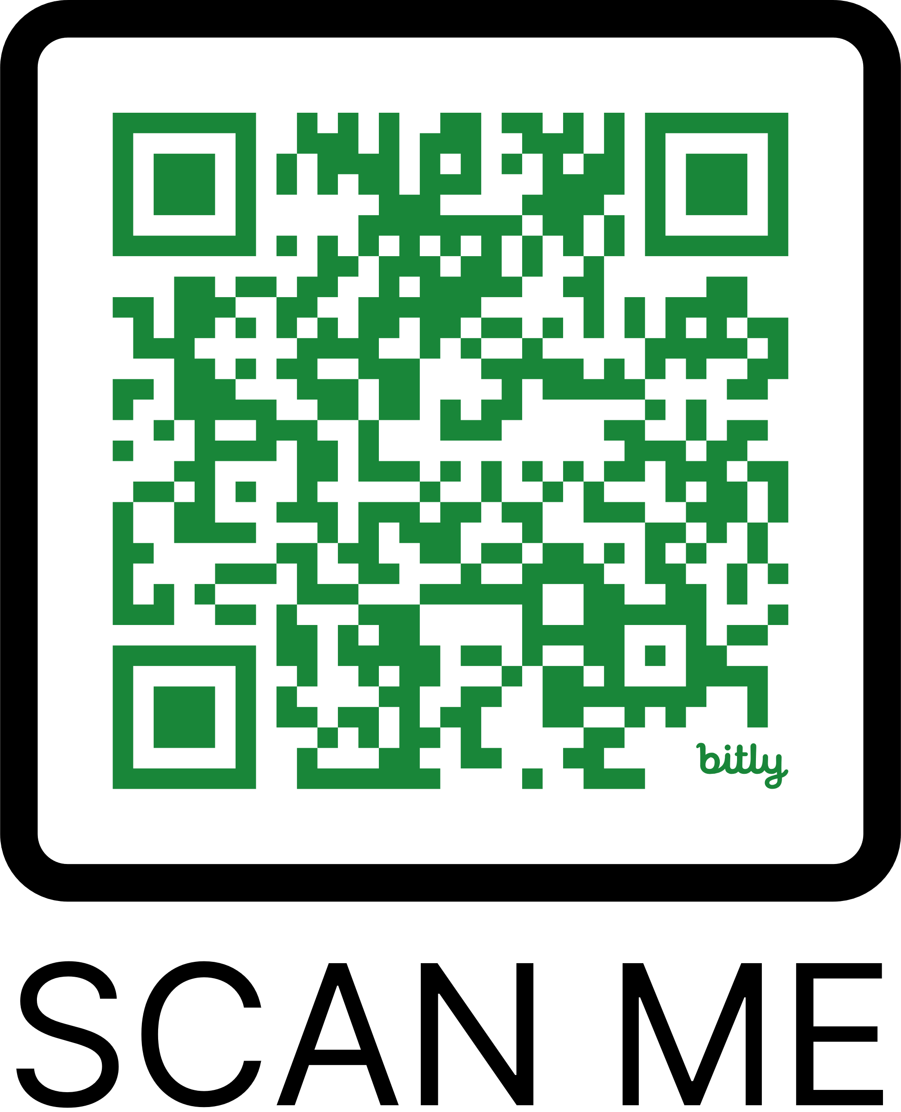
Thank You
for attending!

