Slide 1
VTCDD Showcase
Jake Smith, Spencer Josi, Camila Arbaiza, Shashank Narayanan
CS4624: Multimedia, Hypertext, and Information Access
Instructor: Dr. Edward Fox
Virginia Tech, Blacksburg VA 24061
12-05-2022
Notes:
Jake

Slide 2
Outline
Project Overview
Work Done
Testing
Future Work
Lessons Learned
Acknowledgments
References
Notes:
Jake side start
Project Overview - Jake
Work done
Timeline - Jake
Figma prototype - Camila
Data gathering
Patents - Shashank
Publications - Shashank
Ensemble webpages - Camila + Spencer
Testing
Assessment - Camila
Evaluation - Spencer
Future Work -
Lessons Learned - Camila
Acknowledgments - Camila
References - Camila

Slide 3
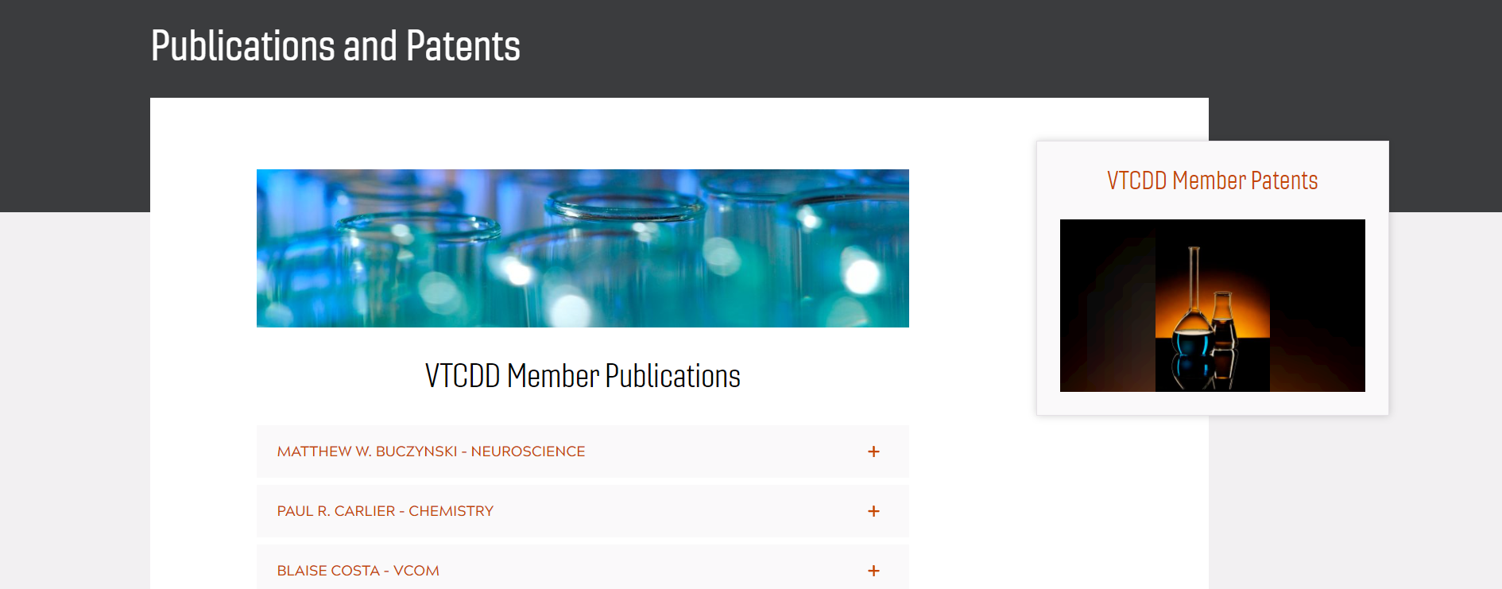
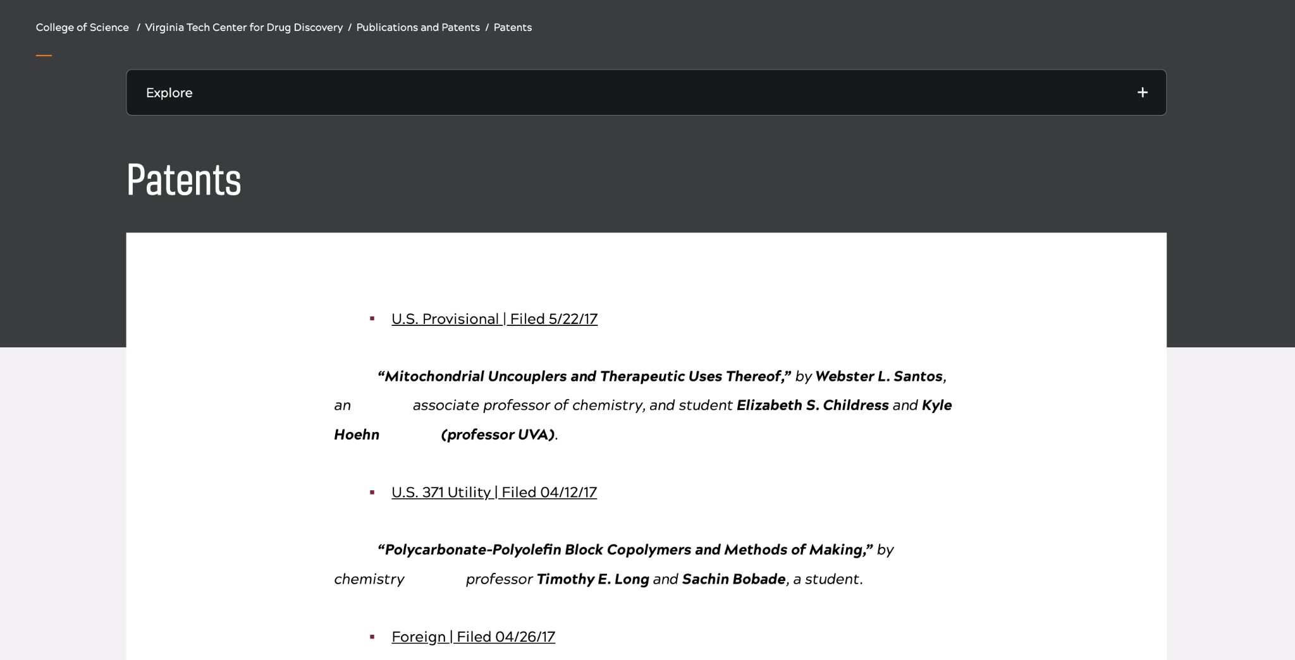
Overview
Goal: Improve the showcasing of patents and publications of the website
The Virginia Tech Center for Drug Discovery (VTCDD) Patents and Publications site hasn’t been updated since 2017
The site showcases the accomplishments of the Drug Discovery Department
Must contact site coordinator to add to site
Notes:
Jake
Working with the VT center for drug discovery to update their p&p site
Site currently shows a poorly formatted list of p&p
The site needs to showcase new p&p, find ways to keep the p&p up-to-date, and display p&p in a well designed and visually appealing format

Slide 4

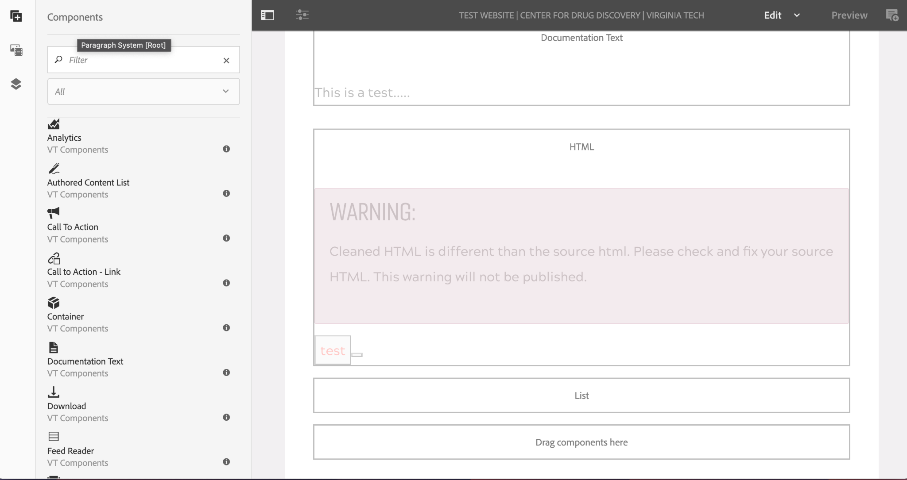
What is Ensemble?
VT Content Management System
Standardized components
  HTML component
Low-code platform
Notes:
Jake
Working with the VT center for drug discovery to update their p&p site
Site currently shows a poorly formatted list of p&p
The site needs to showcase new p&p, find ways to keep the p&p up-to-date, and display p&p in a well designed and visually appealing format
Ensemble is the common name for the content management system used to host websites for Virginia Tech internet domains
HTML allows you to access JSON/XML through asynchronous javascript calls

Slide 5
What We Have Accomplished
Home Page &
Demo data tables
Development: Middleware solution + Data Collection
Design: Figma prototype
Contacted Testers for Feedback
8/29
9/23
10/26
12/4
8/22
9/7
10/19
11/16
Granted “Author” credentials in Ensemble
Google submission forms &
User feedback form
Finalized data tables
Implemented User Feedback
Notes:
Jake
Working with the VT center for drug discovery to update their p&p site
Site currently shows a poorly formatted list of p&p
The site needs to showcase new p&p, find ways to keep the p&p up-to-date, and display p&p in a well designed and visually appealing format

Slide 6
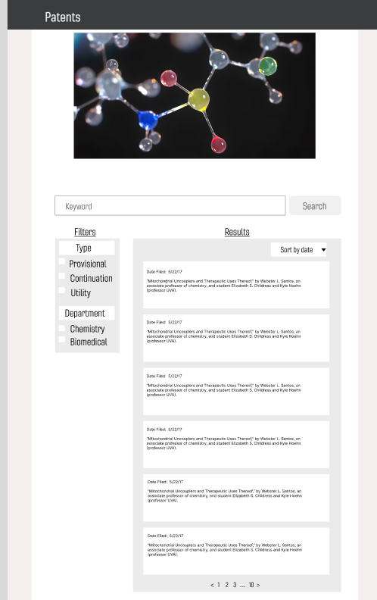
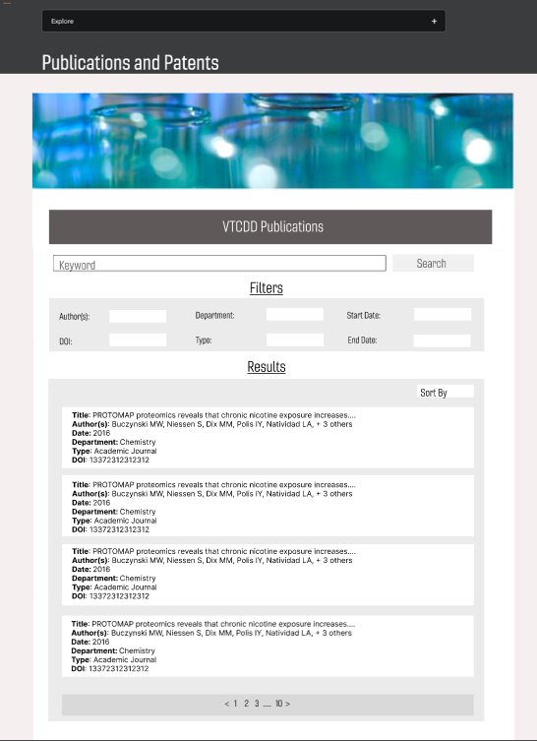
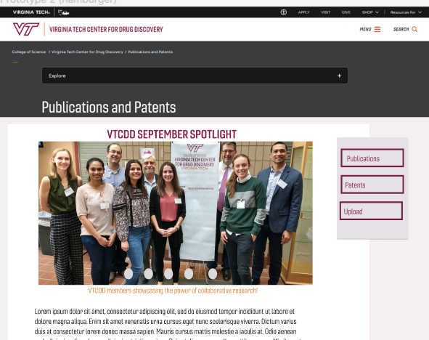
Figma
Patents page prototype
Publications page prototype
Homepage Prototype
Spotlight carousel
Links to submission forms
Links to individual patent
and publication pages
Notes:
Camila

Slide 7
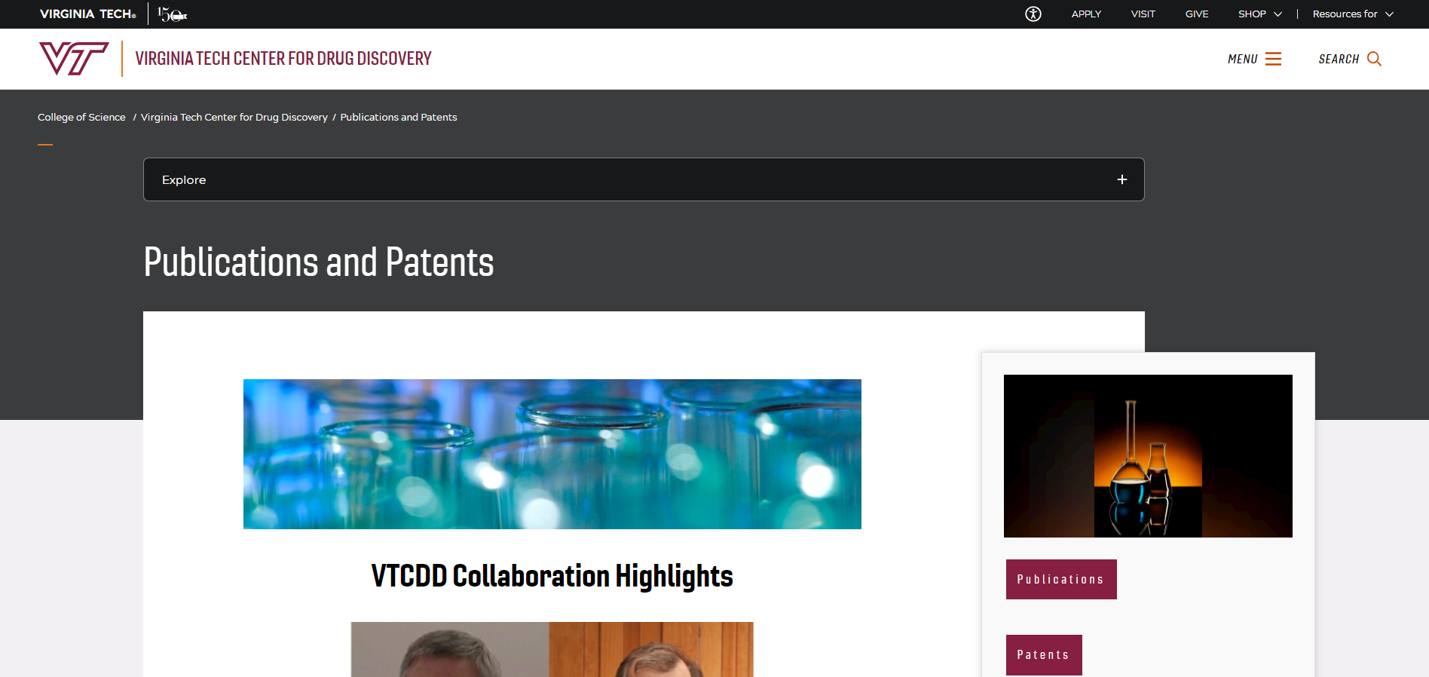
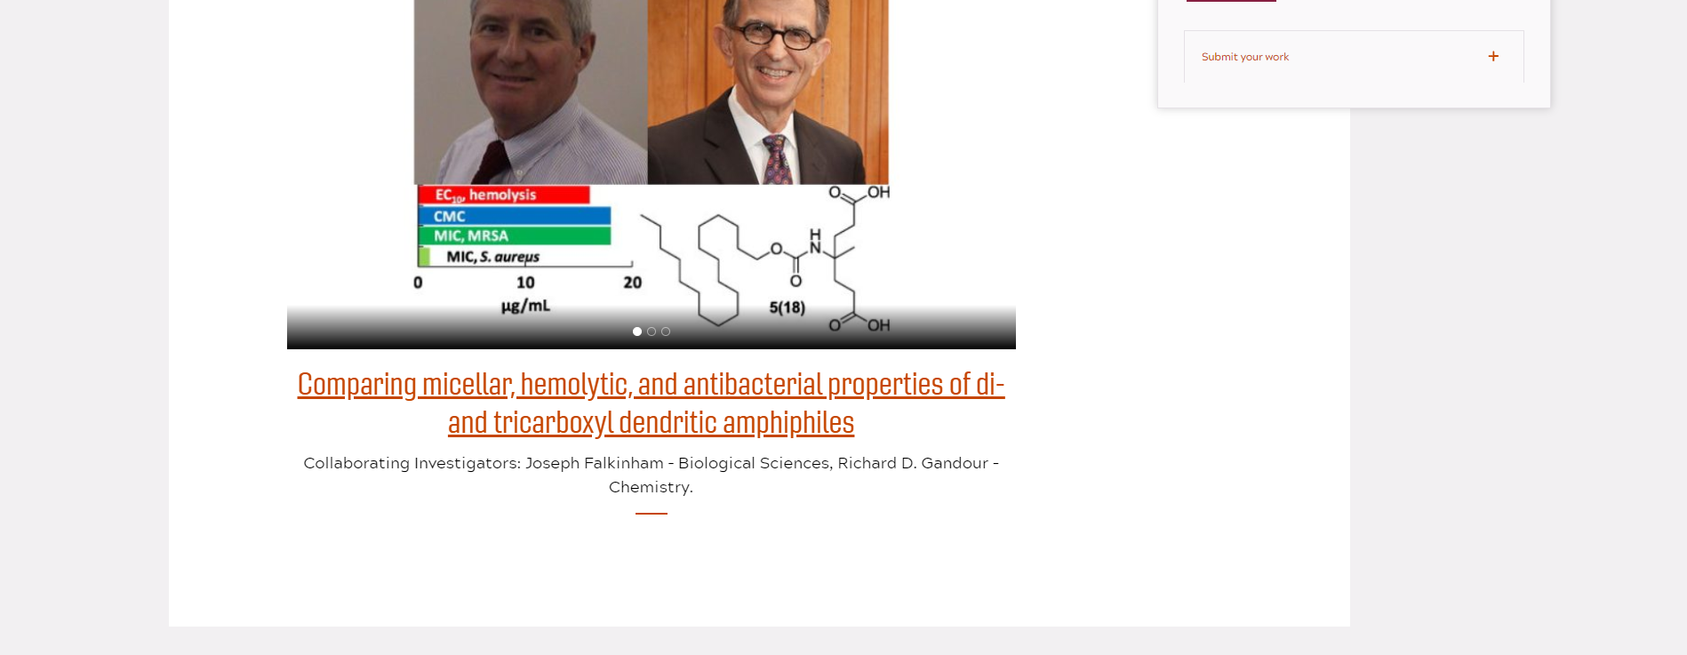
Home Page
Implemented layout, and carousel
Buttons link to other pages:
Publications search page
Patents search page
Accordion links to submission forms
Added images and Caption descriptions about VTCDD Collaborations on spotlight
Notes:
Camila

Slide 8
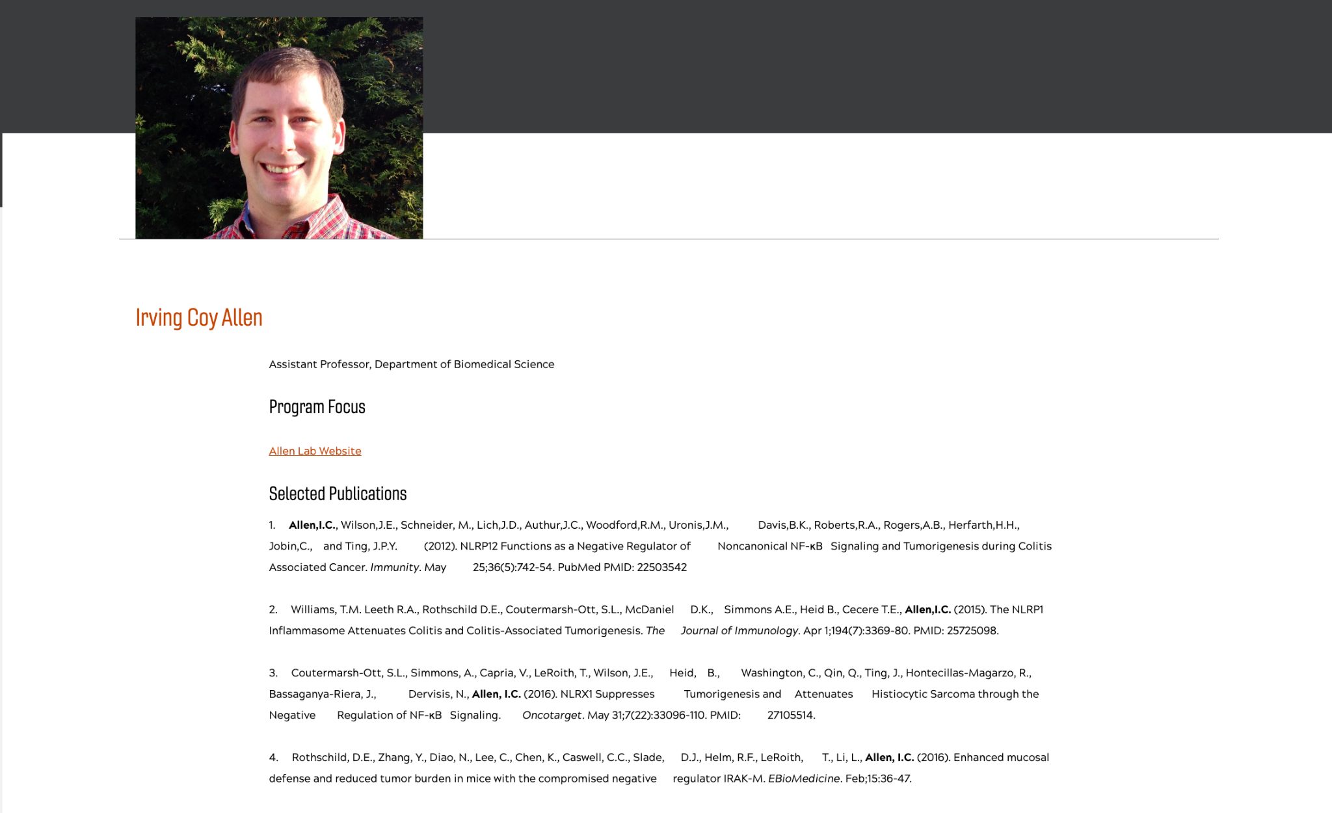
Publication Data Collection
Goal: Gather complete information for all of the publications listed on VTCDD faculty profile pages
Solution:
Append citations that appear on VTCDD faculty pages to our database
Web scrape all of the VTCDD profiles
Gather all faculty member Google Scholar Pages
Gather more pub info on Google Scholar profiles
  Use the Scholarly library
Output to CSV
Result: Expanded dataset from 40 → 225 publications
Output Table: Title, Year, VTCDD Member, Department, Citation
Notes:
Shashank Narayanan

Slide 9
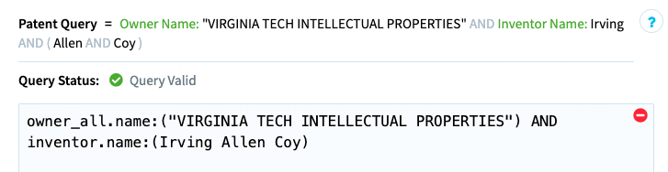
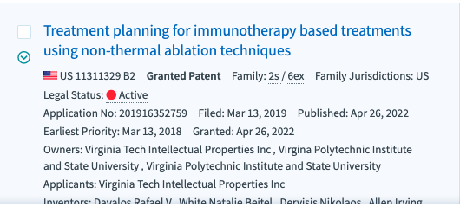
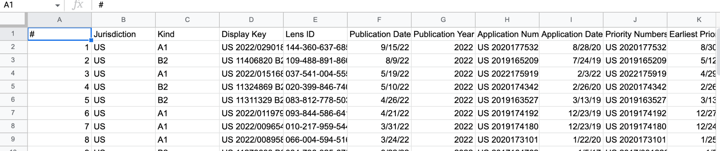
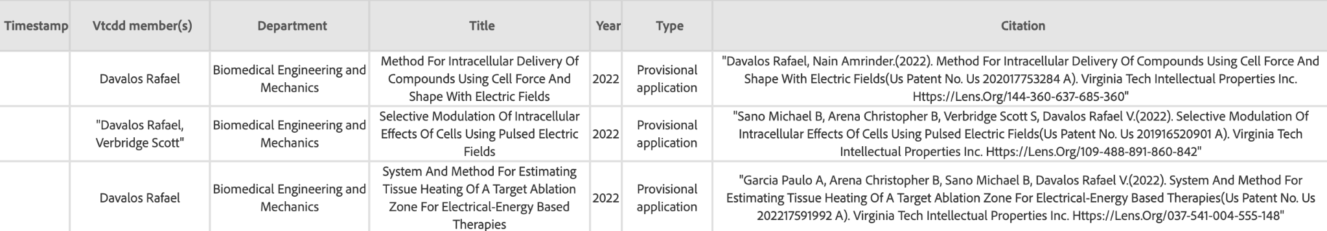
Patent Data Collection
Goal: Gather complete information for all of the Patents listed on VTCDD faculty profile pages
Solution:
Append citations that appear on original website to our database
Collect patent citations from lens.org
Extract data to CSV form
Parse necessary data
Populate database with necessary data
Result: Expanded dataset from 15→ 81 Patents
Output Table: Title, Year, VTCDD Member,
Department, Type, Citation
Parse
Notes:
Shashank Narayanan

Slide 10

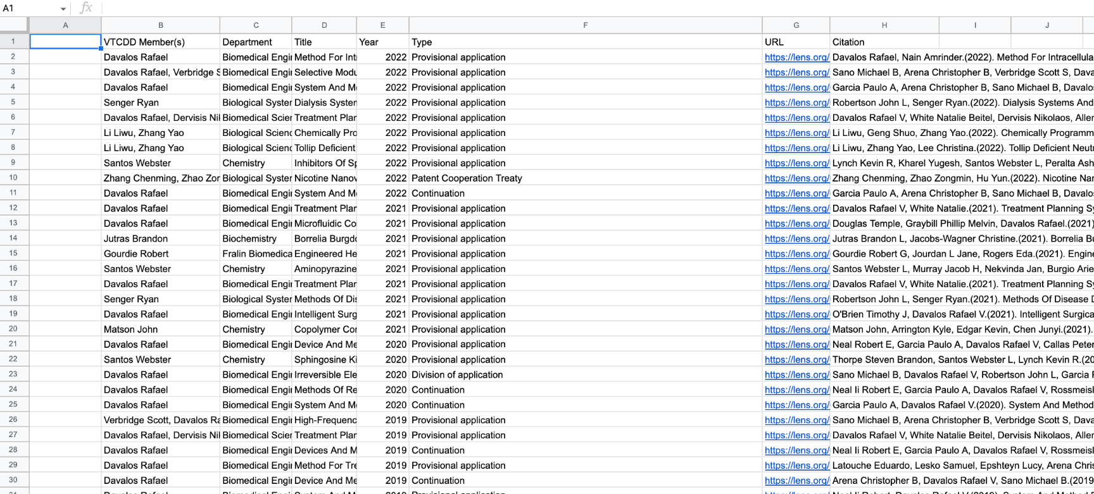
Middleware Solution
Problem: Need a way to upload CSV data for the site coordinator
Solution: Google Spreadsheets
  No tech background needed
  Can edit/receive new entries via Google Forms
Site Coordinator just has to…
  Download CSV
  Upload to Ensemble Assets folder
Notes:
Shashank Narayanan

Slide 11
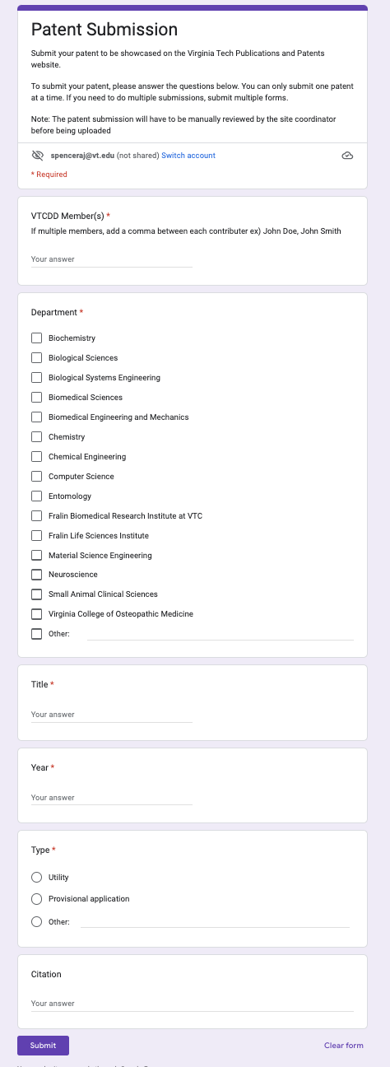
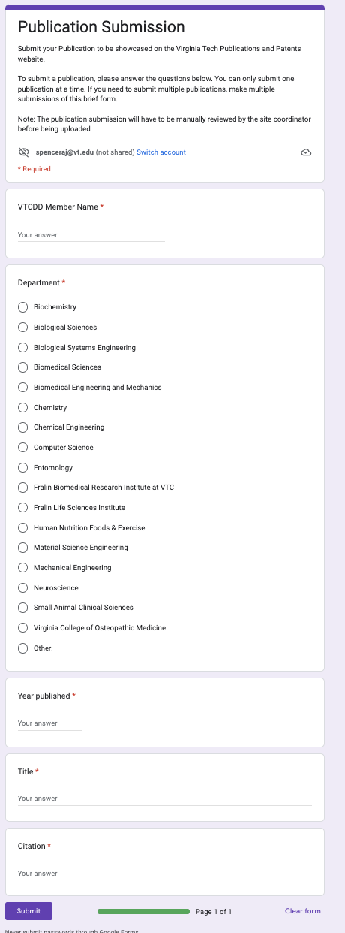
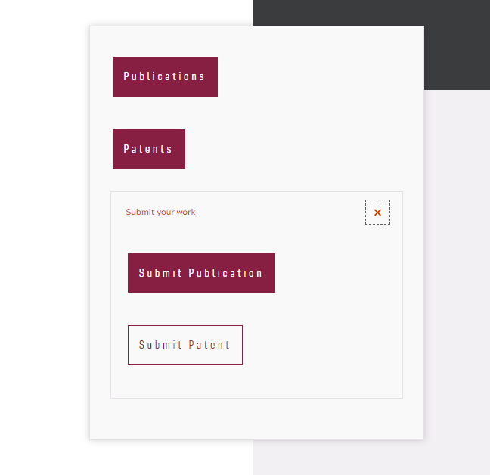
Submission forms
Solves the issue of manually looking through emails for requests to upload someone’s work to the website.
Submission data can be downloaded as a CSV file.
Notes:
Spencer

Slide 12
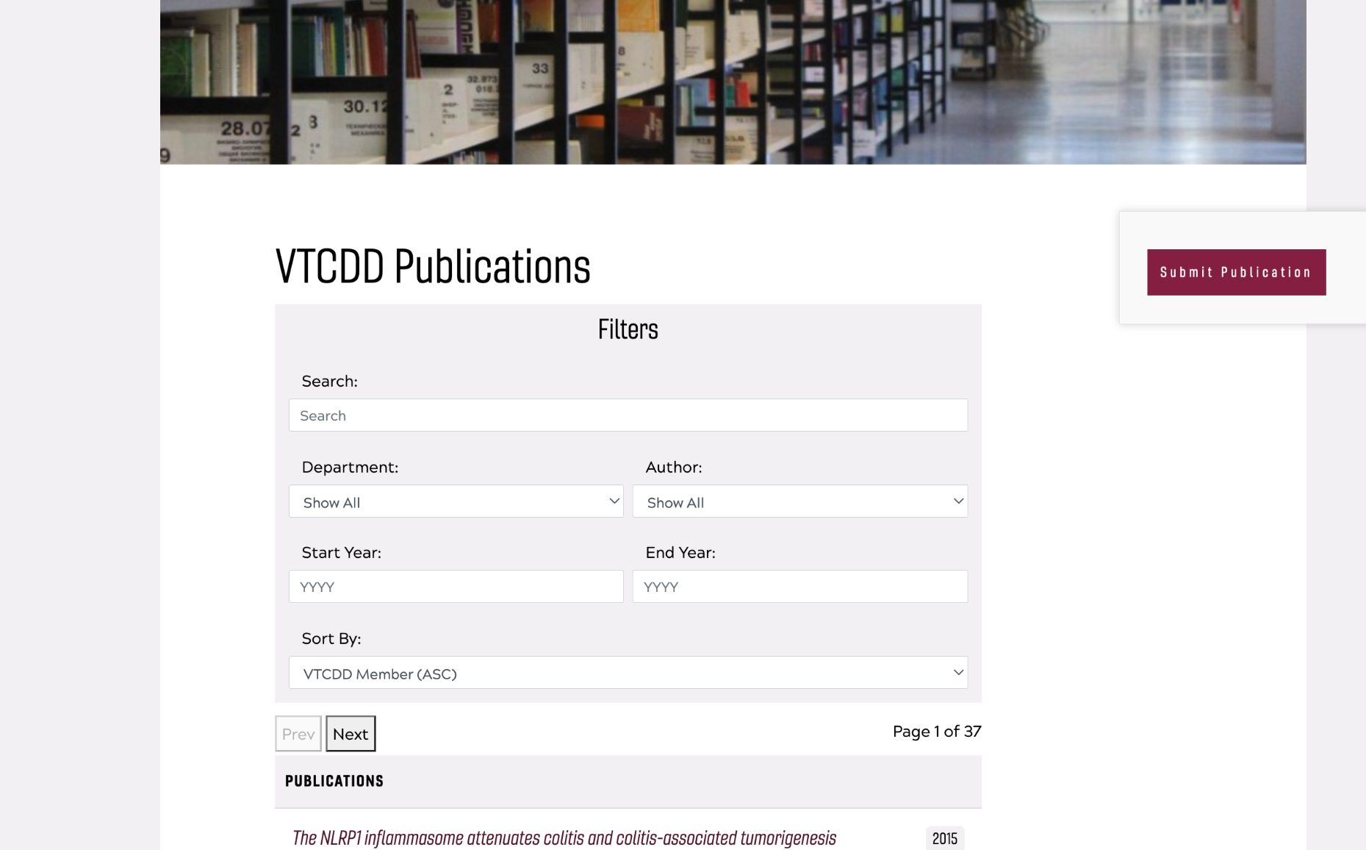
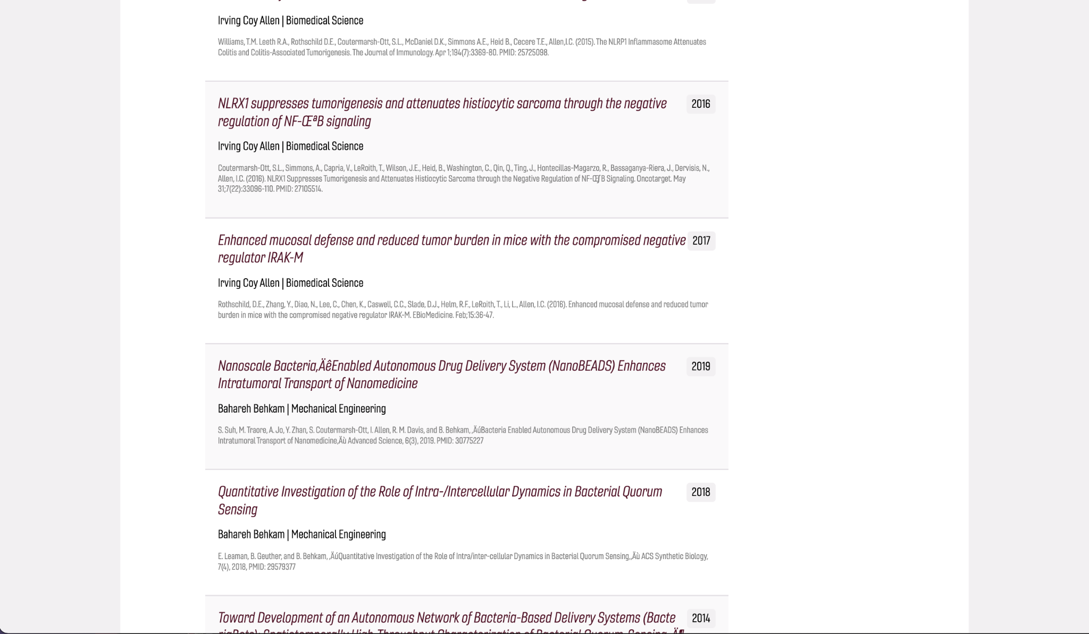
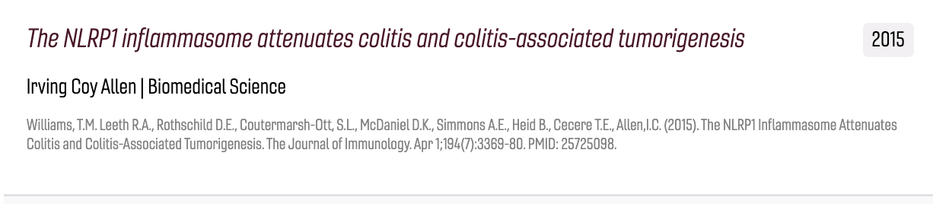
Publications and Patents Page
3 sections
Filters/Pagination
Table of entries
Submit new publication or patent link
Notes:
Spencer

Slide 13
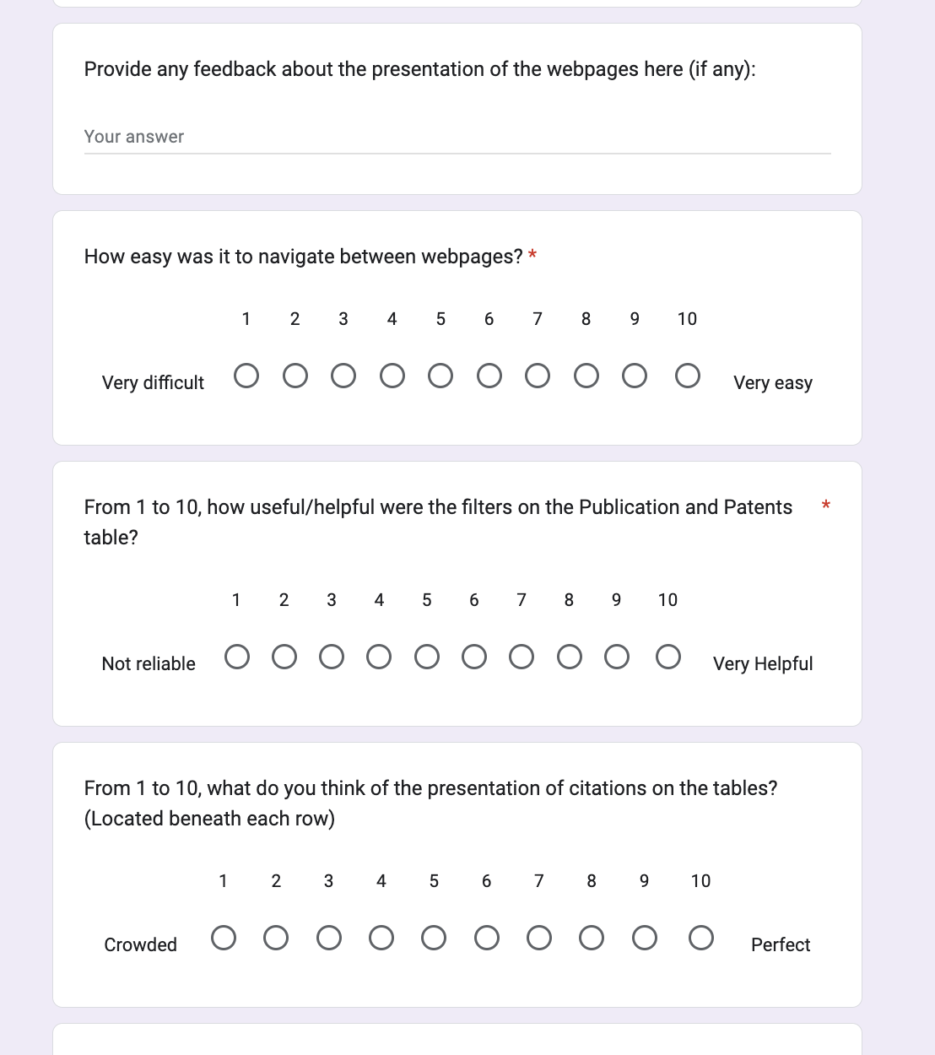
Testing - Assessment
Sent Google Form to beta testers
  Client supplied testers affiliated with VTCDD
14 Questions
  1 to 10 scale
  Free response questions
Types of questions
  UX
  Functionality
  Suggestions/Bug fixes
Notes:
Spencer

Slide 14
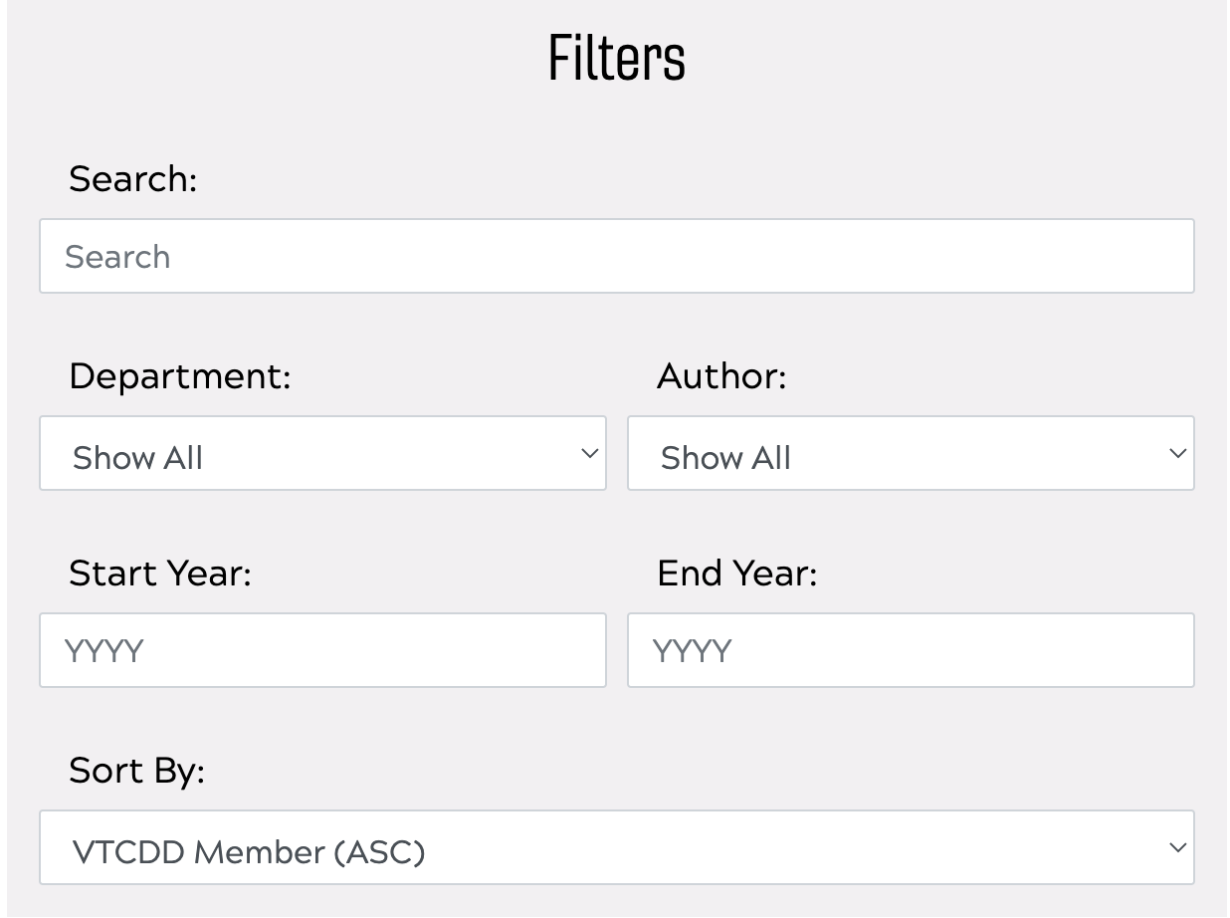
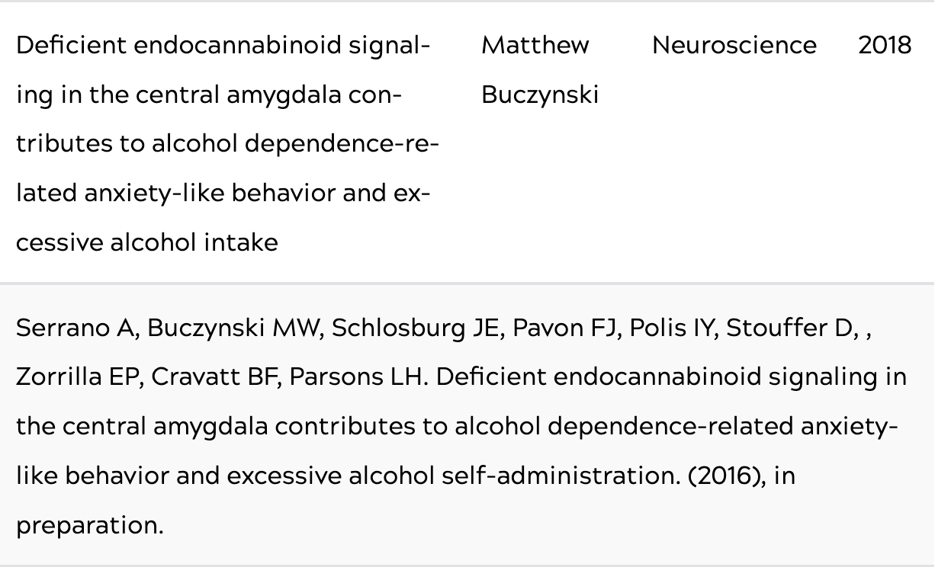
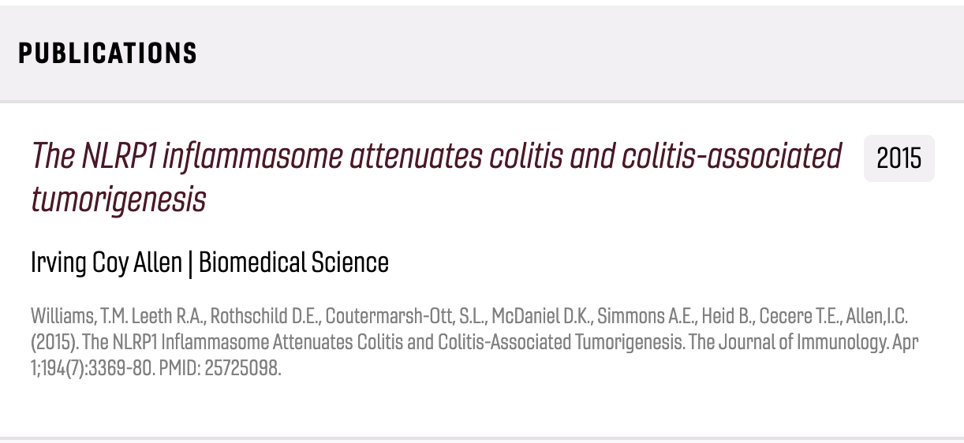
Testing - Evaluation
Positive feedback
Home page
Uploading new patents and publications
Areas of Improvement
Filters
Table Presentation
Notes:
Spencer

Slide 15


Future Work
Cloud-based approach
Account for data hosting option as data size increases
Google API so no longer have to manually upload a CSV file
Notes:
Camila

Slide 16
Lessons Learned
Learned about Virginia Tech’s own CMS used to host websites, assessed its limitations, and extended its capabilities by adding custom code to add to its UI components.
Gained exposure to working with clients and understanding how to iteratively improve requirements and solutions while maintaining a timeline.
Gained experience with gathering relevant data through web-scraping faculty pages and Google Scholar pages for the publications and patents.
Notes:
Camila

Slide 17
Acknowledgements
Rachel Dalton (VTCDD & VDCC Program coordinator)
Office: Hahn Hall South 3111A
Email: racheldd@vt.edu
Edward Fox
Office: 2160G Torgeson Hall
Email: fox@vt.edu

Slide 18
References
VTCDD Publications and Patents: https://www.vtcdd.science.vt.edu/publicationsandpatents.html
Ensemble: https://ensemble.cms.vt.edu/webadmin.html
Ensemble Docs: https://ensemble.cms.vt.edu/
Figma https://www.figma.com/files/team/1149771700320174620/VTCDDShowcase?fuid=1149771691979084172
Google Sheets: https://www.google.com/sheets/about/
Google Forms: https://www.google.com/forms/about/
Notes:
Camila

