Slide 1
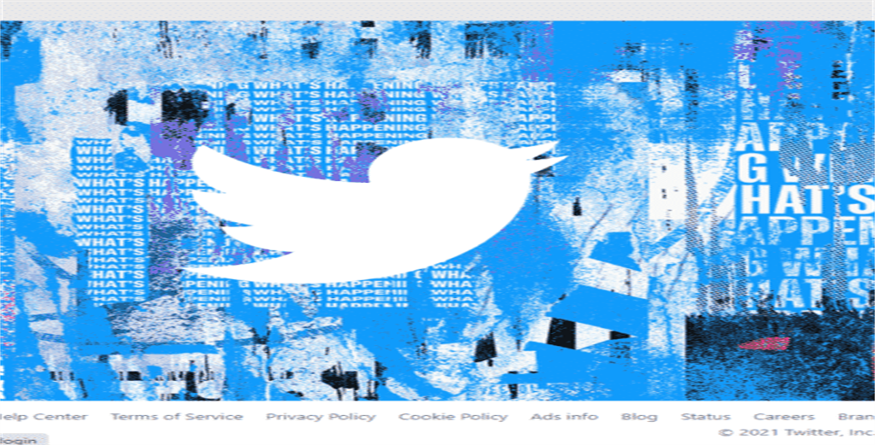
Discovery Portal for Twitter Collections
Team 10: Vaasu Agadkar, Sai Duduru, Kyra Forest, Fiona Mustard, Hamza Saif
Course: CS 4624 13415
Instructor: Mohamed Farag
School: Virginia Tech, Blacksburg VA 24061
Date: 04/25/2024

Slide 2
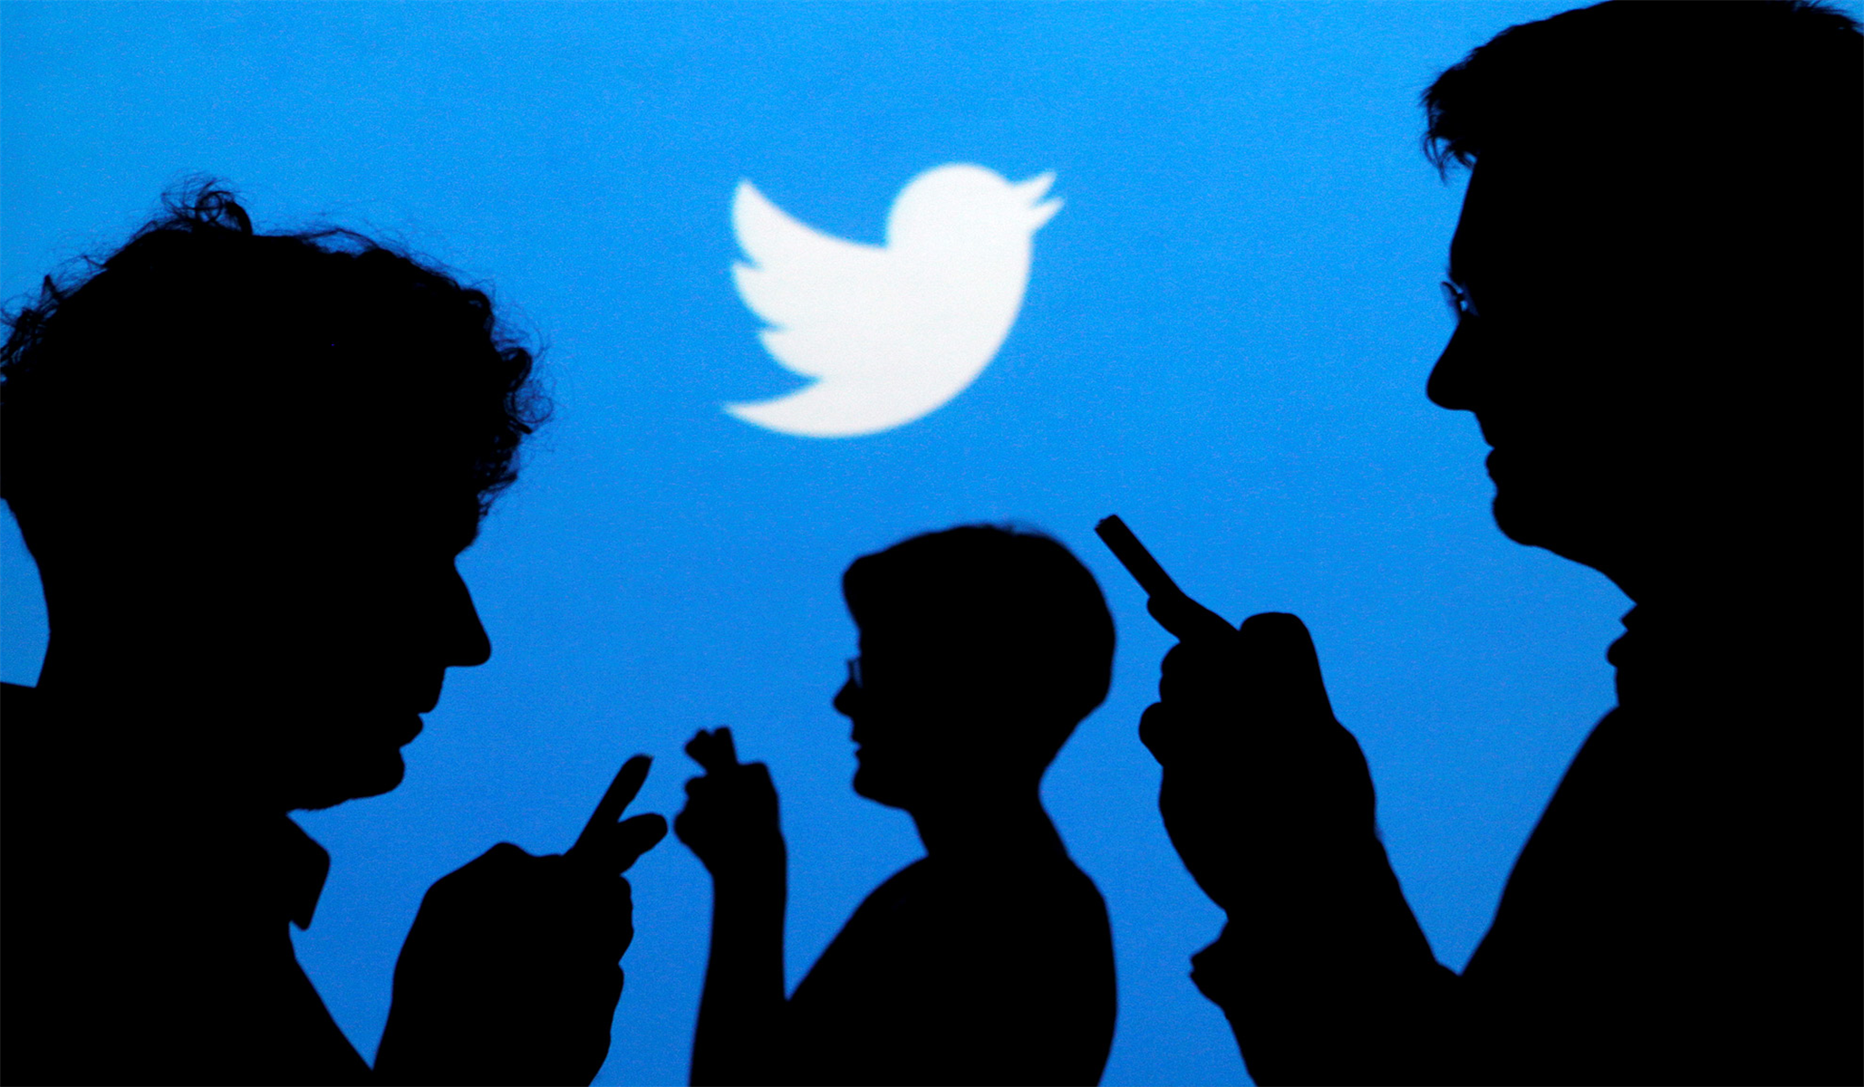
Presentation Outline
Problem & Approach
Features
Updated Dataflow
Architecture
Live Demo
Lessons Learned & Issues
Last Steps
Acknowledgements

Slide 3

1. Problem
We have 3 large databases with 3 different schemas
Tweets were scraped by "event" (collection)
Previous team identified collections, processed some tweets
​
Goal 1: Identify remaining collections​
​
Goal 2: Retrieve and display collection data

Slide 4

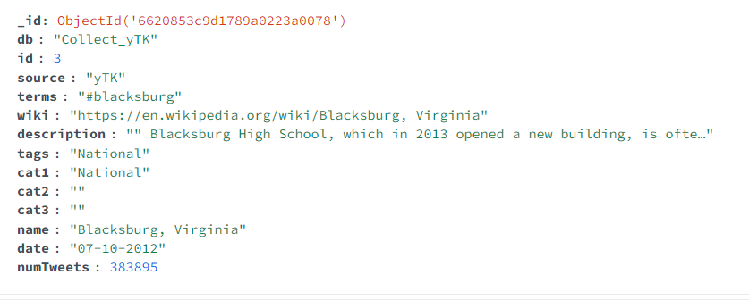
2. Features
Event: collection details
Number of Tweets (numTweets)
Collection Date (date)
Sorting
Alphabetical (name)
Chronological (date)
Keyword Search
Collection name
Data Display
Filtering
Home: scrollable list + pagination
Collection Schema:

Slide 5



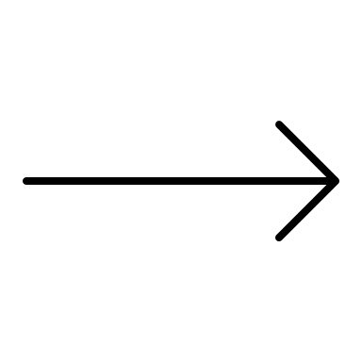







3. Data-Flow Diagram
Collection Database
Front End
Back End
User Request
GET request
JSON List Request
Formatted/
Visualized Data
Filtered/Sorted JSON Object List
JSON Objects
Python script
JSON File with Collection Data
This Photo by Unknown author is licensed under CC BY-NC-ND.
Tweet & Collection Database
This Photo by Unknown author is licensed under CC BY-SA-NC.
This Photo by Unknown author is licensed under CC BY-NC.
This Photo by Unknown author is licensed under CC BY-SA.

Slide 6
4. Architecture
SQL Tweet & Collection Data:
MongoDB: JSON Objects of Collection List & Data
Front: Displays Data
YTK: 1429 Collections (includes overlap with some SFM; 430 in SQL Database)
SFM: 31 (205 identified)
DMITCAT: 25
Back: filters, sorts, searches, and retrieves JSON Object(s)
Connects to mongoDB
Sends GET requests for specific Collections
Previous teams' scripts retrieved data from 3 Tweet Dbs -> Excel sheet (represents Collection Data Summary)
Displays data that has already been sorted/filtered
Queries mongoDB using keywords
Retrieve Excel sheet data by Python script
EFC: 8
NIH: 4

Slide 7
5. LIVE DEMO

Slide 8
6. Lessons Learned & Issues
Connecting the back end to the front end!
Differentiating between schemas
Doing anything in the front end is EXPENSIVE
Access to Databases
Ran into issues with SFM

Slide 9
7. Last Steps
Report
Date sorting (mm/dd -> dd/mm)
Final Touches
Documenting latest changes
Updating Jira board with work completed
Event page aesthetics

Slide 10
8. Acknowledgements
Client – Dr. Mohamed Farag
MVP GTA – Vedant Shah
Previous Work - VTWorks
TwitterCollections (2022)
Combined three formats into JSON
Library6Btweets (2021)
Provided conversion scripts for three formats
Collection-level schema for tweets
Digital Library Research Laboratory (DLRL)
Collected the billions of tweets

Slide 11

Thank you!
Questions

