Slide 1
Virginia Master Cattlemen’s Program
Southwest District, Virginia Cooperative Extension
Presented by : Dr. Andy Overbay
ANR Extension Agent
Smyth County

Slide 2
Biosecurity….
What does it mean and should you be concerned?

Slide 3
Biosecurity defined….according to John Shutske, author “Beef Magazine”
…..specific actions a producer can take to reduce the chances of animal diseases or harm to their herd caused by contamination of water, feed, or facilities where done intentionally or unintentionally.

Slide 4
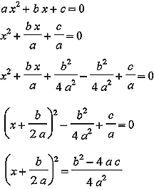
A Problem for the Unprepared
Solve for the Equation:

Slide 5
What is the easiest problem to solve???
The one you don’t have….

Slide 6
Importance of Biosecurity
Disease Prevention ($$$$$$)
  morbidity and death
  Lower treatment costs
  Marketing Options
Legal/Ethical Incentives
  Help keep your neighbors safe
  Reduce likelihood of disease spread to wildlife
  Lowers your litigation risks

Slide 7
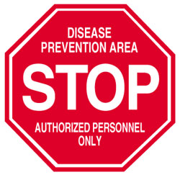
Biosecurity is Important!
Why Don’t Producers Do It?

Slide 8
Attitudes of many producers…
Producers perceptions
  We’ve always done it this way
  This is too complicated
  We are just too small…we don’t have the space
  It won’t make a difference…..we’ve already had about every disease anyway
  Our farm is safe and this is too expensive!
  BUT…..Prevention is always less costly than treatment!!!!

Slide 9
Our Farm is Safe…
Which herd needs a more stringent vaccination program?
A. A Closed Herd
B. A Feedlot

Slide 10
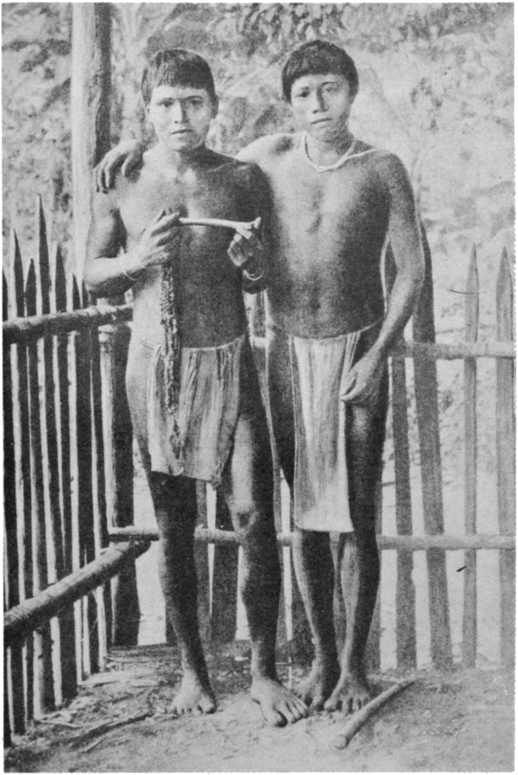
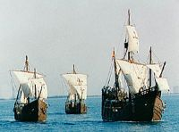
Most Correct Answer….
They both do but different reasons…

Slide 11
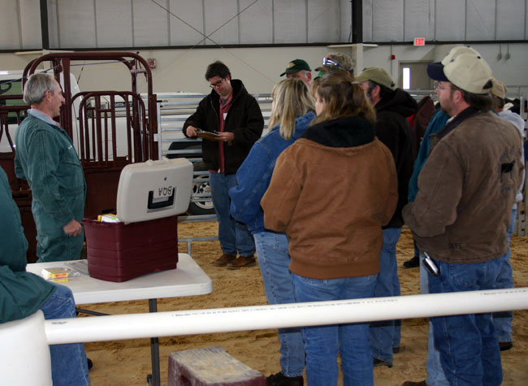
It’s a Question of Exposure

Slide 12
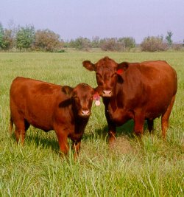
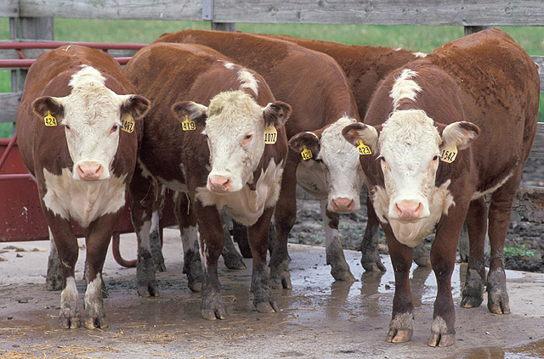
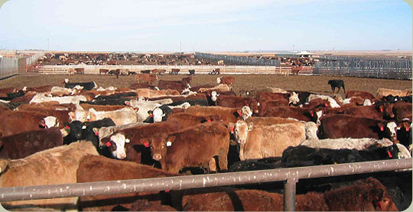
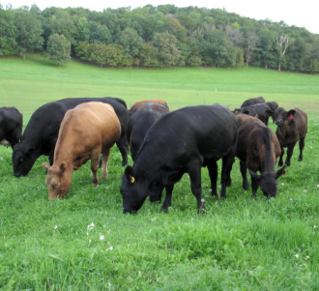
Which cattle are most healthy?

Slide 13
General Management Procedures
ID of all animals should be established
Segregate animals into like groups
Keep stocking density to minimum levels
Limit areas of congregation
Reduce stress when handling
Keep Records

Slide 14
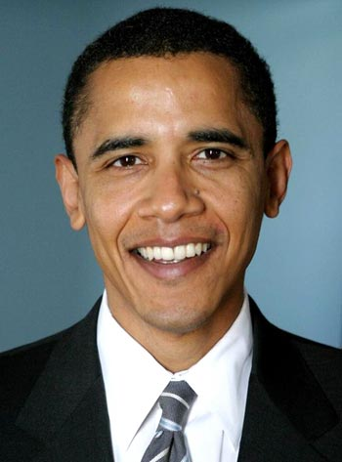

Why Records Matter
Hoof and Mouth Disease Outbreak

Slide 15
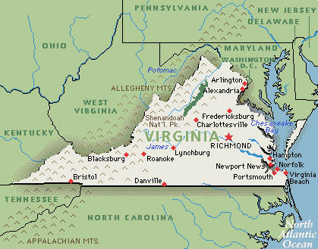
Records Continued..

Slide 16
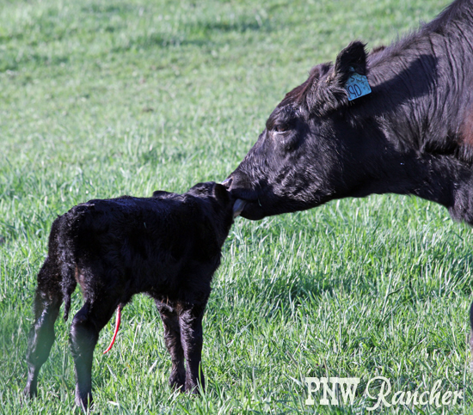
General Management for the Cow/Calf Producer
Keep a good clean calving environment
Calve heifers prior to mature cows
Keep foster calving to a minimum

Slide 17
Commingling/Introducing New Cattle
“Closed Herds” are cleanest, but usually not feasible
Limit animal traffic and new introductions
Returning animals are just like new introductions
Receiving pins should be close to the perimeter

Slide 18
Commingling/Introducing New Cattle
Clean trailers after use
Animals should be quarantined for at least 3 weeks
Try to limit new introductions….the fewer times and from fewer sources….the better
Vaccinate to herd protocol prior to release from quarantine

Slide 19
Human traffic, visitors, and pests
Limit as much as feasible
Have a visitors log and mark restricted areas
Footwear and clothes should be clean
  Disposable overboots are cheap
  Footbaths are good if they are kept clean
Pests also can serve as a vector (anything that can spread disease)
  Rodents
  Birds
  Strays

Slide 20
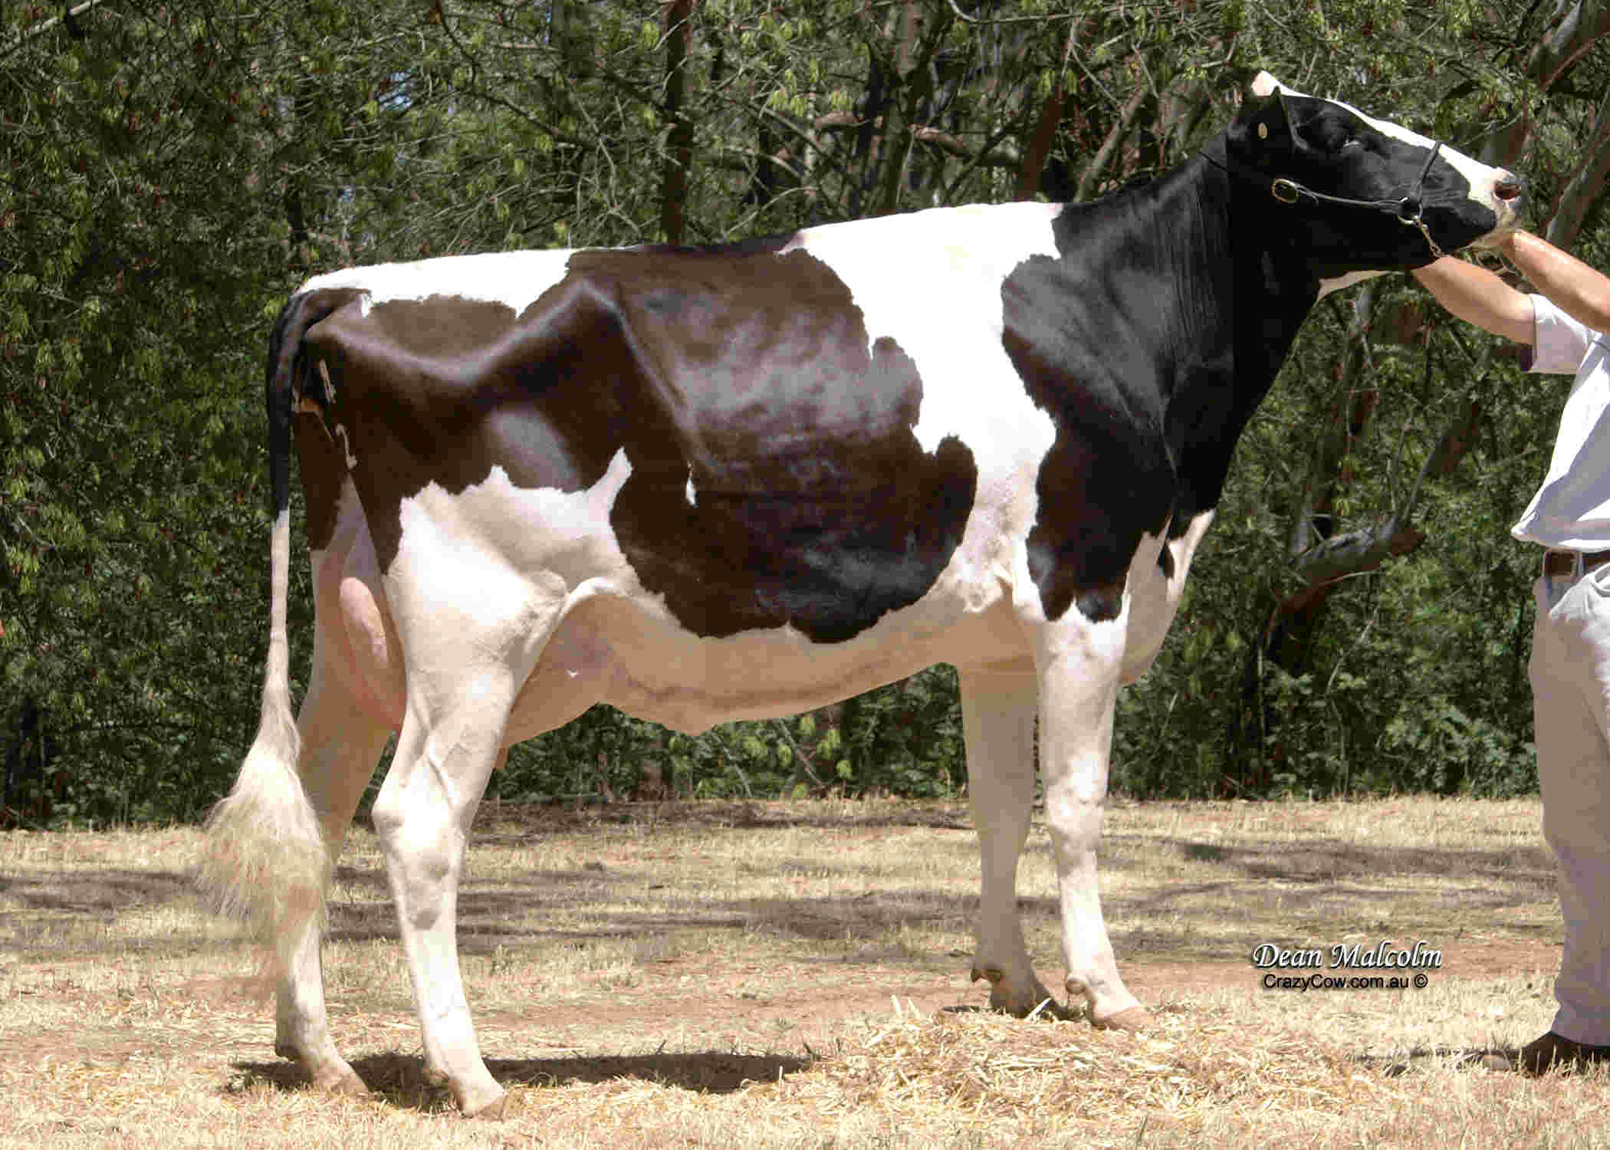
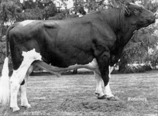
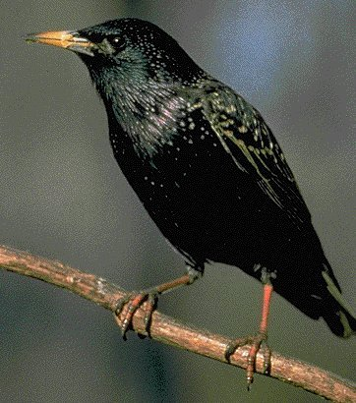
A Terrible Example

Slide 21
Routes of Transmission
Aerosol
Oral
Direct Contact
Fomites

Slide 22
Routes of Transmission
Fomites (Inanimate objects that carry a pathogen)
  Handle/treat sick animals after other groups
  Sanitize equipment used in treatment
    Cleaning supplies can be carriers too!
  Vehicles, fence panels, buildings, etc. can transfer pathogens
  SOP’s (standard operating procedures) should be in place

Slide 23
Routes of Transmission
Vectors
  Can be controlled by elimination (chemical or biological) or preventing access to the animal
  Eliminate access to wet/muddy areas and manure piles

Slide 24
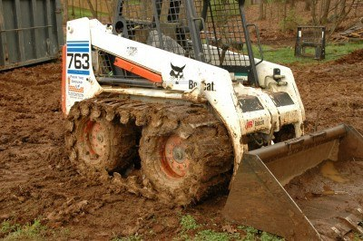
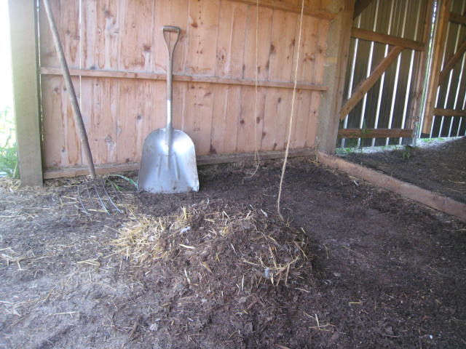
An Easy (and often overlooked) Path to Trouble

Slide 25
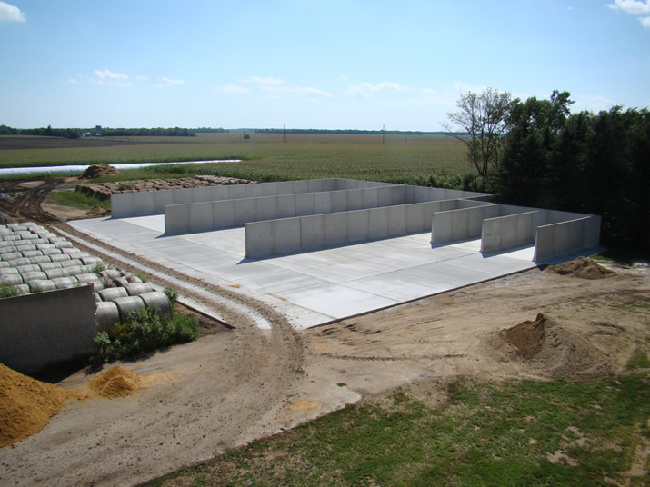

Slide 26
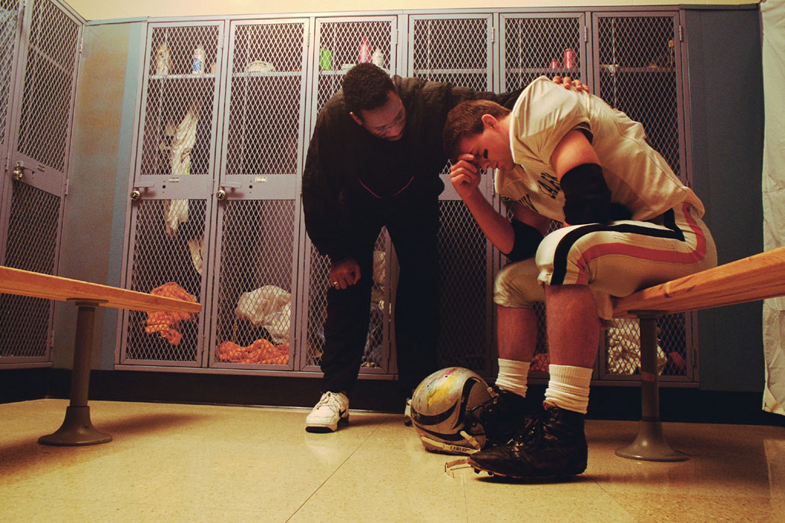
Gosh! This is Overwhelming!

Slide 27
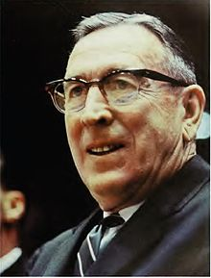
Have a Plan!

Slide 28
John Wooden
“Failing to plan is
planning to fail!”

Slide 29
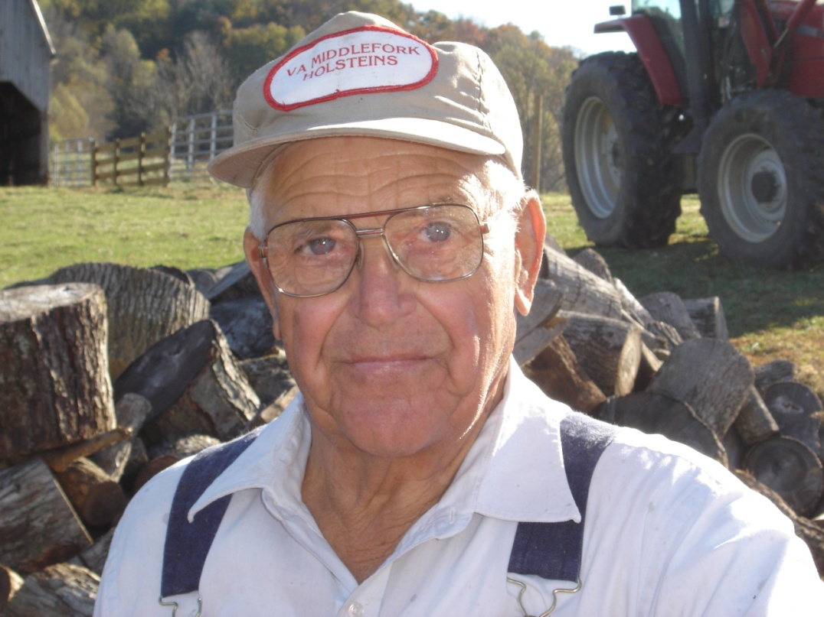
One more “Andy-ism”
You CAN take it with you!

Slide 30
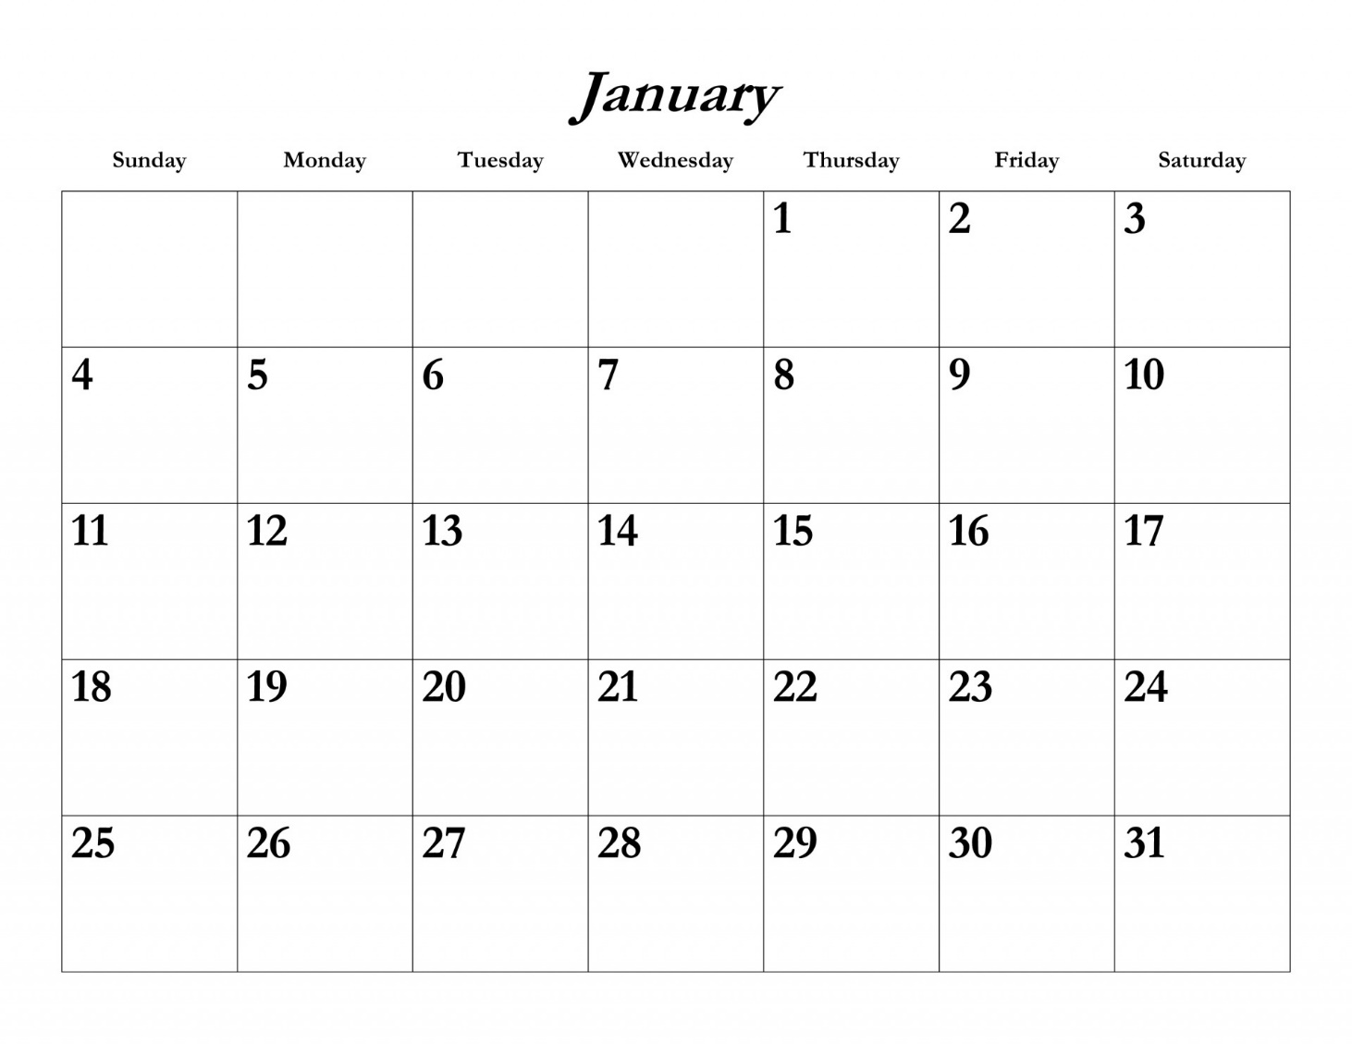
A Simple Journal
48 calves in Well Field
67 calves at old dairy
Water froze
Sold
28 steers
Sold
26 heifers

Slide 31

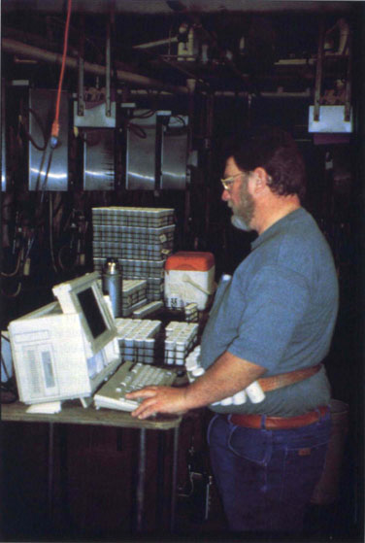
Better Records

Slide 32
What if something happens?
Take action! Sooner the Better
Hopefully you have a plan in place prior to
Do your employees know what the plan is?
A good plan can minimize damage as well as bring awareness to potential threats
Post contact information to key personnel (veterinarian, VDACS, law enforcement, and extension service)

Slide 33
Conclusion
Biosecurity is an essential component of keeping any beef cattle operation secure and successful
No risk can be completely eliminated
No vaccination protocol can overcome a lack of planning (carelessness)

Slide 34
Your Homework Assignment
Develop or refine your farm’s biosecurity plan
  Contact numbers
  Possible exposure points
  Quarantine areas
  Cleanliness issues?
  Records….
  Plan? ….where is it and who knows where it is

Slide 35
Resources
“Beef Biological Risk Management” from the Center for Food Security and Public Health
“Biosecurity on the Farm” John Shutske, University of Minnesota Beef Team
“Biosecurity for the Livestock Enterprise” Dr. Matt Herson, Extension Beef Cattle Specialist, University of Florida

Slide 36
Thank You
Questions: Andy Overbay
aoverbay@vt.edu
(276) 783-5175

