Slide 1
Developing an improved focused crawler for the IDEAL project
Ward Bonnefond, Chris Menzel, Zack Morris, Suhas Patel, Tyler Ritchie, Mark Tedesco, Franklin Zheng

Slide 2
Refresher - IDEAL project
Integrating Digital Event Archiving and Library
Finding webpages related to an event (i.e. natural disaster)
Store found webpages locally for parsing and analysis

Slide 3
Refresher - Enhanced focus crawler
Extract key words and key concepts (i.e. date, location, type of disaster)
Construct trees based on these words and concepts
Develop algorithm to compare different trees and their relationships
Make this process accessible via a web application

Slide 4
Refresher - Project components
Tree construction and visual representation
Event representation (i.e. key words and key concepts) versus actual event (i.e. webpage)
Integrating updated modules into the existing focused crawler

Slide 5
Refresher - Original Implementation
Start with a list of seed URLs
Web-crawler crawls through list of URLs
Searches the webpage for other URLs
Outputs a score for each URL based on keyword matchings
Adds any good URLs found to the list

Slide 6
Final Results
Front-End
  User can enter multiple seed URLS and other important attributes (date, location, type of disaster, etc.)
  Constructs a visual tree representation of the articles found via the web application
  Loads back-end results using JavaScript (previously PHP)
Back-end
    Constructs a full event tree from query created by the user
    Intelligently extracts location, date, type of disaster, etc. using natural language processing as opposed to keyword analysis

Slide 7
Scoring Algorithm
Date: 20%
  Year (365) + Month (30) + Day (1)
  i.e. Year has 365 times the weight of a Day
Location, Type of Event, Event Name, etc.: 80%
  Replaces the previously used tree-edit distance
New scoring algorithm provides more accurate articles that using only tree-edit distance did not find

Slide 8
Final Implementation
Start with a list of seed URLs
Web-crawler crawls through list of URLs
Searches the webpage for other URLs
Outputs a score for each URL based on custom scoring algorithm
Adds any good URLs found to the list

Slide 9
Current Back End Example Data
Base Focused Crawler
0.479449956362|0.555185525105|http://www.tmz.com/2014/04/27/donald-sterling-photos-magic-johnson-matt-kemp-v-stiviano-racist-audio/2/0.479449956362|0.555185525105|http://www.tmz.com/2014/04/27/donald-sterling-photos-magic-johnson-matt-kemp-v-stiviano-racist-audio/1/0.479449956362|0.555185525105|http://www.tmz.com/2014/04/27/donald-sterling-photos-magic-johnson-matt-kemp-v-stiviano-racist-audio/20/0.479449956362|0.596680123725|http://www.tmz.com/2014/04/27/donald-sterling-photos-magic-johnson-matt-kemp-v-stiviano-racist-audio/14/0.479449956362|0.614986314544|http://www.tmz.com/2014/04/27/donald-sterling-photos-magic-johnson-matt-kemp-v-stiviano-racist-audio/11/0.479449956362|0.603562290076|http://www.tmz.com/2014/04/27/donald-sterling-photos-magic-johnson-matt-kemp-v-stiviano-racist-audio/10/0.479449956362|0.555185525105|http://www.tmz.com/2014/04/27/donald-sterling-photos-magic-johnson-matt-kemp-v-stiviano-racist-audio/12/0.479449956362|0.682182274472|http://www.tmz.com/2014/04/27/donald-sterling-photos-magic-johnson-matt-kemp-v-stiviano-racist-audio/13/0.479449956362|0.621091837905|http://www.tmz.com/2014/04/27/donald-sterling-photos-magic-johnson-matt-kemp-v-stiviano-racist-audio/15/0.479449956362|0.588410106633|http://www.tmz.com/2014/04/27/donald-sterling-photos-magic-johnson-matt-kemp-v-stiviano-racist-audio/16/
Visited: 100Accepted: 81
Extended Focused Crawler
0.469920800878|0.52|http://www.dailymail.co.uk/tvshowbiz/article-2511646/Kim-Kardashian-eBays-old-clothes-help-Philippines-typhoon-victims--donates-just-10-proceeds-charity.html0.469920800878|1.0|http://www.fao.org/emergencies/crisis/philippines-typhoon-haiyan/en/0.469920800878|0.901299136822|http://www.fao.org/emergencies/crisis/philippines-typhoon-haiyan/crop-damages-map/en/0.469920800878|0.919740571108|http://www.fao.org/emergencies/crisis/philippines-typhoon-haiyan/impact-assessment-map/en/0.469920800878|0.855014256832|http://www.fao.org/emergencies/crisis/philippines-typhoon-haiyan/input-distribution-map/en/0.469920800878|1.0|http://www.fao.org/emergencies/crisis/philippines-typhoon-haiyan/seed-distribution-map/en/
Visited: 100Accepted: 73

Slide 10
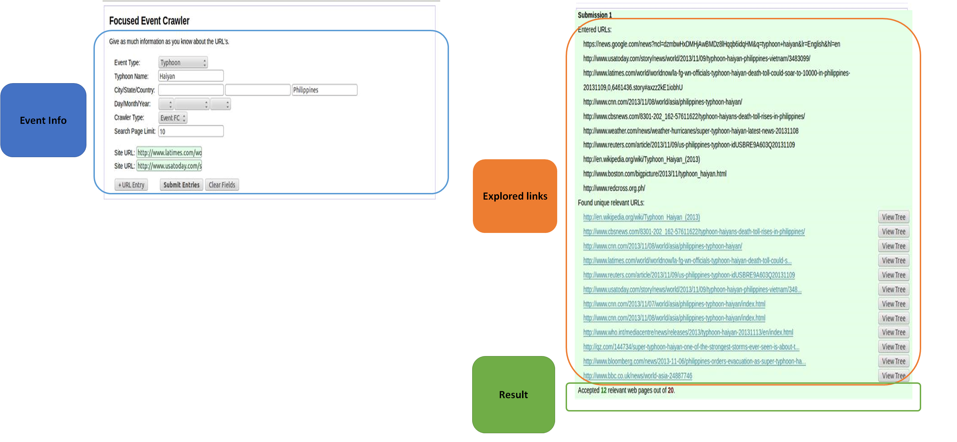
Current Front-End Example

Slide 11
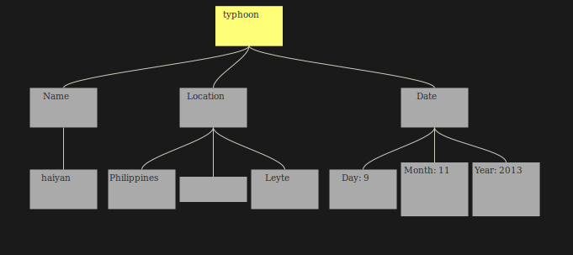
Current Front End – Tree View

Slide 12
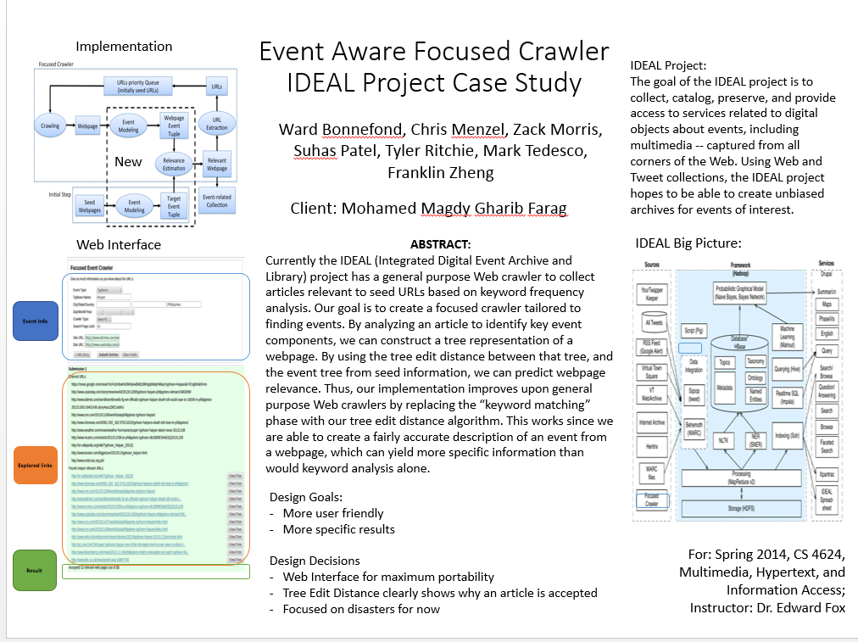
Extras – Poster

Slide 13

Extras – Second Place Letter

Slide 14
Questions?

