Slide 1
Pd-L2Ork
CS 4624: Multimedia, Hypertext and Information Access
Instructor: Edward A. Fox
Team Members:
Drew Bowman, Sahar Farzanehpour,
Ethan Springs, Lily Khochareun
Virginia Tech, Blacksburg VA 24061
April 18, 2023
Notes:
Project title
full names of all team members
course number and name, instructor
Virginia Tech, Blacksburg VA 24061
date

Slide 2
Outline
Recap
Timeline
Implementation
Tooltips Implementation
Tooltips for Objects and Inlets/Outlets
Next Steps for Tooltips
Single button automation
Browser Patch Implementation
Future Work
Acknowledgements
References

Slide 3
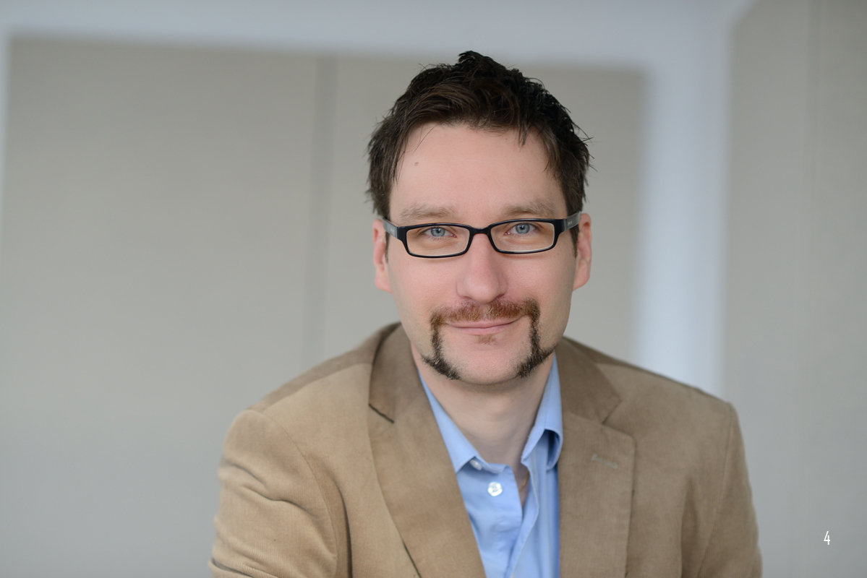
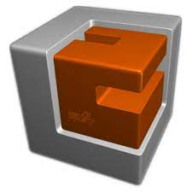
Recap
Dr. Ivica Ico Bukvic
Founder and Director of the Digital Interactive Sound and Intermedia Studio (DISIS) and Linux Laptop Orchestra (L2Ork)
Tasks given:
Tooltips
Single button automation

Slide 4
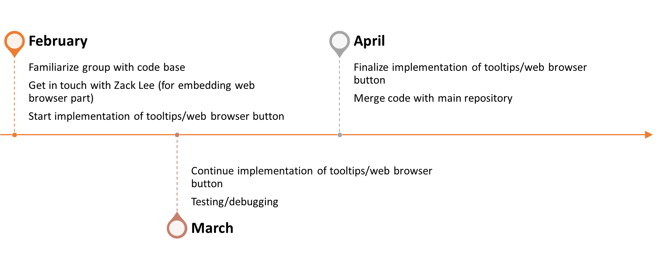
Timeline

Slide 5
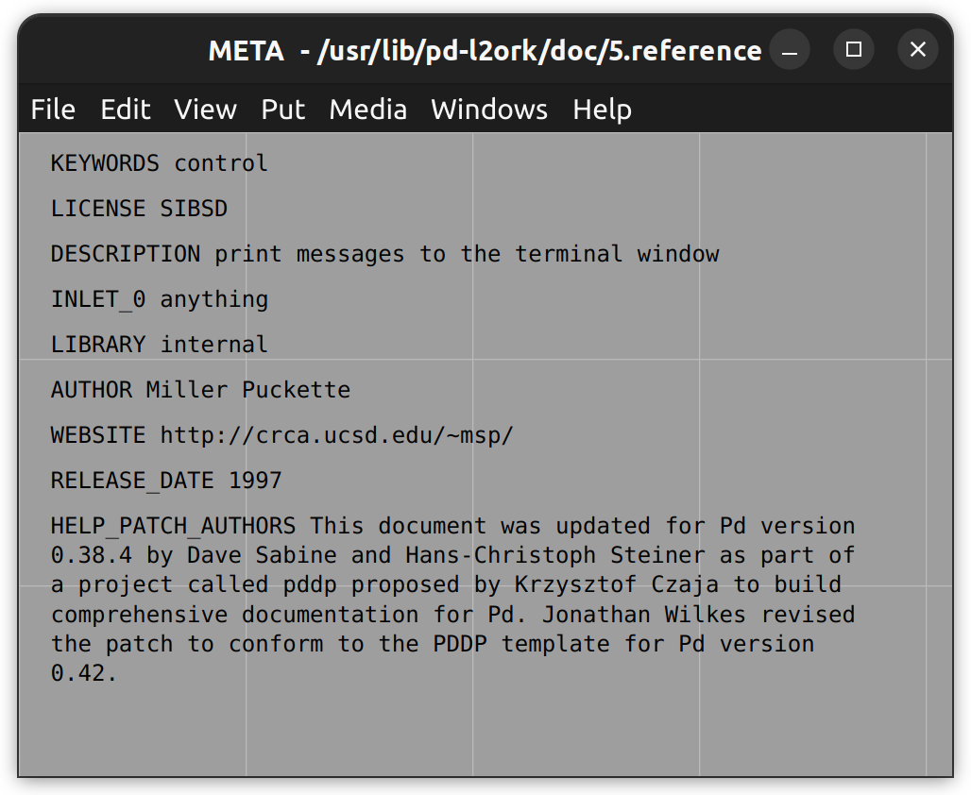
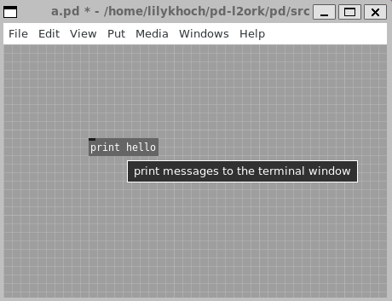
Tooltips
Notes:
Hoverable tooltips for objects

Slide 6
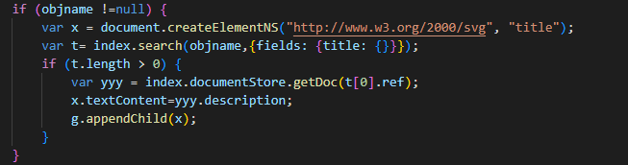
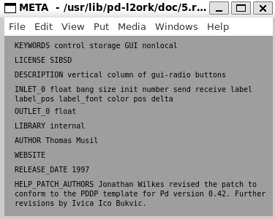
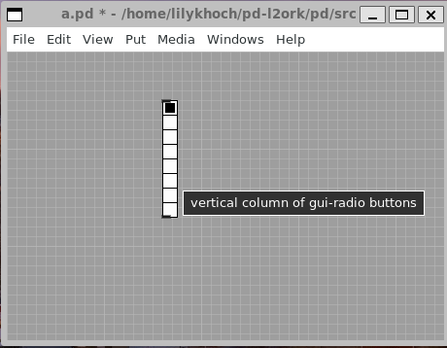
Adding title tag to each object

Slide 7
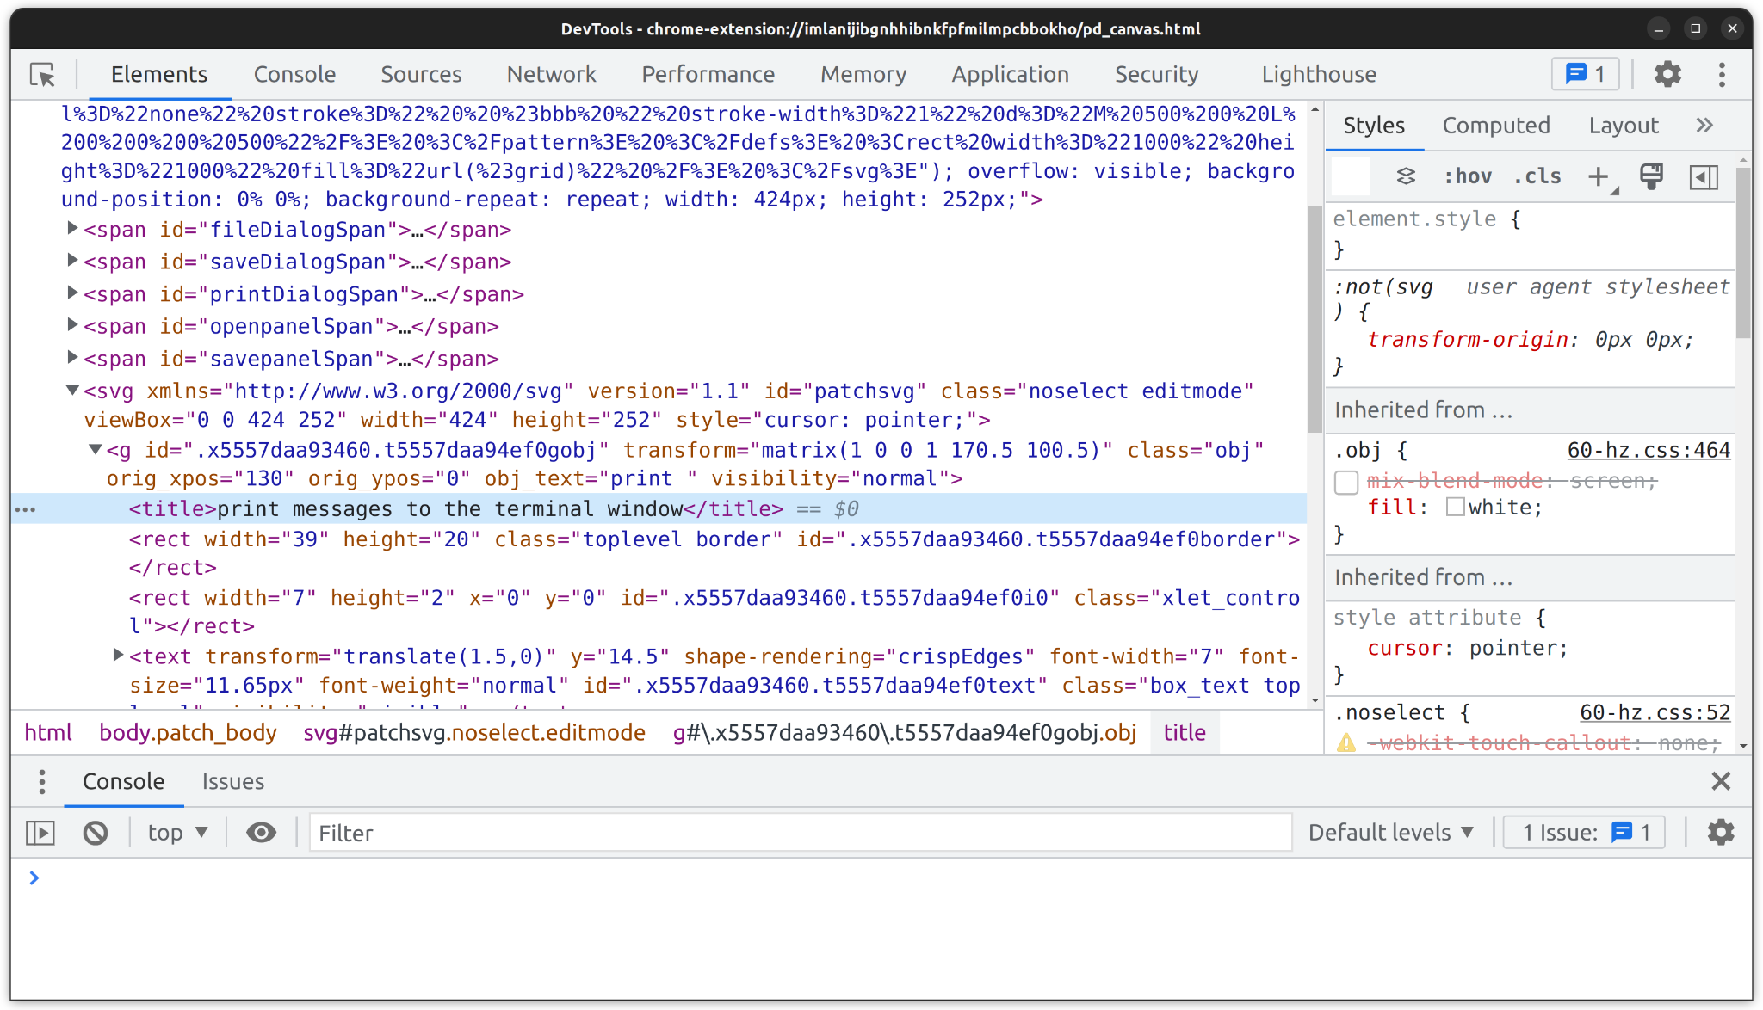
Tooltips Implementation
Notes:
Added a title tag to a object

Slide 8
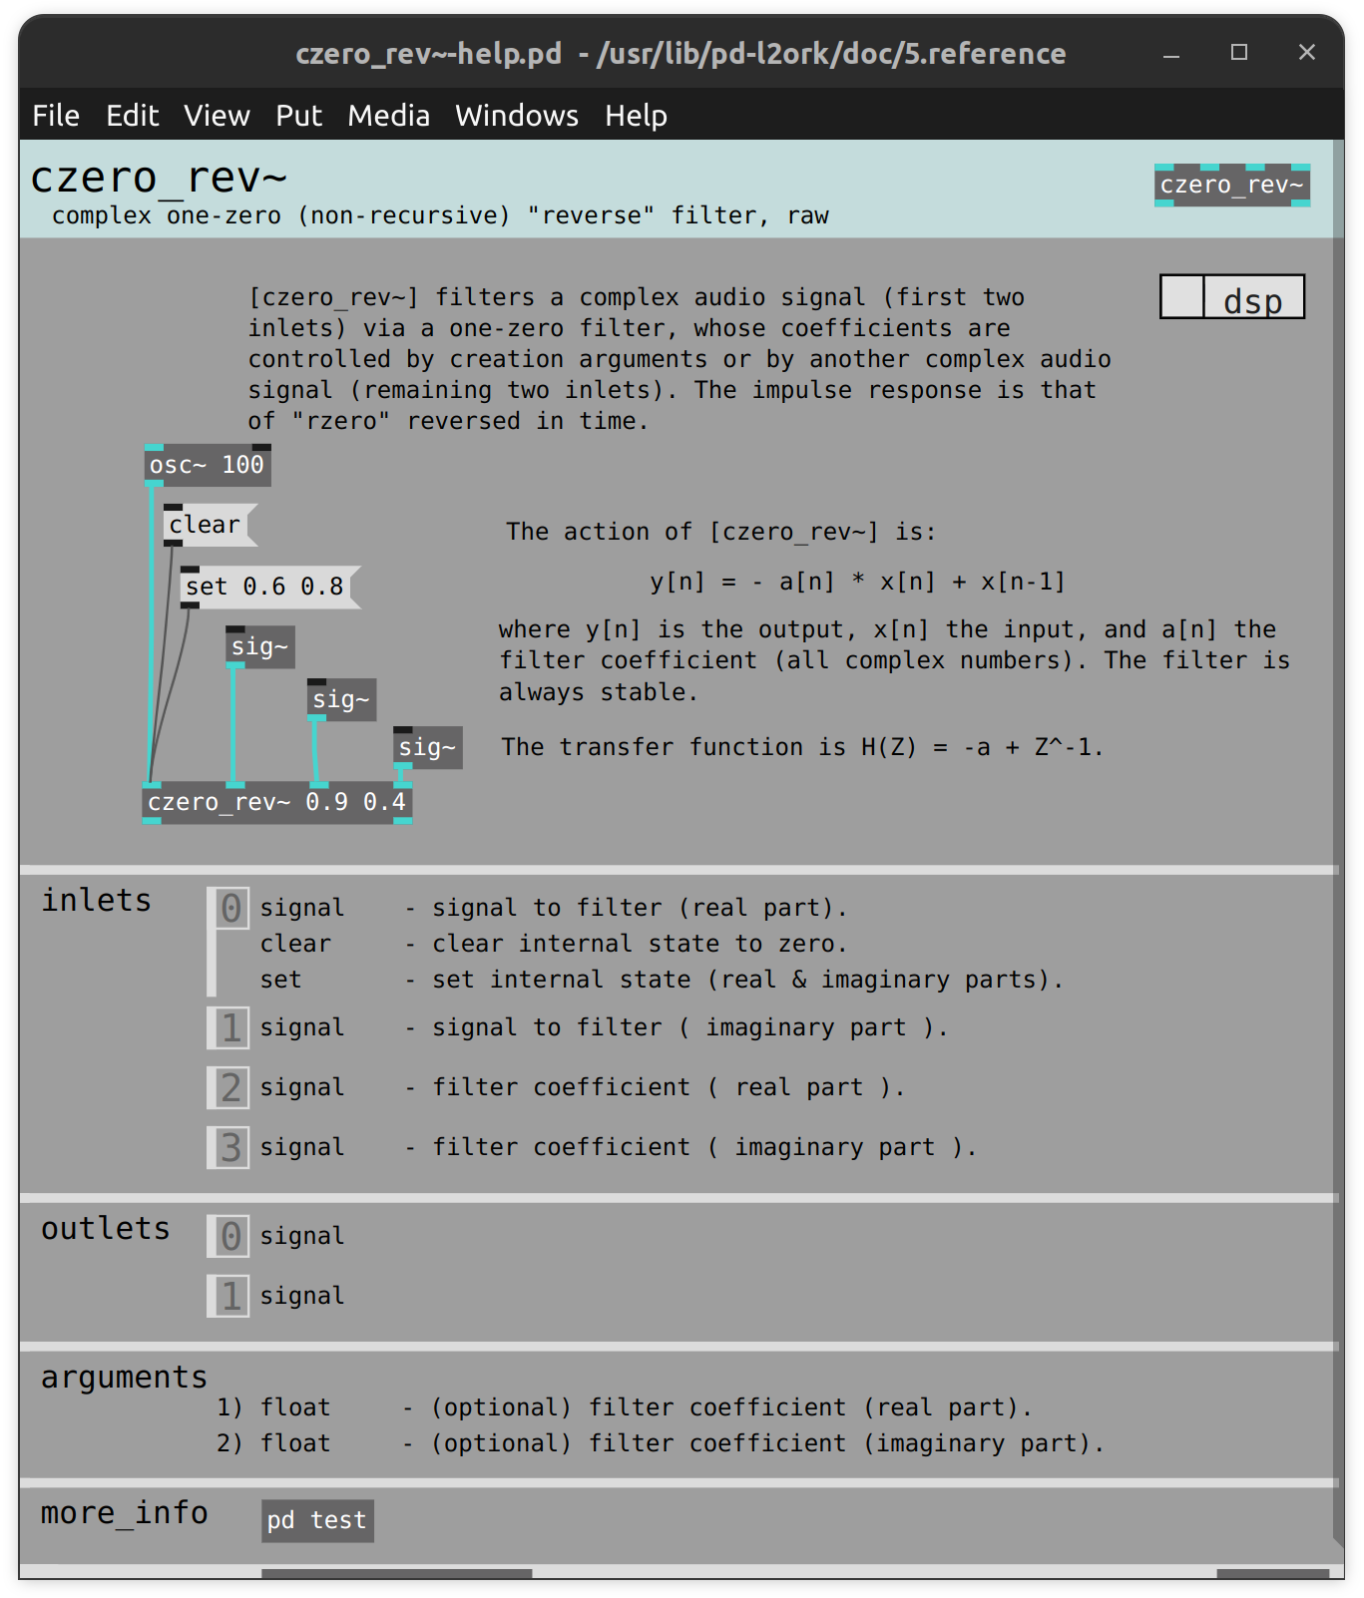
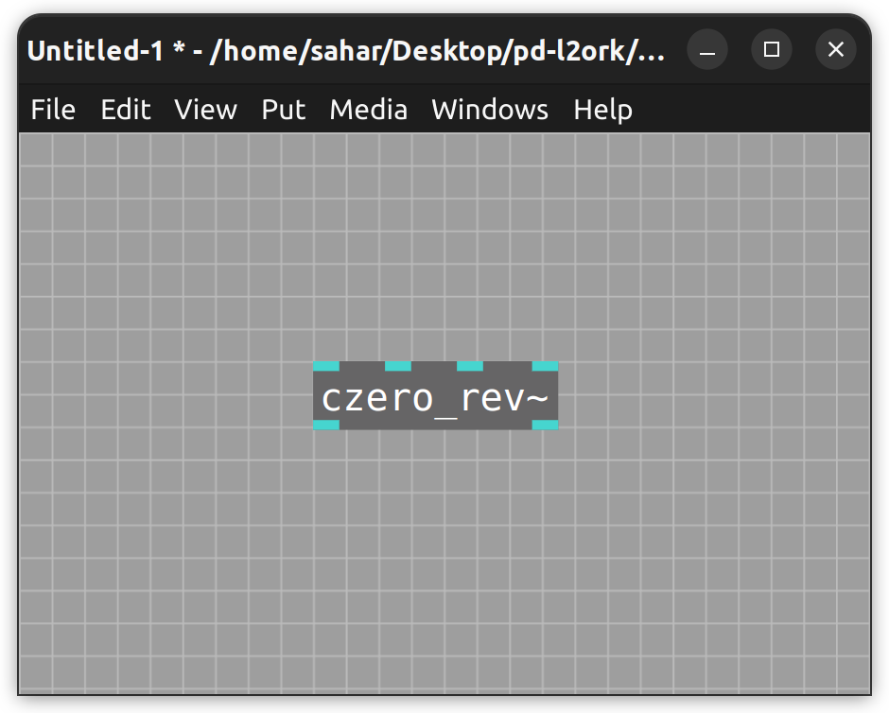
Object with Multiple inlet/outlets
Inlets
Outlets

Slide 9
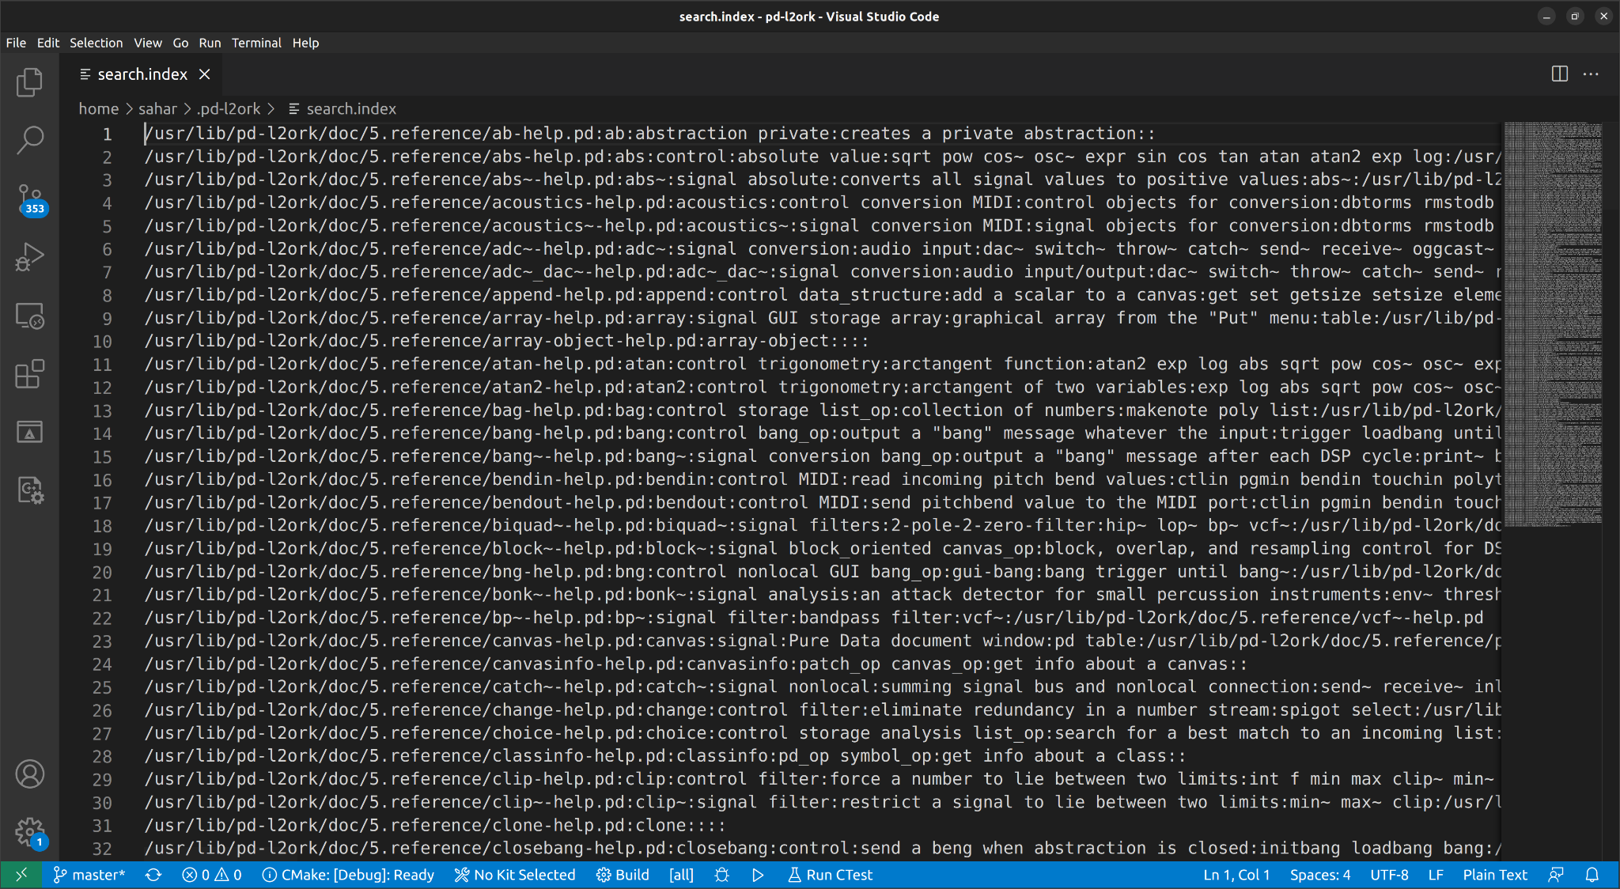
Change the search.index file
Notes:
The parsing from the document page is already done.
We have to figure out a way to add parts for inlet and outlet and separate them by something like pipe(|) and so then it will be easy to get access to them.

Slide 10
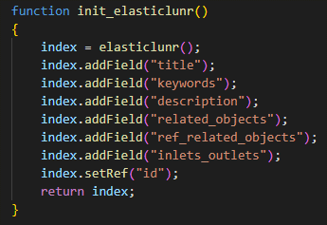
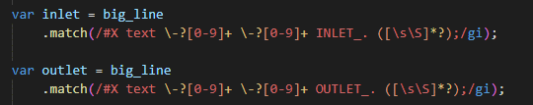
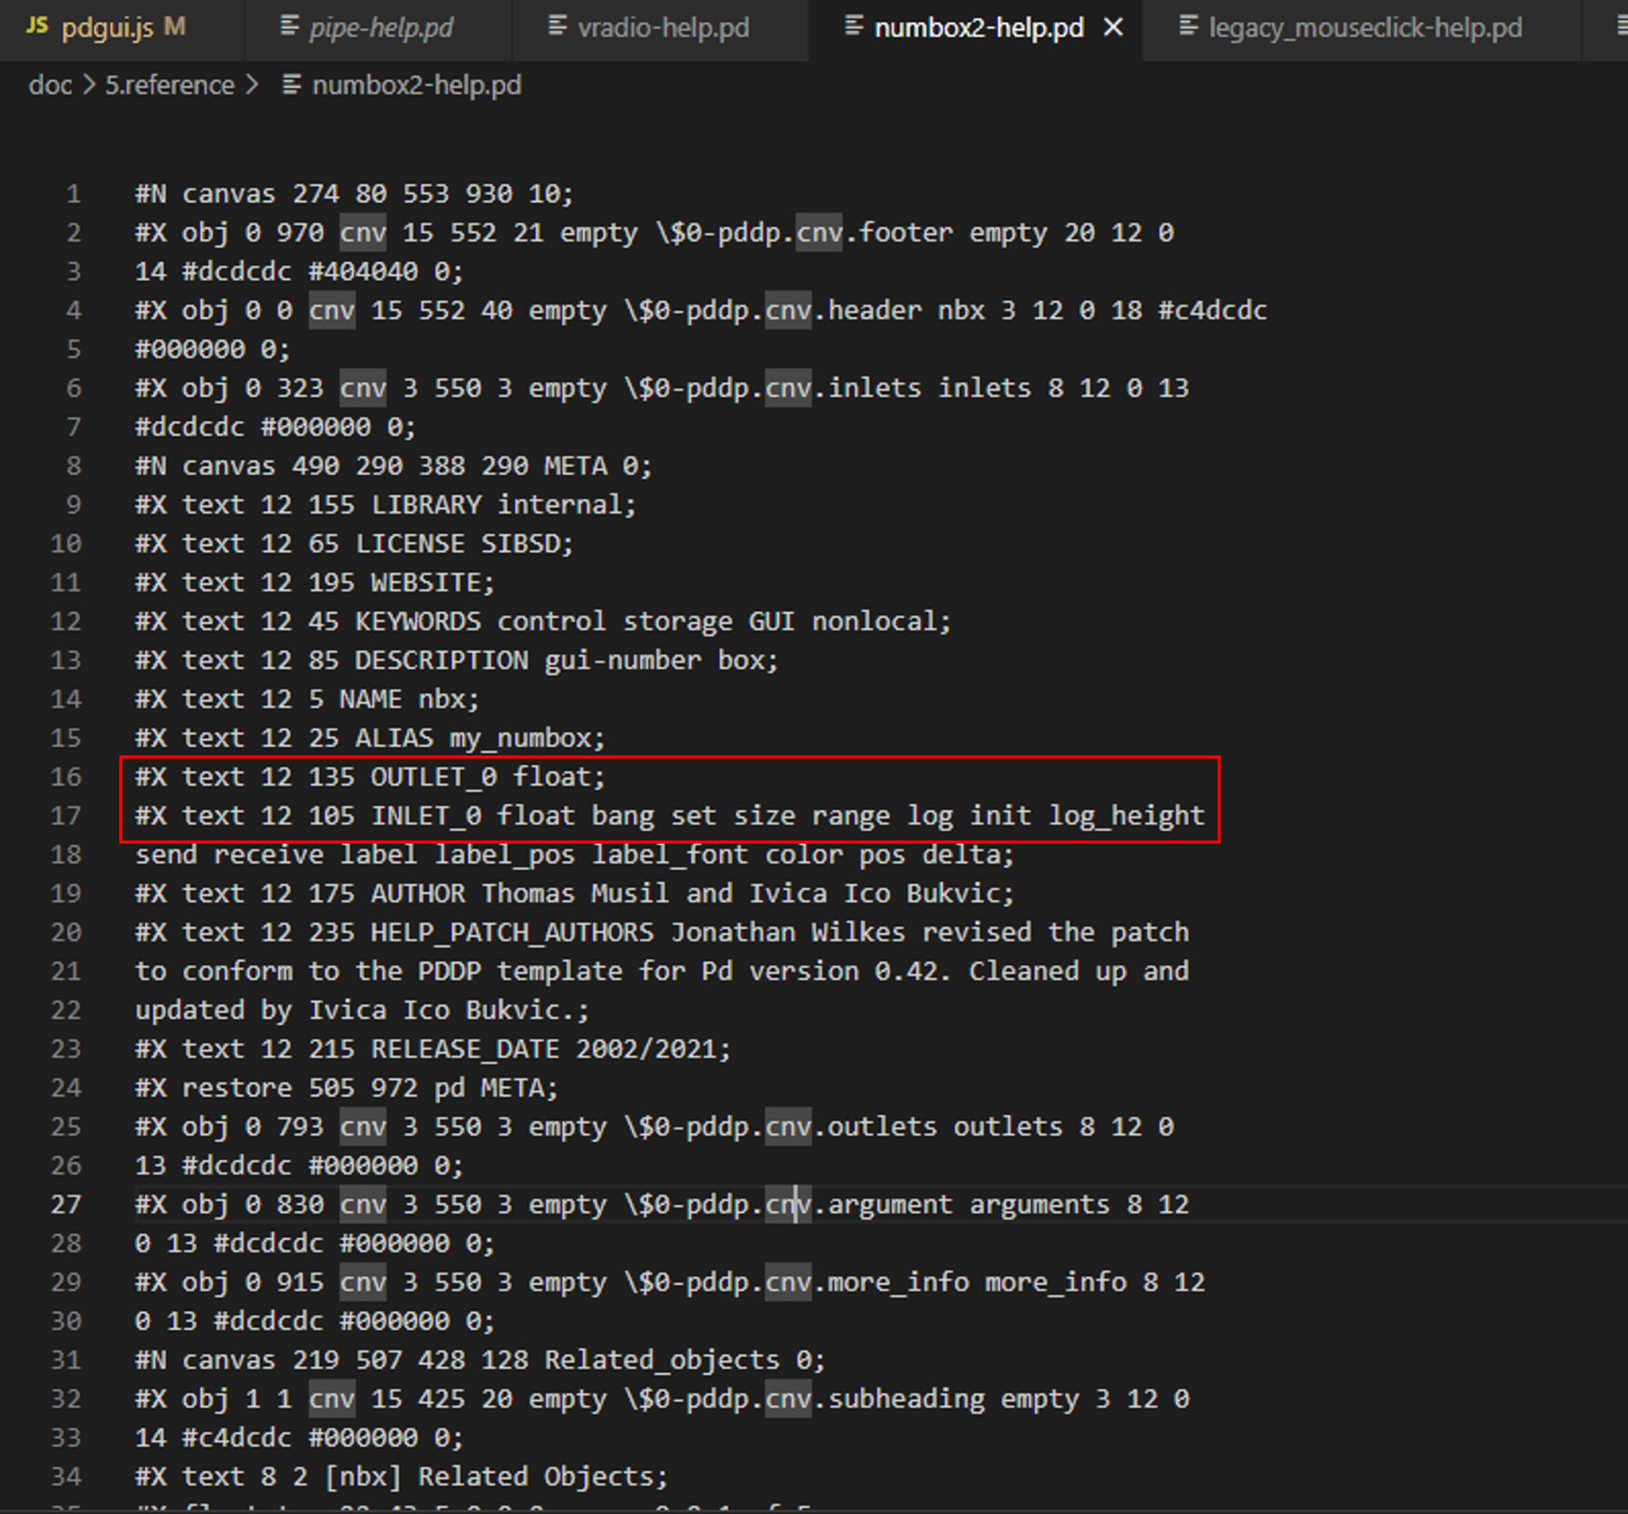
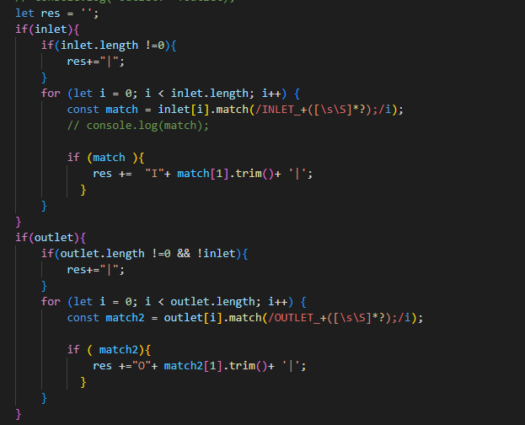
Parsing the Help files

Slide 11
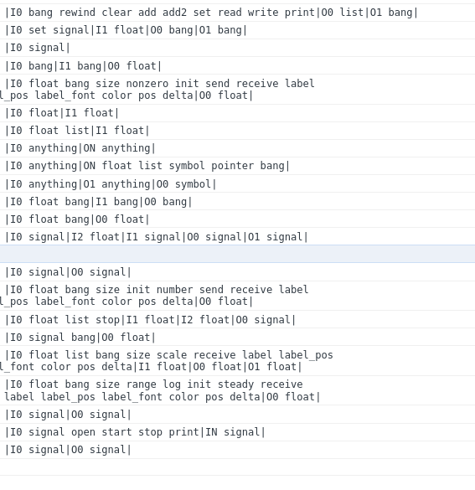
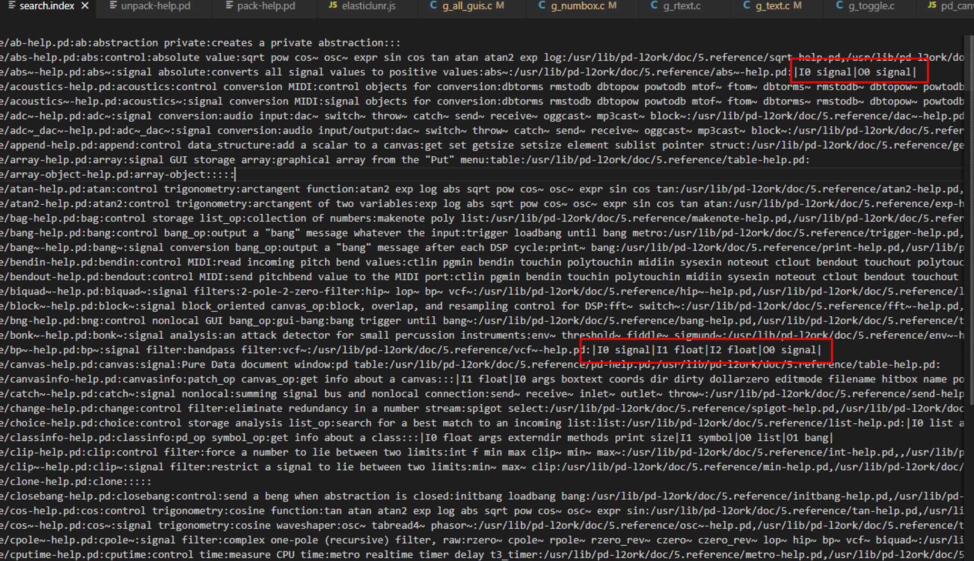
Extracting inlet/outlet info for each object and adding to search.index file
Notes:
-Needed something where we could easily read in when we later have to attach each piece to the object itself

Slide 12
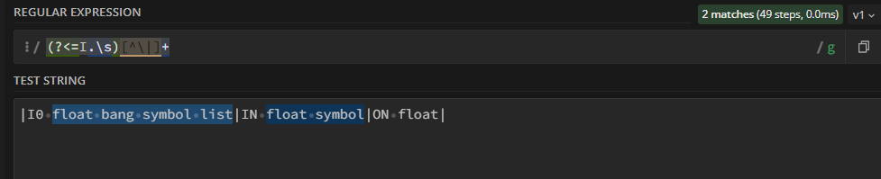
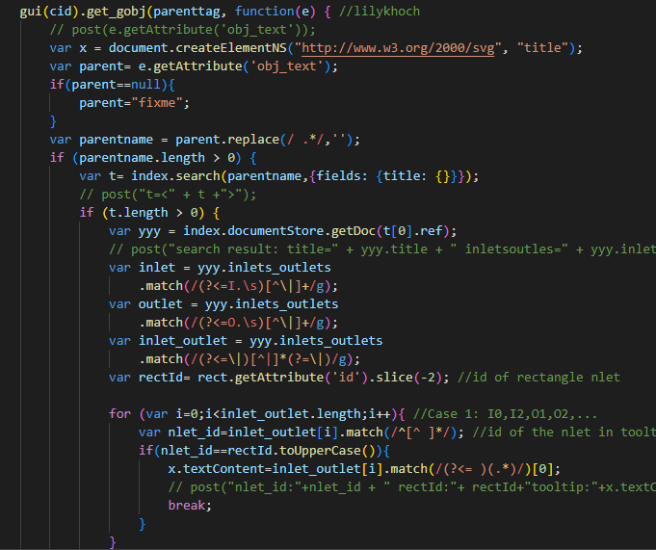
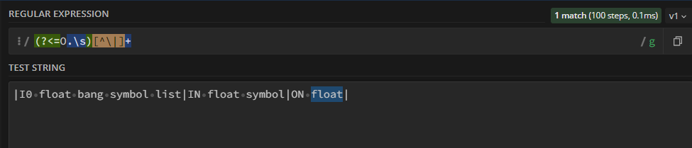
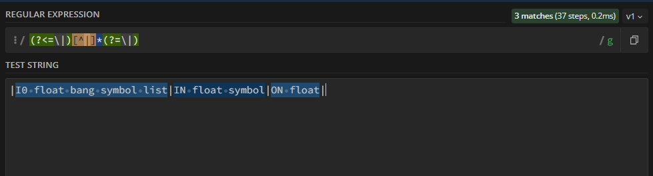
Regex for the extracted Inlet/Outlet Strings

Slide 13

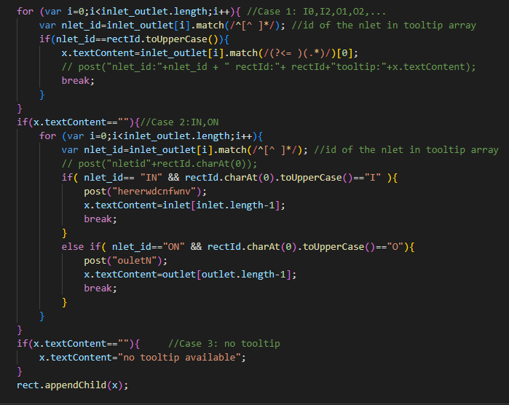
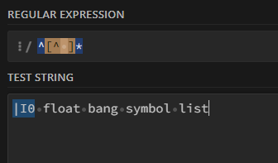
Matching the IDs with the inlet/outlet IDs of the object

Slide 14
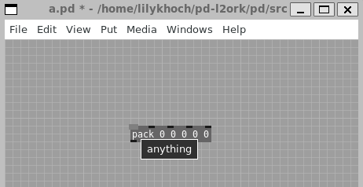
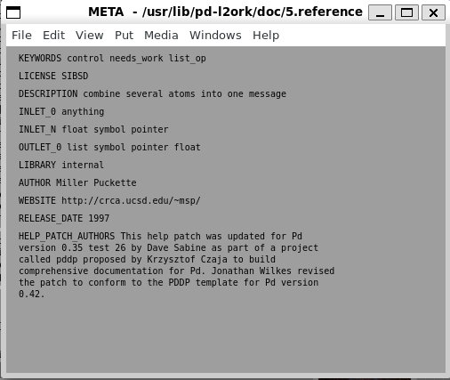
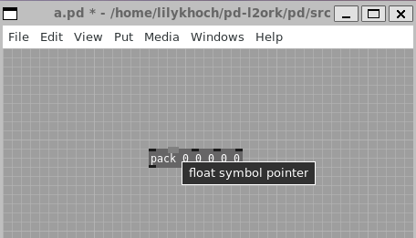
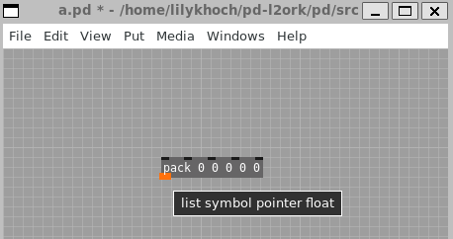
Inlets/Outlets Tooltips

Slide 15
Next Step for Tooltips
Inconsistencies of the naming of objects
Example: “toggle” being named as “tgl”.
Address other outlying cases

Slide 16


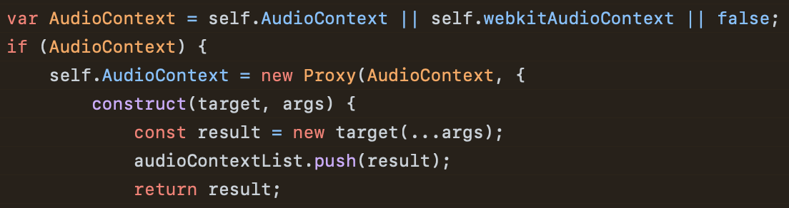
Browser Patch Implementation
Steps we wanted to complete:
Compile Pd-L2Ork (C) to WebAssembly using Emscripten
Correct some C code to make it emscripten compatible (in progress)
Include the generated main.js file in index.html
Link the front-end (GUI) inside the browser and the backend

Slide 17
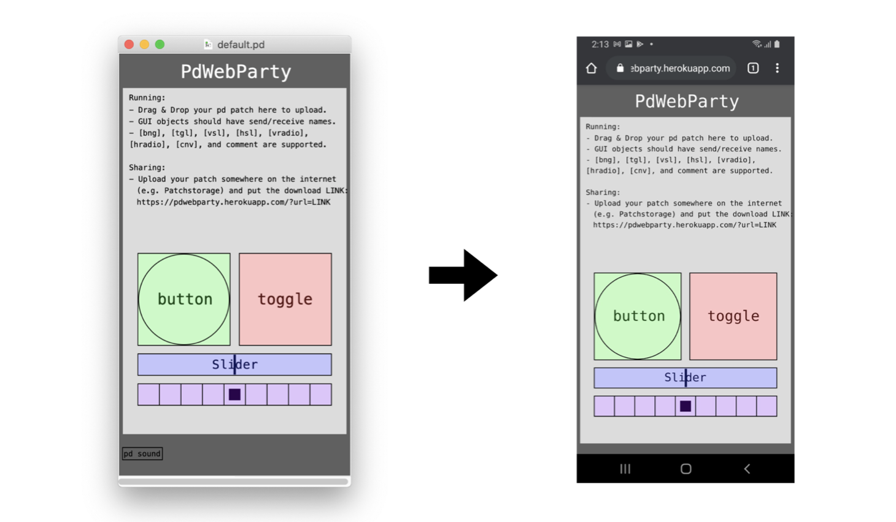
Browser Patch Implementation

Slide 18
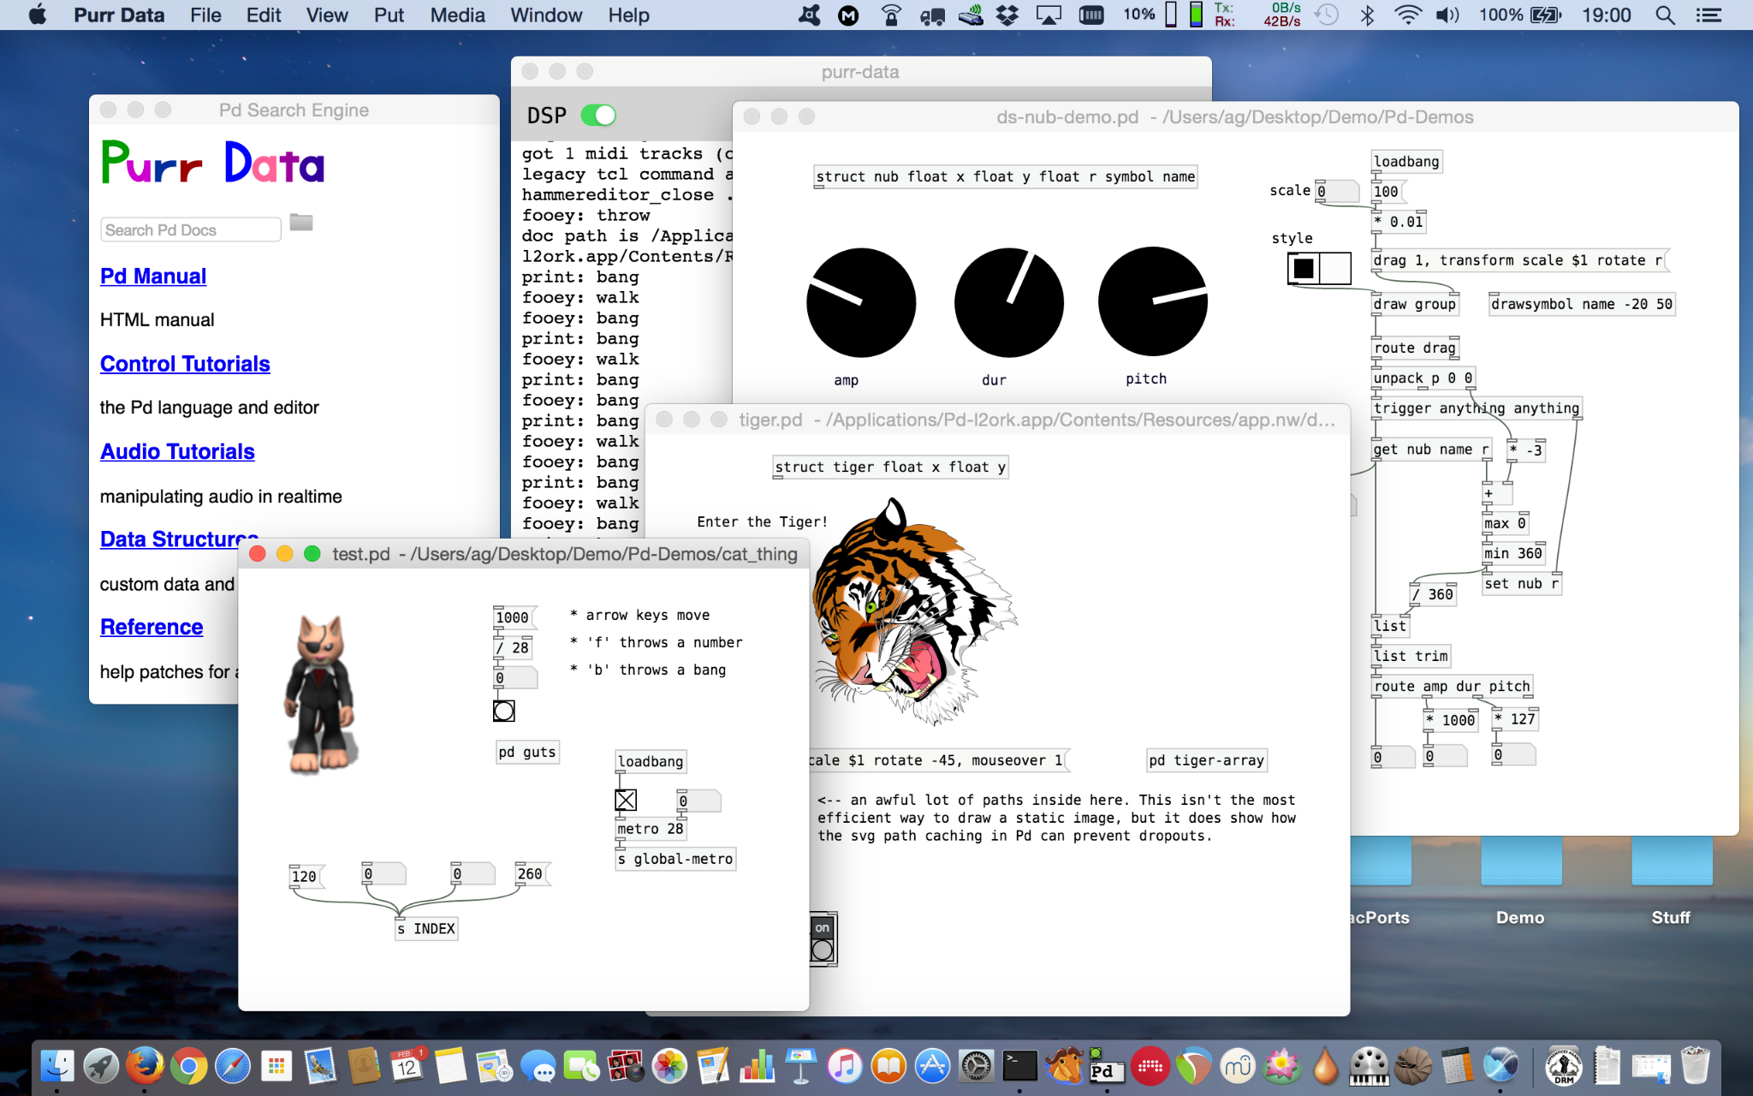
Compiling with Emscripten
Referencing Purr-Data
Addressed errors as they arose
Fundamental differences between Pd-L2Ork and Purr-Data
Did not want to fully merge because Purr-Data:
Has new functions/variables that Pd-L2Ork doesn’t define
Creates editor and graphics differently

Slide 19
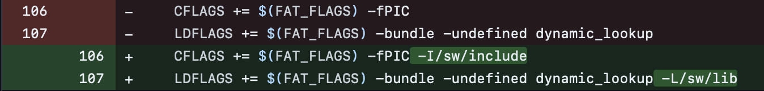
Compiling with Emscripten: Examples
Special Flags:

Slide 20

Compiling with Emscripten: Function Pointer Example

Slide 21
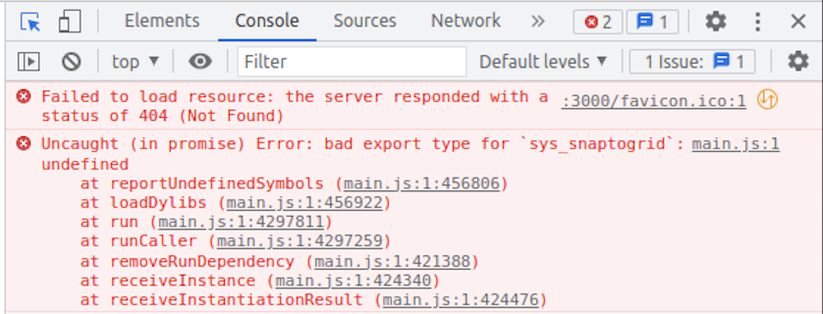
Running in PdWebParty
New features break PdWebParty

Slide 22
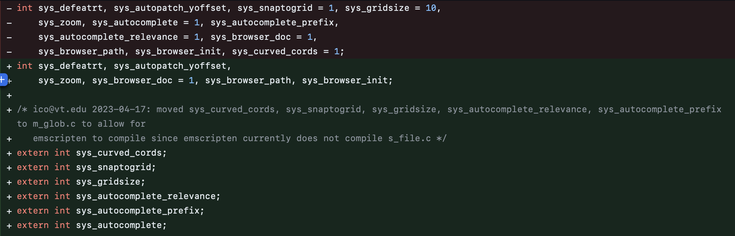
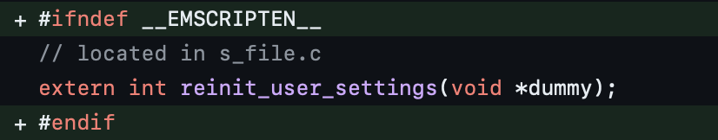
Fixes

Slide 23
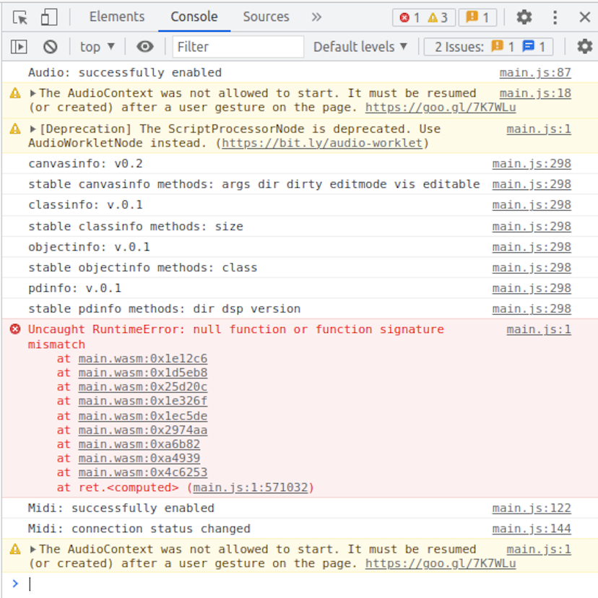
Current Status

Slide 24
Future Work
Fix remaining bugs keeping frontend from running
Modify build script
Testing and integration

Slide 25
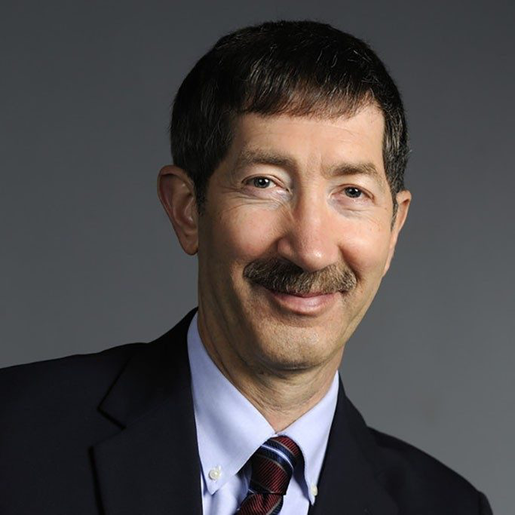

Acknowledgements
Dr. Ivica Ico Bukvic
Dr. Edward Fox
Zack Lee
Previous Pd-L2Ork teams

Slide 26
References
https://sopa.vt.edu/faculty_staff/music-faculty/comp-and-creative-tech-faculty/ivica-ico-bukvic.html
https://l2ork.music.vt.edu/main/make-your-own-l2ork/software/
https://github.com/pd-l2ork/pd-l2ork/
https://github.com/cuinjune/PdWebParty
https://git.purrdata.net/jwilkes/purr-data/-/tree/emscripten

