Slide 1

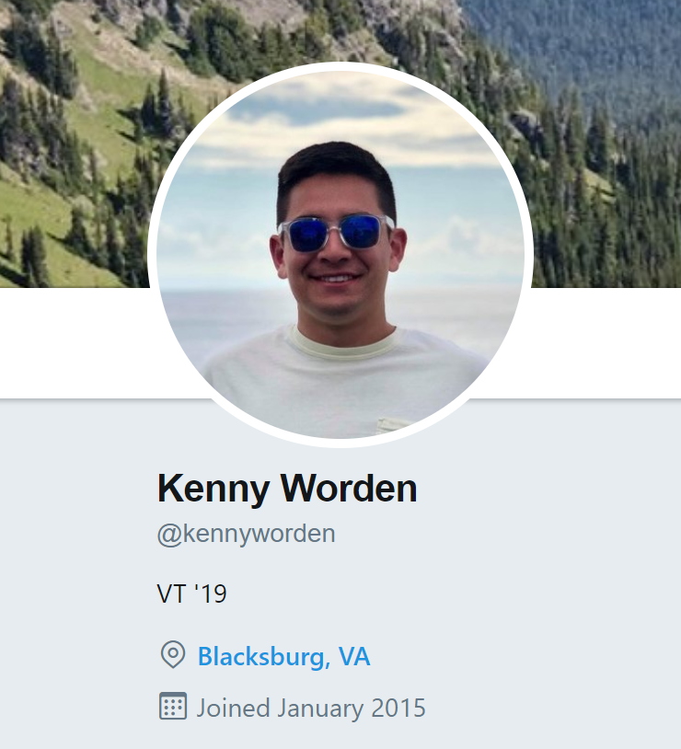
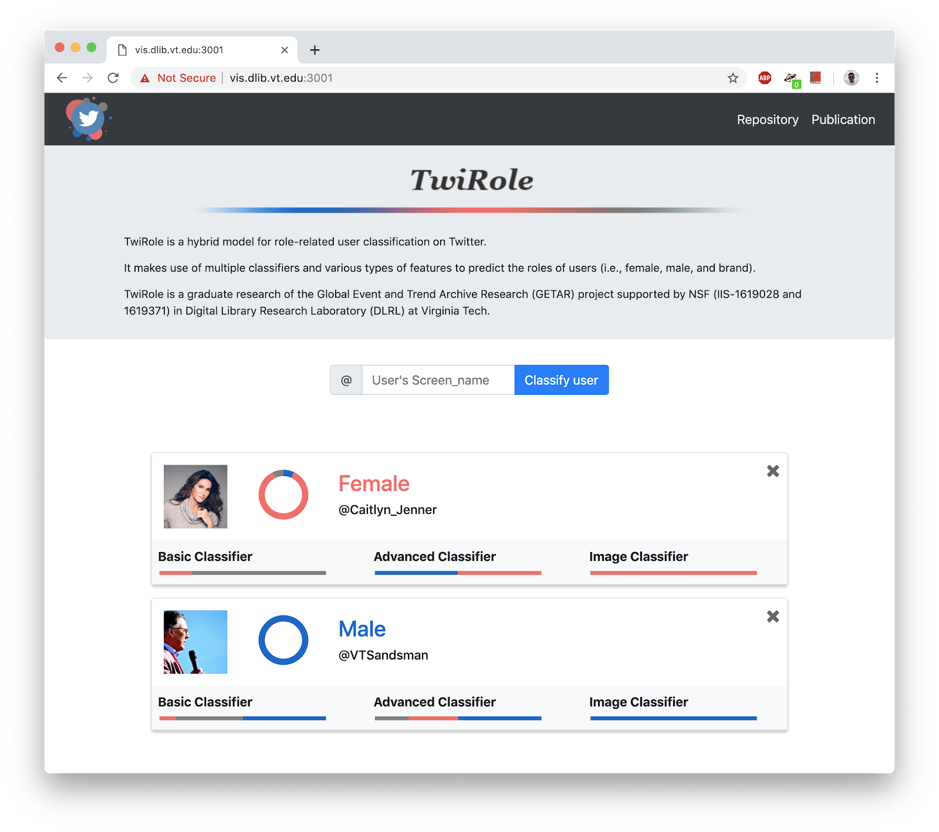
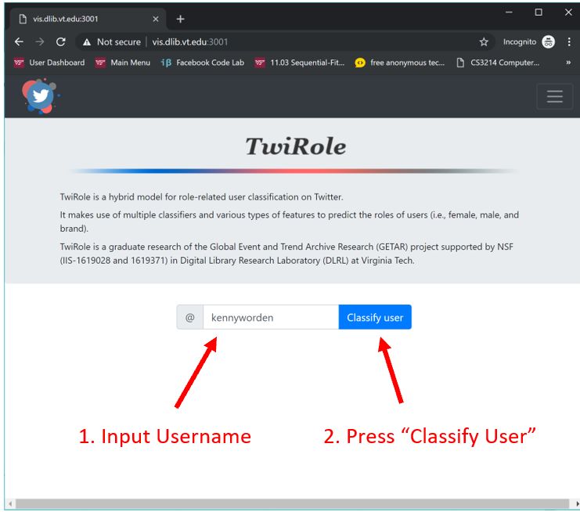
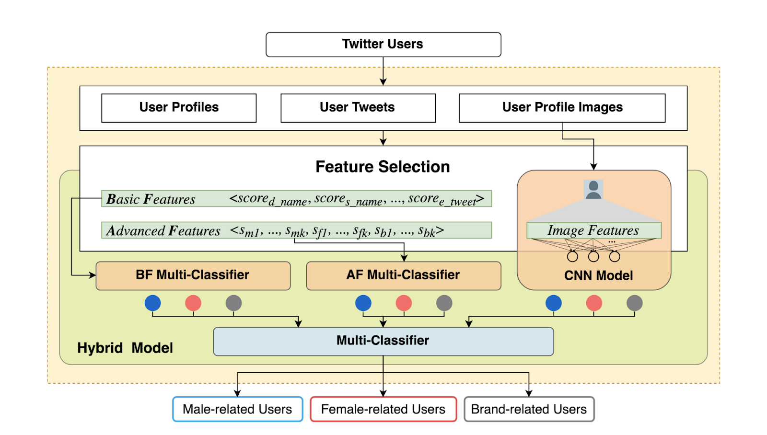
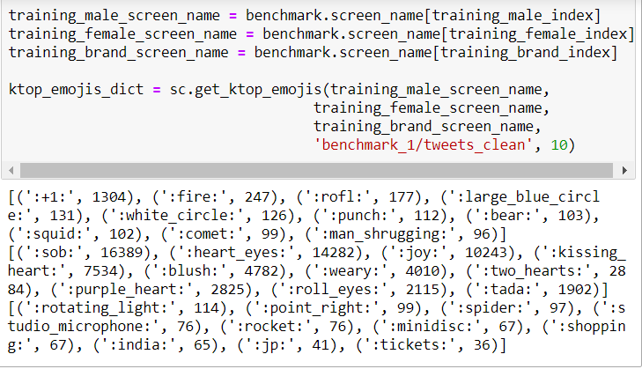
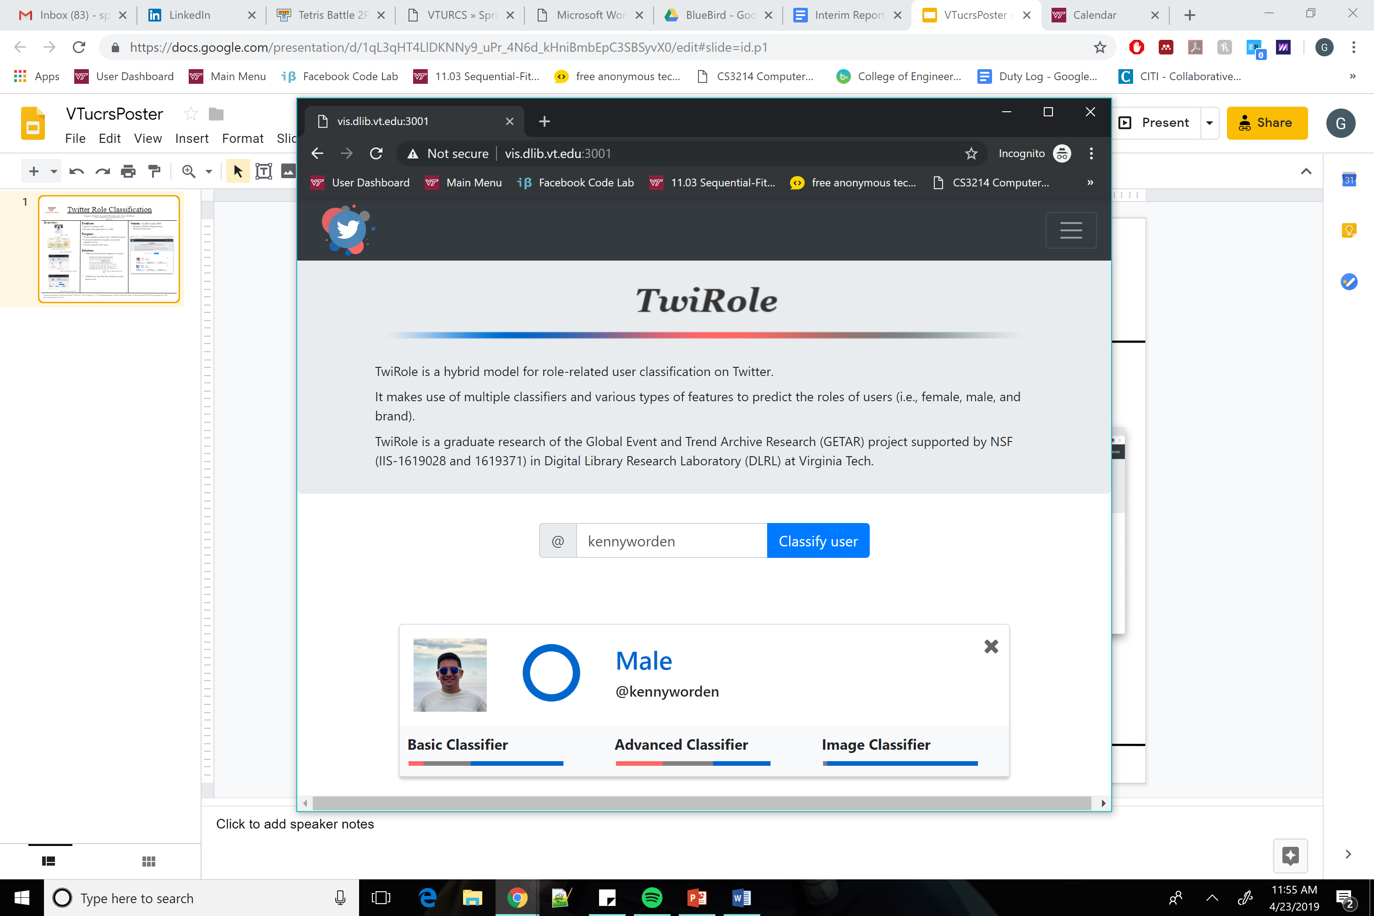
Twitter Role Classification
Gregory Pickett, Kenneth Worden and Adam Wilborn
CS 4624 – Multimedia, Hypertext, and Information Access Spring 2019
Overview:
Problem:
Improve existing model
Develop web application for model
Purpose:
Social scientists can have user –centered research
Consumer-oriented companies can provide targeted services
Classify general twitter users
Solution:
Added advanced feature of emoji frequency
Added basic classifier that calculates second person score
Website: vis.dlib.vt.edu:3001
Hosted by DLIB of Digital Library Research Laboratory
Twitter user
Front end
Back end
Male
Female
Brand
Emojis commonly used by each class
Final Website design
Results
Acknowledgements: Professor Edward Alan Fox, Client Liuqing Li, VT CS department and Global Event and Trend Archive Research (GETAR) supported by NSF (IIS-1619028 and 1619371)

