Slide 1
Avoid Infection, and While You’re At It, Have a Demographic Transition
or
Allocating Energy: What Social Activists Know About Metabolism
Timothy G. Bromage
Biomaterials & Biomimetics
New York University College of Dentistry
Sophie Wenzel
Population Studies
370-380 Shanks Hall
November 7,2013
for
Notes:
microstructural studies allow retrieval of longitudinal data about the chronology of dental development events
circaseptan rhythm of amelogenesis (crown formation) -> enamel prism varicosities & constrictions = cross striations → daily rate of enamel secretion – cf. counting tree rings for ages
angulation of Striae in sectioned enamel & spacing of perikymata on surface indicate enamel extension rate (number of newly differentiated ameloblasts secreting enamel over a standard period (1 yr.)) – fewer perikymata = relatively greater number of ameloblasts secreting enamel (but same daily rate)
cuspal vs. imbricational enamel indicating the overall progress of crown formation – more imbricational enamel indicates a slower overall rate of crown formation (longer CFTs)
THUS, ABLE TO RETRIEVE SOME VERY DETAILED INFORMATION ABOUT THE TIMING OF DENTAL DEVELOPMENT EVENTS – links to functional aspects of tooth morphology?

Slide 2
OUTLINE
1. TEETH AND METABOLISM
2. MICROBES TO METABOLISM
3. SOLUTIONS TO PROBLEMS

Slide 3



1, WHAT HAVE TEETH GOT TO DO WITH IT?
Striae of Retzius
dry
year
rainy
year
scar from
forest fire
first year growth

Slide 4
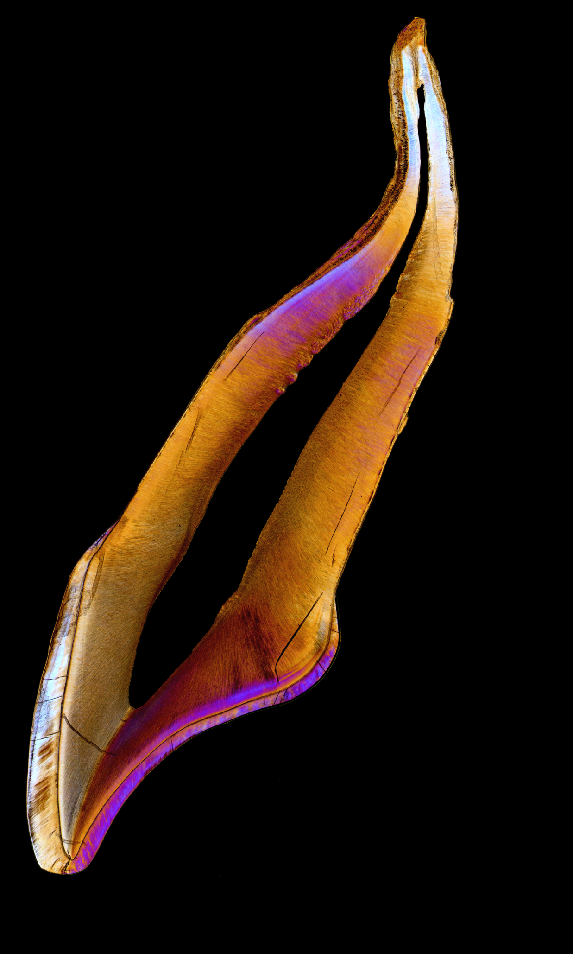

FOR INSTANCE, A BABY TOOTH
Perturbation to enamel and dentine formation at birth, the “neonatal line”
Carious enamel
(42 days)

Slide 5
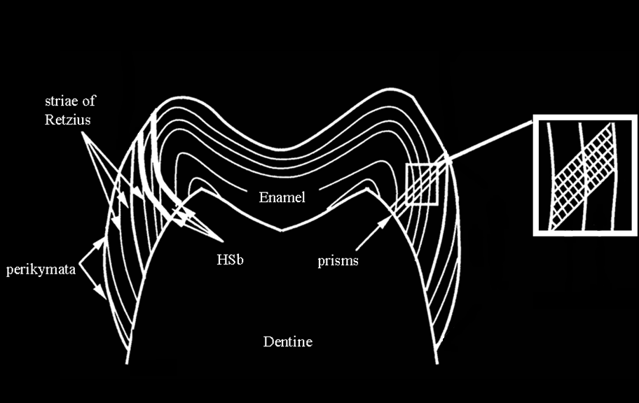

A QUICK REFRESHER ON ENAMEL STRUCTURE AND, YES, ITS RELATION TO METABOLISM !
striae of Retzius
daily increments:
The number of increments between striae is called the “repeat interval”

Slide 6
ENAMEL STRIAE OF RETZIUS
Striae of Retzius

Slide 7
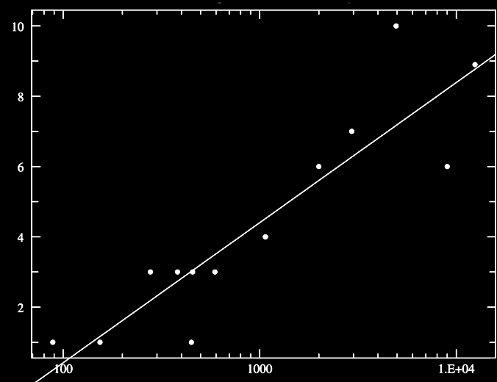

RELATIONSHIP BETWEEN STRIAE OF RETZIUS REPEAT INTERVAL AND BMR (ml O2/h) AMONG PRIMATES
Pongo pygmaeus
Homo sapiens sapeins
Papio anubis
Striae of Retzius Repeat Interval
Alouatta palliata
Pan troglodytes
Erythrocebus patas,
Hylobates lar
Callimico goeldii, Leontopithecus rosalia, Aotus sp., Saimiri sciureus
Callithrix pygmaea, Callithrix jacchus ,
r = 0.90, p < 0.001
Sagunius oedipus
Basal Metabolic Rate (log)

Slide 8
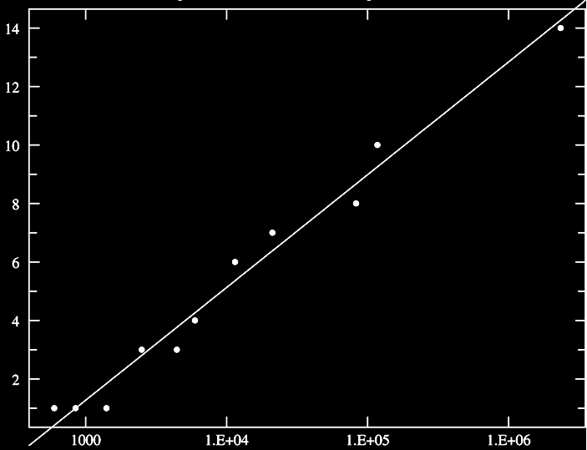
RELATIONSHIP BETWEEN STRIAE OF RETZIUS REPEAT INTERVAL AND BMR (W) AMONG PRIMATES PLUS RAT AND ELEPHANT
Elephant
Orangutan
Striae of Retzius Repeat Interval
Human
Baboon
Howler monkey
Patas monkey
Owl & Squirrel monkeys
Rat
r = 0.99, p < 0.001
Common & Pygmy Marmosets
Basal Metabolic Rate (log)

Slide 9

2. THE HUMAN ECONOMIC PRODUCTION SYSTEM FROM MICROBES TO METABOLISM
THE MAIN ELEMENTS
IIIa
ENERGY, METABOLISM & GROWTH
IIIb
MICROBES AND METABOLIC ADAPTATION
IIIc
ECONOMIC STOICHIOMETRY

Slide 10
A METABOLIC THEORY OF ECOLOGY AND THE ENERGETIC-EQUIVALENCE RULE
The metabolic theory of ecology posits that the metabolic rate of organisms is the fundamental biological rate that governs most observed patterns in ecology
ENERGY, METABOLISM & GROWTH
The Energetic-Equivalence Rule reflects mechanistic connections between individual metabolic rates, rates of energy flux by populations, and the partitioning of available energy among species in a community.
Allen, 2002; Brown, 2004

Slide 11
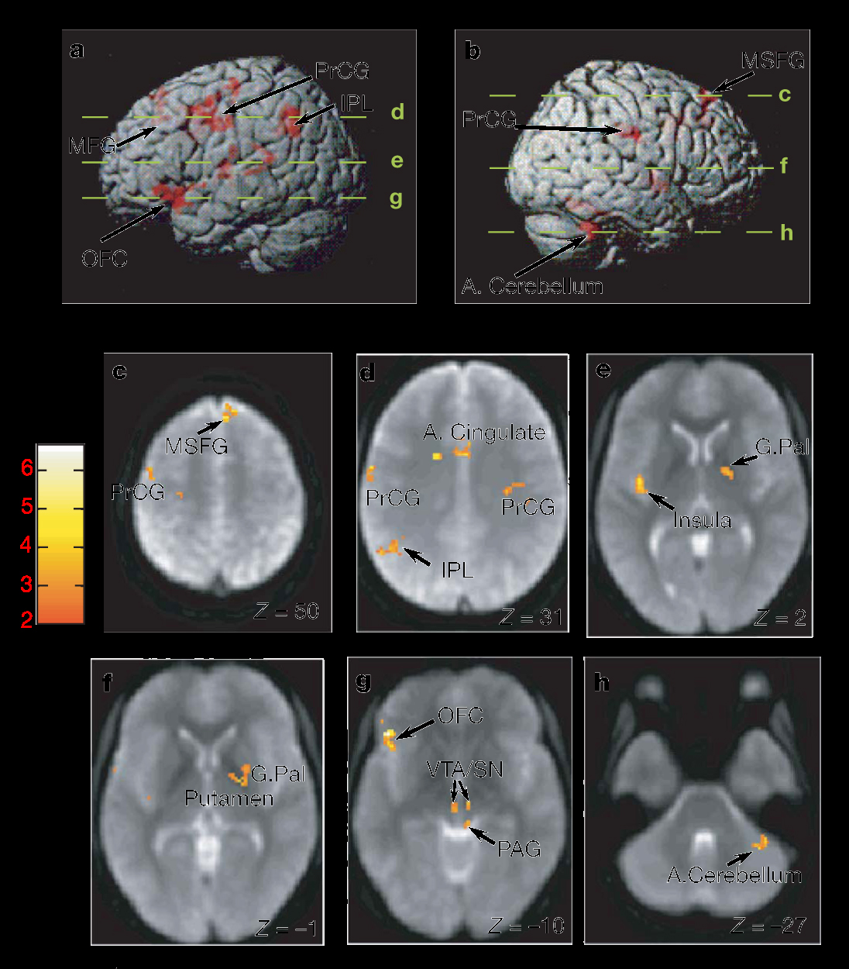
YOU CAN ONLY EAT SO MUCH !
NEUROBIOLOGY OF THE REGULATION OF FOOD INTAKE IN HUMANS
Batterham, 2007

Slide 12
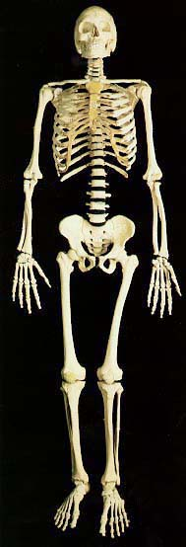
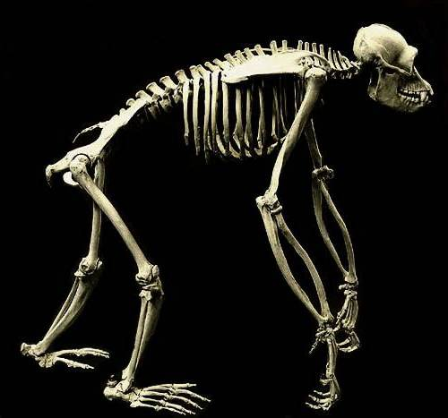


ORGAN MASSES FOR THE AVERAGE HUMAN
Expected
Observed
100%
Brain
Brain
?
Gut & Fat
Gut & Fat
!
Liver
Liver
Kidney
Kidney
Heart
Heart

Slide 13


GROWTH LAW IN THE CONTEXT OF FINITE METABOLIC SUPPLY AND DEMAND
AS A YOUNG
GIRL SHE NEEDS
ENERGY FOR
GROWTH
AS A MOTHER SHE NEEDS ENERGY FOR
REPRODCUTION
MAINTENANCE
MAINTENANCE
ACTIVITY
ACTIVITY
WHEN GROWN
SHE NEEDS
ENERGY FOR
MAINTENANCE
ACTIVITY
Semana Santa, Seville

Slide 14
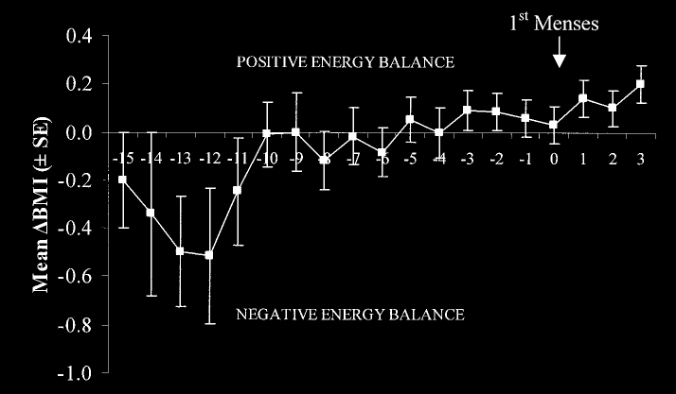
RESUMPTION OF CHILDBEARING IS LINKED TO
METABOLIC BALANCE
months
CHANGES IN THE ENERGY BALANCE OF BREAST-FEEDING WOMEN
Valeggia, 2003

Slide 15
WHAT IS COMPLEXITY?
The world is indeed made of many highly interconnected parts on many scales, the interactions of which result in a complex behaviour that requires separate interpretations of each level… New features emerge as one moves from one scale to another, so it follows that the science of complexity is about revealing the principles that govern the ways in which these new properties appear. These principles include, for instance, self-organization, self-adaptation, rugged energy landscapes, and scaling (e.g. power-law dependence) of the parameters and the underlying network of connections.
They are open systems which require exchanges of energy, materials, and/or information from extrinsic sources to maintain highly organized states far from thermodynamic equilibrium.
They are historically contingent, so that their present configurations reflect the influence of initial conditions and subsequent perturbations.
They are often nested within other complex systems, giving rise to hierarchical organizations that can be approximated by fractal geometry and dynamic scaling laws.
MICROBES AND HUMAN METABOLIC ADAPTION
WITH SOMETHING TO SAY ABOUT COMPLEXITY
Nekola, 2007; Vicsek, 2002

Slide 16
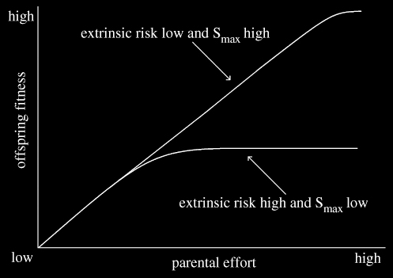
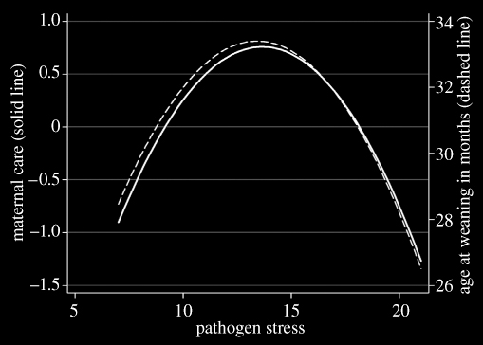
PARENTAL CARE: THE MICROBIAL LINK
Maternal care:
(i) mother’s sleeping proximity to infant
(ii) parental response to infant crying
(iii) bodily contact in early infancy
Quinlan, 2007

Slide 17
A MOTHER’S ENERGY FLOW WHEN MICROBIAL AND HUMAN SYSTEMS COLLIDE
REDISTRIBUTION OF MOTHER’S ENERGY
MOTHER’S ENERGY
TARGET
GROWTH
BABY
MAINTENANCE
REPRODCUTION
ACTIVITY
MAINTENANCE
ACTIVITY
HOUSEHOLD
LIFE
SOCIAL ACTIVITIES
EMPLOYMENT
OWN MORBIDITY
OTHER
(MICROBIAL)
INFANT/CHILD MORBIDITY
REALLOCATION TO NEW BABY

Slide 18
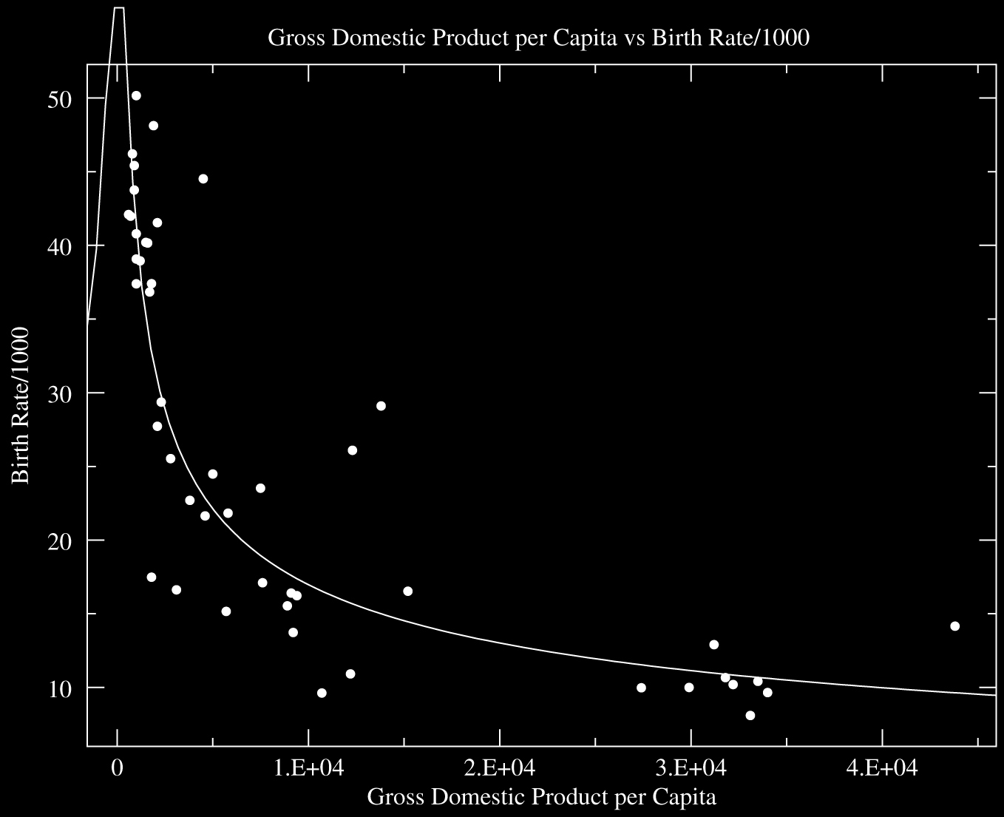

r = -0.884 ( p < 0.01 )
n = 47 countries
MIGHT BIRTH RATES IN THE PRESENCE OF HIGH LEVELS OF INFECTIOUS DISEASE RELATE TO REDUCED EMPLOYMENT AND NATIONAL PRODUCTION?
Birth Rate / 1000
A POWER LAW !
Ordinary least-squares regression of log transformed data on linear scales
Gross Domestic Product per Capita (log)

Slide 19
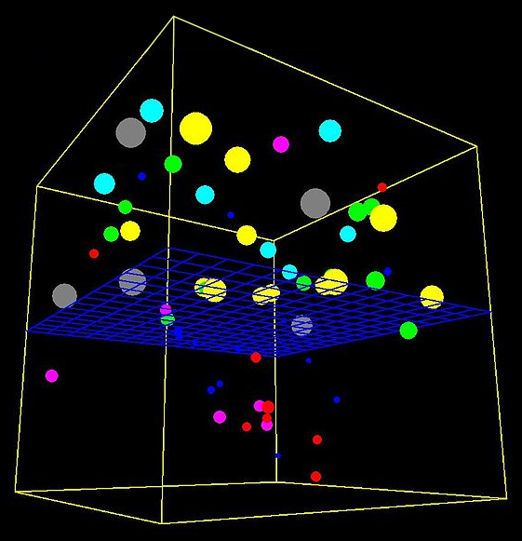


OSMOSIS AND MATERNAL METABOLIC BALANCE
MATERNAL METABOLIC ENERGY DEVOTED TO HUMAN BIOMASS PRODUCTION IN THE FACE OF INFECTIOUS DISEASE
A MESH MAINTAINS ENTROPY GRADIENT
(WHAT COULD THIS FILTER BE?)
MATERNAL METABOLIC ENERGY DEVOTED TO NATIONAL PRODUCTION IN THE FACE OF INFECTIOUS DISEASE

Slide 20
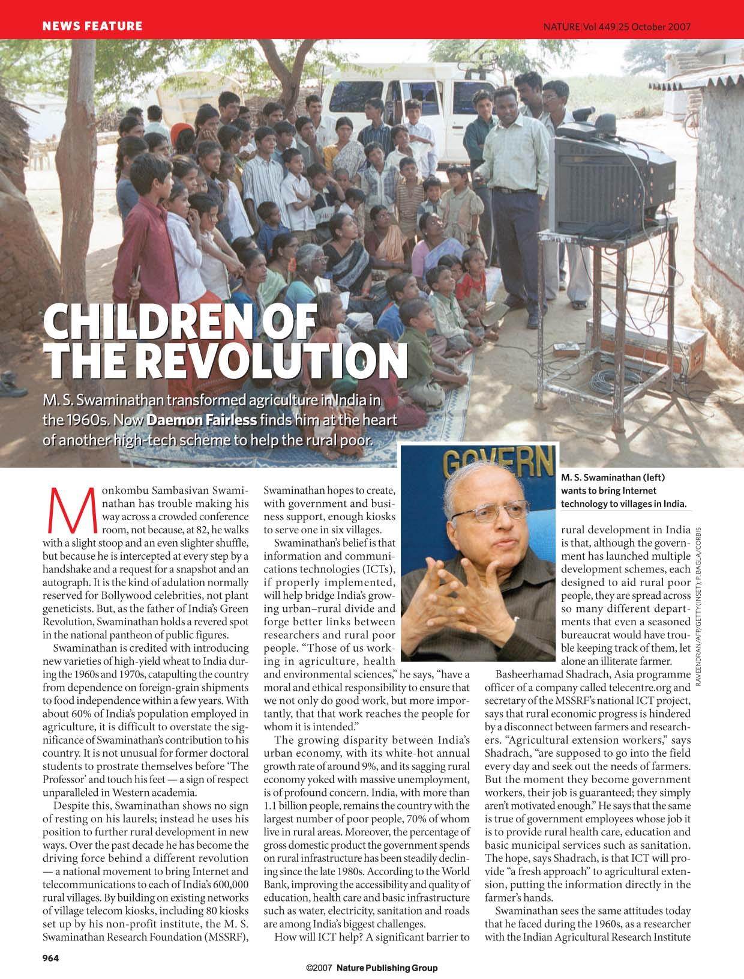
A POLICY, RURAL INFRASTRUCTURE AND HEALTHCARE FILTER?
“The growing disparity between India’s urban economy, with its white-hot annual growth rate of around 9%, and its sagging rural economy yoked with massive unemployment, is of profound concern. India, with more than 1.1 billion people, remains the country with the largest number of poor people, 70% of whom live in rural areas. Moreover, the percentage of gross domestic product the government spends on rural infrastructure has been steadily declining since the late 1980s. According to the World Bank, improving the accessibility and quality of education, health care and basic Infrastructure such as water, electricity, sanitation and roads are among India’s biggest challenges.”
“The growing disparity between India’s urban economy, with its white-hot annual growth rate of around 9%, and its sagging rural economy yoked with massive unemployment, is of profound concern. India, with more than 1.1 billion people, remains the country with the largest number of poor people, 70% of whom live in rural areas. Moreover, the percentage of gross domestic product the government spends on rural infrastructure has been steadily declining since the late 1980s. According to the World Bank, improving the accessibility and quality of education, health care and basic Infrastructure such as water, electricity, sanitation and roads are among India’s biggest challenges.”

Slide 21
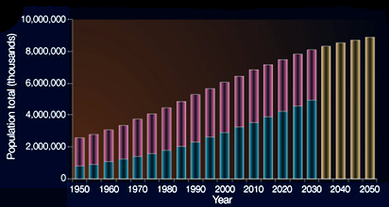
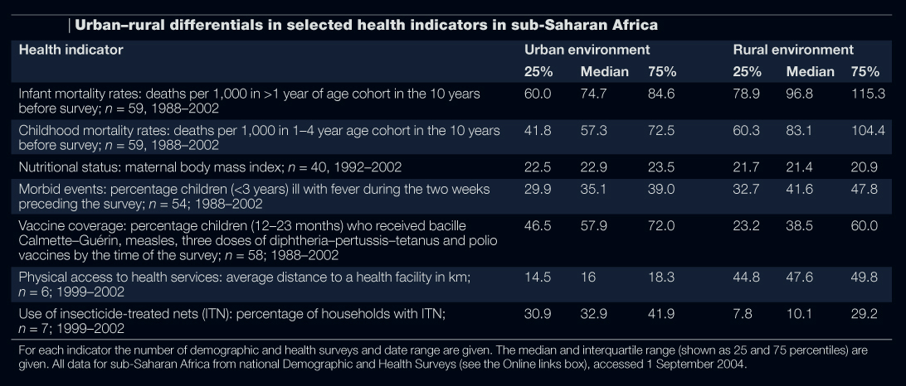
ECONOMIC STOICHIOMETRY
the availability and distribution of
metabolic resources for nations
POPULATION TOTALS FROM 1950-2050. URBAN (BLUE) AND RURAL (RED) IN THE WORLD
SHOWS THAT ACCESS TO HEALTHCARE, JUST LIKE IN KERALA, INFLUENCES THE HEALTH STATUS, EXCEPT THAT IN KERALA, POPULATION INCREASE HAS SUBSIDED, SO MORBIDITY IS INCREASING
Example
Hay, 2005

Slide 22
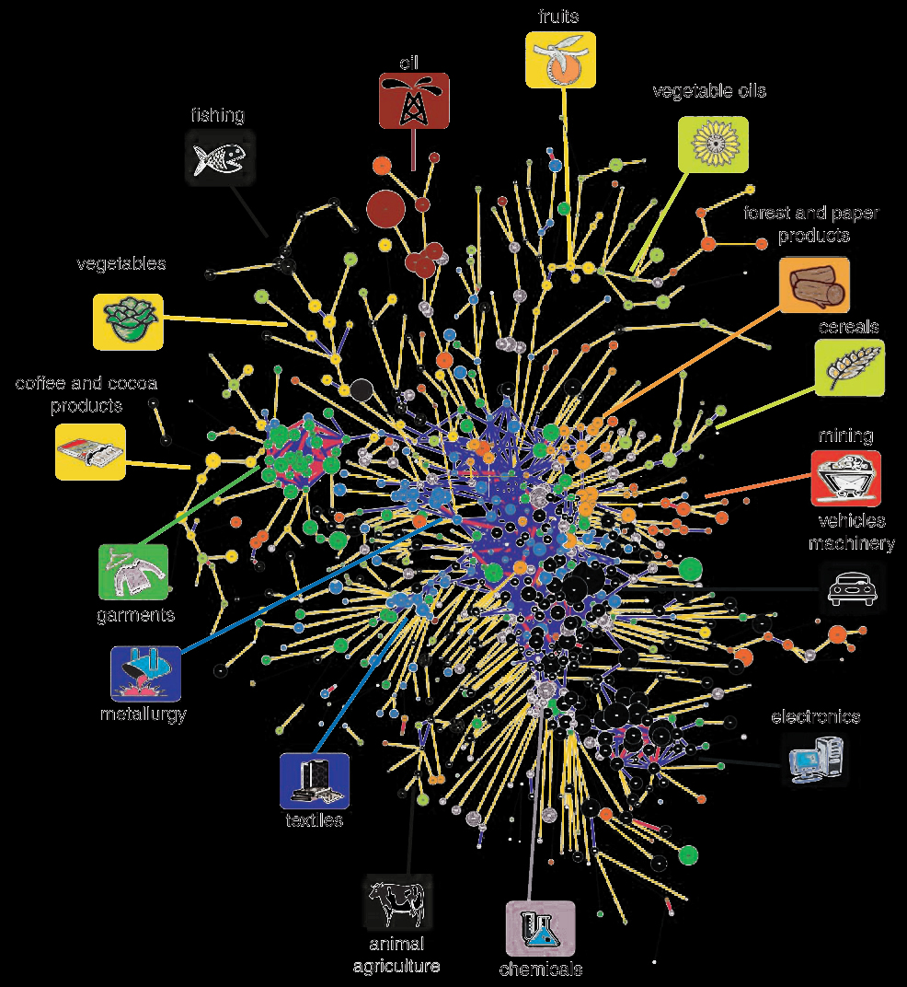
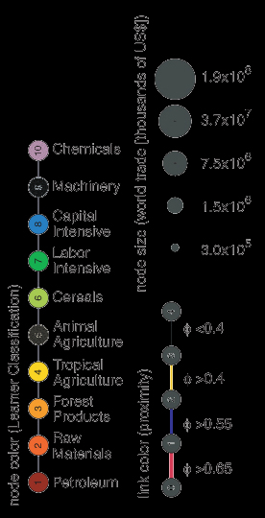
NATIONAL PRODUCTION AND THE COMPLEXITY OF PRODUCT SPACE
Hidalgo, 2007

Slide 23
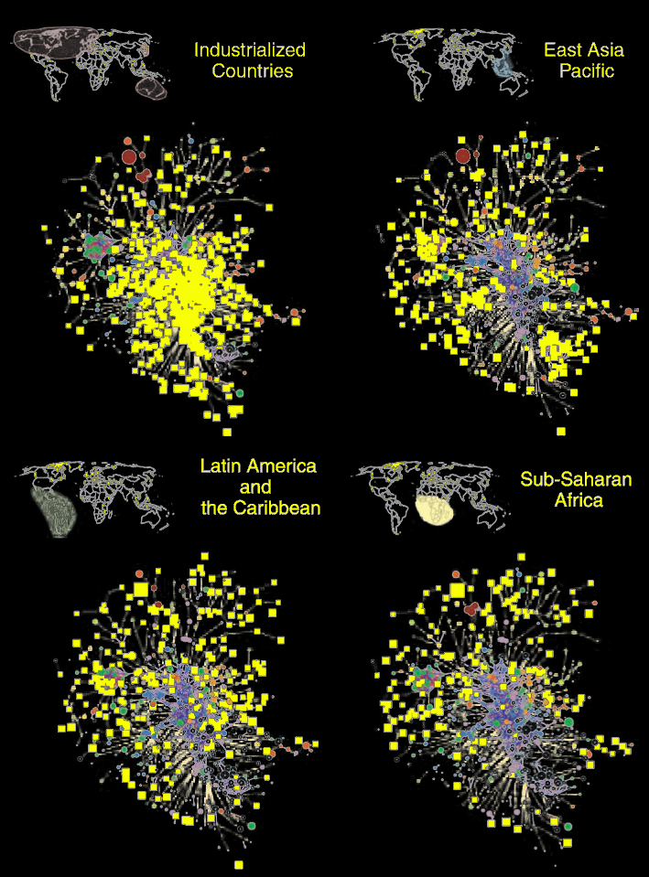
REGIONAL PRODUCT SPACE
In these illustrations, yellow squares mark products successfully
exported. The industrialized countries' products occupy the highly connected core of world trade. Goods from Southeast Asia and the Pacific region cluster in the garment industry and in electronics, while products exported from sub-Saharan Africa and Latin America are mostly peripheral.
Hidalgo, 2007

Slide 24

TO THE FINAL QUESTION, IS THERE A RELATIONSHIP BETWEEN INFECTIOUS MATERNAL METABOLIC BURDON, INFECTIOUS DISEASE, AND NATIONAL PRODUCTION?

Slide 25
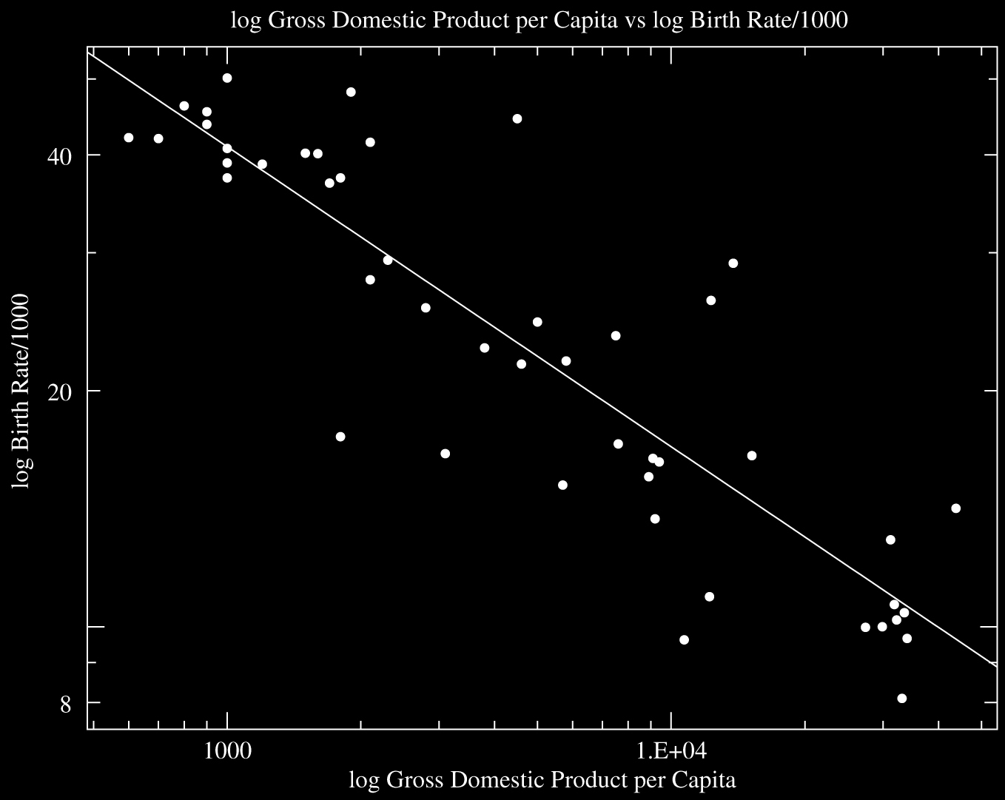
NIGER
r = -0.884 ( p < 0.01 )
slope = -0.38
n = 47 countries
AFGHANISTAN
UGANDA
ANGOLA
MALAWI
LIBERIA - SIERRA LEONE
ZAMBIA
GUINEA
BURUNDI
NIGERIA - RWANDA
PER UNIT GDP, HUMAN BIOMASS PRODUCTION, AND HENCE, ENERGY METABOLISM DEVOTED TO THIS, IS HIGHER IN POPULATIONS EXPERIENCING RELATIVELY HIGHER INFECTIOUS DISEASE.
DJIBUOUTI
KENYA
ETHIOPIA
SENEGAL - TOGO
THE LINK BETWEEN INFECTIOUS DISEASE, HUMAN BIOMASS PRODUCTION AND GDP
BANGLADESH
SAUDIA ARABIA
ZIMBABWE
CAMBODIA
PHILLIPINES
LIBYA
INDIA
NAMIBIA
Birth Rate / 1000 (log)
AMERICAN SOMOA
MOROCCO
BURMA
ALGERIA
TURKEY
ARGENTINA
ARGENTINA
TUNISIA -
KAZAKHSTAN
Major Infectious Diseases:
degree of risk:
ALBANIA
UNITED STATES
THAILAND
FRANCE
SPAIN
EUROPEAN UNION
UNITED KINGDOM
SWEDEN
FINLAND
SWITZERLAND
VERY HIGH
HIGH
RUSSIA
INTERMEDIATE
BULGARIA
LOW
Ordinary least-squares regression of log transformed data on log scales
JAPAN
Gross Domestic Product per Capita (log)

Slide 26
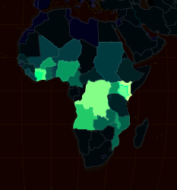
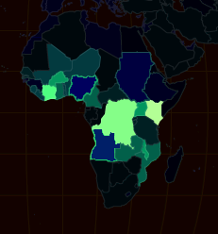
AN IDEA EXPRESSED IN MAPS:
MALARIA DEATHS BY
Total Fertility Rate
Gender Inequality
nd-gi
nd-gi
nd-gi
nd-gi = no data-gender inequality
http://chartsbin.com/graph

Slide 27
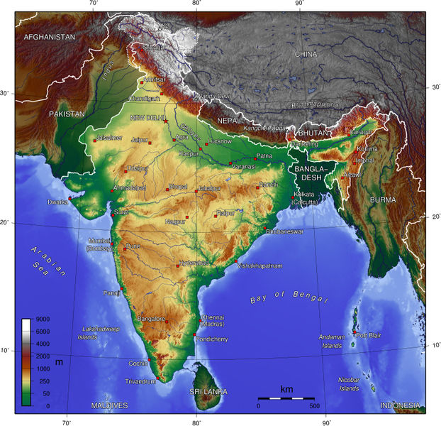
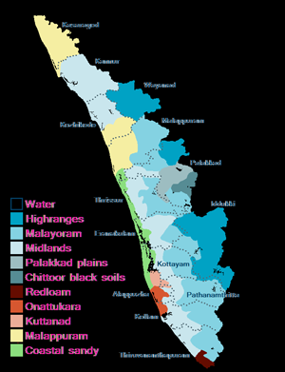
3. SOLUTIONS: THE KERALA PHENOMENON
Kerala

Slide 28


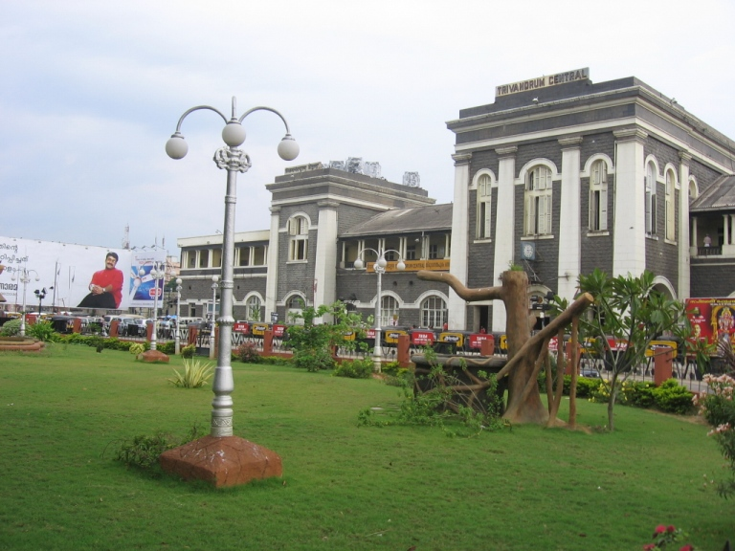
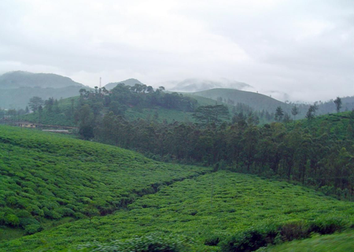
THE KERALA PHENOMENON
The service sector (tourism, public administration, finance, transportation, and communications) were 63.8% of GDP in 2002–2003, while agricultural and fishing industries made up 17.2% of GDP.
Kerala's per capita GDP of 11,819 INR is significantly higher than the all India average.

Slide 29
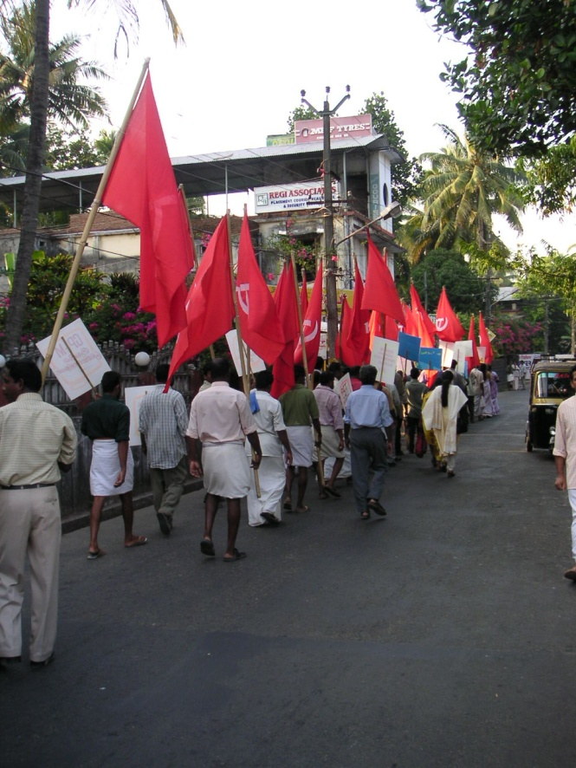
THE KERALA PHENOMENON
Kerala is home to 3.44% of India's people; at 819 persons per km², its land is three times as densely settled as the rest of India.
Till 1971, Kerala had the highest population growth rate in India and there after it showed a declining trend.
Today, Kerala's rate of population growth is India's lowest, and human development indices—elimination of poverty, primary level education, and health care—are among the best in India
PERCENT POPULATION BY DECADE AND AGE COHORT
Strikes, protests, rallies, and marches are ubiquitous among Kerala's people.
Age | 1961 | 1971 | 1981 | 1991
0-14 | 42.6 | 40.3 | 35.0 | 29.6
15-59 | 51.6 | 53.5 | 57.5 | 59.8
60+ | 5.9 | 6.2 | 7.5 | 10.6

Slide 30
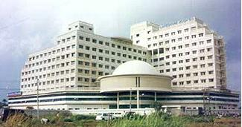
THE KERALA PHENOMENON
Low birth rate and death rate along with higher female life expectancy and low infant mortality due to:
Wide network of health infrastructure and manpower.
Social factors like women’s education, general health awareness.

Slide 31
TODAY WE KNOW THAT SCALE-FREE NETWORK ARCHITECTURES LAY AT THE HEART OF NATURAL SYSTEMS AND SOLUTIONS TO VEXING PROBLEMS
REGULAR
RANDOM
Few nodes with many connections, while remaining nodes have reduced connectivity with other nodes. (obey power law)

Slide 32
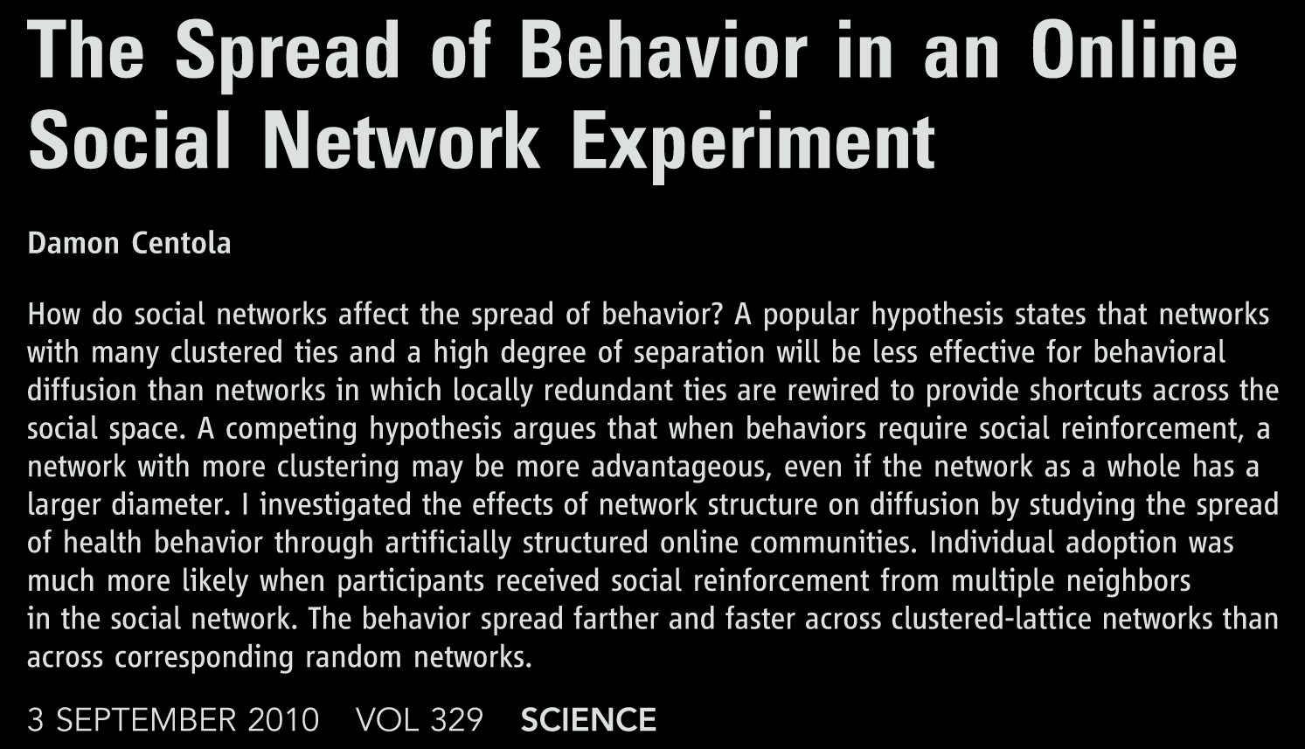
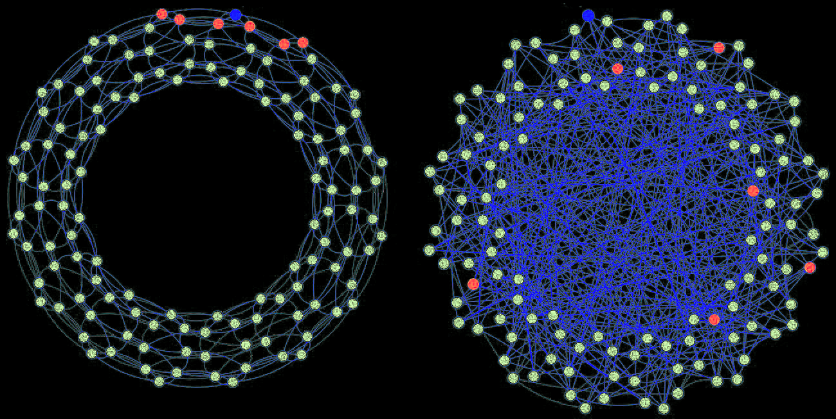
THE BLUE NODE IS THE FOCAL NODE OF A NEIGHBORHOOD TO WHICH A PERSON IS ASSIGNED
CLUSTERED LATTICE OF NEIGHBORS
RANOM NETWORK OF NEIGHBORS

Slide 33
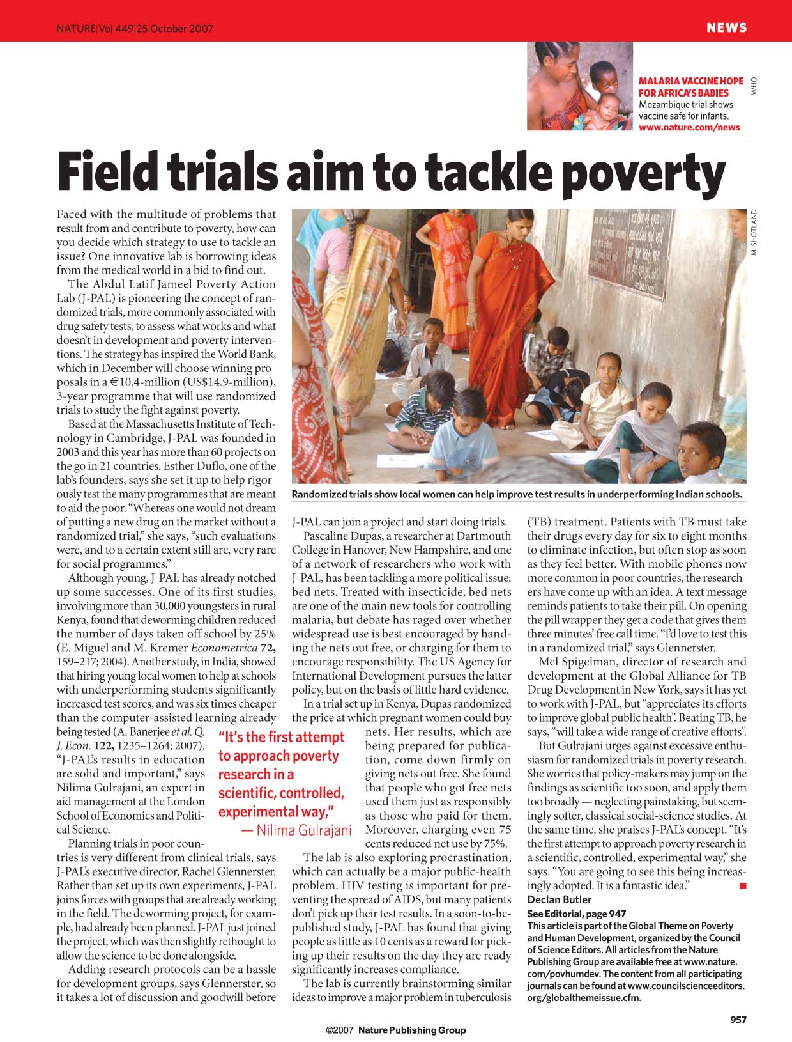
CAN A VIRTUAL COMMUNICATIONS NETWORK TRANSFORM INDIA’S HEALTH LANDSCAPE?
“India boasts the fastest-growing mobile-phone market in the world. One-fifth of its 218 million mobile-phone users live in rural areas and the country’s service providers are rapidly expanding wireless coverage to villages.” (Fairless, 2007)
“Patients with TB must take their drugs every day for six to eight months to eliminate infection, but often stop as soon as they feel better. With mobile phones now more common in poor countries, the researchers have come up with an idea. A text message reminds patients to take their pill. On opening the pill wrapper they get a code that gives them three minutes’ free call time.”

Slide 34
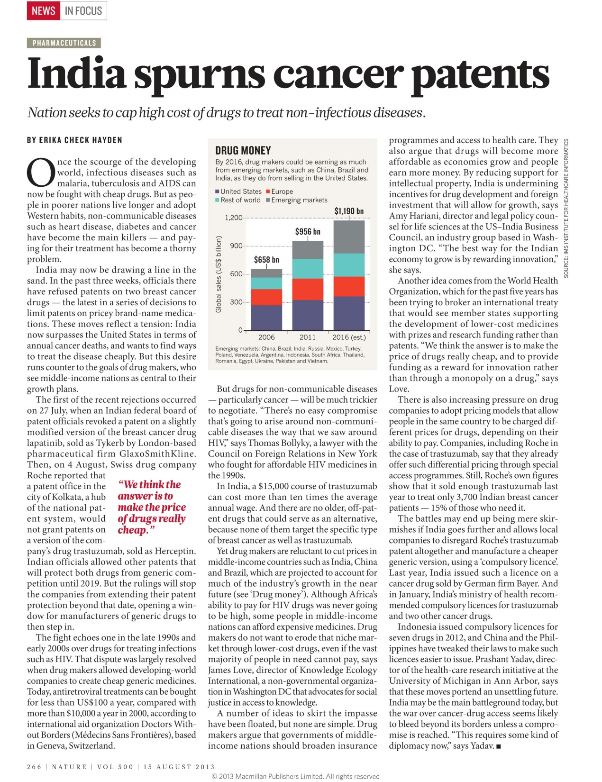
HOW ELSE DOES EFFICACIOUS TREATMENT OF INFECTIOUS DISEASE AFFECT THE HEALTH LANDSCAPE?
“Once the scourge of the developing world, infectious diseases such as malaria, tuberculosis and AIDS can now be fought with cheap drugs. But as people in poorer nations live longer and adopt Western habits, non-communicable diseases such as heart disease, diabetes and cancer have become the main killers — and paying for their treatment has become a thorny problem.”
(Hayden)
“India now surpasses the United States in terms of annual cancer deaths, and wants to find ways to treat the disease cheaply. But this desire runs counter to the goals of drug makers, who see middle-income nations as central to their growth plans. “

Slide 35
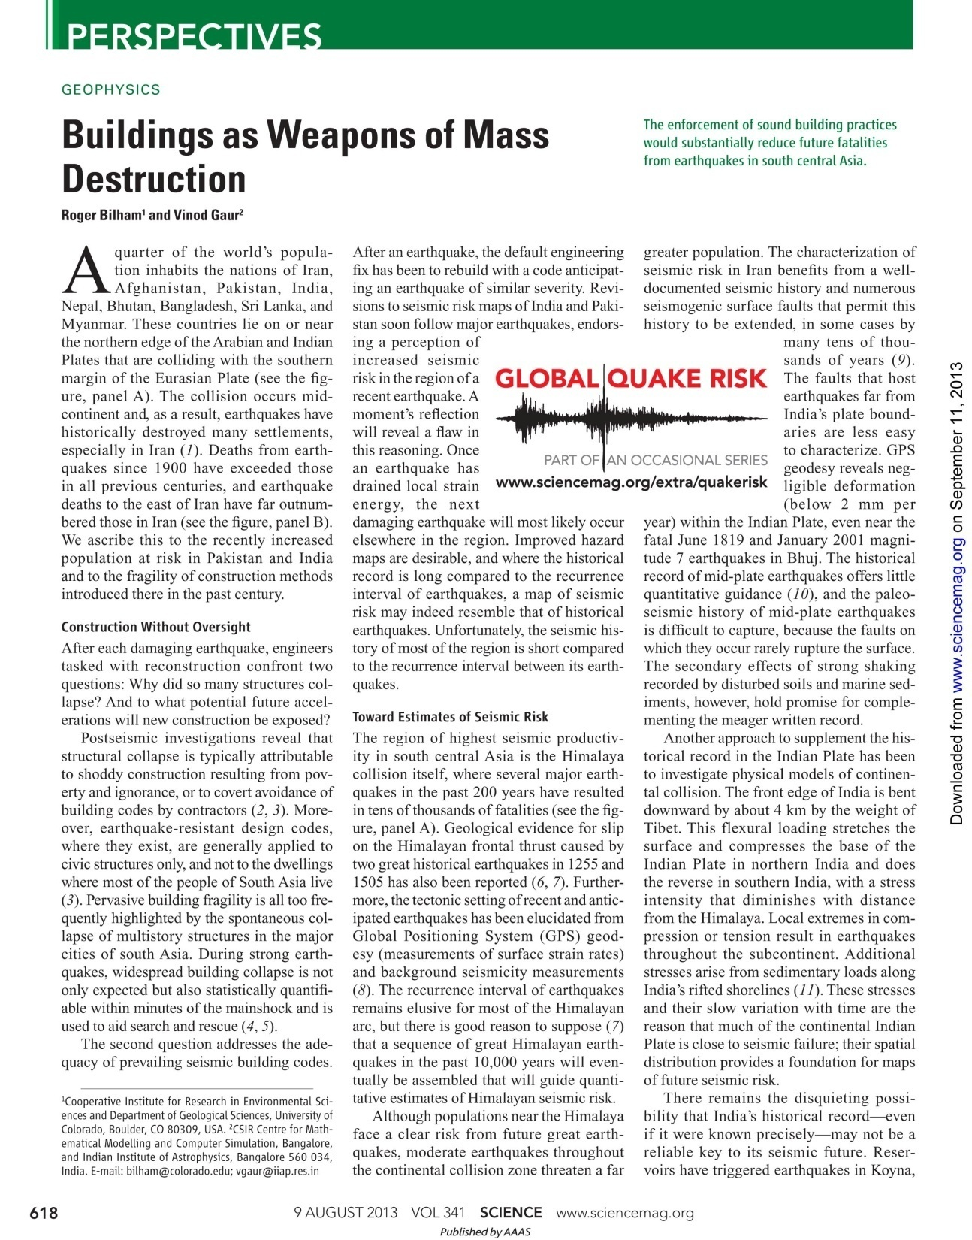
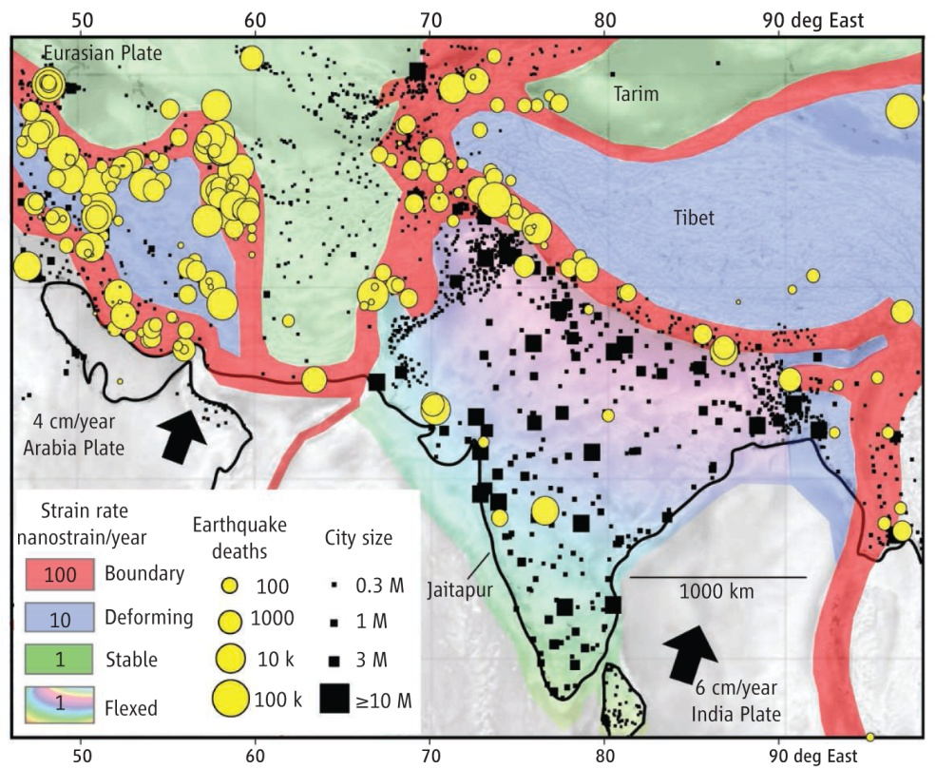
THE RURAL DIASPORA COUPLED WITH INFECTIOUS DISEASE AND POOR NATIONAL PRODUCTION AFFECTS THE MORTALITY LANDSCAPE IN UNEXPECTED WAYS
“Postseismic investigations reveal that
structural collapse is typically attributable
to shoddy construction resulting from poverty
and ignorance, or to covert avoidance of
building codes by contractors.” (Bilham & Gaur)

Slide 36



Many thanks to:
and for
Thinking Out of the Box
Phi Beta Kappa Mu of Virginia Chapter
THIS SIDE UP

