Slide 1

Chapter 4
Sustainable Building Maintenance and Repair Practices
Unless otherwise noted, this slide deck is (c) Erin A. Hopkins.
It is released under a Creative Commons Attribution NonCommercial ShareAlike 3.0 license (CC BY NC-SA 3.0).

Slide 2
Chapter Sections
4.1 Introduction
4.2 Energy Efficiency
4.3 Water Efficiency
4.4 Indoor Environmental Quality
4.5 Waste Management
4.6 Site Sustainability
4.7 Conclusion

Slide 3
Learning Objectives
Describe pathways to increase energy efficiency
Describe pathways to increase water efficiency
Describe pathways to increase indoor environmental quality
Describe pathways to waste management
Describe pathways to increase site sustainability

Slide 4
4.1 Introduction
Making these functions more sustainable can further the efficiency and effectiveness of the building systems while also lowering operational costs, decreasing ecological disturbances, and increasing building occupant comfort

Slide 5
4.2 Energy Efficiency
In 2020, residential and commercial buildings in the United States consumed 40% of total U.S. energy consumption

Slide 6
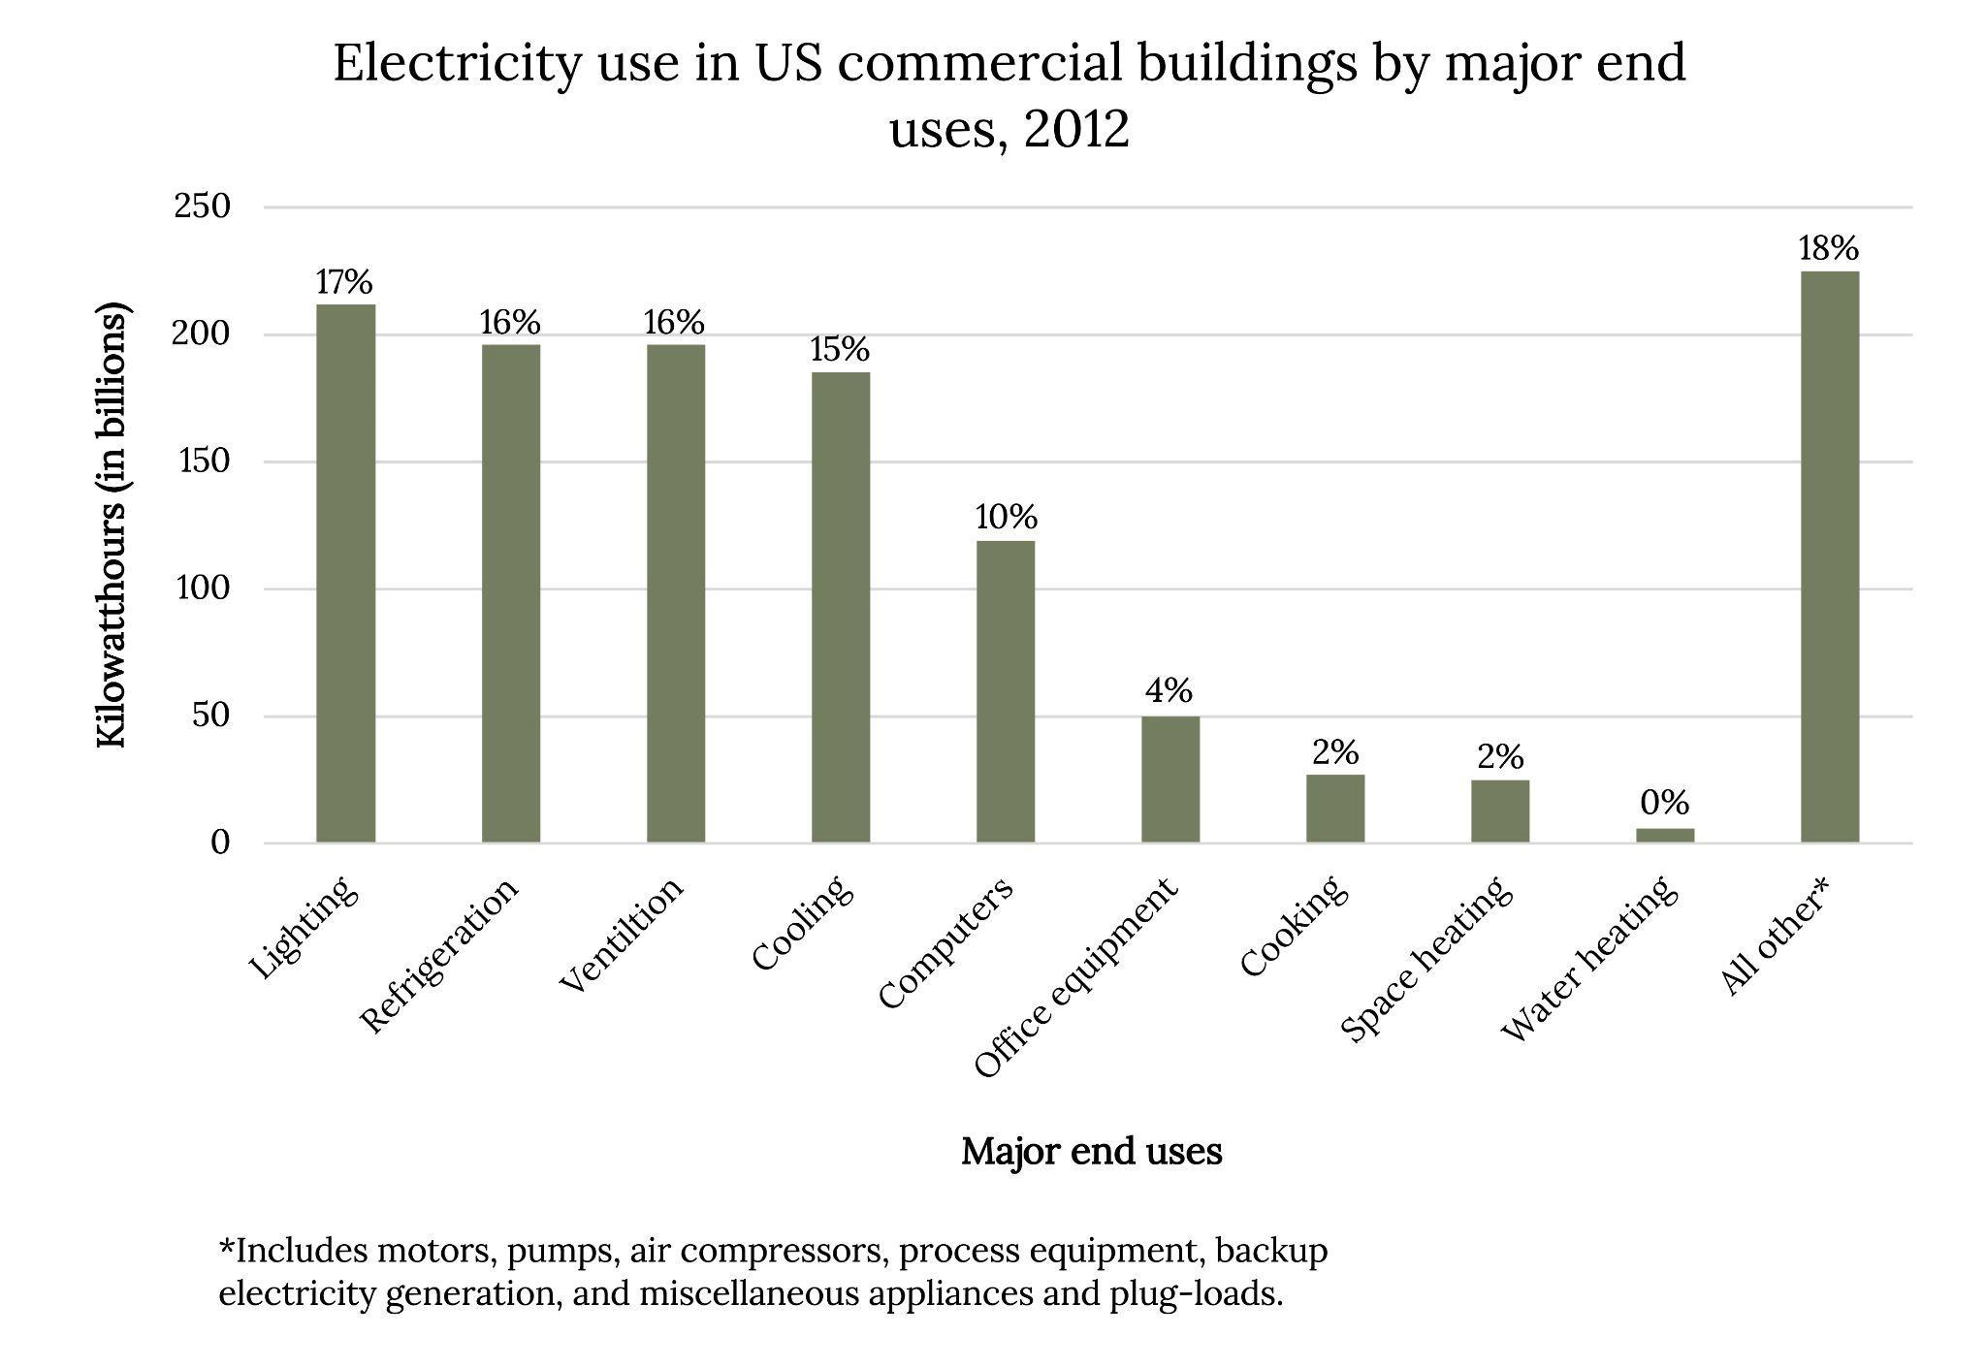
Energy Efficiency part 2
Figure 4.1: Electricity use in U.S. commercial and residential buildings by major end use. Kindred Grey. 2023. CC BY 4.0. Data from U.S. Energy Information Administration (https://www.eia.gov/energyexplained/use-of-energy/commercial-buildings-in-depth.php).
Notes:
The text box above the slide is for accessibility purposes. If you edit this PPT, please leave it there. It doesn’t show up in preview mode.

Slide 7
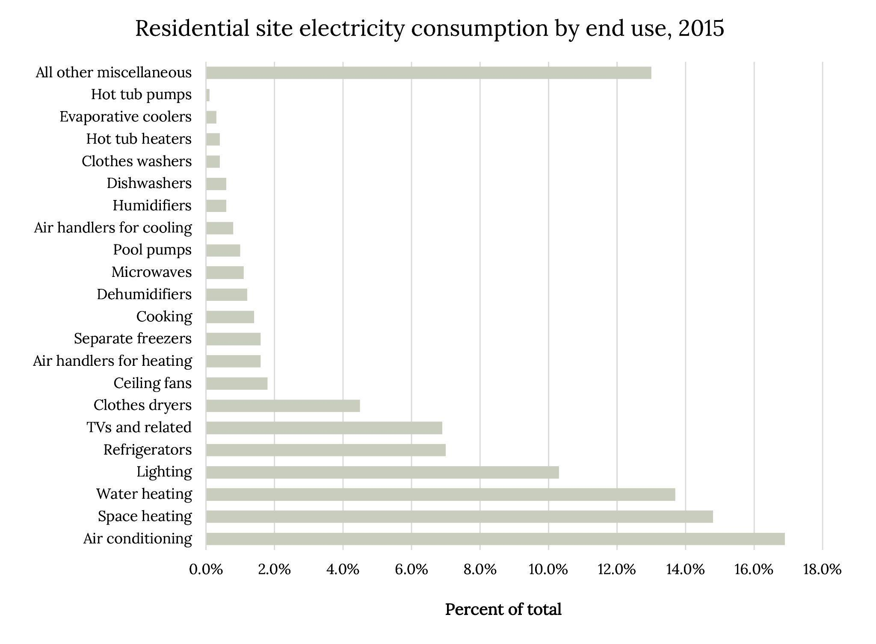
Energy Efficiency Part 3
Figure 4.2: Residential site electricity consumption by end use (2015). Kindred Grey. 2023. CC BY 4.0. Data from U.S. Energy Information Administration (https://www.eia.gov/energyexplained/use-of-energy/electricity-use-in-homes.php).
Notes:
The text box above the slide is for accessibility purposes. If you edit this PPT, please leave it there. It doesn’t show up in preview mode.

Slide 8
Strategies for Energy Efficiency
Energy Audit
Lighting
Motion sensors
More energy efficient light bulbs
HVAC
Regular service and filter changes
Evaluate for any air leaks and level of insulation
Appliances and Electronics
Adjust settings or purchase a more energy-efficient device
Reduce vampire loads
Water Heating
Decrease the thermostat
Cold water for clothes washing
Insulate the storage tank and the pipes

Slide 9
4.3 Water Efficiency
Connection between water efficiency and energy efficiency

Slide 10
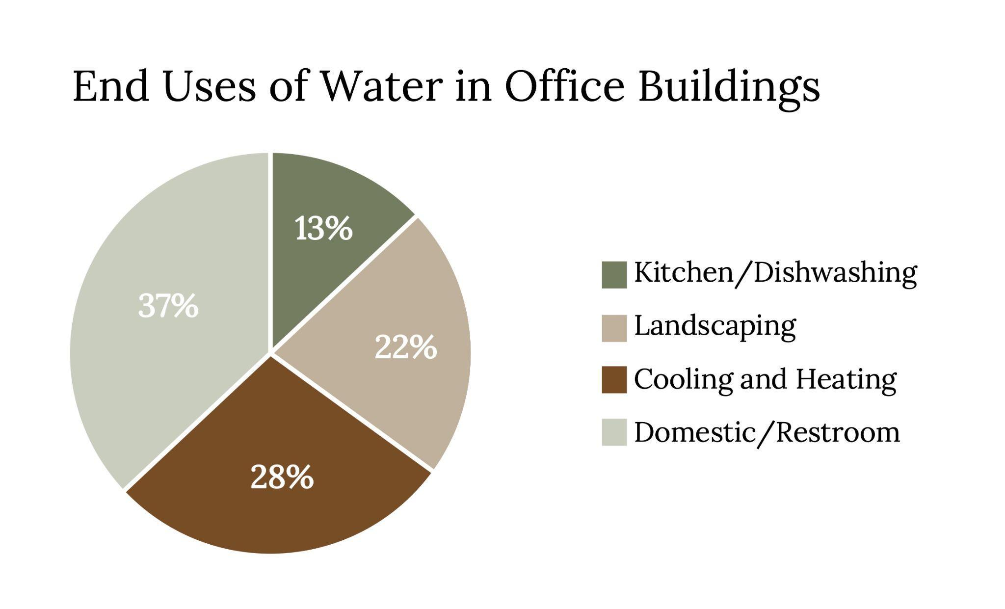
Water efficiency Part 2
Figure 4.9: Water use in U.S. office buildings by major end use. Kindred Grey. 2023. CC BY 4.0. Data from U.S. Environmental Protection Agency (https://www.epa.gov/sites/default/files/2017-01/documents/ws-commercial-factsheet-offices.pdf).
Notes:
The text box above the slide is for accessibility purposes. If you edit this PPT, please leave it there. It doesn’t show up in preview mode.

Slide 11
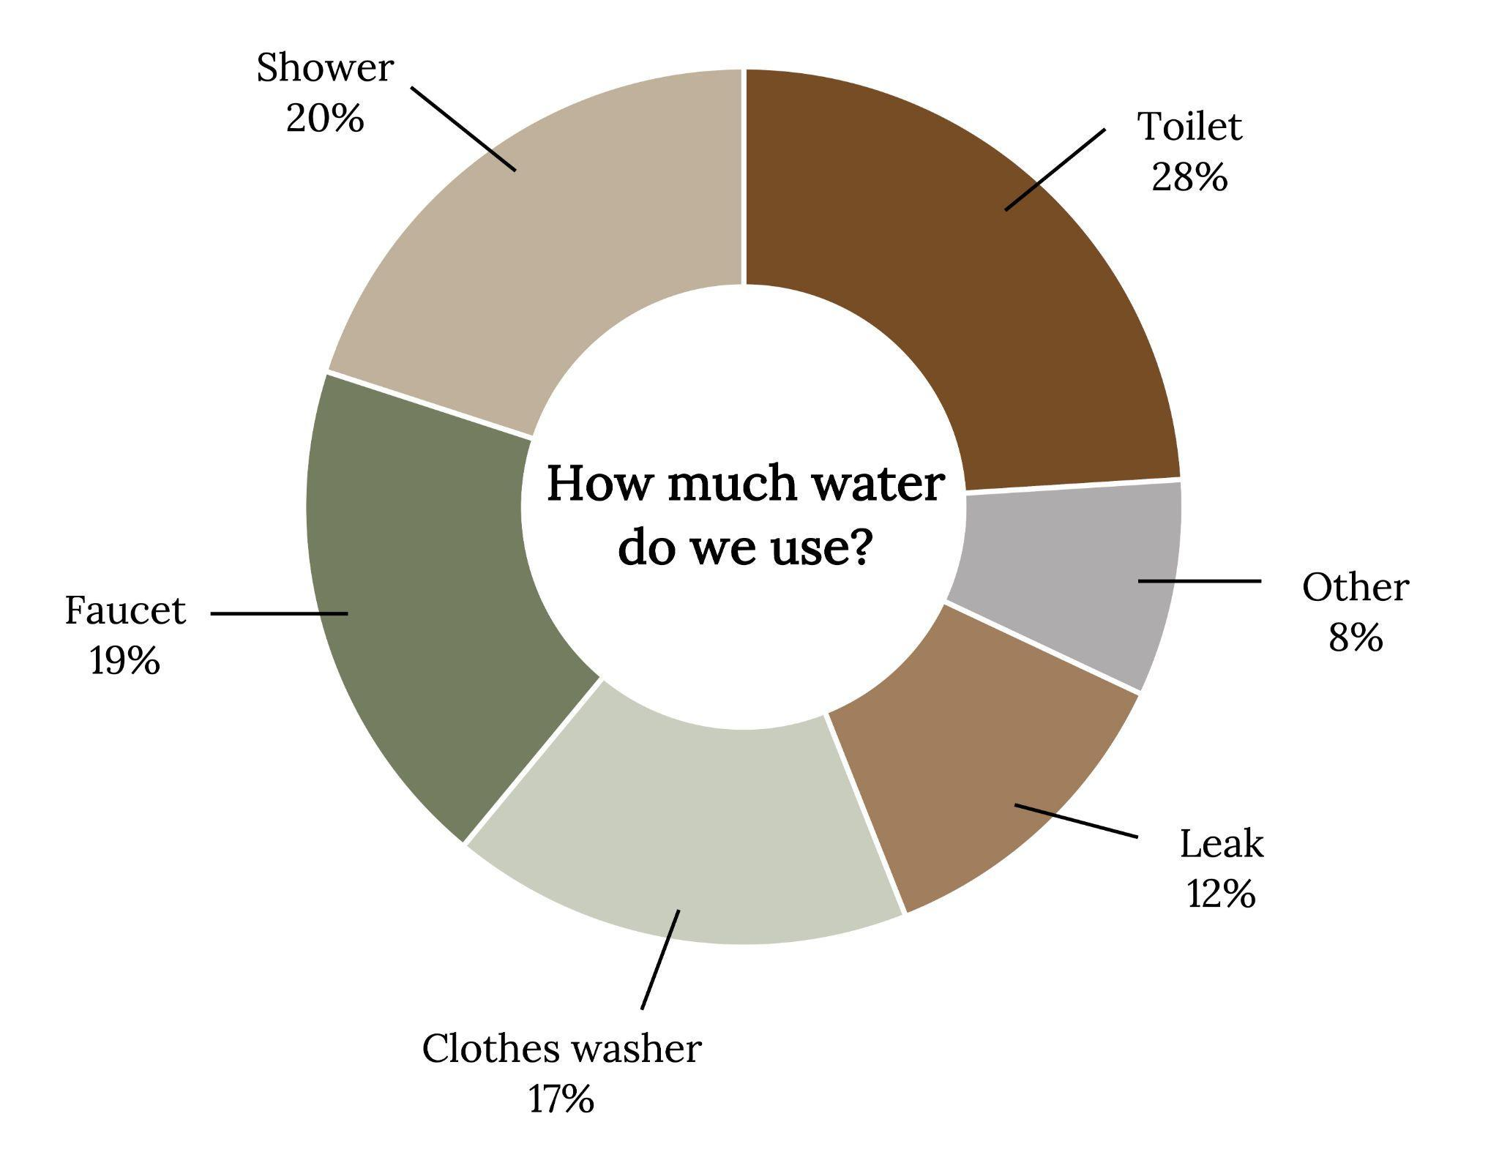
Water use in U.S. residential buildings by major end use
Figure 4.10: Water use in U.S. residential buildings by major end use. Kindred Grey. 2023. CC BY 4.0. Data from U.S. Environmental Protection Agency (https://www.epa.gov/watersense/data-and-information-used-watersense).

Slide 12
Strategies
Water assessment
Check for leaks
Regularly check plumbing fixtures and valves
Regularly evaluate appliances
Cooling and heating evaluation
Landscaping

Slide 13
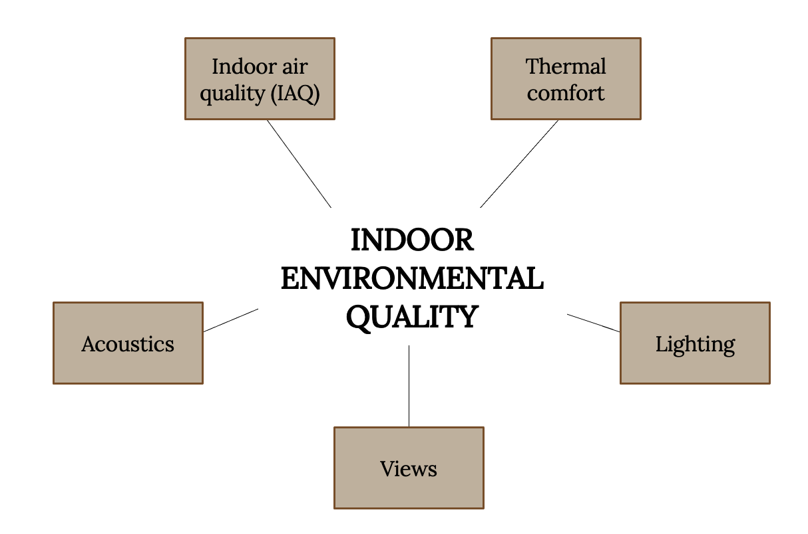
4.4 Indoor Environmental Quality
Figure 4.15: Main IEQ components. Kindred Grey. 2023. CC BY 4.0.

Slide 14
4.5 Waste Management

Slide 15
Strategies for Waste Management
Waste Stream Audit
TRUE
Reduce, Reuse, Recycle

Slide 16
4.6 Site Sustainability
Many site sustainability options are considered during the building design and construction process

Slide 17
Strategies for Site Sustainability
Transportation options
Paving options
Roof considerations
Light pollution

Slide 18
4.7 Conclusion
Many opportunities for sustainability
Can holistically improve sustainability by saving both building owners and building tenants money, mitigating negative ecological externalities, and providing a nice place for building occupants
Upfront costs and operational cost savings a consideration

Slide 19
Chapter Activity
Read the article titled “Proposal seeks to dim NYC skyline at night to save energy” at the link below:
https://www.pressherald.com/2015/05/16/proposal-seeks-to-dim-nyc-skyline-at-night-to-save-energy/
Read the webpage: https://www.darksky.org/light-pollution/
Based on these readings, what are the pros and cons of this proposal?

