Slide 1
Games Behavior
CS 4624 Multimedia, Hypertext, and Information Access
Instructor: Dr. Edward A. Fox
Virginia Tech, Blacksburg, VA 24061
Authors: Daniel Lanigan, Renzo Neps, Liam McBride
May 9, 2024
Notes:
Should include: Project title, full names of all team members, course number and name, instructor-name:Edward A. Fox, Virginia Tech, Blacksburg VA 24061, date

Slide 2
Outline
1. Project Overview
2. Timeline
3. Deliverables
4. YouTube Scraper
5. Forum Scraper
6. Data
7. Visualizations
8. Future Work
9. Acknowledgements
10. References
Notes:
Outline, with a list of key headings of the sections of the presentation that follow.

Slide 3

1. Project Overview
Client
  Dr. James D. Ivory
  Virginia Tech Gaming and Media Effects Lab
Problem: Unknown data on extremist behavior in online game communities
Deliverables
  Forum scraper
  Cleaned data and analysis
  Visualizations
Dr. James D. Ivory
Notes:
Professor Ivory Image: https://liberalarts.vt.edu/departments-and-schools/department-of-english/faculty/Jimmy-ivory.html

Slide 4
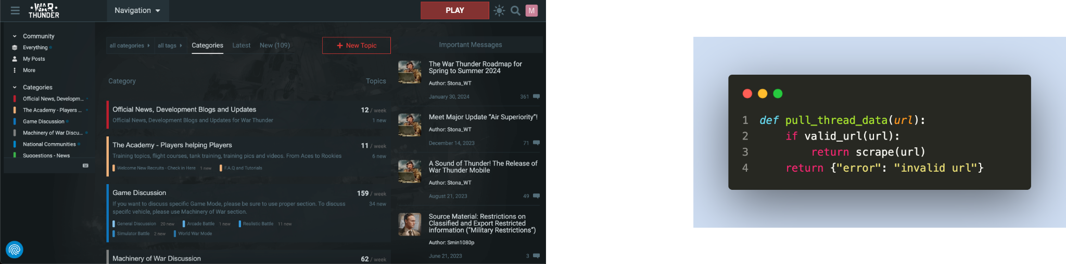
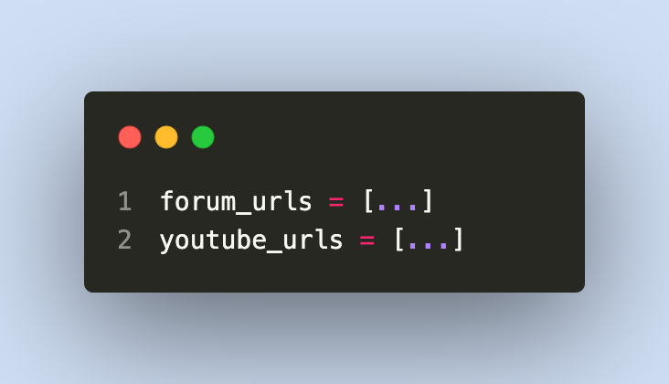

2. Timeline: February
Research scraping
Develop blog scraper
Understand/Modify previous scraper
Determine media to scrape
Test and begin scraping
Report #1
Notes:
Green which has been accomplished. Yellow is in progress
Finish researching how to scrape the blog
Develop blog scraper
Understanding previous teams code and modifying if required
Determine list of videos and blog posts to scrape from
Set up unclean dataset storage
Begin scraping
Report #1
War Thunder Scraping image: Created by group using screenshot from: https://forum.warthunder.com/
Media to scrape image: Created by group

Slide 5

Timeline: March
Presentation #2
Finish scraping
Create storage of clean dataset
Begin cleaning data
Determine what we want to visualize
Notes:
Finished scraping then develop a way to sift through the data that was obtained from the scraper. Also, research a way to begin the visualization of the cleaned data.

Slide 6

Timeline: April
Finish cleaning data
Sentiment analysis with client
Finalize visualization
Begin/finish final report
Final presentation
Notes:
Finished cleaning the data and talk with client on finalizing the data. Also, adding the final touches on the visualization and the report.

Slide 7

Timeline: May
Report #2
VTechWorks Submission
Notes:
Final presentations and reports.

Slide 8
3. Deliverables
YouTube Scraper Script
Forum Scraper Script
Raw Data
Cleaned Data
Visualizations
Notes:
Our deliverables for this project were a script to get War Thunder YouTube video comments, a script to get War Thunder public forum comments, and to hand off both the raw and cleaned data.

Slide 9
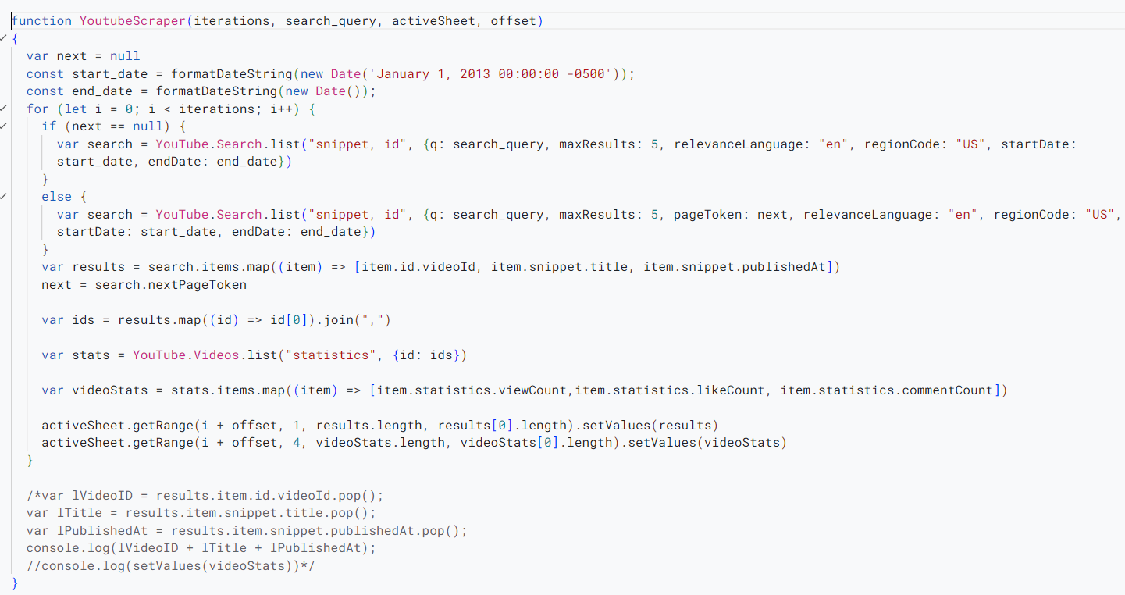
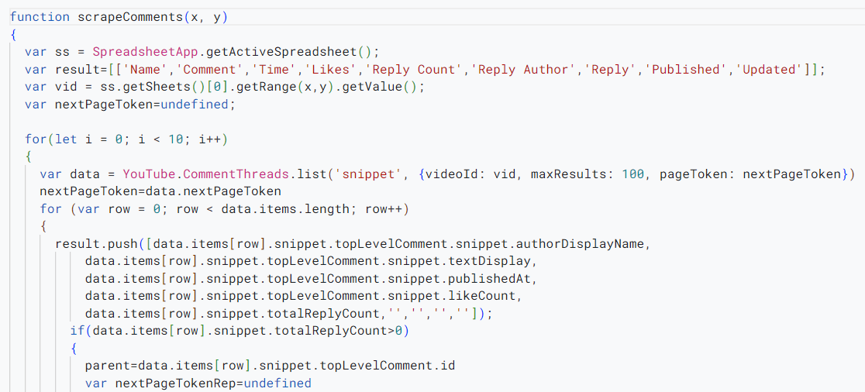
4. YouTube Scraper Script
Notes:
The scraper was split into 2 scripts. One was the original scraper from last semester that we modified. It would scrape videos on YouTube and flood the first sheet with the ID, title, publish date, view count, like count, and comment count. The Second came from a short medium article that used the video ID and scraped all of the comments. It takes the videos IDs that the first scraper obtained and scrape the first 100 top comments and all of their replies. Then it creates a new sheet with the title of that sheet being the specific ID and pastes all of the content there. The content being the name of the commenter, the comment, publish date, likes, reply count, reply author, the reply, the publish date of the reply, and the most recent update time.
Credit:
https://medium.com/@randiepathirage/youtube-comment-scraping-made-easy-with-apps-script-a66acfdb5ffd

Slide 10
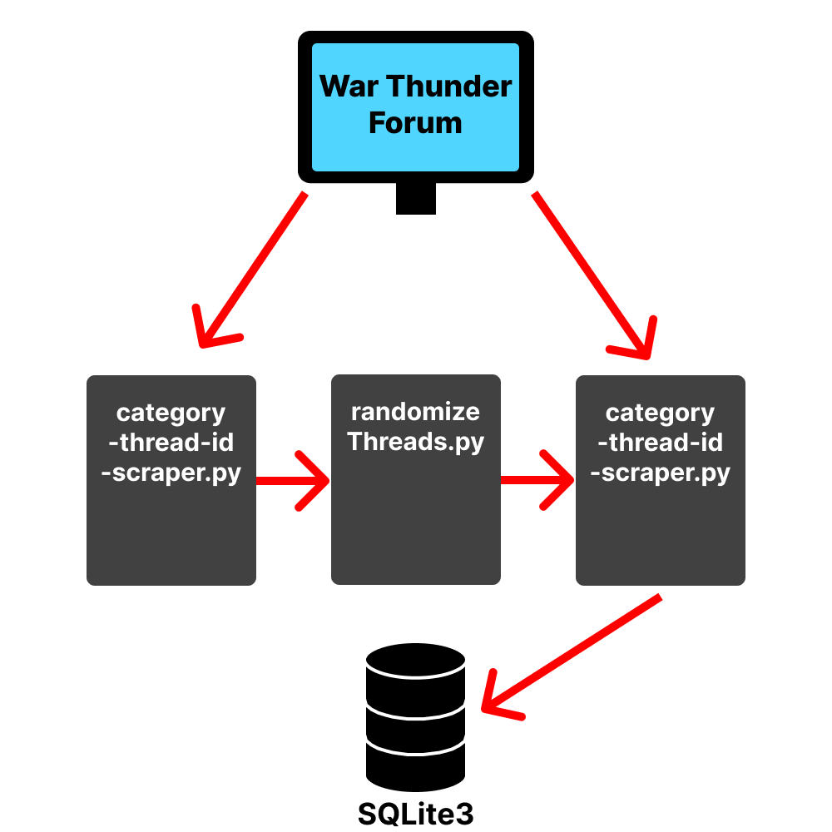
5. Forum Scraper Script
Files
  category-thread-id-scraper.py
  post-scraper.py
  randomizeThreads.py
Post
scraper.py
Notes:
Our code base started out with just the post-scraper which utilized requests and lxml trees to target and parse through specific thread IDs and insert the data in our database.
Once confirming that we could not specifically target threads that would contain more extremist language we developed category-thread-id-scraper. This script would spam a specific category URL with different values and would record the ones that didn’t send a 404 response. This was an effective way to collect all public categories on the site. We ended up capturing 70 categories. We followed that up by scraping each category URL we recorded to find all available threads in the categories. We ended up with 18,150 thread URLs in our database.
To ensure our data is a valid sample without cherry picking we created randomizeThreads which would randomly mark threads to be scraped. We then used post-scraper to scrape 73,595 posts from 2,750 different threads meeting our requirement of 60,000 data points.
The segmented pieces of the script allowed easier testing and improvement of one script separated from the others due to most script interactions being through the database which had a unchanging format. This also allowed us to do different parts of the scraping at different times so the computer wouldn’t be running a script for more than 5 minutes at a time.

Slide 11
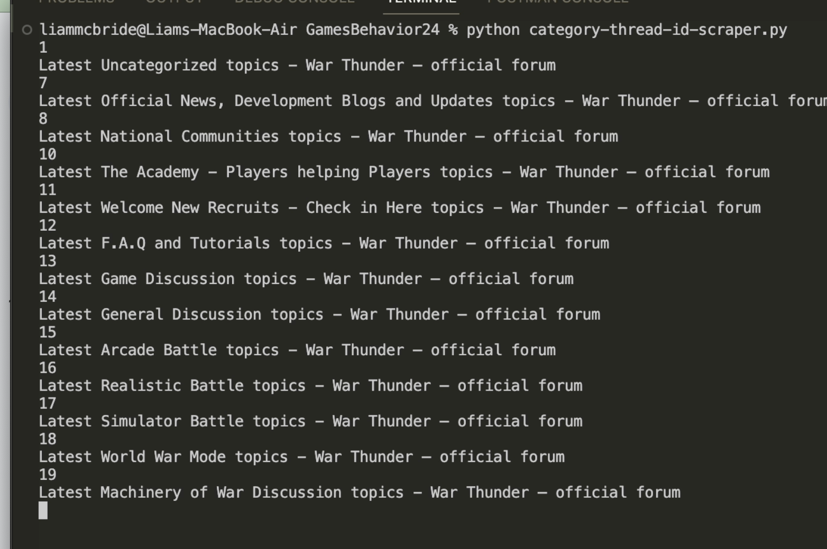
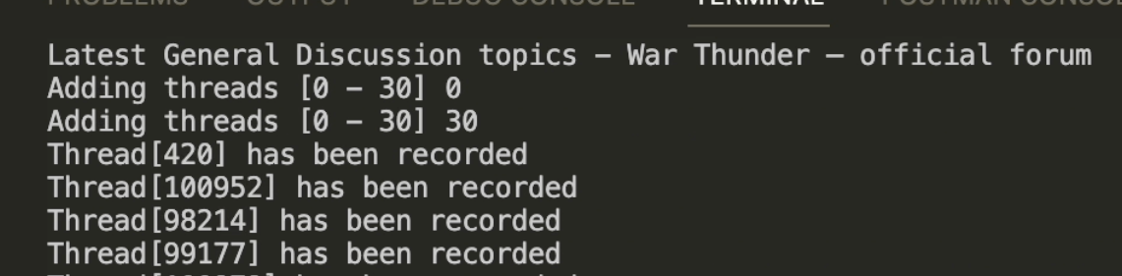
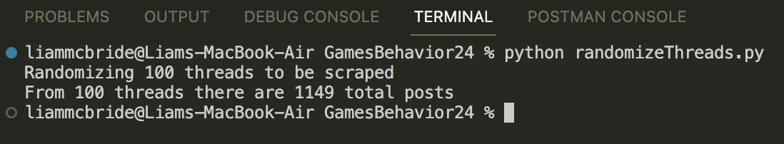
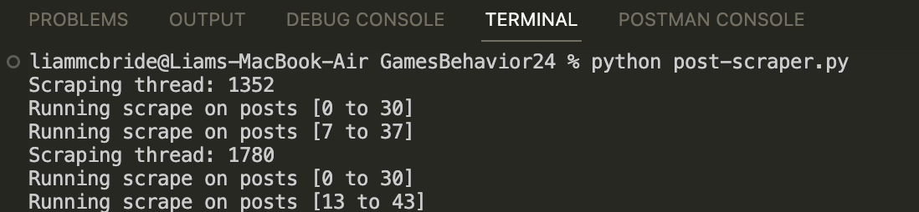
5. Forum Scraper Script cont.
Getting Threads
Randomizing Threads
Getting Categories
Scraping Posts
Notes:
Here’s a brief demo of what it actually looks like to run the Forum scraper. It only takes 4 terminal commands to populate the entire Forum database.

Slide 12
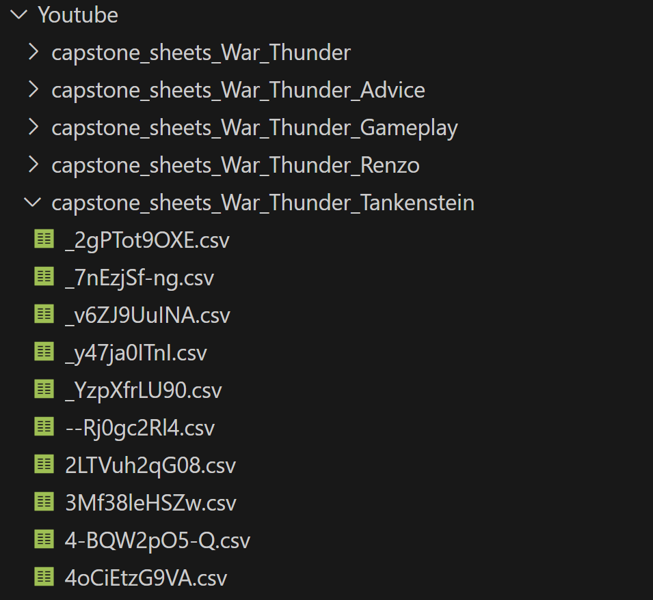
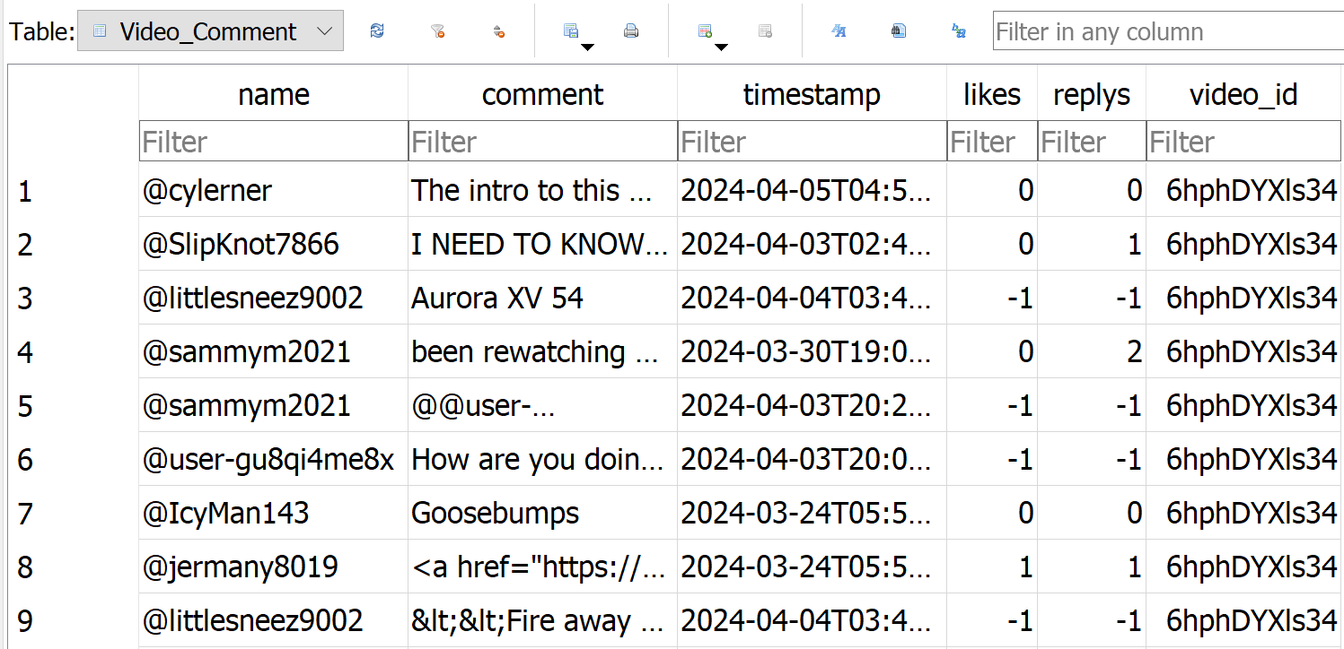
6. Raw Data
Forum Data
  SQLite3 database
YouTube Data
  CSV file
  SQLite3 database
Notes:
For the raw War Thunder data, we were able to scrape it and store it directly into our SQLite3 database. Here we were able to store information about potential thread id’s as well as categories within the forums. Ultimately, after scraping, we were able to store the post id, the thread id on which the post came from, the author, the data, and finally the actual message of the post.
For the raw YouTube data, we were able to scrape the videos we wanted and store them into a csv file. Due to YouTube's token limit, we could only scrape 100 videos at one time per account. This affected what we searched to scrape as if we scraped just “War Thunder”, then we would get the same videos as before. This is why you can see in the top picture the different sections which we used different keywords. After creating csv files full of just videos, we used the video id to scrape the comments of that specific video. Each video created its own csv file full of the comments scraped. After doing all of this we then had to create a script that went through all the csv files inside each keyword folder that stored the correct information in the correct places inside our already existing SQLite3 database.

Slide 13
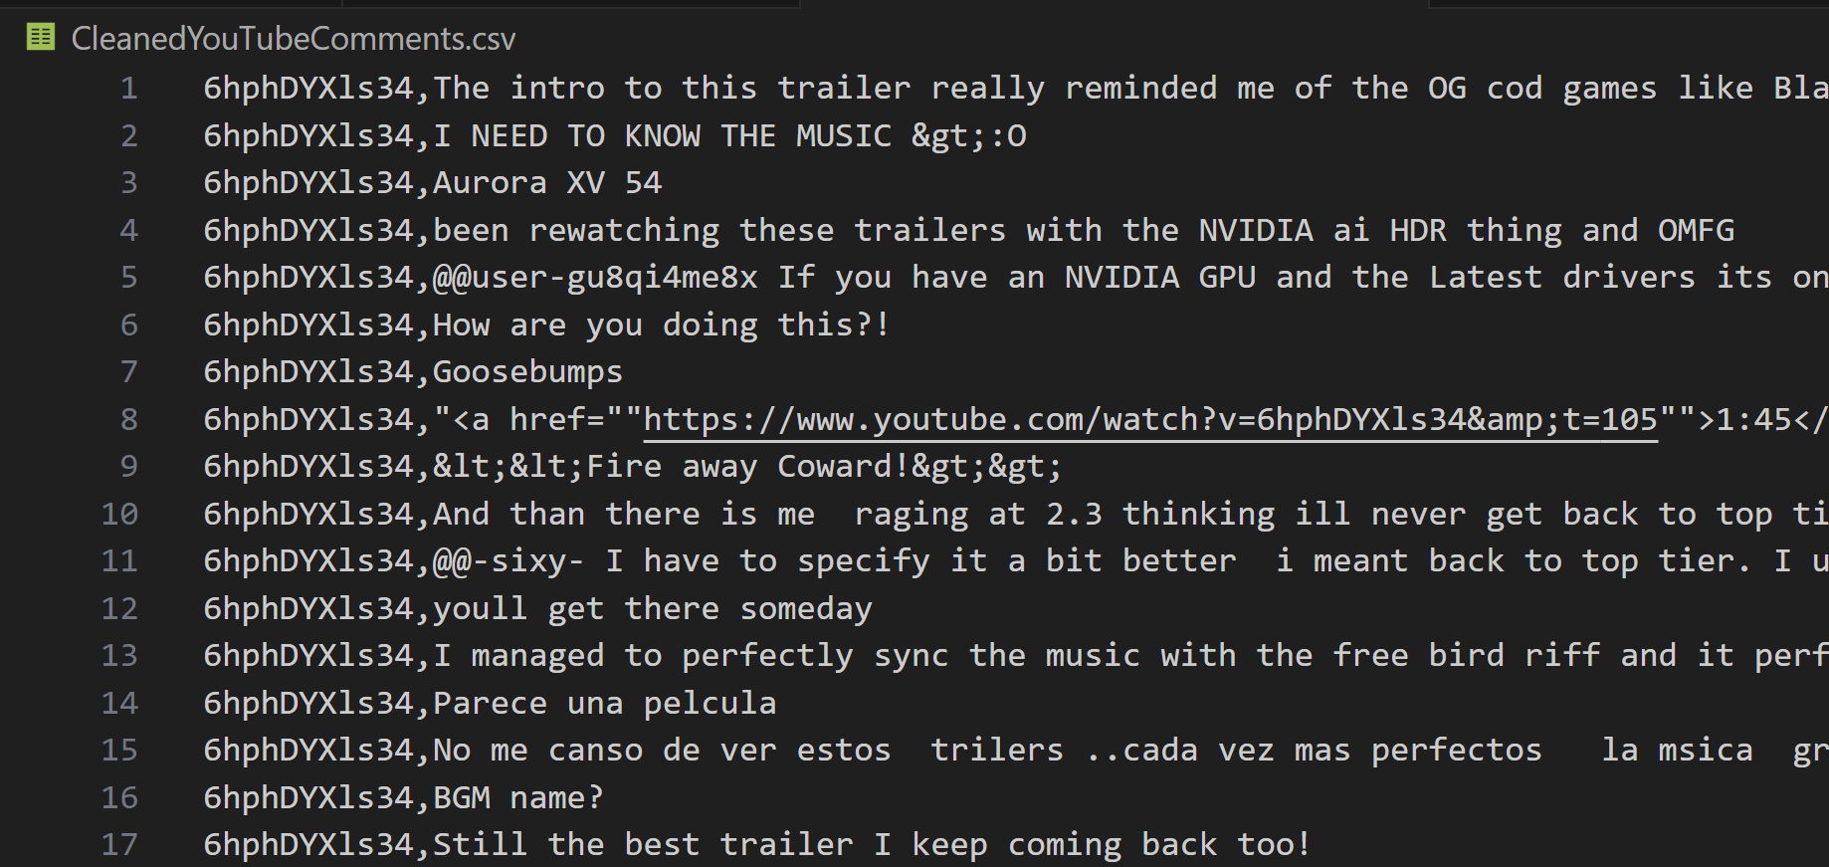
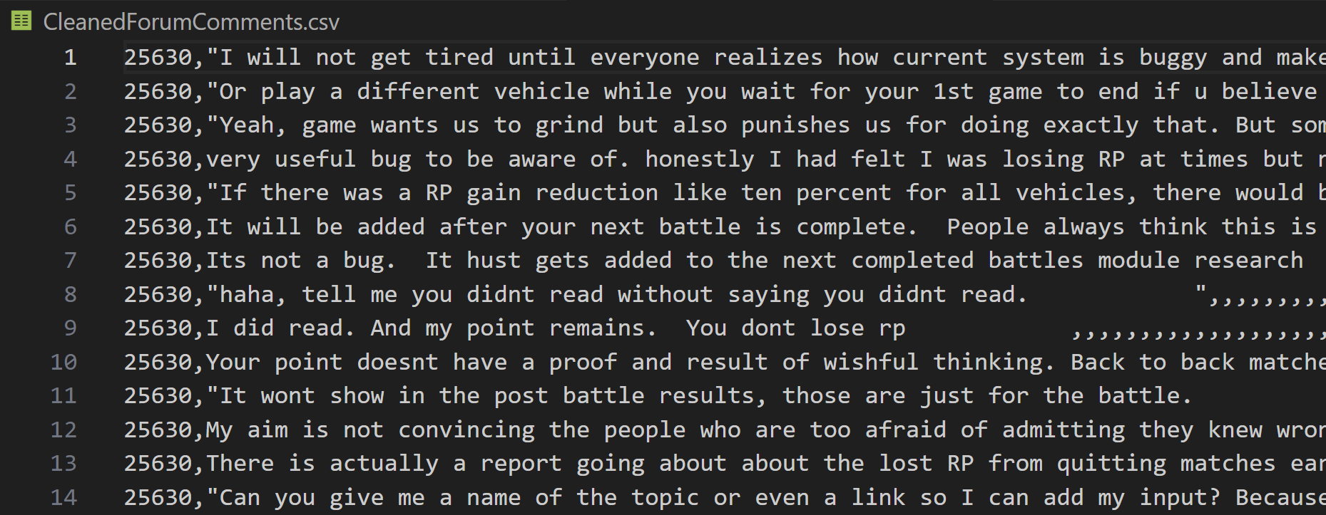
6. Cleaned Data
CSV files
  YouTube
  Forum
Notes:
Once we had all of the data in our database, we could run our cleaning script that gathered all the comments and their corresponding either video id, for the YouTube comments, or the thread id, for the War Thunder forum comments. Once the data was gathered, it was then run through a small cleaning of the comments themselves, to get rid of emojis, unnecessary spaces and non-ASCII characters. Then we saved the updated comments to their respected new clean csv file.

Slide 14
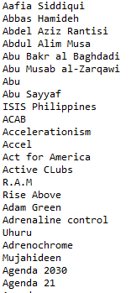
7. Visualizations
War Thunder Forum Data
YouTube Data
Previous Team’s Dictionary
Extremist Dictionary
“Hate on Display”, 2024, Anti-Defamation League, Accessed April 2024 https://www.adl.org/resources/hate-symbols/search?f%5B0%5D=topic%3A1703
Notes:
We have created visualizations for both the YouTube data and the War Thunder data. In those visualizations we utilized the previous teams dictionary text file, which is essentially a large text file full of phrases and words that could be related to extremism. However, actually identifying if it is extremist or not is done with sentiment analysis, which is what our client is going to do with our cleaned data.

Slide 15
War Thunder Forum Visualizations
Notes:
First we have our War Thunder Forum Visualizations

Slide 16
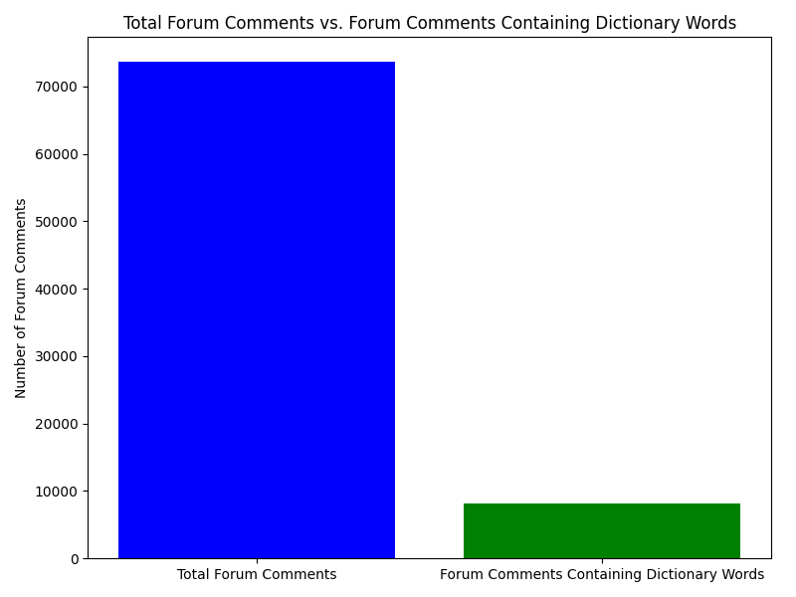
Notes:
Here you can see the number of comments that we scraped and the amount of comments that contain one or more of the keywords in the dictionary text file. We scraped about 73,000 comments total and a little less than 10,000 of those comments contained those keywords.

Slide 17
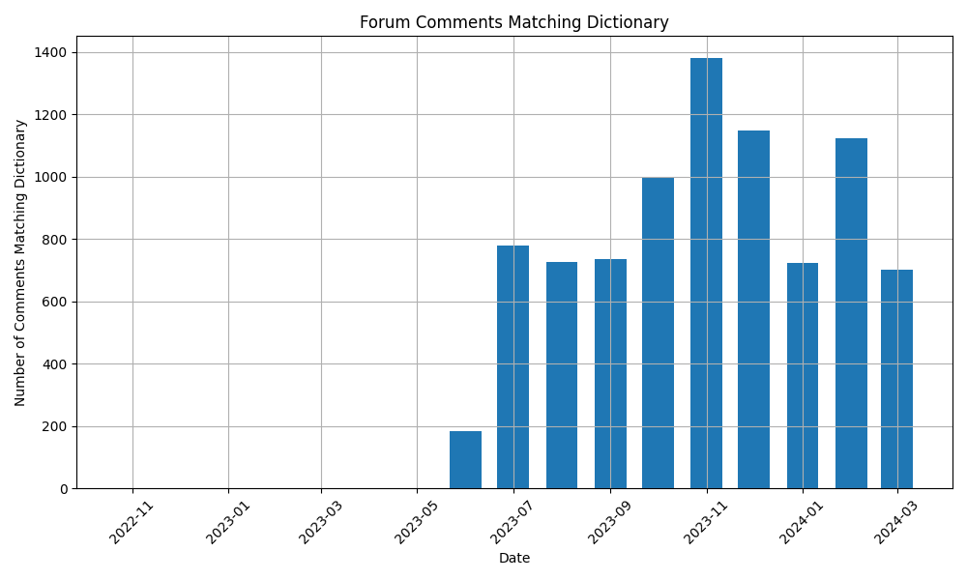
Notes:
This graph is showing the number of comments that contain one or more keywords in the dictionary text file over the date of the post. One thing to note is that the forum we scraped is the newest forum for War Thunder and does not contain any of the content of the old forum.

Slide 18
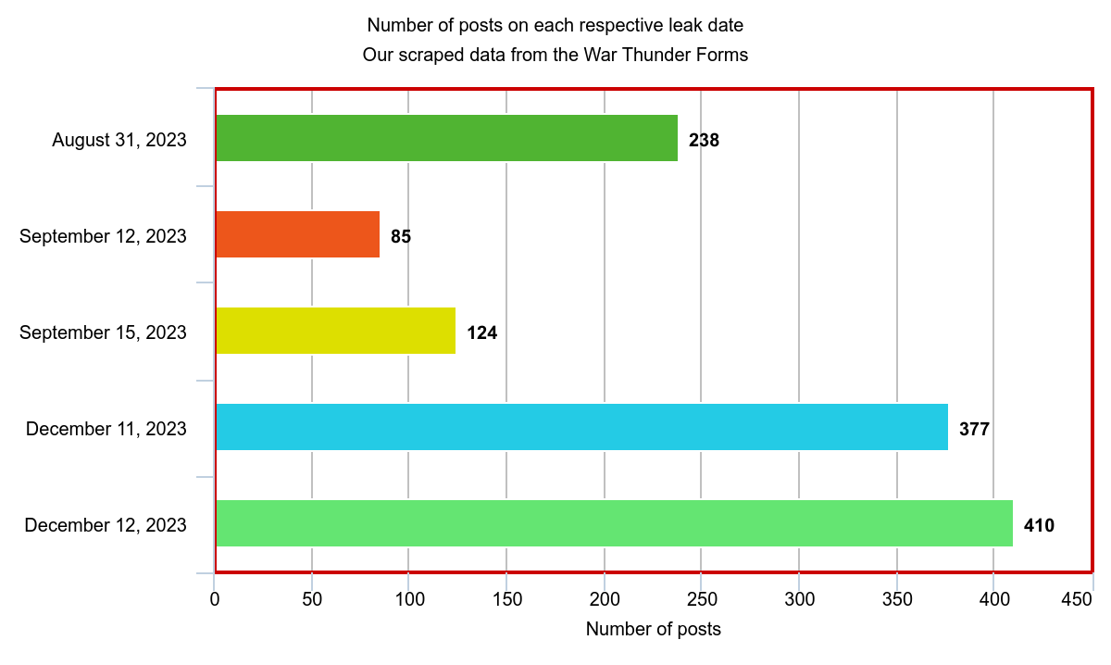
Document Leak
Eurofighter Typhoon DA7 fighter jet
Lockheed F-117 Nighthawk stealth attack aircraft
Boeing AH-64D Apache helicopter
Norinco VT-4 tank
M2A2 Bradley IFV
Notes:
Raw data not cleaned
August 31, 2023
Eurofighter Typhoon DA7 fighter jet
Export restricted
238
September 12, 2023
Lockheed F-117 Nighthawk stealth attack aircraft
Export restricted
85
September 15, 2023
Boeing AH-64D Apache helicopter
Export restricted
124
December 11, 2023
Norinco VT-4 tank
Unclassified
377
December 12, 2023
M2A2 Bradley IFV
Export restricted
410
Total scraped: 73595

Slide 19
YouTube Visualizations
Notes:
Next is our YouTube Visualizations

Slide 20
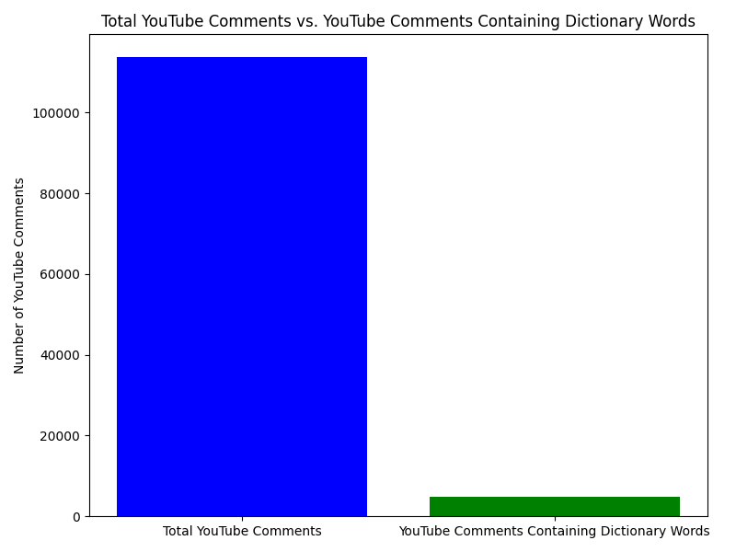
Notes:
Here you can see the number of comments that we scraped and the amount of comments that contain one or more of the keywords in the dictionary text file. We scraped about 113,000 comments total and less than 10,000 of those comments contained those keywords.

Slide 21
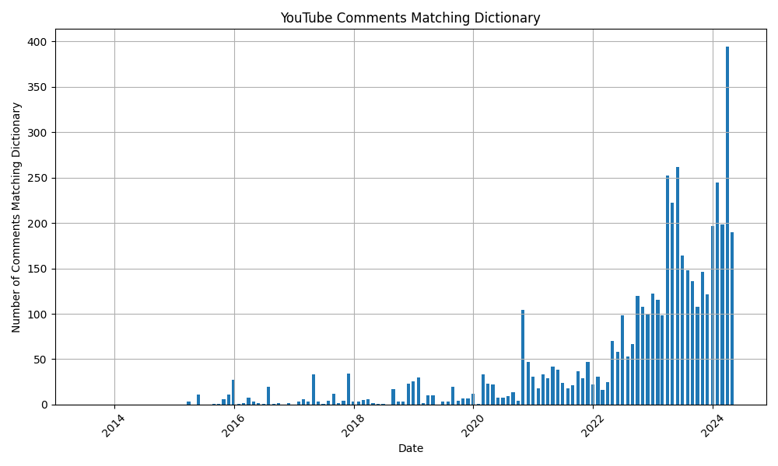
Notes:
Here you can see the comments that contain those keywords over a larger timeline than the War Thunder forum. We can really see a pick up in usage over time.

Slide 22
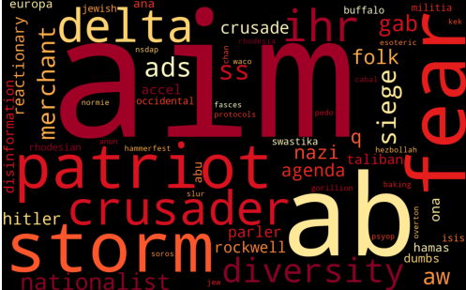
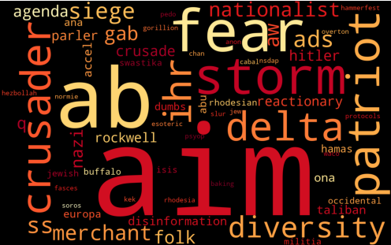
Comparing word frequency
Forum Word Cloud
YouTube Word Cloud
Notes:
We created these word clouds by writing down every word that was in a post and also in our extremist language dictionary for both YouTube and the Forums.
Just to note, the extremist words are not necessarily extreme on their own, they more are commonly occurring in recorded extremist language and thus are a decent indicator of extremism in combination
.
It’s interesting to see most of the larger words on one cloud are faithfully reflected in the other cloud meaning there’s a general trend of the particular extremist language across both platforms.

Slide 23
8. Future Work
Scrape Old War Thunder Forum
Notes:
The main thing we could have done differently is research the War Thunder Forums more before beginning to code. Unknown to us the Forums had actually switched websites in 2022, they transferred users but not the posts themselves. So we realized too late that our data was only from 2022 to today. A future project would be developing a script to scrape the old War Thunder Forums.

Slide 24

9. Acknowledgements
Professor Fox
Client:
  Dr. James D. Ivory
  Michael Senters (Grad Researcher)
Professor:
  Dr. Edward A. Fox
Dr. James D. Ivory
Notes:
Professor Fox Image: https://website.cs.vt.edu/people/faculty/edward-fox.html
Professor Ivory Image: https://liberalarts.vt.edu/departments-and-schools/department-of-english/faculty/Jimmy-ivory.html

Slide 25
10. References
James D. Ivory, College Of Liberal Arts and Human Sciences, Accessed January 2024 https://liberalarts.vt.edu/departments-and-schools/department-of-english/faculty/Jimmy-ivory.html
Niko Olson, Mauricio Lovelace, Earl Carter, “Gaming and Political Extremism”, 2023, CS4624 team term project, Accessed January 2024 http://hdl.handle.net/10919/115018
Gaijin Games Kft, War Thunder Forums, 2024, Accessed January 2024 https://forum.warthunder.com/
Randie Pathirage, “YouTube Comment Scraping Made Easy with Apps Script”, May 16, 2023, Medium, Accessed March 2024 https://medium.com/@randiepathirage/youtube-comment-scraping-made-easy-with-apps-script-a66acfdb5ffd

Slide 26
10. References P2
Soham, Script to export all sheets in a Google Sheet to CSV, Stackoverflow, Accessed March 2024 https://stackoverflow.com/questions/28707169/google-spreadsheet-download-all-the-sheets-at-once/28711961#28711961
Google, Google Sheets Official API Documentation, April 3, 2024, Accessed March 2024 https://developers.google.com/sheets/api/guides/concepts

Slide 27
Questions

