Slide 1
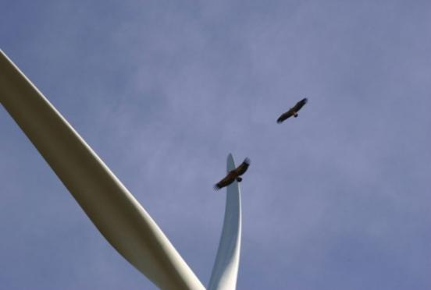



Design and Development of an Integrated Avian and Bat Collision Detection System for Wind Turbines
Robert Suryan, Roberto Albertani, Brian Polagye,
Jeremy Flowers, Trevor Harrison, Concong Hu, William Beattie
© M. Mirinha/STRIX

Slide 2
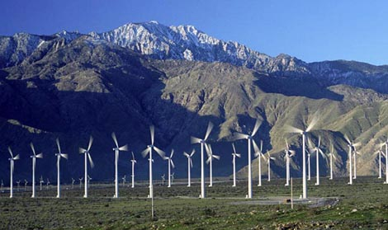
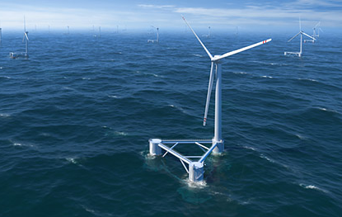
Avian and Bat Mortality
On Land
At Sea
Assessment via carcass surveys
Effective but problematic on land
Not effective at sea

Slide 3
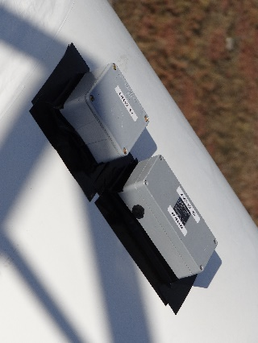
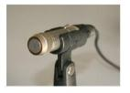
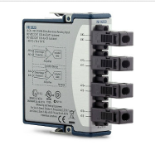
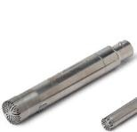
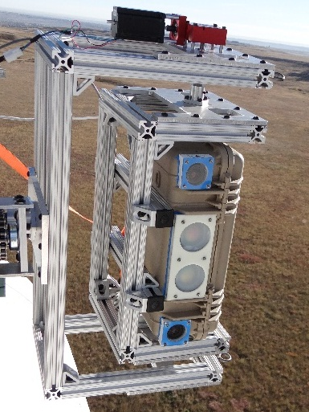
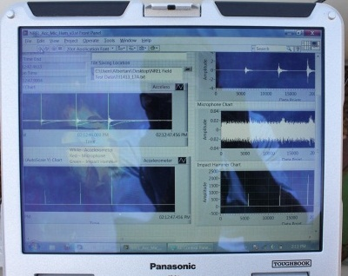
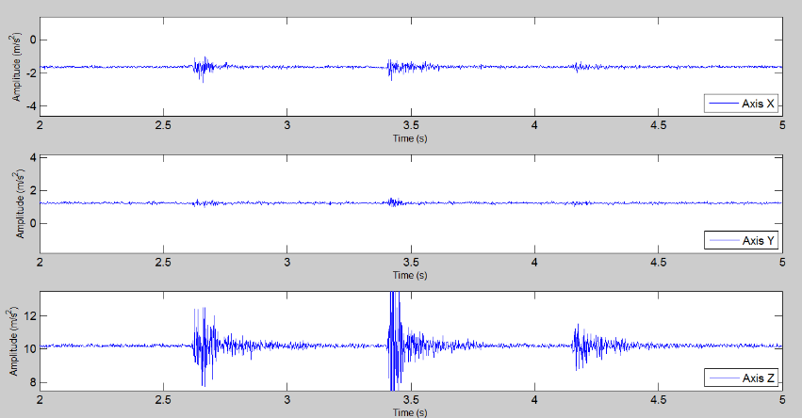
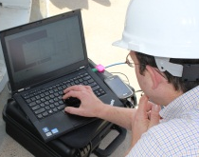
Onboard Synchronized Sensor Array
Vibration Node Accelerometers &
Contact Microphones
Bioacoustics Node Acoustic and
Ultrasonic Microphones
Optical Node
Stereo Infrared & Visual Spectrum Cameras
Remote Transmission of “Event” Data
Central Processing Onboard Turbine
Notes:
Cameras in stereo allow distance and size estimates of targets

Slide 4
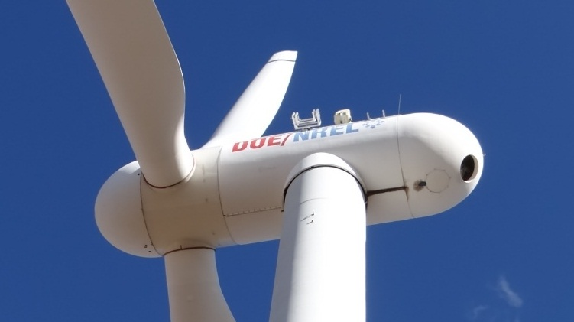
System Configuration
Camera
(downward orientation)
Bioacoustic Microphone
Accelerometers
Contact Microphones
Notes:
Cameras in stereo allow distance and size estimates of targets

Slide 5


Data Acquisition - ring buffer architecture
Problem: Optics alone generate 20 TB Data/day
Solution: Event based trigger of data recording
Data Streams
Event Detector
Presence
Real time image processing
20 sec buffer
Acoustic detectors
Collision
Accelerometers
Contact Microphones
Oldest data
Save data 10 s before to 10 s after trigger event to permanent file.
Newest data
Notes:
Camera data stream enter
circular buffer,
user defined, for example 20 sec
Watching the data stream: event detection systems – critical potential even for low resolution IR
Event detected
Records another 10 sec, from oldest to newest
Really good success with this and would recommend the data structure.

Slide 6


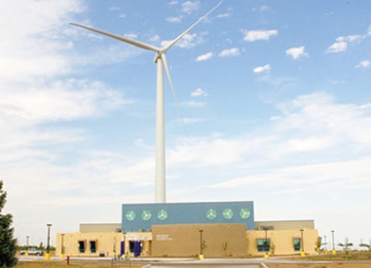

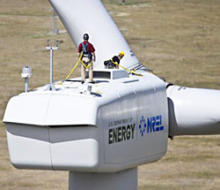
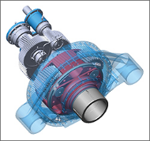
Experimental Testing
North American Wind Research and Training Center
Tucumcari, NM
National Wind Technology Center
Golden, CO
600 kW CART 3
1.5 MW GE

Slide 7
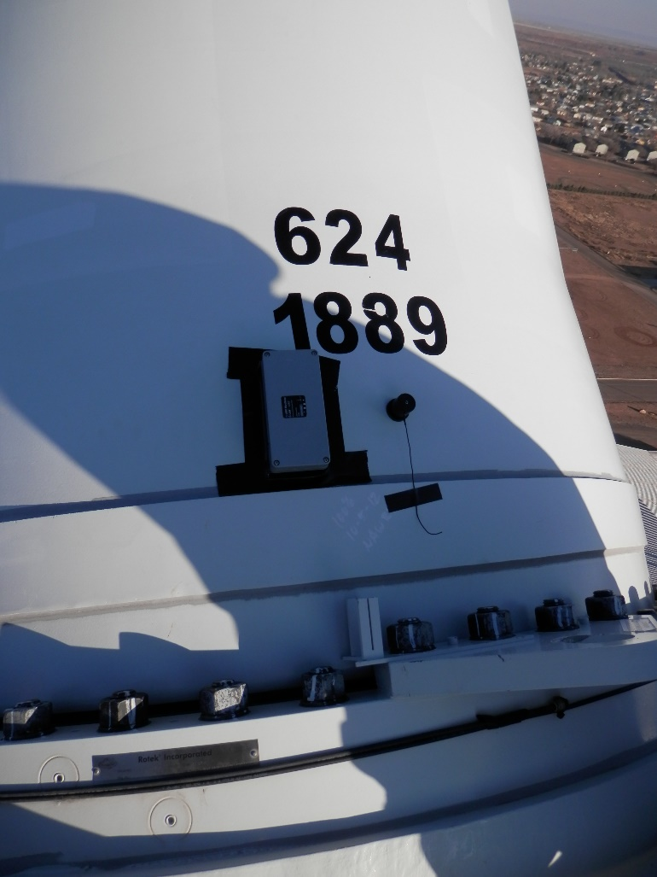
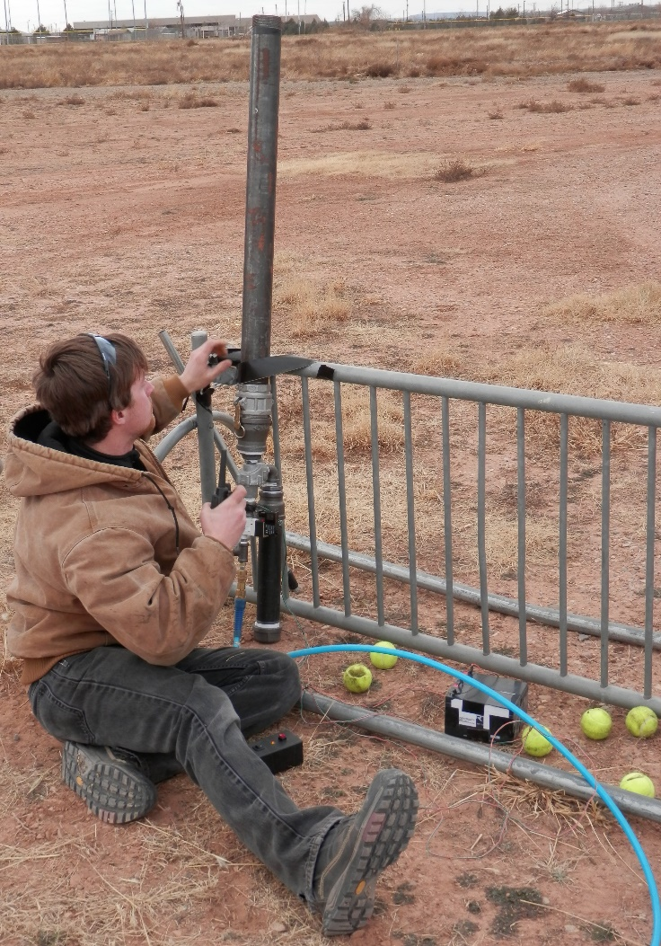
Field Experiments

Slide 8
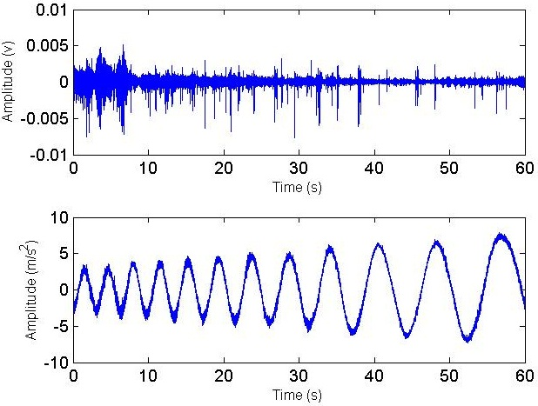
Raw data: routine shut-down
Contact microphone
Accelerometer
Flowers et al. 2014 METS Proc.

Slide 9
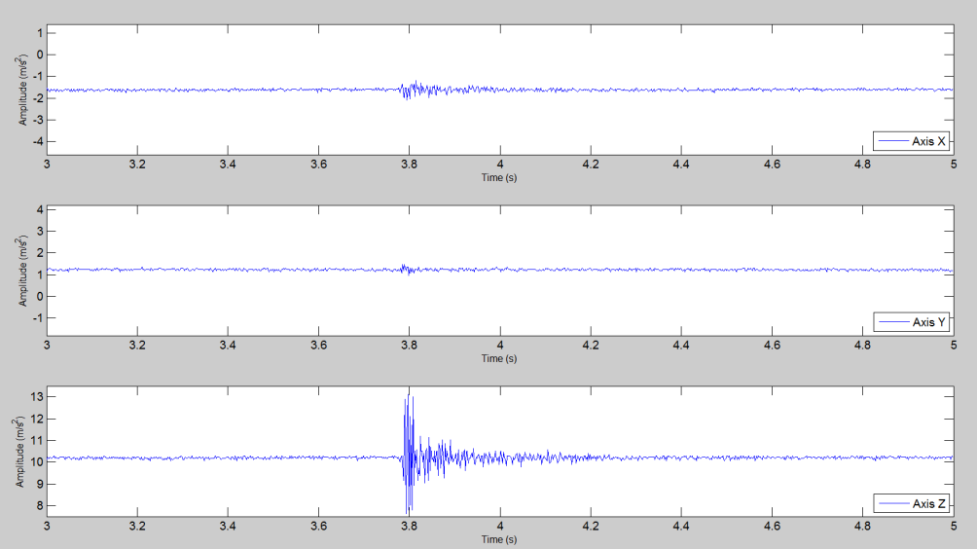
Vibration Node – Impact Tests
Tennis ball - ~ 57 g
Low impact stationary blade
1 accelerometer – 3 axes

Slide 10
Variable Background Signals: accelerometers
CART 3 (600 kW)
normal operation
GE (1.5 MW)
normal operation
CART 3 (600 kW)
idle rotation
Time (s)

Slide 11
Impact Detection - Vibration Node
n=4
72% of detected impacts observed on > 1 blade
n=23
% of Impacts detected
n=6

Slide 12
Vibration Node – Impact Tests
Tennis ball - ~ 57 g
High impact moving blade
Accelerometers & Contact Microphones – 3 blades

Slide 13

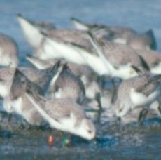
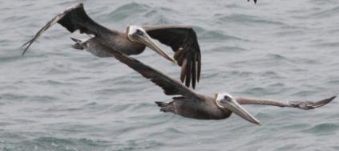
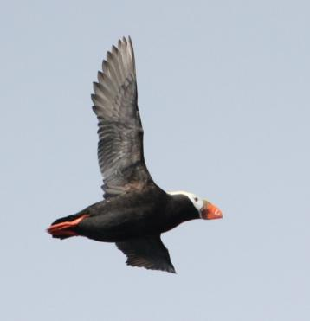
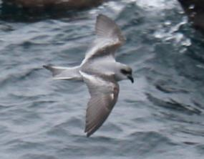
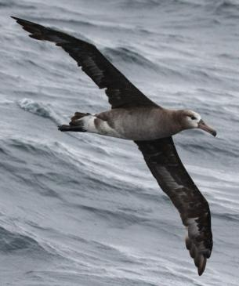
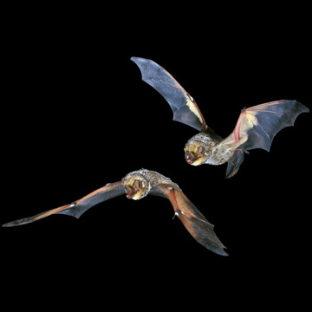
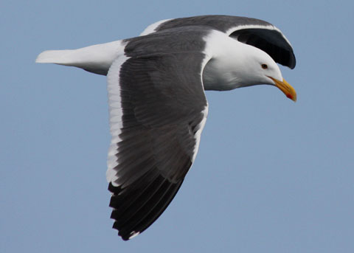
Range of Bird and Bat Sizes - Offshore
10 g …….………..800 g………………. 6,000 g
Shorebird
Puffin
Storm-Petrel
Pelican
Albatross
Hoary Bat
Western Gull
Utah Dept. of Natural Resources
© John Avise

Slide 14
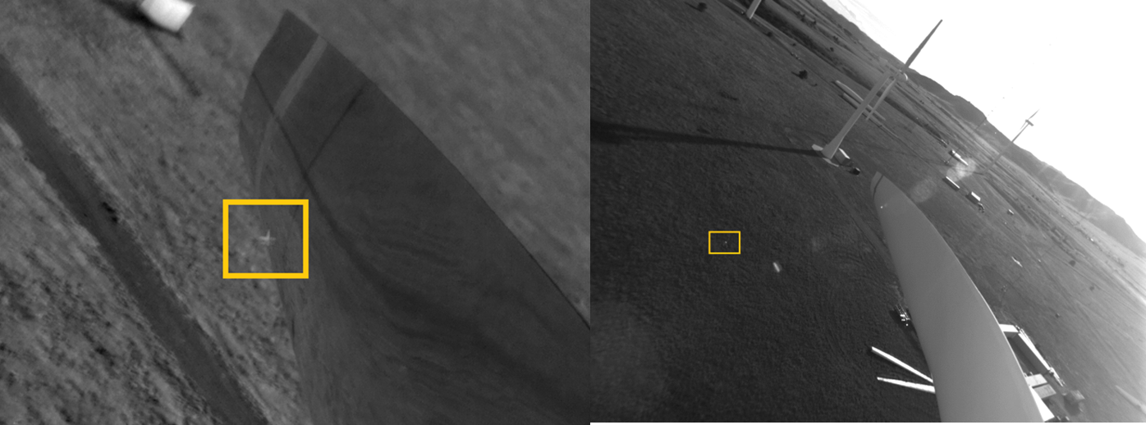
Optical Node - Impact Tests
Ball fired from air cannon on ground
IR camera
FLIR A655sc
640 X 480
10-12 fps
Visual Camera
Allied Vision, Manta 201‐C
1624 X 1234
6 fps

Slide 15
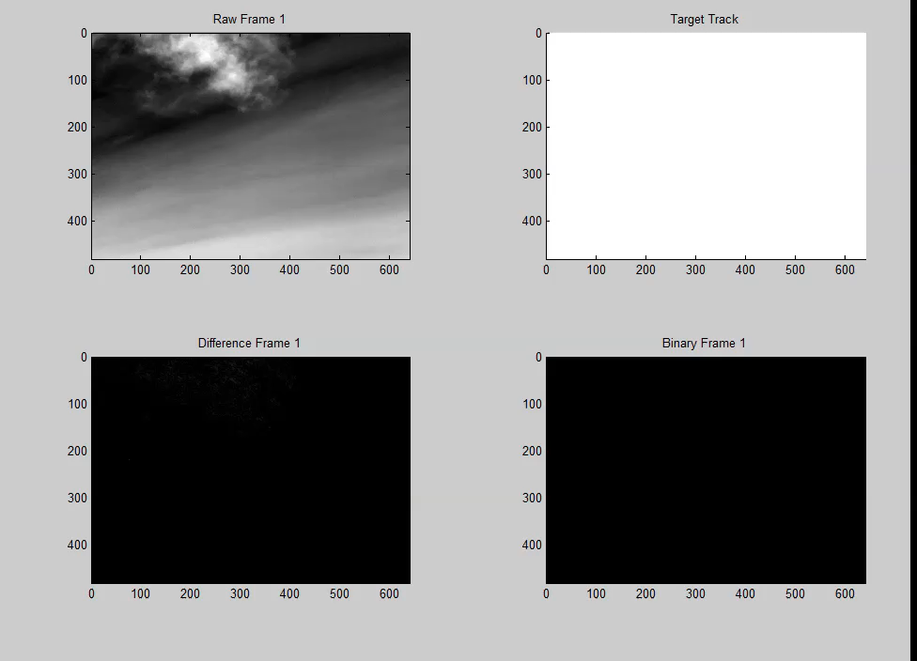
Optical Node - IR Image Analysis

Slide 16
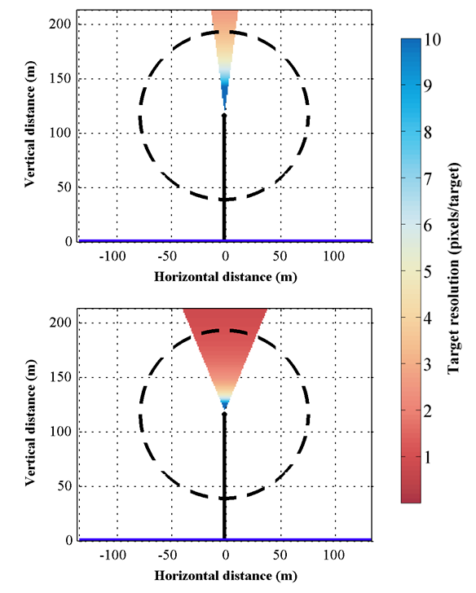

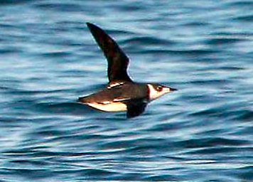
Optical Node –
Target Resolution
(For a 640 X 480 IR camera)
15º FOV lens
Marbled Murrelet
Length: ~24 cm
45º FOV lens

Slide 17
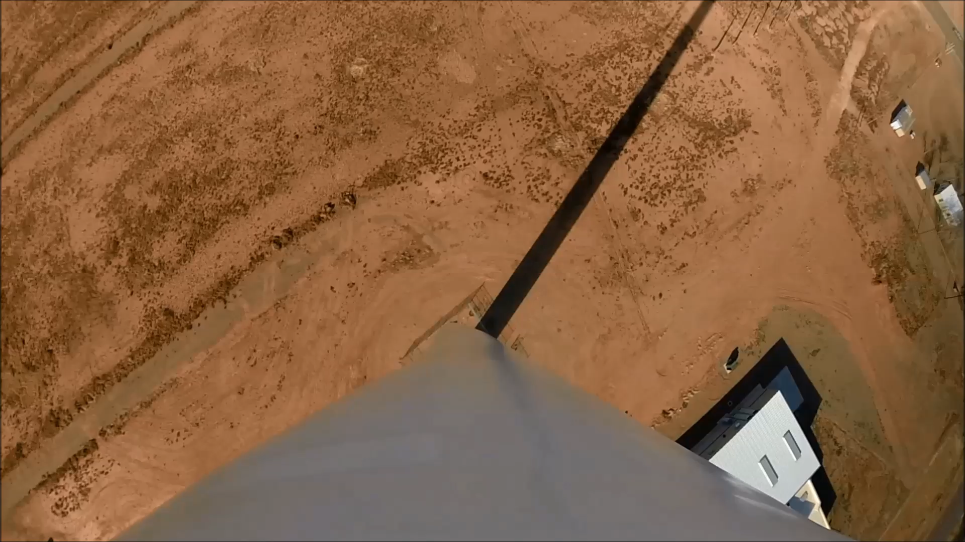
Optical Node – Camera Positioning

Slide 18
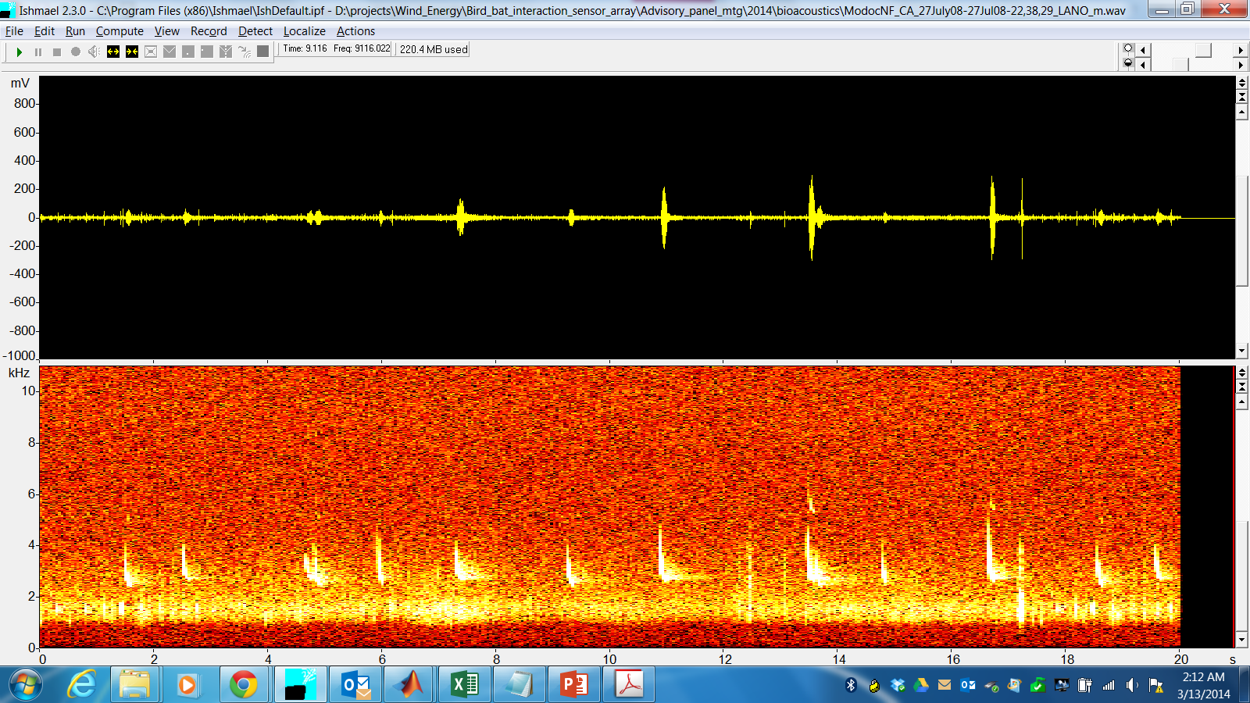
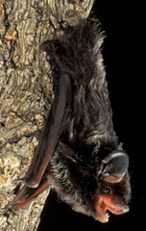

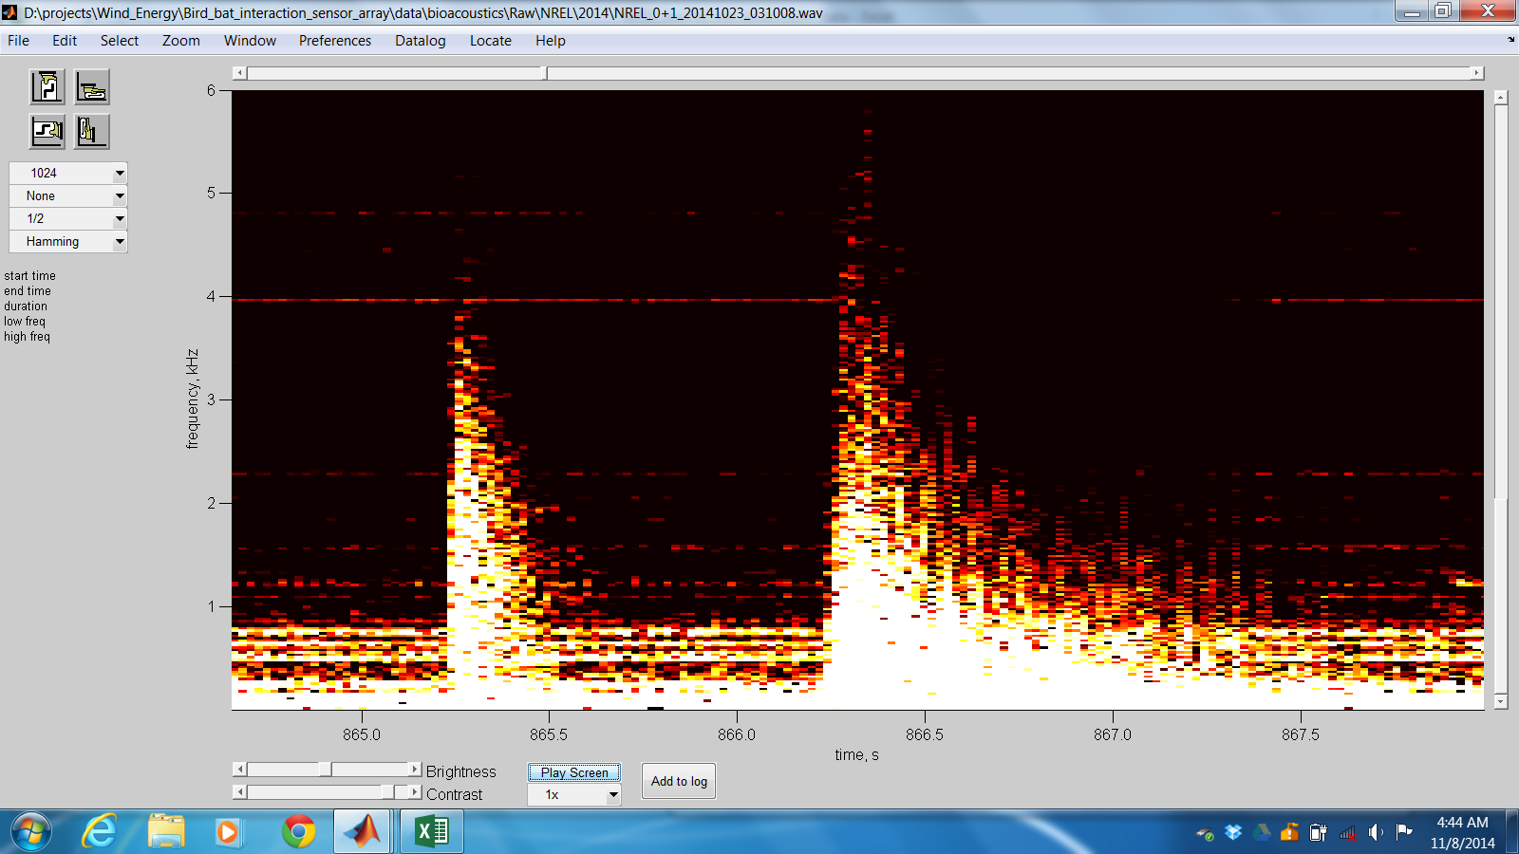
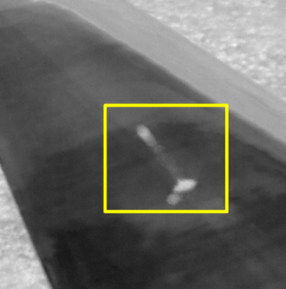
Bioacoustics Node
Silver-haired bat
Firing and impact of a tennis ball on a stationary blade

Slide 19
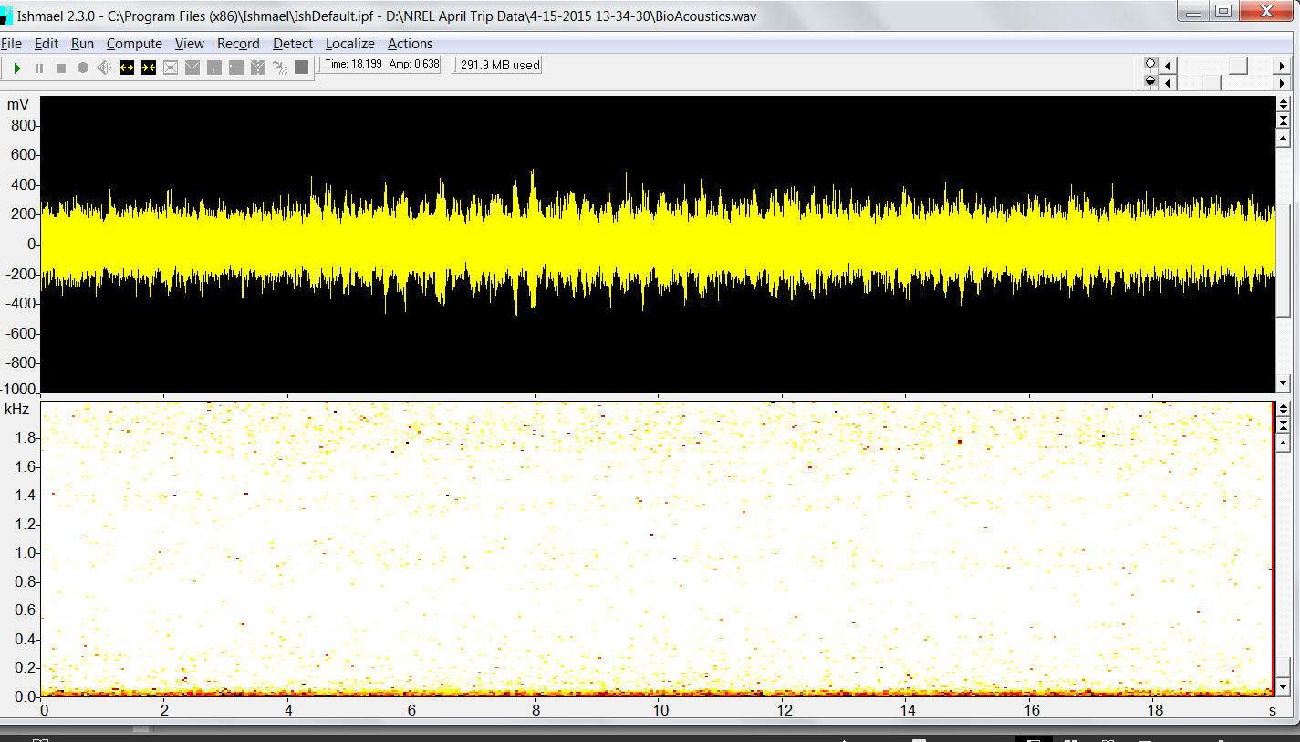
Bioacoustics Node
Cart 3 Normal Operation
microphone INSIDE nacelle with impact
Accelerometer
Impact acoustic signal masked

Slide 20
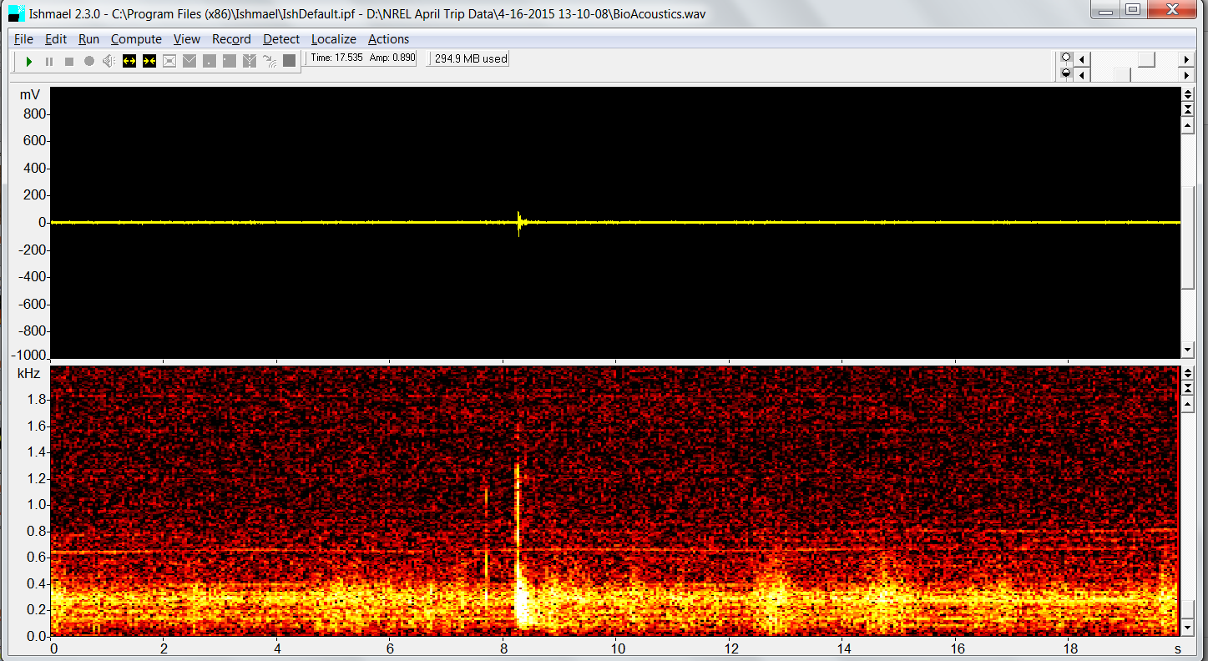
Bioacoustics Node
Cart 3 Idle Operation
microphone OUTSIDE nacelle with impact
Accelerometer
Impact acoustic signal detected!

Slide 21
Summary
*Design & Initial Tests Very Promising*
Vibration Node:
Impaction detection dependent on background signals and impact kinetics
Optical Node:
Target identification will depend on frame rate and pixel resolution, ideal placement may be on blades
Bioacoustic Node:
Valuable for impact and environmental assessment (e.g., rain, lightning, etc.), in addition to species identification

Slide 22
Future Directions
Incorporate newer, smaller, low power sensors.
Continue developing operational software and automated event detection.
Extended deployment on commercial scale, grid connected, onshore turbine.
Work with manufacturers to build sensors into turbine design.

Slide 23
Conclusions
Integrated sensor array capabilities thus far show promise and will be instrumental during:
Site assessments for proposed facilities
Conducting impact assessments of established wind facilities
Assessing efficacy of operational mitigation or deterrent technologies.
Operational monitoring of turbine

Slide 24
Acknowledgements
Collaborators and Advisors:
• Mesalands Community College
• H.T. Harvey & Associates
• ABR, Inc. Environmental Research &
Services
• Floating Power, Inc.
• Principal Power, Inc.
• CCAP – Coastal Energy Project
• NREL, National Wind Technology Center
• Bat Conservation International
Funding:
US Department of Energy
Oregon State University
University of Washington

Slide 25
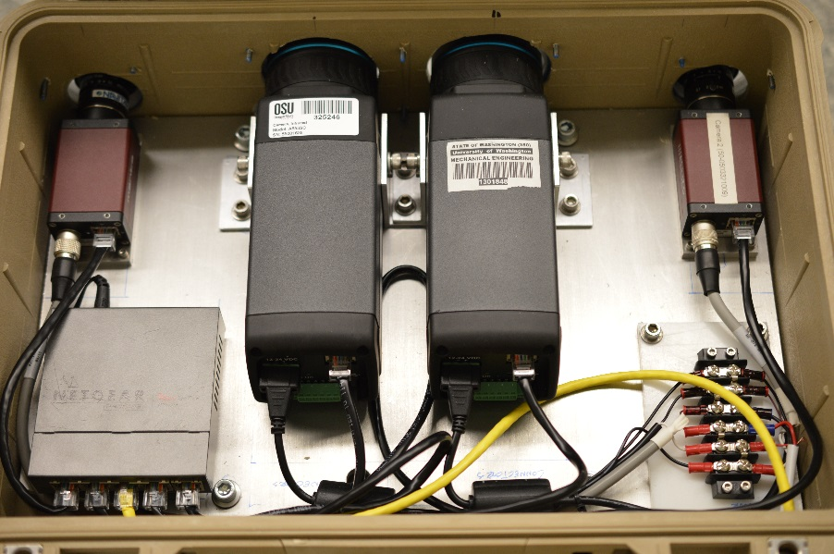
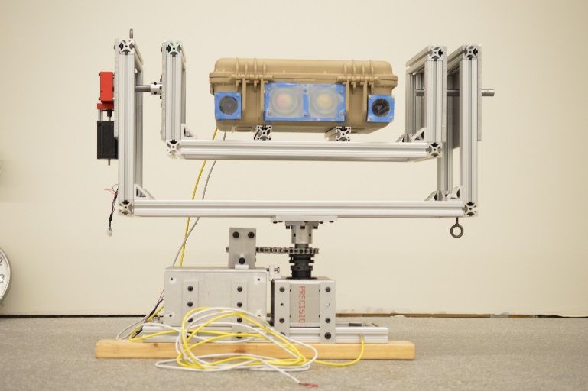
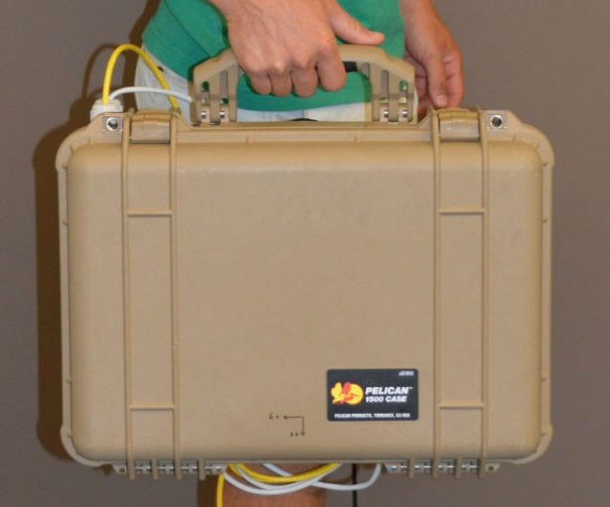
The Optical Node
Visual
Visual
Infrared
Infrared
1G Ethernet switch
Power distribution
On turbine pan and tilt mount
Travel profile

Slide 26
System specifications
Thermal Infrared
Visual
Model
FLIR A615sc
Manta G-210
Resolution
640 x 480
1624 x 1234
Lens FOV
15° x 12°
52° x 45°
Frame rate
50 fps
12 fps
Bandwidth
0.25 Gbps
~ 1 Gbps
Interface
1 Gbit Ethernet
1 Gbit Ethernet
Trigger
Software
Hardware
Cost
~ $ 20 k
~ $ 3 k
Software Infrastructure: Labview
Notes:
Coming back to the question of effectiveness, I’d like to now describe the system we used.
Model:
Ifrared Camera
380 meters away from turbine – discuss application later
Unfortunately, FLIR only subject to software trigger
IF we wan to answer the question of whether the added value of stereo IR worth that additional cost?

Slide 27
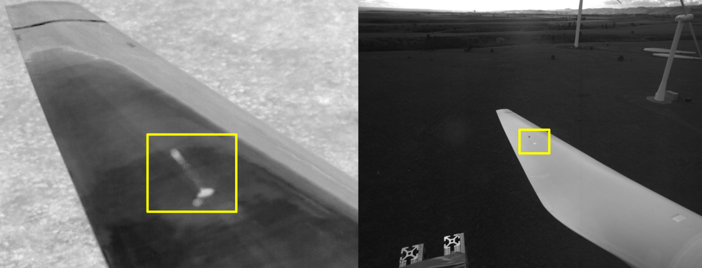
Optical Node - Impact Tests
Ball thrown from nacelle
IR camera
FLIR A655sc
640 X 480
10-12 fps
Visual Camera
Allied Vision, Manta 201‐C
1624 X 1234
6 fps

Slide 28
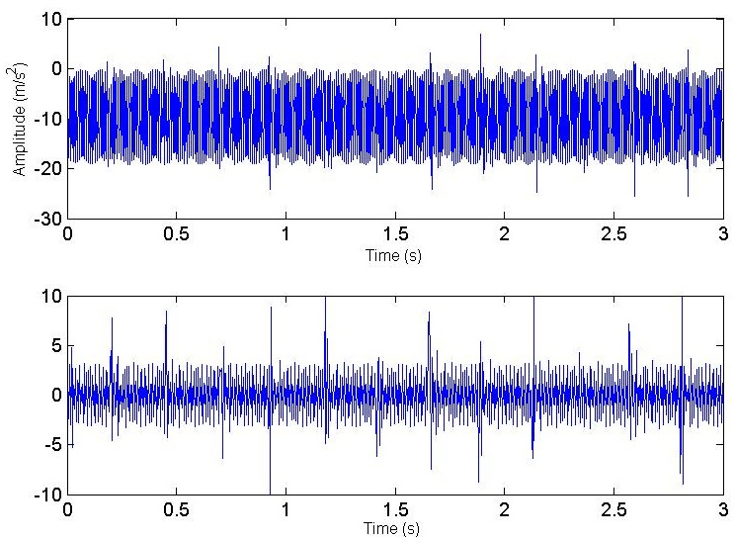
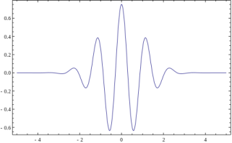
Signal Analysis
Break-down multi-frequency signal and detect single events (non-frequency domain)
Continuous wavelet transform (CWT) brakes signal into wavelets
Construct a time-frequency representation of a signal for time and frequency localization
Real-valued wavelet
Flowers et al. 2014 METS Proc.

