Slide 1
VT Web Archiving
Anthony Rinaldi and Dev Mehta
CS 4624
Clients: Mohamed Magdy and Tarek Kanan
Blacksburg, VA
5/6/2014

Slide 2
Project Goals
Setup a web-crawler with Heritrix
Archive files from vt.edu
Integrate with Wayback
Set-up Search with Solr (Stretch)

Slide 3
Problems Encountered
Older version of software.
Finding documentation to configure Heritrix.
  Only crawl vt.edu pages.
  Crawl all vt.edu pages.
Issues with CentOS firewalling.

Slide 4
Work Accomplished
Working set-up of Heritrix that successfully crawls vt.edu web-pages.
  Customized configuration to increase crawl depth.
  Reject non-domain based URLs.
Working set-up of Wayback machine:
  Processes warc files from Heritrix.
  Front-end for Heritrix-based crawls.

Slide 5
Lessons Learned
Sometimes, documentation leaves much to be desired.
Crawls can be extremely large if not configured properly.

Slide 6
Demo
Heritrix:
https://administrator:mQW8GzEsZAr8SxAketPY@webarchive.cc.vt.edu:12222/
Wayback:
http://webarchive.cc.vt.edu/

Slide 7
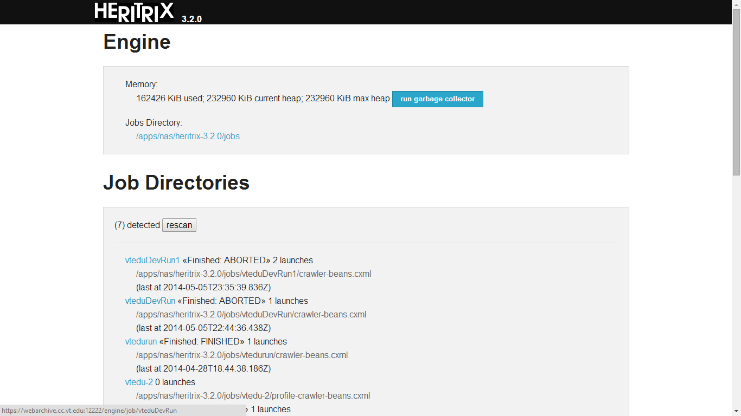

Slide 8
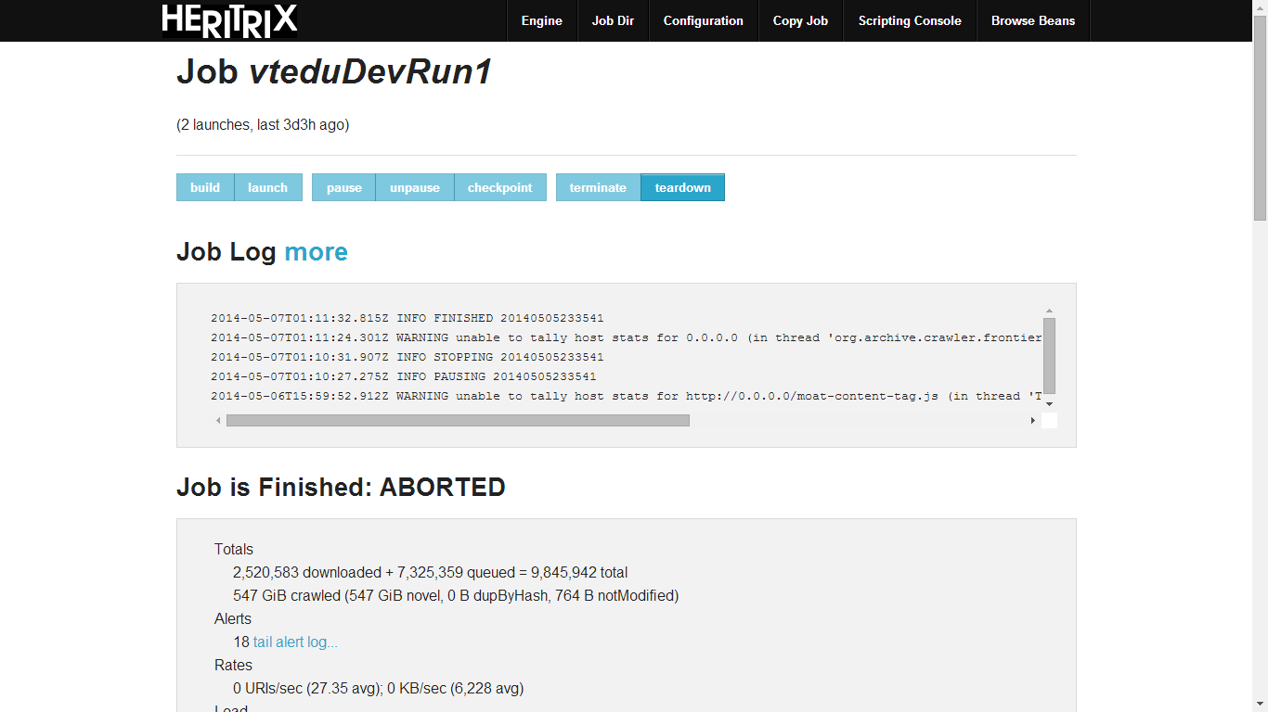

Slide 9
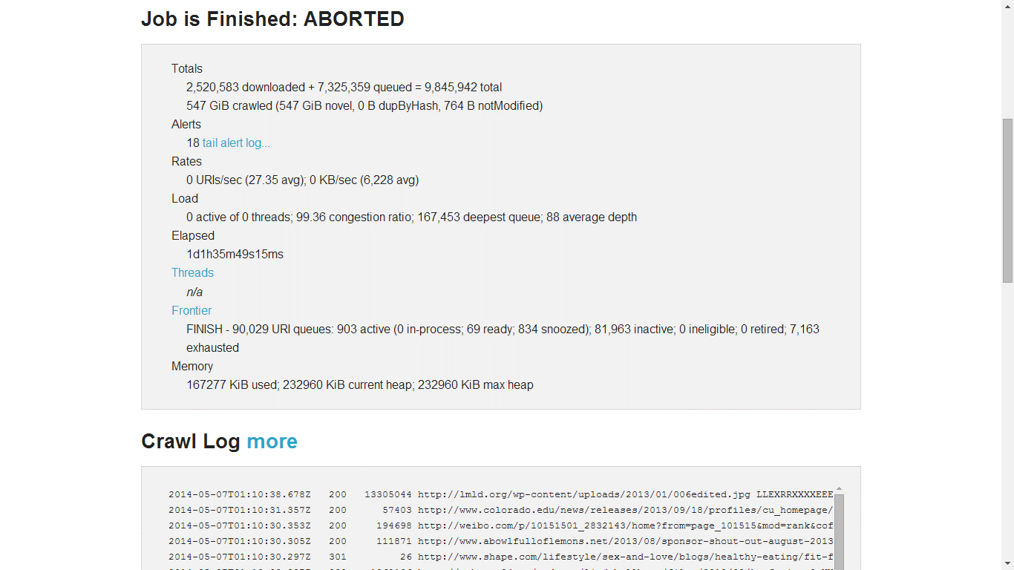

Slide 10
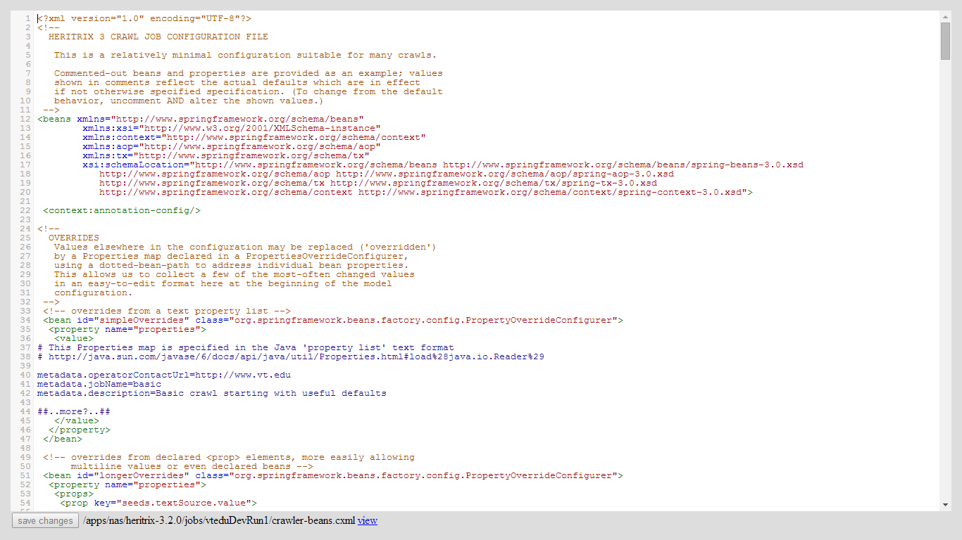

Slide 11
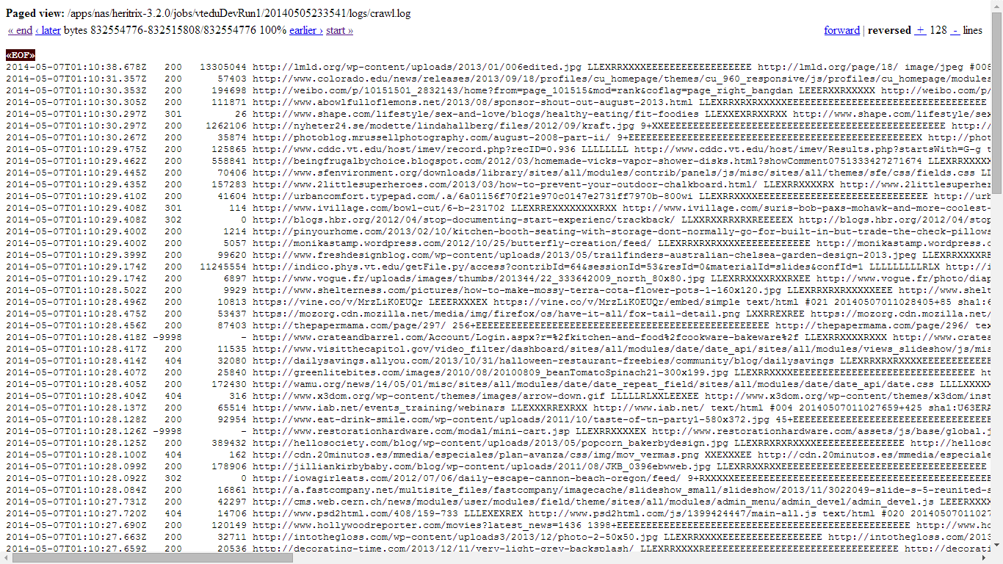

Slide 12
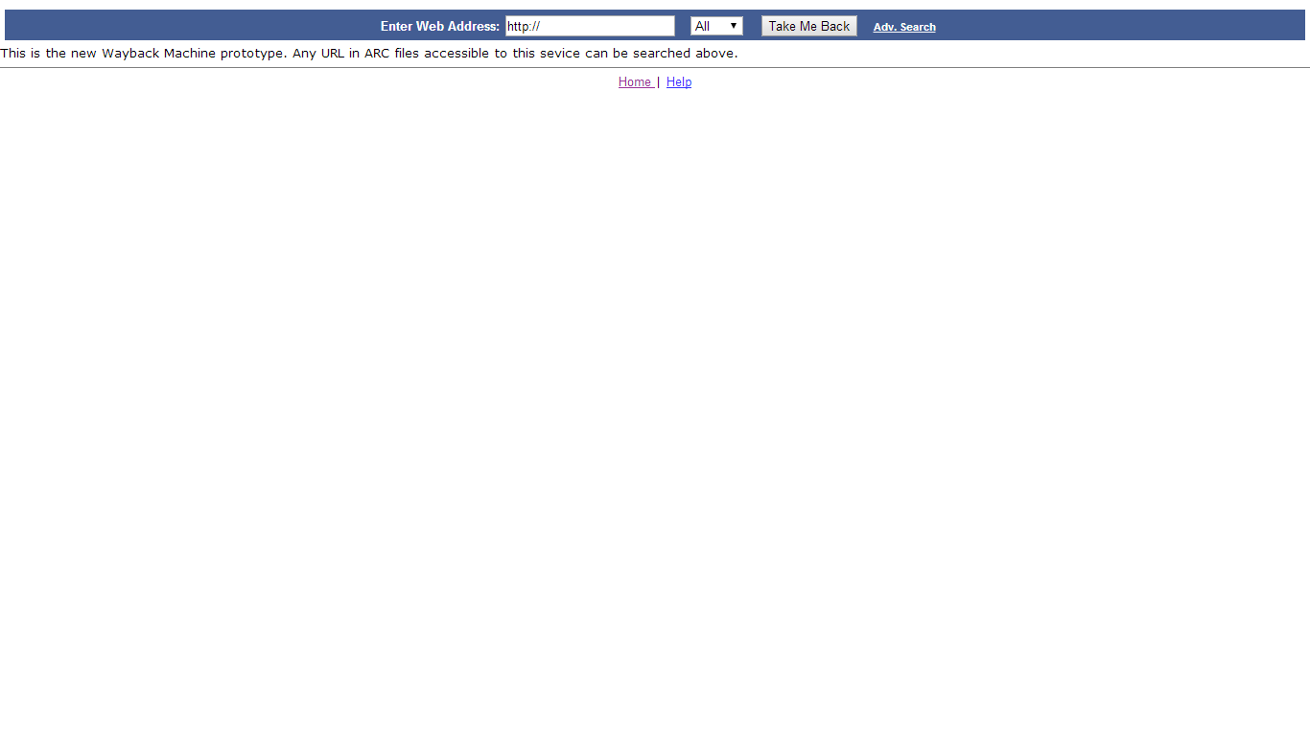

Slide 13
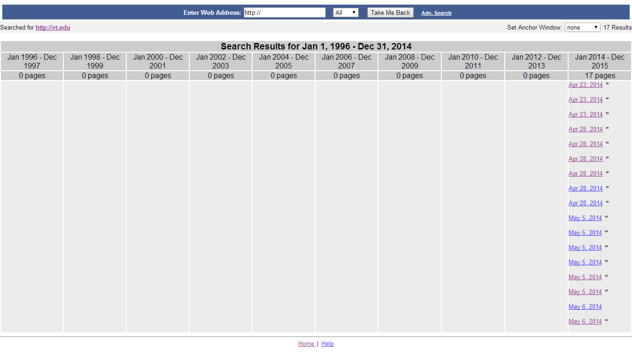

Slide 14
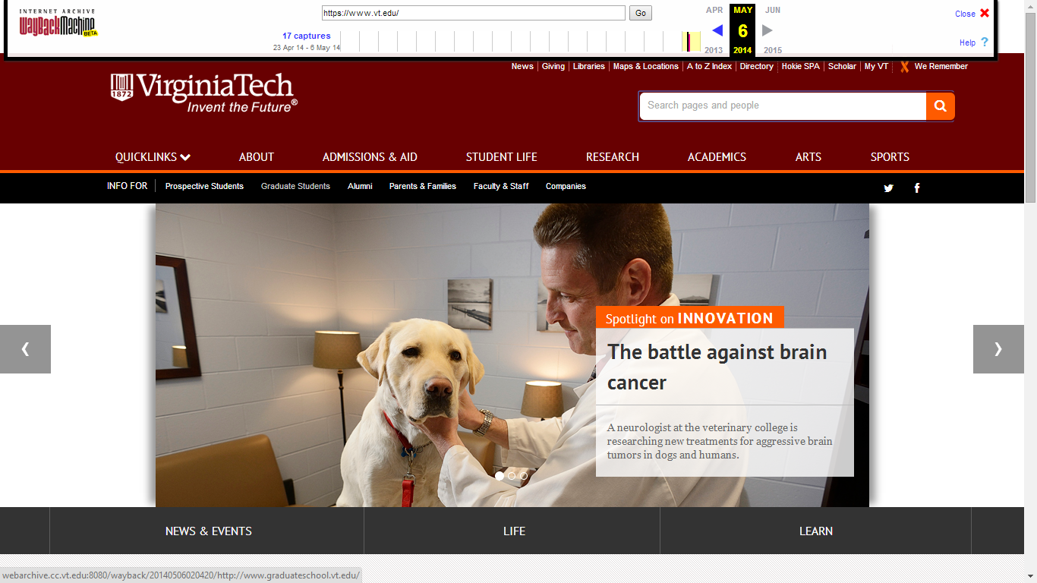

Slide 15
Questions?

