Slide 1
CS3604 Case Study Library 2
Team Members: Daniel Setareh, Trevor Bagbey, Matthew Betsill, Omar Elgeoushy
Client: Professor Dunlap
CS4624: Multimedia, Hypertext, and Information Access
Dr. Fox
Virginia Tech
Blacksburg, VA 24061
12/16/2022

Slide 2

Outline
Motivation
Project Overview
Work Completed
Future Work
Acknowledgements
References

Slide 3
Motivation
Give students of CS3604 a way to access previous case study projects
Improve previous semesters’ site
Ease current burden of work required by professor for site

Slide 4
Project Overview - Work from Previous Semester
Launched site from VTDLP Access Project Fork
AWS Amplify for deployment
OpenSearch for GraphQL Queries
S3 for file storage
DynamoDB for archive, collection, and site metadata
Python Script for Batch Uploads
Allows for batch uploads of case studies to specified collection
Site Admin Page
Allows for simplistic changes to the site
Create / edit / delete specified collections / archives
Home page changes

Slide 5
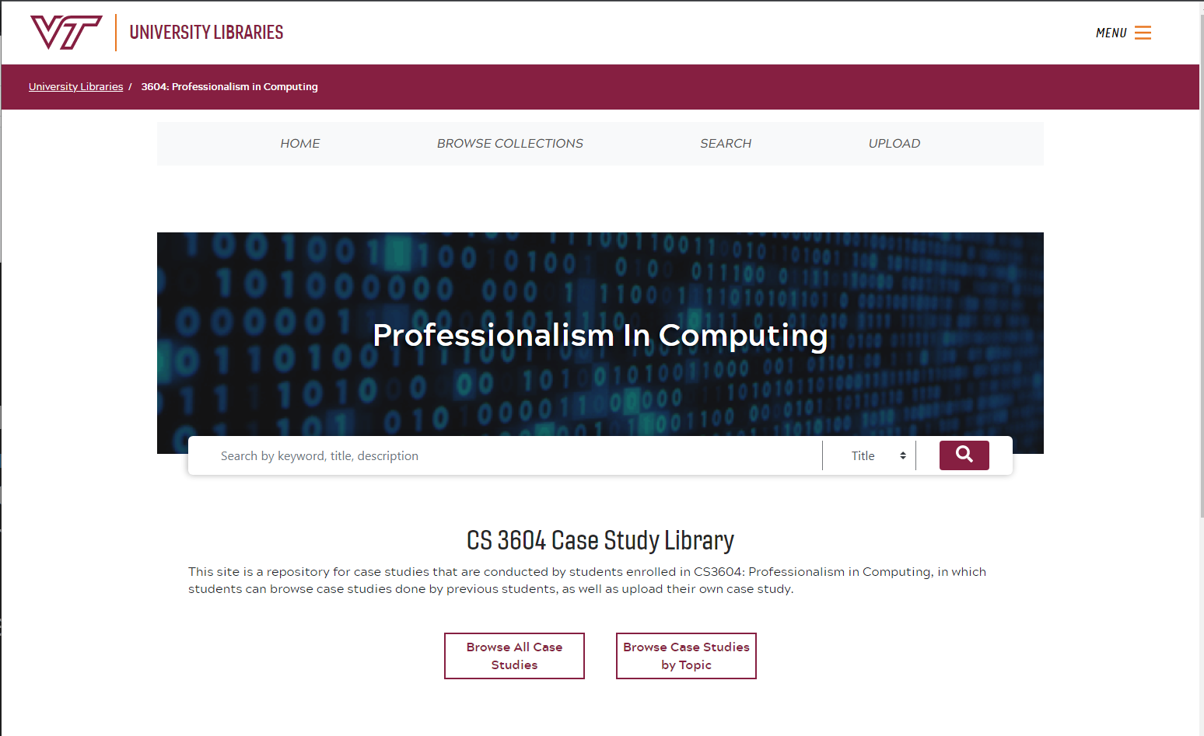
Current Home Page

Slide 6
Project Overview - Problems
Problems with what we were left
Outdated GraphQL API Key causing unresponsive site
Case studies categorized by course semester
Professor Dunlap required to upload case studies using Python script
Hundreds of uploaded case studies in .pptx with no display support

Slide 7
Project Overview - Solutions
Update GraphQL API Key
Notify Professor Dunlap to prevent further site crashes
Create Collection for Each Course Topic
Intellectual Property, Privacy, Artificial Intelligence, etc.
Create Upload Page for Students
Allow student to specify name, title, description, and course topic
Only allow for PDF and MP4 files to be uploaded

Slide 8
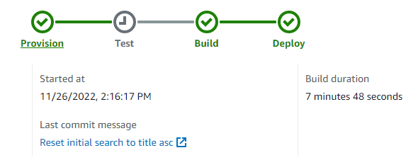
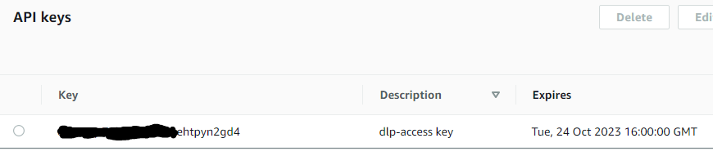
Work Completed - Deployment
Successfully re-deployed site on Amplify
Updated GraphQL API Key
Created new VTDLP fork to work with

Slide 9
Work Completed – Browsing
Created new collection for each course topic
Change old collection metadata in Collections and CollectionsMap DynamoDB tables
Implemented Lambda Function for case study thumbnails

Slide 10
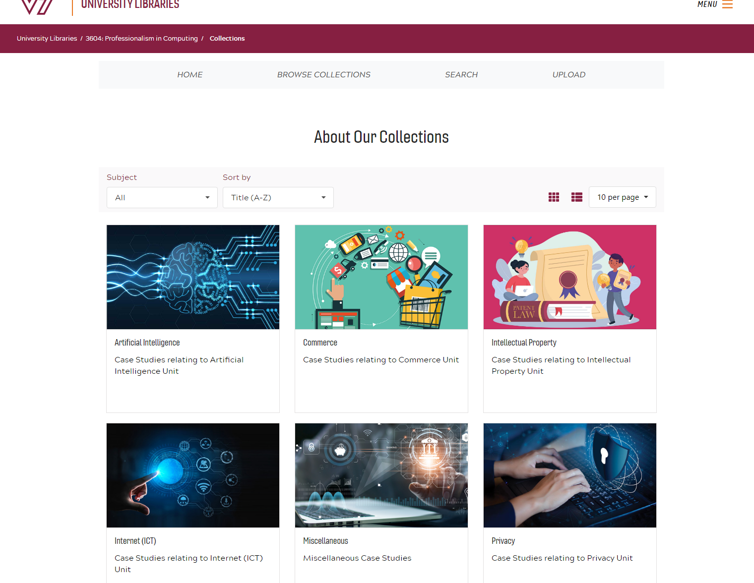
Collections Page

Slide 11
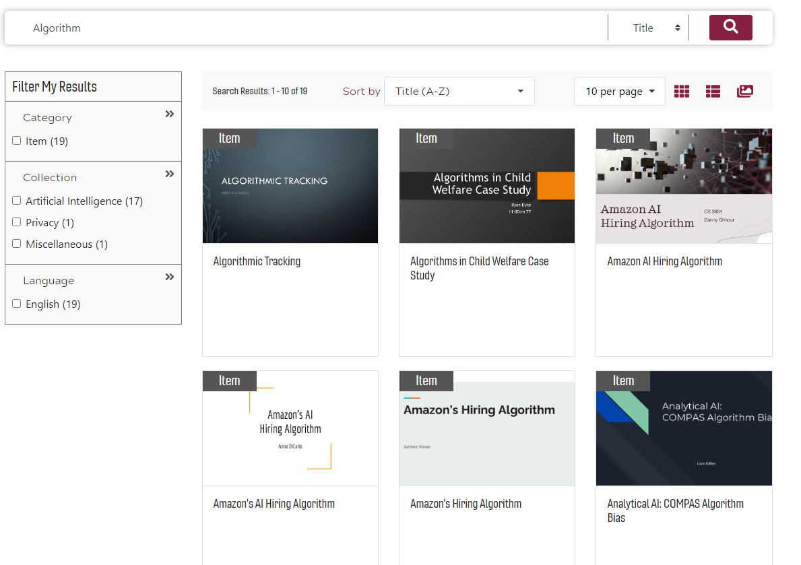
Example Search

Slide 12
Work Completed – Archive Management
Removed all archives to re-upload
Update to have title, course topic, and name (if possible)
Assisted by CS 3604 Honors students Raseen Nirjhar & Joseph O’Such
800+ re-uploaded
Files moved to Amplify Storage S3 bucket
Easier-to-use API in React

Slide 13
Work Completed - Upload
Created student upload page
Authenticated using Cognito User Pools
Accepts name, title, description, files, and course topic
Either 1 or 2 files per upload (PDF or MP4)
Front-end validation

Slide 14
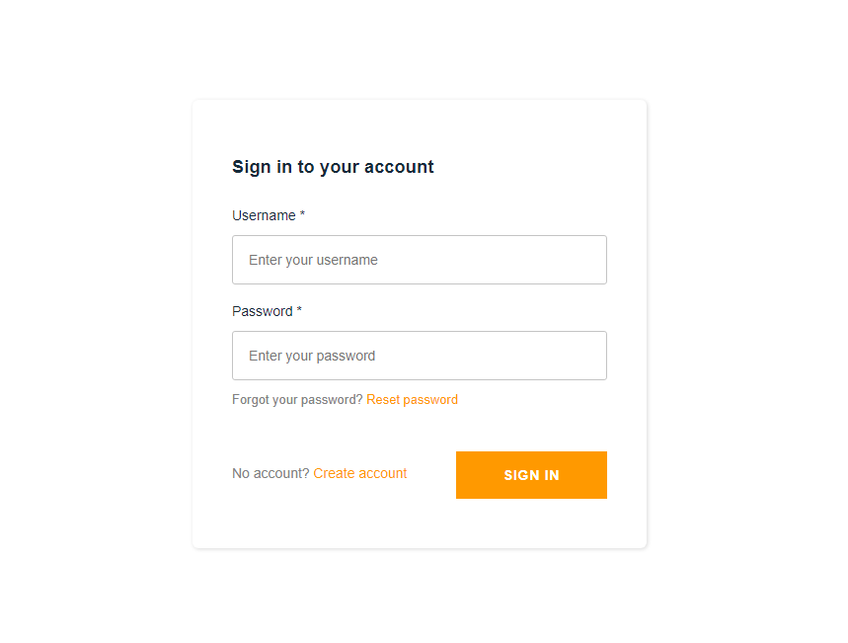
Upload Page Login

Slide 15
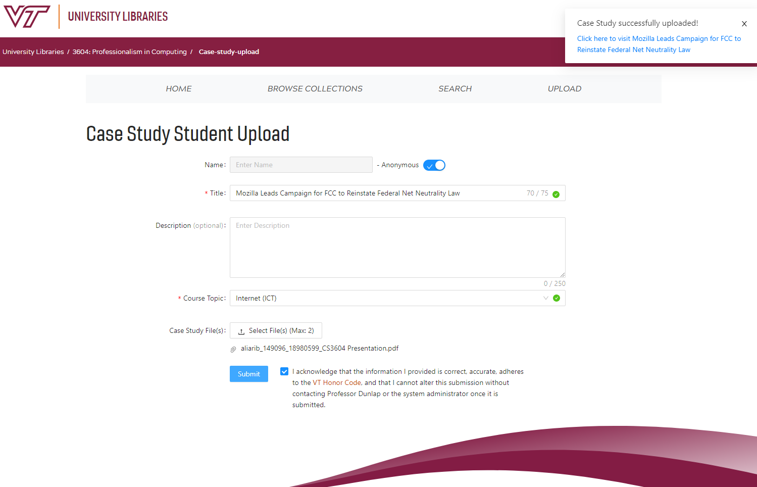
Student Upload Form

Slide 16
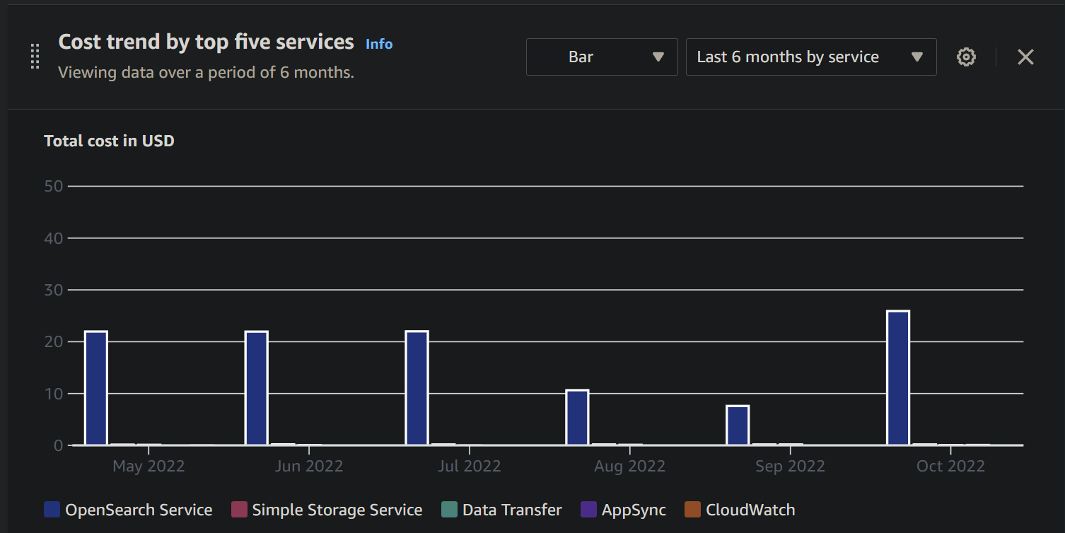
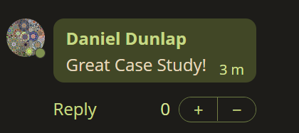
Future Work
Reducing cost of searching
CAS Authentication
Edit, delete submissions
Comments for case studies

Slide 17
Acknowledgements
Dr. Dunlap
Project client
Raseen Nirjhar & Joseph O’Such
CS 3604 Honors students assisting with project
Yinlin Chen
VTDLP maintainer
Dr. Edward Fox
Professor

Slide 18
References
[1]
Current Site: https://casestudies.cs.vt.edu/
Previous Semester Team’s Report: http://hdl.handle.net/10919/109970
VTDLP Access: https://github.com/vt-digital-libraries-platform/dlp-access
AWS Amplify: https://aws.amazon.com/amplify/
AWS OpenSearch: https://aws.amazon.com/opensearch-service/
AWS S3: https://aws.amazon.com/s3/
AWS DynamoDB: https://aws.amazon.com/dynamodb/
VT CAS: https://www.middleware.vt.edu/sso/cas.html
Second Slide Image: https://www.linkedin.com/pulse/internet-huge-source-information-philip-meyers

