Slide 1

Interactive Text Classification & Evaluation
Jarvis Ly, Jason Tran, Subeom Kwon, and Thinh Truong
CS 4624 Multimedia/Hypertext
Mohamed Farag
Virginia Tech
Blacksburg VA 24061
April 20th, 2023

Slide 2
Outline
1. Recap
2. Implementation
3. Testing
4. User & Dev. Manual
5. Accomplishments
6. Lessons Learned
7. Future Work
8. Demo

Slide 3
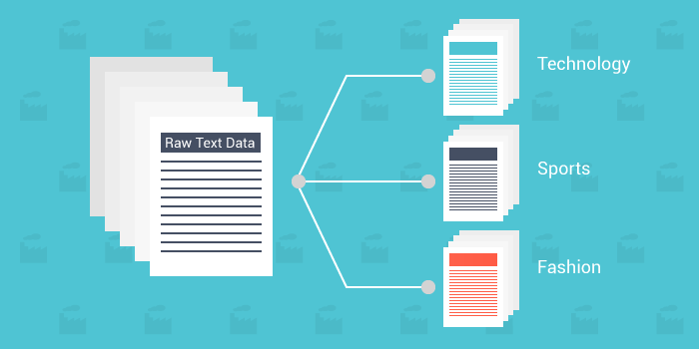
Recap
WHAT?
Assign predefined categories or labels to text documents
WHY?
Text is one of the most common types of unstructured data
HOW?
Using an ML model to automate this process
Image credits: Moosend

Slide 4
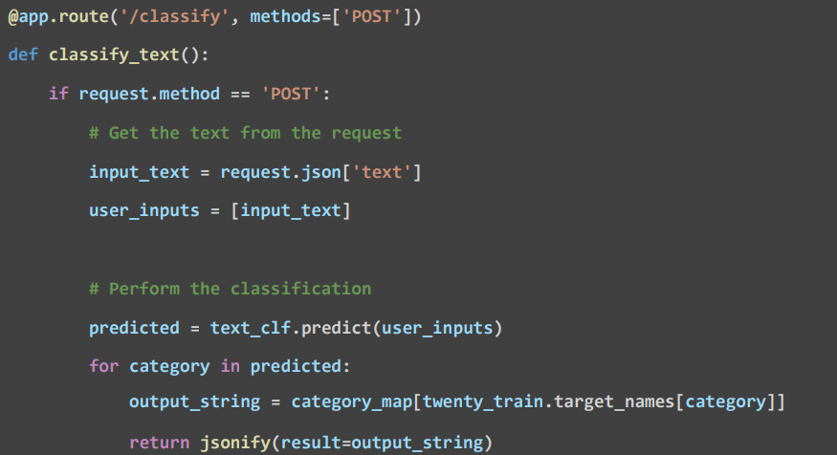
Implementation (FLASK Back-End)
Flask API to Create a /classify end point
This end-point works as a communication
channel between front-end and back-end
Once the endpoint receives a request (user input)
It processes & extract the user input to a variable
Performs the classification by calling predict function
to generate prediction and result.
Finally, return the result as a JSON Object, and send the
result back to the front-end.

Slide 5
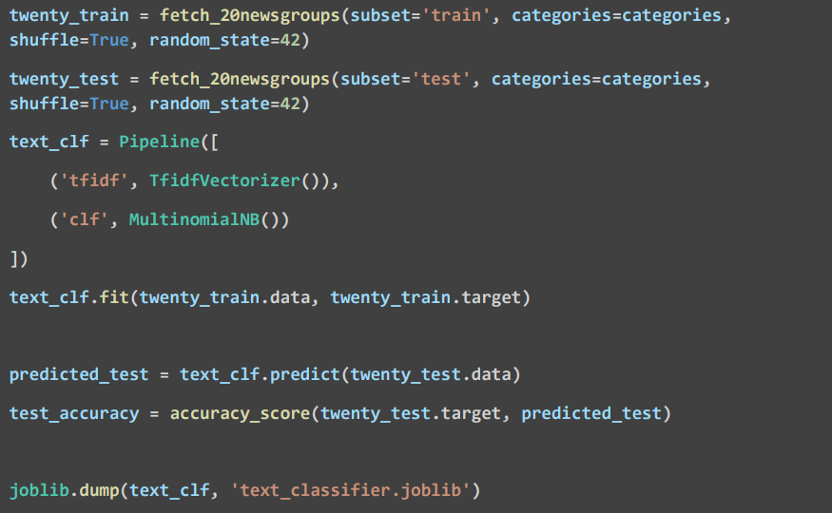
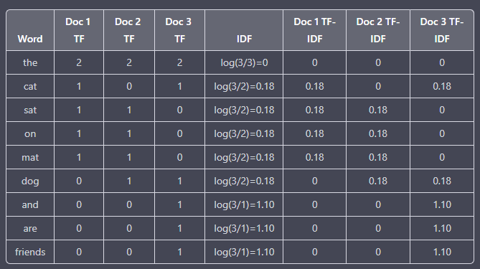
Machine Learning Model
Start by fetching train & test dataset from 20 newsgroup
Construct a pipeline object that contains 2 essential steps
Step 1: TF-IDF Vectorizer (Feature Extraction Step)
  Tokenizes input document into separate words
  Assign numerical values based on the importance
  TF: How many times a certain word appears in a text
  IDF: Measures how significant or unique a word is
  TF-IDF: Multiply TF & IDF values. Higher value
  indicates higher importance of the word
Step 2: MultinomialNB (Classification Step)
  Suitable for discrete features
  like word counts or term frequency
Finally, we train and test the classifier and
save the model as a binary file using joblib library so that we can
easily load this classifier when we start the application

Slide 6
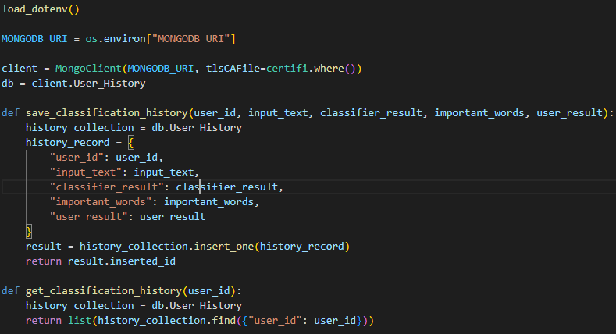
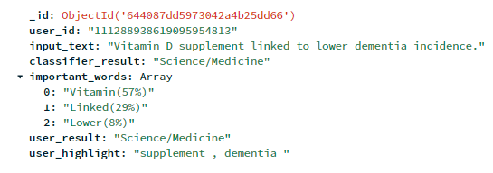
Implementation (Database)
Used MongoDB store user data in a BSON (binary JSON) format
Since our back-end is using python, we had to use PyMongo library to connect mongoDB with the python script to save user data
We store data such as, userID, user input, classifier result, user result and highlights
We display the stored data to the front-end once the user login to the application

Slide 7

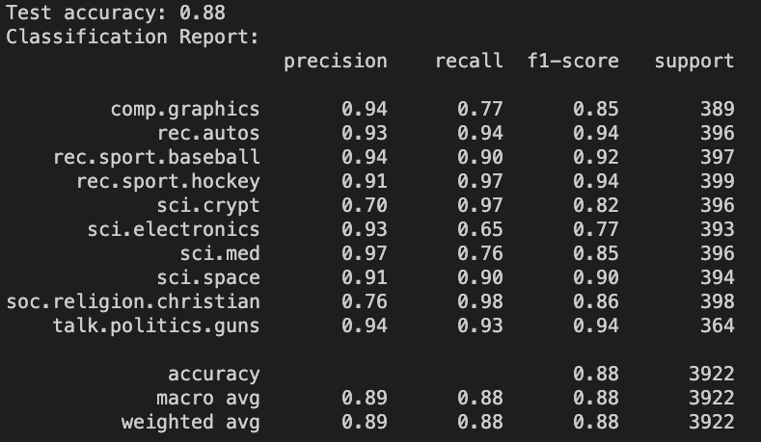
Testing & Assessment
Used joblib to train and test the classifier and saved the model as a binary file so that we can easily load this classifier when we start the application
Manually tested application with texts from online articles
Tested edge cases that might lead to errors (ex. putting one word as an input)

Slide 8
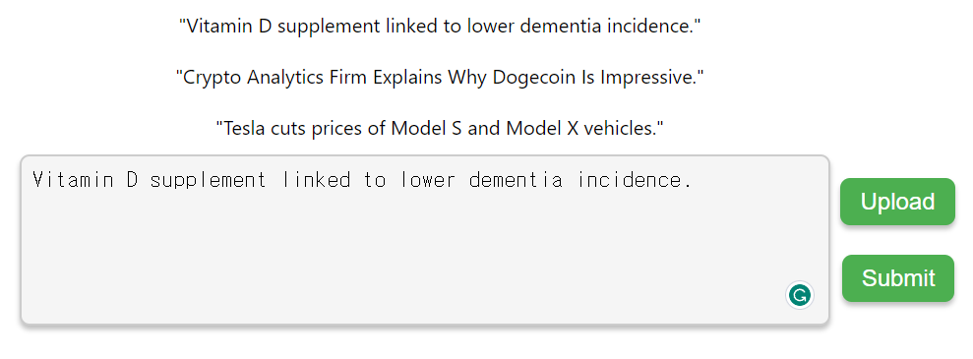
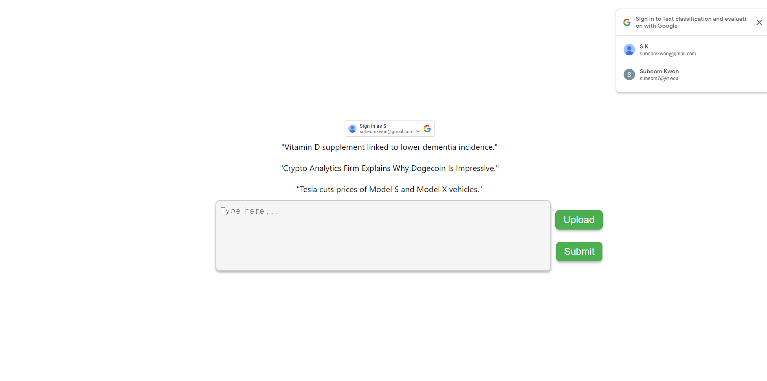
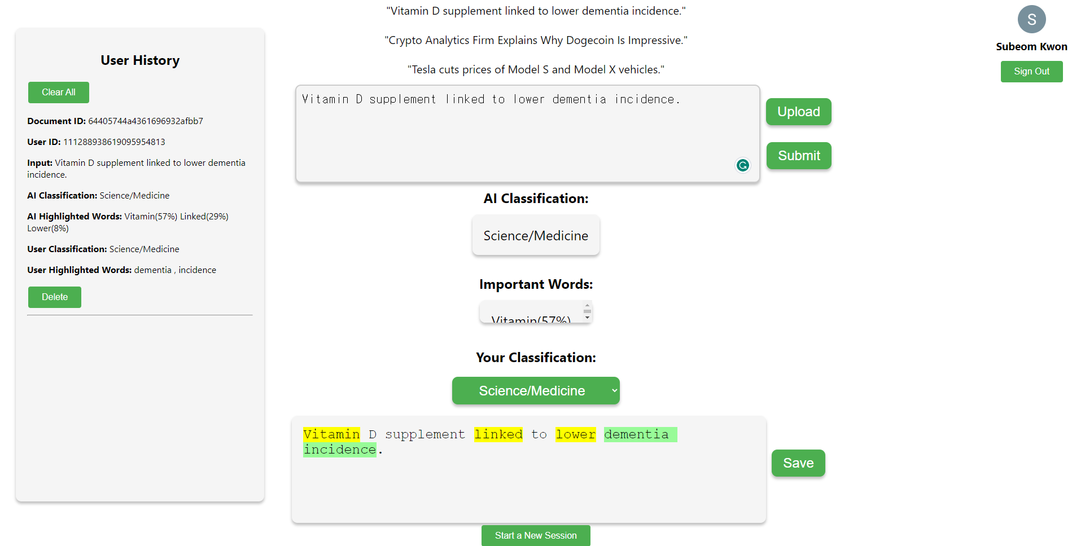
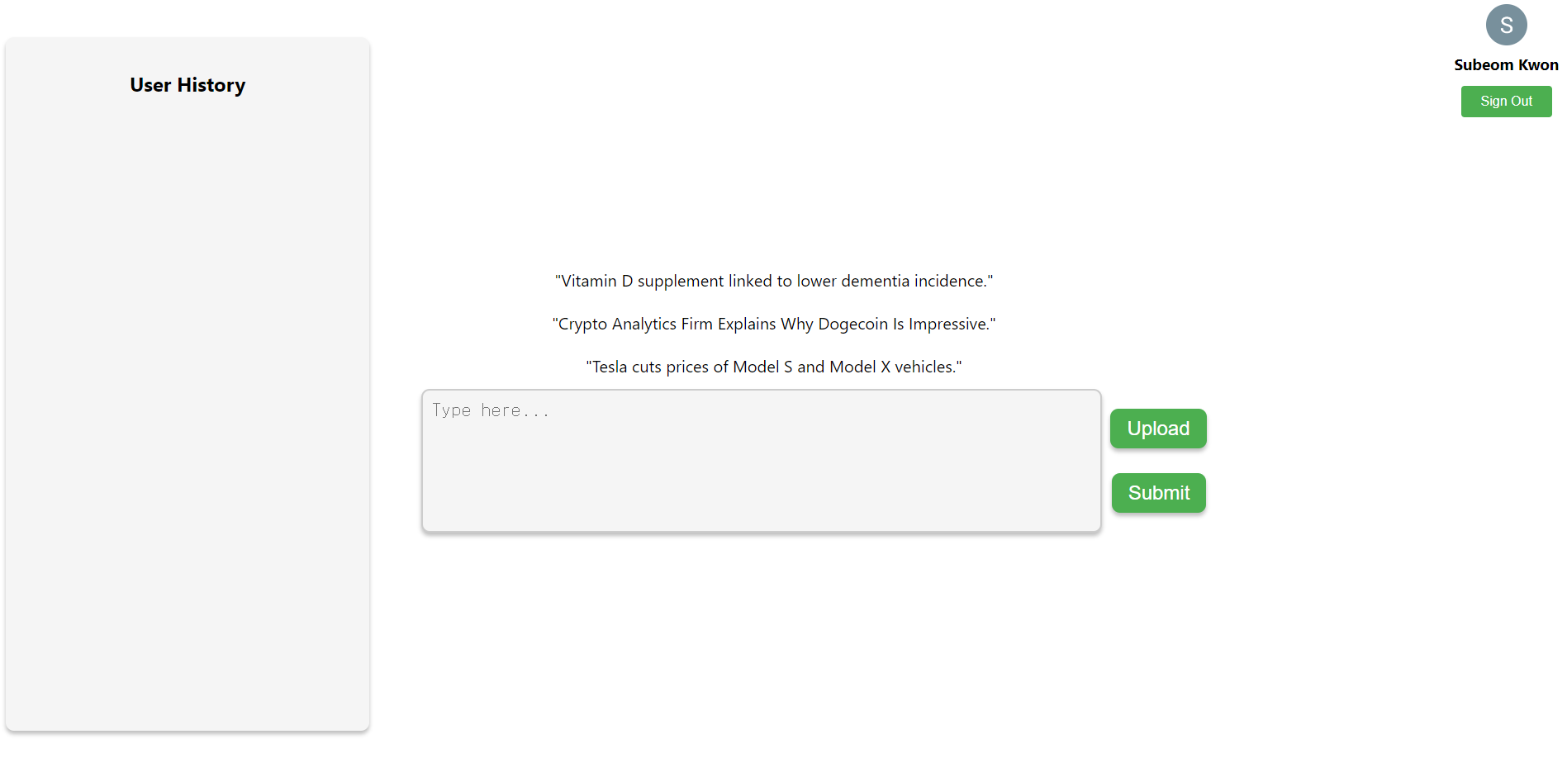
User Manual - Raw Text
3
1
2
4

Slide 9
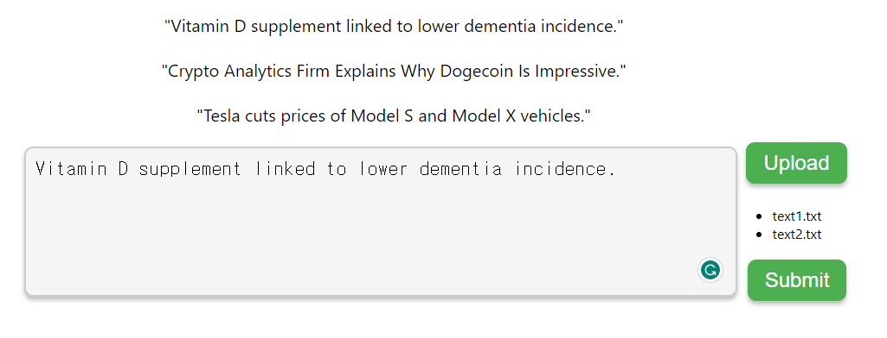
User Manual - File Upload
2
1
3

Slide 10
Developer’s Manual
Setup
  Clone the Repository (git clone https://github.com/subeom7/Text-Classification-and-Evaluation.git)
  Install Dependencies (npm run install-all)
  Enter Project Directory (cd Text-Classification-and-Evaluation)
  Run the Client & Server (npm run dev)

Slide 11
Accomplishments
Milestone 2
File Uploading + Text Extraction
User Highlighting + Annotations
Authentication
Result Storage
Milestone 1
User text input
Text Classification feature
Frontend
Milestone 3
Bug fixes / cleanup

Slide 12
Lessons Learned
Finding an efficient method to install dependencies
First time using many unfamiliar tools/technologies like Scikit-learn/Flask/MongoDB
Bounced ideas/features off of eachother
Merged feature branches in Git
Found meetings to be more efficient than individual work
Bulk work in meetings and individual features on our own
Document during development rather than at the end

Slide 13
Future Work
Future Additions:
User Selected Model
Additional Filetype Support
Enhanced Interactivity Features
Account Registration/Auth (non-google)

Slide 14
Acknowledgements
Special thanks to:
Instructor: Dr. Mohamed Farag
TA: Ansh Gwash

Slide 15
References
[1] Text classification: What it is and why it matters. MonkeyLearn. (n.d.). Retrieved February 15, 2023, from https://monkeylearn.com/text-classification/#:~:text=Tutorial-,What%20is%20Text%20Classification%3F,and%20all%20over%20the%20web
[2] V. Rani, “NLP tutorial for text classification in Python,” Medium, 26-Jan-2023. [Online]. Available: https://medium.com/analytics-vidhya/nlp-tutorial-for-text-classification-in-python-8f19cd17b49e. [Accessed: 15-Feb-2023].
[3] What is text classification? - hugging face. What is Text Classification? - Hugging Face. (2022, May 17). Retrieved February 15, 2023, from https://huggingface.co/tasks/text-classification
[4] “TF–IDF,” Wikipedia, 06-Mar-2023. [Online]. Available: https://en.wikipedia.org/wiki/Tf%E2%80%93idf. [Accessed: 21-Mar-2023].
[5] “Naive Bayes classifier,” Wikipedia, 03-Mar-2023. [Online]. Available: https://en.wikipedia.org/wiki/Naive_Bayes_classifier. [Accessed: 21-Mar-2023].

