Slide 1
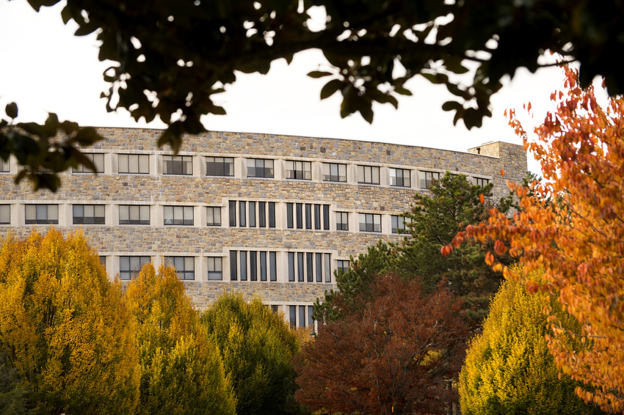


Auditing an Institutional Data Repository With Respect to the CoreTrustSeal Certification Requirements
Jonathan Petters
Data Management Consultant/Curation Services Coordinator
Virginia Tech University Libraries
Naina Pisharoti
Graduate Assistant
Aerospace and Oceanic Engineering

Slide 2
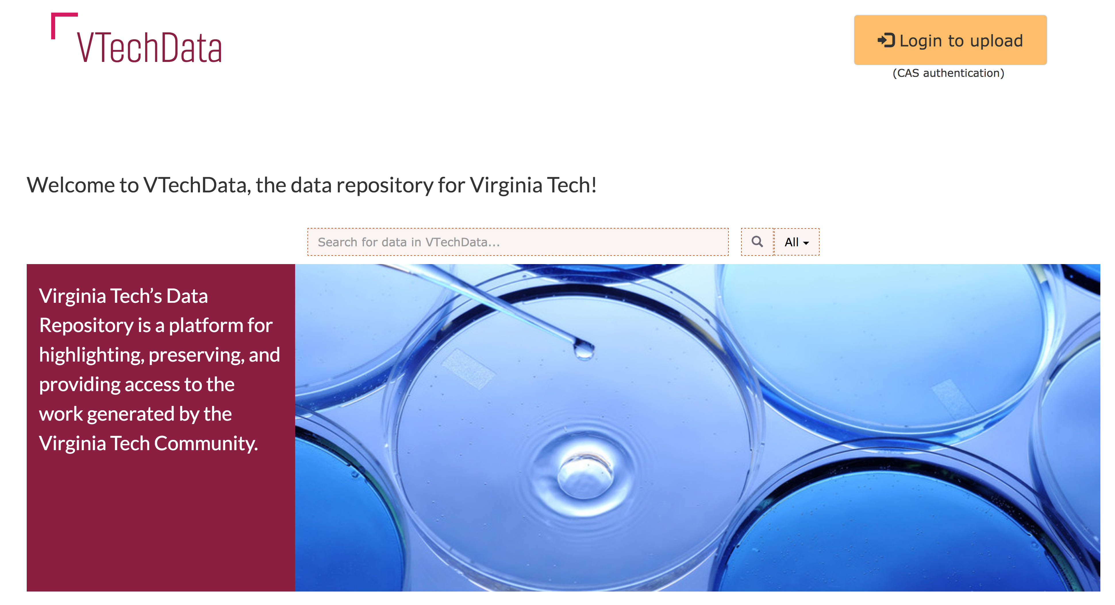

Slide 3
About VTechData
VTechData highlights, preserves, and provide access to research products (e.g. datasets) of the Virginia Tech community
  Meeting journal and funder requirements for data sharing/availability
Open access repository
Virginia Tech researchers can self-deposit
Curators suggest dataset/metadata enhancement by depositors, meeting minimum metadata requirements
74 published datasets since 2016
Notes:
So why do better? #1 Make it easier on ourselves….and others can benefit too (think of those poor group members following your work
#2 – smooth your research process by planning ahead…could lead to gains in research efficiency, but must acknowledge that it also takes time to plan…harder to prove this one unequivocally but I’d rather have a smoother process anyway. (personal story about master’s research??)

Slide 4
Internal Assessment – Why CoreTrustSeal?
evaluation process looks at technical, curatorial, and organizational infrastructure
lightweight repository certification process (relative to TRAC)
gaining in notoriety within research data circles (e.g. Enabling FAIR Data Project)
Facilitate conversation around Libraries’ digital infrastructure development/support

Slide 5
Assessment Process
Interviewed Data Services and Information Technology Services personnel within Libraries towards 15 of the 16 CoreTrustSeal requirements
  Requirement regarding funding and staffing out of scope
For each CoreTrust Seal requirement authors gave
  Ratings for VTechData
  Recommendations for improving VTechData

Slide 6
Report Completed February 2019
VTechData does not yet meet the CoreTrustSeal Repository Requirements
Improvements and documentation required towards digital curation, digital preservation, and systems administration
Report available online

Slide 7
Challenge for CoreTrustSeal Audit
VTechData gives Virginia Tech researchers a way to provide access to their data
Discipline-agnostic; serve political scientists, aerospace engineers, ecologists…
As curators we are not in a position to evaluate the quality/reusability of all the data or metadata to which we provide access, now or in the future
  Data Curation Network may lead to this capability for generalist repositories

Slide 8
Definition of Designated Community
“the Designated Community of VTechData comprises researchers at Virginia Tech who can deposit and publish their data therein”
With this definition, 3 of the 16 requirements (8, 11, 14) were deemed not applicable – would this have been alright towards CoreTrustSeal certification?
Defining Designated Community an active point of discussion
  CoreTrustSeal Review of Requirements
  ‘Access is What we are Preserving’: But for Whom?

Slide 9
jpetters@vt.edu
@jon_petters
Thanks!
Questions?

Slide 10
Our Rating Spread
Rating | Description | # Reqs at this Rating
0 | Not Applicable | 3
1 | The Repository has not considered this yet | 0
2 | The Repository has a theoretical concept | 4
3* | The Repository is in the Implementation Phase | 6
4* | The guideline has been fully implemented in the Repository | 2
Notes:
Question – how to rate requirements for which some parts are fully implemented others are not yet addressed?

Slide 11
OAIS Designated Community definition
An identified group of potential Consumers who should be able to understand a particular set of information in ways exemplified by the Preservation Objectives. The Designated Community may be composed of multiple user communities. A Designated Community is defined by the Archive and this definition may change over time. (draft OAIS Reference Model v3)

