Slide 1
Project MELT
Midterm Report
Zachary Lytle – Tam Ayers – Michael Goheen

Slide 2
Middle English Language Translator
Easy Use
Sustainable Lexicon
Robust Rule-Set
Emphasis on audio pronunciation
Low maintenance
Usable by English students
Includes research materials and historical information
Uses only open-source resources

Slide 3
Three Phases of Development
Research
Implementation
Testing

Slide 4
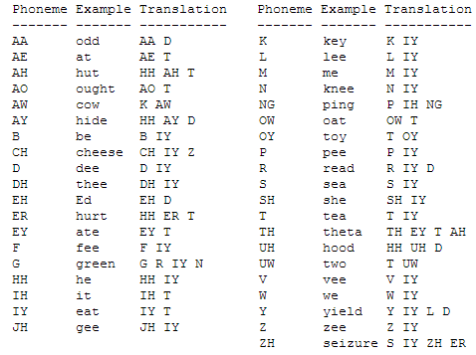
Research: Pronunciation
Books and more books.
ARPAbet
CMU Pronouncing Dictionary
Flite (Festival Lite)

Slide 5
Research: Translation
Scope of Dictionary
Portability into Applet
Google Books
Oxford University Press
University of Michigan
Project Gutenberg

Slide 6
Implementation Approach
Model
View
Control
Lexicon Management
Language to Phoneme
Speech Synthesis
Front Applet
Website
Audio Control
User Feedback
Server-side Operations
Database Query
Listener for New Activity

Slide 7
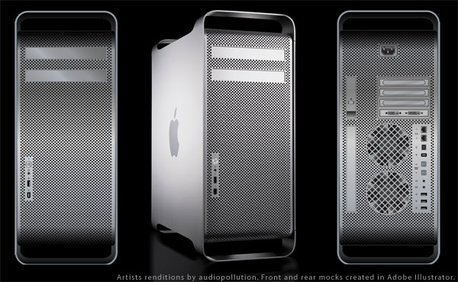
Server is Go
Using Gstreamer multimedia framework to bring audio into view
Open port for Flite ready to receive command
Website is active

Slide 8
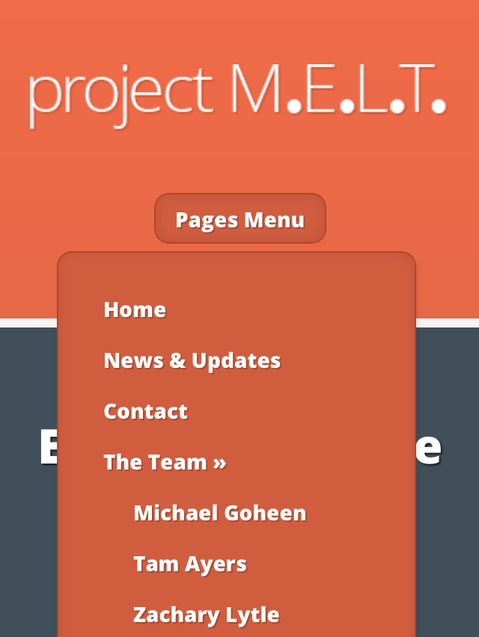
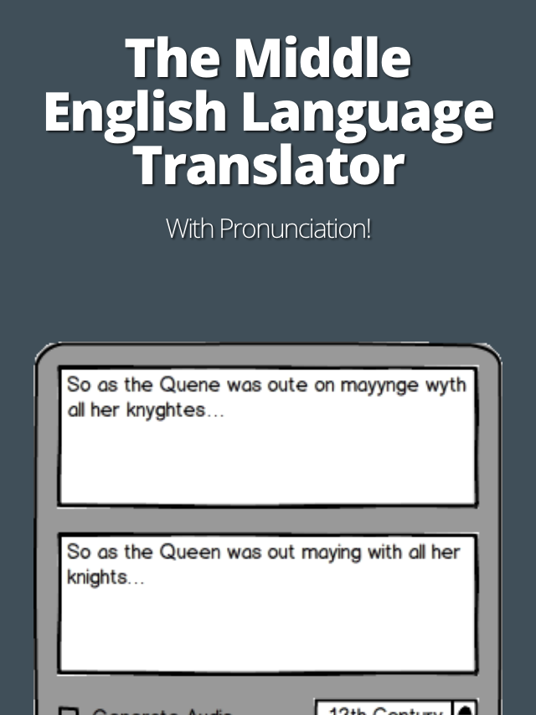
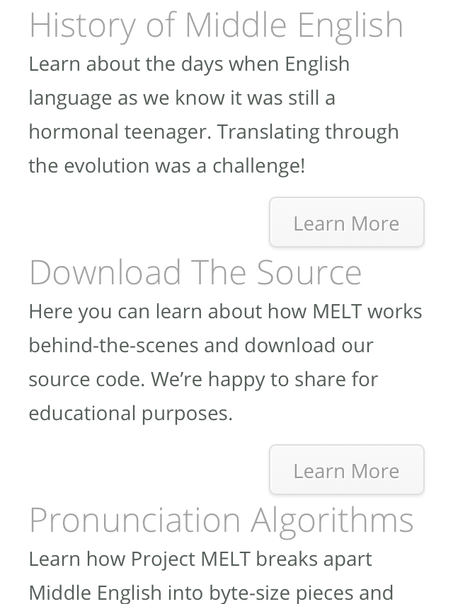
Fully Responsive Web Portal

Slide 9
The Next Steps
Rule-set based on Flite’s modern English equivalent. (IMPLEMENT)
Multi-user server-side processing for text and audio (TESTING)
Content for website (RESEARCH)
Web Applet

