Slide 1
CS 5604: Information Storage and Retrieval
TWT - Tweet Collection Management
Akash Patil, Hitesh Baadkar, Ikjot Juneja, Irith Sharma, Manisha Kusuma, Megan Hicks, Pranav Chimote, Ujjval Mehta
Instructor: Dr. Edward A. Fox
SME: Xinyue Wang
Department of Computer Science, Virginia Tech
Blacksburg, VA 24061
December 2, 2020
Notes:
Megan

Slide 2
Agenda
Overview
Requirements
Design and Implementation
Deliverables
Future work
Notes:
Megan

Slide 3
Overview
Project overview:
Milestone 1. Tweet collections (Ingestion)
Milestone 2. Content of tweets cleaned and metadata extracted
Milestone 3. Tweet categorization via TwiRole
Milestone 4. Extracted/derived information from Tweets
Milestone 5. Store tweets in a more compact and accessible format for big data systems
Notes:
Irith

Slide 4
Overview (Cont’d)
For each information goal:
Draft workflow (a sequence of steps/information states to reach the information goal)
Identify services (block of operation/code that will have its own section in the pipeline)
Develop service
Register service with the Integration team
Notes:
Irith

Slide 5
Information Goals
Goal ID | Input | Information Goal
1 | Raw collection of tweets | ELS field on geolocation
2 | Raw collection of tweets | ELS field on hashtags
3 | Raw collection of tweets | ELS field on originating username
4 | Raw collection of tweets | ELS field on user mentions
5 | Raw collection of tweets | Filename for user download
6 | Local file of tweets | Uploaded collection of tweets
7 | Raw collection of tweets | ELS field on keywords
8 | Raw collection of tweets | ELS field on TwiRole
9 | Raw collection of tweets | ELS field on timestamp
Notes:
Irith

Slide 6
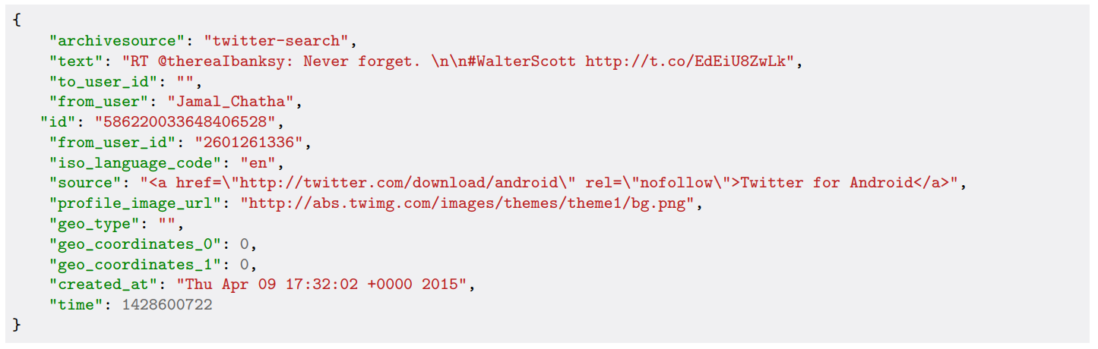
Preprocessing
3 formats for tweets (yourTwapperKeeper (YTK) , Social Feed Manager (SFM), DMI-TCAT)
Collections stored in WARC files
Example tweet in YTK format
Notes:
Manisha
3 format for tweets
WARC format - Web ARChive format

Slide 7

Indexing
Extract key fields, such as hashtags, username, mentions, geo-location, keywords, and timestamp
Indexed these tweets into Elasticsearch
Modularized our services to extract a single field
3K Tweets
Notes:
Manisha

Slide 8
Collaboration
FE
INT
Provided a sample dataset, data types, and information about user interactions
Provided our Workflow Artifacts
Prepared the Service Registry Database Schema (Goals, Scheme, Services) together
ES
SME
Assisted in connecting Elasticsearch client
Provided centralized service to index our tweets
Determined milestones
Brainstormed user scenarios together
Gathered/provided Tweet collections
Notes:
Manisha

Slide 9
Design & Implementation
Notes:
Pranav/Megan

Slide 10
Tools
Python: for framework
Docker: to run services
TwiRole: to classify user
Gensim (Text Summarization module): to find keywords within a tweet’s textual content.
Elasticsearch: for processing and querying collections of tweets, based on the different columns of the index created for our collections.
Apache Parquet: to backup large collections of tweets (complement existing collections in JSON format).
YTK and SFM: to collect data
WARCIO: to read data from .warc format (and store in .json format)
Notes:
Megan/Pranav

Slide 11
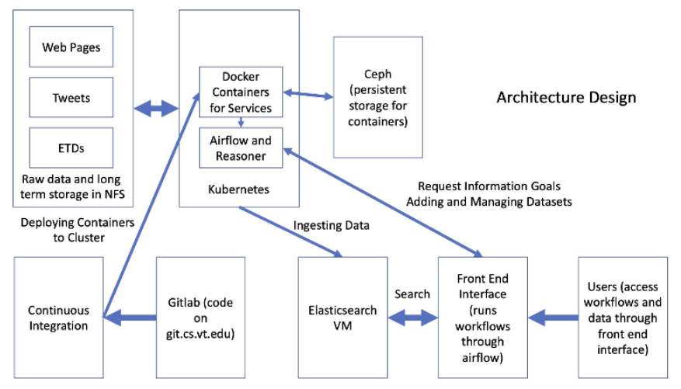
Workflow
Workflow-based system solution
4 other teams: ETD, WP, FE, INT
Overview of Fall 2020 system and team interactions
Notes:
Megan/Pranav

Slide 12
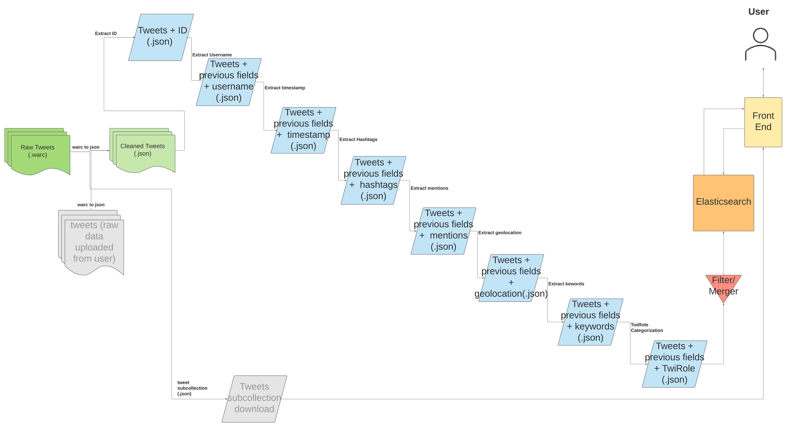
Implementation
Workflow diagram, depicting states of data and services to move between states
Notes:
Megan/Pranav

Slide 13
ID | Service Name | Input(s) | Output
1 | WARC to JSON converter | Name of raw tweets .warc, backup location for collection | Name of .json containing cleaned tweets, name of .parquet containing cleaned tweets
2 | Add ID field | Name of .json containing cleaned data | Name of .json containing tweets with ID field added
3 | Add username field | Name of .json containing cleaned data | Name of .json containing tweets with username field added
4 | Add timestamp field | Name of .json containing cleaned data | Name of .json containing tweets with timestamp field added
5 | Add hashtags field | Name of .json containing cleaned data | Name of .json containing tweets with hashtags field added
6 | Add username mentions field | Name of .json containing cleaned data | Name of .json containing tweets with username mentions field added
7 | Add geo-location field | Name of .json containing cleaned data | Name of .json containing tweets with geo-location field added
8 | Add keywords field | Name of .json containing cleaned data | Name of .json containing tweets with keywords field added
9 | Generate list of unique users | Name of .json containing cleaned data | Name of .json containing unique users
10 | Add TwiRole classification field | Name of .json containing cleaned data, name of .json containing unique users and previous categorizations | Name of .json containing tweets with TwiRole classification field added, name of .json containing updated unique users and their categorizations
11 | Filter/merge fields | Name of .json containing cleaned data + fields of interest | Name of .json containing only fields of interest
12 | Generalized indexing using Elasticsearch | Name of .json containing tweets with fields to be indexed | Name of .json containing indexing results
Services to support tasks

Slide 14
Services
Notes:
Ujjval

Slide 15
Services:
WARC to JSON:
Original/raw tweet collections are in WARC format
All the tweets are compiled into one WARC file along with the metadata
Utilize WARCIO streaming library to search for tweet data in the WARC records
The JSON file can now be processed with our other services

Slide 16
Services (Cont’d)
Username:
Look for users field containing username data and add data to new username column
Hashtags:
Look for hashtags data already extracted and add data to new hashtags column
If not true, extract hashtags using regular expression operations from the tweet’s text.
Mentions:
Look for mentions data already extracted and add them to new mentions column
If not true, extract mentions using regular expression operations from the tweet’s text

Slide 17
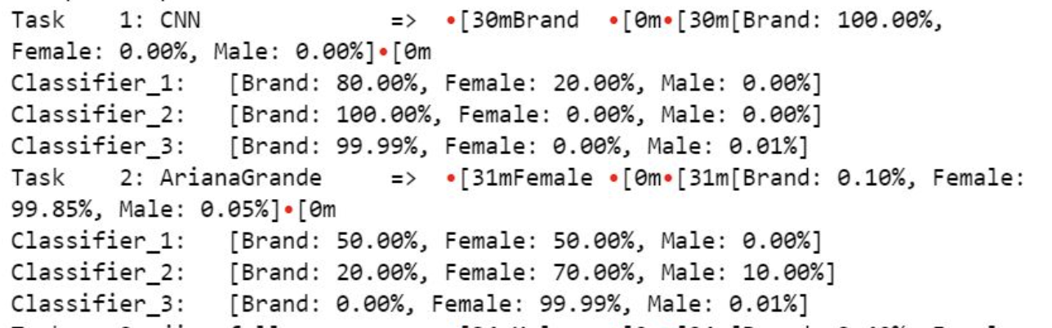
Services (Cont’d)
Twirole
TwiRole for role-related user classification on Twitter by Liuqing Li, Ziqian Song, Xuan Zhang and Edward A. Fox
Crawl a user's profile, profile image and recent tweets, and classify a Twitter user into Brand, Female or Male
Sample TwiRole categorization
Notes:
Akash

Slide 18
Services (Cont’d)
ID:
Extract unique ID as string for index versioning.
Timestamp:
Check various fields for tweet time and extract for time range searches.
Keywords:
Use the gensim keywords library to determine relevant keywords from corresponding tweets’ texts.

Slide 19
Services (Cont’d)
Geolocation
Geolocation service on Twitter is used to track breaking news and events. Some researchers/users are also interested in knowing what topics are trending in certain locations.
For each tweet, look for “coordinates” field which will have location information, and add them to new column ‘geolocation’ and write it file back to .json.
Notes:
Ikjot

Slide 20
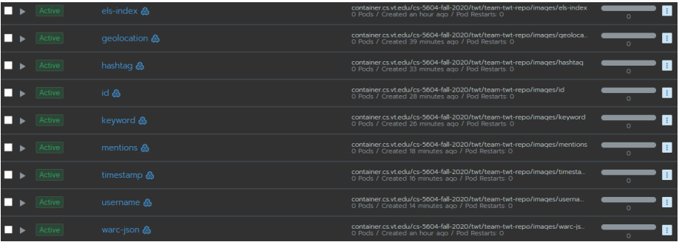
Testing
End-to-end test
Containers used in manual end-to-end test

Slide 21
Unit Testing
Use of pytest framework
Unit tests for each service (running in CI/CD)
Test cases:
  Null input/non-ASCII
  Non-existing file
  Invalid format (not YTK or SFM JSON etc.)
  Correct output otherwise
Notes:
The pytest framework makes it easy to write small tests, yet scales to support complex functional testing for applications and libraries.
https://docs.google.com/document/d/1y779LuEoRmD-FafIuPxtjQmlJgS9gg4lrZ0pwuDwanU/edit

Slide 22
Deliverables
Services registered and working
  warc-to-json conversion, ID, username, timestamp, hashtags, mentions, geolocation, keywords, filter, index
Dockerized services
End-to-end test through CS cluster and Airflow/reasoner

Slide 23
Future Work
Parallel workflow based system (parallel configuration)
  Run a specific service
Work on DMI-TCAT
Extracting implicit Geolocation information from tweets

Slide 24
Acknowledgements
Thank you to the guidance and support from:
  Dr. Edward Fox
  Prashant Chandrasekar
  Xinyue Wang
  NSF (through CMMI-1638207)

Slide 25
Q&A

