Slide 1

NSF Programs in Energy and Power Systems
Eyad H. Abed
Program Director
Electrical, Communications and Cyber Systems
National Science Foundation
Arlington, VA
eabed@nsf.gov
2015 North American Wind Energy Academy (NAWEA) Symposium
Virginia Tech, Blacksburg, VA
June 9, 2015
Notes:
Image: Multicolored sound wave
Credit: Thinkstock

Slide 2

Outline
Overview of NSF organization
Energy, Power, Control and Networks (EPCN) Program
The Evolving Electric Grid
NSF Review Process
NSF EAGER Mechanism
Cyber Physical Systems (CPS)
Open/Remote Access Test Beds

Slide 3
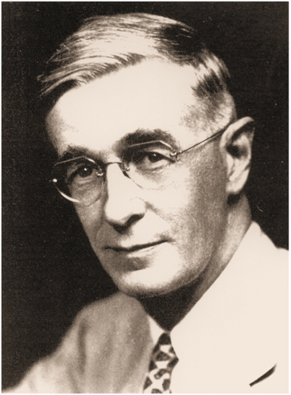

“to promote the progress of science; to advance the national health, prosperity, and welfare; to secure the national defense…” NSF Act, 1950
Image courtesy MIT Museum

Slide 4
Unique Features of NSF
Supports fundamental research and education across all fields of science and engineering
Discipline-based structure with cross-disciplinary mechanisms
Emphasis on integrating research and education
Close interaction with Universities
Rotator System: About 50% Program Directors are on loan from universities, labs, or industries
FY2014 NSF Appropriation of $7.2 billion (total) – FY2015 Budget ~ $7.5 billion

Slide 5
National Science Foundation
Director
and Deputy Director
Office of Diversity & Inclusion
National Science Board (NSB)
Office of the General Counsel
Office of the
Inspector General
(OIG)
Office of Integrative Activities
Office of Legislative and Public Affairs
Biological
Sciences
(BIO)
Computer &
Information
Science &
Engineering
(CISE)
Engineering
(ENG)
Geosciences
(GEO)
Office of International Science and Engineering
Mathematical
& Physical
Sciences
(MPS)
Social,
Behavioral,
& Economic
Sciences
(SBE)
Education
& Human
Resources
(EHR)
Budget, Finance, & Award Management (BFA)
Information
& Resource
Management
(IRM)
Notes:
5

Slide 6
NSF ENG Organization
Office of the Assistant Director
Assistant Director
Deputy Assistant Director
Emerging Frontiers in
Research and Innovation (EFRI)
Senior Advisor for
Nanotechnology
Program Director Evaluation and Assessment
Program Director for I-Corps
Engineering
Education and
Centers
(EEC)
Chemical,
Bioengineering,
Environmental,
and Transport
Systems
(CBET)
Civil,
Mechanical, and
Manufacturing
Innovation
(CMMI)
Electrical,
Communications,
and Cyber
Systems
(ECCS)
Industrial
Innovation and
Partnerships
(IIP)

Slide 7
Electrical, Communications and Cyber Systems (ECCS) Division
Electronics, Photonics, and Magnetic Devices
Communications, Circuits, and Sensing Systems
Energy, Power, Control and Networks

Slide 8
Proposals Received by ECCS
Faculty Early Career Development (CAREER)
Single Investigator / Small Group
Industry Collaborations (GOALI)
Exploratory Research (EAGER)
Workshops on emerging areas
International collaborations
Research experience for undergraduates (REU)
Research experience for teachers (RET)

Slide 9

Engineering CAREER Awards for FY 2015
$73M total investment in the next generation of engineering early-career faculty
146 grants at $500K each
81 institutions in 36 states, including 16 EPSCoR states
29% women and 9% under-represented minorities, according to available demographic data
51% to new PIs
Announcement at http://www.nsf.gov/news/news_summ.jsp?cntn_id=134554
Notes:
Announcement at http://www.nsf.gov/news/news_summ.jsp?cntn_id=134554

Slide 10
Energy, Power, Control and Networks (EPCN) – A Core Program
Design and analysis of complex systems including sensing, imaging, control and computational technologies
Emphasis on electric power systems, especially with renewable energy integration
Power electronics and drives
Energy harvesting devices and systems
Regulatory and economic structures for power and energy

Slide 11
A Partnership
We are committed to working with the community to discover and support innovation in electrical power and energy research and education ----
There is currently a great need for advancing such efforts

Slide 12
Electric Power Networks
Critical infrastructure for society
Large scale spatially distributed nonlinear dynamic systems with multiple time scales
Hierarchical control and management system involving cyber-physical components, sensors, algorithms, and economic markets
Techno-socio-economic system with multiple stakeholders
Regulation and policy (and economics!)

Slide 13
Major Trends and Drivers
Aging infrastructure in developed world and new infrastructure in the developing world
IHS Global Insight estimates $12 trillion to be spent on electric grid between 2014-2020
The rise of distributed generation (DG) and microgrids
Integration of renewable electric energy from wind and solar, including independent “prosumers”
Changing demand profiles
Increasing natural gas generation
Need for greater resilience in the face of natural and man-made disasters
Cybersecurity
All of these challenges require greater power system innovation and a new generation of power system engineers with broad and deep training.

Slide 14
Power System Planning and Operations w/ DG
Power systems with DG are different; new questions arise:
Stability criteria for traditional power networks do not carry over to systems with significant penetration of renewable sources.
Mandated feed-in tariffs (apply even if the power isn’t needed).
Lack of storage means that the utility may have to pay for power it doesn’t benefit from.
No economic policy to cover utility costs to support voltage at DG sources (newer DG sources add to the financial stress; should they pay more than earlier deployed DG?).
How to price high variability power sources (solar, wind)?
Demand response design (“demand dispatch”).

Slide 15
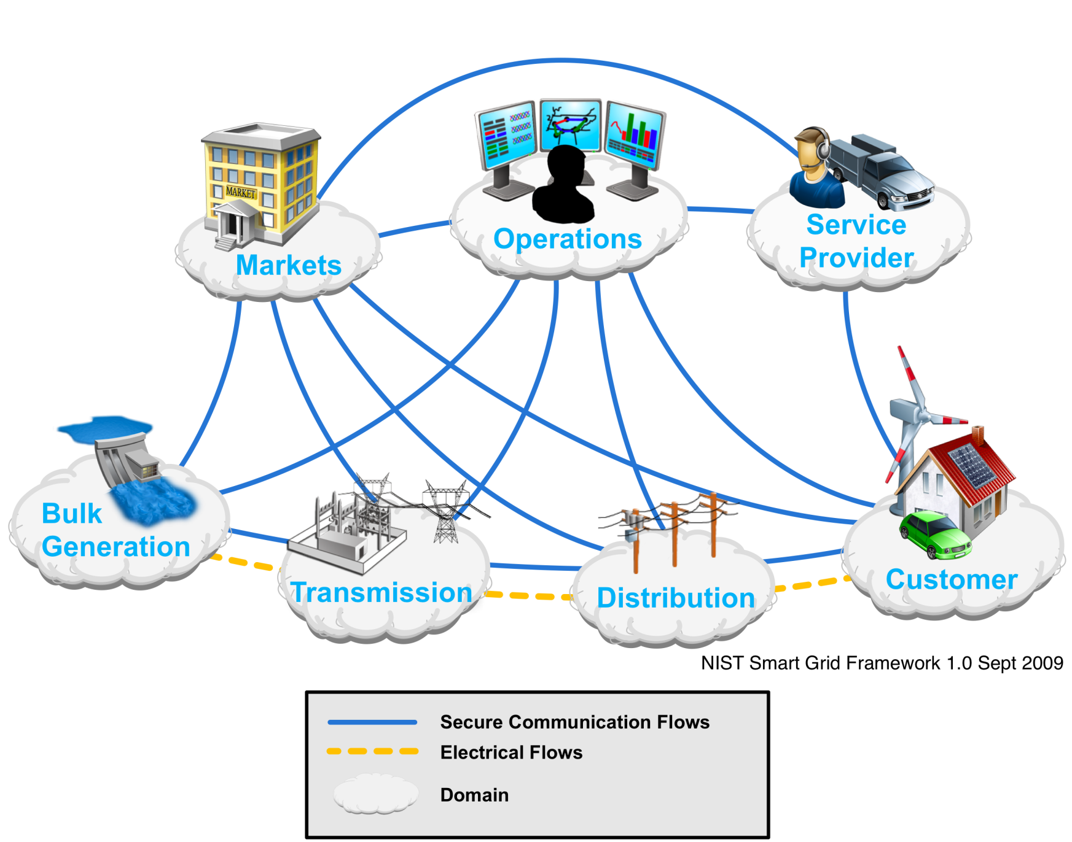
Smart Grid Framework

Slide 16
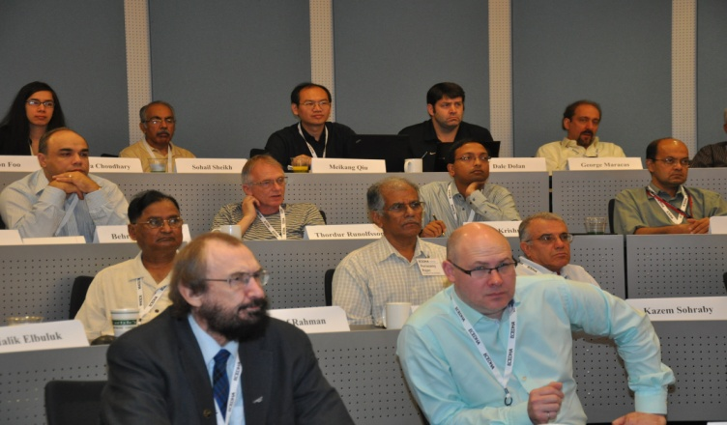
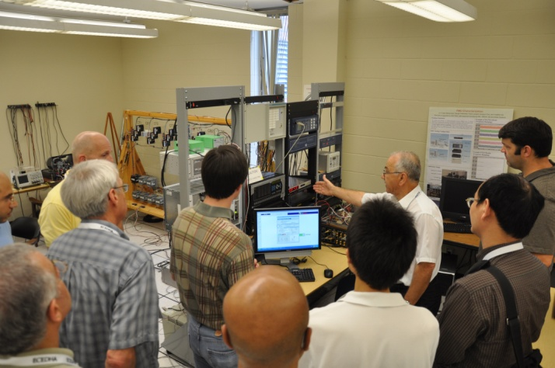
Shortage of Energy and Power Faculty in ECE Departments
Electrical and Computer Engineering Departments Head Association (ECEDHA)
NSF/ECEDHA faculty development workshop held at Georgia Tech on July 9-12, 2011
Workshop Focus:
Cyber Technologies for Electric Power Grid

Slide 17

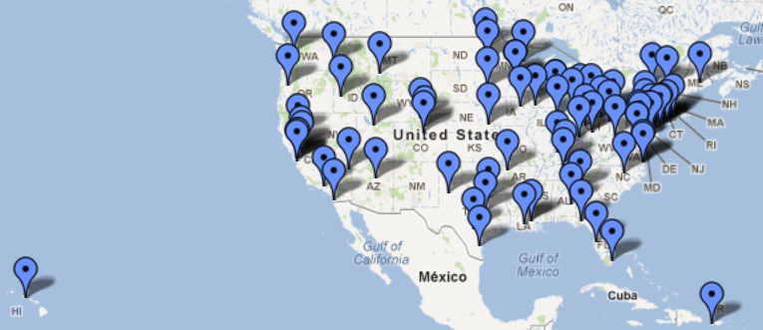
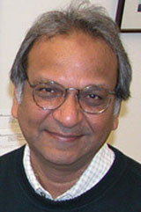
Electrical Energy Systems Education with Emphasis on Sustainable Power (ECCS- 0901635/1028326, Mohan, University of Minnesota – Twin Cities)
(Supported by NSF, NASA, ONR, DOE and EPRI)
Vision: Revitalizing Electric Energy Systems Education worldwide through proactive dissemination and the Internet using CUSP™
80-Universities DOE Consortium
Outcomes:
Power & Energy Curriculum
Undergraduate & Graduate Courses
Workshops
Laboratories
Student Enrollment
Published Textbooks
Professor Ned Mohan
University of Minnesota

Slide 18
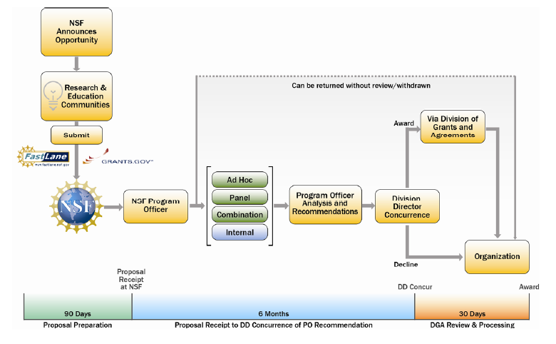
NSF Proposal & Award Process

Slide 19
Merit Review Criteria
Intellectual Merit
Advance knowledge and understanding within its own field or across different fields
Explore creative, original or potentially transformative concepts
Broader Impacts
Benefit society or achieve specific desired societal outcomes

Slide 20
NSF AWARD SEARCH
www.nsf.gov
Search awards
Advanced search
Program officer
Many options available
Program Information
Keyword search, such as “Wind Energy” “Power Systems” “Power Electronics” “Energy Harvesting”…

Slide 21
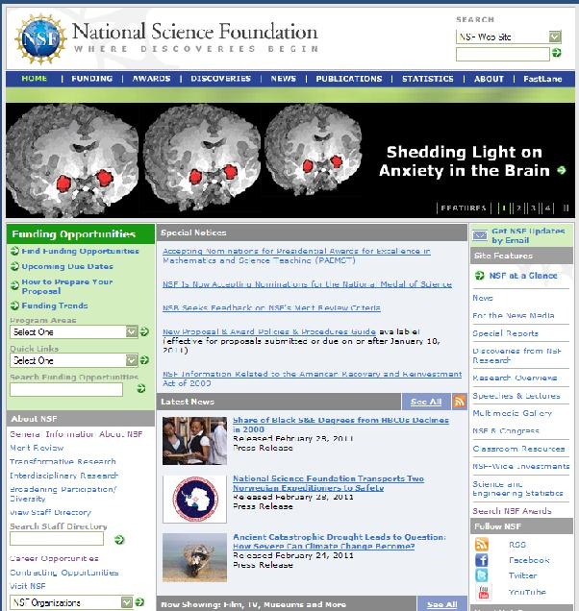
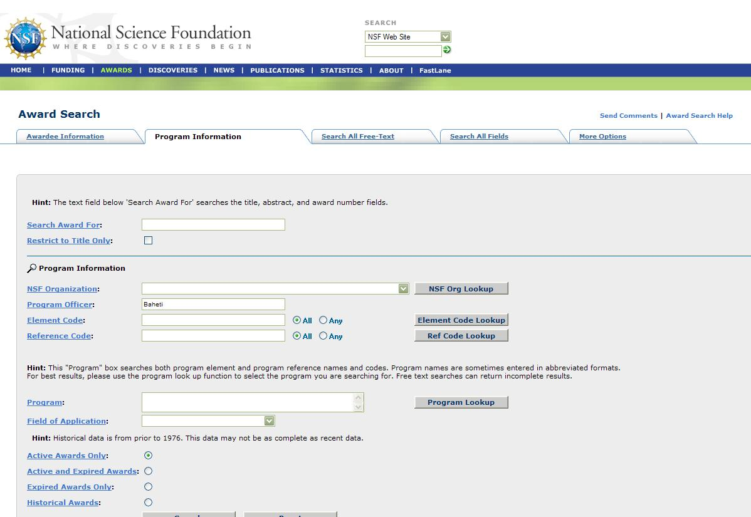
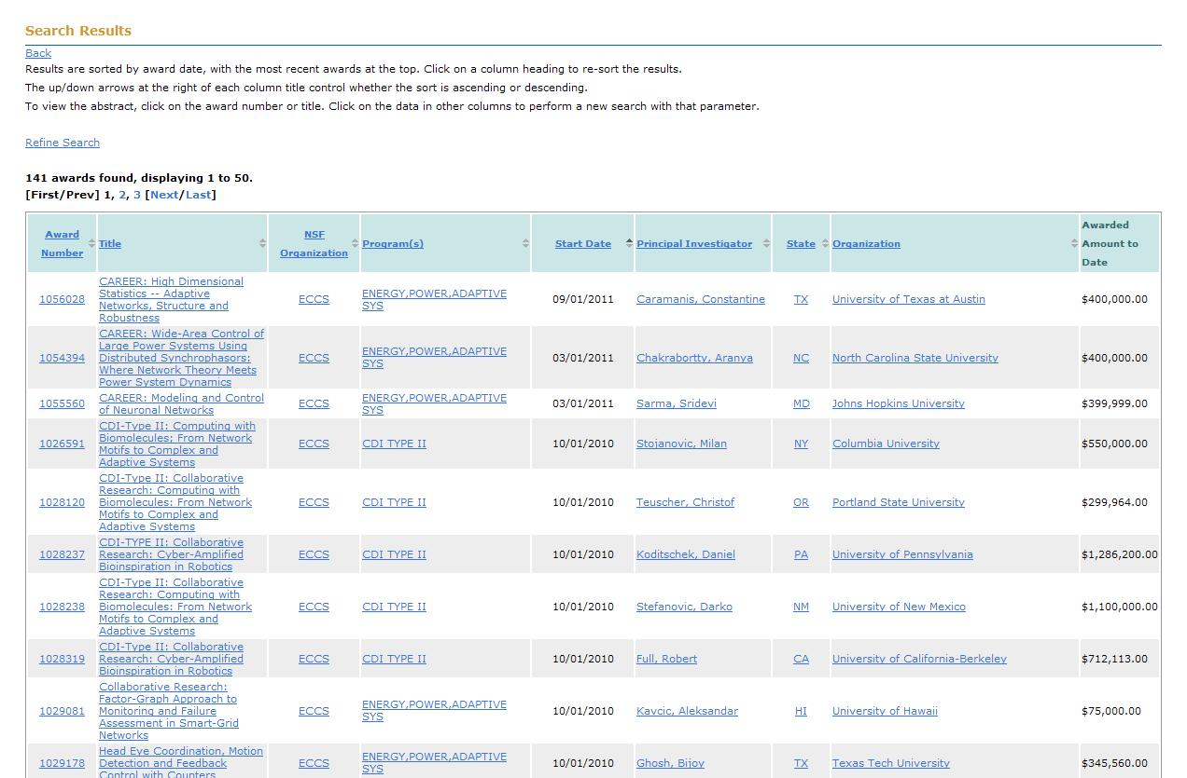

Slide 22

NSF EAGER Mechanism

Slide 23
EAGER
The EAGER funding mechanism can be used to support exploratory work in its early stages on untested, but potentially transformative, research ideas or approaches.
This work could be considered especially "high risk-high payoff" in the sense that it, involves radically different approaches, applies new expertise, or engages novel disciplinary or interdisciplinary perspectives.
Exploratory proposals may be submitted directly to an NSF program. Principal Investigators (PIs) must contact the NSF program officer(s) whose expertise is most germane to the proposal topic prior to submission of an EAGER proposal to determine the appropriateness of the work for consideration under the EAGER mechanism.
The EAGER mechanism should not be used for projects that are appropriate for submission as “regular” (i.e., non-EAGER) NSF proposals.

Slide 24
EAGER
Project Description should be brief (5-8 pages) and include clear statements as to why this project is appropriate for EAGER funding, including why it does not “fit” into existing programs and why it is a “good fit” for EAGER. Note this proposal preparation instruction deviates from the standard proposal preparation instructions contained in the Grant Proposal Guide (GPG); EAGER proposals must otherwise be compliant with the GPG.
The box for “EAGER” must be checked on the Cover Sheet.
Only internal merit review is required for EAGER proposals. However, if external review is to be obtained, then the PI will be so informed in the interest of maintaining the transparency of the review and recommendation process. The two standard NSB-approved merit review criteria will apply.
Requests may be for up to $300K and of up to two years duration. The award size, however, will be consistent with the project scope and of a size comparable to grants in similar areas.

Slide 25
Watch for EAGER DCL’s (Dear Colleague Letters)
For example there is one 15-082 with a June 19, 2015 due date on “Research on Theory and Analytical Tools for Power Networks with High Levels of Renewable Generation” http://www.nsf.gov/pubs/2015/nsf15082/nsf15082.jsp
When a DCL is issued requesting EAGER proposals in a specific area, many proposals are expected, and therefore panel review may be used instead of internal review.

Slide 26
Cyber-Physical Systems
Next generation of engineering systems in which computing, communications, and control technologies are tightly integrated
Enabler for “Internet of Things”

Slide 27
Cyber-Physical Systems
Transportation
Energy and Industrial Automation
Healthcare and Biomedical
Critical Infrastructure
Faster and safer aircraft
Improved use of airspace
Safer, more efficient cars
Homes and offices that are more energy efficient and cheaper to operate
Distributed micro-generation for the grid
Increased use of effective in-home care
More capable devices for diagnosis
New internal and external prosthetics
More reliable power grid
Highways that allow denser traffic with increased safety
Networked and controlled at multi- and extreme scales
Dynamically reorganizing / reconfiguring
High degrees of automation and potential human role
Dependable operation with high assurance of reliability, safety, security and usability

Slide 28
CPS Approach
Application Sectors
Abstract from application sectors to more foundational principles
Apply these principles to problems in new sectors
Safe, secure, reliable, verification, real-time adaptation, …
energy
aeronautics
agriculture
Core Science, Technology, Engineering
Safety
Control
Verification
automotive
manufacturing
Real-time
Systems
Networking
medical
Security
civil
chemical
materials

Slide 29
Present - Some CPS Program Info
Cross-cutting initiative including Directorate for Computer and Information Science and Engineering (CISE) and Directorate for Engineering (ENG)
Since CPS Launch in 2009:
Well over $200M investment
More than 300 awards
350+ PIs and Co-PIs in 35 states
Over $35M investment in FY13, over $40M in FY14
Mission Agency Partners since 2014 solicitation

Slide 30
Federal Government-Wide Effort
Cyber-Physical Systems Working Group
under NITRD (The Networking and Information Technology Research and Development Program)
Co-chaired by NIST and NSF and includes DOD, NIH, NTIA, DOT, FDA, …
At NSF: CISE and ENG Directorates
ECCS Division plays a key role in CPS in ENG

Slide 31

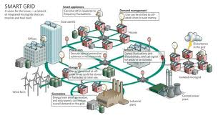
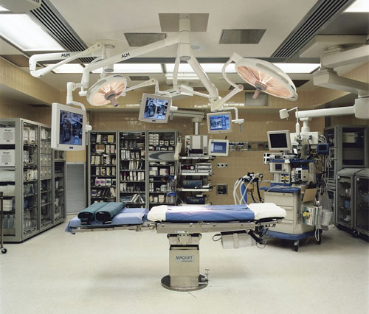
Open/Remote Access Test-beds
A new opportunity for the research community

Slide 32
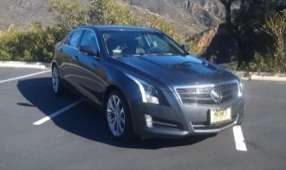
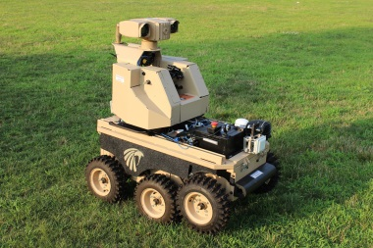
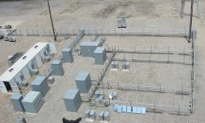
Approach: Distributed laboratory space with open/remote access
Develop and use remote-access, online, shared engineering laboratory spaces
Potential laboratories: robotics, power systems, drones, medical systems, etc.
Shared cost and leveraging expertise
IMU
GPS
Left Encoder
Camera
Right Encoder
Images: Vehicle: I. Lee, KOCSEA Workshop 2014; Microgrid: https://der.lbl.gov/

Slide 33
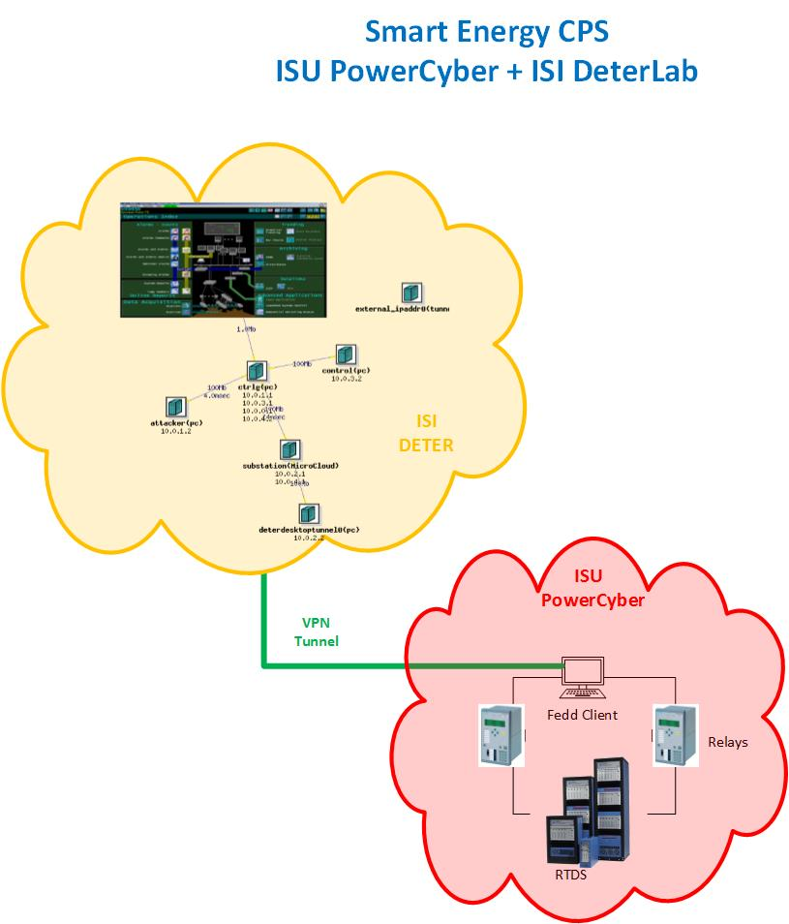
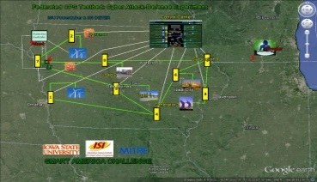
Benefits: Improving research through better access to resources
Significantly lower cost for access to expensive hardware/software
Advance the participation of non-traditional and under-privileged students
Encourage industry participation
CPS Security Testbed Federation (ISU, USC, MITRE)
Attack-Defense Demo @ Smart America Challenge Expo
Visualization
USC/ISI DETER Testbed
(DHS, NSF funded)

Slide 34
Thank you Questions?

