Slide 1
IDEALvr
Team: Luciano Biondi, Omavi Walker, Dagmawi Yeshiwas
Client: Mohamed Magdy
May 2nd, 2016
Virginia Polytechnic Institute and State University, Blacksburg, Virginia

Slide 2
Overview
IDEAL tweet collection virtual reality visualization
Android phone with Google Cardboard
Parsing into hierarchical structure of collections
Word Cloud display
Frequent word analysis
Category <-> Collections <-> Frequent Words

Slide 3
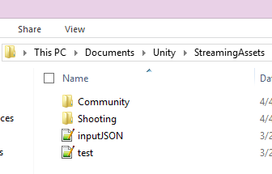
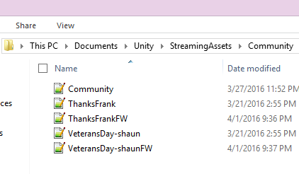
Hierarchy Structure

Slide 4
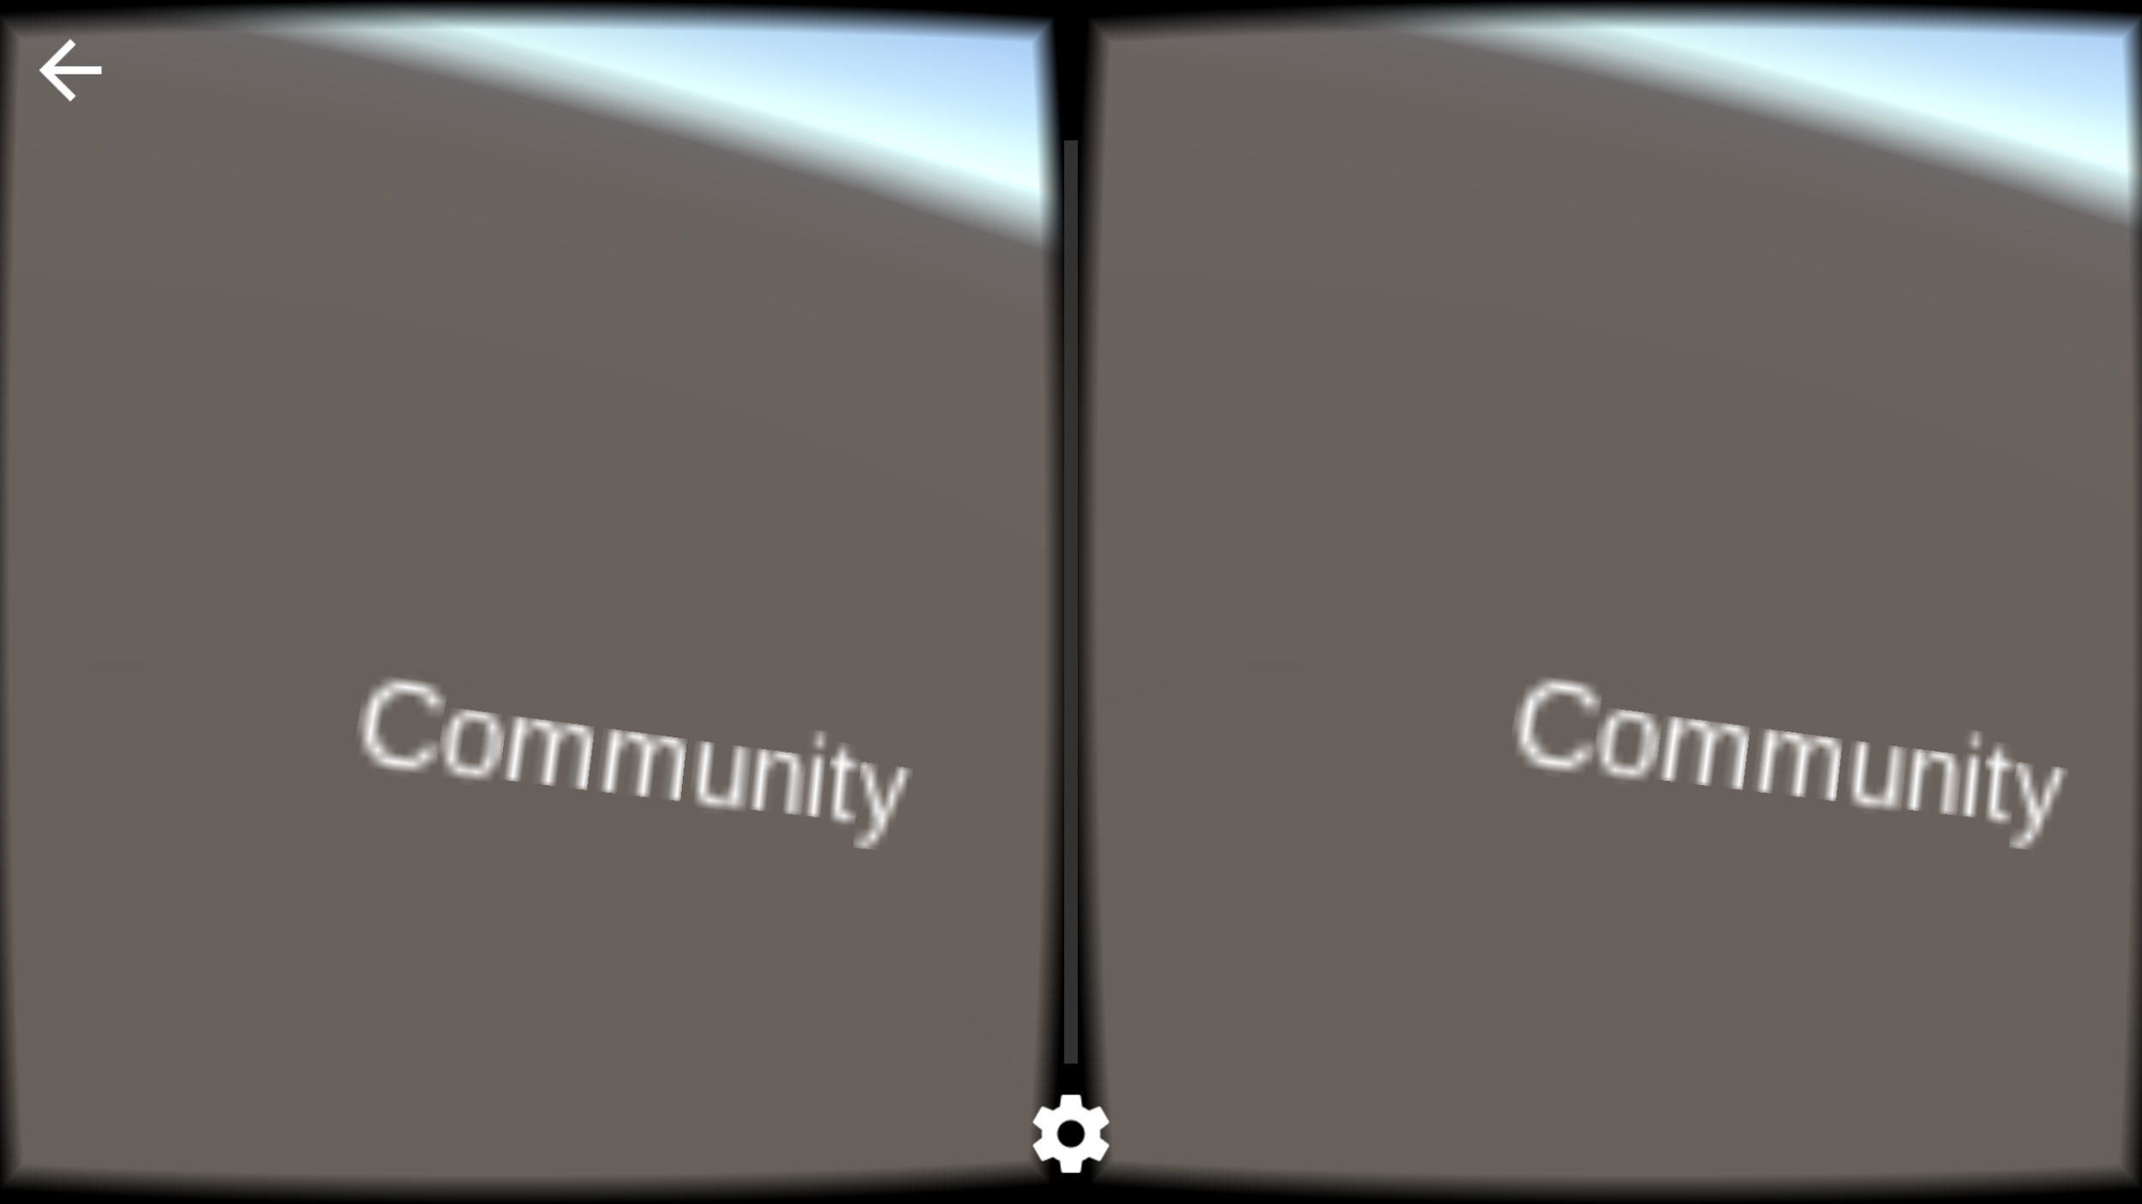
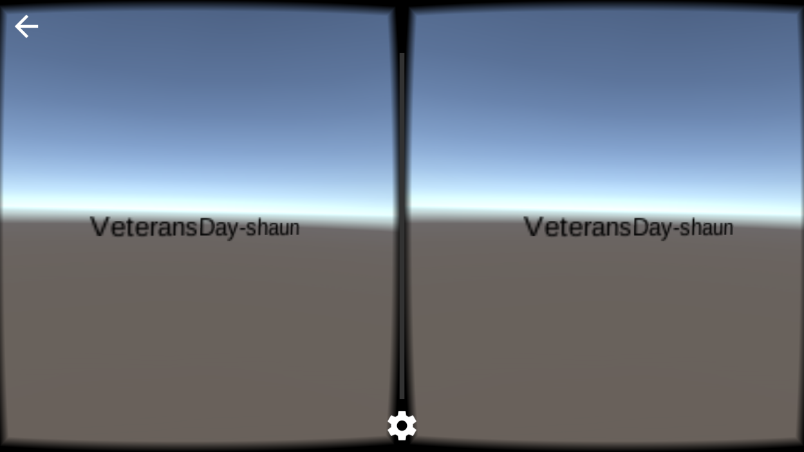
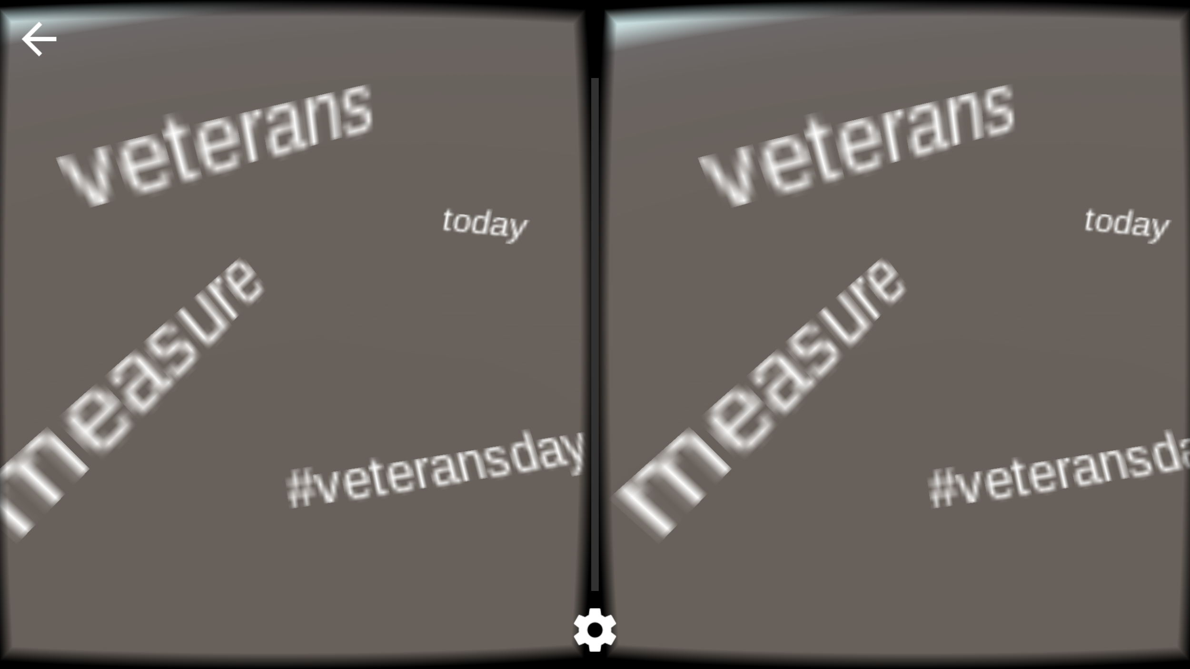
Interaction Flow
Categories
Collections
Frequent Words

Slide 5
Problems Solutions
JSON Local Storage Not Accessible | StreamingAssets for Android Locality
Temporal Date Cloud Filter Does not affect cognitive functionality | Ignored Implementation of Date Cloud
Tweets are difficult to read | From Tweet Visualization to Frequent Words
Arrangement of Words Crowded | Limited space because of amount of Objects
Calculating Specific Positioning In Word Cloud | Requires better algorithm for organized display

Slide 6
Future Work
Work to make the display of tweets beneficial
Use of other metadata of collections
Porting the Application to any device (web/mobile)
Differentiate Organization of data by view
Fix inconsistent output during parsing
Improve usability

Slide 7
Acknowledgements
Team: Luciano Biondi, Omavi Walker, Dagmawi Yeshiwas
Client: Mohamed Magdy and Edward A. Fox
Support Developer: Andrew Sage
iOS and Android developer researching experimental virtual reality technologies
Project Grant: IDEAL NSF grant #1319578

Slide 8
References
1. IDEAL database. Web. 24 March 2016. <http://hadoop.dlib.vt.edu/>
2. Laha, Bireswar, et al. "Effects Of Immersion On Visual Analysis Of Volume Data." IEEE Transactions On Visualization & Computer Graphics 18.4 (2012): 597-606. Computers & Applied Sciences Complete. Web. 15 Feb. 2016.
3. "A VR Word Cloud in Unity." Medium. Andrew Sage, 07 Oct. 2015. Web. 29 Feb. 2016.
<https://medium.com/@SymboticaAndrew/a-vr-word-cloud-in-unity-f7cb8cf17b6b#.nrys96obv>.

