Slide 1

Chapter 6
Integrating Sustainable Practices into Marketing and Leasing
Unless otherwise noted, this slide deck is (c) Erin A. Hopkins.
It is released under a Creative Commons Attribution NonCommercial ShareAlike 3.0 license (CC BY NC-SA 3.0).

Slide 2
Chapter Sections
6.1 Introduction
6.2 Market Analysis
6.3 Marketing Plan
6.4 Leasing Plan
6.5 Tenant Satisfaction Survey
6.6 Conclusion

Slide 3
Learning Objectives
Explain how a market analysis informs the supply and demand of sustainable building initiatives
Identify sustainable building initiatives in a marketing plan
Describe greenwashing
Identify green lease components
Explain the role of a tenant satisfaction survey in assessing sustainable building initiatives

Slide 4
6.1 Introduction
Social sphere of sustainability = happier tenants
Economic sphere = increased revenue
Environmental sphere = mitigation of ecological impacts

Slide 5
6.2 Market Analysis
Marketing and leasing activities are informed by a market analysis
What is the supply and demand of sustainable building initiatives?

Slide 6
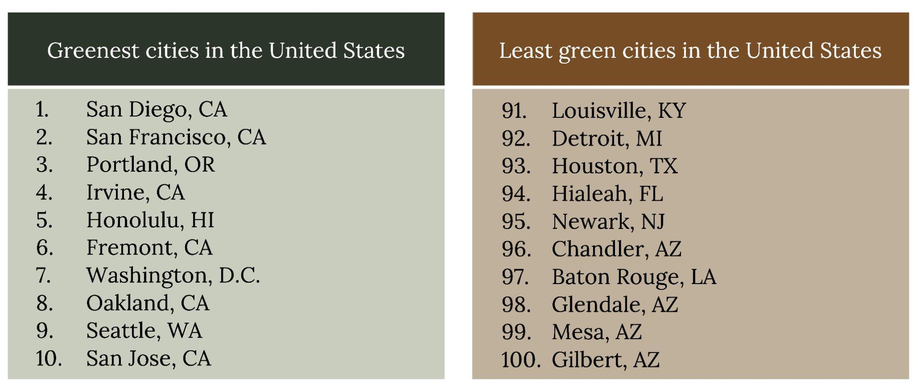
Greenest and least green cities in the United States
Figure 6.1: Greenest and least green cities in the United States (2021). Kindred Grey. 2023. CC BY 4.0. Data from https://wallethub.com/edu/most-least-green-cities/16246.
Notes:
The text box above the slide is for accessibility purposes. If you edit this PPT, please leave it there. It doesn’t show up in preview mode.

Slide 7
6.3 Marketing Plan
Addition of sustainable property management activities to the property marketing plan can help attract tenants that value green building initiatives
If market does not place value on sustainable building initiatives, they can still be part of the marketing plan, but focus should be on the business case or health and well-being

Slide 8
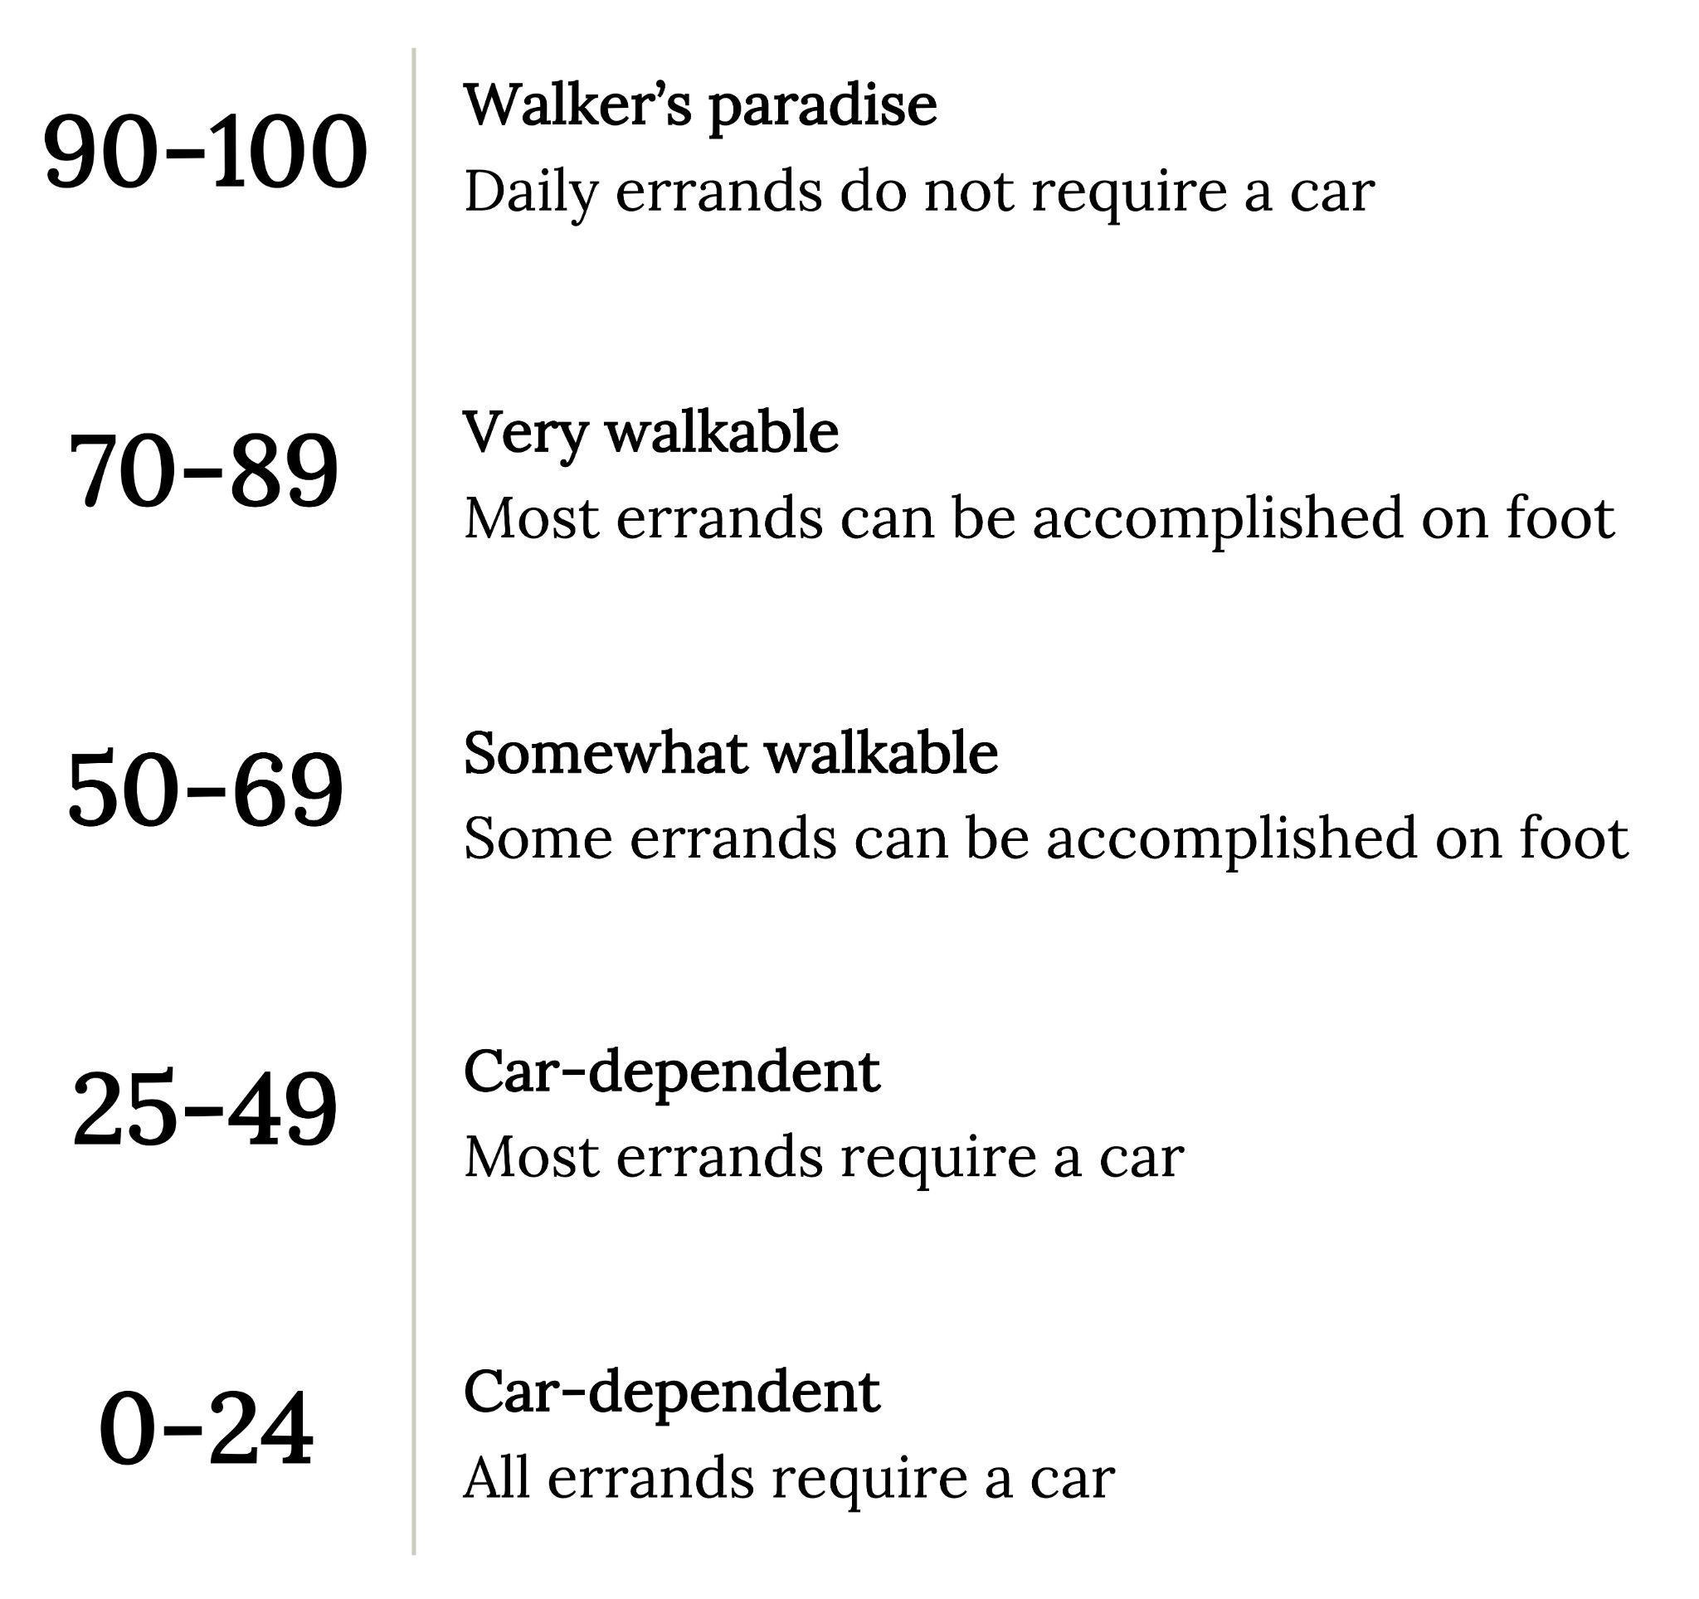
Marketing Plan Considerations
Greenwashing
Walk Score
Figure 6.2: Walk score levels. Kindred Grey. 2023. CC BY 4.0. Data from https://www.walkscore.com/how-it-works/.

Slide 9
6.4 Leasing Plan
Contents will vary based on property sector and company guidelines
Lease Request for Proposal (RFP)
Green lease

Slide 10
6.5 Tenant Satisfaction Survey
Helps the property company understand issues that are important to the building occupant and helps retain these tenants by addressing these issues

Slide 11
Tenant Satisfaction Survey Formats
A questionnaire, interview, focus group, or a combination
Areas of focus:
  Energy Efficiency
  Water Efficiency
  Indoor Environmental Quality
  Waste Management
  Site Sustainability
Iterative process

Slide 12
6.6 Conclusion
The interest in sustainable building activities will likely vary by tenant, property, and market so the property company needs to understand the market they are operating within

Slide 13
Chapter Activity
Research a multifamily community in the municipality where you reside and answer the following questions:
a. Does their website advertise any sustainable building initiatives?
b. If so, do you believe any greenwashing is occurring? Why or why not?
Look up the Walk Score, Transit Score, and Bike Score of the building you researched in the above question and answer the following questions:
a. What is the Walk Score?
b. What is the Transit Score?
c. What is the Bike Score?
d. Do you find value in these scores? Why or why not?

