Slide 1
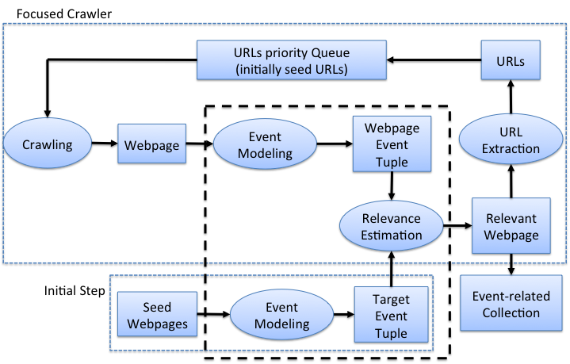
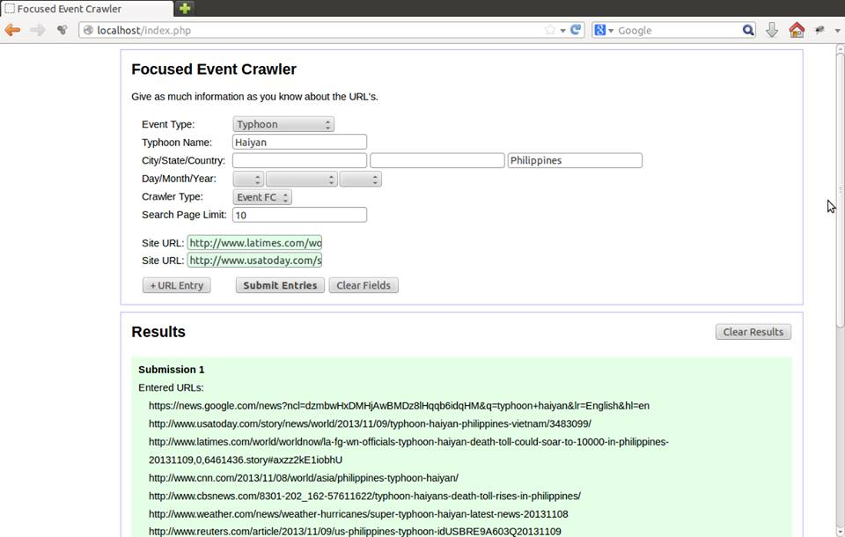
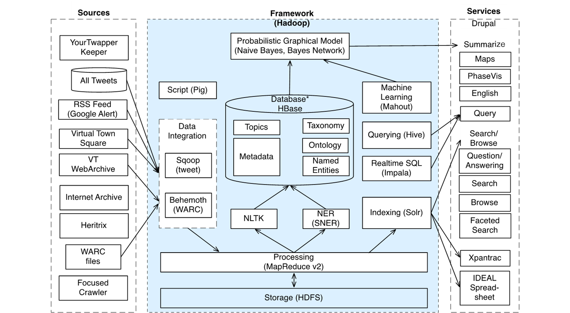
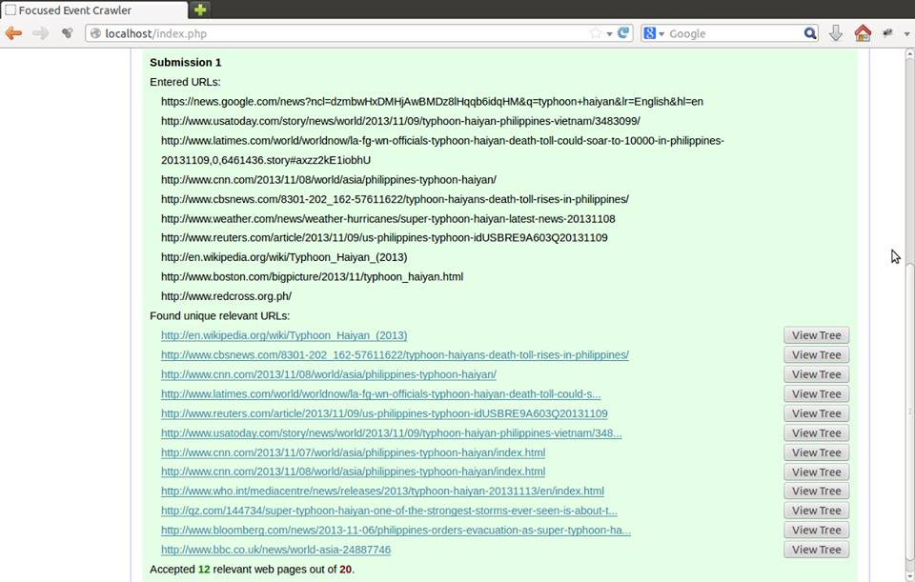
Event Aware Focused Crawler
IDEAL Project Case Study
Implementation
IDEAL Project:
The goal of the IDEAL project is to collect, catalog, preserve, and provide access to services related to digital objects about events, including multimedia -- captured from all corners of the Web. Using Web and Tweet collections, the IDEAL project hopes to be able to create unbiased archives for events of interest.
Ward Bonnefond, Chris Menzel, Zack Morris, Suhas Patel, Tyler Ritchie, Mark Tedesco, Franklin Zheng
New
Client: Mohamed Magdy Gharib Farag
Web Interface
ABSTRACT:
Currently the IDEAL (Integrated Digital Event Archive and Library) project has a general purpose Web crawler to collect articles relevant to seed URLs based on keyword frequency analysis. Our goal is to create a focused crawler tailored to finding events. By analyzing an article to identify key event components, we can construct a tree representation of a webpage. By using the tree edit distance between that tree, and the event tree from seed information, we can predict webpage relevance. Thus, our implementation improves upon general purpose Web crawlers by replacing the “keyword matching” phase with our tree edit distance algorithm. This works since we are able to create a fairly accurate description of an event from a webpage, which can yield more specific information than would keyword analysis alone.
IDEAL Big Picture:
Event Info
Explored links
Design Goals:
More user friendly
More specific results
Design Decisions
Web Interface for maximum portability
Tree Edit Distance clearly shows why an article is accepted
Focused on disasters for now
Result
For: Spring 2014, CS 4624,
Multimedia, Hypertext, and Information Access;
Instructor: Dr. Edward Fox

