Slide 1
Tourism Destination Websites
Matt Crawford, Viet Doan, Aki Nicholakos, Robert Rizzo, Jackson Salopek
Course: CS 4624 Multimedia/Hypertext/Information Access, Dr. Edward A. Fox
Virginia Tech, Blacksburg VA 24061, 5/01/2019

Slide 2
Outline
Project Background
Initial Implementation
Setbacks and Project Review
Project after Review
Lessons Learned
Future Work

Slide 3
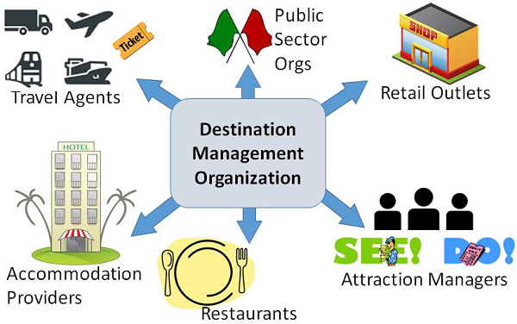
Background

Slide 4
Overview
Given:
List of DMO websites from each state and Washington DC
Deliver:
A matrix for each month dating back to 1996 for cross-referencing DMO websites that month and their outbound links
A dictionary structure with historical structural data on the DMO websites dating back to 1996
Goal:
Provide decision makers at tourism destinations with information about past trends to potentially determine the future direction of destination online marketing.

Slide 5
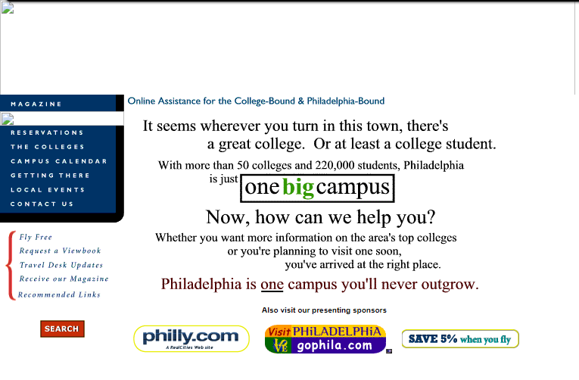
2001

Slide 6
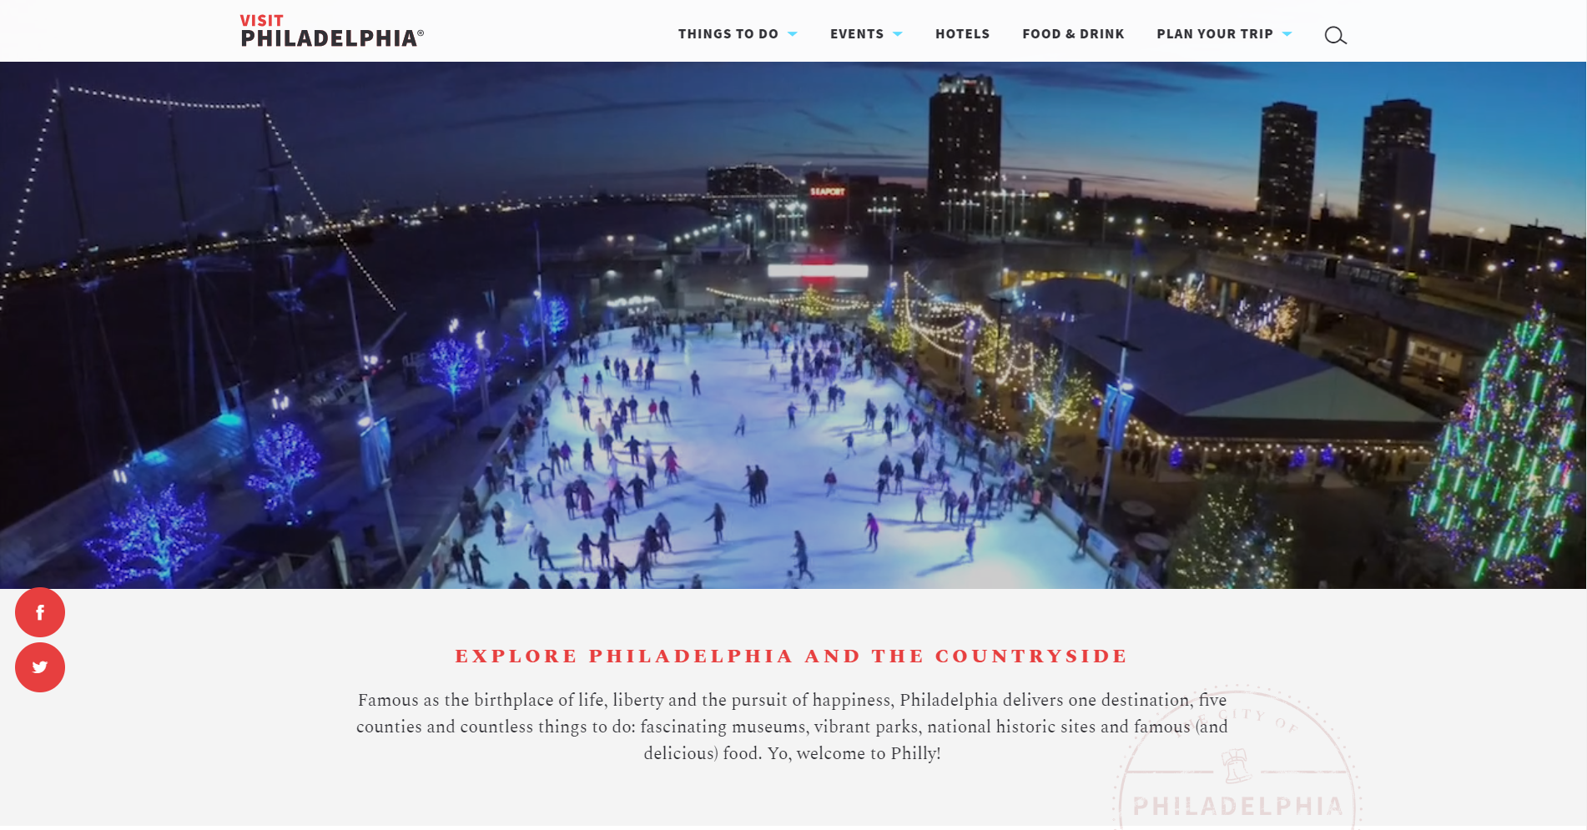
2019

Slide 7
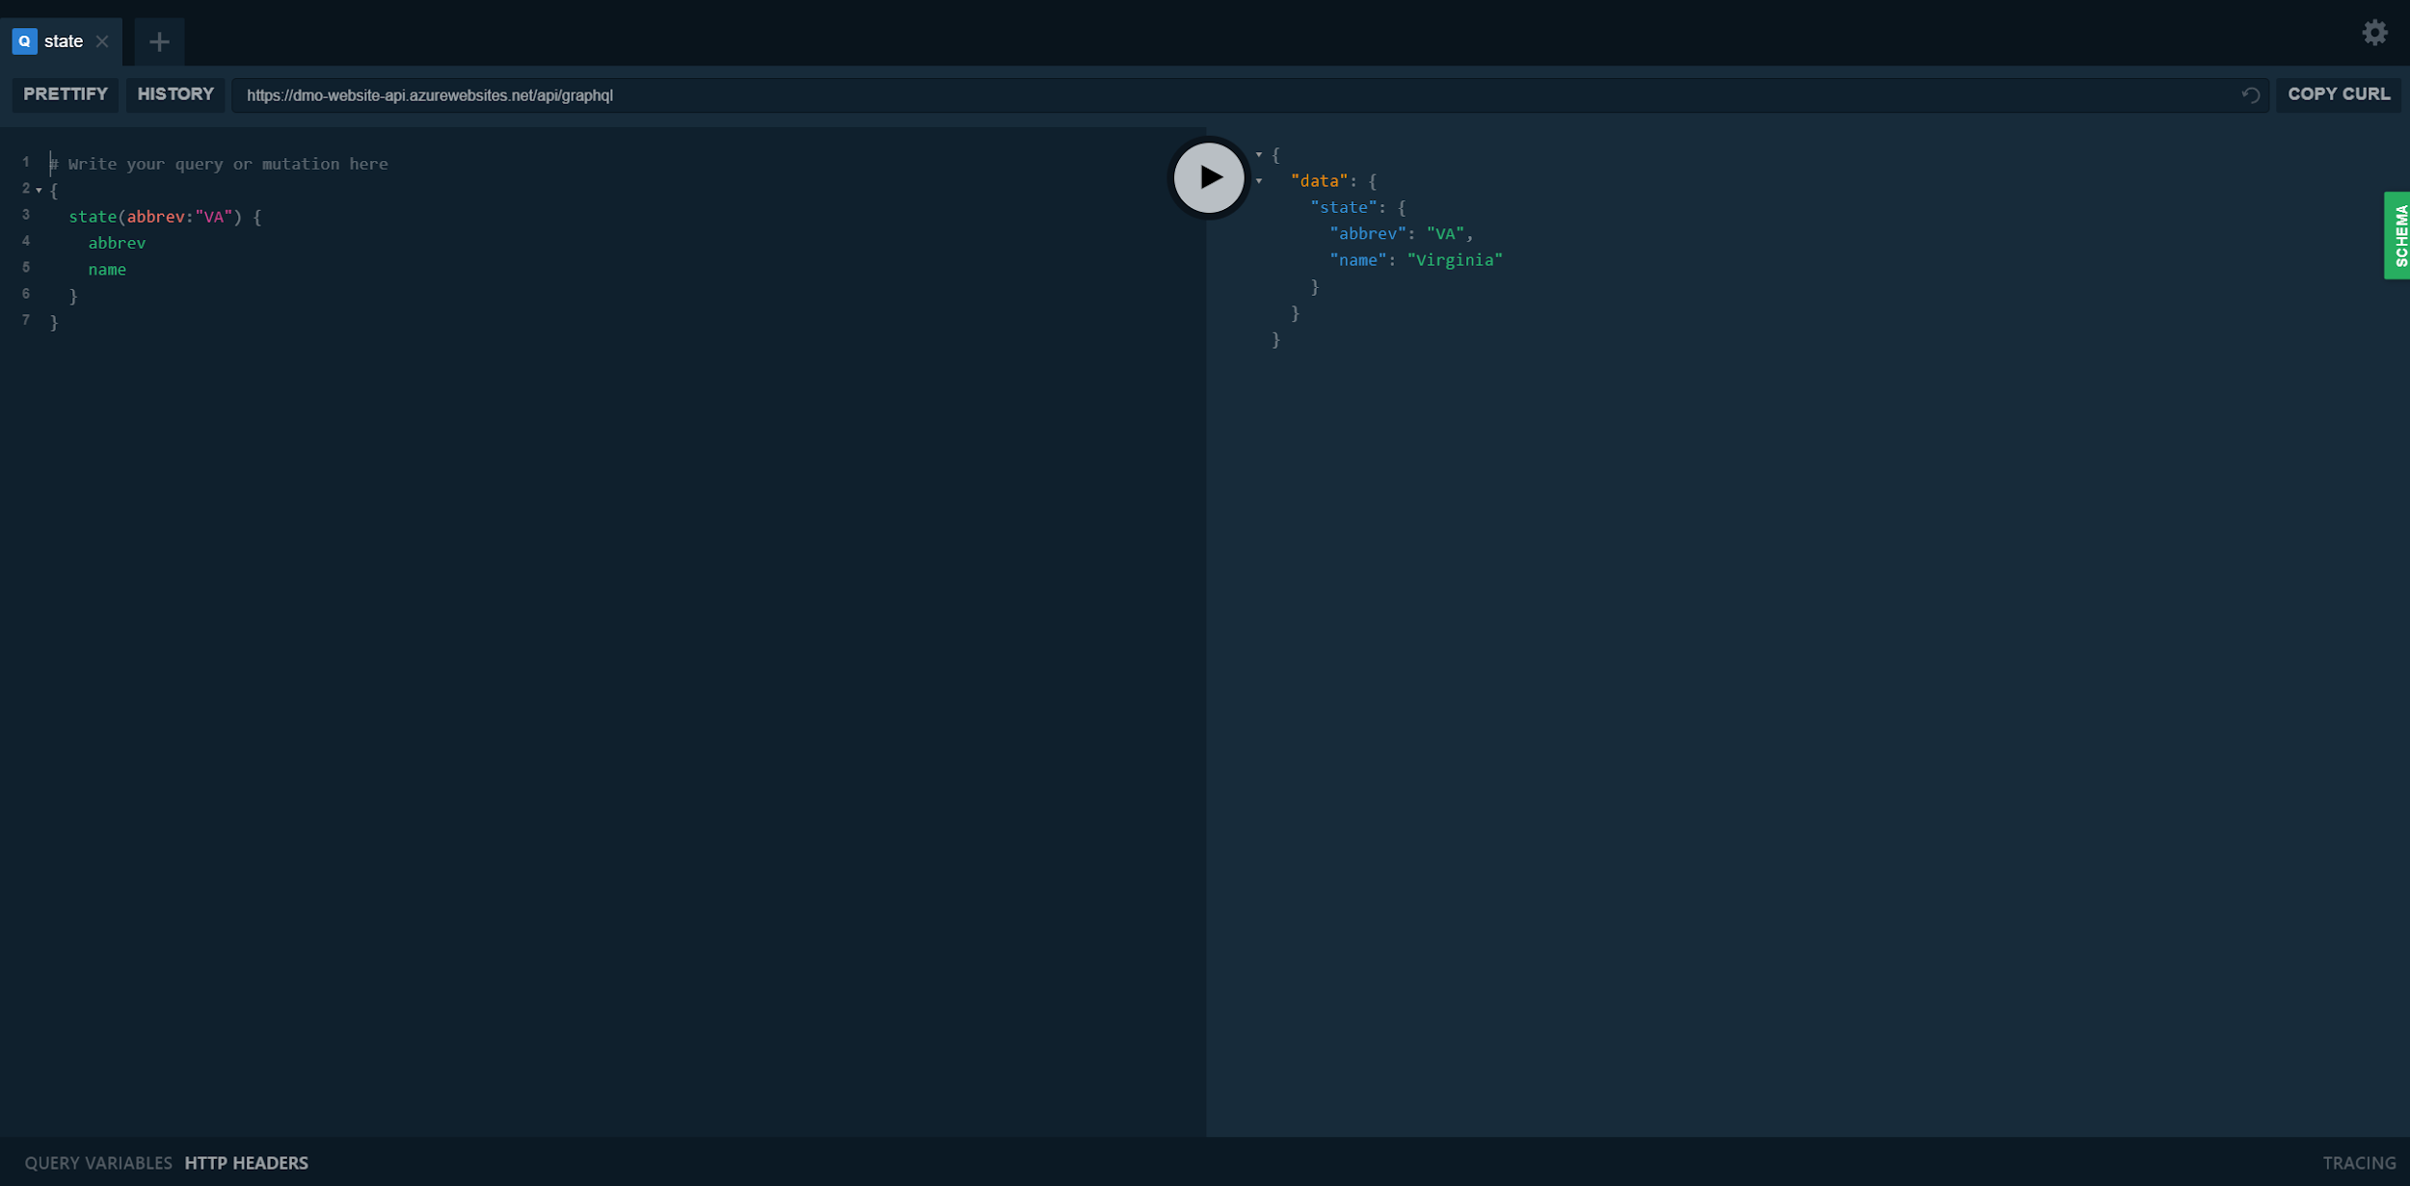
Initial Implementation

Slide 8
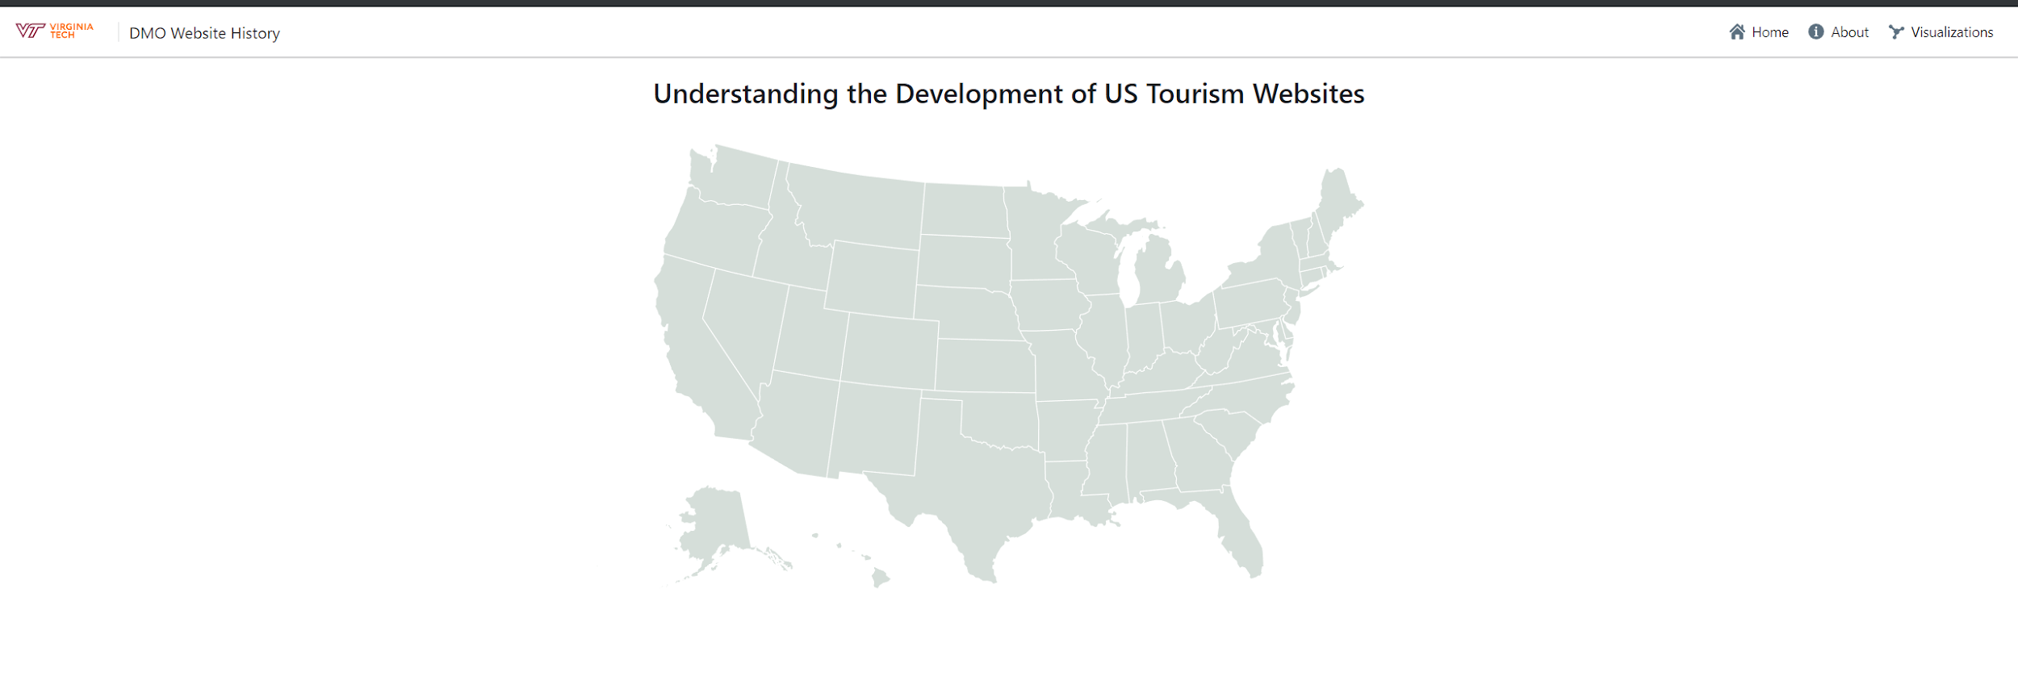
Initial Implementation

Slide 9










Tech Stack

Slide 10





Front-End Tech Stack

Slide 11
Setbacks and Project Review
Desired product too expensive
Scope of project too large for one semester of work
Abandon website
Downsize scope of data to manageable size
Visualizations are stretch goals, no longer requirements

Slide 12

Project After Review
Matrices:
A matrix for each month dating back to 1996 for cross-referencing DMO websites that month and their outbound links
Dictionary:
A dictionary structure with historical structural data on the DMO websites dating back to 1996

Slide 13
Matrices
Snapshot
Intermediate Text File
CSV File
Client Software

Slide 14
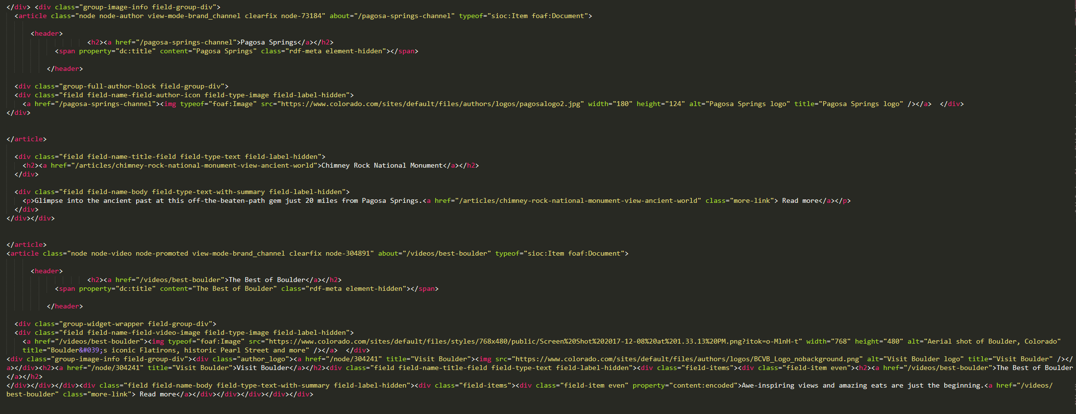
Snapshot

Slide 15
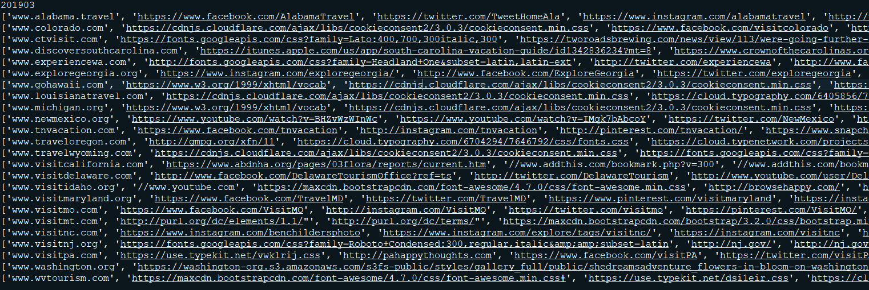
Intermediate Text File

Slide 16
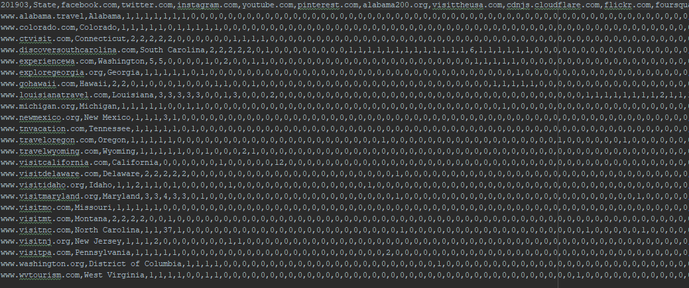
CSV File

Slide 17
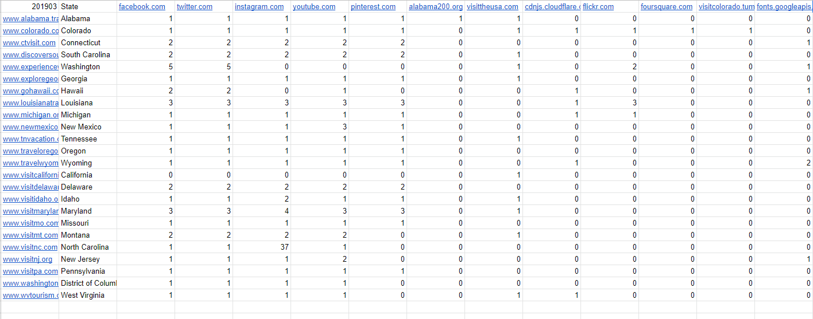
Client Software

Slide 18
Dictionary
Websites
  Year
    Month
      State
        Domain
          Internal Links
          External Links
          Meta Tags
          Text
          Number of Images

Slide 19
Lessons Learned
Don’t underestimate the learning curve of certain technologies
Discover the exact format your data will be as early as possible
When dealing with external organizations, take a lot of care

Slide 20
Future Work
Deploy website
Create visualizations of the data
Collect additional data
Further refine parsing

Slide 21
Acknowledgements
Florian Zach, PhD, <florian@vt.edu>, Assistant Professor, Howard Feiertag Department of Hospitality and Tourism Management, Pamplin College of Business, Virginia Tech, Wallace Hall 362, Blacksburg VA 24061 USA
Zheng (Phil) Xiang, PhD, <philxz@vt.edu>, Associate Professor, Howard Feiertag Department of Hospitality and Tourism Management, Pamplin College of Business, Virginia Tech, Wallace Hall 353, Blacksburg VA 24061 USA
Edward A. Fox, PhD, <fox@vt.edu>, Professor, Department of Computer Science, Virginia Tech, 114 McBryde Hall, Blacksburg VA 24061 USA
Jim Dickhans, <jdickhans@vt.edu>, Director of IT, Pamplin Office of Information Technology, Pamplin College of Business, Virginia Tech, Pamplin Hall 2004 B, Blacksburg VA 24061 USA

Slide 22
Questions?

