Slide 1


Strategic Management
Chapter 6 Generic Business Strategies:
Amazon vs. Barnes and Noble
Unless otherwise noted, this slide deck is (c) Virginia Polytechnic Institute and State University. It is released under a Creative Commons Attribution NonCommercial ShareAlike 3.0 license (CC BY NC-SA 3.0)
Instructor Name | Name of Institution
http://hdl.handle.net/10919/102735
Photo by Jon Sailer on Unsplash

Slide 2
Today’s Learning Objectives – Date Here
Business-Level Strategy:
How to Compete for Competitive Advantage
Differentiation Strategy: Understanding Value Drivers
Cost-Leadership Strategy: Understanding Cost Drivers
Best Cost Strategy: Combining Differentiation
http://hdl.handle.net/10919/102735

Slide 3
What is Business Level Strategy?
Competitive actions a firm takes
  To achieve competitive advantage
  In a single product market
How to gain & sustain competitive advantage?
  Who? which customer segments to engage?
  What? customer needs, wishes, and desires to satisfy?
  Why? satisfy them?
  How? to satisfy the customers’ needs?
http://hdl.handle.net/10919/102735

Slide 4
There are Strategic Trade-Offs
Firms choose between cost/price and value
Trade-Offs exist between:
  Creating value and
  Keeping costs low
Purpose of trade offs are to maximize the firm’s:
  Economic value creation
  Profit margin
http://hdl.handle.net/10919/102735

Slide 5
Primary Generic Business Strategy
Cost Leadership
  Products or services produced at lower cost
  Attempts to have equal or similar value to competitors’ product or service
  Can charge lower prices or increase profit margin
Differentiation
  Products or services have unique features or attributes
  Creates higher value than competitors’ products or services
  Attempt to keep costs low
  Can charge higher prices, increase profit margin
http://hdl.handle.net/10919/102735

Slide 6
Focused Business Strategies
Focus on a narrow market /customer base
Types:
  Focused Differentiation
      Ex: Anthropologie follows a focused differentiation strategy by selling unique (and pricey) women’s apparel, accessories, and home furnishings.
  Focused Cost Leadership
      Ex. In using a focused cost leadership, Dollar General does not offer a full array of consumer goods, but those that it does offer are priced to move.
Remember – focused means engaging a narrow target market, not a narrow product line
http://hdl.handle.net/10919/102735

Slide 7
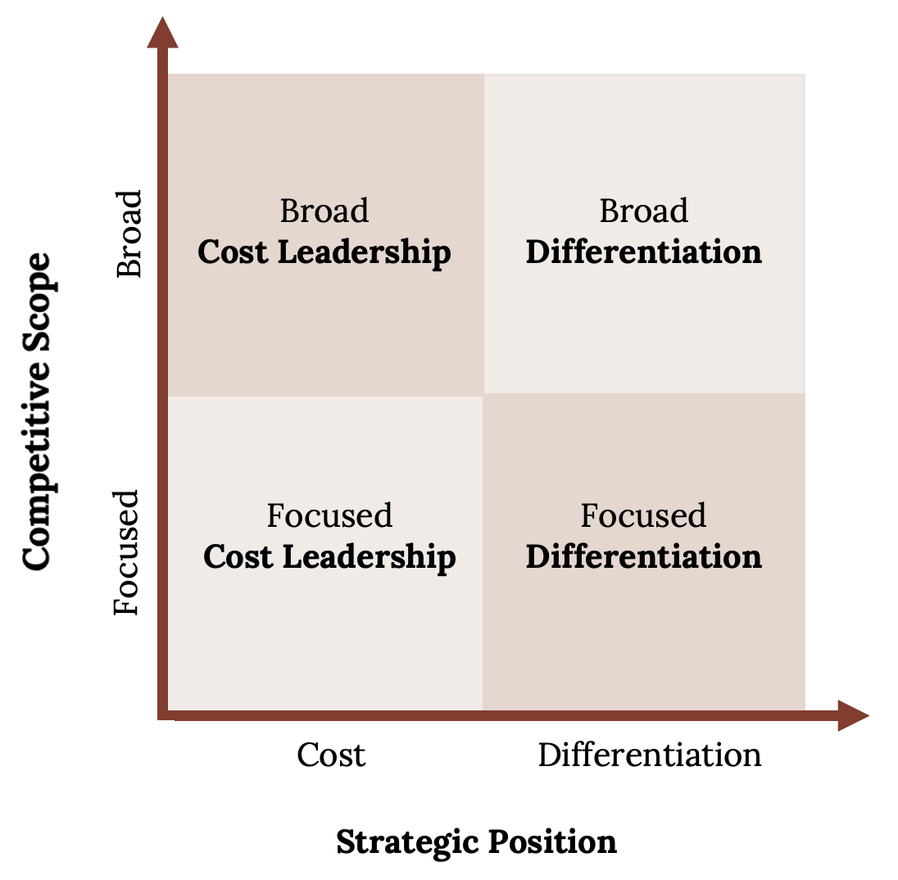
Generic Business Strategies: Position and Scope
http://hdl.handle.net/10919/102735

Slide 8
Differentiation Strategy
Unique features that increase value of goods and services
Consumers are willing to pay a higher price.
The focus of competition:
  Unique product features
  Service
  New product launches
  Marketing and promotion
Competitive advantage achieved when:
  Value – Cost > competitors
http://hdl.handle.net/10919/102735

Slide 9
What Differentiation Strategies do
Add value to products and services
Are responsive to customer preferences
Can increase costs
  Additional R&D is needed
  Innovation is needed
  But customers are willing to pay a premium
http://hdl.handle.net/10919/102735

Slide 10
Three Drivers That can Increase Value
Product features
Customer service
Complements
http://hdl.handle.net/10919/102735

Slide 11
Cost Leadership Strategy
Goal:
  Reduce the firm’s cost below its competitors
  Offer adequate value
Resources are focused on:
  Reducing cost
    To manufacture a product
    To offer a service
  Reducing prices for customers
  Optimizing the value chain to achieve low-cost
http://hdl.handle.net/10919/102735

Slide 12
Two Cost Drivers
Cost of input factors
Economies of scale
http://hdl.handle.net/10919/102735

Slide 13
Economies of Scale Allows Firms to:
Spread fixed costs over a larger output
  Ex: Walmart spent approximately $3.5 billion on advertising in 2019
Employ specialized systems and equipment
Take advantage of certain physical properties
  Ex: Big box stores can stock more merchandise and handle inventory efficiently
http://hdl.handle.net/10919/102735

Slide 14
What Cost Leadership Strategies do
Appeal to the bargain-conscious buyer
Offer lower prices than competitors
Attract an increased volume of sales
Can be profitable over a long period of time
http://hdl.handle.net/10919/102735

Slide 15
Best Cost Strategy
Hybrid Strategy
Attempts to achieve both differentiation and low cost
Hard to achieve
Can get “Stuck in the middle” and not do either strategy well
Firms attempting this strategy
Target
Southwest Airlines
http://hdl.handle.net/10919/102735

Slide 16
The Success of Business Strategy?
How well the strategy…
  Leverages the firm’s internal strengths
  Mitigates its weaknesses
How well it helps the firm…
  Exploit external opportunities
  Avoid external threats
http://hdl.handle.net/10919/102735

Slide 17
Let’s Discuss Amazon vs. Barnes & Noble
Identify Amazon’s (retail book industry segment) and Barnes & Noble’s competitive strategy by defining their respective value proposition and target market.
What are the key strategy elements that support your choice of strategy for each using the generic business strategy framework?
Conduct a value chain analysis (see chapter 4) of Amazon. How might this value chain be similar or different from Barnes and Noble’s value chain? (See next slide)
http://hdl.handle.net/10919/102735

Slide 18
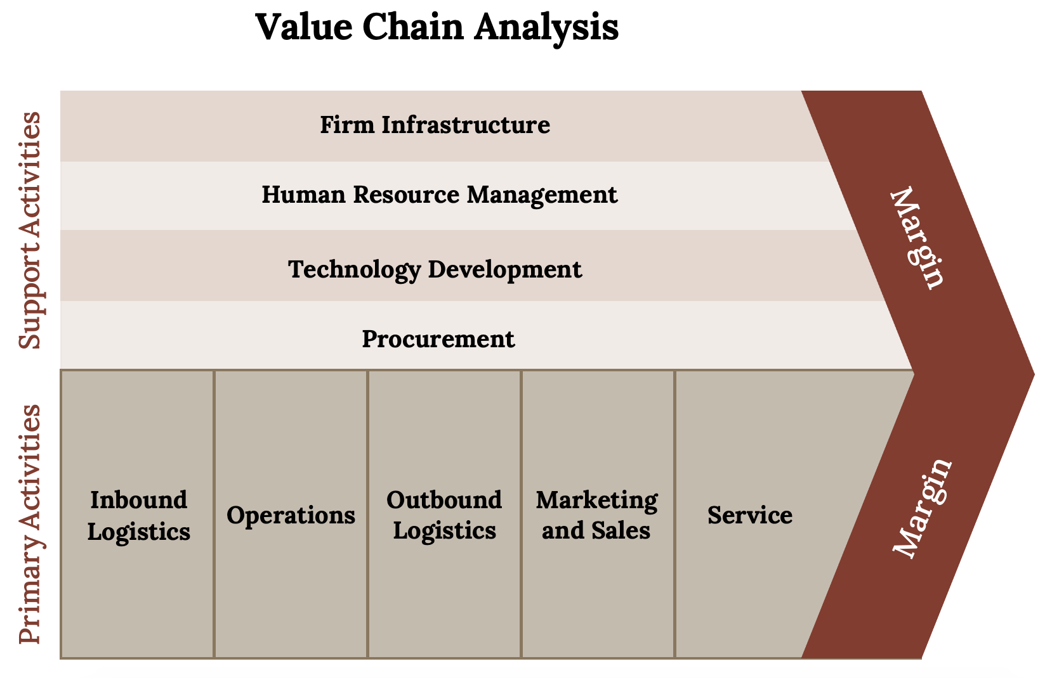
Amazon vs. Barnes and Noble
Kindred Grey (2020). “The value chain.” CC BY NC SA 4.0. Adaptation of Figure 4.11 from Mastering Strategic Management (2015) (CC BY NC SA 4.0).
Retrieved from https://open.lib.umn.edu/app/uploads/sites/11/2015/04/b38d1270a489c447e16e30df24d931aa.jpg. Available at
http://hdl.handle.net/10919/102735

