Slide 1
VTHSPC Website
Jakob Ashworth, Josh Martin
CS4624 Multimedia, Hypertext and Information Access
Professor Edward Fox
Virginia Tech, Blacksburg VA 24061
4/13/2023
Notes:
Josh

Slide 2
Outline
Overview
New Website
Testing
Future Work
Lessons Learned
Acknowledgements / References
Notes:
Josh

Slide 3
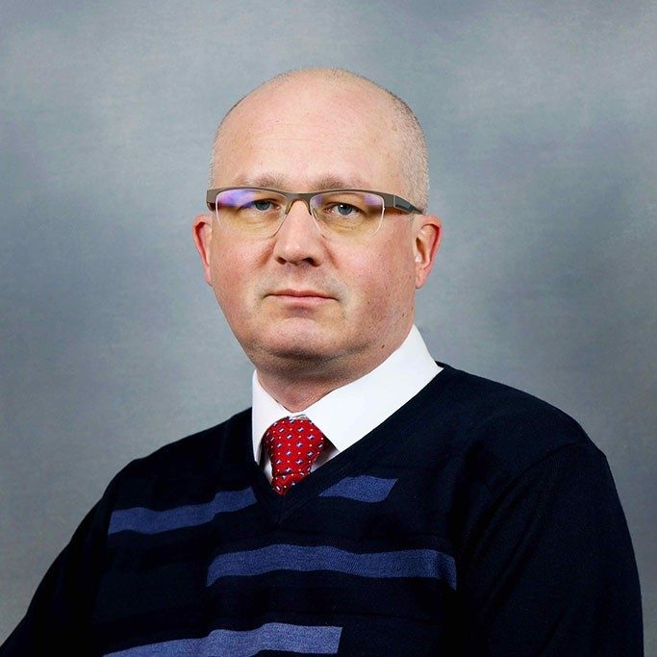
Overview - Problem
Yearly high school coding competition
  Contest is held online
  Contains info of current and past contests
  Website is dated and unappealing
Tasked with creating new website
  Contemporary design
  Easy-to-update and maintain
Client: Dr. Godmar Back
Notes:
Jakob

Slide 4
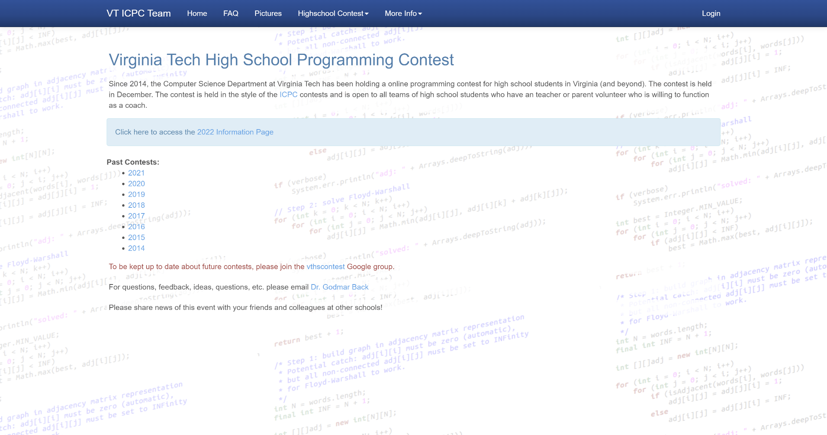
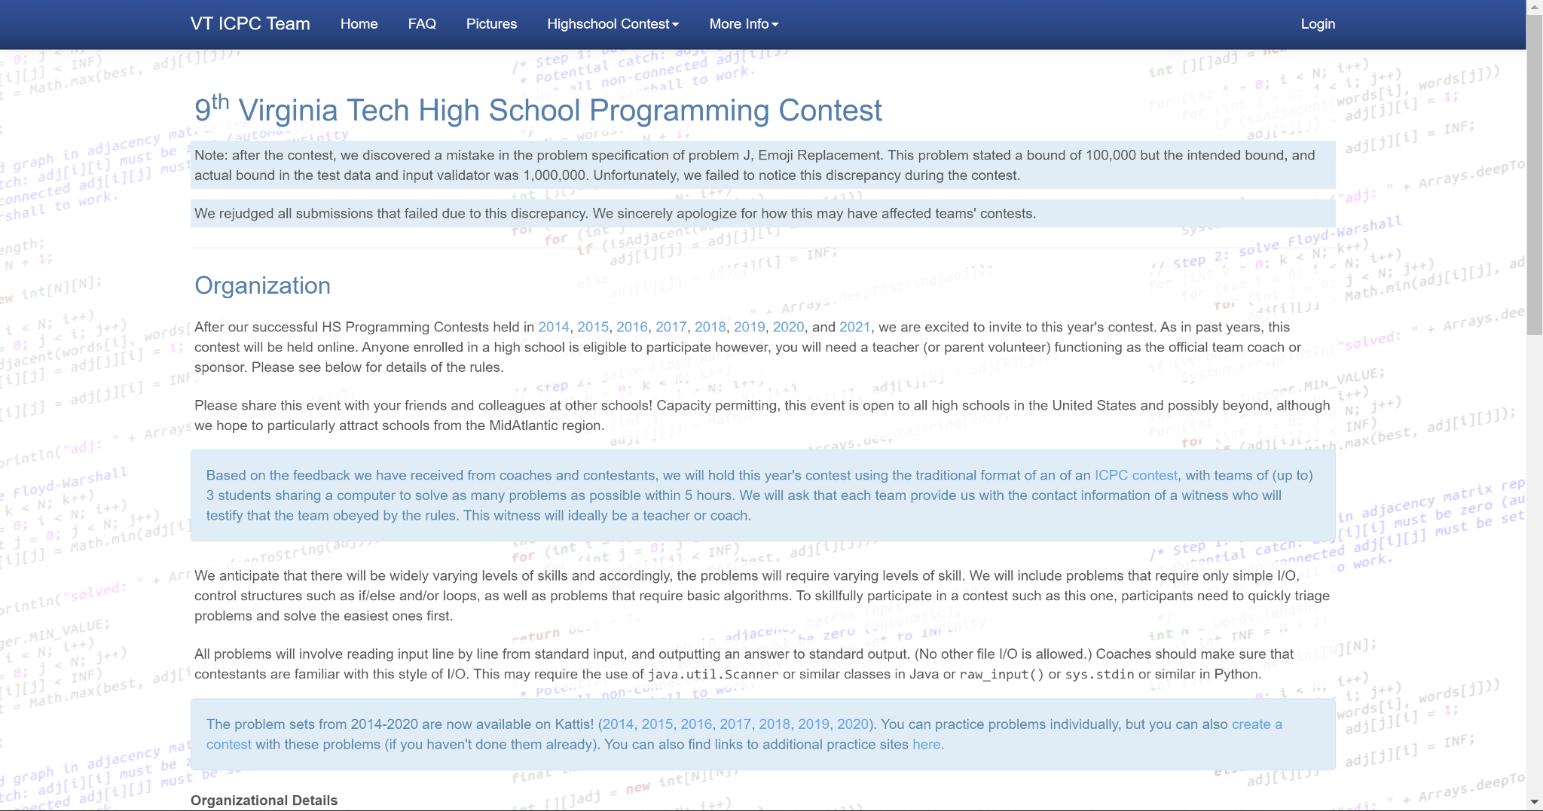
Overview - Previous Website
Home Page Contest Page
Notes:
Jakob

Slide 5
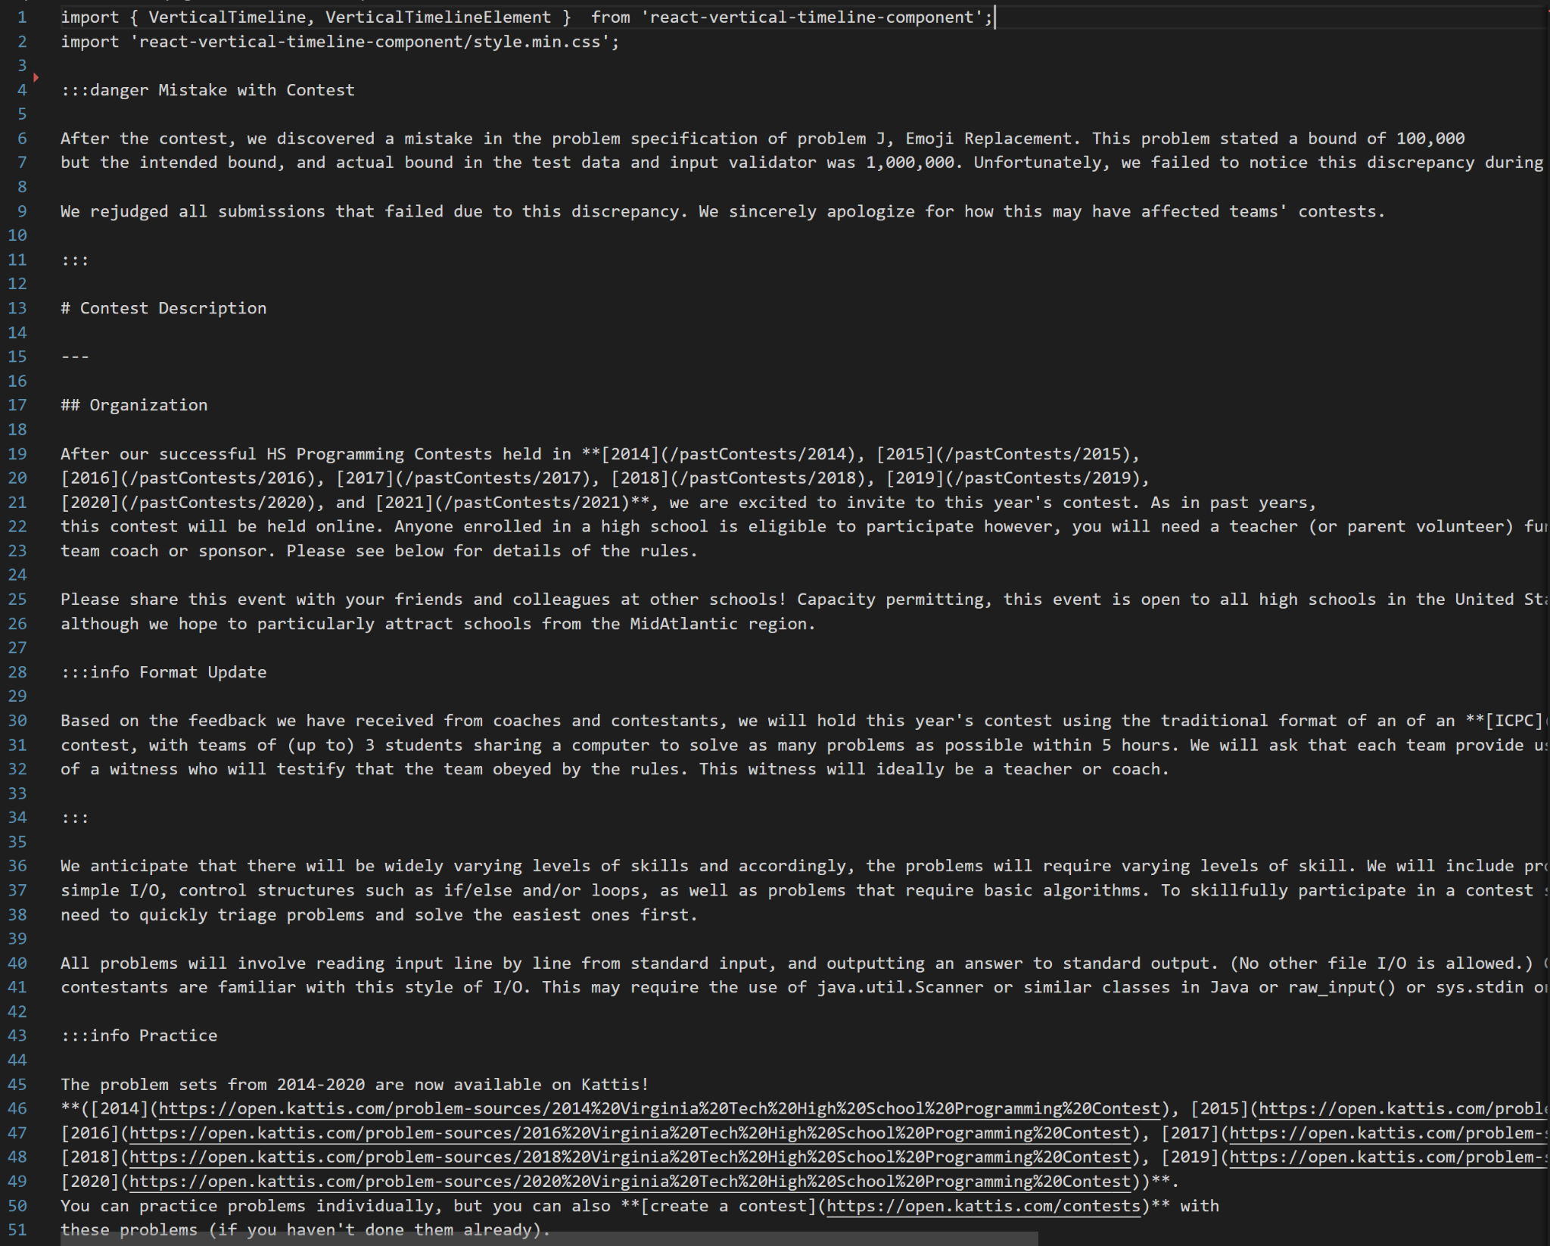
New Website
Created with Docusaurus
All webpages primarily written in Markdown (MDX)
Built and runs on VT server
MDX of Content Description Page
Notes:
Jakob

Slide 6

New Website - Home Page
Notes:
Jakob

Slide 7
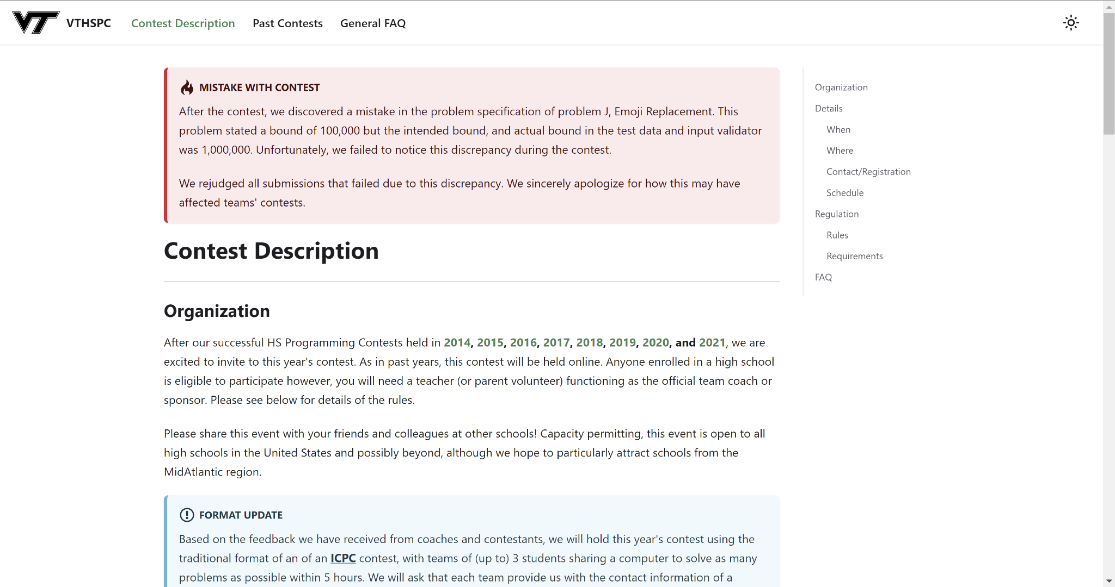
New Website - Contest Description
Notes:
Jakob

Slide 8
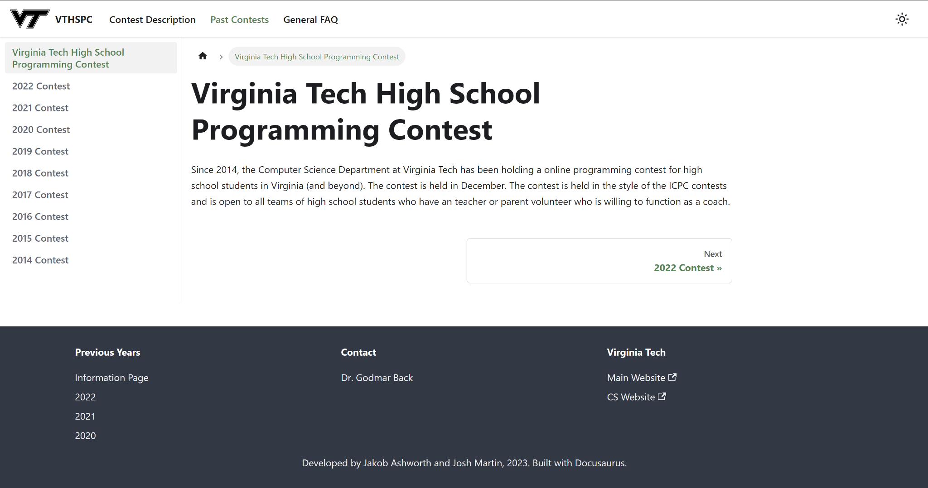
New Website - Past Contests
Notes:
Jakob

Slide 9
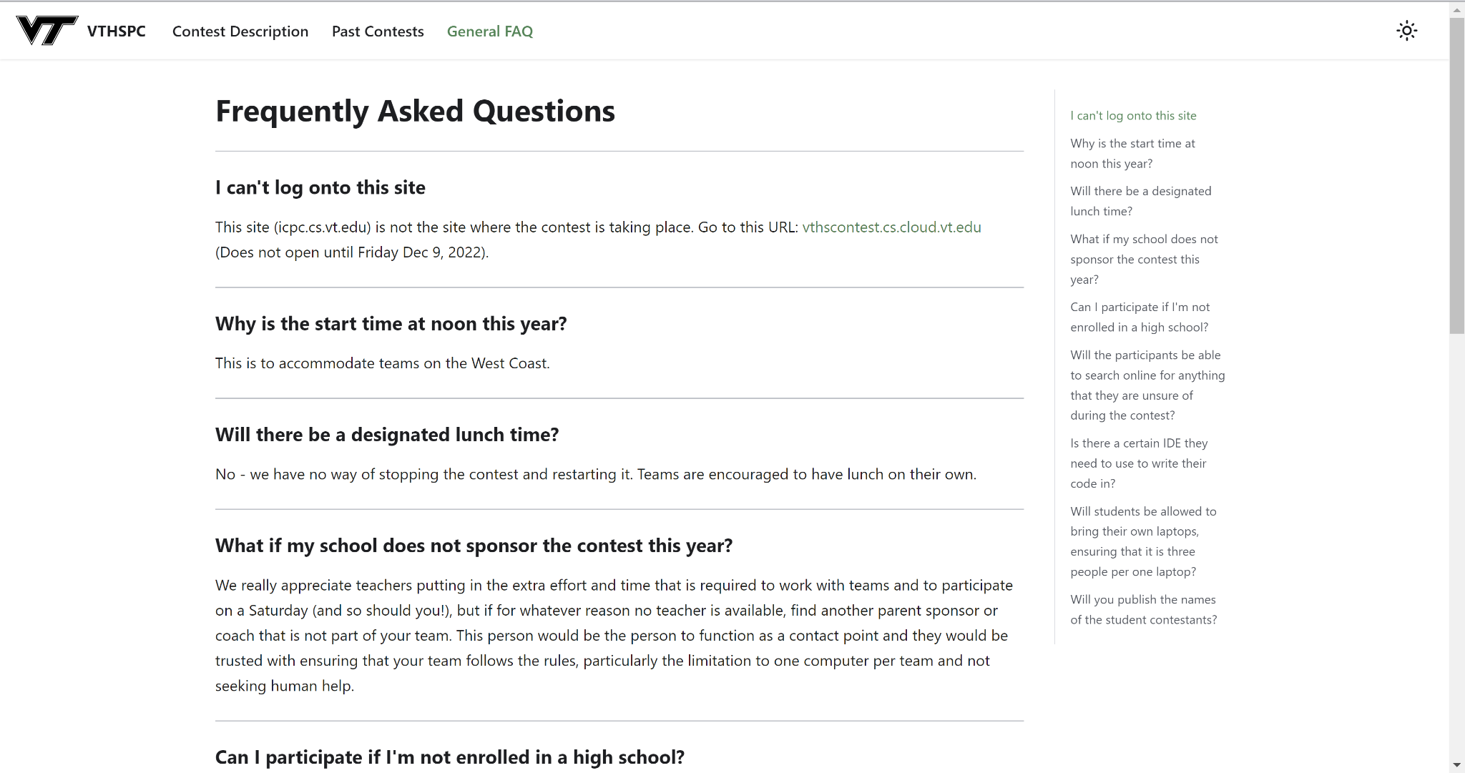
New Website - FAQ Page
Notes:
Jakob

Slide 10
Testing
Most of our testing was on the front end design and SEO
  These were tested mainly two ways: survey feedback and PageSpeed
Other requirements like ease of update were simple to test using the time command when starting up the website
Notes:
Josh

Slide 11
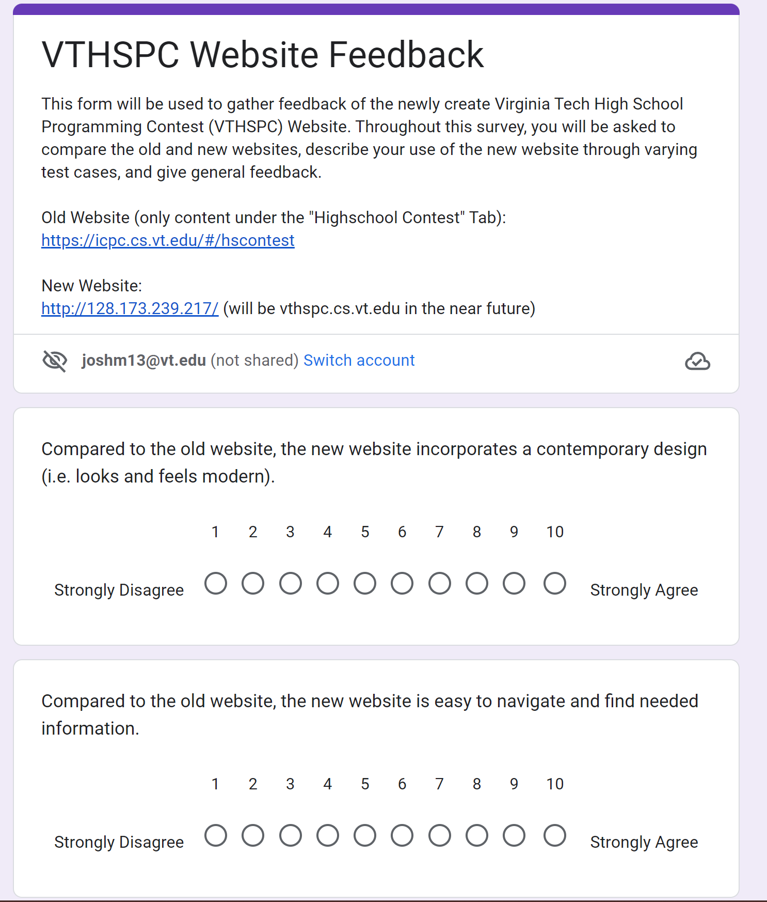
Testing: Survey Feedback
We sent out a survey to the class to test out our website and give us feedback on it
This was a great way to see if our design was effective
Overall our feedback was mostly positive
Notes:
Josh

Slide 12
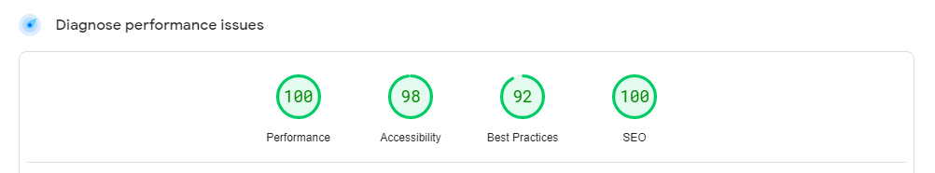
Testing: PageSpeed
PageSpeed is a tool by Google that rates a website’s performance, accessibility, best practices, and SEO
Easy to see how we were doing and what we needed work on
Overall had great results that made our client and us happy
Notes:
Josh

Slide 13
Future Work
Future work would be on the stretch goals we were unable to complete
  User profiles
  Dynamic content
    maintaining profiles and signing up for contests every year
  Keeping track of statistics for each contest
Notes:
Josh

Slide 14
Lessons Learned - Time Management
Presentation 2
Websites pages complete/considerable progress
3/15
Presentation 1
Complete, full plan of project
2/14
Tests ran on website, working towards stretch goals
4/15
February March April
Progress
2/28
Website in first stages
Interim Report in progress
3/31
Front-end for website is completed
4/30
Project completed
Website running and available
Notes:
Jakob

Slide 15


Lessons Learned - Setbacks
Version 1 would not meet requirements
Switched approach, restarted project one month in
Version 1 Version 2

Slide 16
Acknowledgements / References
Acknowledgements:
Dr. Godmar Back
Dr. Edward Fox and TAs
References:
https://icpc.cs.vt.edu/#/hscontest
https://balsamiq.com/
https://getbootstrap.com/docs/5.3
https://docusaurus.io/
https://vthspc.cs.vt.edu/

