Slide 1
Green Goes with Anything
Balancing Sustainability, Archives, and Outcomes
April 9, 2025
Alex Kinnaman, Assistant Director, Digital Libraries & Preservation, alexk93@vt.edu
Alan Munshower, Digital Collections Archivist, alanmun@vt.edu
Notes:
Hello! Thank you to the organizers of this great series, and to our co-presenters. This is Green Goes with Anything: Balancing Sustainability, Archives, and Outcomes. My name is Alan Munshower, and I am joined by my colleague from Virginia Tech, Alex Kinnaman.
Virginia Tech acknowledges that we live and work on the homeland of the Tutelo / Monacan people, and we recognize their continued relationships with their lands and waterways. We further acknowledge that the Morrill Land-Grant College Act (of 1862) enabled the commonwealth of Virginia to finance and found Virginia Tech through the forced removal of Native Nations from their lands.
Please also note that the opinions expressed in this presentation do not represent the views of Virginia Tech or the University Libraries.

Slide 2
Original Paper
Work stemming from original 2022 iPRES paper and subsequent WDPD presentation
Full paper:
Kinnaman, A. and Munshower, A. (2022 September). “Green Goes with Anything: Decreasing Environmental Impact of Digital Libraries at Virginia Tech." In Proceedings of the 18th International Conference on Digital Preservation (iPRES) 89-98. http://doi.org/10.7207/ipres2022-proceedings
Notes:
This is an abbreviated version of our iPRES presentation with a stronger focus on actionable first-step recommendations and less focus on methodology. You can find the full paper and presentation in the iPRES 2022 proceedings!

Slide 3
Introduction
Reevaluating sustainability across digital curation practices library wide
  Inter-departmental nature of digital curation and digital lifecycle
Prioritizing considerations for environmental sustainability
Investigating workflows of appraisal, digitization, fixity checking, and storage choices
Finding balance between best practices, KPIs, and environmental sustainability
Using K. Pendergrass et al. “Towards Environmentally Sustainable Digital Preservation” as a guide
Notes:
As digital library practitioners, we are investigating ways to guide digital curation practices more broadly across Virginia Tech University Libraries (VTUL), while prioritizing considerations for environmental sustainability. In doing so, we explore university and professional standards and ethics, using the 2019 article “Towards Environmentally Sustainable Digital Preservation” as a guide to focus on immediate areas that we can address in our digital library workflows. We investigated our workflows for appraisal, digitization, fixity checking, and storage choices to identify areas of improvement that find balance between best practices and environmental sustainability. We seek to understand the environmental impact of VTUL’s digital preservation choices on the community in which we live.

Slide 4
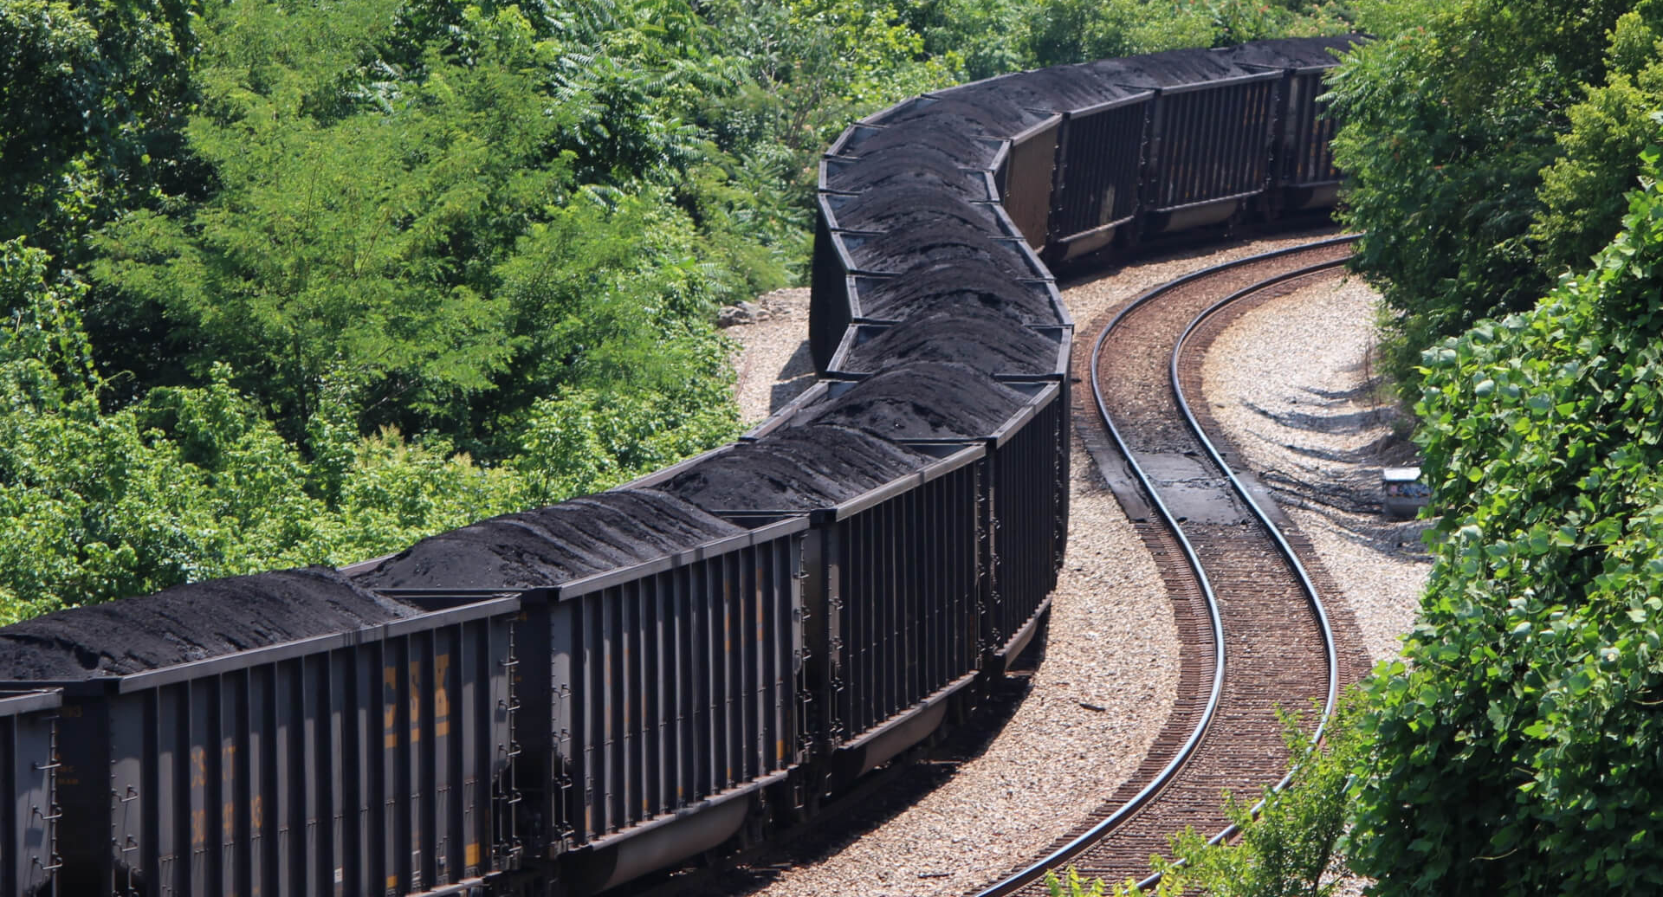
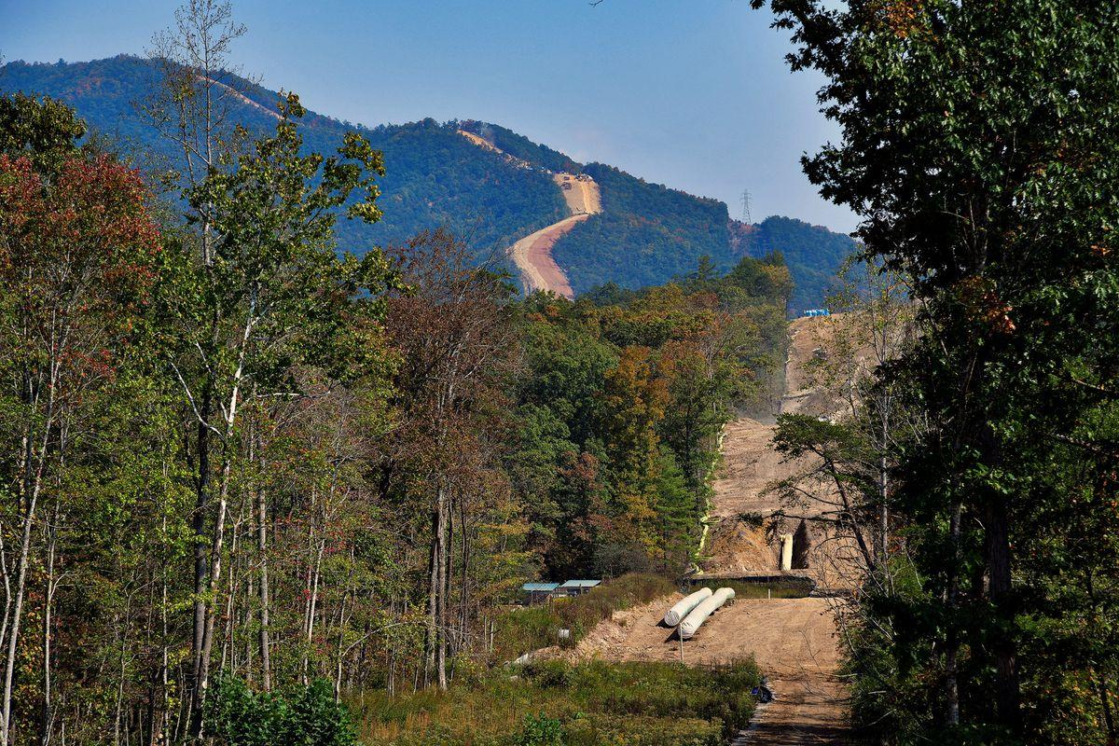
Southwest Virginia
A CSX train carrying a load of coal stops near the James River in Richmond in July 2019. Photo taken by Sarah Vogelsong / Virginia Mercury. https://virginiamercury.com/briefs/mining-company-bankruptcy-stills-10-mines-in-southwest-virginia/
Workers construct the Mountain Valley Pipeline near Elliston, Virginia, U.S. September 30, 2019. Picture taken September 30, 2019. REUTERS/Charles Mostoller/File Photo
Notes:
As a land grant institution, our work with community archives and the collecting of the history of Southwest Virginia is part of our institutional mission. Though there is an inherent dichotomy when actively seeking out, building and maintaining collections in or adjacent to extractive industries, while also considering climate impacts of our practice. This dichotomy is likely to exist in some form at most archives and historical societies that are taking a holistic view at the history of their place.
For us here in Southwest Virginia, a couple examples which are depicted here, are the region’s long history of coal and the Mountain Valley Pipeline. Coal trains continue to be a daily sight in the area, and railroad history is prominent both in the Highlands and our nearby city Roanoke, which was founded in 1882 as a railroad town. The Mountain Valley Pipeline which runs north to south through Montgomery county, went online in 2024. There were many years of resistance, which resulted in stalled progress, leaving the work sites looking abandoned. The ultimate approval for the pipeline’s completion was ushered in by an outgoing senator from WV who added it to a debt ceiling bill in 2023.

Slide 5
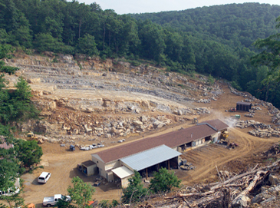
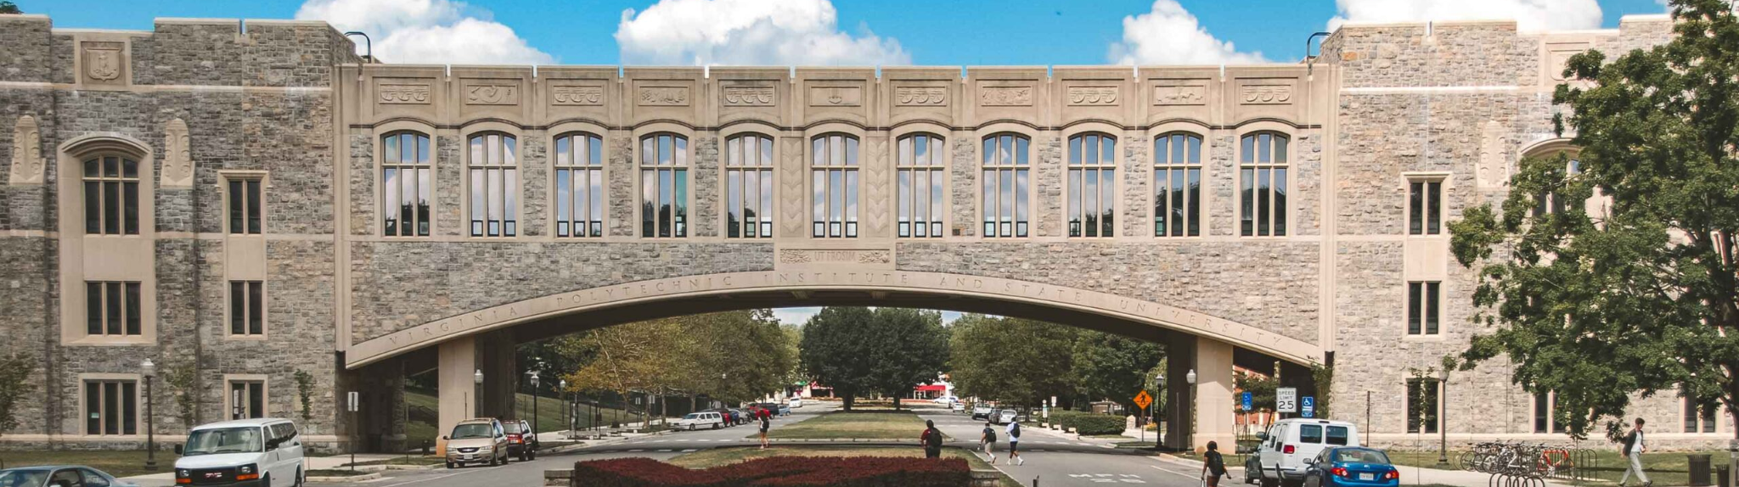
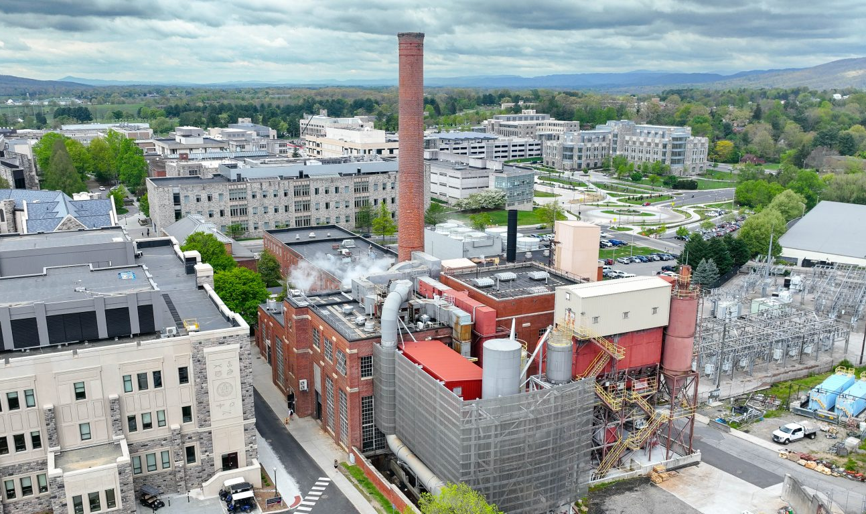
Virginia Tech
Torgersen Hall. Composed of 2,700 tons of stone
Virginia Tech Quarry
Photo taken by Logan Wallace, 2016. Virginia Tech Magazine.
https://www.archive.vtmag.vt.edu/winter17/virginia-tech-quarry.html
Virginia Tech Power Plant
Photo from the Division of Facilities.
https://www.facilities.vt.edu/energy-utilities/power-plant.html
Notes:
Moving from regional history to institutional history, a couple other impactful practices that are still ongoing are the VT Quarry and VT Power Plant.
The university mines limestone at its own quarry on the fringes of Blacksburg. Having become a key design feature of campus architecture over 120 years ago, the rock has become affectionately known as Hokie Stone. The 40-acre quarry, which is surrounded by a residential area, provides 80 percent of the stone used in campus construction.
Our Power Plant at Virginia Tech generates an annual steam output greater than 943 billion BTUs, and provides steam heat and electricity to the campus and beyond. Having now transitioned to only gas to operate the multiple boilers on campus, the VT power plant supplies power at an efficiency considerably better than our local utility, Appalachian Power (AEP). However, even considering the size of the operation, they are only able to meet 8% of VT’s power demand annually. The actual percentage fluctuates based on the time of the year.

Slide 6
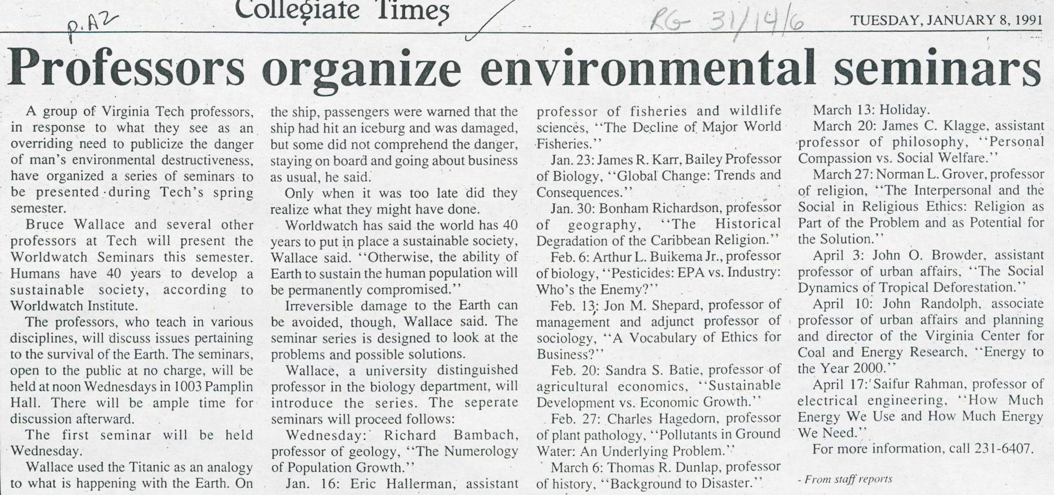
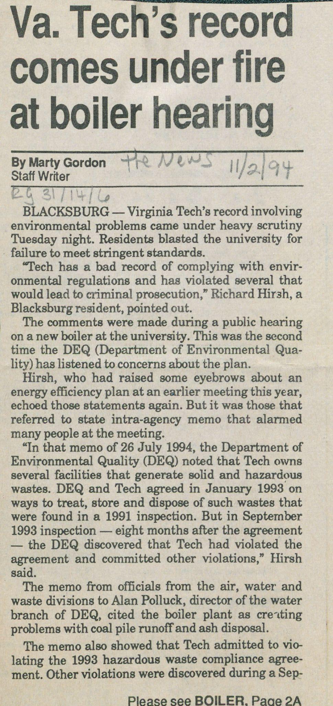
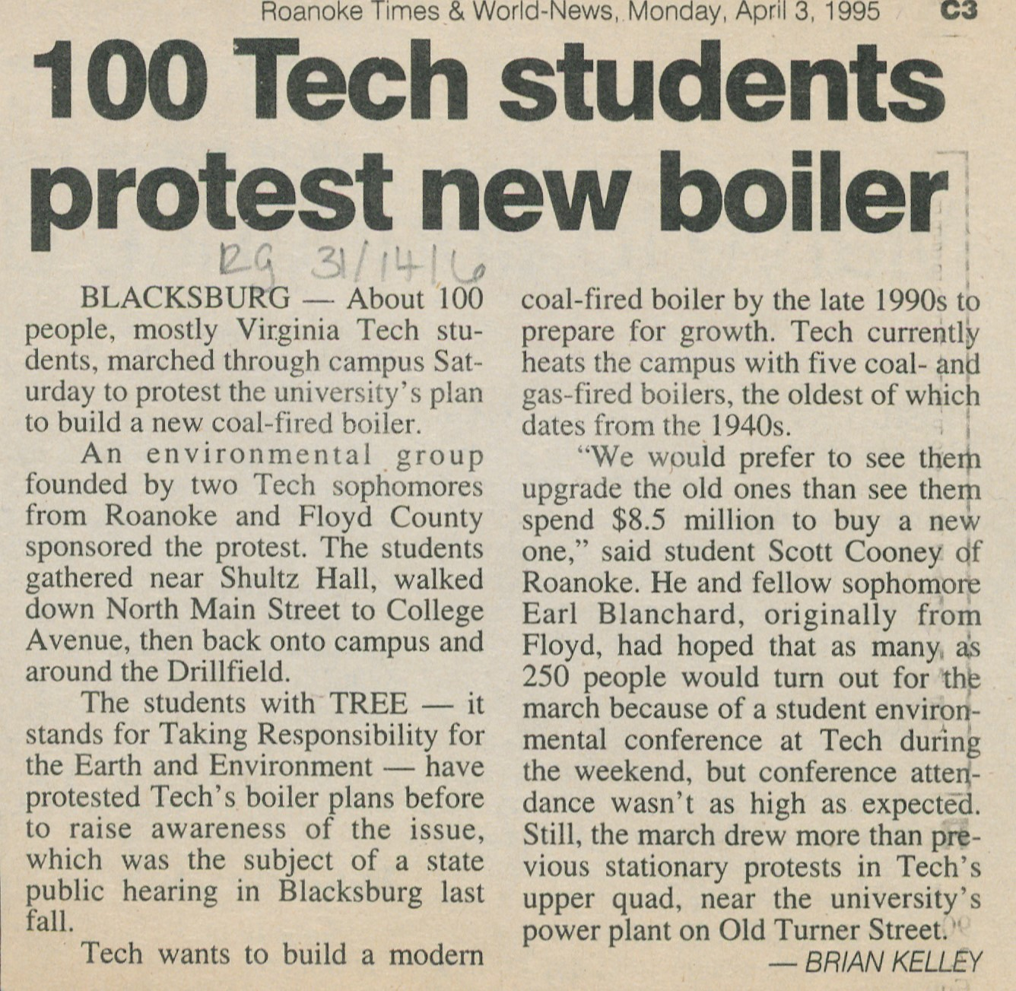
Notes:
While the school’s policy and history constitute one record, there has also been a parallel environmental awareness movement, often led by students and faculty.
We are a large state institution in a rural location, but one that draws a considerable number of students from the Washington DC metropolitan area. While this brings an influx of diverse conservation ideas and urban living concepts, especially as in relates to conservation and planning, it can also run up against local and institutional traditions.
In that way, the University’s dialogue around climate issues is always multi-faceted, and includes issues of local industry, recreation, and the intersection of local, state and federally managed lands. 9.3 % of land in Virginia is federally owned, including a large district of the Jefferson National Forest, bordering the town of Blacksburg.
We believe that understanding a bit of your regional and institutional history is important as it relates to climate, especially as information professionals. Shown here are a few examples I’ve pulled from our archives covering campus organization happening at Virginia Tech in the early to mid 90’s. There was a large effort to stop the installation of a new coal boiler on campus in 1995. Ultimately boiler #11 was installed in 1997, though it was equipped with a scrubber and baghouse system to control particulate and acid gas emissions. The community voice was heard in considering these measures, and an older boiler was eventually retrofitted with these new containment systems. The coal boilers were taken offline in February 2020.
A large land-grant state institution in the middle of coal-country in SouthWest Virginia, Virginia Tech has a responsibility to engage with our history of industrial energy extraction and build better sustainability strategies into each aspect of our university. The Virginia Tech Climate Action Commitment aims to set the university on a path to carbon neutrality by 2030. VTUL is unique among other local energy consumers, given its management of multiple stores of data in our institutional repositories, digital libraries, Special Collections and University Archives, and data repository. It is with this history and context in mind that we explore the current environmental impact of our digital library choices and recommendations for decreasing this impact through changes in our workflows.

Slide 7
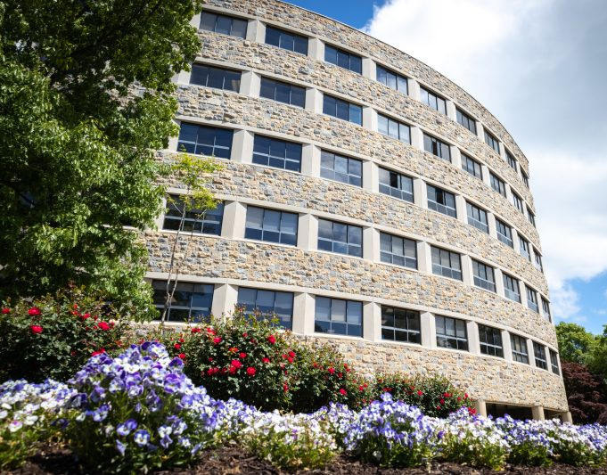
University Libraries
Terabytes of data: What we know
  10-15 TB in on-prem NAS
  6 TB in APTrust (AWS)
  11-15 TB on -prem high-speed NAS
  47 TB in digital library (AWS) - not including pre-prod
  ~6 TB in Omeka
  22TB in SCUA - on-prem NAS
  5-6 TB in Data Repo (Figshare)
  ~>1 TB received from MetaArchive (LOCKSS)
What we don’t know
  Ephemeral/working items
  Shared cloud storage
  Affiliated department storage
  AI usage
Newman Library
Notes:
Narrowing the scope even further to just Newman Library on campus, we’re managing terabytes of data across multiple storage mediums. We have on-prem NAS where most folks have some data stored either temporarily or long-term and the numbers are unknown overall, but between Alan and I we have at least 35-40TB, plus and on-prem High Speed drive that usually has anywhere from 11-15 for items being processed out of the 2D and 3D labs and their local documentation. Our AWS has 47 TB of data on production, not including pre-prod or what is currently moving to Glacier; DSpace has the majority of our institutional repository, Figshare has around 6 TB of our datasets, SCUA manages a 6TB Omeka, and MetaArchive had less than 1TB.
That’s all we really know right now, what we don’t know are other departments usage, what ephemeral or working items exist and their schedule for deletion, cloud storage, and how much storage and energy is expended by AI.

Slide 8
Complicating Factors
Traditional performance metrics for digital preservation focus on access, digitization output, and technological innovation, and often neglect environmental impact
  Sustainability metrics are not included in our strategic plan or aspirational identity
There is significant pressure to always do more and prove that the library needs to be well-resourced
Increasing usage of AI, larger and more complex digital objects
Library is not included in university-level Climate Action Commitment, no representation on Climate Action, Sustainability, and Energy Committee, therefore little available guidance
Notes:
While the amount of data isn’t fully known, there are a number of factors that we originally didn’t consider for scope reasons but further complicate our goals to understand energy consumption. Thinking about strategic planning, most metrics are number of items digitized, number of items accessible, number of efficiencies, but don’t include environmental impact, and this is true for us as well, we’re in the middle of strategic planning and sustainability metrics are not included in our mission, aspirational identity, or strategic plan. In order to keep our funding by the university we’re always pressured to do more and prove that we need the resources. We’re also increasing our AI exploration, particularly in the digital library and on complex files in multiple viewers.
At a university level, the Library is not included in the Climate Action Commitment plan, and we have no representation on the committee managing the project, so there is little guidance provided to individual colleges on improvements and impacts.

Slide 9
Complicating Factors (cont.)
Traditional performance metrics for AI focus on “intelligence”, speed, and price, and frequently ignore environmental impact implications
Black Box nature to many essential technologies, including utilities, AI, and cloud storage.
Notes:
https://artificialanalysis.ai/
Electronic devices and appliances come with energy ratings, but when dealing with digital technologies, there is often a black box nature to their climate impact. For a number reasons including lack of government regulations, industry secrets, or constantly evolving or streamlining (read: enshittification), the data is not typically available. AWS technically has energy reports, but when you don’t know the data and algorithms behind the numbers, it’s difficult to determine their accuracy. To determine where you electricity is coming from, what type of encoding or compression is being applied to your files, or what your geographic distribution looks like, there is work involved.

Slide 10
How do we balance environmental sustainability and archives with ongoing pressures to meet and exceed KPIs?
Notes:
Building upon the issues this series has been exploring and our own context in Virginia, the big question we are trying to explore is, how do we balance environmental sustainability and archival work with the ongoing pressures to meet and exceed key performance indicators?

Slide 11
Calls to Action
Organization Level
policies
committees
resources
roadmaps
Department Level
workflow efficiencies
storage redundancy
Individual Level
prioritization
advocacy
outreach
modeling practice
Notes:
As far as actionable steps, in an ideal situation, it would start at the top with the organization providing tangible policies and roadmaps, inclusive committees, and roadmaps that include good practices for conserving energy. At the department level, what we have a little more autonomy over are finding and implementing workflow efficiencies, like an SOP for how long we keep short-term backups, and relatedly, reducing storage redundancy. As individuals in our respective fields, we still have some control over how we prioritize data, how we advocate for sustainable practices and educate our communities, and being good role models to follow.

Slide 12
Original Recommendations
(with background and additional thoughts)
Notes:
The conclusion of our 2022 paper “Green Goes With Anything”, provided several broad recommendations to move VTUL into a greener state in terms of our digital libraries and workflows. Using those recommendations as a jumping off point, and with additional contextualization, we hope to spark a conversation about ways to address each opportunity. We start at the institutional level proceed to action item that can be incorporated by a department or individual.

Slide 13
Revist collection policies and institutional mission
Adjusting an existing collection policy or mission to reflect a commitment to sustainably manage digital resources and guide future decision-making
This may include a goal to reduce carbon emissions from the digital library, reflecting new methods for appraisal
Notes:
Starting at the organizational level, we recommend adjusting an existing collection policy or mission to reflect a commitment to sustainably manage digital resources and guide future decision making. This might look like a formal sustainability statement, a value added to a list, or part of the criteria to consider before accepting collections.
Using the plainly-stated charge of Pendergrass et al. to reduce digital content overall, appraisal and digitization practices are areas which should be scrutinized. A well defined collecting policy will help control the scope and prioritize the collecting efforts. It may be beneficial to directly name environmental considerations in a future revision. VTUL SCUA mission to provide materials in digital format “when possible”
Advisory Council for Digital Collections selection rubric focuses on mission-specific projects and technical details This Could be a logical check on unsustainable digital projects in pipeline
Clarity in how collections are prioritized internally for digitization is another area to address. The existing Advisory Council for Digital Collections could be a logical check on unsustainable digital projects in the pipeline. This scrutiny should also exist within submitting library departments prior to review by the Advisory Council. Departments should clarify how collections are prioritized internally.
Departmental collection digitization prioritization focuses on time/effort, access restrictions, copyright, uniqueness, etc
Sustainability goals not a component of prioritization
Clarify prioritization decisions when submitting proposals

Slide 14
Frame Sustainability as Cost-Effective
Less content means less storage and less cost
Optimized workflows means reducing time on a project
Address excessive employment of ‘speedy’ technologies
Notes:
And if the previous recommendation doesn’t quite work, reframe sustainability as cost-effective.
Yesterday I had the pleasure of being on a panel at CNI with Snowden Becker and she said, “Instead of thinking about, “how cheaply can we get this done,” how can our necessary expenditure on preservation of digital assets become an investment in staff, community, and relationship-building?” Snowden Becker, CNI 2025
Making any decision to “do less” or “preserve less” is potentially in conflict with meeting KPIs, so we show that the cost of recovering data is far more than management and maintenance, creating lasting value in the digital assets to (on paper) keep the numbers up without having too many copies, reducing storage use reduces cost, etc.
In the case of available AI metrics and the lack of specific sustainability data, speed measurements can be used as a proxy. Similarly, options like AWS Glacier give archives a slower, cheaper, and more sustainable option when speed is not the primary objective. Often, the ‘default’, can be to reach for the fastest and most readily available technology, but there is an underlying cost to that readiness.
This is particularly prevalent in Digital Humanities work, where a variety of proprietary new technologies are employed.

Slide 15
Sustainability commitment
As an organization, we recommend that VTUL develop a Sustainability Statement for the Digital Libraries at VTUL to scope our work and to emphasize not only the importance of but the immediate need for greener digital library curation strategies
Notes:
As an organization, we recommend that VTUL develop a Sustainability Statement for the Digital Libraries at VTUL to scope our work and to emphasize not only the importance of, but the immediate need for greener digital library curation strategies. This one could be challenging - we all have red tape when it comes to affecting our entire organization’s mission, and starting at the department level can serve as a step towards advocacy and making those smaller changes a little quicker.

Slide 16
Determine acceptable loss
Reducing security will reduce energy consumption
We need to determine acceptable loss for each of the storage vendors we contract with and alter our workflows with mechanisms for faster healing to compensate for any loss
Notes:
Moving to the department level and the content you manage, we refer back to the Pendergrass et. al. paper, to emphasize the importance of determining our acceptable loss. Our IT Division has similar protocols in their software, and the same should be applied to our collections. Simply, reducing security (e.g. hashes) and reducing number of copies will reduce energy consumption. We need to determine acceptable loss for each of the storage vendors we contract with and alter our workflows with mechanisms for faster healing to compensate for any loss. This might look like defining a percentage or fixed number, or generally reducing frequency for preservation activities, understanding that more manual investigation will be necessary.

Slide 17
Storage Results
The environmental impact of digital library storage choice is also very complicated to define and impacted by the various workflows, number of copies, distribution of copies, and collection needs
  We might have anywhere from 2-8 copies of a digital object
Appraisal at all workflow steps is key
We have not determined what Pendergrass et. al. describes as acceptable loss
Energy efficiency is predominantly measured by financial cost rather than environmental cost
  E.g., the AWS Carbon tool is located in the AWS Billing Console under Cost & Usage Reports, emphasizing financial cost
Notes:
As with fixity, environmental impact of digital library storage choices is also very difficult to define. We found we might have anywhere from 2-8 copies of a digital object based on storage locations.
Appraisal at all steps of the workflow is key. In the case of a large ongoing digital collections migration, collection needs are considering individually, rather than across the whole platform. The time and effort dedicated to this process is in service of efficiency and minimizing future waste, such as when you institution switches from one cloud storage service to another, and you need to address years of unchecked management of personal and shared storage.
We have not determined what Pendergrass et. al. describes as the “level of acceptable loss in collection under [our] care” to make better use of what resources we do have, indicating improved and increased appraisal is necessary. We also found that energy efficiency is almost always measured by financial cost rather than by environmental cost. Libraries are businesses and energy consumption is usually conveyed in terms of money, but measuring the environmental impact would not only help us to decrease that impact, but could positively affect the bottom line as well.
All of our initial results are really showing us what all we haven’t considered that impacts energy consumption, storage usage, and financial cost.

Slide 18
Preservation appraisal
Expand on our defined levels of preservation
Modifying them to include more direct appraisal strategies and a determination of acceptable loss for each level
Notes:
As noted in a previous slide, we must investigate stricter preservation appraisal methods by expanding on our current levels of preservation and modifying them to incorporate more direct appraisal. This is especially relevant in terms of all storage costs - less content means less money, less energy consumption, and less manual labor.

Slide 19
Community training
The Libraries are responsible for keeping up with digital trends and practices and educating the University and larger community
Develop regular Professional Development Network training sessions on ensuring good practices in personal and professional archiving that also emphasize environmental sustainability
Notes:
There are actions we can take as individuals. The Libraries are responsible for keeping up with digital trends and practices and educating the University and larger community, and we’re the experts in this field. We recommend regular training sessions on ensuring good practices in personal and professional archiving that also emphasize environmental sustainability. For VTUL, this is again especially relevant as more data comes our way from the University community.

Slide 20
Decrease redundancy of working files
Streamlining the transfer process to minimize the multi-department storage redundancy of working files
Understanding that redundancy is a necessity, determine which stages of the collection management process should be the most secure
Schedule a process for deletion after migration and quality assurance
Digitization with intention
Notes:
Streamlining the transfer process will help minimize the multi-department storage redundancy of working files. Understanding that redundancy is a necessity, we aim to determine which stages of the collection management process should be the most secure. Scheduling a process for deletion after migration and quality assurance is also key. This is especially relevant for VTUL as redundancy across the University has revealed some cybersecurity risks, and for the library in defining the canonical collection.
Among digitization practices, organizations should identify areas where changes can be made. In some cases this will mean going against industry standards of resolution or bit depth. While the biggest results will come from a reevaluation of standards contributing to file size, simple cleanup to digitized material can play a role in sustainability goals. This could mean addressing duplicate or blank pages or editing dead air and trimming commercial/non-relevant content from digitized sources prior to repository ingest.

Slide 21
Reduce ongoing fixity checks
We recommend reducing scheduled fixity checks of all AWS objects from every 90 days to every 120 days or possibly more
Increase spot-checking fixity from a randomly selected subset of files in each digital collection
Increase test restorations to account for the decreased fixity checking.
Notes:
Reducing ongoing fixity checks is a conversation that has been happening more and more in the digital preservation field, and after this investigation into VTUL fixity practices, we recommend reducing scheduled fixity checks in AWS from every 90 days to possibly every 120 days, as a start. To account for this, we should increase spot-checking fixity from a randomly selected subset of files in each collection, and increase test restorations to account for the decreased fixity checking. This could also include using different hashes based on size, even less frequency on items in cold storage, and reducing the number of points where fixity is run.

Slide 22
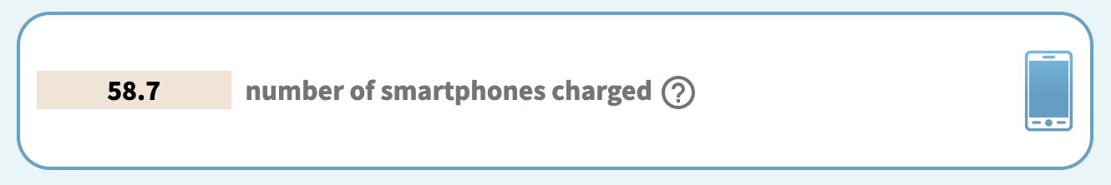
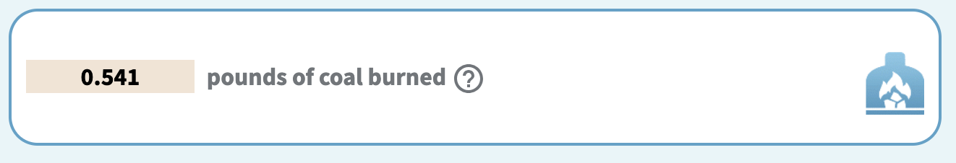
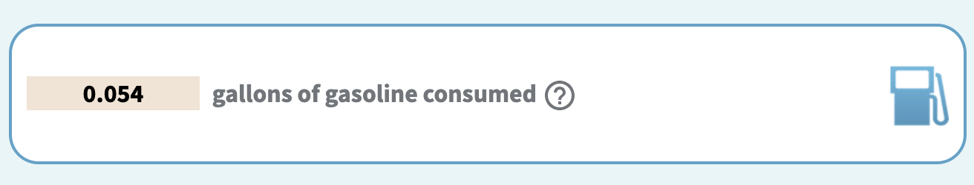
Fixity Results: ~.483 kg CO2e
The environmental impact of running fixity is very complicated to define
  Fixity algorithm, fixity frequency, file size, file count, storage type all should be considered
  We considered algorithm and collection size
Validating these results would involve a time-intensive research study in collaboration with our IT division, vendors, and preservation vendors
  Currently no support or bandwidth to perform
If our final result of ~.5 kg CO2e for running 3 fixity checks on all of our approximate data is even close to accurate, this is a motivation to modify workflows
epa.gov/energy/greenhouse-gas-equivalencies-calculator
Notes:
Just to give you a sense of the complication of trying to calculate the energy consumption of a single fixity check on the data we held in 2022, these results are based on other’s research and validating even our small investigation would be a time-intensive study in collaboration with our IT division and vendors, which we still do not have the support or bandwidth to perform.
**Just a quick note that my original calculations were incorrect (I’m a librarian for a reason) and an iPRES audience member helped correct the results. These are the correct numbers, multiplied by 3 fixity checks rather than one**
However, if our result of ~.5 kg of carbon dioxide equivalent ( or a half a pound of charcoal or .05 gallons of gas, per the EPA translation tool), is anywhere near accurate, this is concerning and has been a clear motivation for us to modify our workflows.

Slide 23
Investigate smaller object sizes
The size of a digital object directly impacts the energy consumed in running fixity, transferring between storage locations, and ongoing storage maintenance
Explore collections or data types where there are options for creating lower resolution or otherwise smaller objects
Notes:
The size of a digital object directly impacts the energy consumed in running fixity, transferring between storage locations, and ongoing storage maintenance. We recommend exploring collections or data types where there are options for creating lower resolution or otherwise smaller objects. One area we are successfully exploring are lower resolutions specifically for access copies and derivatives, which helps with reducing storage and also speeds up transfer and rendering times.

Slide 24
Next Steps
Notes:
All of our recommendations are broad but have served as a first step for us to begin rethinking as a library and within our individual day to day work.

Slide 25
Changes at VTUL Since 2022…
Many discussions on best practice vs. good practice, greener options
Fixity frequency changed to every 120 days
…but we need to use SHA-1, especially for complex objects
Investigating how we might decrease file sizes/resolutions for access copies of naturally large files (e.g. stitched images, 3D/VR)
Beginning discussions on appraisal for APTrust and MetaArchive ingest
Multi-factor accessioning and storage considerations for large files such as video, especially in oral history collections
University-wide cloud storage service provider transition has prompted broad ‘interest’ in digital preservation practices
Notes:
The original paper was presented in 2022 and we started making changes based on our recommendations and on changes in our University. We’ve officially changed the fixity frequency to every 120 days, but do have to use a larger hash algorithm due to AWS requirements and to better monitor our complex files.
I’m working with our 2D and 3D labs to generate smaller file sizes and resolutions for access files. We’re also finally beginning to discuss better appraisal for what goes into APT and MA. So we’re not forsaking our preservation practices, but trying to save space whenever possible, which again helps us on multiple fronts.
We’re adding additional considerations when accessioning large digital files in Special Collections and University Archives. All potential donated materials within the collecting policy and scope are considered, but extra consideration is given for large files to be able to sustainably manage them. Lastly, an overhaul in University-wide Google storage allotment has created a ‘scramble’ and broad conversations around digital preservation, with a lack of appraisal considerations - a literal box of digital chaos, if you will. Many departments and colleges leaned on Library expertise and resources during this transition.

Slide 26
…And Since 2024
Shifted from X3D to to glTF for 3D access formats
Fixity Service API developed to show the health of the system, help us monitor how we use the service
Regular, intentional deletions of working content in the digitization labs
Increased centralization of storage, supporting better monitoring
Intentional migration of a legacy VT IR-type Digital Collections site, almost 30 years old: addressing file redundancy and metadata quality at the collection level for ingest into multiple new systems
MetaArchive sunsetted and content has been returned
Beginning a Library-wide storage survey
Notes:
More recently, we’ve had more substantial changes. A significant one is for our 3D content - we use X3D, a large 3D file format with its multiple packages and embedded metadata for preservation, but switched to using the much more lightweight glTF file format for access.
We are about to launch an alpha fixity service API, which will enable us to see the actual health of the system and to monitor trends in digital asset management.
For the digitization labs, we’ve established regular and intentional deletions of working content so that we’re not keeping lab copies indefinitely after they’ve been ingested to their final storage and access platform.
The digital library is also becoming a centralized storage location, which will again help with monitoring and preparing better preservation plans.
We’re actually in the process of intentionally migrating a legacy, 30 year old VT institutional repository-like digital collections site to newer systems including the digital library, which is drastically reducing file redundancy and improving metadata quality.
We’ve just received our MetaArchive content back from LOCKSS after MetaArchive’s sunset which will be a very useful exercise in appraisal.
And finally, we’re beginning a library-wide storage survey to answer some of the original “what do we even have” questions mentioned earlier.

Slide 27
Long-Term Goals
Exploring time and money spent on all of these steps to reinforce the areas where we need improvement on multiple levels
Explore other preservation activities including migration, restoration, transfer and syncing, file format verification, alternate storage opportunities, and appraisal
Validate energy consumption numbers by collaborating with our IT Division and vendors
Use AI to our benefit for finding redundant files, smarter workflows, metadata optimization
Notes:
In the long term, we do want to explore the time and money expended at all of these steps to really identify and reinforce areas of improvement. We also want to explore other preservation activities for energy consumption to determine what is justifiable to run more often and what should be performed sparingly. We would love to actually validate the energy consumption numbers in this investigation by collaborating with our IT Division and vendors. And lastly, we hope to use AI to our benefit, beginning with finding redundant files, producing smarter workflows that increase efficiency, and in metadata optimization (e.g. not a million spreadsheets but a centralized location).

Slide 28
Thank you!
Alex Kinnaman
Assistant Director, Digital Libraries & Preservation
Virginia Tech University Libraries
alexk93@vt.edu
Alan Munshower
Digital Collections Archivist
Virginia Tech University Libraries
alanmun@vt.edu
Notes:
Thank you all for listening to our talk! We look forward to further discussion after the final presentation.

