Slide 1
"More Hack, Less Yak," An Oral History of the Digital Humanities
Blacksburg, VA. Virginia Tech. CS 4624. 6 May 6 2013. Purdom Lindblad. Nikhil Plassmann, Jacob Sheppard, Ximeng (Simon) Yuan, Brandon Myers
Notes:
Simon

Slide 2
Project Objectives
Document the history of Digital Humanities
Interview digital humanists (professors, faculty, archivist, practitioners)
Video recording and editing of interviews
Create a promotional video of the project
Notes:
Simon

Slide 3
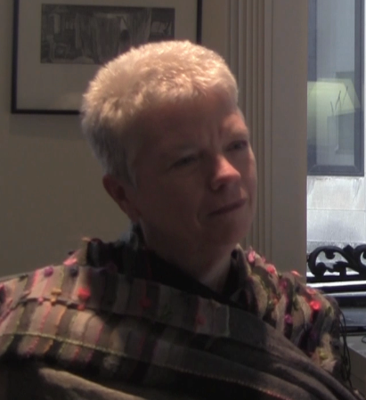
Interview 1
Gail McMillan - Virginia Tech, Director of Digital Library and Archives
Previously an archivist at the Smithsonian Institution
VT ImageBase
EJournal
ETD-db
Notes:
Jacob

Slide 4
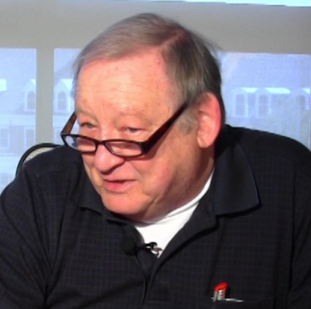
Interview 2
Jim Glanville - retired Virginia Tech chemistry professor
Identifies more as a digital historian than digital humanist
Publishes writings
on the history
and archeology of
Southwest Virginia
Notes:
Jacob

Slide 5
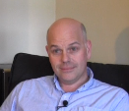
Final Interview:
Scott Pennington - eResearch Projects Coordinator
Worked for MATRIX
Focus is on
maintaining
endangered
archives
Has worked
extensively in
parts of Africa
Notes:
Jacob

Slide 6
Problems and Concerns:
Camera availability
difficult during second half of semester
Lighting kit availability
footage of Gail was dark
Due to time constraints, some that were planned to be interviewed were not
Andrew Stauffer - Director of NINES at UVA
David Radcliffe - Virginia Tech English Professor
Video editing isn't quite done yet
1080p footage requires better computers
Innovation Space
Variety of video formats
due to different cameras
Audio problems with lapel mics
Notes:
Brandon

Slide 7
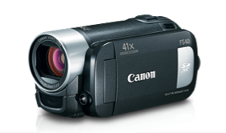

Equipment
Cameras
Variety used
Lighting
Only used once
Audio
Lapel Mics made quality much better
Notes:
Nikhil

Slide 8
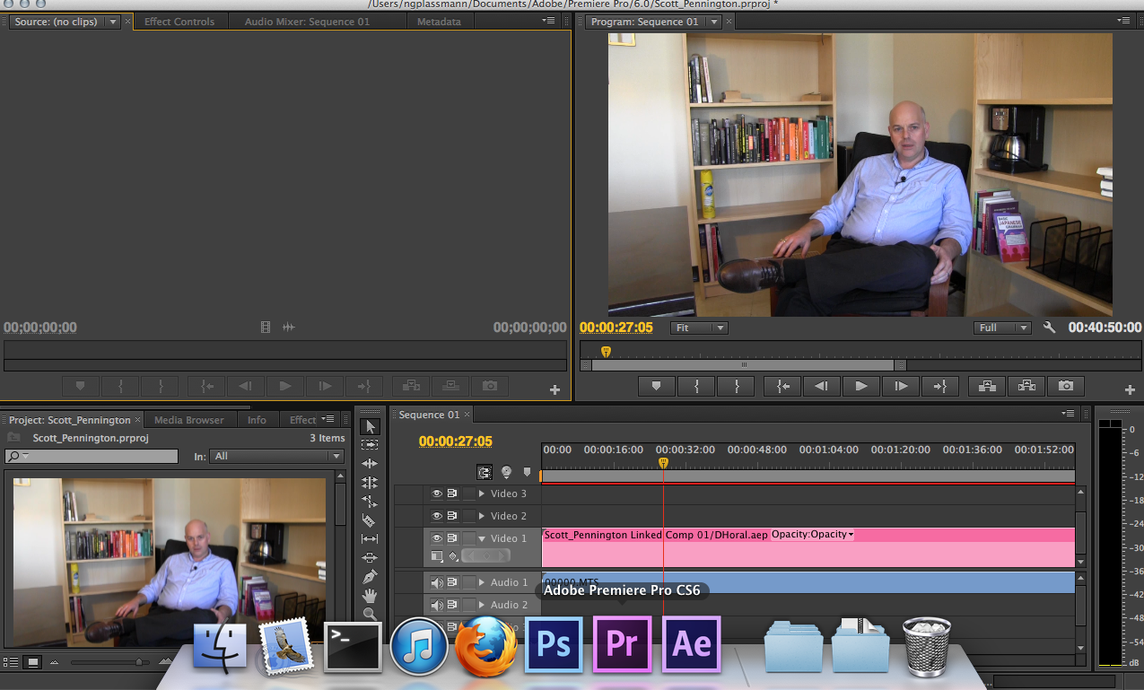
Adobe Premiere
Notes:
Nikhil

Slide 9
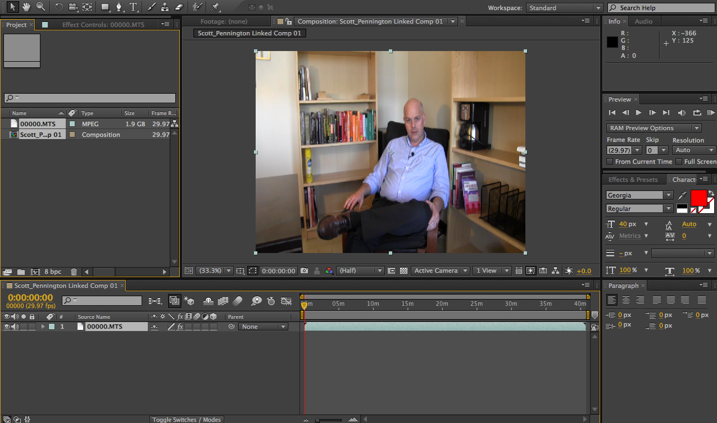
Adobe After Effects
Notes:
Nikhil

Slide 10
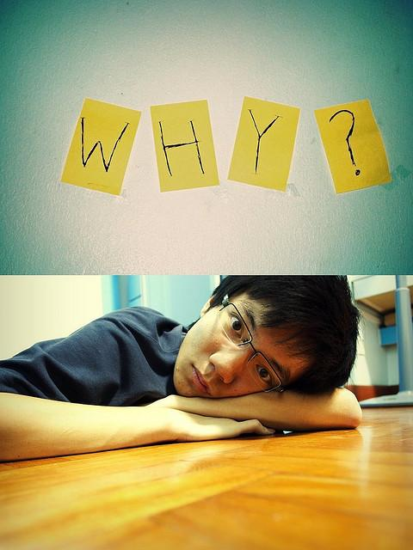
Questions?
Notes:
Anyone who knows the answer

