Slide 1




Wind Turbine Tower Fairing Geometries to Decrease Shadow Effects
NAWEA 2015 Symposium
Virginia Tech in Blacksburg, VA
June 9-11, 2015
Carlos Noyes (Graduate Student)
Jay Fuhrman (Undergrad Student)
Eric Loth (Professor)
Notes:
Tower fairing geometry optimization to decrease shadow effects
Thanks to sponsors NREL and Dominion

Slide 2
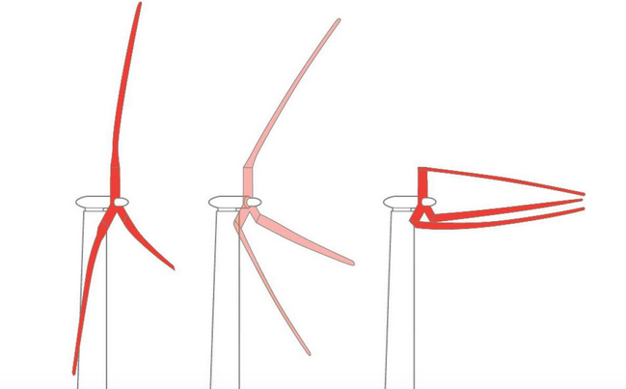
Project Motivation
New designs are more readily considering downwind configurations
Downwind pre-aligned and morphing rotors decreases blade stress, leading to mass savings, and consequently less expensive rotor (Qin, et. al)
However, upstream tower adds an aerodynamic complication. The tower wake can fatigue the blades leading to premature failure
Notes:
Driven by economics to increase rotor size
Blade stresses increase exponentially with rotor diameter
Downwind prealligned decreases stress and you can see our colleague Chris Qin’s presentation on Thursday for more detail on this
However, when you move the rotor downwind of the tower, you’re left with aerodynamic complication of shadow effect

Slide 3
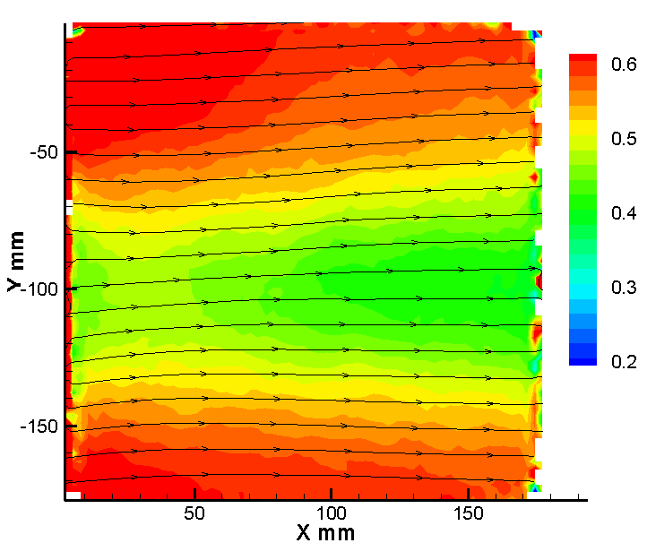
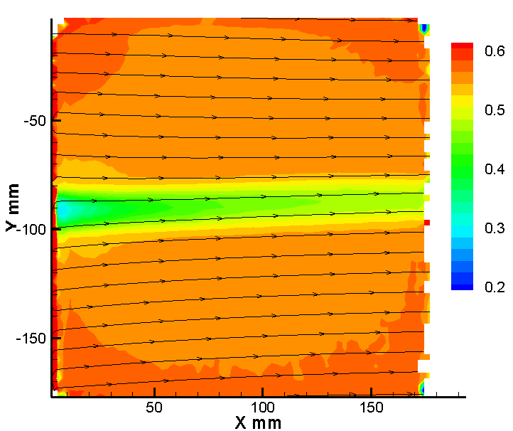
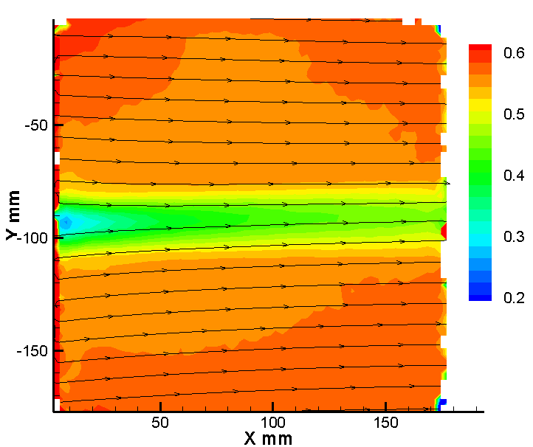
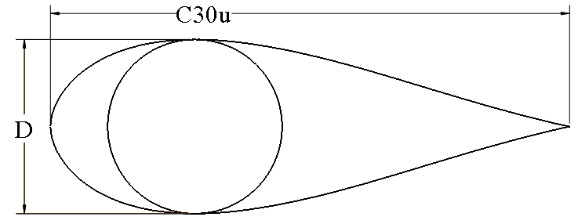
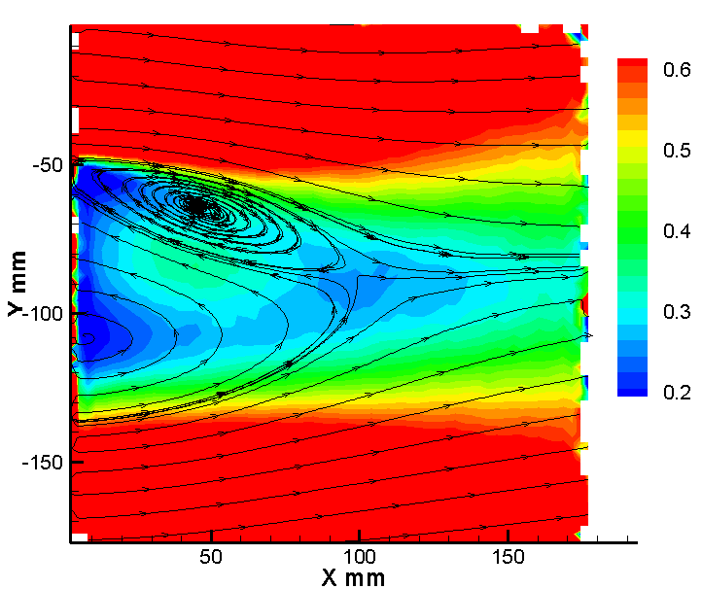
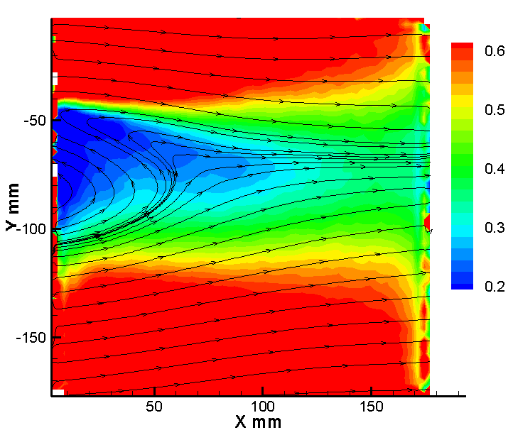
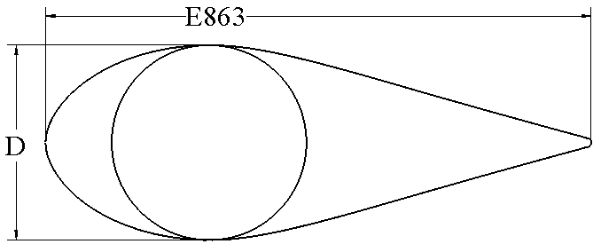
Previous Work
Cylinder
Average Velocity
O’Conner, et. al (2015) investigated thick symmetric airfoils as tower fairings
C30u
E863
θ = 0°
θ = 20°
Wake reduced with flow aligned fairing, θ = 0°
Wake from fairing at θ = 20° worse than unfaired
Notes:
A c30u thick symmetric airfoil been designed by O’connor & loth at UVA with help from Michael selig
We’ve also done testing on the eppler e863 airfoil
Both were very successful when the fairing is alligned with the flow or a fairing yaw of 0 degrees
However at higher fairing yaw wake intensity quickly approaches and sometimes surpasses that of the unfaired case
To illustrate this point, the top plot shows the average velocity deficit of a cylindrical tower while the images below it show average velocity defecits for the faired cases at yaws of 0 and 20 degrees and you can see that at 20 degrees, both the faired cases perform worse than the cylinder

Slide 4
Research Goals
Design modified E863 tower fairing
Test fairings
Analyze effectiveness

Slide 5
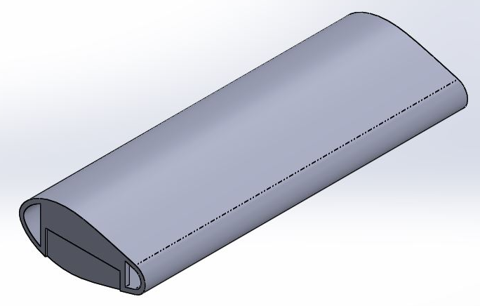
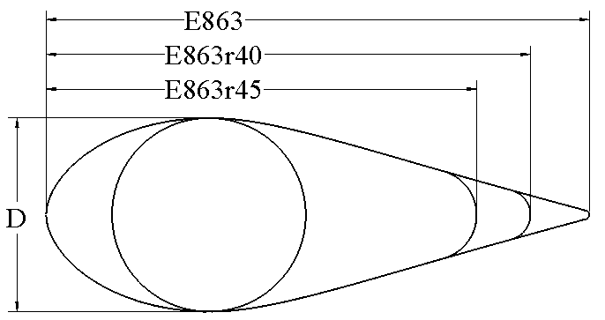
Fairing Models
E863r series designed by forcing a thickness ratio of 0.40 and 0.45 by rounding trailing edge
Manufactured using Fortus 3D printer by Stratasys
Tower Diameter: D=67mm
Fairing Span: S=381mm
Fairing Chord: C=149,167,188mm
Notes:
Modified original e863 profile
Forced thickness ratio of 0.4 and 0.45 by circularly rounding trailing edge
Manufactured models using ABS plastic 3d printer provided at UVA

Slide 6
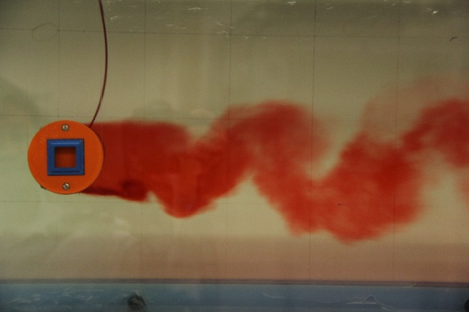
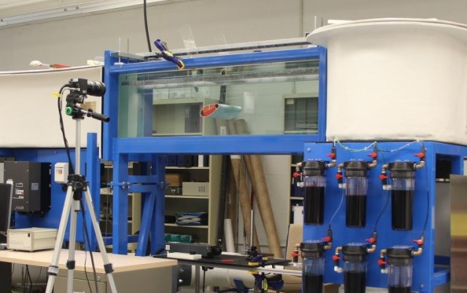
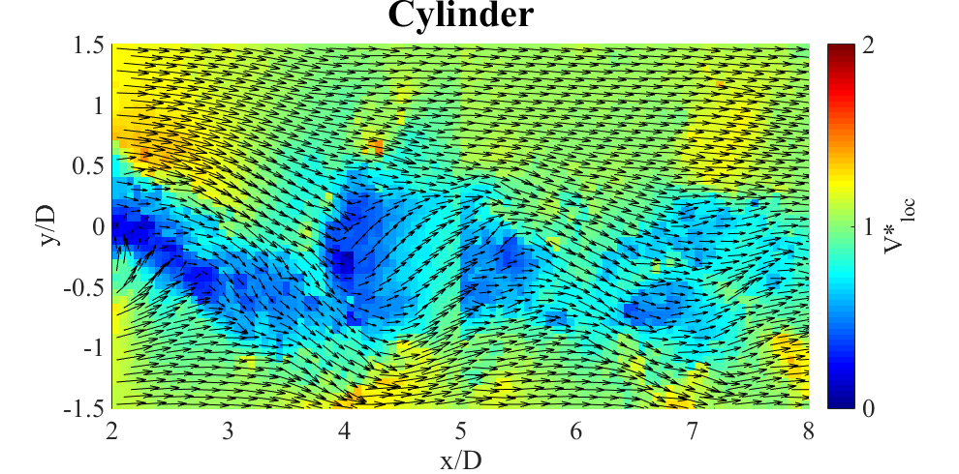
Experimental Description
Dye Visualization
Particle Image Velocimetry (PIV)
Fairing Yaw: θ = 0, 10, 20°
Flow speed: V_{inlet} = 1 m/s
Reynolds Number: Re_{D} = 6.82e4
Test Section: 0.38m x 0.38m
Notes:
We tested all of these models in a water tunnel which is capable of flow speed of up to 1 m/s at fairing yaw of 0 10 and 20 deg
Report Re of 6.82e4 using the tower diameter as the characteristic length because the chord lengths vary
If you used chord length, Re would be 2-3 x larger
Because we are at lower Re than we would see in a full scale system we tried to represent more realistic flow field by using trip tape to prematurely trip the boundary layer into turbulence
Tested all of our models using dye vis and PIV

Slide 7
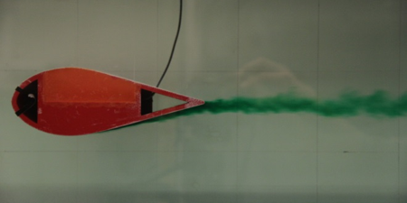
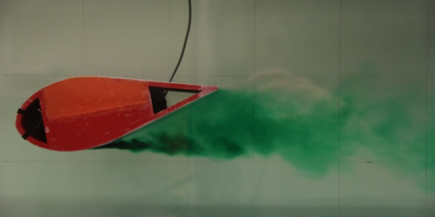
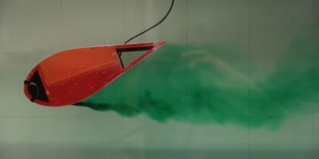
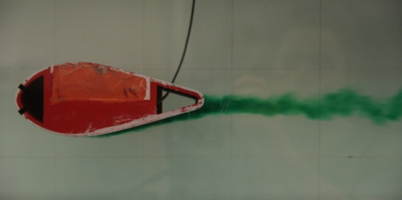
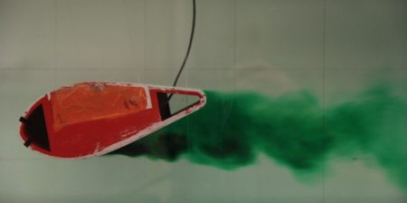
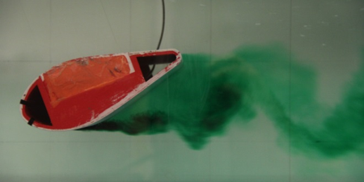
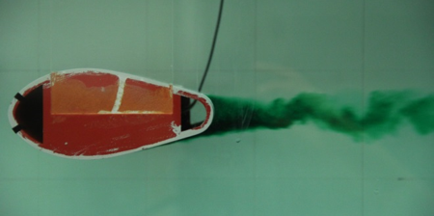
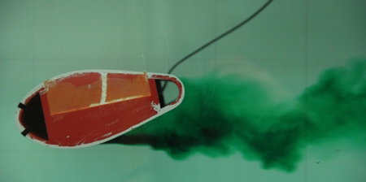
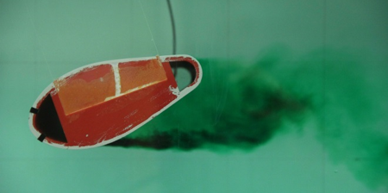
Dye Visualization
Cylinder
E863
E863r40
E863r45
θ=0°
θ=10°
θ=20°
Notes:
Here are the 10 cases we tested shown with dye visualization
I don’t want to go into too much detail
Similarly to Oconnor’s findings, the fairings at 0 deg yaw all significantly outperform the unfaired case, but when the yaw is increases, the performance of all the fairings decreases substantially
PIV gives much more quantitative results

Slide 8
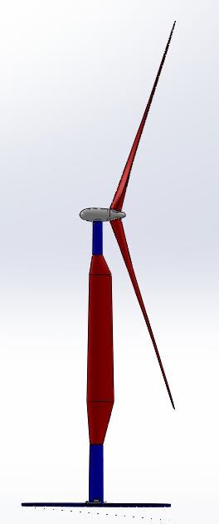
PIV Window Location?
Q: Where would blade pass through field?
A: Depends on turbine geometry
A: Depends on spanwise location on blade
D2, and D2PA geometries from Qin, et. al
2 bladed, downwind, modifications of NREL 13.2 MW turbine
Coning angle of 2.5°and 17.5°
Upward shaft tilt of 5°
Notes:
With PIV must be more intentional with where we take our data
Want to center image where blade could pass through flowfield
This depends heavily on turbine geometry as well as spanwise locatioon of blade
Decided to base analysis on geometries taken from work done by Chris Qin,
two turbine geometries are 2 bladed downwind modifications to NRELs 13.2 MW, 3 bladed upwind turbine
Downwind 2 bladed (D2) has 2.5 deg and D2PA (downwind prealligned) has coning angles of 17.5
Have 3d printed model of D2PA to demonstrate

Slide 9
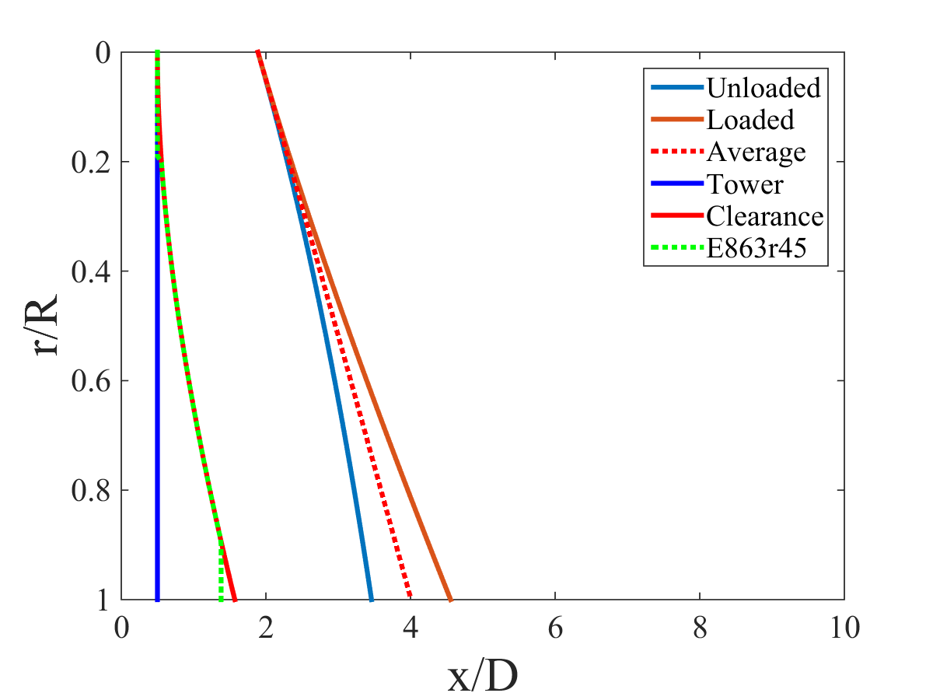
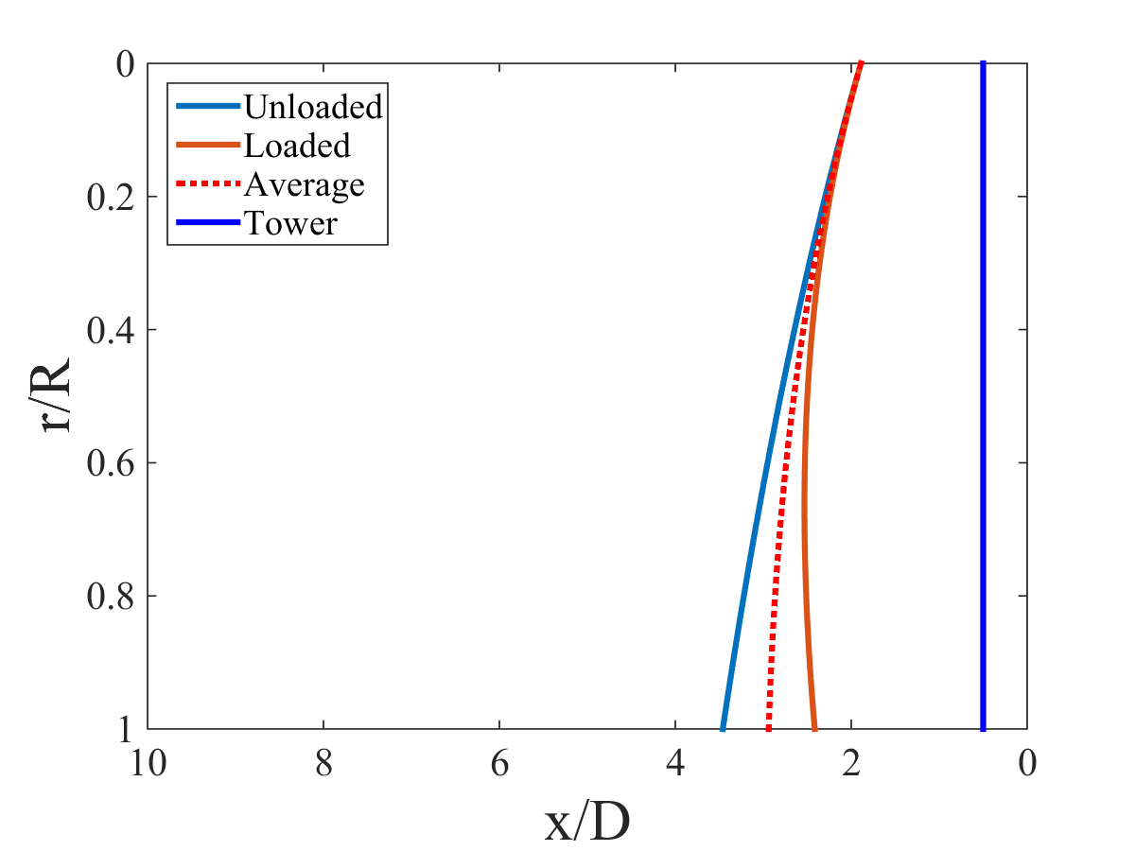
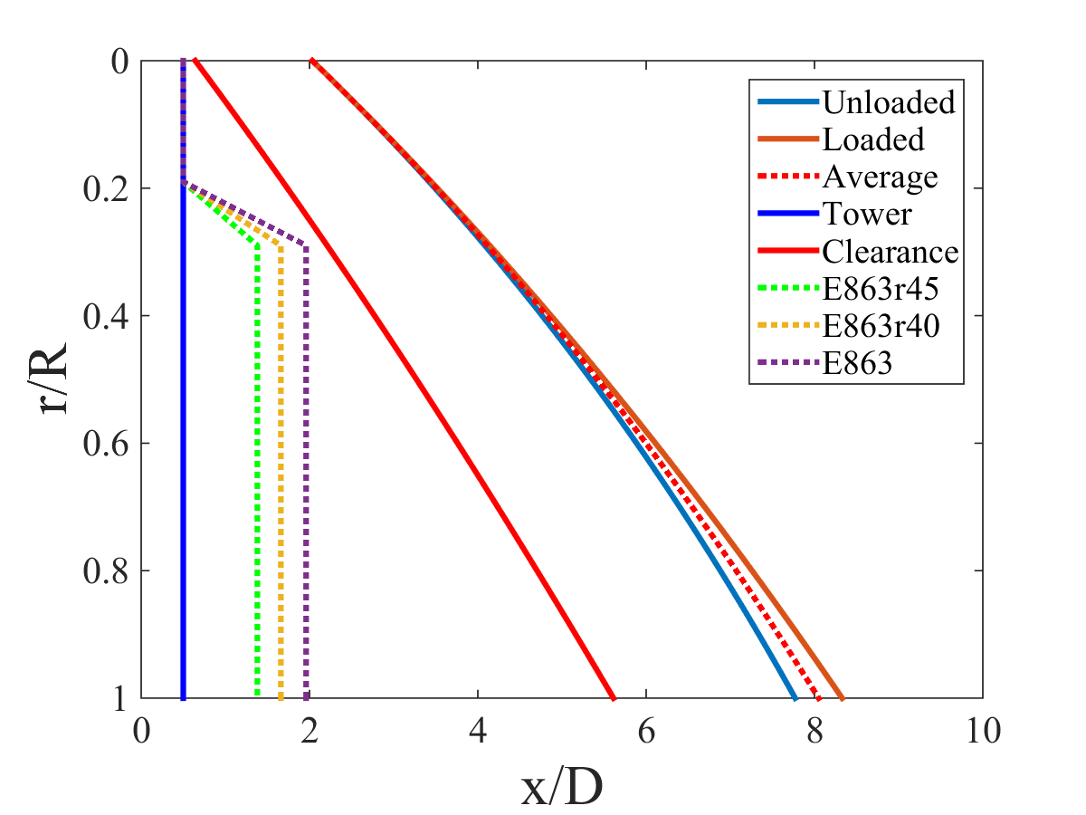
Clearance Plots
D2
U2
V∞
R
R
r
V∞
x
r
D
x
D
D2PA
Average downwind fairing clearance is forced to be at least as great as average upwind tower clearance
Notes:
Before we go further into PIV window, I want to take moment to talk about blade clearance issues just to make sure that the fairings don’t add additional clearance complications to the downwind cases
We had 3 plots: upwind 2 bladed, downwind 2 bladed and downwind 2 bladed prealligned
Blue is blade position in unloaded case (i.e., no wind, no spinning)
Orange line is maximum blade deflection for steady wind speed at rated conditions
In fairness blades will not spend their time at either of these two lines, but centered about the average positionrepresented by the dotted red line We use this average blade position to define the clearance region between the blade and the tower
Wanted to make sure that we kept as least as much clearance between the blade and the trailing edge of the fairing as we have for the standard upwind case.
In the D2 case, we have to reduce the chord length for almost for the entire span of the blade (about 90 percent of the blade length)
However with the prealligned case we reach the full length fairings at less than 30 percent the blade length
If asked:
Took tip deflection and parabolically fit a curve based on the flexure formula, a good first order approximation

Slide 10
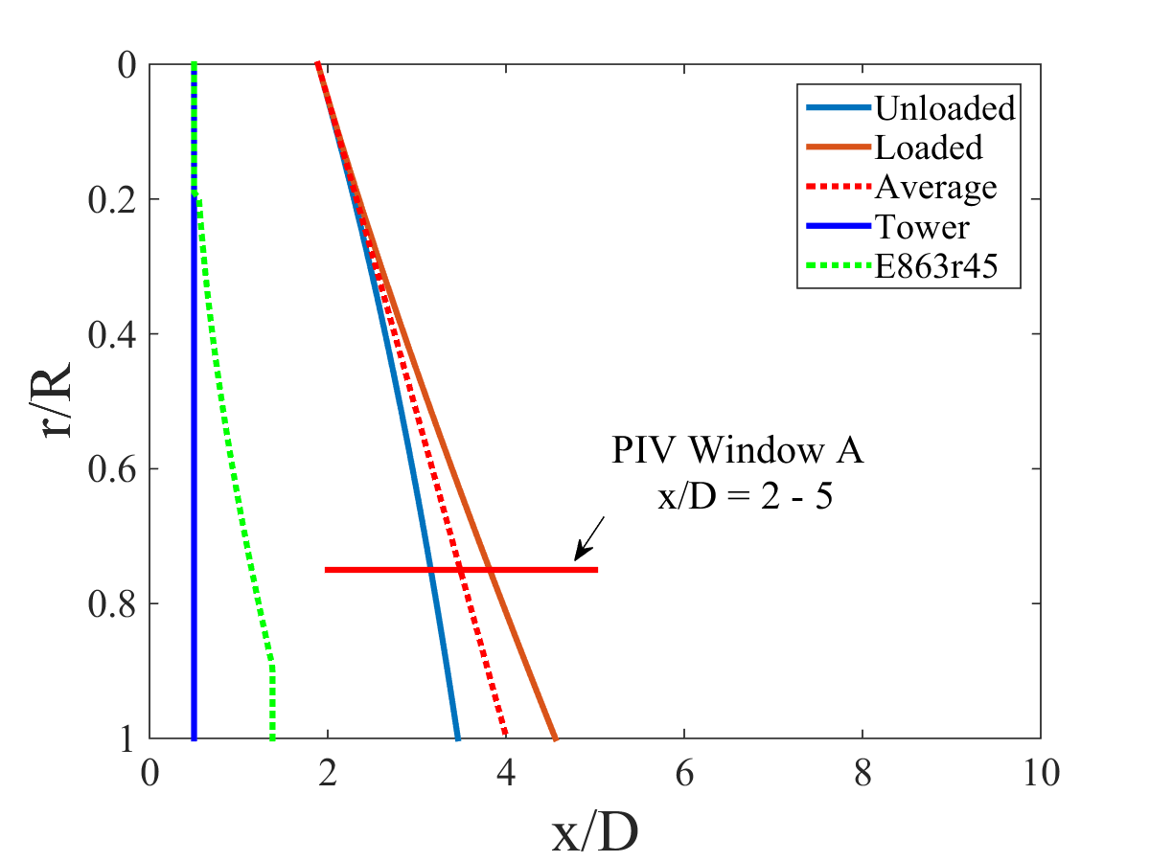
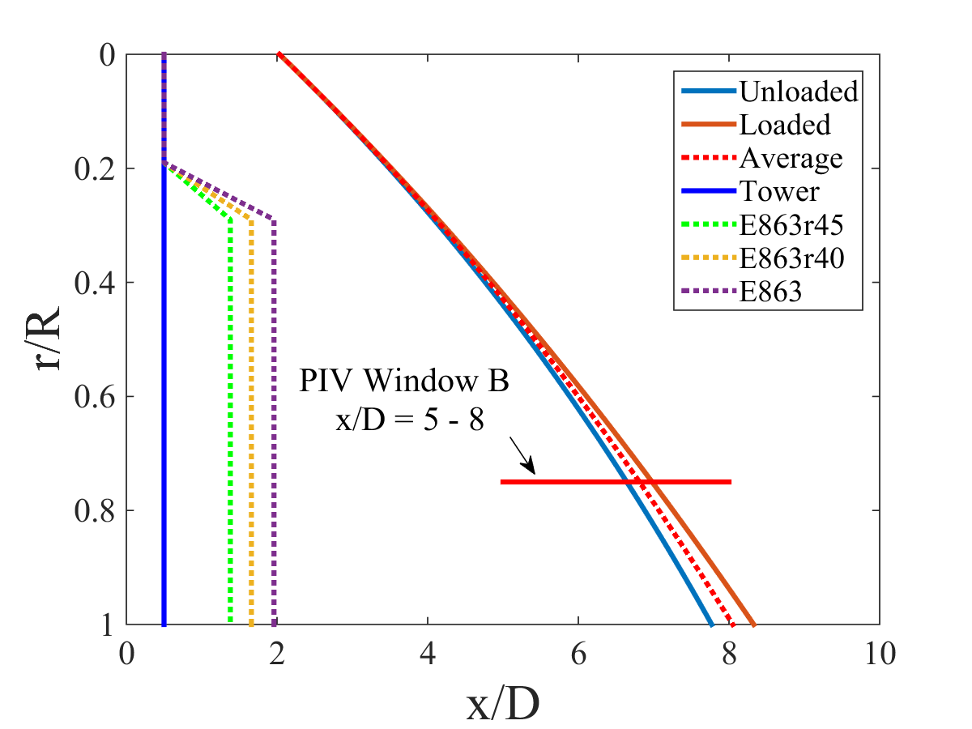
PIV Windows
D2
D2PA
Notes:
Now we have enough information to determine our PIV windows
We chose our first window to be between 2 and 5 tower diameters downstream of the tower center
This captures the aerodynamics of the blade fo rthe downwind 2 bladed case
Our second window was chosen between 5 and 8 tower diameters downstream of the tower center, As an added bonus, these two windows are continuous allowing us to get large flow field plots

Slide 11


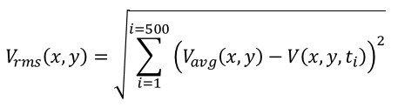

PIV Nomenclature
Window A Window B
y
x
V_{inlet}
D
V
α
V_{inlet}
Notes:
We have uniform velocity inflow
example of an instantaneous flow field: note that the two windows are taken at different times
We take 2 parameters, the instantaneous flow velocity magnitude, and the instantaneous flow angle
Will use v_star to represent the instantaneous flow velocity normalized by the input velocity
We also took the ensemble average of all 500 of the flow fields, additionally, we report the RMS values, which is the RMS of the error between the average and the instantaneous values

Slide 12
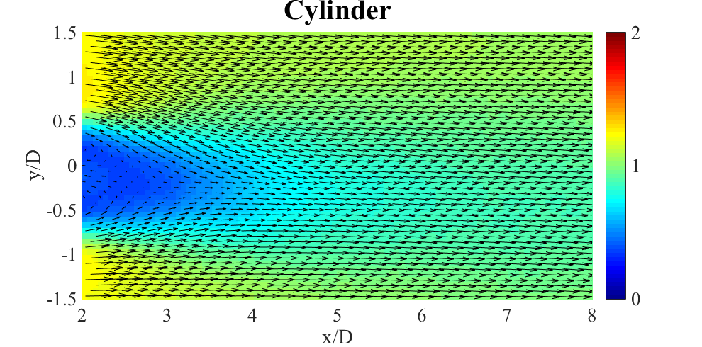
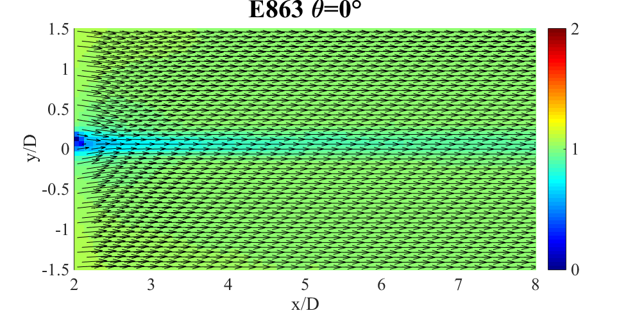
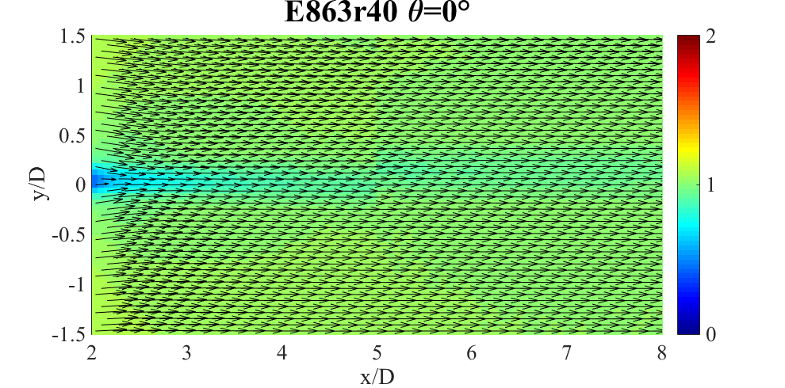
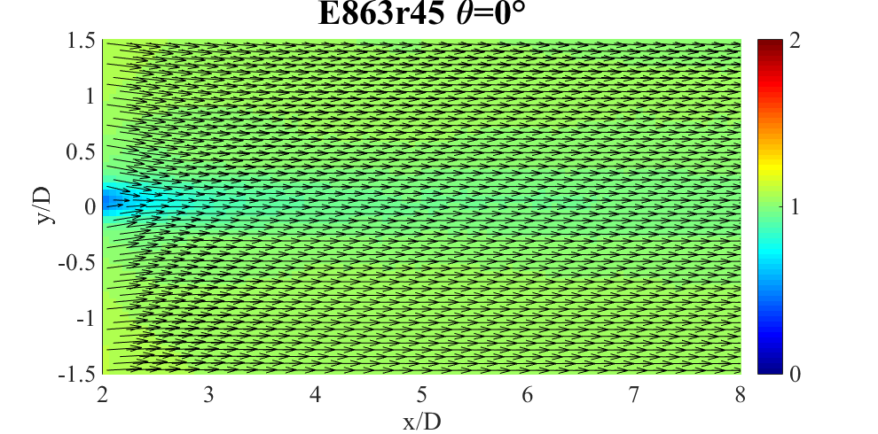
V*_{avg} θ = 0°
Notes:
To be concise I’m only going to show the plots for fairing yaw of 0 and 20 degrees, but we also have data for the 10 degree case which fell somewhere in between
First we’ll look at average velocity field
You can get a basic idea of what’s going on: the top left is the unfaired case
Top right is unmodified e863
Bottom cases are rounded trailing edge
Right one more aggressive thickness ratio of 0.45
As you can see, the faired cases all signfcantly outperform the unfaired case at this 0 deg yaw angle

Slide 13
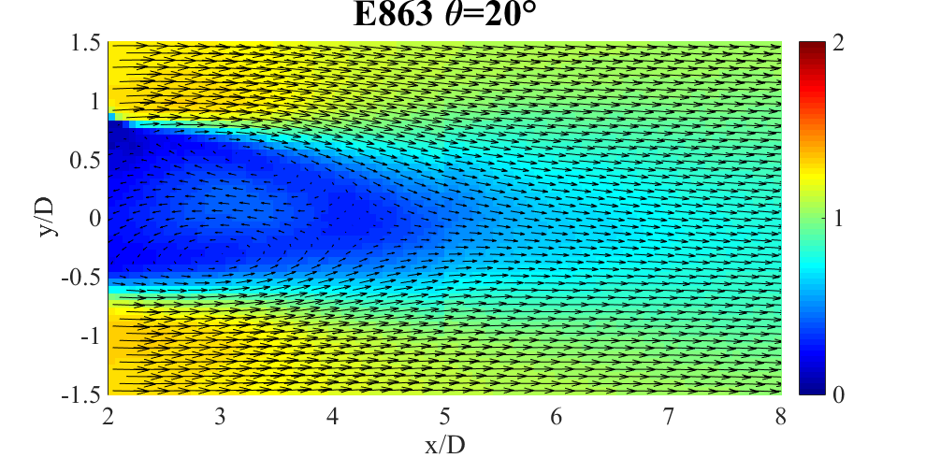
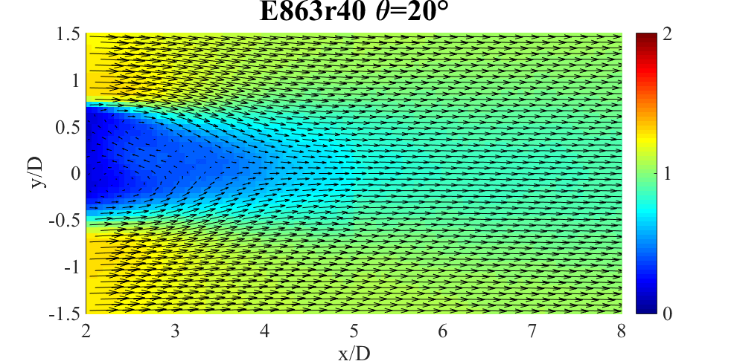
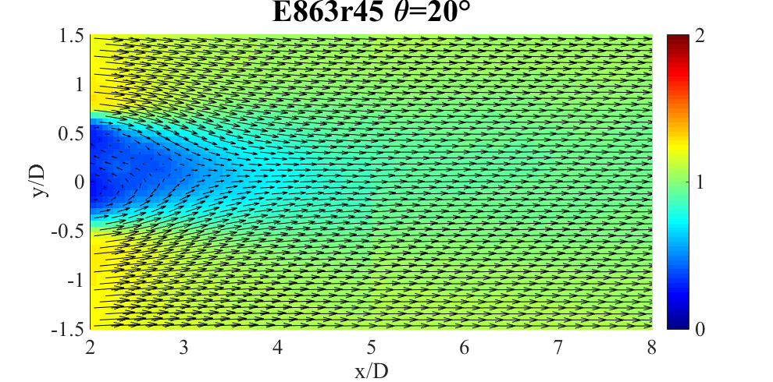
V*_{avg} θ = 20°
Notes:
Now let’s look at fairing yaw of 20 degrees: it’s clear that they perform muc worse than they do at 0 degrees: visually the unmodified faired case appears to be performing worse than the unfaired case, and the r45 appears to perform similarly to the cylinder
In fairness, the average velocity only tells part of the story: we can get a better idea of the chaotic nature of the flow field, by looking at the RMS values

Slide 14
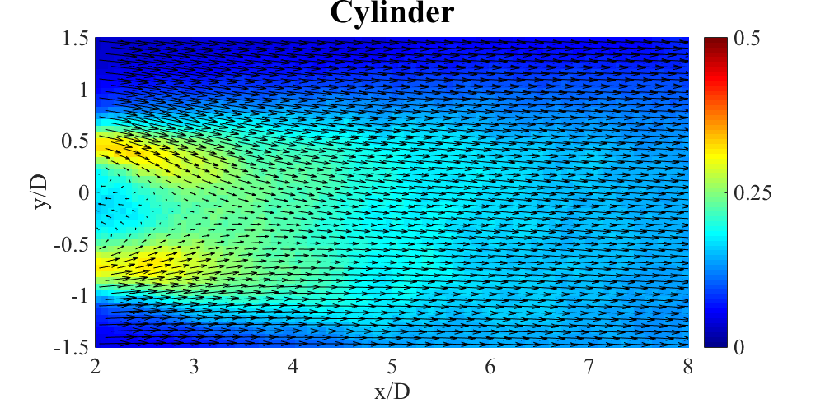
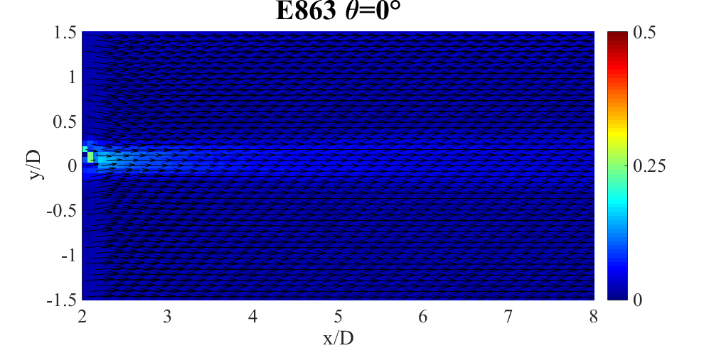
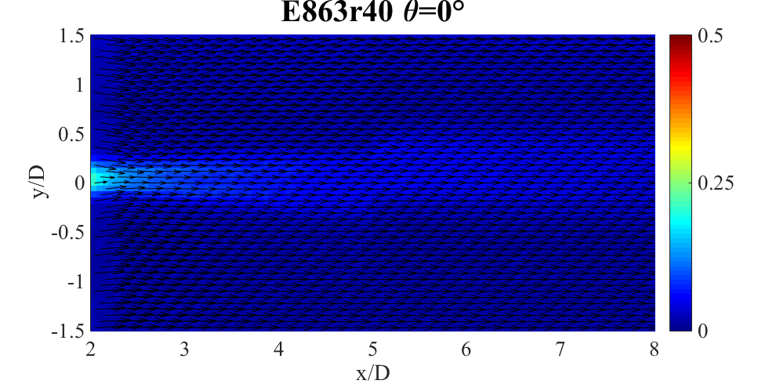
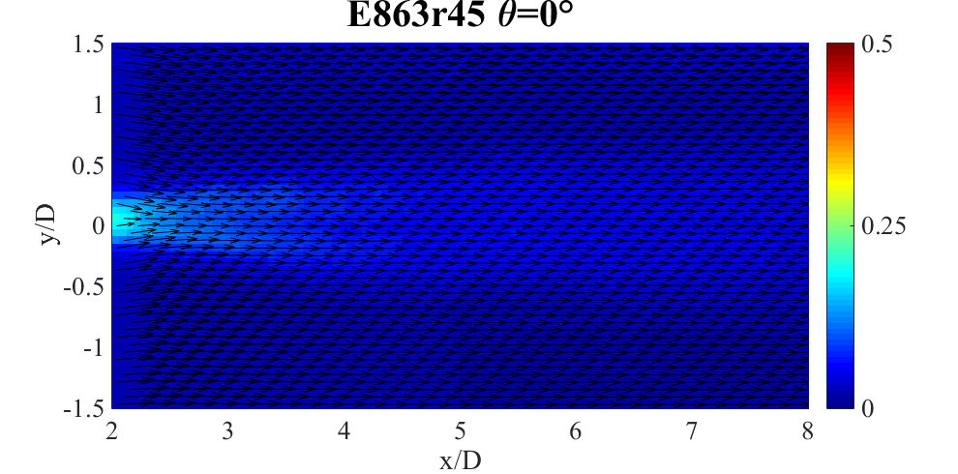
V*_{rms} θ = 0°
Notes:
Very similar story: all fairings outperform cylinder

Slide 15
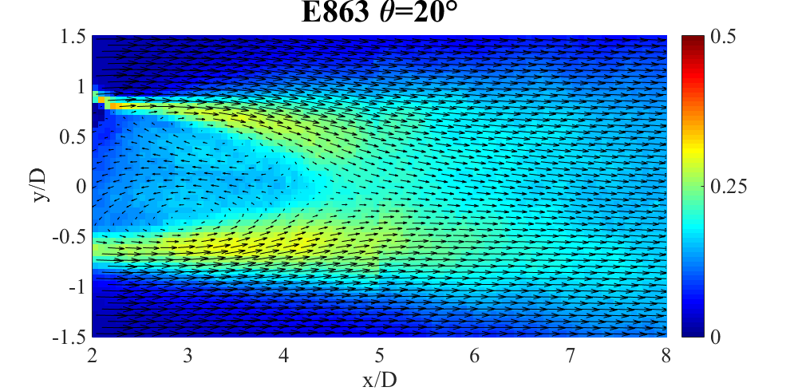
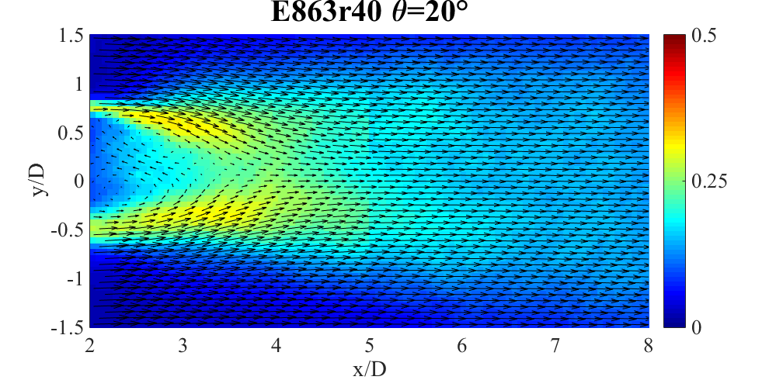
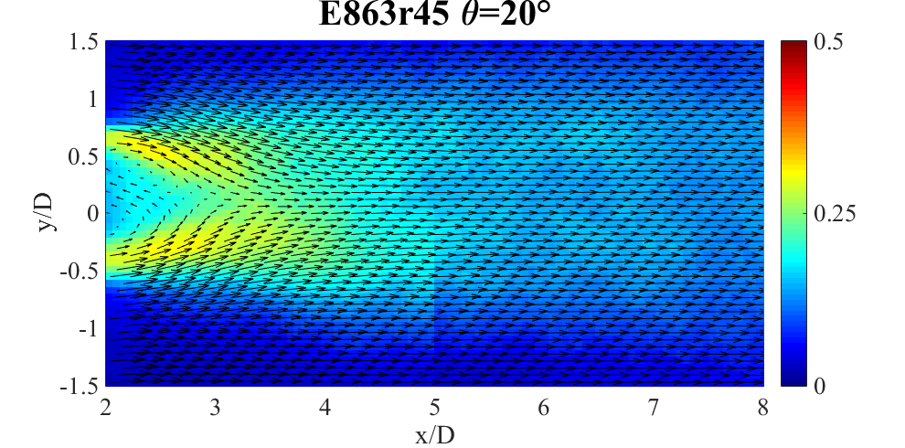
V*_{rms} θ = 20°
Notes:
Moving to fairing yaw of 20 degrees, performance drops off, and I think it’s fair to draw the conclusion that unmodified fairing case performs the worst

Slide 16
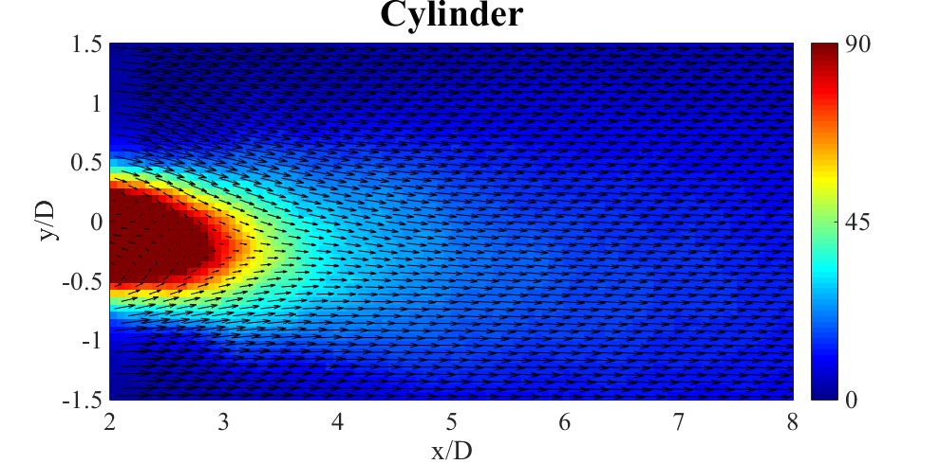
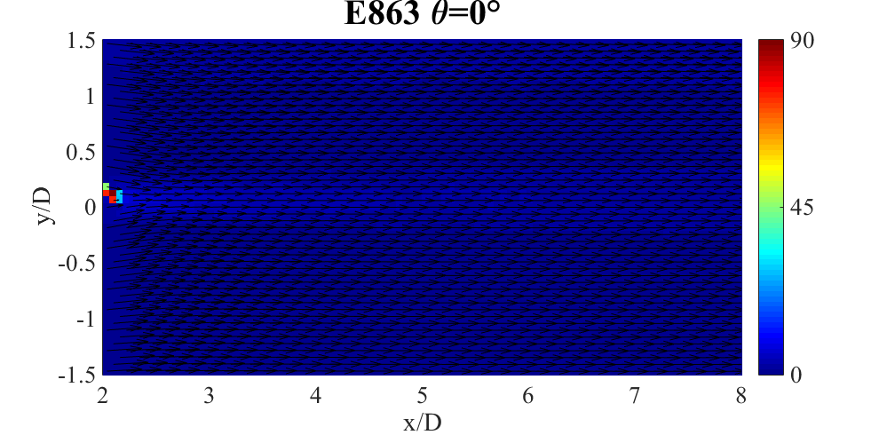
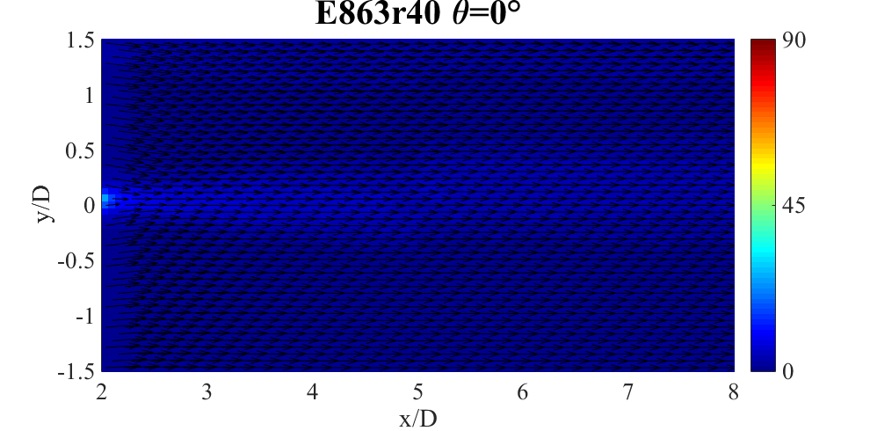
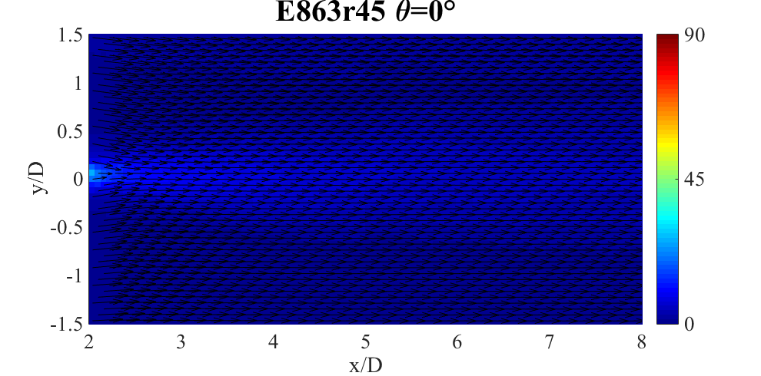
α_{rms} θ = 0°
Notes:
The changes in flow angle also affect the aerodynamics of the blade
You can see here again that all faired cases outperform the cylinder

Slide 17
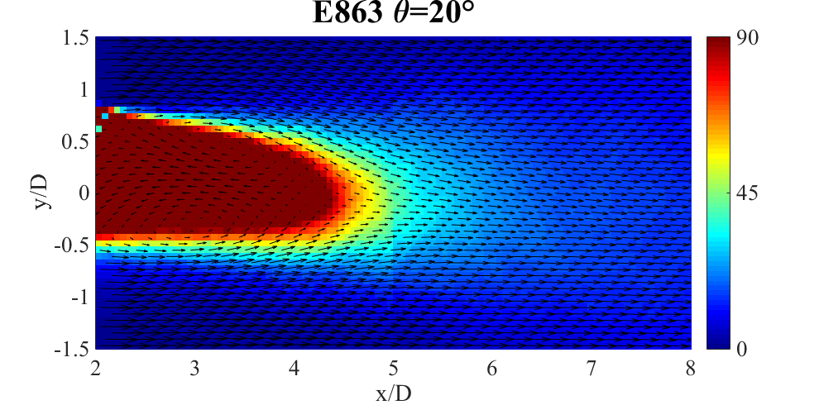
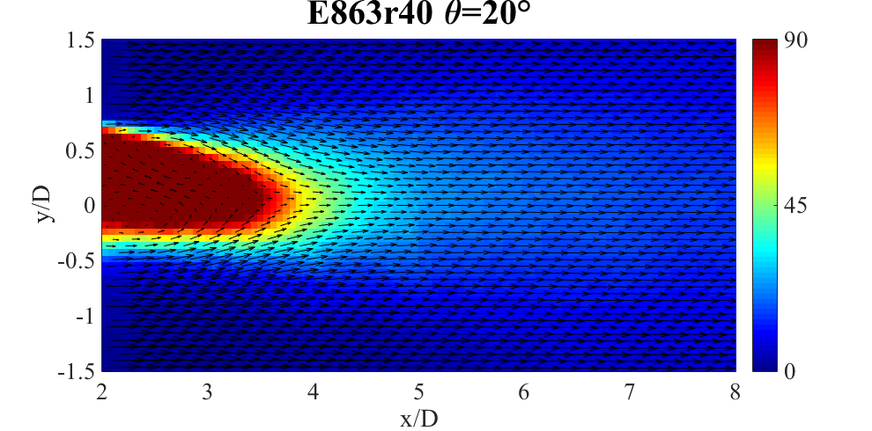
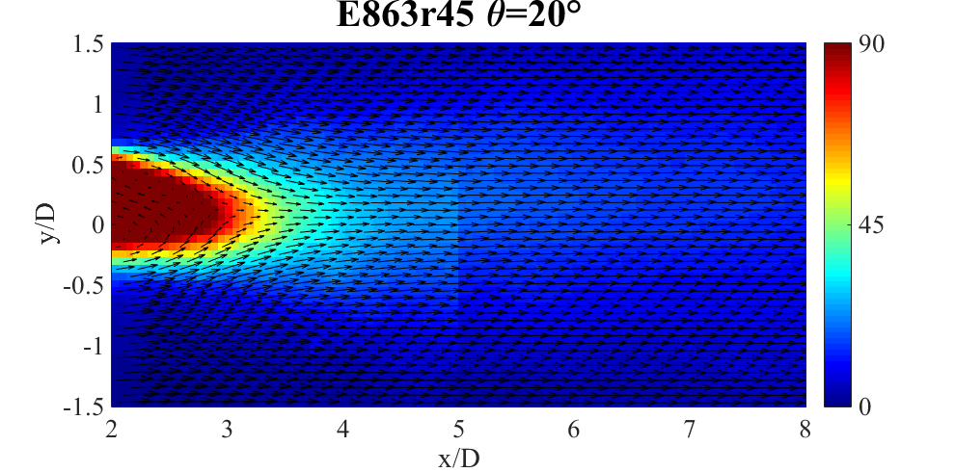
α_{rms} θ = 20°
Notes:
But at 20 degrees, the fairings perform worse again with the unmodified case clearly performing the worst, with the r45 performing as well or better than the cylinder

Slide 18



Relative Flow Analysis
Tower Diameter: ≈5.7m
Wind Speed: 11.3m/s
V_{ind} = V∞x2/3: 7.53m/s
Re_{D} (Full Scale): 2.85e6
Re_{D} (Model): 6.82e4
Turbine Specifications:
Height: 142.4m
Blade Length: 100m
Shaft Tilt: 5°
RPM: 8.93
Span: 75%
Pitch + Twist (β): 0.6°
Notes:
Here we’ve listed all the specifications necessary to make the following calculations
What’s important to know that we were able to use the instantaneous flow velocity and instantaneous flow angle ad combined with the rotational flow velocity to calculate the relative flow field seen by the blade

Slide 19




Relative Flow
Local Flow
Notes:
Left column reports the local flow velocity and flow angle that the blade would experience as it passes through the frozen flow field measured from PIV
The right column takes instantaneous values and performs the trigonemtric equations shown on the previous slide to calculate the relative flow velocity and angle experienced by the blade

Slide 20




Shadow Load
Shadow Load, S*, is the fractional lift lost due to shadow effect
L∞
ΔL
Notes:
Using the relative flow velocity and relativ flow angle, we can almost calculate the lift that the blade experiences. Unfortunately, there’s one parameter (k) that we don’t know. But we can avoid having to use it by reporting the non-dimensionalized lift by the free stream lift, which is the average of the leftmost and rightmost values measured.
Then we can use this to define a new parameter that we call shadow load or s_star, which is the fractional lift loss due to the shadow effect. What that means is that an s_star of 0 would be a perfect fairing, and an Sstar of 1 would mean that the blade has lost 100% of its lift due to the wake.
Due to the unsteadines, you can even have instantaneous negative Sstars, meaning the fainring can sometimes momentarily increase lift
So looking at the figure on the right The blue line indicates the location where the maximum mean shadow load was experienced

Slide 21


Maximum Shadow Load
The E863r45 has the smallest S* without exception
Notes:
Here we report the maximum shadow load for all cases. The left plot shows the conventinal downwind case while the right plot reports the downwind prealligned case
For 0 degree case, all fairings outperform the cylinder by this parameter. Only the e863r45 fairing improved upon the cylinder at the higher fairing yaw. IN fact, the r45 outperformed the cylinder and the other fairings in every case, which is a highly encouraging positive result.

Slide 22
Conclusions
Shadow load, S*, is related to max change in lift caused by wake
All fairings had a lower S* compared to the circular tower at θ=0°
E863r45 fairing had the lowest S* of all geometries
E863r45 allows largest blade clearance of models tested
Notes:
Summarize

Slide 23

Questions and Comments

