Slide 1
ICAT Day
360-Degree Video
of North Cross Camp
Virginia Tech CS4624: Multimedia, Hypertext,
and Information Access
3 May 2016
Blacksburg, VA 24061
By Benjamin Kodres-O’Brien, Sean Goodrich, Zack Stefan
Client: Liesl Baum

Slide 2
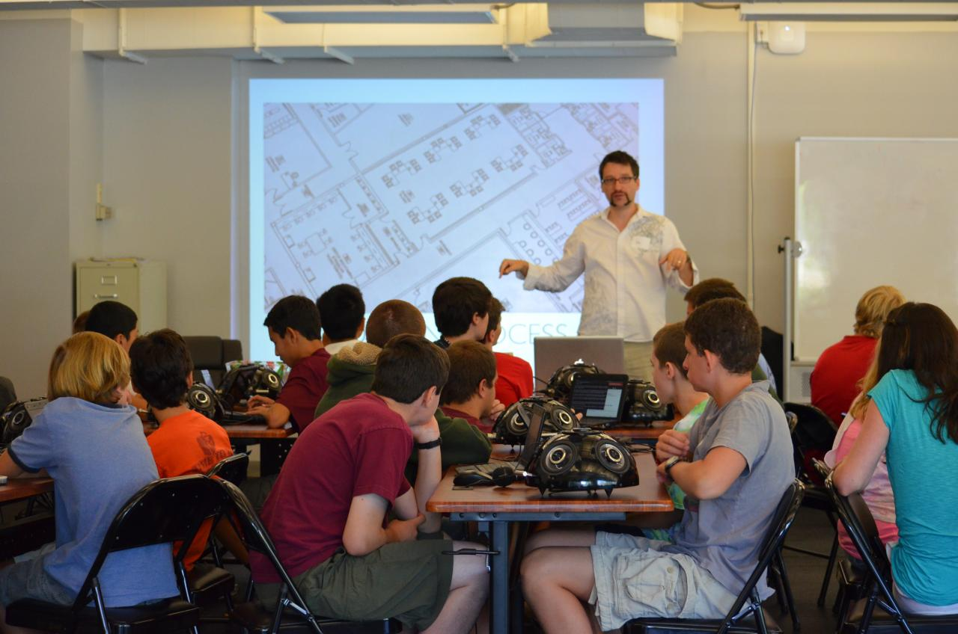
ICAT’s History
Transdisciplinary Education
Summer Maker Camps (2012-2016)
ICAT Day (2012-2016)
Ivica Ico Bukvic speaking about sound technology in 2013
https://www.icat.vt.edu/sites/default/files/u46/Maker_5.jpg
Notes:
Add caption to say what the photo is
Dates if possible

Slide 3
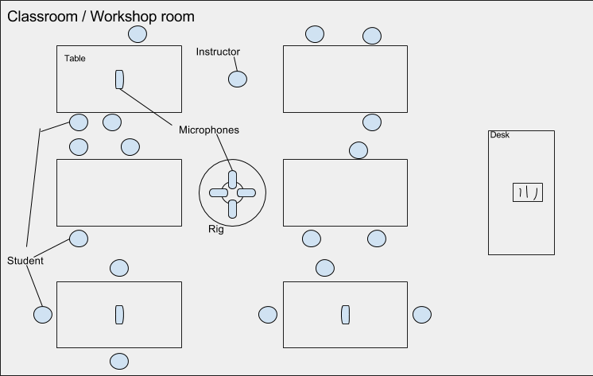
Document the North Cross School Camp
Film 360 degree video of the camp
  Record and integrate spatial audio
Present students’ perspective

Slide 4
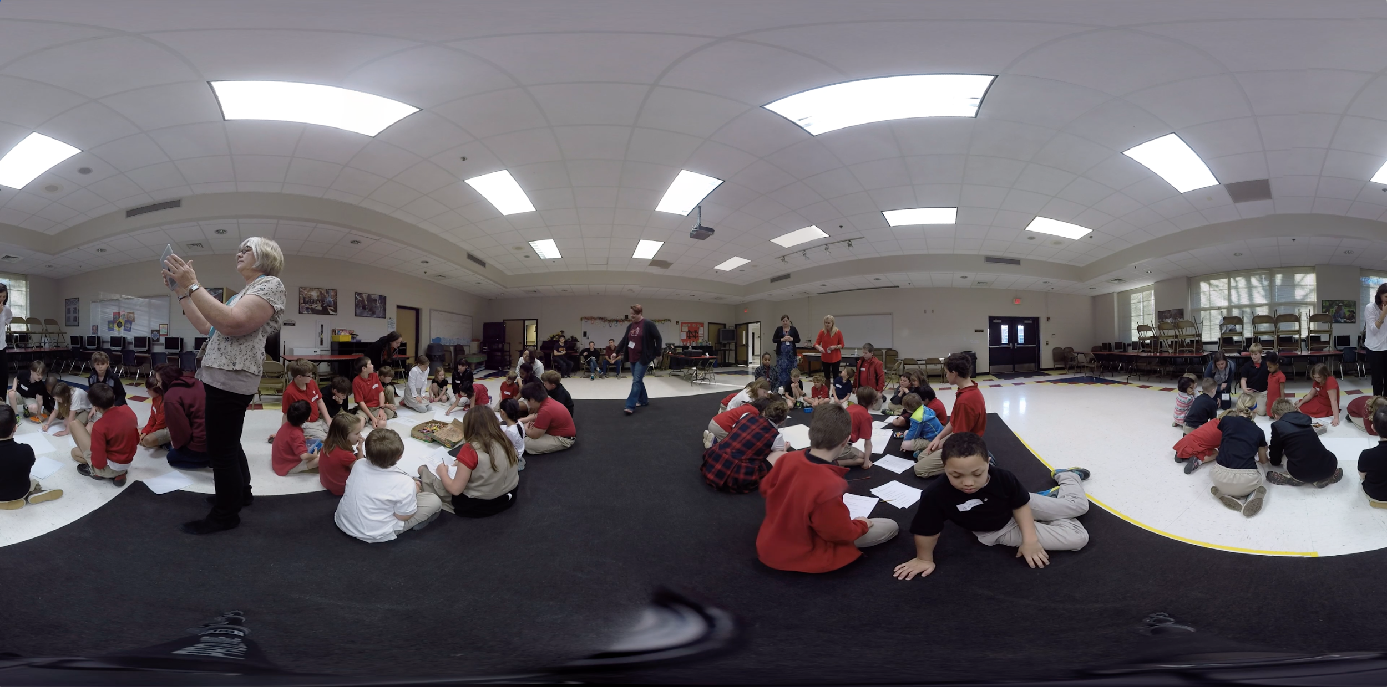
During the North Cross School Camp
Indoors in the multipurpose room
Syncing video and audio
Outdoors in the courtyard
  Children and chaos

Slide 5

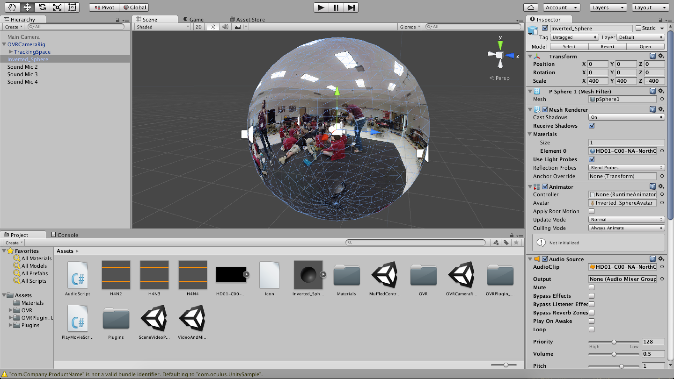
After the North Cross School Camp
Selected and stitched footage
Merged spatial audio with 360-degree video
Selected student materials and developed accompanying website to display them

Slide 6
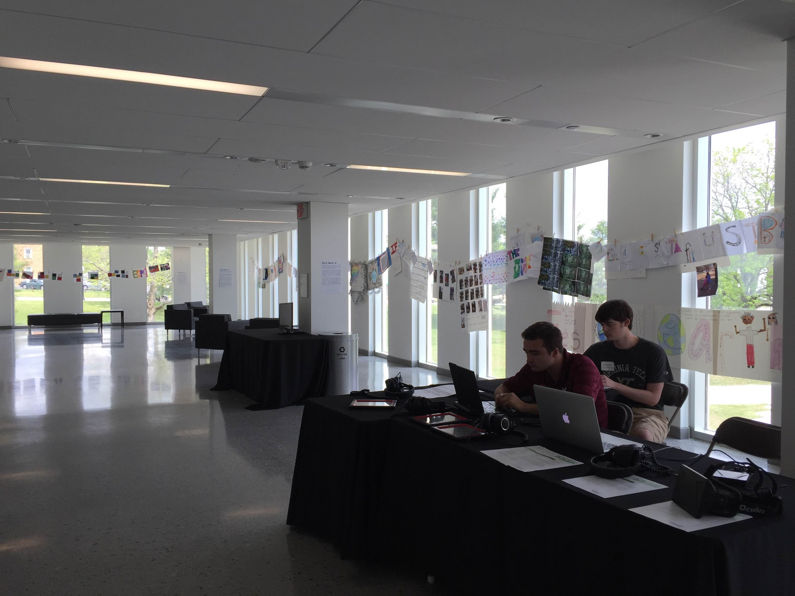
Project by the Numbers
3 early alarm clocks
3 major software applications
3 dimensional Unity sphere
104 GB of GoPro footage
1.37 GB of audio
Final Exhibit
  324 MB of video, 34 MB of audio, 3 iPads, 1 Oculus Rift

Slide 7








Notes:
Gather some links for these and put in acknowledgements

Slide 8
Lessons Learned
Open-endedness as a strength and a weakness
  “Keep an open mind, but not so open that your brain falls out.” - Claudio D’Amato, VT ASPECT Program
Challenges with 360-degree video
  Spatial audio
  Stitching/software
  The future of VR
Future Virginia Tech 360 video efforts
  TLOS (Technology-enhanced Learning and Online Services)

Slide 9
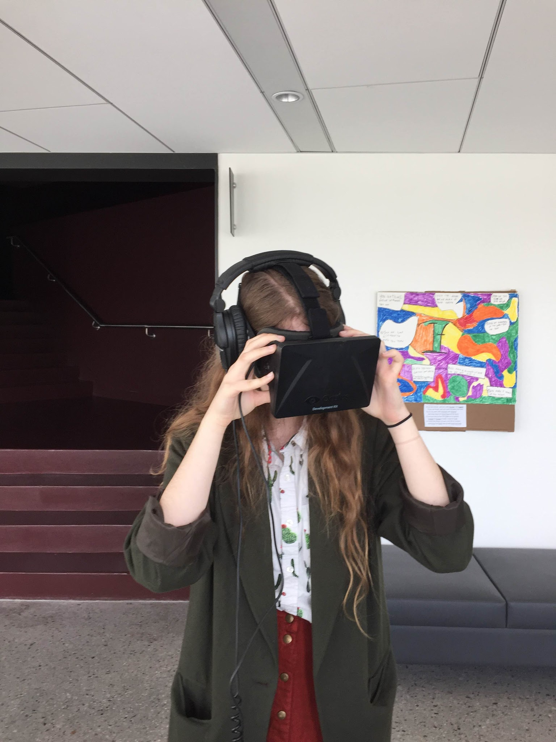
Demos
https://www.youtube.com/watch?v=ICNTcIoVztg
Molly Graham watches the 360 video on ICAT Day

Slide 10
Acknowledgements
Liesl Baum - Senior Fellow and Assistant Professor at the Institute for Creativity, Arts and Technology
Zach Duer - Immersive Technology Specialist, Institute for Creativity, Arts and Technology
Todd Ogle - Senior Director, Networked Knowledge Environments at TLOS
Jackie Meese - Assistant Director, Computer Systems Administration
Tanner Upthegrove - Media Engineer, Institute for Creativity, Arts and Technology
Phyllis Newbill - Associate for Outreach and Engagement at the Institute for Creativity, Arts, and Technology.
Meggin Hicklin -Exhibitions Program Manager, Center for the Arts at VT
North Cross School
Kolor, Amazon, Bootstrap, Adobe, Oculus, Unity, Soundcloud, Flask - usage of their logo
Notes:
Contextualize their departments

