Slide 1

Sacrifice Areas in your Pasture
Charlotte Maxwell, Associate Agriculture and Natural Resources Extension Agent (Animal Science) for Goochland and Chesterfield

Slide 2

Objectives
What are sacrifice areas?
Why are sacrifice areas important?
How do I create and maintain one?
What are some of the pros and cons?

Slide 3
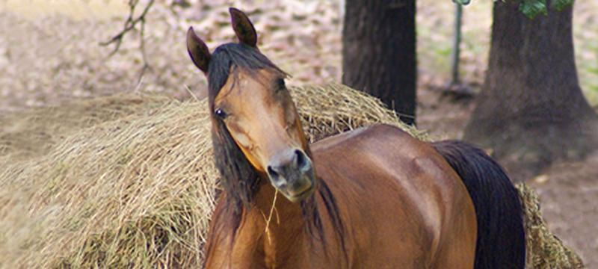
What is a sacrifice area?
In the simplest terms, a sacrifice area is a section of your land that is separate from your grazing pastures, where you do not intentionally keep grass growing.

Slide 4
Some other names for a sacrifice pasture area are...
Run
Paddock
Winter Paddock
Turnout Paddock

Slide 5
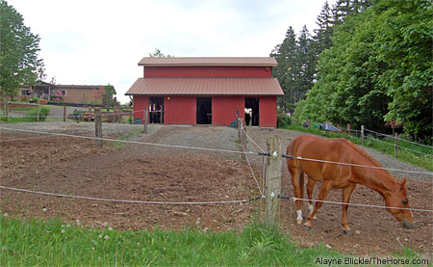
What does a sacrifice area look like?
This is one version of a sacrifice area.
Each stall has it’s own sacrifice area.
What are some things you notice about this set- up?

Slide 6
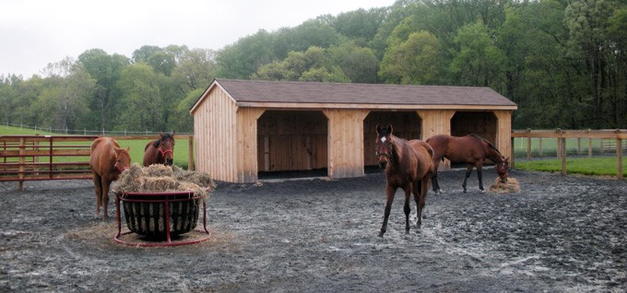
What does a sacrifice area look like?

Slide 7
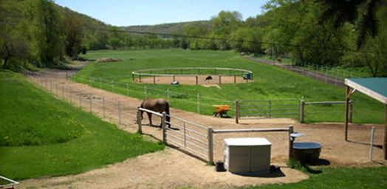
What does a sacrifice area look like?

Slide 8
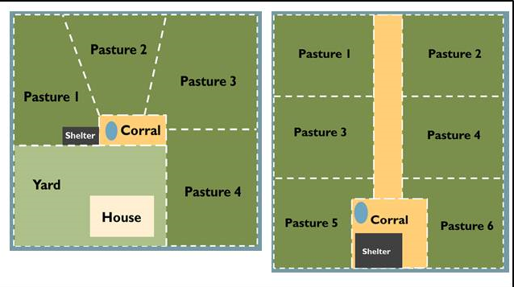
What Does a Sacrifice Area Look Like?

Slide 9
Why are Sacrifice Areas Important?
Pasture Health
Horse Health

Slide 10
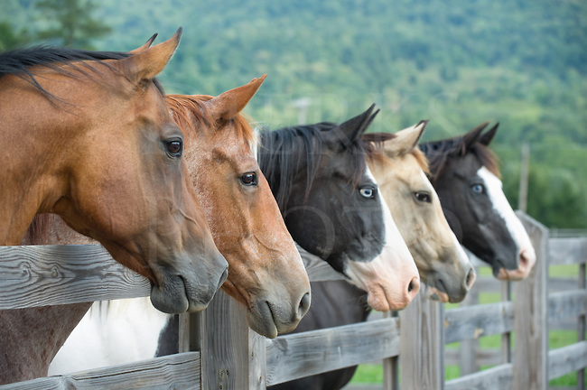
How do I create and maintain a sacrifice area?
Locate an Appropriate Site
Pick Your Footing
Water and Runoff Management
Fencing
Manage

Slide 11

What are some of the pros and cons?
You need to have or make the space for this area.
Weeds
Money*
Time
Erosion if stormwater management practices aren’t implemented.
Improved Pastures
Nutrient Management

Slide 12

Questions?

Slide 13
Thank you!
Charlotte Maxwell
mcharley@vt.edu
804-556-5872

