Slide 1

OER Advocacy: Applying Economic Thinking to Program Design
Anita Walz, University Libraries at Virginia Tech
VIVA-OTN Best Practices Forum
September 21, 2018, Virginia Commonwealth University, Richmond, VA
Images are public domain unless otherwise noted.

Slide 2

Before you conclude that
economics = Zzzz
Fair Use. Adapted from: http://bradish.com/wp-content/uploads/2017/12/asleep-at-work.jpg

Slide 3
information
incentives
ideology
decisions

Slide 4
Let’s talk about Information

Slide 5
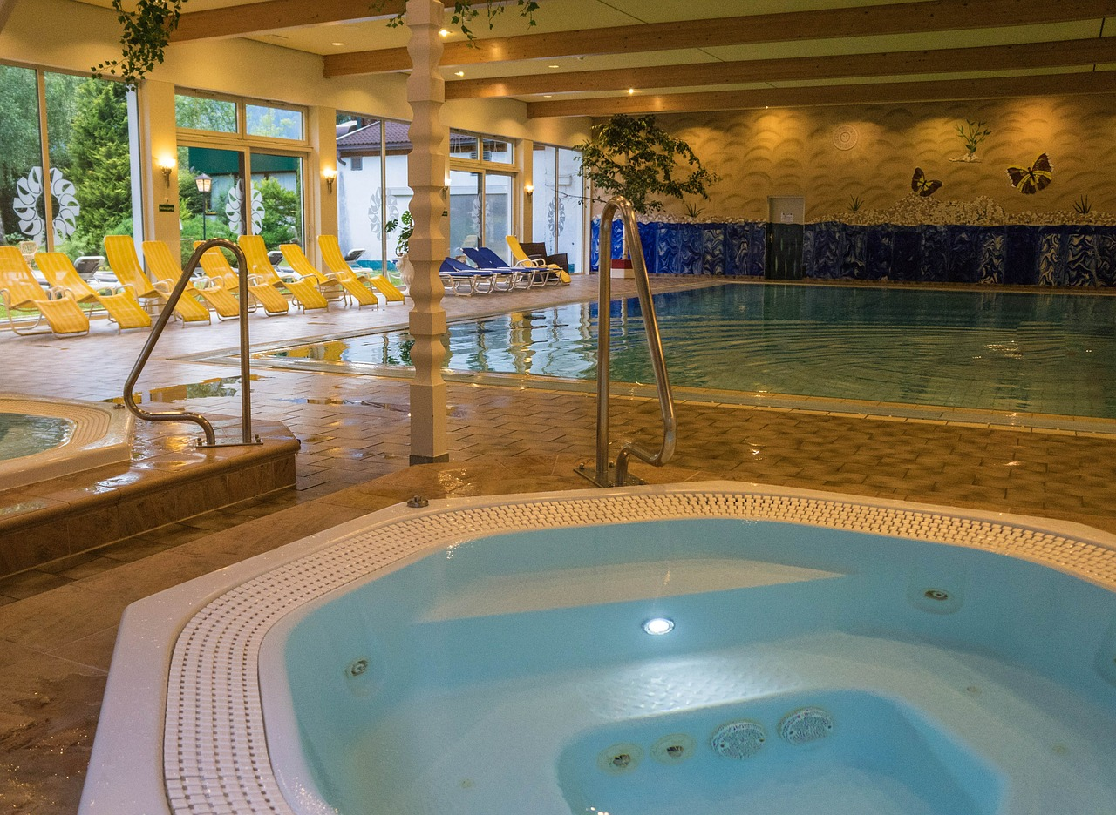

Slide 6
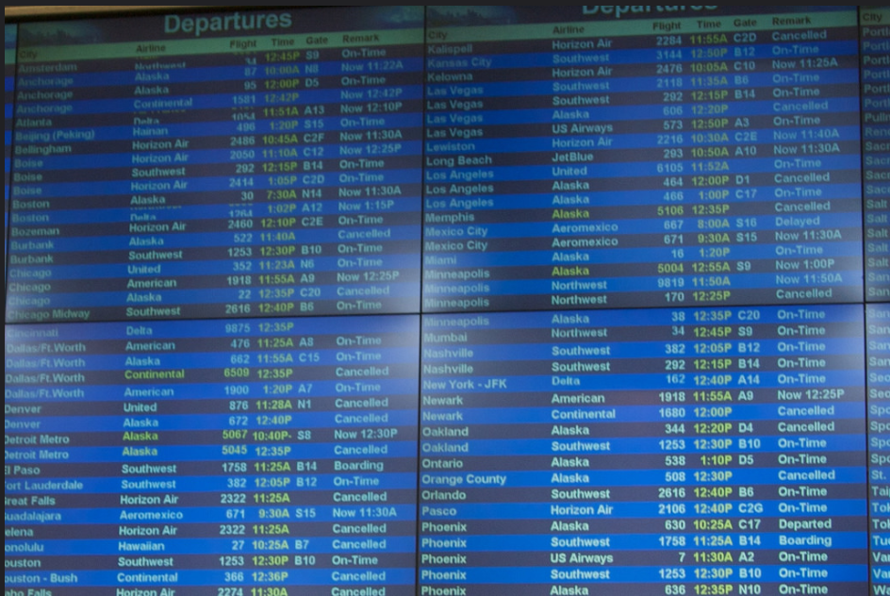

Slide 7
Different, current, or correct
Information
= different decision

Slide 8
Let’s talk about Incentives

Slide 9


Incentives as motivating “pressures”
Notes:
Can also feel negative.

Slide 10


Slide 11


Slide 12
Meaningful
Incentives
Maybe = different decision
Notes:
Extrinsic motivators

Slide 13
Let’s talk about Ideology
Notes:
Intrinsic motivations

Slide 14
Ideology - who and how we aspire to be, especially when we act on it is sometimes more powerful than
external pressures.
Ideology also includes
things we think should
be widely accepted or
practiced (e.g. norms).

Slide 15

Notes:
It’s “just what we do!”

Slide 16
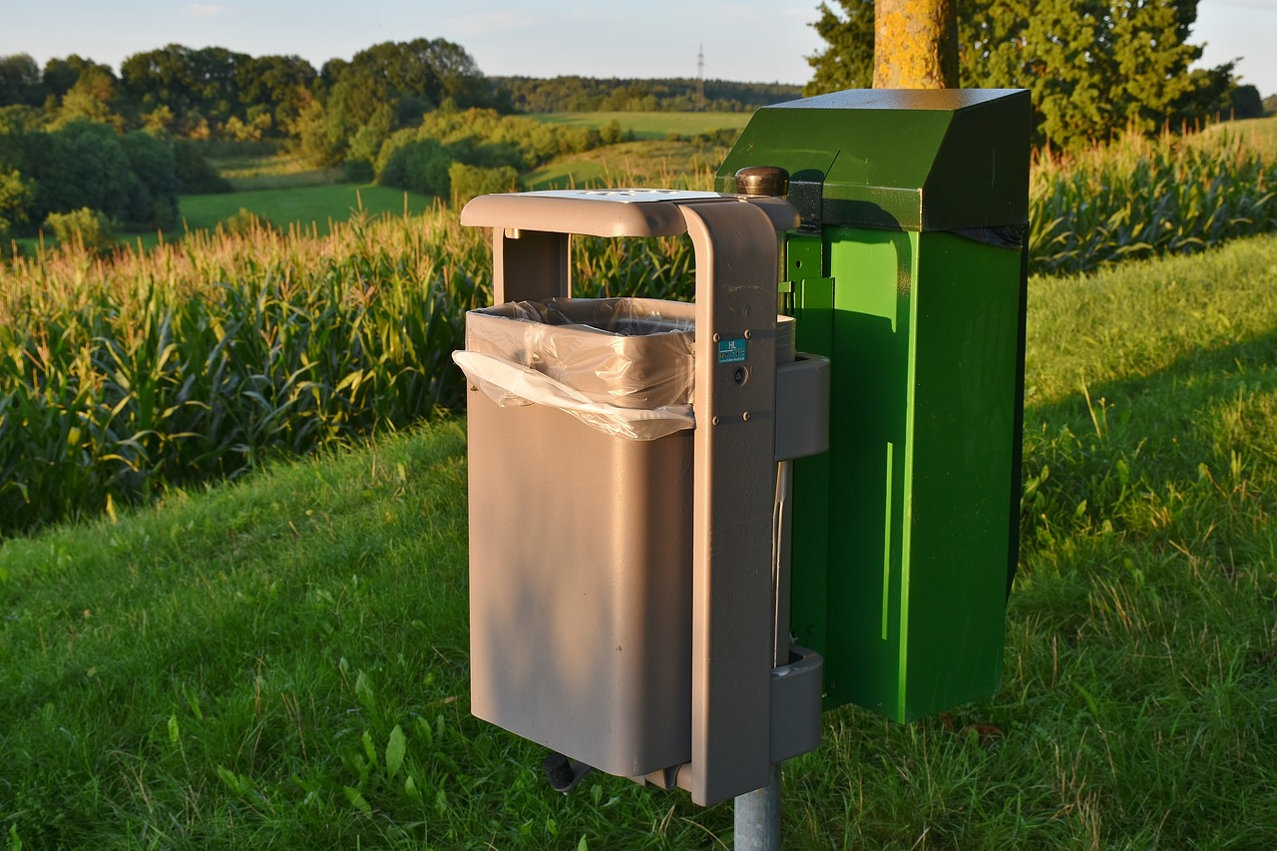

Slide 17
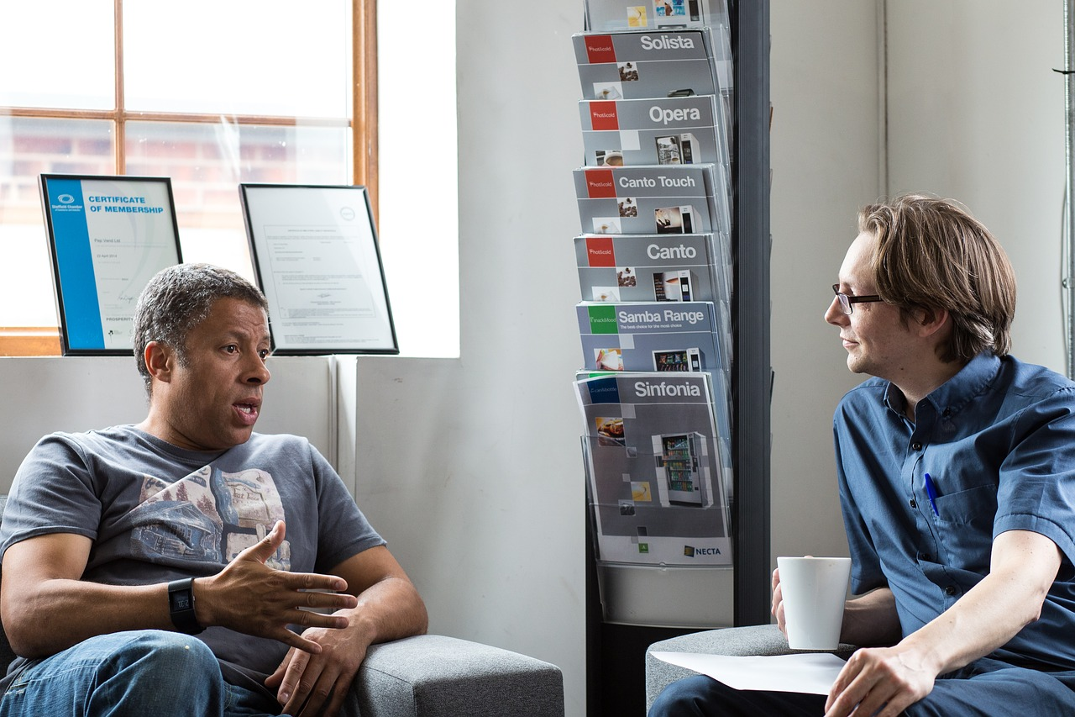

Slide 18
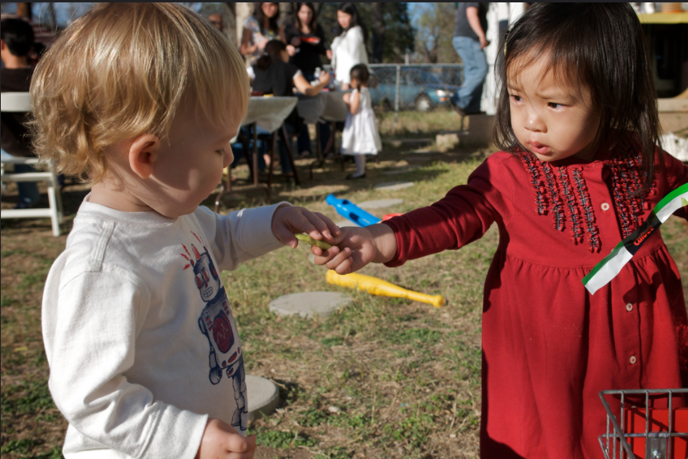
© Enoch Lai “Sharing is Caring” CC BY NC ND

Slide 19
Affirmed, changed, or acted on
Ideologies
= different decision

Slide 20
information
incentives
ideology
decisions

Slide 21
How is this related to OER?

Slide 22
information
incentives
ideology
(about course materials & OER)
Decisions about courses & course material
(about course materials & OER)
(about course materials & OER)

Slide 23
Sometimes . . .

Slide 24

Sometimes . . .
Why won’t you
adopt the open
textbook????
others make decisions
which don’t make sense
. . . to us

Slide 25
Sometimes we don’t know what information and incentives people have regarding course materials & OER. Sometimes we fail to persuade them to affirm and act on the idea that “sharing is good.”

Slide 26

Practical contributions:
Empathy & understanding of your audience
Program design
Identify values to model

Slide 27


Regarding course materials . . .
What information does this person have?
What incentives does this person face?
What is this person’s ideology? Aspirational? Currently acting on?

Slide 28

What information does this person have?
What additional (or corrected) information does this person need about OER?

Slide 29

What incentives (external motivators or pressures) does this person face?
What incentives (rewards or pressures) do we bring?

Slide 30

What values or aspirations does this person act on (or want to act on)?
Which ones can we encourage them to act on?
Which ones could we challenge with a different way of thinking?

Slide 31

Name:
Demographics:
Role:
Information:
(about course materials)
Incentives:
(about course materials)
Ideology: (about course materials)
Aspirational:
Acting on:
Summary & Program Actions:
© Joseph Wilson CC BY https://thenounproject.com/term/profile/95841/

Slide 32
Name: Sam
Demographics: 35, physicist
Role: Pre-tenure faculty member
Information: OER= free stuff
Incentives: I’m under a lot of pressure to achieve great things in my academic career. Research > teaching.
Ideology:
Aspirational: Write my own.
Acting on: Using my predecessor’s selection.
© Joseph Wilson CC BY https://thenounproject.com/term/profile/95841/

Slide 33
Name: Sam
Summary & Actions:
Sam likely doesn’t know that open= free+permission to modify & share.
Sam is under (time/effort) pressure to focus mainly on research.
Sam might benefit from a nudge to approach teaching with OER as a potential research area.
© Joseph Wilson CC BY https://thenounproject.com/term/profile/95841/

Slide 34
Name: Jack
Demographics: 50s, empty nest, 2 jobs
Role: Adjunct (part time)
Information:
Incentives:
Ideology:
© Joseph Wilson CC BY https://thenounproject.com/term/profile/95841/

Slide 35
Name: Jack
Demographics: 50s, empty nest, 2 jobs
Role: Adjunct (part time)
Information: OER = digital textbooks
Incentives: I make instructional choices but don’t get to choose a text.
Ideology: Aspirational: I want to use a diff text.
Acting on: Making but not sharing content.
© Joseph Wilson CC BY https://thenounproject.com/term/profile/95841/

Slide 36
Take Aways:
What information about course materials and OER do people have and need?
What pressures, incentives, support and rewards might be significant influences on course material decisions?
What are their intrinsic motivations?
Can you connect these to OER?
How can you encourage them to act not just intellectually ascent?
How can you model the way or connect with others who model actions of using/sharing/creating OER? (which they might not have not previously seen modelled)?

Slide 37
information
incentives
ideology
decisions

Slide 38
© Enoch Lai “Sharing is Caring” CC BY NC ND

Slide 39
Thank you!
Anita Walz, University Libraries at Virginia Tech arwalz@vt.edu
Acknowledgement: Thanks to my economics professor, Dr. P.J. Hill who taught me about the three “I”s.
I decided to major in Economics in large part because of his class.

