Slide 1
Hybrid Summarization of Dakota
Access Pipeline Protests (NoDAPL)
CS 5984/4984 Big Data Text Summarization Report
Xiaoyu Chen*, Haitao Wang, Maanav Mehrotra, Naman Chhikara, Di Sun
{xiaoyuch, wanght, maanav, namanchhikara, sdi1995} @vt.edu
Instructor: Dr. Edward A. Fox
Dept. of Computer Science, Virginia Tech
Blacksburg, Virginia 24061
December 2018

Slide 2
Outline
Introduction
  Automatic Summarization and NoDAPL Dataset
  Related Work
  Overview of the Proposed Framework
Preprocessing of Data
  Classification of Relevance
  Topic Modelling by Latent Dirichlet Allocation (LDA) and LDA2Vec
Hybrid Method
  Latent Dirichlet Allocation based Extractive Summarization
  Pointer-generator based Abstractive Summarization
  Text Re-ranking based Hybrid Summarization
Results and Evaluation
  Compiled Summary
  Extrinsic Evaluation
Conclusion and Future Work

Slide 3
Introduction
Automatic Summarization
  Automatic summarization: has been investigated for more than 60 years since the publication of Luhn’s seminal paper (Luhn, 1958)
  Challenges: large proportion of noise texts (i.e., irrelevant documents/topics, noise sentences, etc.), highly redundant information, multiple latent topics
Problem Statement
  How to automatically / semi-automatically generate a good summary from a corpus collected from webpage with noisy, highly redundant, and large-scale text dataset?
  Topic: NoDAPL - Protest movements against Dakota Access Pipeline construction in U.S.
  Method: Automatic text summarization techniques with deep learning methodology.
Quality Quantity

Slide 4
Related Work
Text Summarization Categories
Deep Learning-based Automatic Text Summarization
  Seq2Seq model (Khatri, Singh, & Parikh, 2018)
  Pointer-generator network (See, Liu, & Manning, 2017)
(Gupta & Lehal, 2010)
Extractive
Abstractive
(Banerjee, Mitra, & Sugiyama, 2015)
Output type
(Litvak & Last, 2010)
Single doc
Generic
(Zha, 2002)
Doc
number
Text Summarization
Multi-doc
Audience
Query-focused
(Banerjee, Mitra, & Sugiyama, 2015)
(Daumé III & Marcu, 2006)
External sources
(Chen & Verma, 2006)
Knowledge rich
Knowledge poor
(Bergler et al., 2003)

Slide 5
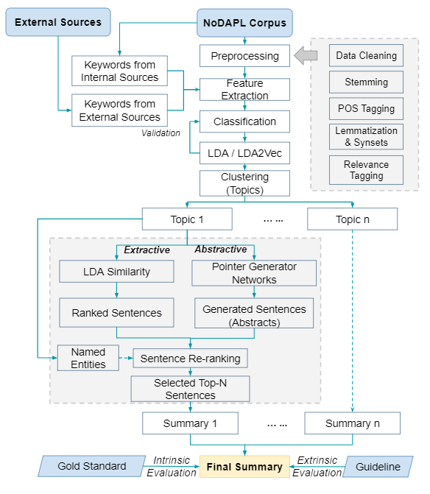
Proposed Framework
Proposed automatic text summarization framework with limited human effort
Adopted both deep learning-based abstractive and LDA-based extractive summarization technologies to create hybrid method
Advantages:
  Without rely on deep understanding of the given events
  Can be easily extended to other events
  Not require large computation workload
Disadvantages:
  Highly depends on accuracy of extracting named entities and topics
  Requires manually label 100 documents

Slide 6
Outline
Introduction
  Automatic Summarization and NoDAPL Dataset
  Related Work
  Overview of the Proposed Framework
Preprocessing of Data
  Classification of Relevance
  Topic Modelling by Latent Dirichlet Allocation (LDA) and LDA2Vec
Hybrid Method
  Latent Dirichlet Allocation based Extractive Summarization
  Pointer-generator based Abstractive Summarization
  Text Re-ranking based Hybrid Summarization
Results and Evaluation
  Compiled Summary
  Extrinsic Evaluation
Conclusion and Future Work

Slide 7
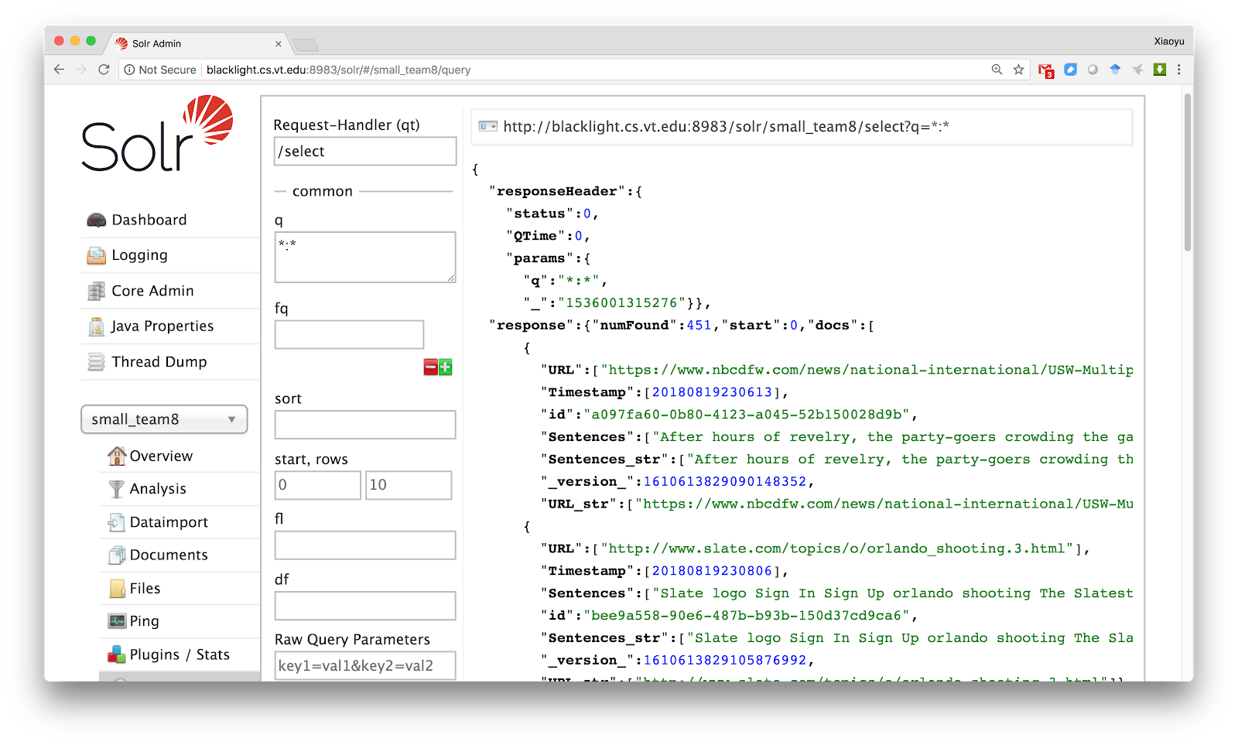
Formatting and Solr Indexing
Converted WARC and CDX files into JSON formatted file
  Total records (small dataset) : ~ 500
  Total records (big dataset) : ~ 1,1000
  Cleaned irrelevant content like HTML tags, javascript etc.
Solr Indexing
  Allowed us to query the data
  Helped other teams for creating a
  gold standard

Slide 8
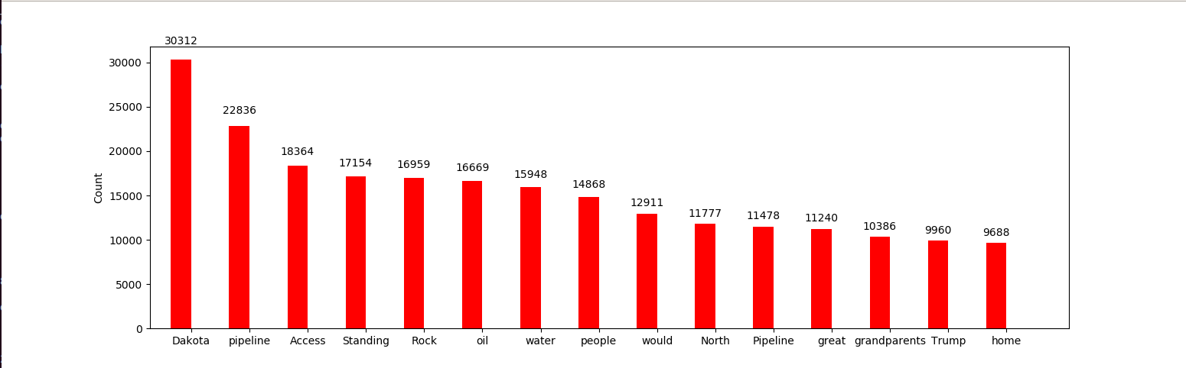
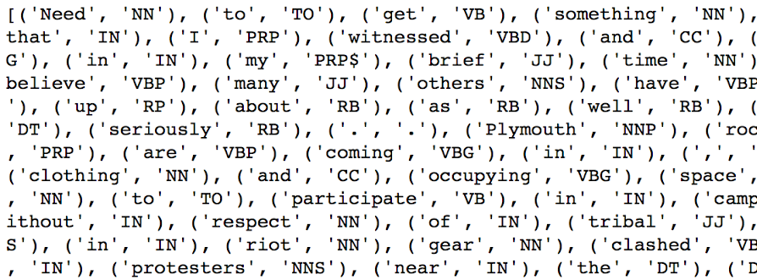
Stopwords Removal and POS Tagging
Stopwords Removal
  Used NLTK’s default stopwords list
  Made a custom stopwords list
POS Tagging
  Used NLTK’s default POS Tagger to tag tokens correctly
  Note- Needs to be done without removing stopwords

Slide 9
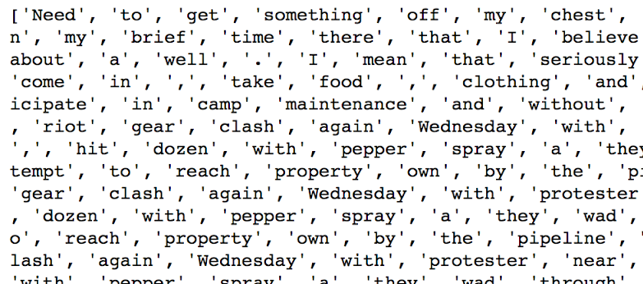
Lemmatization
Lemmatization
  Lemmatization takes into consideration the morphological analysis of the words.
  Analysed that it worked better than stemming
  Used the WordNet library for lemmatization

Slide 10
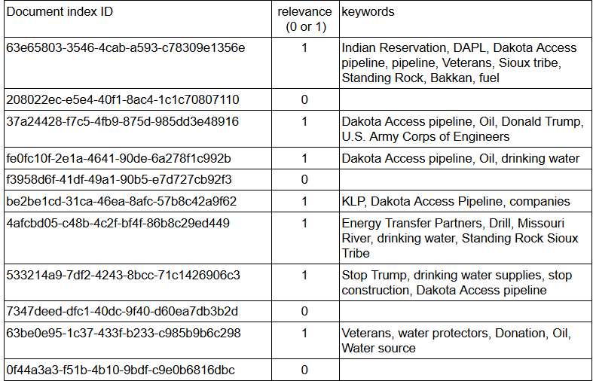
POS-Tagging
Manual Document Relevance Tagging and Internal Keywords Extraction
  Initially tagged 50 documents as relevant and irrelevant for classifier.
  Increased it to 100 documents.
  Used it as our training set to classify all the documents as relevant and irrelevant.
Using wikipedia as an external source
  Two wikipedia articles (Dakota Access Pipeline,#NODAPL) used to extract keywords which were given as input to the classifier.

Slide 11
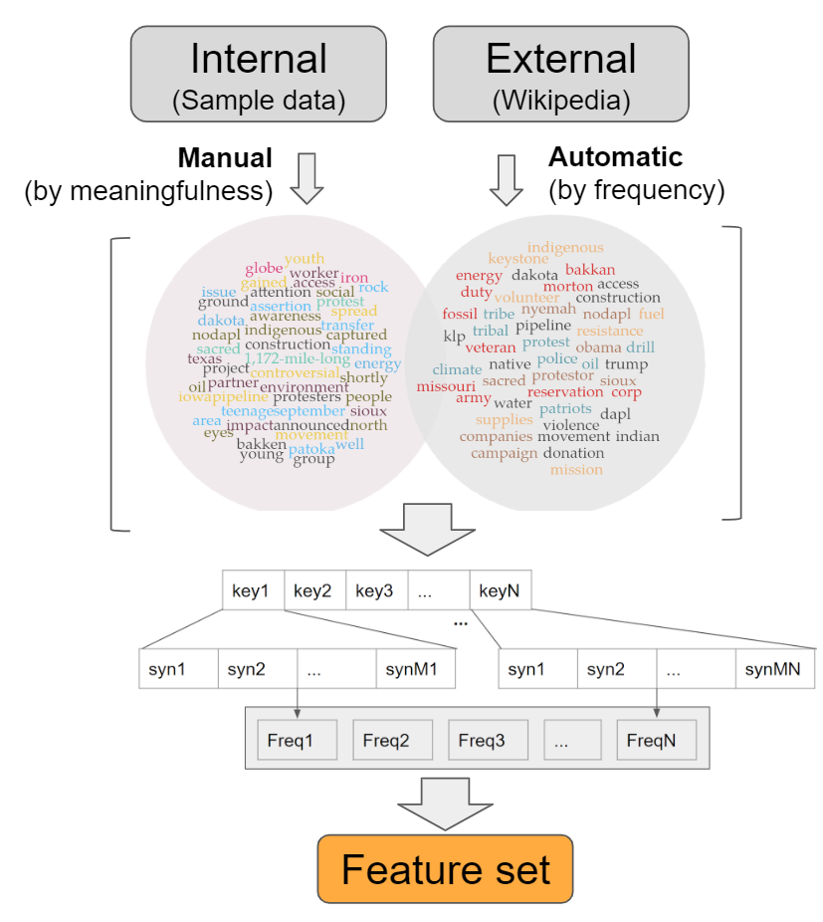
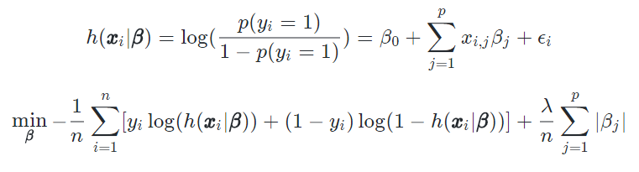
Feature Extraction and Model
Feature Extraction
  Calculated frequency of keywords and their synsets as features.
Regularized Logistic regression-based Classification
  Used 5-fold cross-validation (CV) to select the tuning parameter (λ) as well as to evaluate the model performance.

Slide 12
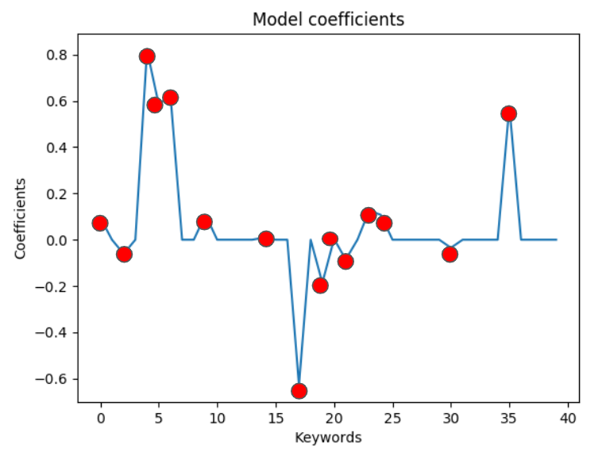
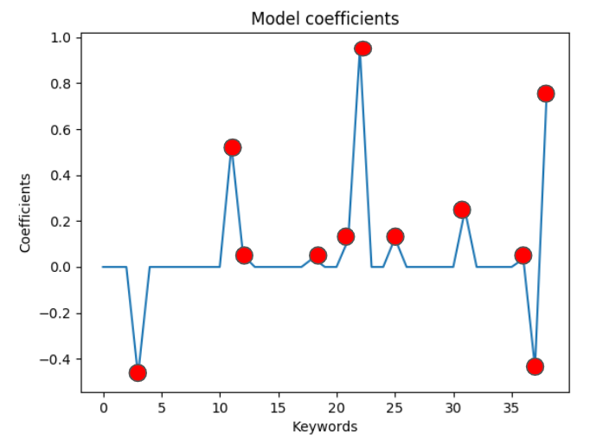
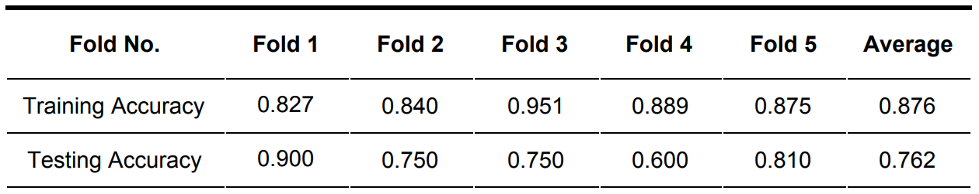
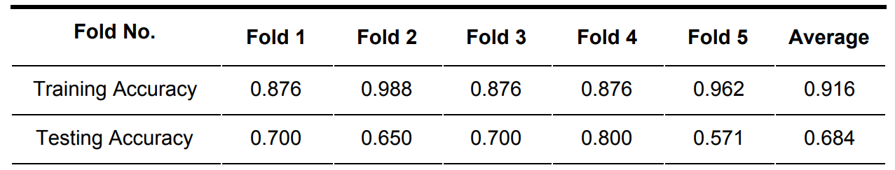
Classification Results
LR1 using keywords from Wikipedia
LR2 using keywords from internal source

Slide 13
Topic Modelling - Using LDA and LDA2Vec
LDA Model:
  Document within a collection: is modeled as a finite mixture of topics
  Each topic: is modeled as an infinite mixture distribution over an underlying set of topics probabilities.
Used LDA model provided by Gensim
Evaluation with small corpus
  Performed LDA analysis on small corpus both before and after classification
  Purpose: to evaluate the testing classification performance on corpus
LDA2Vec:
  A deep learning variant of LDA topic modelling developed recently by Moody (2016)
  The topics found by LDA were consistently better than the topics from LDA2Vec

Slide 14
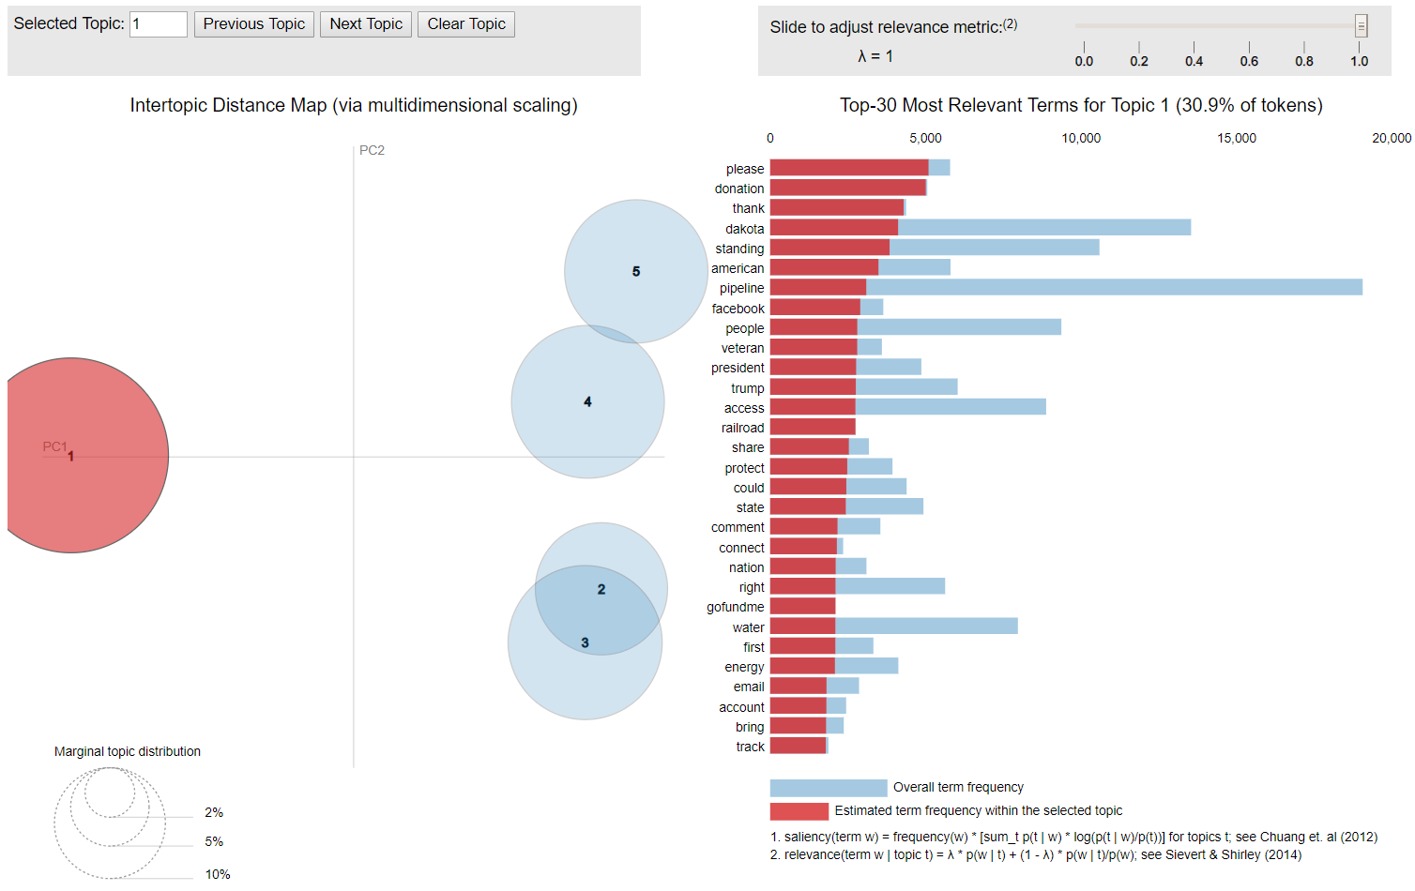
Topic 1: Donation Petition
Topic 2: Government Activities
Topic 3: Protest Preparation
Topic 4: Details of Protest
Topic 5: Concerns of Pipeline

Slide 15
Outline
Introduction
  Automatic Summarization and NoDAPL Dataset
  Related Work
  Overview of the Proposed Framework
Preprocessing of Data
  Classification of Relevance
  Topic Modelling by Latent Dirichlet Allocation (LDA) and LDA2Vec
Hybrid Method
  Latent Dirichlet Allocation based Extractive Summarization
  Pointer-generator based Abstractive Summarization
  Text Re-ranking based Hybrid Summarization
Results and Evaluation
  Compiled Summary
  Extrinsic Evaluation
Conclusion and Future Work

Slide 16
Extractive Summary - TF-IDF based Ranking
Sentence Extraction Using TF-IDF based Ranking
  Created a counting vector (bag of words)- using sklearn’s CountVectorizer
  Built TF-IDF matrix- using sklearn’s TF-IDF Transformer
  Scoring each sentence
    We only considered and added the tf-idf values where the underlying token was a noun. This total was then divided by the summation of all the document tf-idf values.
    We added an additional value to a given sentence if it had any word that was included in the title of the document. This value was equal to the count of all words in a sentence found in the title divided by the total number of words in the title. This “heading similarity score” was then multiplied by an arbitrary constant (0.1) and added to the tf-idf value.
    We then applied a position weighting. Each sentence was ordered from 0 to 1 equally based on the sentence number in the document. This weighting was then multiplied by the value in point 2.

Slide 17
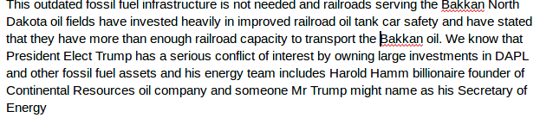
Extractive Summary - TF-IDF Text Ranking Result
Example: Summary for the first document.
Limitations:
Requires large memory to store the frequent word dictionary and TF-IDF matrix
Does not guarantee relevance of the top-ranked sentences

Slide 18
Extractive Summary - LDA based Ranking
LDA based Ranking
  Use LDA model to rank sentences within each document for all topics
  The rationale behind using LDA similarity queries as ranking score is
    Given a topic, extracted sentences should be highly relevant to the topic
  As a result, a list of sentences and the associated similarity measures (range: 0~1) were obtained for each document
  The Top-N sentences were extracted by sorting the similarity scores
Example Generated Summary
The permitting and construction process for the expansion of the existing clean energy facility has also been slowed because Dominion accountants, planners and decision makers convinced themselves that their stockholders would see more immediate profit from fracking, building pipelines, and converting the Cove Point facility into an export terminal than completing a facility that would supply a couple million of my fellow Virginians with 60-80 years worth of clean electricity. ...
Limitation: Failed to contain named entities.

Slide 19
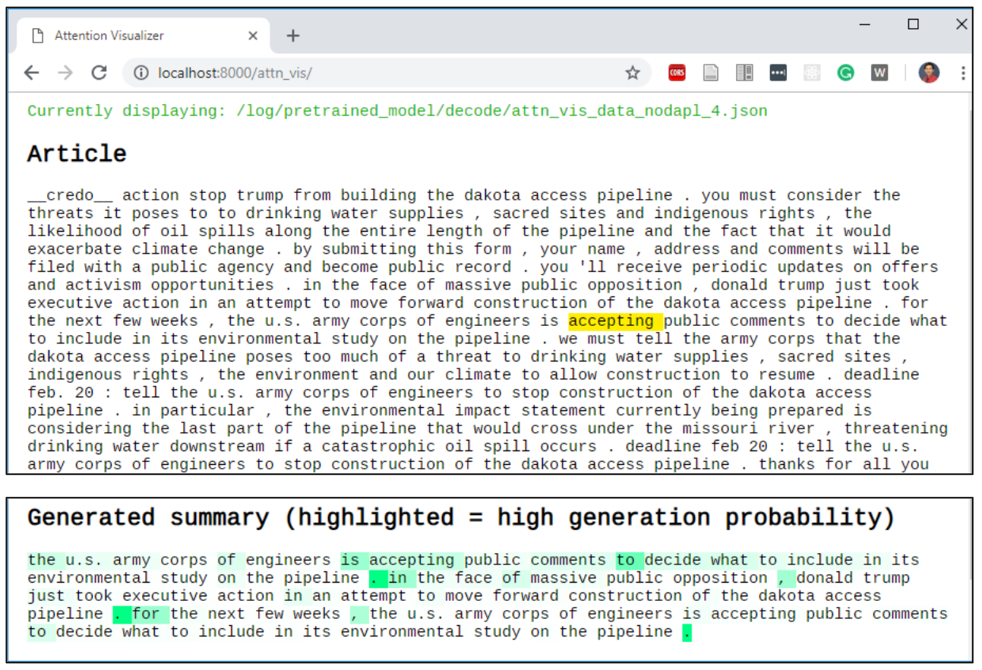
Abstractive Summary
Pointer Generator Network*
  Generated 3-sentence abstract for each document
  Used pre-trained with CNN/Daily Mail dataset
  Used default hyperparameters with TensorFlow 1.2.1
Example PGN-generated abstract (in attention visualization)
* Abigail, et.al . "Get to the point: Summarization with pointer-generator networks." arXiv preprint arXiv:1704.04368 (2017).
Notes:
However, the generated abstractive summary is not guaranteed to be relevant to the topic.

Slide 20
Hybrid Automatic Summarization
We proposed a hybrid automatic summarization approach to further improve the summarization performance in two considerations:
  The extractive summarization only led to sentences which were highly relevant to corresponding topics but ignored the important named entities
  The abstractive summarization produced high level summarization of documents but may not have high relevance with topics
Therefore, we proposed to re-rank these sentences to generate better summarization according to two aspects:
  The topics
  The named entities

Slide 21
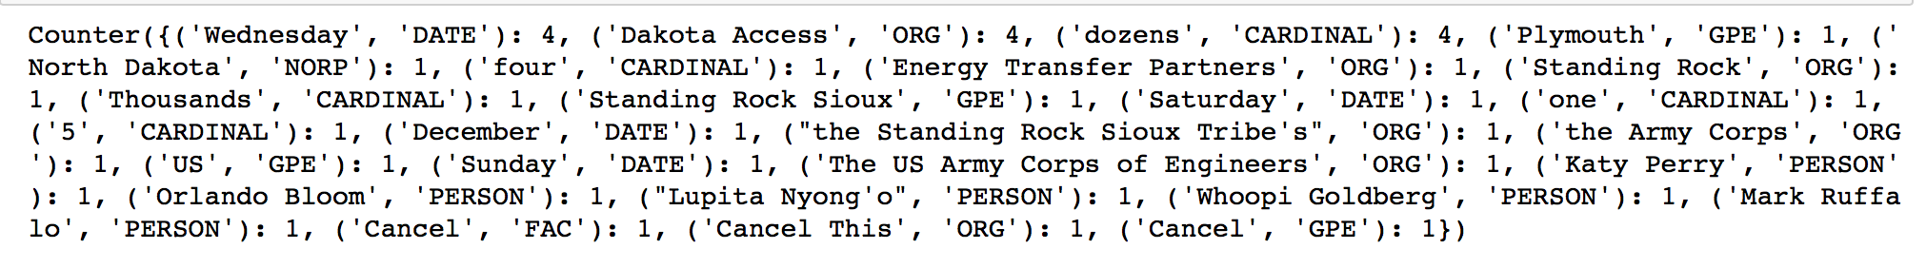
Named Entity Recognition
Extracted information through named entity recognition using spaCy
Type | DESCRIPTION
PERSON | People, including fictional
ORGANIZATION | Companies, agencies, institutions etc
GPE | Countries, cities, states
LOCATION | Non GPE locations, bodies of water etc
Type | DESCRIPTION
DATE | Absolute or relative dates or periods
TIME | Times smaller than a day
ORDINAL | First, second etc
CARDINAL | Numerals that do not fall under another type

Slide 22
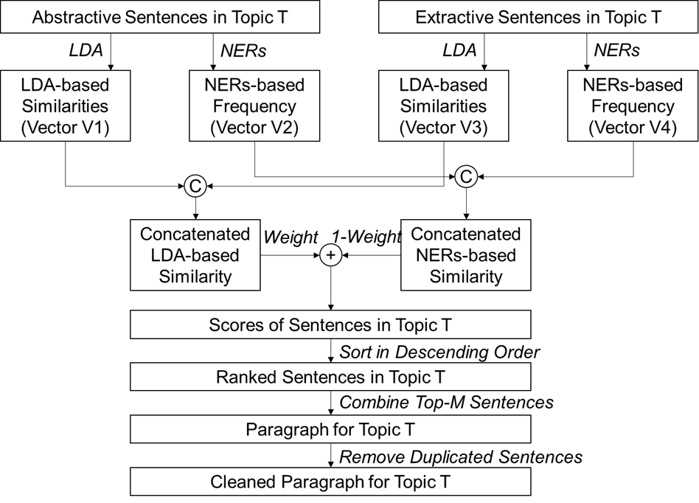
Hybrid Summary
Higher weight: Higher relevant to Topics, but lower coverage of named entities
Lower weight: Lower relevant to Topics, but higher coverage of named entities

Slide 23
Outline
Introduction
  Automatic Summarization and NoDAPL Dataset
  Related Work
  Overview of the Proposed Framework
Preprocessing of Data
  Classification of Relevance
  Topic Modelling by Latent Dirichlet Allocation (LDA) and LDA2Vec
Hybrid Method
  Latent Dirichlet Allocation based Extractive Summarization
  Pointer-generator based Abstractive Summarization
  Text Re-ranking based Hybrid Summarization
Results and Evaluation
  Compiled Summary
  Extrinsic Evaluation
Conclusion and Future Work

Slide 24
Hybrid Summarization Results
Resulting in five paragraphs for five topics, respectively
Summary on Topic 5 - Concerns about the Pipeline:
In particular, the environmental impact statement currently being prepared is considering the last part of the pipeline that would cross under the missouri river, threatening drinking water downstream if a catastrophic oil spill occurs. We must tell the army corps that the dakota access pipeline poses too much of a threat to drinking water supplies, sacred sites, indigenous rights, the environment and our climate to allow construction to resume. The dakota access pipeline would result in oil leaks in the missouri river watershed. Oil pipeline threatens standing rock sioux land, drinking water holy places. For the next few weeks, the u.s. Army corps of engineers to stop construction of the dakota access pipeline.

Slide 25
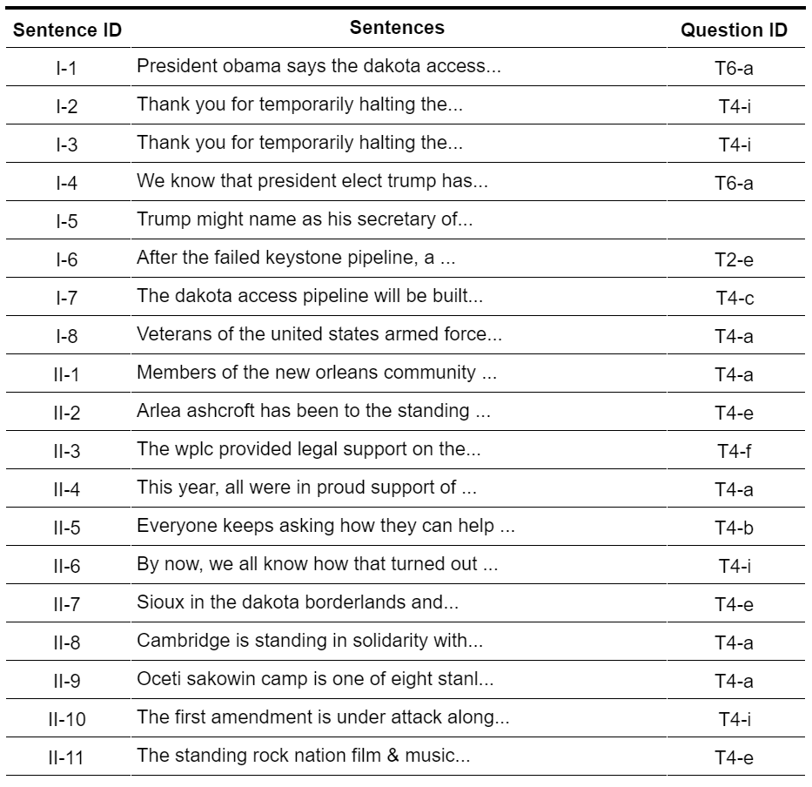
Extrinsic Evaluation
Task-based Measurement:
  Developed guideline question as standards: 23 questions covering import information for NoDAPL
  Built question-answer matches: mark questions that answered by summary sentences
Evaluate Summarization Quality by Two Measures
  Content relevance: 91.3%
  Question coverage: 69.6%
… … ...

Slide 26
Outline
Introduction
  Automatic Summarization and NoDAPL Dataset
  Related Work
  Overview of the Proposed Framework
Preprocessing of Data
  Classification of Relevance
  Topic Modelling by Latent Dirichlet Allocation (LDA) and LDA2Vec
Hybrid Method
  Latent Dirichlet Allocation based Extractive Summarization
  Pointer-generator based Abstractive Summarization
  Text Re-ranking based Hybrid Summarization
Results and Evaluation
  Compiled Summary
  Extrinsic Evaluation
Conclusion and Future Work

Slide 27
Conclusion and Future Work
Conclusion
  A hybrid automatic summarization approach is proposed and tested on NoDAPL dataset with limited human effort
  A summarization guideline according to our thorough understanding of NoDAPL events/topics was developed to extrinsically evaluate the generated summary
  The content relevancy score and question coverage score indicates acceptable relevance and coverage of the generated summary
Future Work
  More text dataset for interesting topics can be tested by using the proposed hybrid text summarization approach
  Topic modeling-supervised classification approach can be investigated to minimize human efforts in automatic summarization
  Deep learning-based recommender system can be investigated for better sentence re-ranking.

Slide 28

Acknowledgement
We would like to thank the instructions and invaluable comments from Prof. Fox and GTA Mr. Liuqing Li. And special thanks to the creative ideas provided by our classmates!
NSF IIS-1619028

Slide 29
Thank you!
Questions?

Slide 30
Backup

Slide 31
Related Work
Based on Processing Techniques
  Extractive summarization (Gupta & Lehal, 2010)
  Abstractive summarization (Banerjee, Mitra, & Sugiyama, 2015)
Based on Documents
  Single document summarization (Litvak & Last, 2010)
  Multi-document summarization (Banerjee, Mitra, & Sugiyama, 2015)
Based on Audiences
  Generic summarization (Zha, 2002)
  Query-focused summarization (Daumé III & Marcu, 2006)
Deep Learning-based Automatic Text Summarization
  Seq2Seq model (Khatri, Singh, & Parikh, 2018)
  Pointer-generator network (See, Liu, & Manning, 2017)

Slide 32
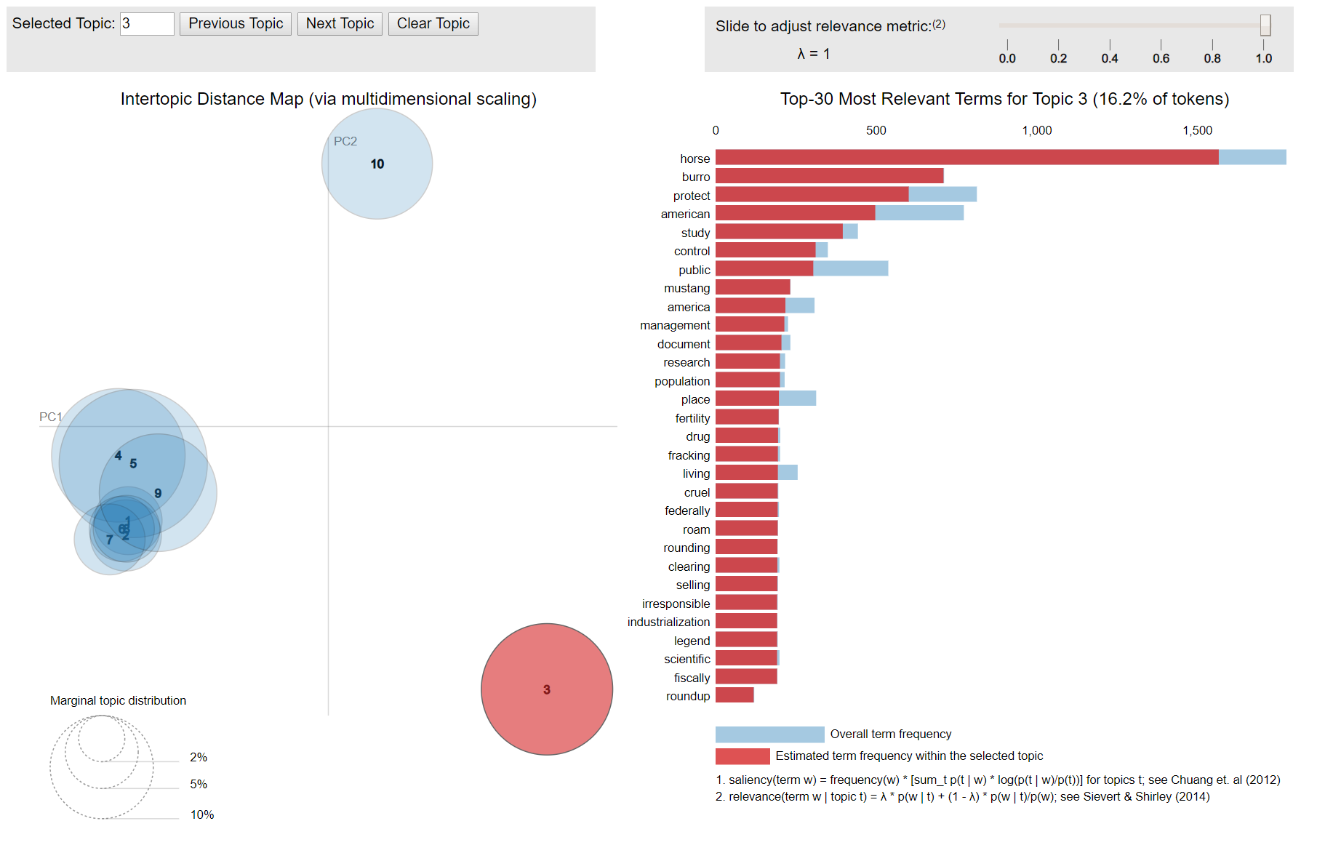
LDA analysis on original corpus without classification, the Topic 3 in red (i.e., circle in red) is irrelevant according to the frequent word list on the right hand side.

Slide 33
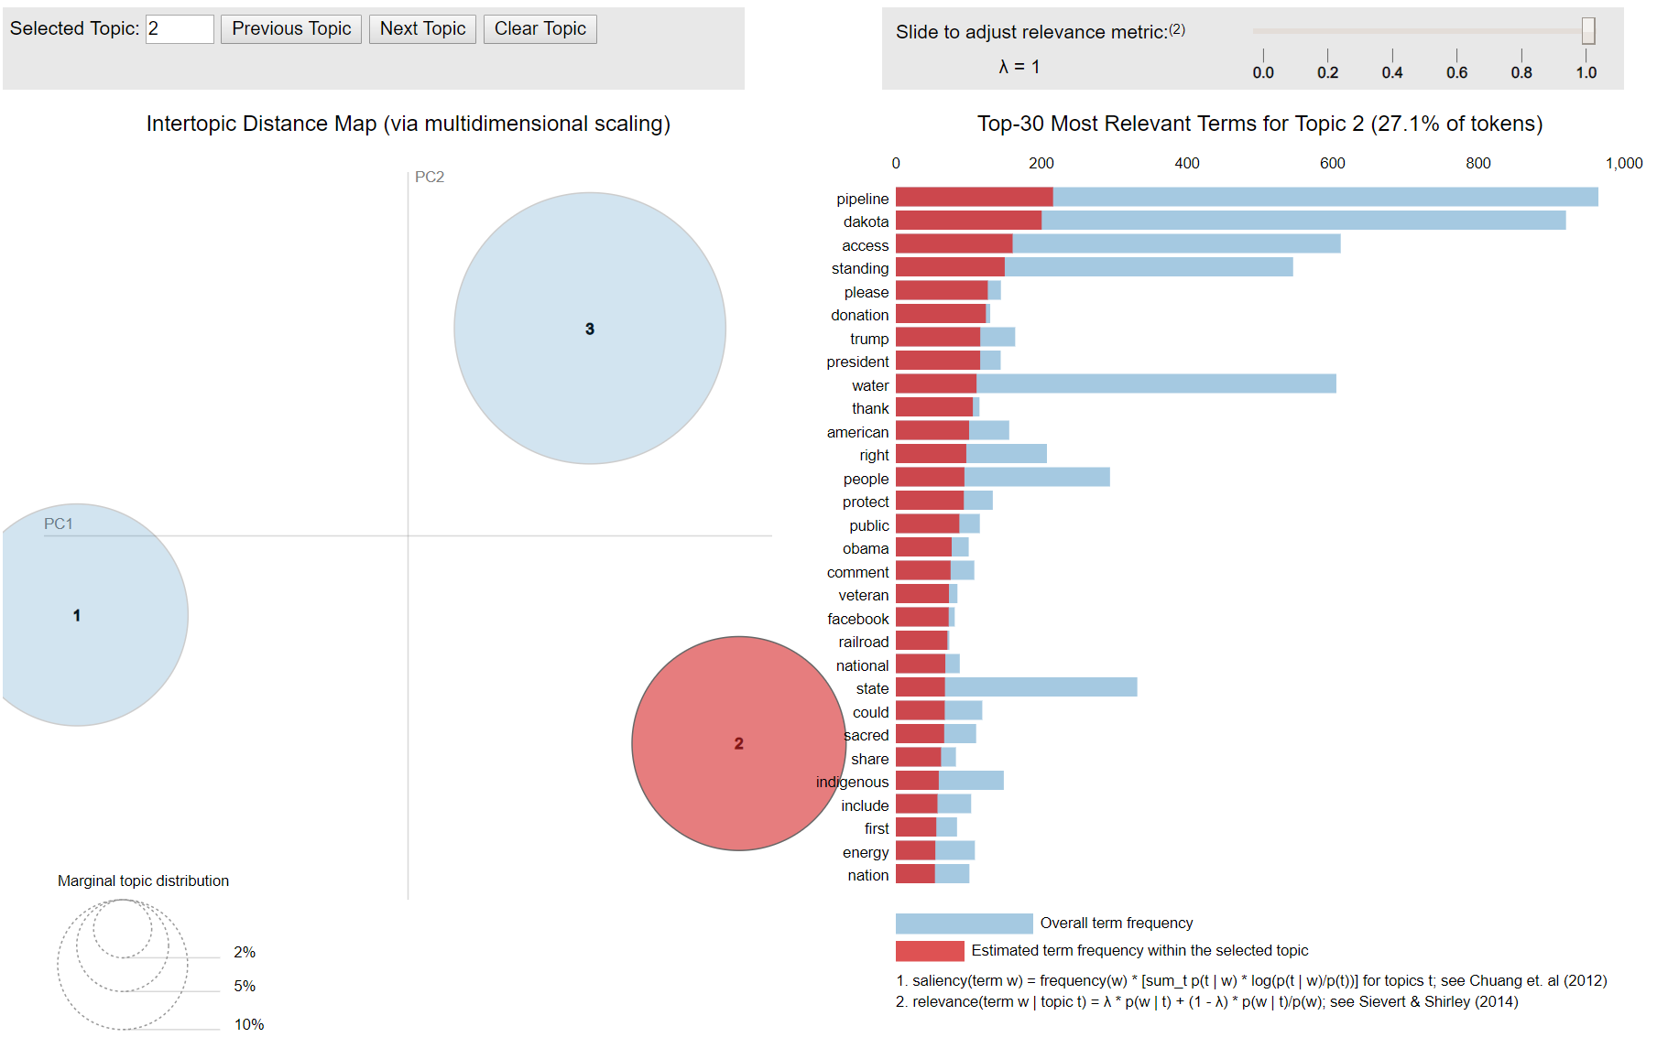
LDA analysis on the corpus after classification (relevant documents only). Three topics are found from the small corpus, each represents different relevant NoDAPL events/topics.

Slide 34
Abstractive Summary
Beam Search Decoder
  The framework we implemented relied on the encoder-decoder paradigm.
  The encoder encoded the input sequence of words, while the decoder which uses a beam search algorithm transformed the probabilities over each word in the vocabulary and produced a final sequence of words.
  The hyperparameters used for beam search decoder were
    max_enc_steps=400
    max_dec_steps=120
  Coverage=1 eliminated repetition of same words

Slide 35
Topic Modelling- Using LDA2Vec
LDA2Vec is a deep learning variant of LDA topic modelling developed recently by Moody (2016)
LDA2Vec model mixed the best parts of LDA and word embedding method-word2vec into a single framework
According to our analysis and results, traditional LDA outperformed LDA2Vec
The topics found by LDA were consistently better than the topics from LDA2Vec
Hence, we sticked with LDA for topic modelling and clustering

