Slide 1



Welcome to the North American Wind Energy Academy Symposium 2015
Bob Thresher, NAWEA Launch Director
NAWEA Symposium
Virginia Tech
Blacksburg, Virginia
9 June 2015

Slide 2
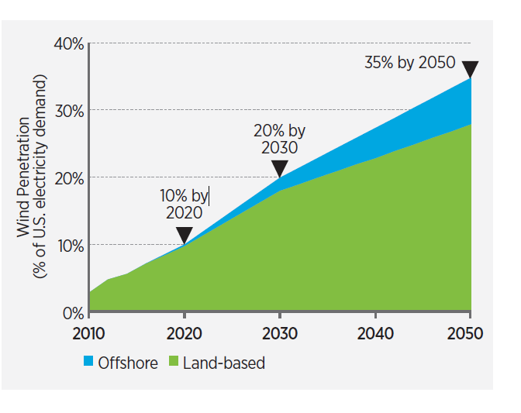
The DOE Wind Vision 2015
“The Wind Vision analysis modeled a future Study Scenario (with various sensitivities) in which 10% of the nation’s electricity demand is met by wind power in 2020, 20% by 2030, and 35% by 2050 “
http://www.energy.gov/windvision

Slide 3
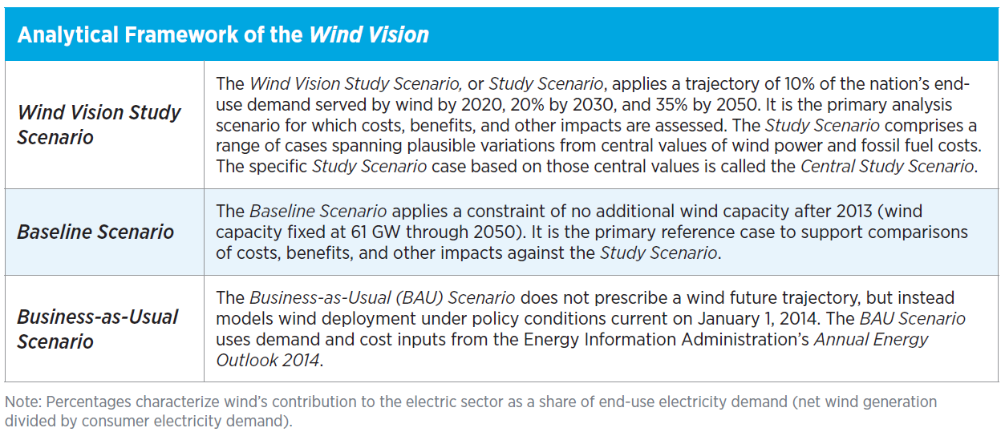
Analysis Approach and Boundaries
The Wind Vision is inclusive of land-based, offshore, and distributed wind technologies; however, distributed wind is not explicitly modeled or quantitatively assessed
Analysis assumes policy as written today (e.g., RPS remains as it is; PTC is expired)
Given DOE Report, Wind Vision is policy agnostic; does not evaluate or consider policy
Wind Vision considers the near-term (2020), mid-term (2030), and long-term (2050)

Slide 4
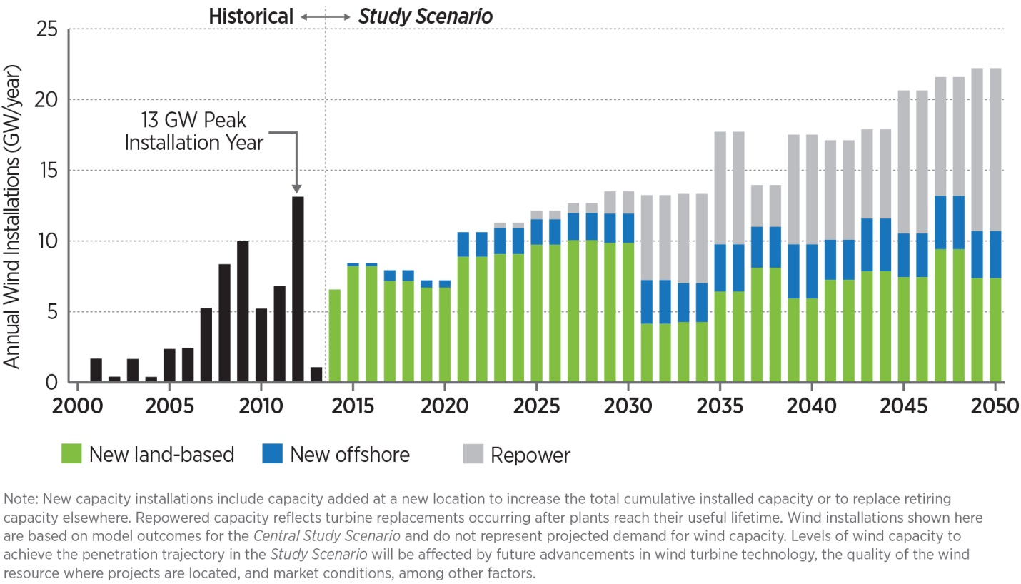
Deployment Over Time

Slide 5
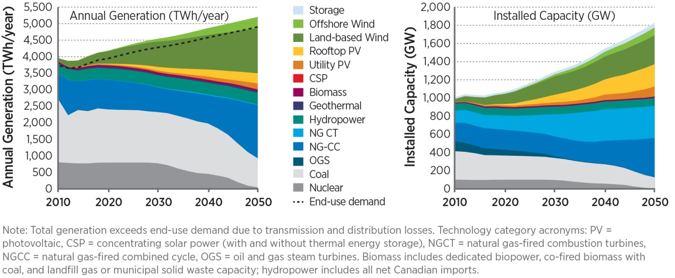
Generation and Installed Capacity Over Time

Slide 6
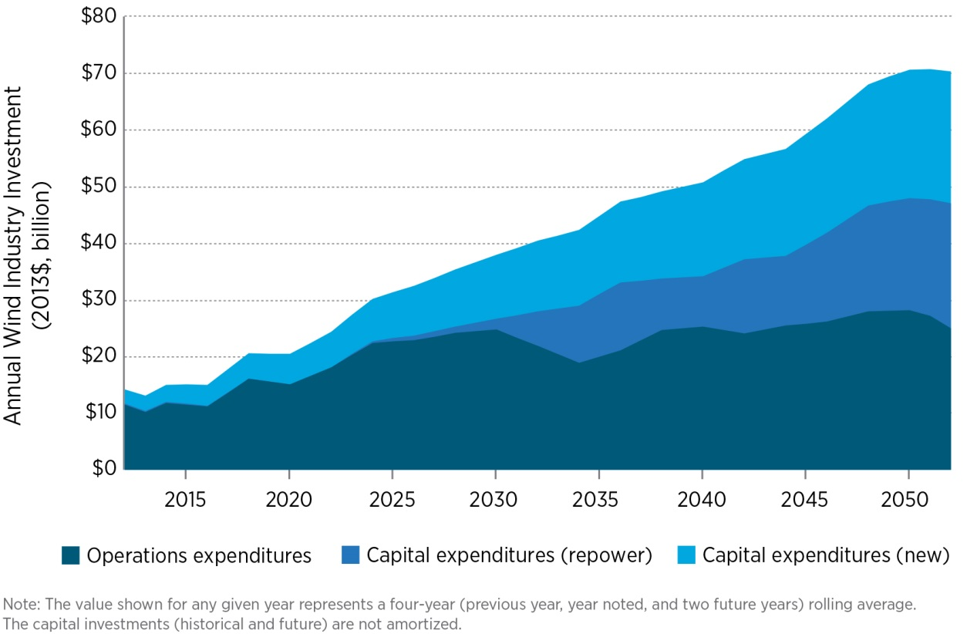
Annual Wind Investments

Slide 7
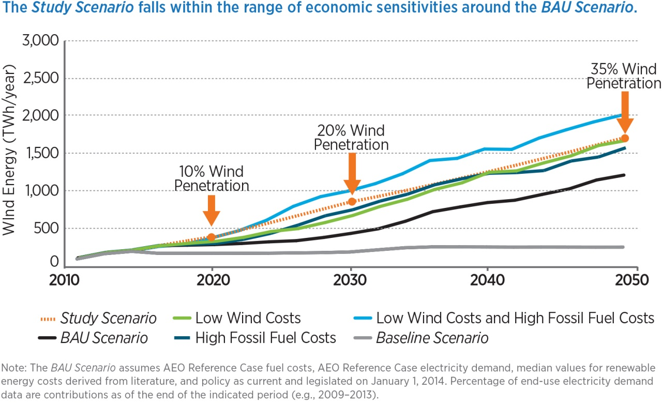
Sensitivity to Cost Scenarios

Slide 8
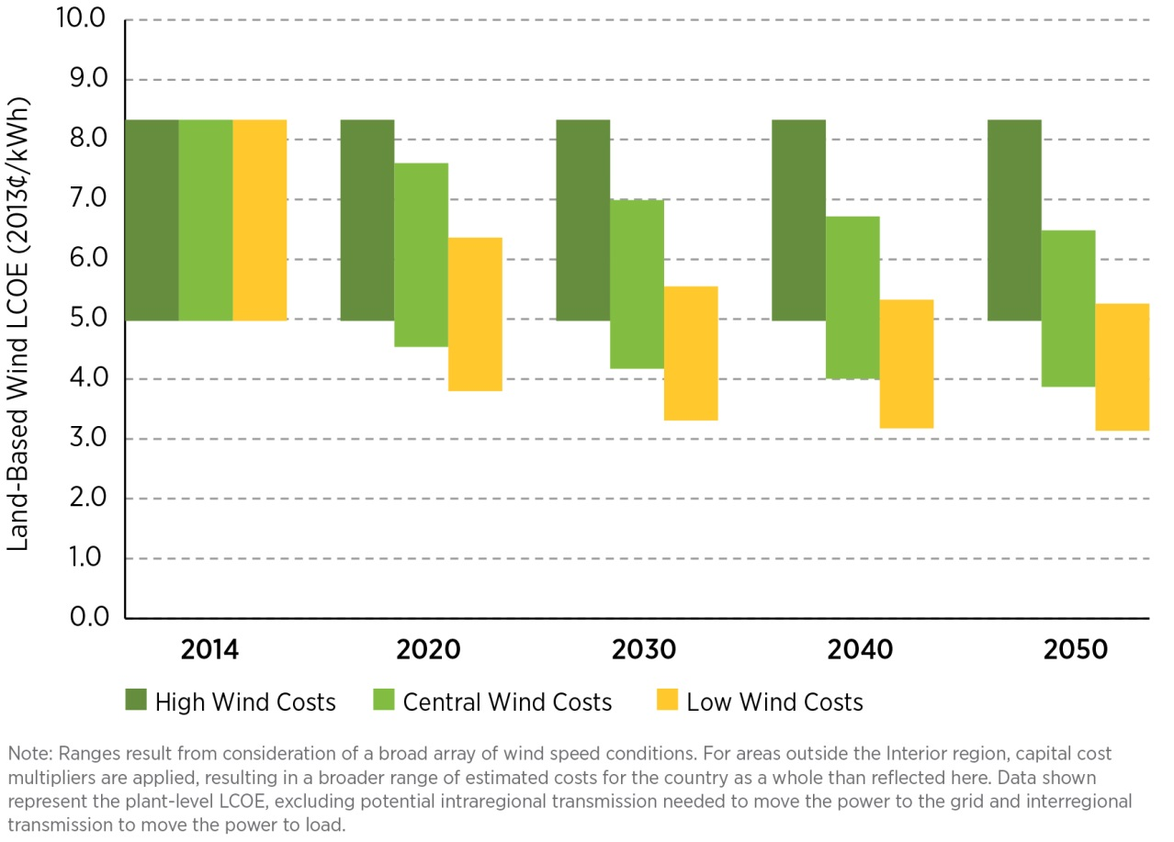
The Wind Cost Reductions

Slide 9
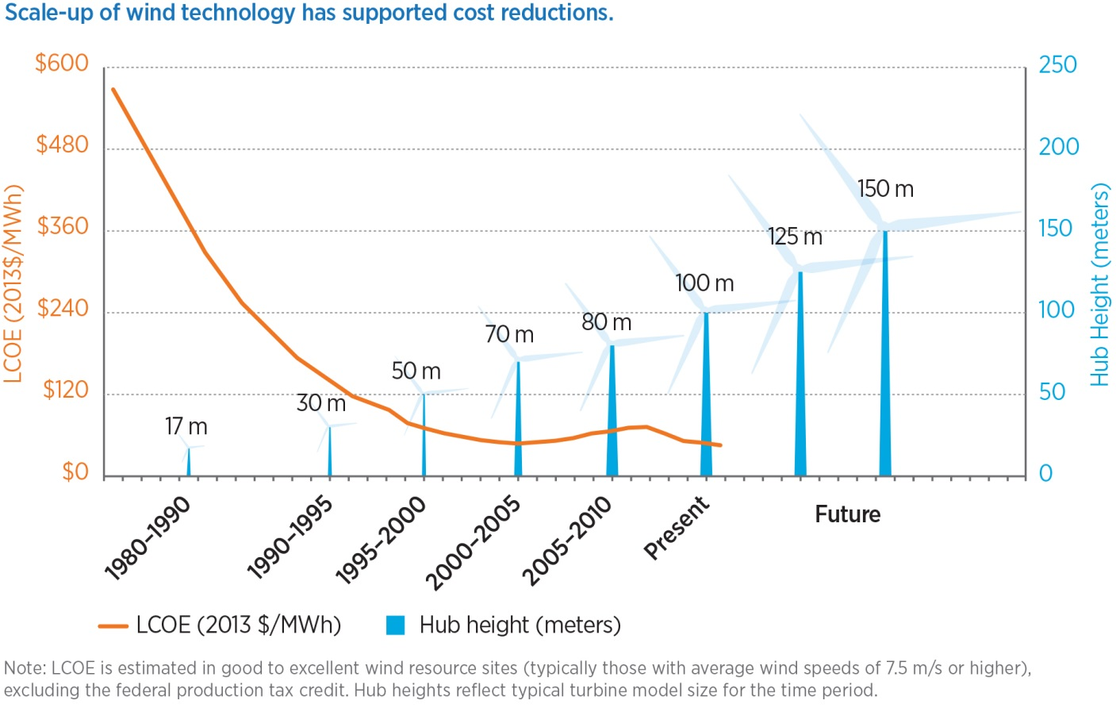
Future Turbine Scale

Slide 10
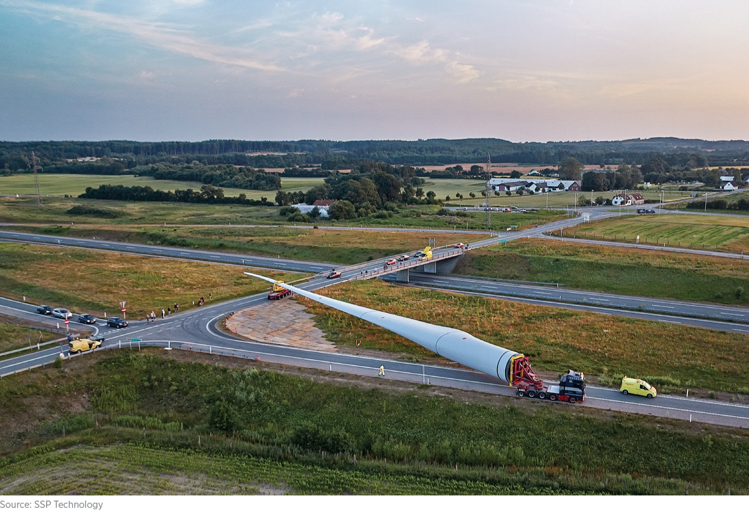
Segmented Blades ?

Slide 11
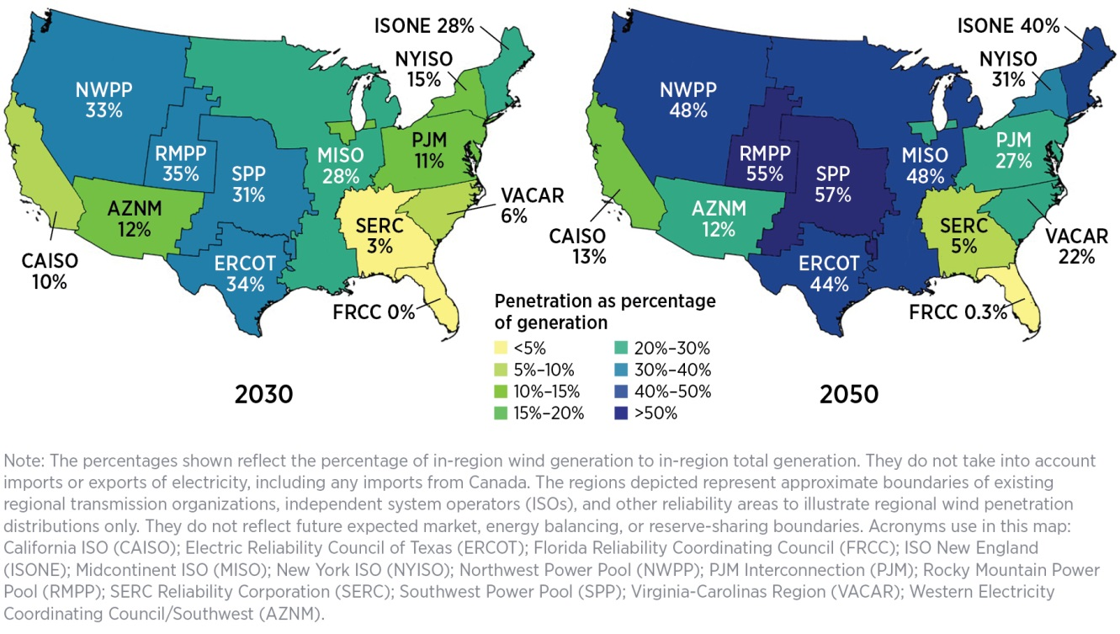
Distribution of Generation

Slide 12
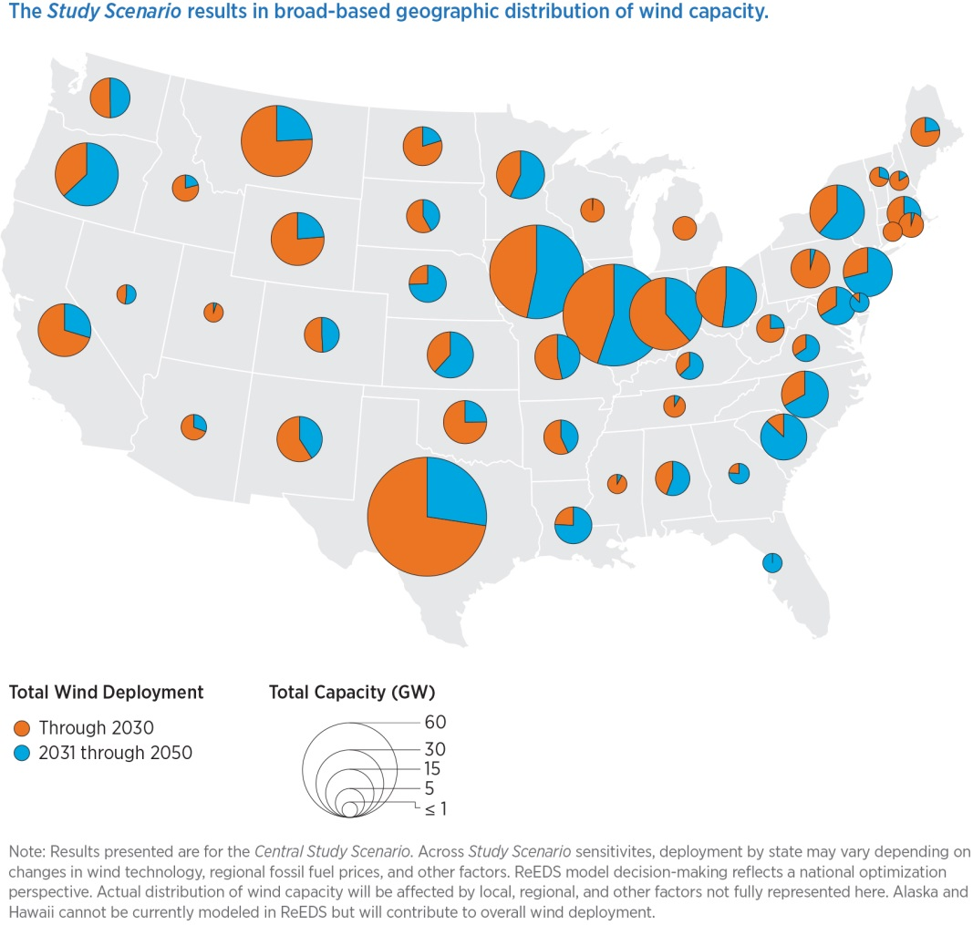
State by State Distribution

Slide 13
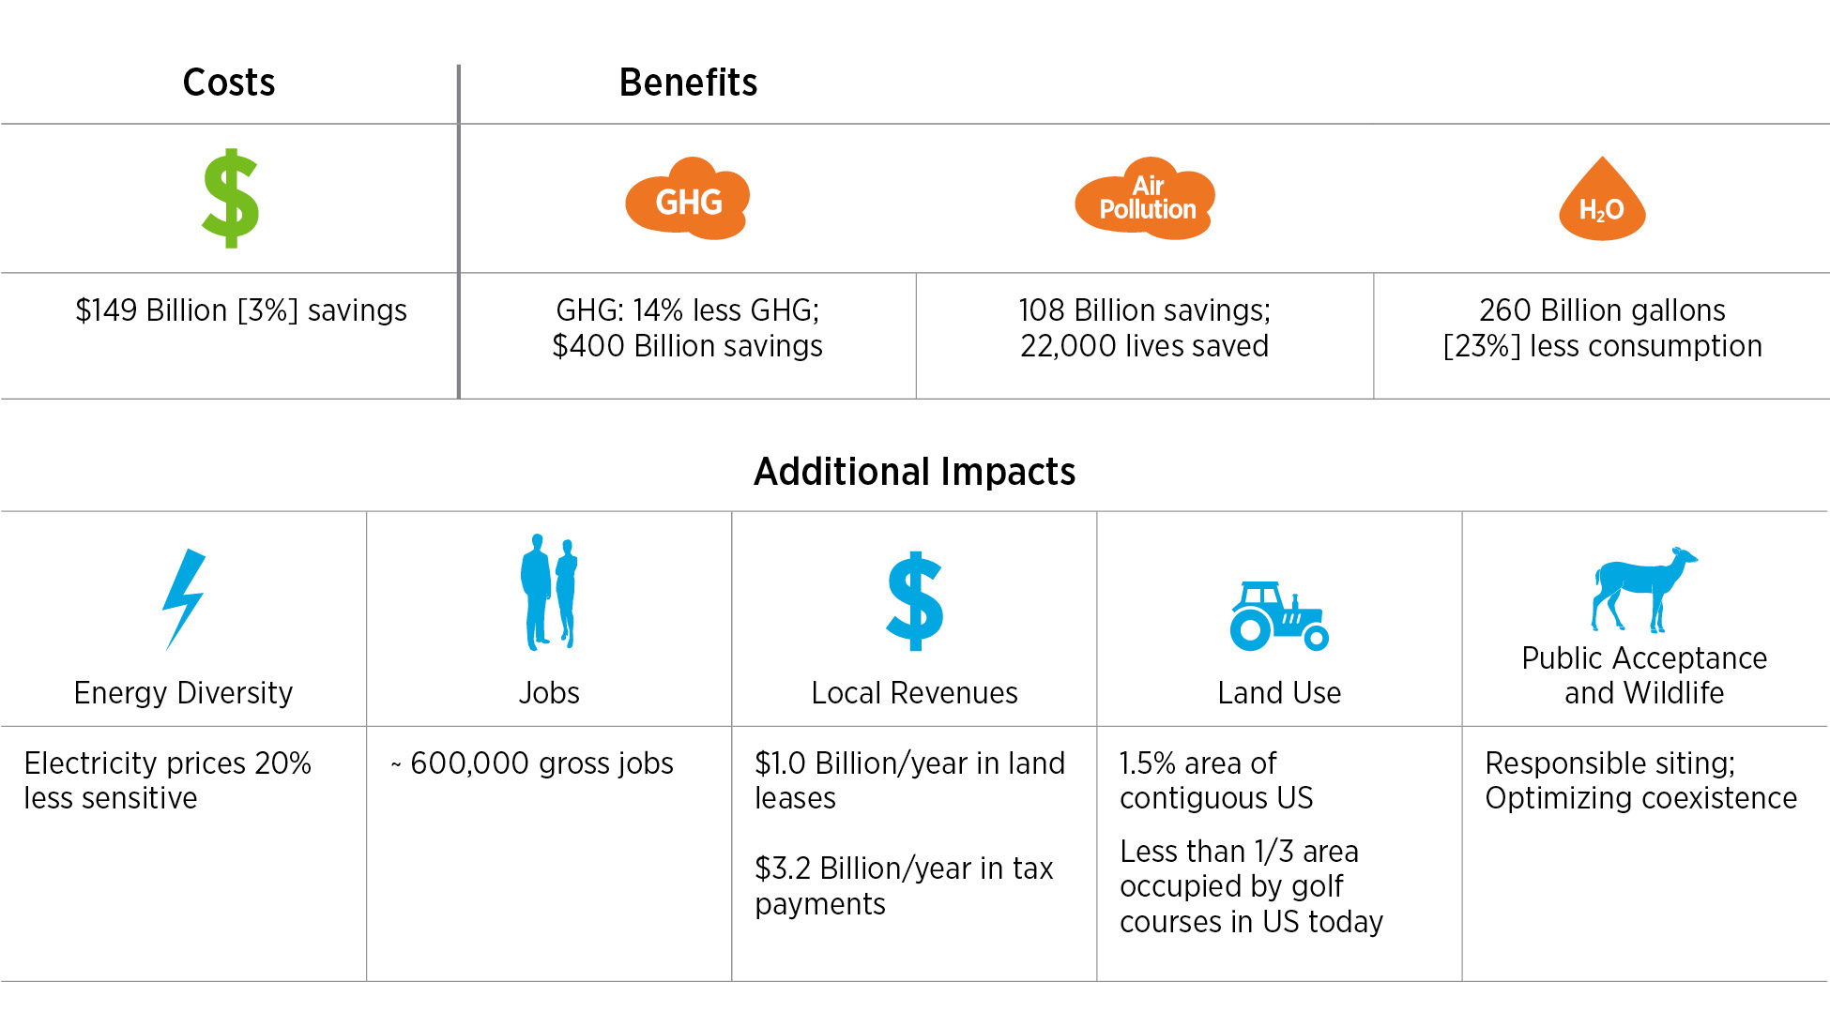
The Wind Vision Results
The Potential of 35% of the Country’s Electricity Coming from Wind Energy by 2050
$
The Wind Vision Study Scenario results in modest increases in electricity cost in the near- and mid-term (<1% price increase), but in the long term electricity costs savings of 2% are achieved by 2050

Slide 14
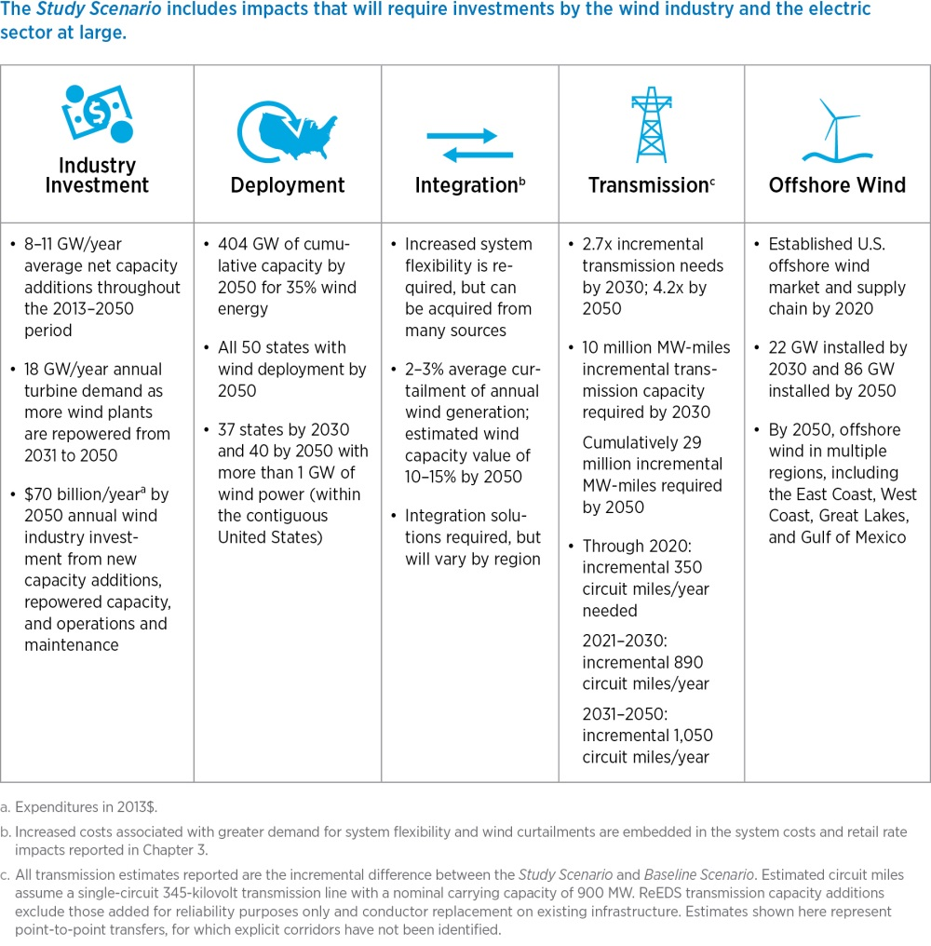
Needed Investments

Slide 15
Needed Actions by Discipline
Wind Power Resources and Site Characterization
Wind Plant Technology Advancement
Supply Chain, Manufacturing and Logistics
Wind Power Performance, Reliability, and Safety
Wind Electricity Delivery and Integration
Wind Siting and Permitting
Collaboration, Education, and Outreach
Workforce Development
Policy Analysis

Slide 16
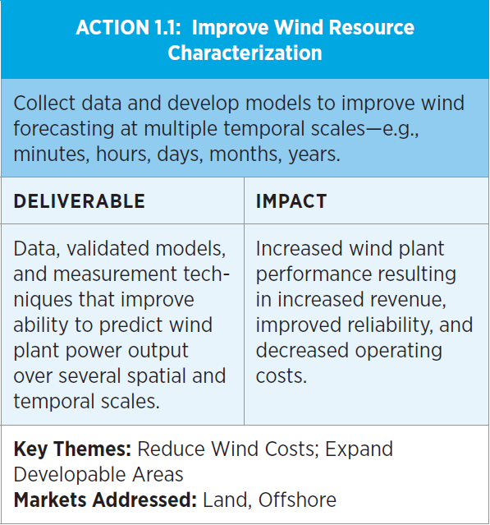
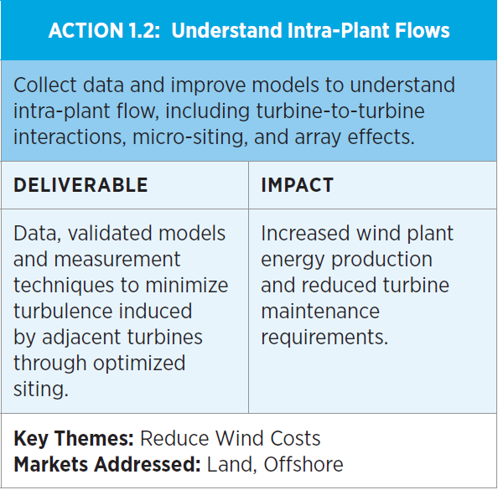
Actions: 1. Wind Resource and Site Characterization

Slide 17
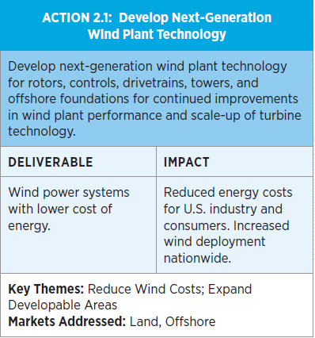
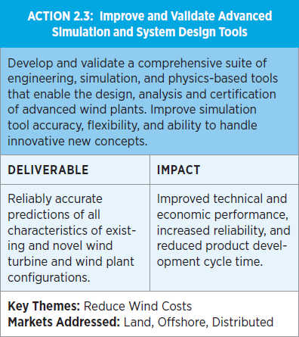
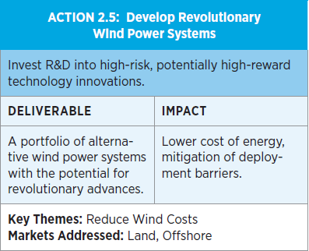
Actions: 2. Wind Technology

Slide 18
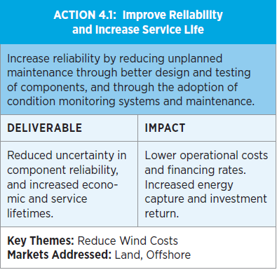
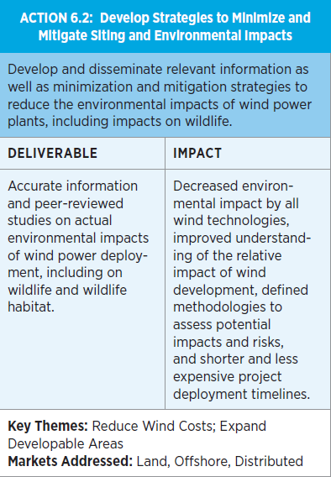
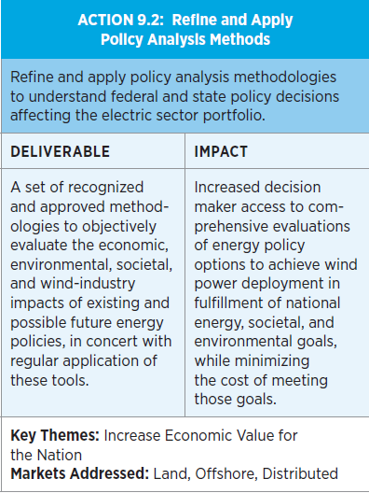
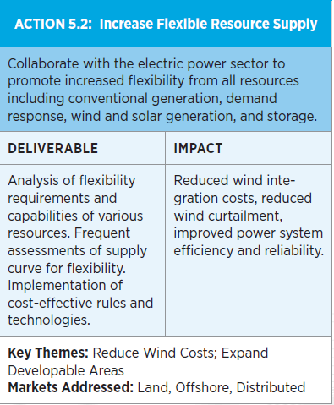
Other Actions:
Other Actions
These are all significant Challenges!

Slide 19
Annual Energy Outlook 2015
Another Perspective and Renewable Energy and Wind
AEO2015 Rollout Presentation
Center for Strategic and International Studies
April 14, 2015 | Washington, D.C.
by
Adam Sieminski, Administrator

Slide 20
Growth in electricity use slows, but electricity use still increases by 24% from 2013 to 2040
Period Average Growth__ Electricity use GDP
1950s 9.8 4.2
1960s 7.3 4.5
1970s 4.7 3.2
1980s 2.9 3.1
1990s 2.4 3.2
2000-2013 0.7 1.9
2013-2040 0.8 2.4
U.S. electricity use and GDP
percent growth (rolling average of 3-year periods)
History
2013
Structural Change in Economy - Higher prices - Standards - Improved efficiency
Electricity use
Projections
Gross domestic product
Source: EIA, Annual Energy Outlook 2015 Reference case
Notes:
20

Slide 21
Over time the electricity mix gradually shifts to lower-carbon options, led by growth in renewables and gas-fired generation
electricity net generation
trillion kilowatthours
History
Projections
2013
1993
2025
2040
31%
27%
Natural gas
27%
13%
13%
16%
Renewables
18%
11%
53%
39%
38%
Coal
34%
19%
Petroleum and other liquids
19%
18%
16%
1%
1%
Nuclear
1%
4%
Source: EIA, Annual Energy Outlook 2015 Reference case
Notes:
21
21

Slide 22
Non-hydro renewable generation grows to double hydropower generation by 2040
renewable electricity generation by fuel type
billion kilowatthours
History
Projections
2013
Conventional Hydroelectric Power
Wind
Solar
Geothermal
Biomass
Municipal waste/Landfill gas
Source: EIA, Annual Energy Outlook 2015 Reference case
Notes:
22

Slide 23
Growth in wind and solar generation meets a significant portion of projected total electric load growth in all AEO2015 cases
U.S. renewable generation in all sectors by fuel
billion kilowatthours
2040
Wind
Solar
Biomass
and waste
Geothermal
Conventional
hydroelectric
power
Source: EIA, Annual Energy Outlook 2015

Slide 24
The Vision’s Actions are Central to NAWEA’s Mission
The Wind Vision “Study Scenario” projects 1,250 TWh/year of wind energy generation in 2040
The EIA Annual Energy Outlook projects wind energy generation of 320 TWh/year in 2040
The contrasting projections clearly show that the Wind Vision Roadmap Actions are needed in order to realize the Wind Vision
The Wind Vision’s multi-disciplinary actions are central to NAWEA’s Mission

Slide 25
The Role of NAWEA
The purpose of the North American Wind Energy Academy (NAWEA or “the academy”) is to facilitate the growth of wind power into a cost-effective, high-penetration, sustainable national energy source producing at least 10 times the 2012 electricity production levels. To meet this energy goal, the academy will expedite the creation of a critical new wind energy research and development agenda that bridges education, multiple disciplines, and diverse organizations, and fosters national and international collaborations
The U.S. Wind Industry
Government
Agencies & Laboratories
The North American Wind Energy Academy
University Research Groups

Slide 26
The Vision and Mission
Vision
The North American Wind Energy Academy will be the leading organization within regions of close proximity to North America, including but not exclusive to the United States, Canada, and Mexico, that are engaged in research, technical, education, market, and policy advancements that will enable wind energy to achieve more than a tenfold increase in 2012 capacity and thereby produce over 20 percent of each region’s or nation’s electrical energy.
Mission
The mission of NAWEA is to bring together North America’s foremost intellectual assets and to apply their collective talents to overcome the challenges of advancing wind power technology and its applications, optimizing its role in meeting national energy needs in an environmentally sustainable manner, while nurturing the development of future generations of technical, management, and policy experts to assure the continued sustainable advancement and optimization of wind power.

Slide 27
NAWEA Activities
Working to expand the breadth and competence of the wind energy academic and national laboratory communities to ensure the continued advancement of wind energy.
Fostering research and development collaborations that bring together the necessary disciplines, agencies, and stakeholders to address topics critical to the advancement of wind energy.
Developing unbiased, accurate, and relevant scientific information on wind power’s benefits and impacts and actively communicate that information to decision makers and the general public though a variety of means such as workshops, symposia, and publications.
Promoting programs and activities that:
  continue the responsible advancement of wind technology;
  accelerate the development of world-class manufacturing capability and jobs creation;
  enhance appropriate widespread deployment; and
  facilitate the full realization of the energy, environmental, and economic benefits offered by wind power in North America.
Conducting any and all other lawful activities consistent with accomplishing the foregoing purpose.

Slide 28
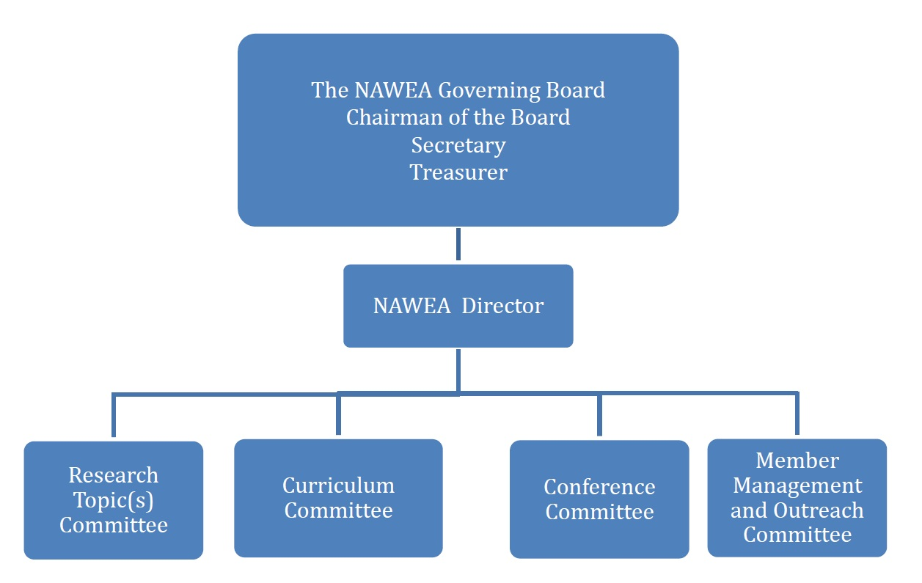
The NAWEA Organization

Slide 29
NAWEA Charter & By-Laws http://www.nawea.org/charter/
The Charter and By-Laws Drafting Committee 2012
Name | Organization
Doug Cairns, Charter Committee Chair | Montana State University
Patrick Butler | University of Iowa
Ed DeMeo | Renewable Energy Consulting Services, Inc.
Michael Knotek | Renewable and Sustainable Energy Institute
James Manwell | University of Massachusetts Amherst
Pat Moriarty | National Renewable Energy Laboratory
Will Shaw | Pacific Northwest National Laboratory
Diane Stults | Renewable and Sustainable Energy Institute
Andy Swift | Texas Tech University
Bob Thresher, NAWEA Director (Interim) | National Renewable Energy Laboratory
Case van Dam | University of California Davis
Paul Veers | National Renewable Energy Laboratory
Additional Contributors:
• Tom Acker, Northern Arizona University (UNC)
• Stephan Barth, ForWind, University of Oldenburg, Germany
(acted as a representative of the European Academy of Wind Energy (EAWE))
• Kevin Doran, RASEI
• Rupp Carriveau , University of Windsor, Canada
• Yves Gagnon, Université de Moncton, Canada
• Sue Haupt, University Corporation for Atmospheric Research (UCAR)
• Hogan Lovells served as pro bono legal counsel to assist the charter committee
  in drafting the by-laws framework on a pro-bono basis.
  Attorneys included: Dennis Arfmann (Denver), Brandon Wilson (WDC), Christian Ulrich (WDC)
• William Mahoney, University Corporation for Atmospheric Research (UCAR)
• Mike Robinson, National Renewable Energy Laboratory (NREL)
• J. Charles (Charlie) Smith, Utility Wind Integration Group (UVIG)

Slide 30
Current NWEA Activities
The Curriculum Committee:
  Developing a “Graduate Certificate Program in Wind Energy”
  Report: Plotting the Couse for Education Program through NAWEA
  Operating under the auspices of the Southwest Renewable Energy Institute a 501 c3 for proposal writing
  Education Committee Meeting Tuesday, 5 pm in 115 Goodwin Hall
NAWEA 2015 Symposium hosted and organized by Virginia Tech Organizing Committee with support of the NAWEA Symposium Executive with DOE Wind Program Sponsorship
Graduate Student Symposium, Monday 1:30 -5:00 pm in Goodwin Hall, Organized by Matthew Lackner, University of Massachusetts, Amherst
NAWEA Sponsored Training Sessions, Monday
  FAST Training Session
  WISDEM Training Session
  SOWFA Training Session

Slide 31
NAWEA Board Meeting
Organizers and supporters are invited to the NAWEA Board Meeting, 115 Goodwin Hall, Wednesday at 7 pm
The Agenda for the Board Meeting:
  Planning the next Symposium in 2017, host, venue and format?
  Should NAWEA organize under the auspices of the Southwestern Renewable Energy Institute, a (501 c3)?
  The Education Committee Report
  Discussion about the Wind Vision Actions and how the Research Committee could contribute
  How to fill the NAWEA Director Position going forward?
  Other Business from attendees
Have a great 2015 Symposium!

