Slide 1
Cell Cycle Visualization Website
Cesar Smokowski, Shuai Lin, Donghyeon Shin
CS 4624 Multimedia, Hypertext, and Information Access, Dr. Fox
Virginia Tech, Blacksburg VA 24061
5/7/22

Slide 2
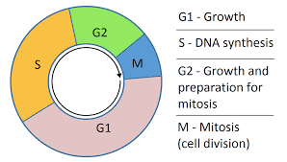
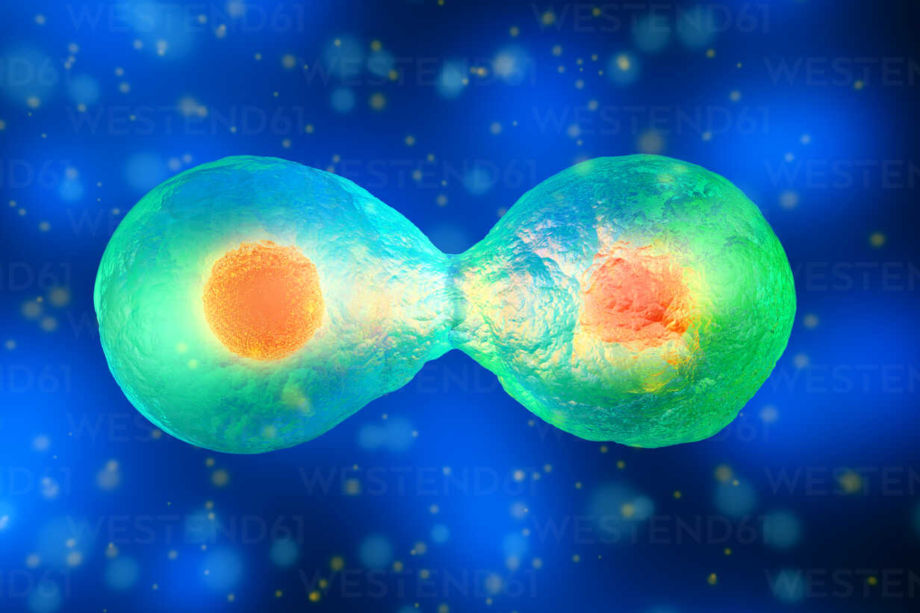
Outline
Project Overview
Team Goals
Deliverables
Demonstration
Project Timeline
Client Feedback
Challenges
Lessons Learned
Work for Future Teams
Acknowledgements
References

Slide 3
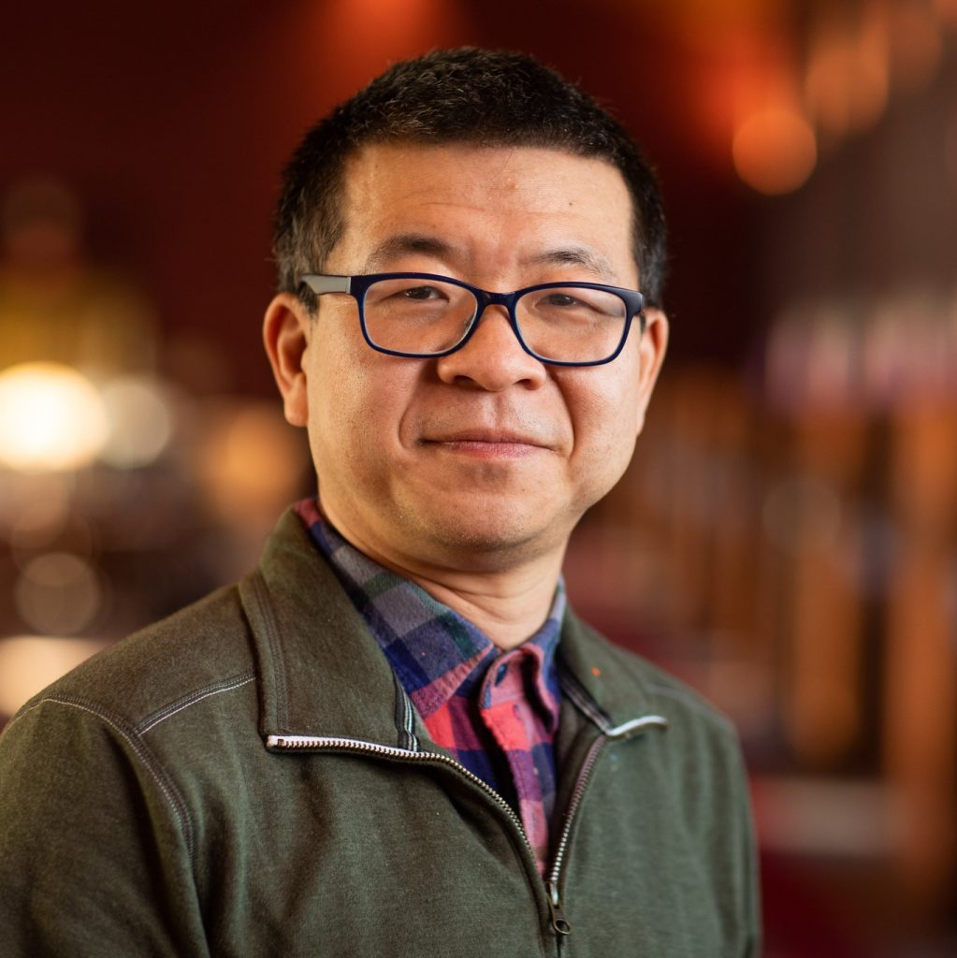
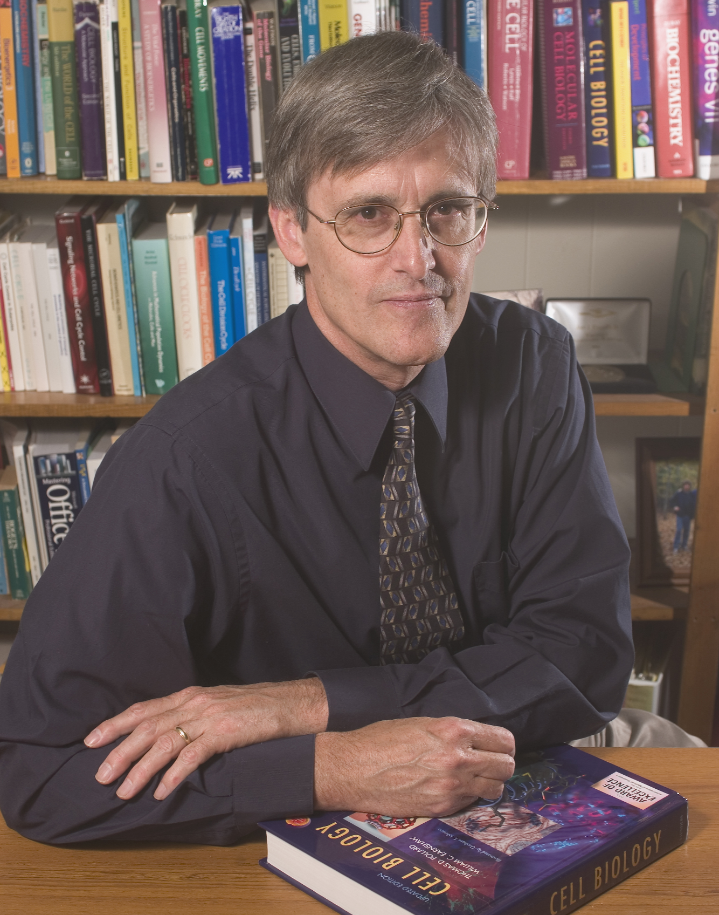
Project Overview
Goal: Create educational Cell Cycle Website
Client: Young Cao + Research from John Tyson
User Groups
Younger Students - Introductory Info
General Public - Cell Cycle Examples
Experienced Users - Mathematical Models
Technology: HTML and JavaScript Files + D3
Professor Young Cao - Client
Professor John Tyson
Biology Researcher

Slide 4
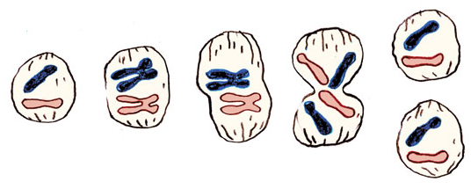
Team Goals
Level 1: lower grades
Accurate, clear information
Site is easy to navigate
Content for each user group
Helpful mathematical models
Links for further learning
Level 2: general public
Level 3: Users with Background Knowledge

Slide 5
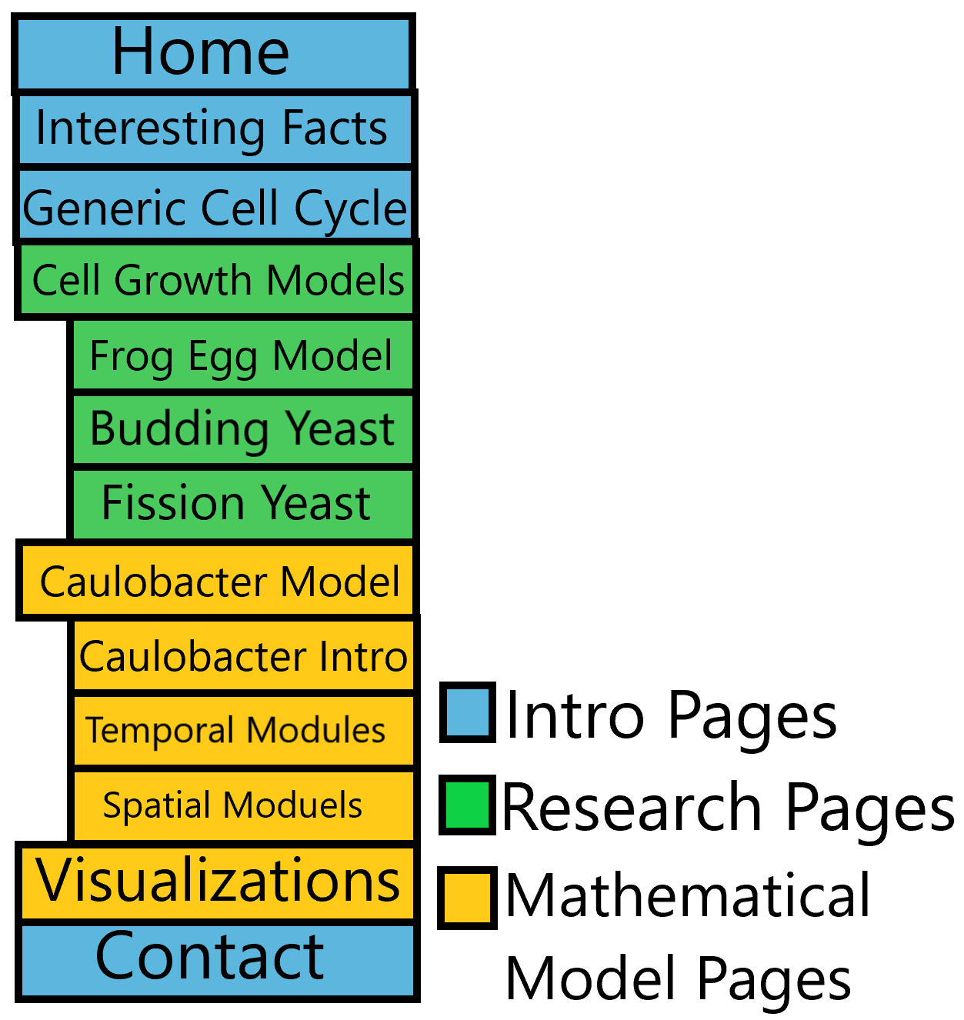
Deliverables Pt 1
Introductory Info
Home Page
Interesting Facts
Cell Cycle Models
Generic Cell Cycle
Frog Egg Model
Budding Yeast Model
Fission Yeast Model
Research Pages
Caulobacter Information
Spatial Cell Modules
Temporal Cell Modules
Mathematical Models
Visualization Page

Slide 6
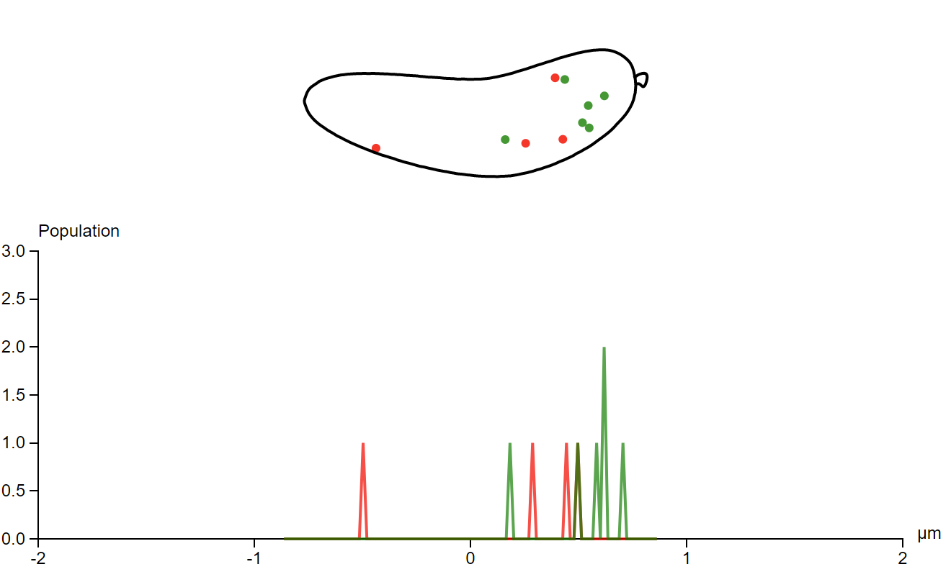
Demonstration
CellCycleVisualizationDemo.MP4 is a walkthrough of the full website
Displays content of Introductory + Research Pages
Shows how to use PopZ mathematical model
Demonstrates navigation sidebar + drop down menu functionality

Slide 7
Project Timeline
Phase 1 1st Week of February | Phase 2 3rd Week of February | Phase 3 2nd Week of March | Phase 4 1st Week of April | Phase 5 End of April
- 1st Meeting with client - Understand website files - Collect background info | - Design website layout - Review each other’s information - Assign web pages to work on | - 2nd meeting with client - Implement Dr. Cao’s feedback - Create cell cycle model pages | - Add links for further learning - Condense research info into two pages | - Final client meeting - Test math models - Improve website design

Slide 8
Client Feedback
Meeting 1 February 4th | Include content for general public & younger students Use up to date research information Order pages from simplest to most complex
Meeting 2 March 18 | Add links for further learning Create separate pages for Cell Cycle Models Add detailed Generic Cell Cycle page
Meeting 3 April 22 | Include all Cell Cycle visualizations on one page Test all mathematical models Include reference section for each page

Slide 9
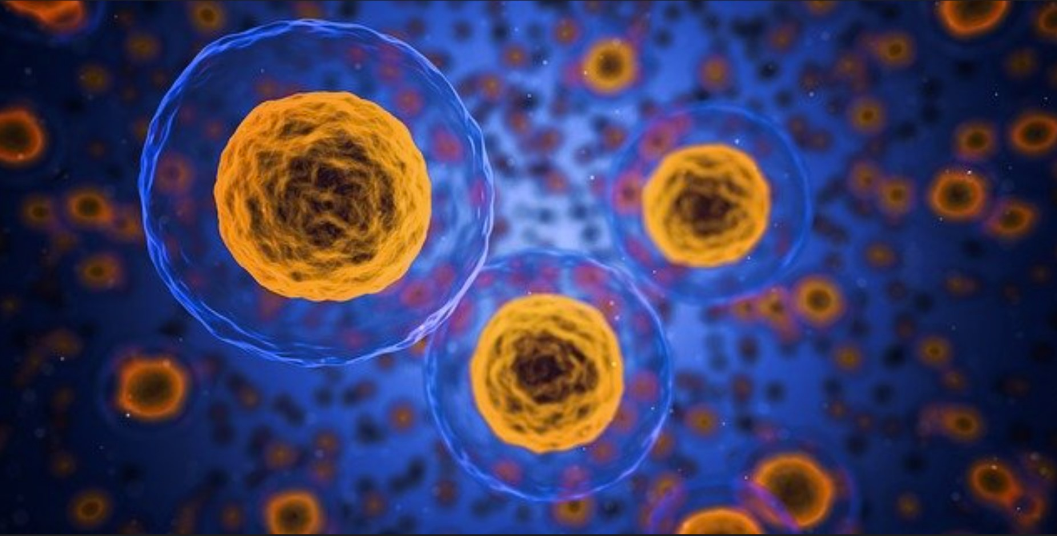
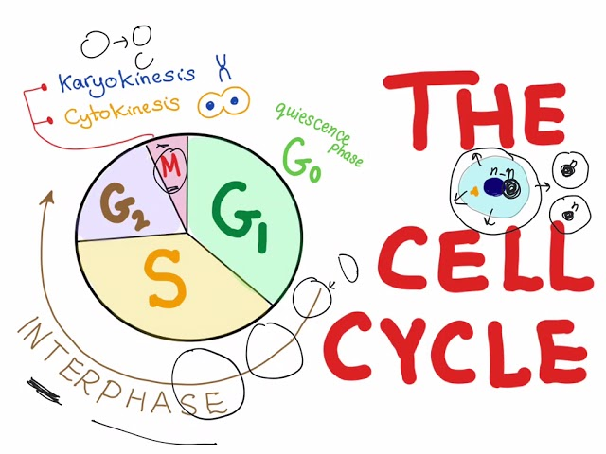
Lessons Learned
Portraying technical information in a clear, concise way is very important
Defining the needs of each user group is helpful for organizing information
Choosing engaging, informative graphics can convey a lot of information in a easy to understand way

Slide 10
Challenges
Finding helpful websites that have clear information
Creating content for younger students, general public & experienced users
Understanding Cell Cycle mathematical models
Dividing work and adjusting to Professor Cao’s feedback

Slide 11

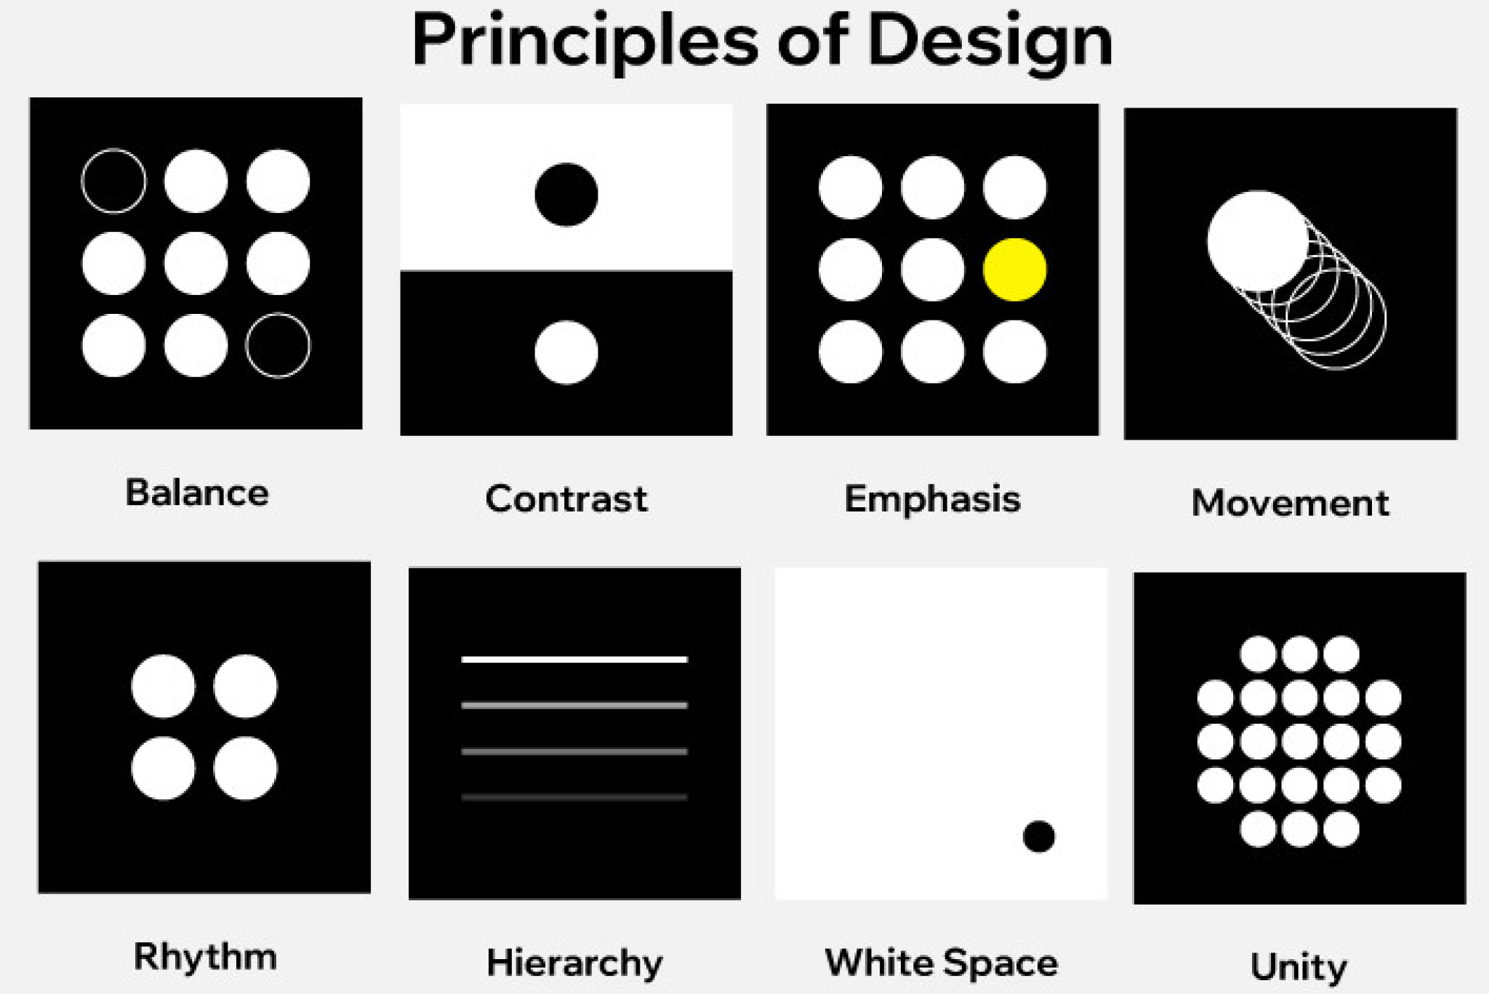
Work for Future Teams
Accessibility Support
Audio translation for each page
Accessibility option for interactive models
Search Bar
Helpful for finding topics
+ keywords
Design/UX Improvements
Add new design elements

Slide 12
Acknowledgements
Client:
Dr. Young Cao, Ph.D, Associate Professor, Department of Computer Science
Source of Research Data
Professor John Tyson, Distinguished Professor, Department of Biological Sciences
Mentor
Dr. Edward Fox. Ph.D, Professor, Department of Computer Science
Ryan Wood, GTA

Slide 13
References
Port, Tami. “Types of Cell Division: Binary Fission, Mitosis & Meiosis.” Types of Cell Division: Binary Fission, Mitosis & Meiosis, Science Prof Online, 12 Mar. 2016, https://www.scienceprofonline.com/genetics/types-cell-division-binary-fission-mitosis-meiosis.html. Accessed 2 May. 2022.
Brody, Lawrence C. “Cell Cycle.” Genome.gov, National Human Genome Research Institute, 8 Oct. 2015, https://www.genome.gov/genetics-glossary/Cell-Cycle. Accessed 2 May. 2022.
Jacobs C, Hung D, Shapiro L (2001) Dynamic localization of a cytoplasmic signal transduction response regulator controls morphogenesis during the Caulobacter cell cycle. Proc Natl Acad Sci U S A 98: 4095-4100.
Reisinger SJ, Huntwork S, Viollier PH, Ryan KR (2007) DivL Performs Critical Cell Cycle Functions in Caulobacter crescentus Independent of Kinase Activity. J Bacteriol 189: 8308-8320.
Yao G, Lee TJ, Mori S, Nevins JR, You L (2008) A bistable Rb-E2F switch underlies the restriction point. Nature Cell Biology 10: 476-482.
Paul R, Jaeger T, Abel S, Wiederkehr I, Folcher M, et al. (2008) Allosteric regulation of histidine kinases by their cognate response regulator determines cell fate. Cell 133: 452-461.
Boldt, R. C. “The Cell Cycle - Phases - Mitosis - Regulation.” TeachMePhysiology, TeachMe Science Series, 26 Jan. 2021, https://teachmephysiology.com/biochemistry/cell-growth-death/cell-cycle/. Accessed 2 May. 2022.
Tyson, John J, et al. Cell Cycle, Budding Yeast, Encyclopedia of Systems Biology, 6 Nov. 2014, https://cannabislifenetwork.com/endocannabinoid-system-face-masks/. Accessed 2 May. 2022.
Kirschner, Marc. “What Makes the Cell Cycle Tick? A Celebration of the Awesome Power of Biochemistry and the Frog Egg.” Molecular Biology of the Cell, The American Society for Cell Biology, 15 Dec. 2020, https://www.ncbi.nlm.nih.gov/pmc/articles/PMC7927191/. Accessed 2 May. 2022.

