Slide 1


Strategic Management
Chapter 4
Internal Analysis
Unless otherwise noted, this slide deck is (c) Virginia Polytechnic Institute and State University. It is released under a Creative Commons Attribution NonCommercial ShareAlike 3.0 license (CC BY NC-SA 3.0)
Instructor Name | Name of Institution
http://hdl.handle.net/10919/102735
Photo by Jon Sailer on Unsplash

Slide 2
Today’s Agenda – Date Here
Understand main premises of the Resource-Based View (RBV) of the firm
Understand how to analyze a firm’s resources and capabilities and determine their potential for creating a sustainable competitive advantage
  VRIN framework
Use the Value Chain Analysis tool to assess and improve competitive advantage
http://hdl.handle.net/10919/102735

Slide 3
What’s a Company Gonna do?
ECOLOGICAL
POLITICAL TECHNOLOGICAL
THREAT OF ENTRANTS BUYERS
ECONOMIC RIVALRY
GLOBAL LEGAL
SUPPLIERS SUBSTITUTES
SOCIOCULTURAL
http://hdl.handle.net/10919/102735

Slide 4
Resources & Capabilities: What are They?
Resources are assets that a company can draw on when crafting and executing a strategy.
  Resources can be either tangible or intangible or human.
Capabilities are the organizational and managerial abilities to orchestrate a diverse set of resources and deploy them strategically.
  Capabilities are born out of the Resources that a firm has.
  Note that different firms with similar resources may develop different capabilities.
Core competencies are unique strengths, embedded deep within a firm, that allow a firm to differentiate its products and services from those of its rivals, creating higher value for the customer or offering products and services of comparable value at lower cost.
http://hdl.handle.net/10919/102735

Slide 5
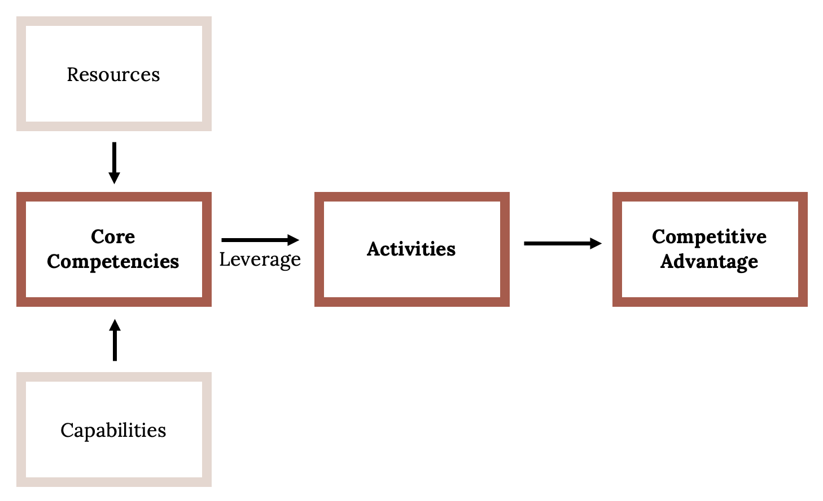
Linking Resources, Capabilities, Core Competencies, and Activities to Competitive Advantage and Superior Firm Performance
http://hdl.handle.net/10919/102735

Slide 6
Examples of Resources and Capabilities
Tangible Resources
  A firm’s property, plant, equipment, and cash
Intangible Resources
  The knowledge and skills of employees, a firm’s reputation, brand name, exclusive rights to intellectual property, leadership traits of executives, or a firm’s culture
Capabilities
  Southwest Airlines has developed the capability of providing excellent customer service by building on its strong organizational culture
http://hdl.handle.net/10919/102735

Slide 7
RBV & VRIO
Resource-based view (RBV):
  Firm performance, which is superior to the average performance of the firms in an industry, is mainly determined by the characteristics internal to the firm (resources and capabilities).
According to the RBV a firm can achieve a competitive advantage if it possesses resources & capabilities that are:
  Valuable
  Rare
  Costly to Imitate
  Organized to Capture Value
VRIO
http://hdl.handle.net/10919/102735

Slide 8
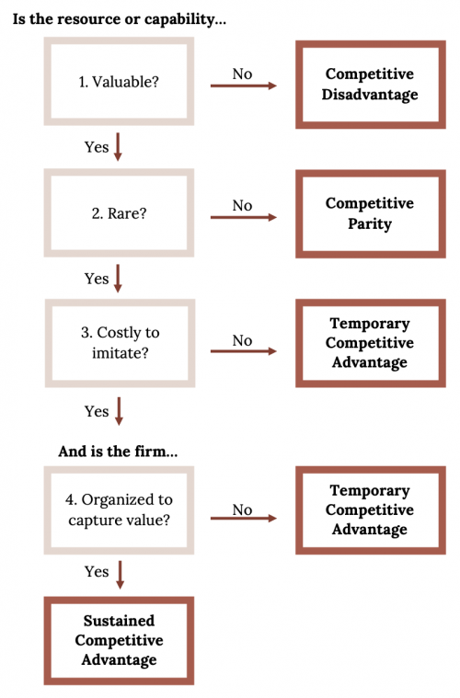
VRIO Framework: Decision Tree
What is the resulting CA?
Figure 4.3: Kindred Grey (2020). “The VRIO Framework with numbers.” CC BY-SA 4.0.
Retrieved from https://commons.wikimedia.org/wiki/File:The_VRIO_Framework_with_numbers.png.
http://hdl.handle.net/10919/102735

Slide 9
Evaluate Resource or Capability
Valuable? | Rare? | Costly to Imitate | Organized to Capture Value | Competitive Implications
No |  |  |  | Competitive Disadvantage
Yes | No |  |  | Competitive Parity
Yes | Yes | No |  | Temporary CA
Yes | Yes | Yes | No | Temporary CA
Yes | Yes | Yes | Yes | Sustainable CA
http://hdl.handle.net/10919/102735

Slide 10
How to Create a Sustainable Resource-based Advantage?
Barriers to Imitation (Isolating mechanisms):
  Social complexity
  Causal ambiguity
  Path dependency
http://hdl.handle.net/10919/102735
Notes:
Barriers to imitation (making it difficult to imitate).
Social Complexity: Deep interpersonal relationships within an organization and with suppliers or customers. Unique organizational cultures.
Causal Ambiguity: Causes of success are obscure and difficult to determine.
Path dependency: The keys to success are from years of learning and iterating processes, or historical circumstances. This could maybe be shown with GE’s culture and HR practices that reward only the highest performers, which may cause a self-selection bias for the people that apply and are willing to work in high pressure situations.

Slide 11
Intangible Barriers to Imitation (Isolating Mechanisms)
Social complexity:
  Interpersonal relations within an organization
  Relations with suppliers and customers
Causal ambiguity:
  Causes of success are obscure and only imperfectly understood
Path dependency:
  Accumulated learning and experience
  Historical circumstances
http://hdl.handle.net/10919/102735

Slide 12
A Framework for Analyzing a Firm’s Resources and Capabilities
4. Develop strategy implications:
-How can VRIO resources and capabilities be exploited more effectively and fully?
-Identify opportunities to outsource activities that can be better performed by other organizations
-How can weaknesses be corrected through acquiring and developing resources and capabilities?
STRATEGY
POTENTIAL FOR SUSTAINABLE COMPETITIVE ADVANTAGE
3. Evaluate resources and capabilities using VRIO framework
2. Explore the linkages between resources and capabilities
CAPABILITIES
1. Identify the firm’s resources and capabilities using value chain or functional analysis
RESOURCES
http://hdl.handle.net/10919/102735
Notes:
Grant, p.157

Slide 13
Develop Strategy Implications
Exploiting key strength
  How can VRIO resources and capabilities be exploited more effectively and fully?
Managing key weaknesses
  Identify opportunities to outsource activities that can be better performed by other organizations
  How can weaknesses be corrected through acquiring and developing resources and capabilities?
http://hdl.handle.net/10919/102735

Slide 14
Team Exercise EXAMPLE? Apple???
What resource or capability do they do especially well?
VRIO
Resource or Capability | Valuable? | Rare? | Difficult to Imitate? | Organized to Capture Value? | Is it a source of sustainable CA?
http://hdl.handle.net/10919/102735

Slide 15
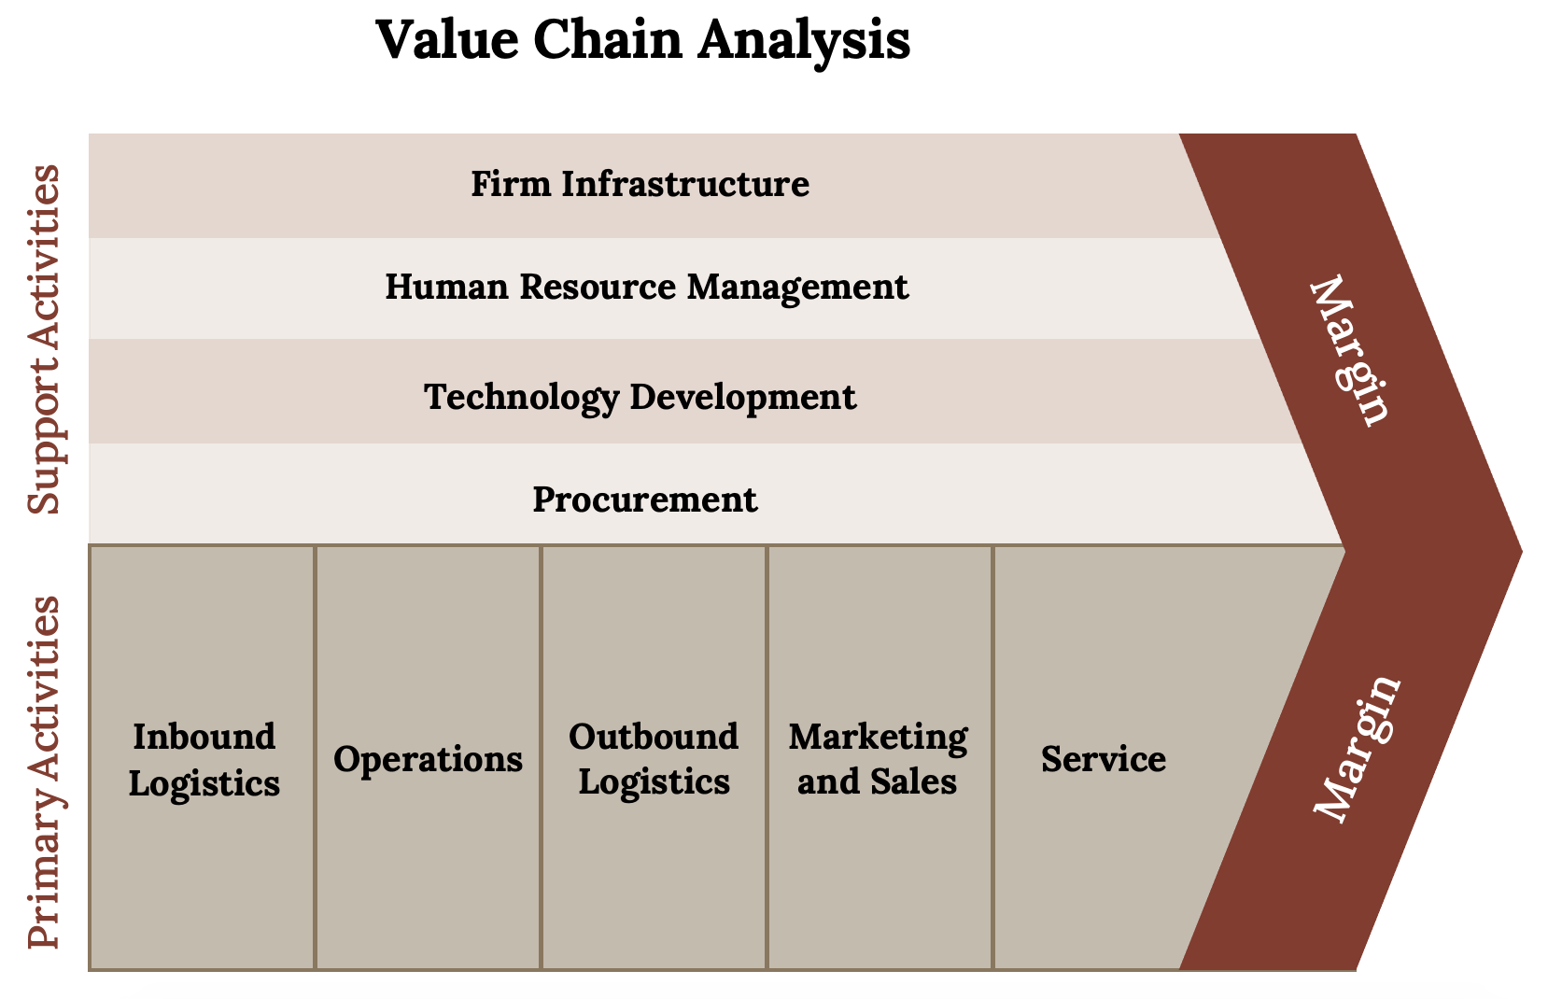
Kindred Grey (2020). “The value chain.” CC BY NC SA 4.0. Adaptation of Figure 4.11 from Mastering Strategic Management (2015) (CC BY NC SA 4.0). Retrieved from https://open.lib.umn.edu/app/uploads/sites/11/2015/04/b38d1270a489c447e16e30df24d931aa.jpg.
http://hdl.handle.net/10919/102735
Notes:
The term value chain reflects the fact that, as each step of this path is completed, the product becomes more valuable than it was at the previous step.
Primary activities are actions that are directly involved in the creation and distribution of goods and services. There are five primary activities:
Inbound logistics refer to the arrival of raw materials.
Operations refer to the actual production process.
Outbound logistics tracks the movement of a finished product to customers.
Marketing and sales attracts potential customers and convinces them to make purchases.
Service refers to the extent to which a company provides assistance to their customers.
Support activities are not directly involved in the evolution of a product but instead provide important underlying support for primary activities.
Company infrastructure refers to how the company is organized and led by executives.
Human resource management involves the recruitment, training, and compensation of employees.
Technological development refers to the use of computerization and telecommunications to support primary activities.
Procurement is the process of negotiating for and purchasing raw materials.

Slide 16
Class Exercise: Value Chain - Netflix
What areas of the Netflix Value Chain provide competitive advantage?
http://hdl.handle.net/10919/102735

Slide 17
Class Exercise: Value Chain - Southwest Airlines
http://hdl.handle.net/10919/102735

Slide 18
SWOT as Tool in Context
External Analysis
Competitive Analysis
Internal Analysis
SWOT
  Summation of major findings
http://hdl.handle.net/10919/102735

