Slide 1

Chapter 10
Operations Management
(c) Virginia Tech, Department of Management, Pamplin College of Business. CC BY NC SA 4.0.
Available from: http://hdl.handle.net/10919/105157

Slide 2
Objectives
Upon completing the learning activities associated with this lesson, class participants should be able to:
Define operations management and discuss the role of the operations manager in a manufacturing company.
Describe the decisions and activities of the operations manager in overseeing the production process in a manufacturing company.
Explain how to create and use both PERT and Gantt charts
Explain how manufacturing companies use technology to produce and deliver goods in an efficient, cost-effective manner.
Describe the decisions made in planning the product delivery process in a service company.
List the characteristics that distinguish service operations from manufacturing operations and identify the activities undertaken to manage operations in a service organization.
Explain how manufacturing and service companies alike use total quality management and outsourcing to provide value to custom

Slide 3
Product Development– Business Growth

Slide 4
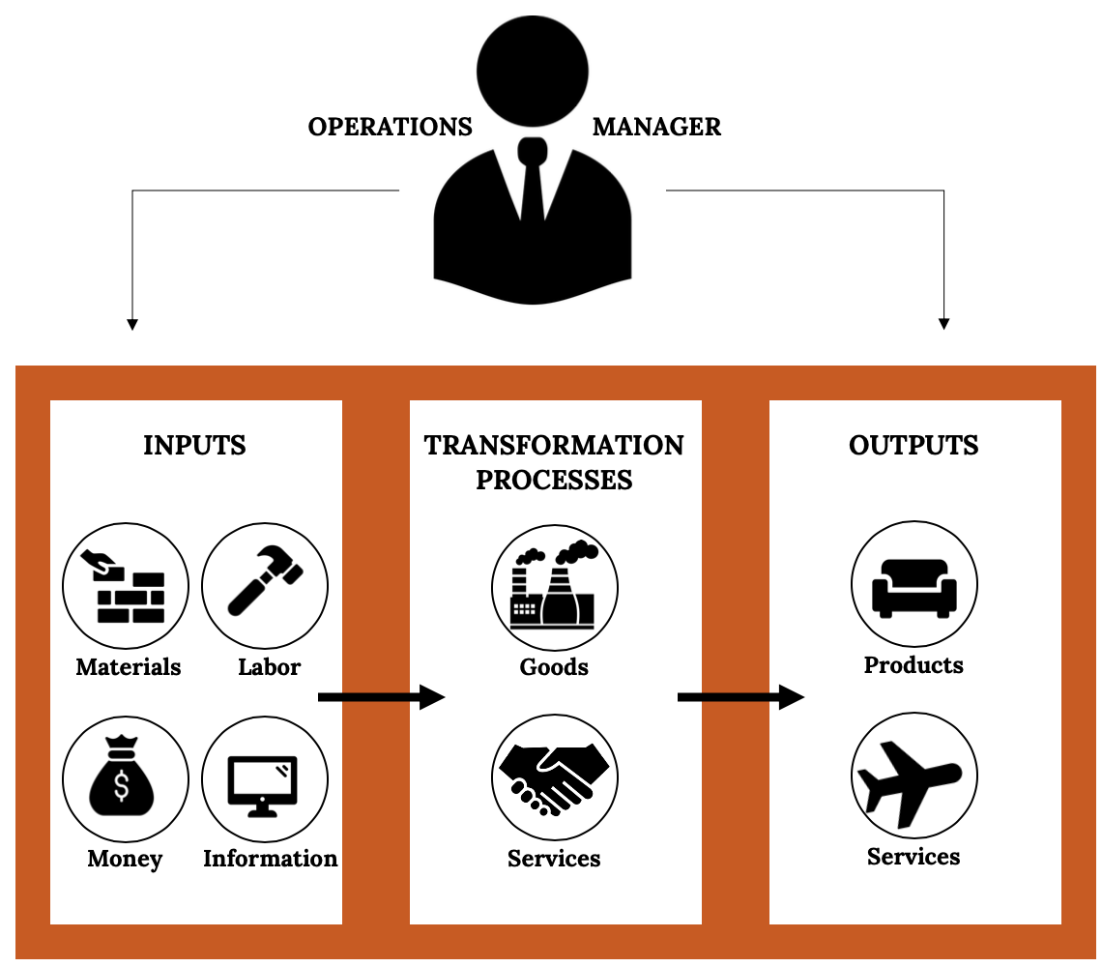
Operation Management in Manufacturing
Figure 10.2: The transformation process.

Slide 5
Operations Management
Production Planning Process
How goods will be produced
Where production will take place
How manufacturing facilities will be laid out
Production Control Process
Continually schedule and monitor the activities that make up that process
Must solicit and respond to feedback
Make adjustments where needed
Oversee the purchasing of raw materials and inventories
Quality Control Process
Ensure that goods are produced according to specifications
Quality standards are maintained

Slide 6
Production Methods
Make-to-Order
Products customized to meet the needs of the buyers.
Low-volume, high-variety goods according to customer specifications.
Often results in a longer production and delivery cycle than other approaches.
Commonly used by such businesses as print or sign shops.
Mass Production
Practice of producing high volumes of identical goods at a cost low enough to price them for large numbers of customers.
Goods are made in anticipation of future demand (based on forecasts).
Kept in inventory for later sale.
Shorter cycle times than a make-to-order process.
Appropriate for standardized goods ranging from processed foods to electronic appliance

Slide 7
Production Methods (cont.)
Mass Customization
Combines the advantages of customized products with those of mass production.
Requires that a company interacts with the customer
Need to manufacture the good, using efficient production methods to hold down costs.
One efficient method is to mass-produce a product up to a certain cut-off point and then to customize it to satisfy different customers

Slide 8
Site Selection
In site selection (choosing a location for the business), managers must consider several factors:
To minimize shipping costs, managers often want to locate plants close to suppliers, customers, or both.
Locate in areas with ample numbers of skilled workers.
Prefer locations where they and their families will enjoy living.
Locations where costs for resources and other expenses—land, labor, construction, utilities, and taxes—are low.
Locations with a favorable business climate
Local governments might offer financial incentives (such as tax breaks) to entice them to do business in their locales.
An enterprise zone is an area in which incentives are used to attract investments from private companies

Slide 9
Site Selection – Amazon HQ2

Slide 10
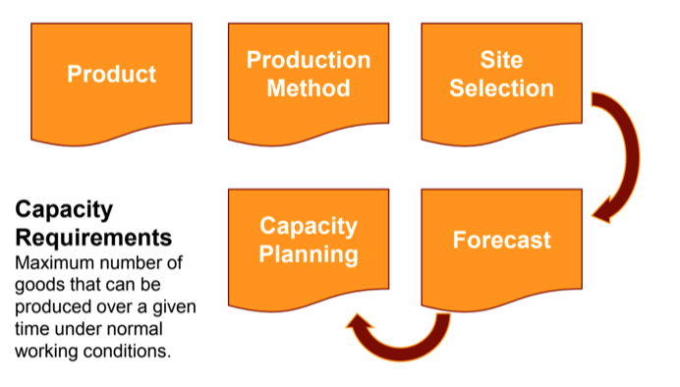
Capacity Planning

Slide 11
Purchasing and Supplier Selection
Purchasing (or procurement) –Process of acquiring the materials and services to be used in production.
Key questions to consider in the Supplier Selection Process –finding the best supplier for the product, technology or process:
Can the supplier supply the needed quantity of materials at a reasonable price?
Is the quality good?
Is the supplier reliable (will materials be delivered on time)?
Does the supplier have a favorable reputation?
Is the company easy to work with?

Slide 12
Inventory Control
Operations Managers within organizations must balance forecasts, capacity and material availability with finance limits and space limitations.
Commonly used inventory control methods include:
Just-in-Time(JIT) production, materials arrive just in time to enter the manufacturing process
Material Requirements Planning(MRP), a software tool to determine material needs.
It uses sales forecasts to anticipate materials that will be needed before ordering them

Slide 13
Graphical Tools
Gantt and PERT charts are two common tools used by operations managers.
A Gantt chart helps operations managers determine the status of projects.
PERT charts diagram the activities and time required and identify the critical path—the sequence of activities that will require the greatest amount of time

Slide 14
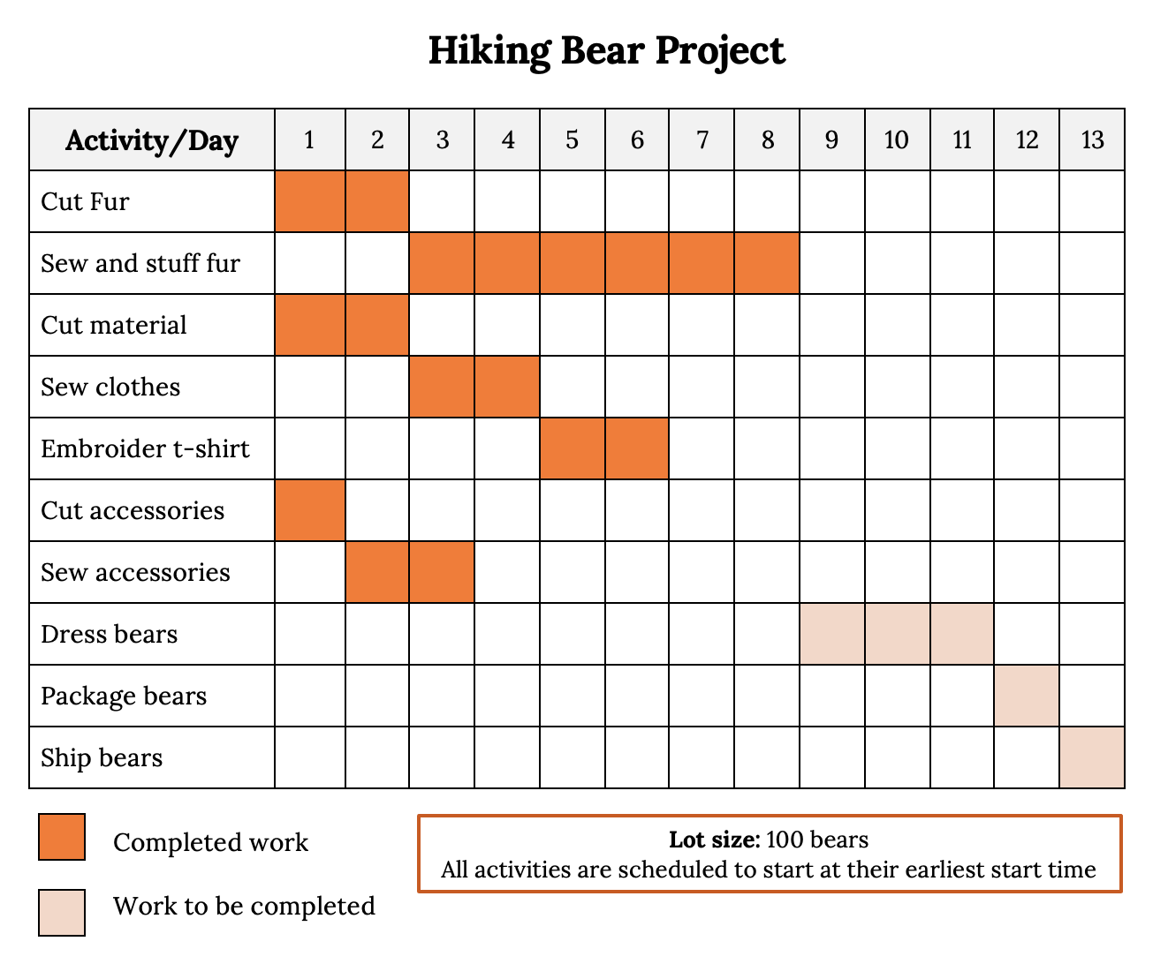
Hiking Bear Project

Slide 15
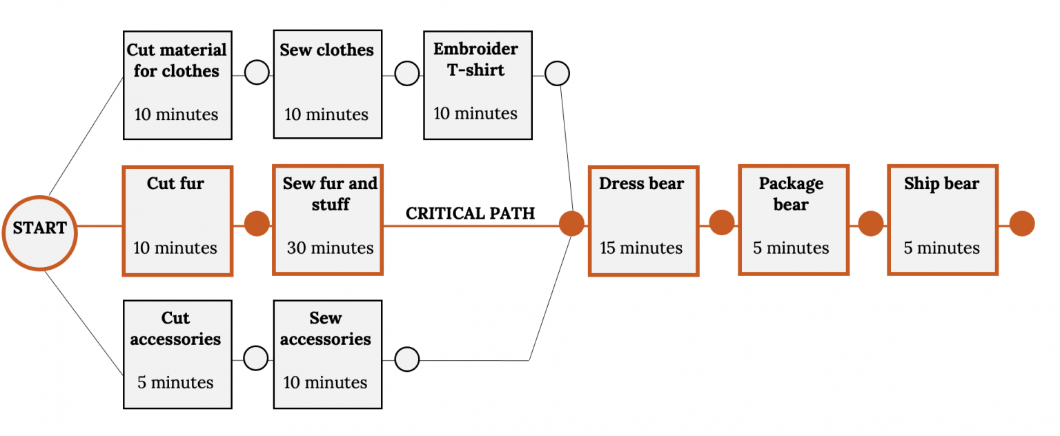
PERT Chart

Slide 16
Quality Management
Total quality management (TQM), or quality assurance, includes all the steps that a company takes to ensure that its goods or services are of sufficiently high quality to meet customers’ needs.
TQM principles focuses on these three tasks:
Customer satisfaction
Encourage customers to tell them how to improve.
Employee involvement
Employees have to be properly trained not only to do their jobs but also to detect and correct quality problems.
Continuous improvement
Commitment to making constant improvements in the design, production, and delivery of goods and services

Slide 17
Takeaways
Operations management oversees the process of transforming resources into goods and services.
During production planning, managers determine how goods will be produced, where production will take place, and how manufacturing facilities will be laid out.
In selecting the appropriate production process, managers consider three basic methods:
make-to-order
mass production
mass customization
Commonly used inventory control methods include just-in-time(JIT) production, by which materials arrive just in time to enter the manufacturing process, and material requirements planning(MRP), a software tool to determine material needs.
Outsourcing can save companies money by using lower cost, specialized labor, located domestically or abroad.

Slide 18
Takeaways
Gantt and PERT charts are two common tools used by operations managers.
A Gantt chart helps operations managers determine the status of projects.
PERT charts diagram the activities and time required and identify the critical path—the sequence of activities that will require the greatest amount of time.
In site selection for a company’s manufacturing operations, managers look for locations that minimize shipping costs, have an ample supply of skilled workers, provide a favorable community for workers and their families, offer resources at low cost, and have a favorable business climate.
Service firms provide intangible products that are often customized to satisfy specific needs. Unlike manufactured goods, many services are bought and consumed at the same time.
Estimating capacity needs for a service business is more difficult than for a manufacturer because service providers can’t store their services for later use.
Many companies deliver quality goods and services by adhering to principles of total quality management (TQM).

Slide 19
Chapter 10
Q&A
(c) Virginia Tech, Department of Management, Pamplin College of Business. CC BY NC SA 4.0.
Available from: http://hdl.handle.net/10919/105157

