Slide 1
Russian Flu
Johanna Pinsirikul, Josh Horn, Taylor Sims, Sam Fisher
Client: Tom Ewing

Slide 2
Introduction
Track the Russian Flu (1889-1890)
Translation Team
  Translate articles obtained from databases from French, German, Spanish, Russian to English
  Pick out specific keywords for faceted search
CS Team
  Provide a way to access articles in the future through a web page
  Different ways of searching and displaying results

Slide 3
Our Work So Far
Worked with client and translation team to decide what features are most important
Designed a GUI template for the website
Currently implementing GUI using Blacklight
Using Solr for searching the database and to interact with our GUI’s search feature

Slide 4
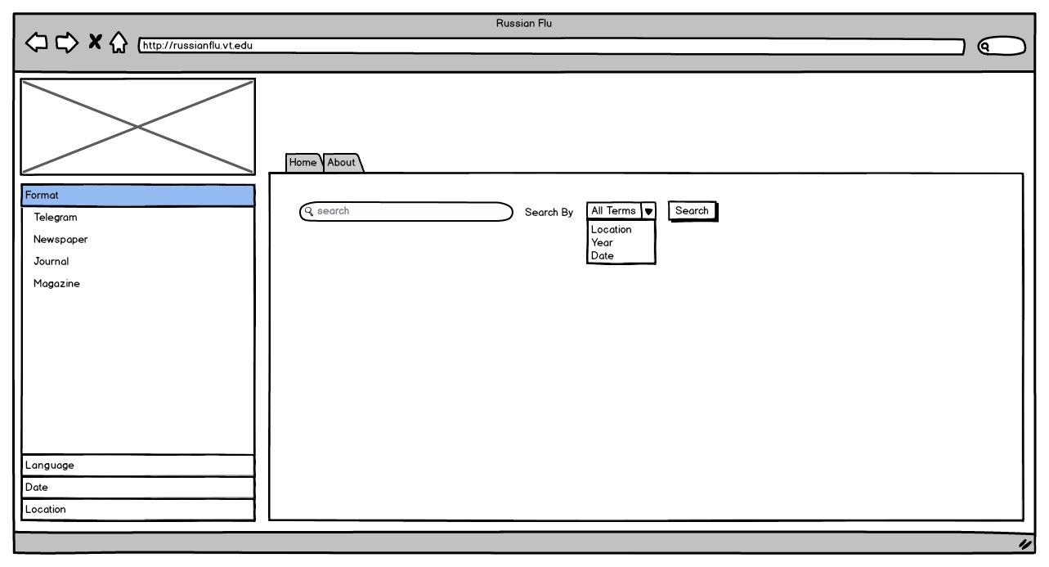
Webpage Features

Slide 5
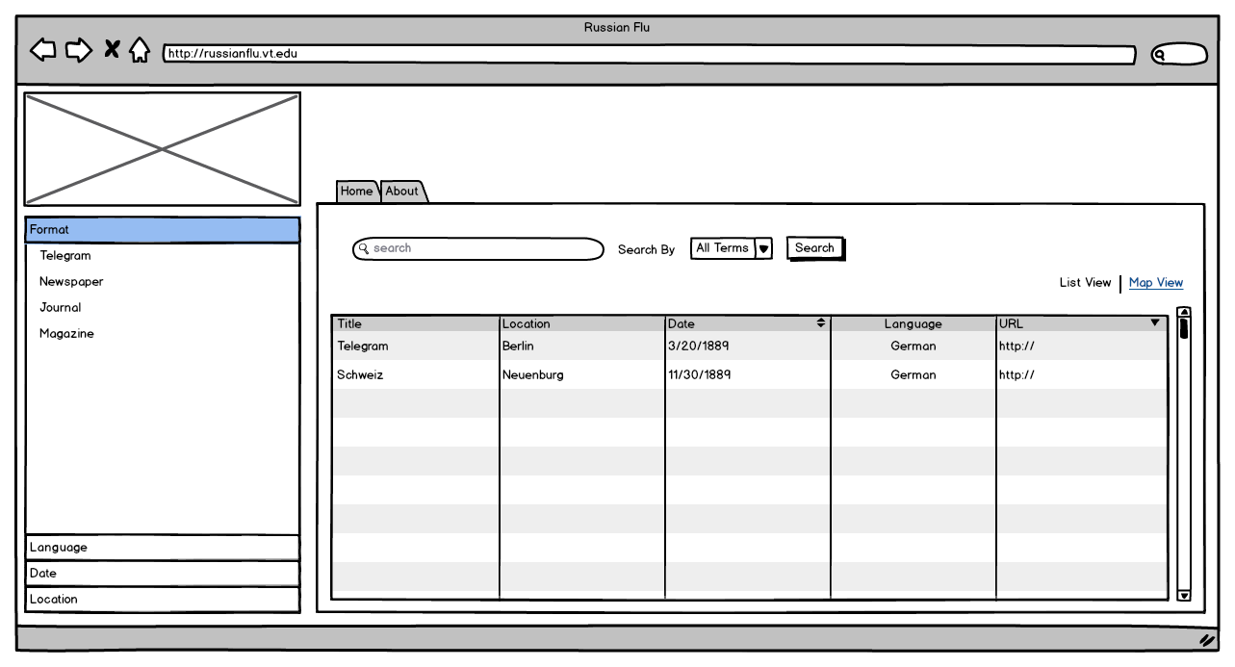
Webpage Features

Slide 6
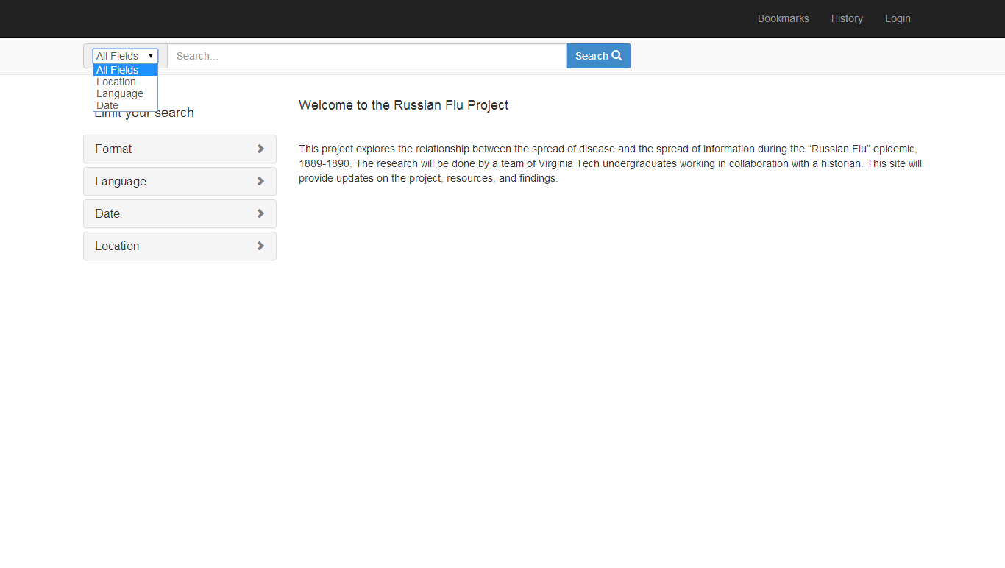
Current Prototype

Slide 7
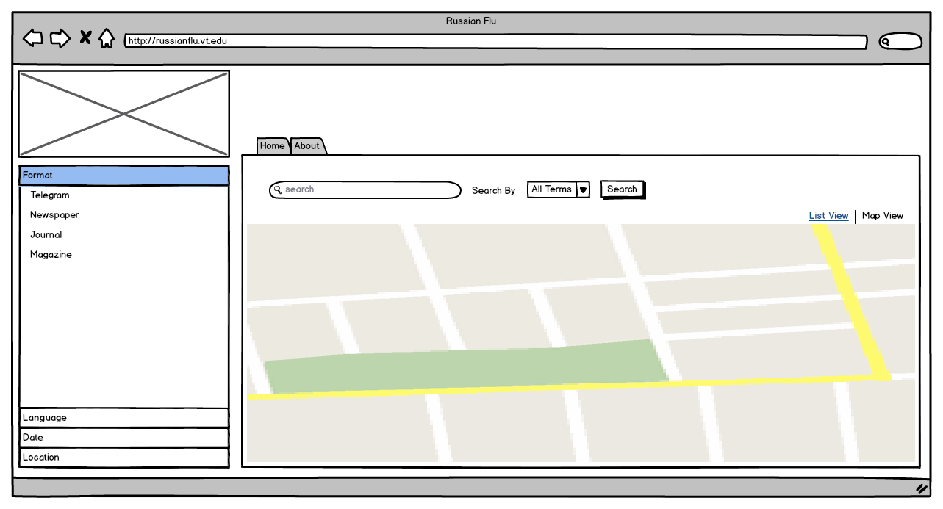
Webpage Features

Slide 8
Setbacks
Originally planned to host webpage and store data within History Department’s clusters
  Access was not granted
Client unsure of website features
Map View
  Client would like to use a map from 1889
  Interactive map vs. stationary 1889 image

Slide 9
Future Plans
Once hosted, move data from local machines to remote
Prototype for NLM Conference March 7
Resolve Map View conflicts and implement map feature
“Flutracker” feature if enough data is provided

Slide 10
Questions?

