Slide 1
Antibiotic Resistance
Seungchan Kweon
CS 4624 Multimedia, Hypertext and Information Access
Dr. Fox
Virginia Tech, Blacksburg VA 24061
11/29/2022

Slide 2
Outline
Overview
Work done
Work in progress
Future Work
Conclusion
Acknowledgements
References

Slide 3
Overview
Gather antibiotic resistance papers
Analyze the papers using DeepEventMine
Analyze the output

Slide 4
Work Done
Gathering Data
Running DeepEventMine
Doing analysis

Slide 5
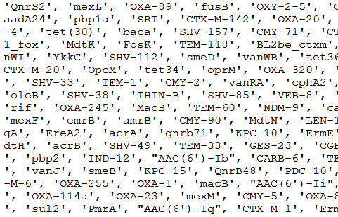
Gathering Antibiotic Resistance Genes
CARD database
ARGminer database
Done with Python
5334 Genes

Slide 6
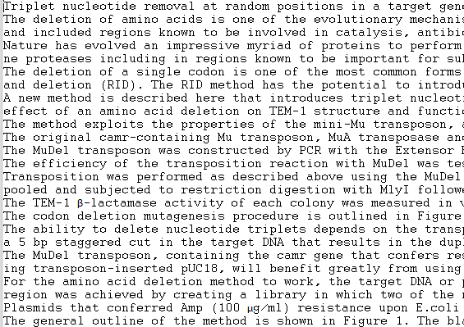
Gathering Papers
Gathered From PubMed
Done with Python
11487 abstracts
3784 full text

Slide 7
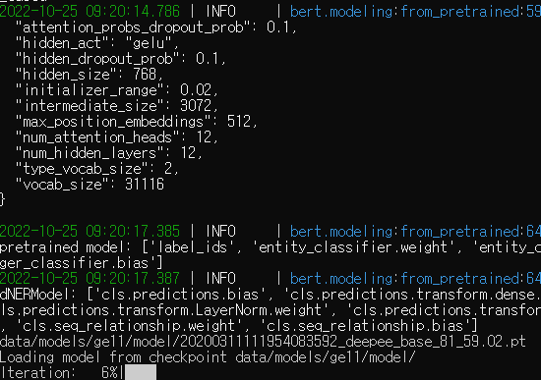
Running DeepEventMine
Input the papers
Run parsing
Set settings
Run the program

Slide 8
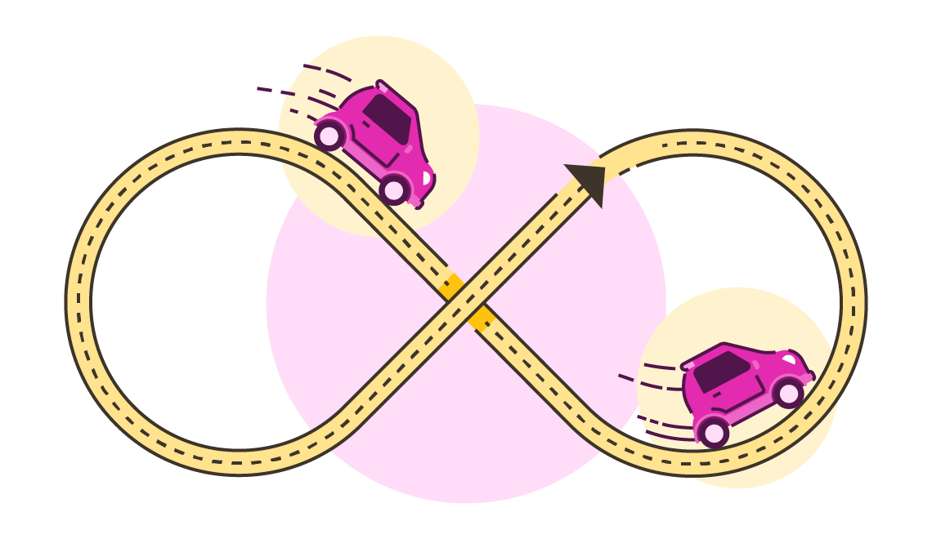
Running DeepEventMine
Infinite loop in parsing
Happens to specific papers
70 papers removed

Slide 9
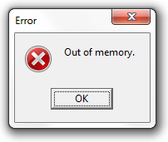
Running DeepEventMine
Out of memory
Data divided into 70 batches
110 abstracts
54 full text

Slide 10
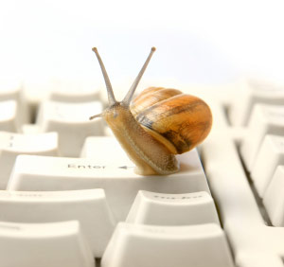
Running DeepEventMine
~90 hours to complete
8900 .ann files
Done on a laptop
Lack of GPU

Slide 11
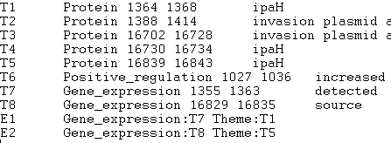
Running DeepEventMine
.ann file
Proteins
Regulation
Gene expression

Slide 12
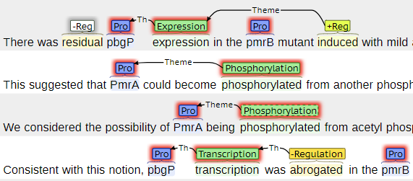
Running DeepEventMine
Visualized with brat
Easier to understand
Useful when reading

Slide 13
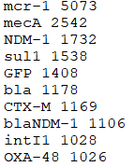
Doing analysis
Combine .ann files
Gather the entity tokens
Parse the relations
Extract complete relations

Slide 14
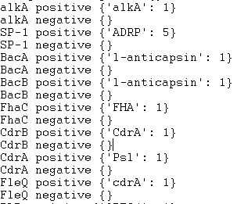
Doing analysis
41283 proteins
806 genes
2735 relations
98 gene relations

Slide 15
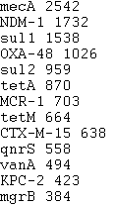
Doing analysis
Most common genes
Relations with genes
Genes that frequently appear together

Slide 16
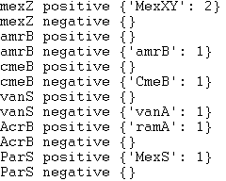
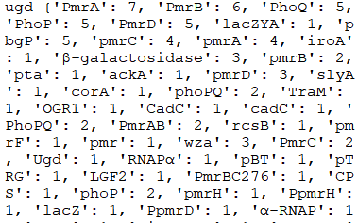
Doing analysis

Slide 17
Future Work
Better data gathering
Further analysis

Slide 18
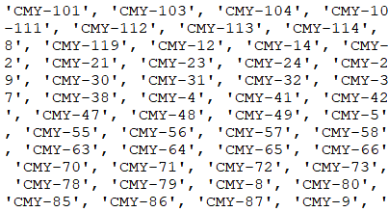
Better Data Gathering
Check gene names
Protein with 4546 results
Combine similar names

Slide 19

Better Data Gathering
More use of advanced search
Search for resistance

Slide 20
Further analysis
Most relations are incomplete
Make use of it
Find a way to complete it

Slide 21

Conclusion
Lot to be desired
Good code for data mining
Later steps could be changed

Slide 22
Acknowledgements
Clients:
Lifu Huang
Liqing Zhang
Instructor:
Dr. Fox

Slide 23
References
https://card.mcmaster.ca/
https://bench.cs.vt.edu/argminer/#/home
https://pubmed.ncbi.nlm.nih.gov/
https://www.ncbi.nlm.nih.gov/research/bionlp/APIs/BioC-PMC/
https://github.com/aistairc/DeepEventMine
https://brat.nlplab.org/

Slide 24
References
https://www.brightcarbon.com/blog/loop-sequence-of-powerpoint-animations/
https://www.scarm.info/blog/problems-and-solutions/cause-and-solution-for-out-of-memory-error-message/
https://www.computerhope.com/issues/ch000179.htm
https://www.flaticon.com/free-icon/search_2344542
https://www.istockphoto.com/photo/sticky-note-on-blackboard-final-thoughts-gm1149872843-311077824

