Slide 1



Maintenance of soil quality and sustainable production through implementation of Conservation Agriculture Production Systems (CAPS) in rainfed, sloping land farming of the mid-hills region of Nepal
BB Tamang
Susan Crow, Theodore Radovich, Puspa Poudyal, Bikash Paudel, Jacqueline Halbrendt, Keshab Thapa

Slide 2
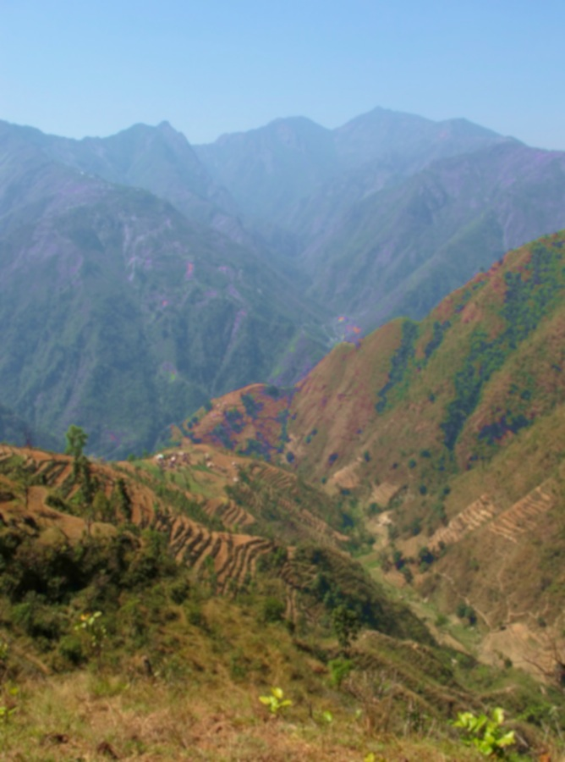
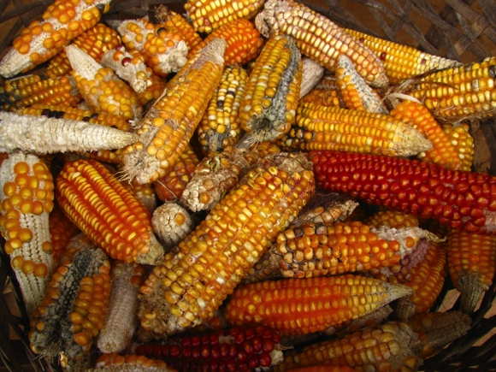
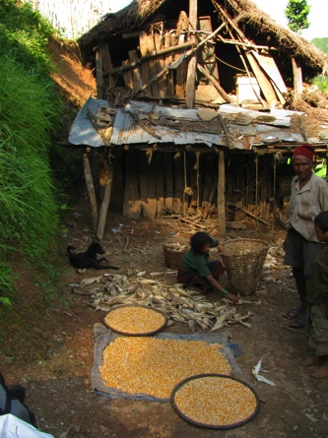
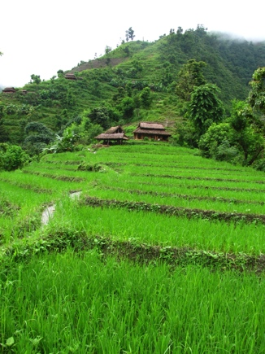
Objectives
To meets the needs of a growing population in a changing world, the
sustainable intensification
of agricultural production systems is required.
To determine the effect of Conservation Agricultural Production Systems (CAPS) on soil quality and crop productivity in the mid-hills region of Nepal.
Photos: J. Halbrendt

Slide 3
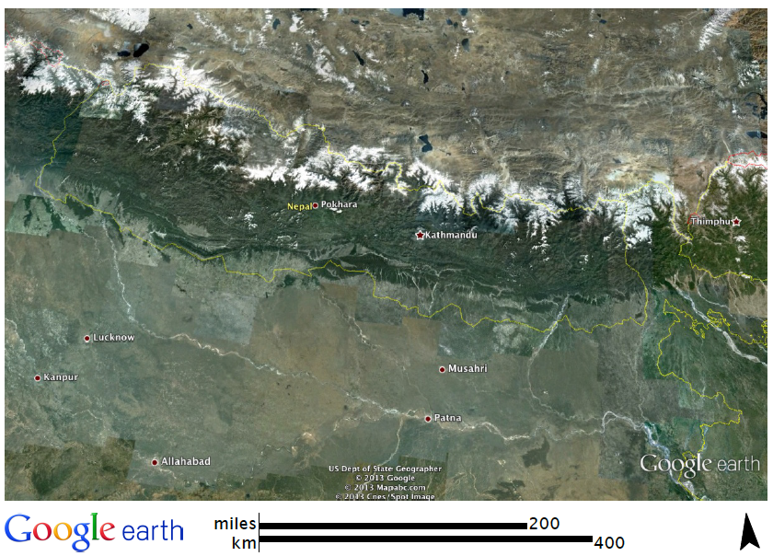
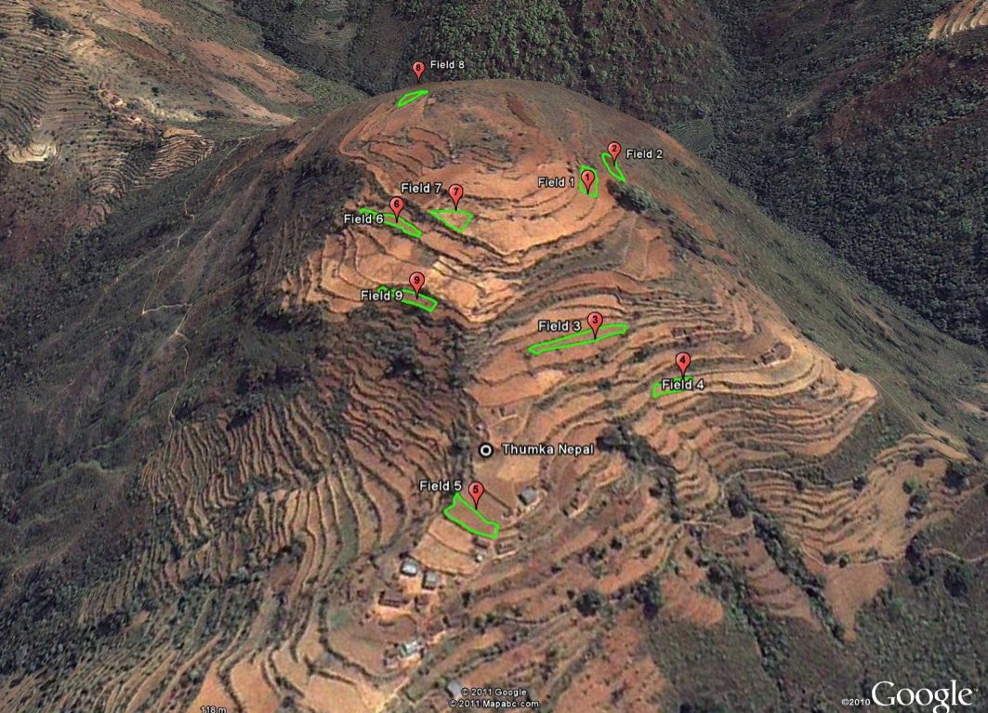
Approach
Replicated on-farm trials at three villages (Thumka, Hyakrang, Kholagaun) in the Trishuli River watershed area in the central mid-hills region of Nepal
Nepal
Mike Mulvaney 2011
Central mid-hills region
Monitoring weather and environmental conditions, determined baseline soil physical and chemical properties and crop yields for each village.

Slide 4
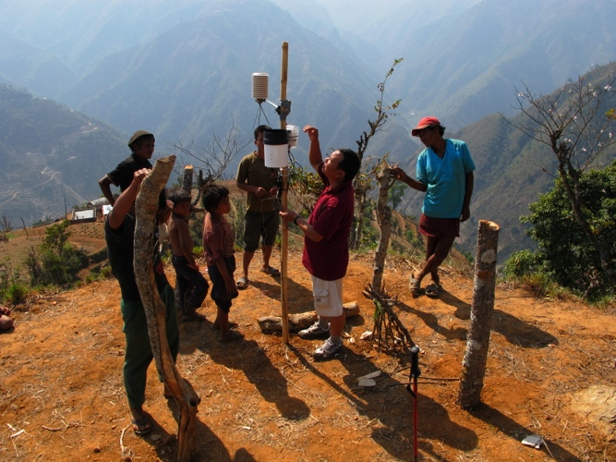
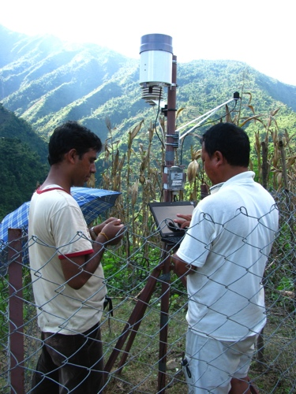
Weather Stations
Installation
Monitoring
Thumka
Photo: S. Crow
Photo: J. Halbrendt
Photosynthetically active radiation (PAR)
Rainfall
Air Temperature
Relative humidity
Soil temperature
Soil moisture
E.g., total PAR, rainfall, air temperature affect productivity

Slide 5
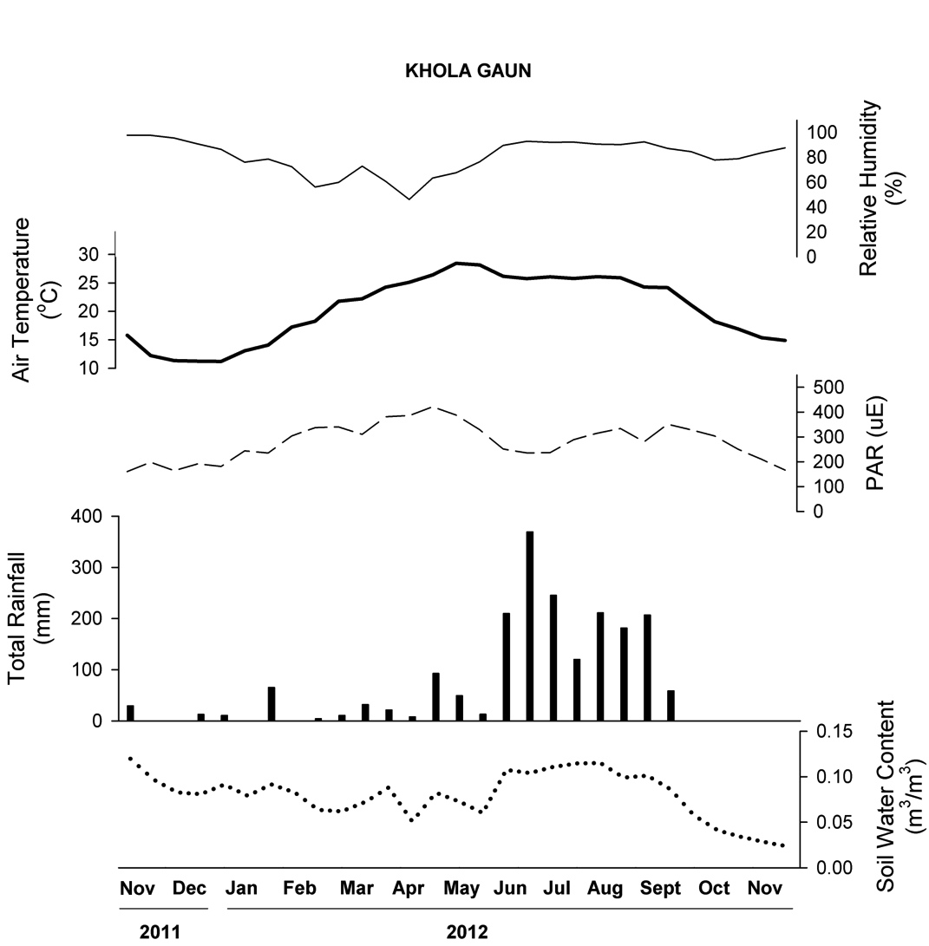
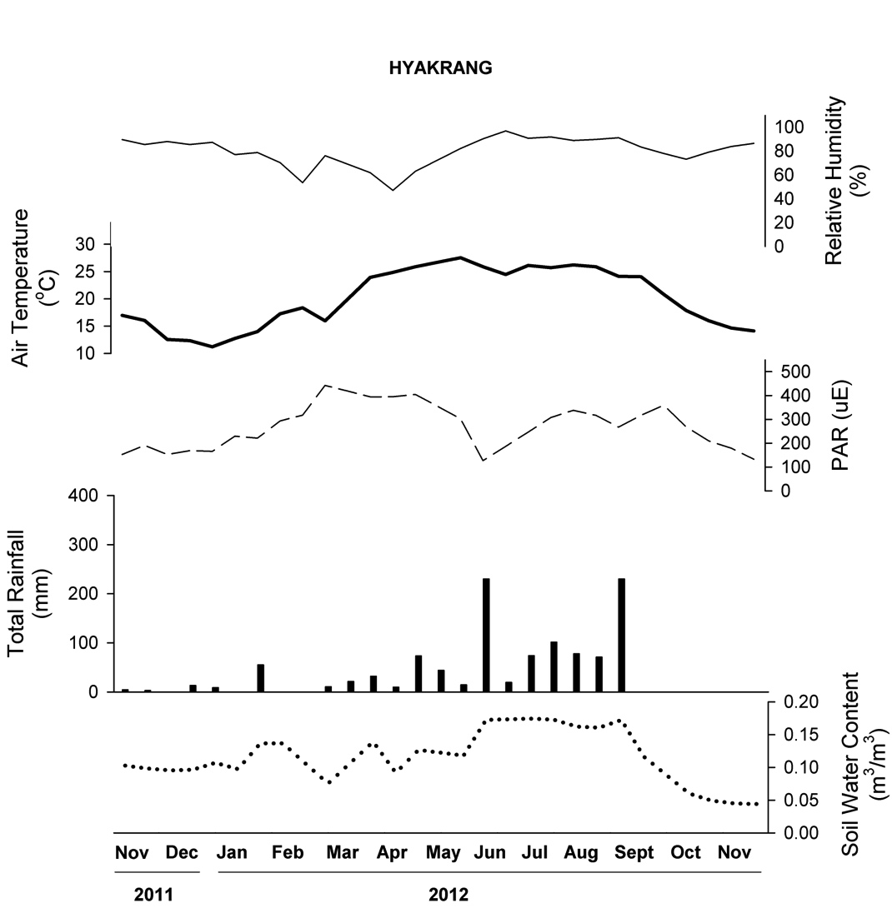
Weather Station Data
Early
rains
Monsoon
rains
With monsoon: RH increases, PAR decreases, rainfall accumulates and soil moisture increases…
Drought

Slide 6
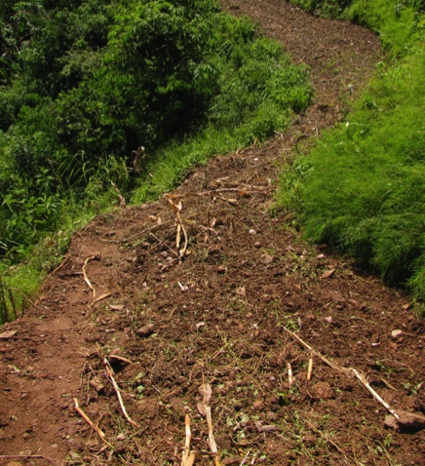
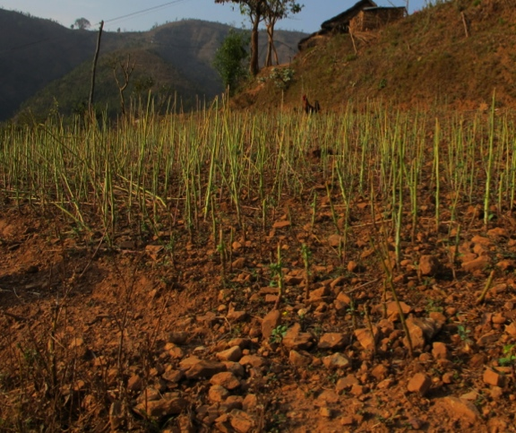
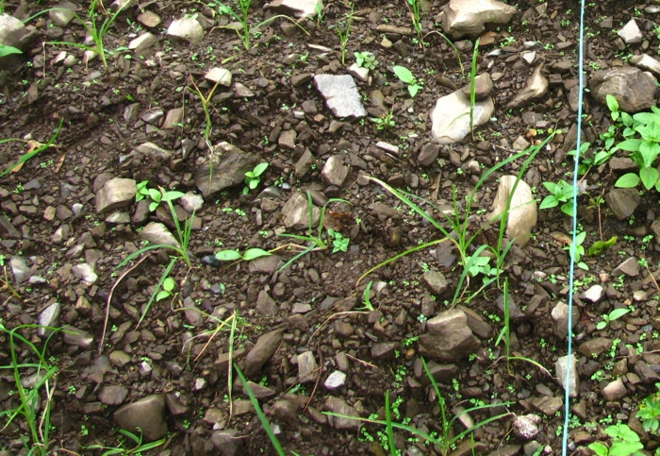
Baseline Soils
Texture (% sand, % silt, % clay; stoniness)
Porosity, bulk density
Total % C (Walkley Black) and % N (Kjeldahl titration)
Available P and K; pH
Total concentration in soil of P, K, Ca, Mg, Zn, Mn, Cu, Fe, and B (Mehlich-1)
Effective cation exchange capacity (ECEC); base saturation and Ca, K, Mg saturation of exchange sites
Inherent differences among villages will underlie the success or failure of CAPS.
Hyakrang
Thumka
Kholagaun
Photo: J. Halbrendt
Photo: S. Crow
Photo: J. Halbrendt

Slide 7
Multivariate Analysis of Soil Data
Characterizes samples based on commonalities among multiple, co-varying parameters
For every field, analyze all soil physical and chemical properties measured simultaneously
Data are presented in 2-D, unit-less space that ideally clusters similar fields together, but multiple dimensions may interpreted
A successful output is a “suite” of properties that characterizes a village and differentiates the villages from one another

Slide 8
Multivariate Analysis of Soil Data
Samples from each village cluster
Axis 1 separates the village centroids nicely, suggests variables correlated with Axis 1 contribute to differences among villages
Axis 2 does not separate village centroids, and does not help explain differences

Slide 9
Multivariate Analysis - Results
2-D figure of Axis 1 and 3 gives the best separation of villages
Allows us to assess which “suite” of variables best characterized differences among villages

Slide 10
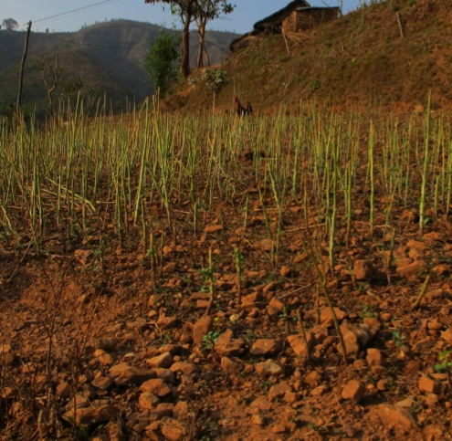
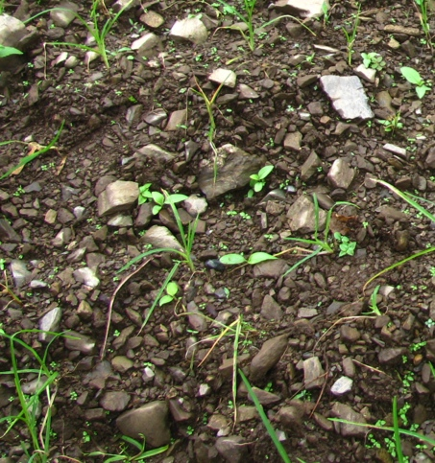
Multivariate Analysis - Summary
The first three axes of the PCA explained a total of 71.7% of the variation in soil physical and chemical properties
Hyakrang
Thumka
Kholagaun
Photo: J. Halbrendt
Photo: S. Crow
Photo: J. Halbrendt
High Ca saturation
Greater bulk density
Lower porosity
High % clay
Greater % silt
Greater Mg saturation
Mn concentration
Greater % sand, stoniness
Greater K saturation
High OM
High % N
High ECEC

Slide 11
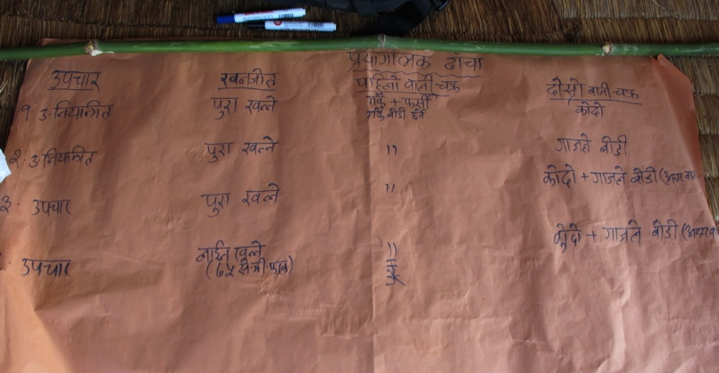
CAPS Treatments
At each village, nine fields were planted in maize followed by four experimental treatments:
Control – Current farmer’s practice; millet monocrop with conventional tillage
Legume monocrop with conventional tillage
Millet-legume intercrop with conventional tillage
Millet-legume intercrop with conservation (strip) tillage

Slide 12
CAPS Hypotheses
We expect that CAPS will improve productivity and economic returns through multiple paths:
1) Inclusion of legumes in crop rotation as a monocrop or intercrop with millet will increase plant available N
and
2) Soil quality indices and aggregate structure will improve from organic matter accumulation under reduced tillage
* although CAPS may take several years to have direct benefits on production

Slide 13
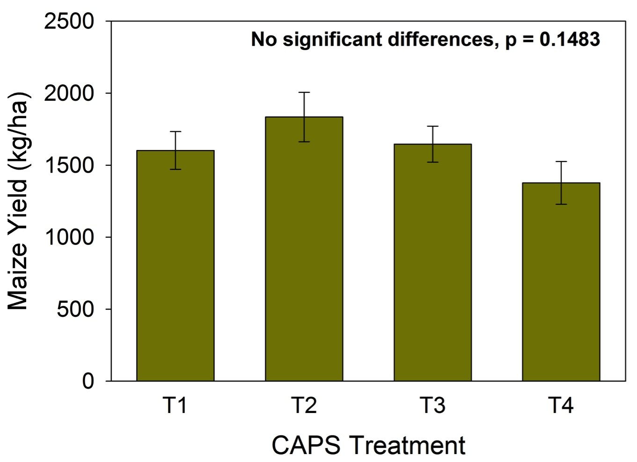
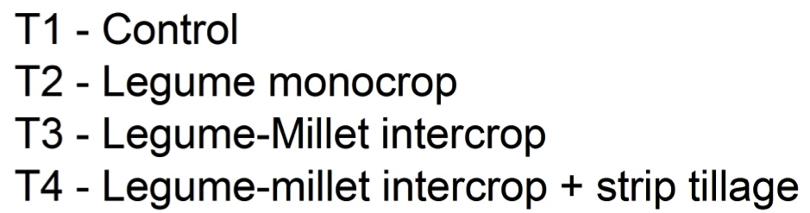
Maize Yields – Year 2 of CAPS
Analyzed with block design (village as the block)
After 2 years of CAPS in the on-farm trials, no significant differences in yield among the CAPS treatments
However, the differences are greater than seen in year 1, suggesting that more time is needed
If you look at the means by village and treatment…

Slide 14
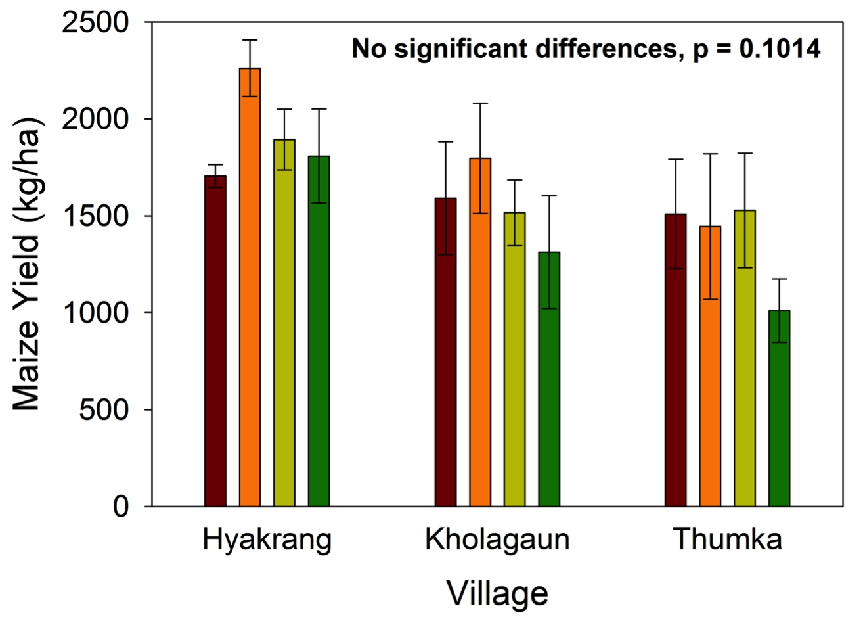
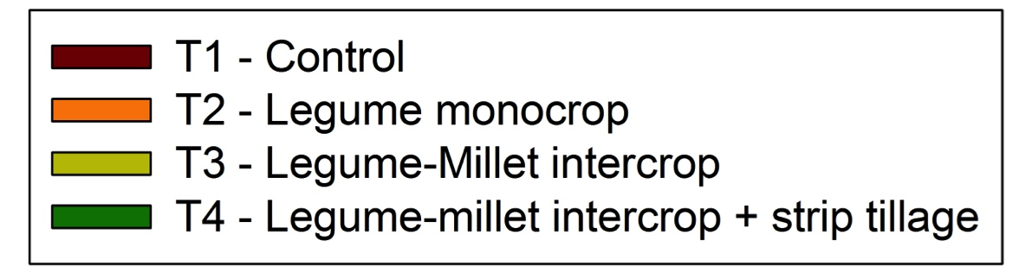
Maize Yields – Year 2 of CAPS
Generally see a consistent pattern among treatments in each village
Except in Thumka, yield under T2 is highly variable and lower than in the other village
May help explain the lack of a significant treatment effect in year 2

Slide 15
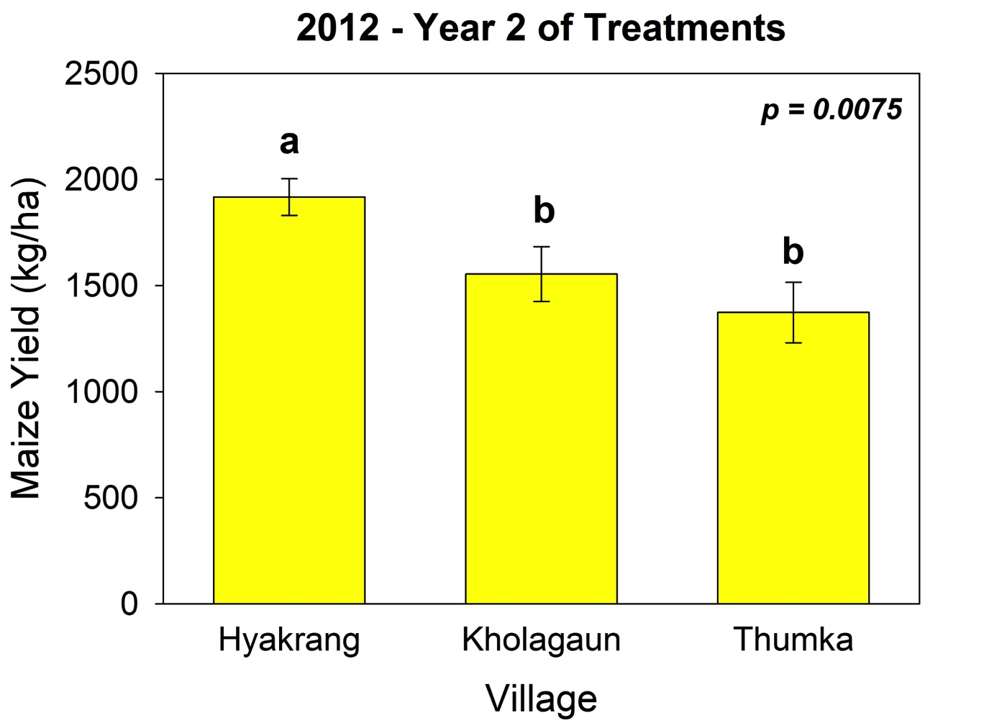
Maize Yields – Villages
Inherent soil and climate differences among villages contributes to yield potential and the farmers’ perceptions of the role that soil properties play in productivity
Socio-economic, environmental, and soil factors must be considered simultaneously to determine the true potential success of CAPS

Slide 16
Summary
1. We expect CAPS will affect soil quality through improvements in nitrogen availability and accumulation of organic matter over time.
Currently, water stable aggregate analysis is being conducted on fields following the 2nd year of CAPS implementation in addition to reanalysis of all soil chemical properties.
2. Further, we expect that CAPS will work indirectly through increased household wealth (via diversification of marketable crops) leading to more livestock and compost for soil amendment.
For sustainability, these practices should be paired with agroforestry to improve access to fodder, reduce erosion, and reinforce traditional linkages of communities to forest resources.

Slide 17
Acknowledgements
US-AID Grant number:
SANREM CRSP and Virginia Tech
  Mike Mulvaney
  Mike Graham
University of Hawaii Soil Ecology and Biogeochemistry Lab
  Mariko Panzella
  Jon Wells

