Slide 1
Visualizations of School Shootings
Gabriel Simmons, Tianna Woodson, Evan Keys, Tomy Doan, Peter Park
CS 4624 Multimedia, Hypertext, and Information Access
Dr. Fox
Virginia Tech
Blacksburg VA 24061
May 1, 2018

Slide 2
Outline
Project Recap
Data Collection, Cleaning and Hydration
Sentiment Analysis
Visuals
Lessons Learned
Acknowledgements

Slide 3

Project Recap
This project was developed in an effort to understand and track emerging trends among incidents of school violence in the United States.
GETAR (Global Event and Trend Archive Research)
Databases
  URLs and Tweets
Our Project - Data visualizations
Figure: https://logos-download.com/169-twitter-logo-download.html

Slide 4
Data Collection
Why did we need new data?
  Custom search filters
GetOldTweets Python script
  Bypasses Twitter API limitations

Slide 5
Data Cleaning
Subject matter
  Basketball references
  Irrelevant URLs
Repetition
Retweets

Slide 6



Data Hydration
Hydrator
Python & Google Maps
  GPS locations
  Extracting states
Notes:
Top image: geographical locations, sandy hook
Bottom image: heat map, sandy hook

Slide 7
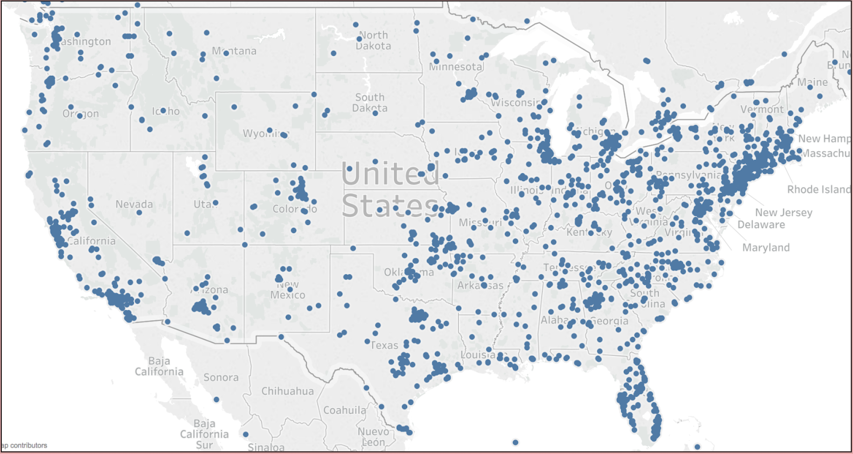
Sandy Hook Visuals - User Locations

Slide 8
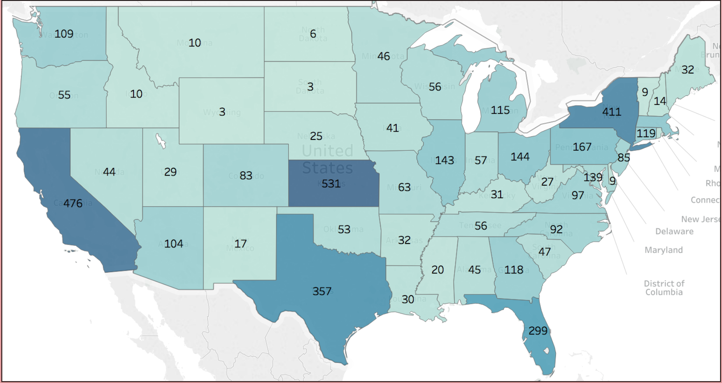
Sandy Hook Visuals - Heat Map

Slide 9
Sentiment Analysis
Natural Language Toolkit (NLTK)
Python
VT Tweets
  Avg: -0.151
  Range: -0.9877 to 0.9622
VT Webpages
  Avg: -0.8419
  Range: -0.9999 to 0.9723

Slide 10
Sentiment Analysis Virginia Tech Tweet
Most Positive: 0.9622
“Congratulations, @chronicle reporter @erichoov ! His incredibly thoughtful piece, The Arc of Her Survival, has won the 2018 Eugene S. Pulliam National Journalism Writing Award. Read the thoughtful profile of a Virginia Tech shooting survivor here: https://www. chronicle.com/article/The-Ar c-of-Her-Survival/239744/#.WqfJzc1rUQM.twitter”

Slide 11
Sentiment Analysis Virginia Tech Tweet
Most Negative: -0.9877
“Texas church shooting: 26 killed Las Vegas shooting: 58 killed Virginia Tech shooting :32 killed Newton shooting:27 killed Sandy Hook: 27 killed Orlando Nightclub:49 killed Stoneman Douglas High: more than 17 killed All and many more shootings have one thing in common: The AR-15 pic.twitter.com/pc8R65Tvs7”

Slide 12
Sentiment Analysis Virginia Tech Webpage
URL: http://www.campussafetymagazine.com/Channel/University-Security/News/2010/11/23/Court-Ruling-Allows-Virginia-Tech-Officials-to-Be-Sued-Over-Shooting.aspx
Most Positive: 0.9723
“...aspects of safety measures including access control video surveillance mass notifications and security staff practices. Take advantage of a free subscription to Campus Safety today and add its practical insights product updates and know-how to your toolkit. Lawsuits School Shooting Virginia Tech Comments…”

Slide 13
Sentiment Analysis Virginia Tech Webpage
URL: https://thelede.blogs.nytimes.com/2007/04/16/shooting-at-virginia-tech/comment-page-72
Most Negative: -0.9999
“...This does nothing of course to ease the pain and suffering of all those in Virginia. But gun violence of a certain type has come about and that is largely copy catting from the movies. Add to that the immediate celebrity of any shooter adds glamour to the deranged minds…”

Slide 14
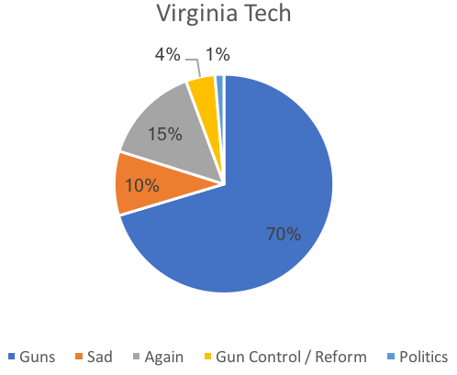
VT Visuals - Keyword Pie Chart

Slide 15
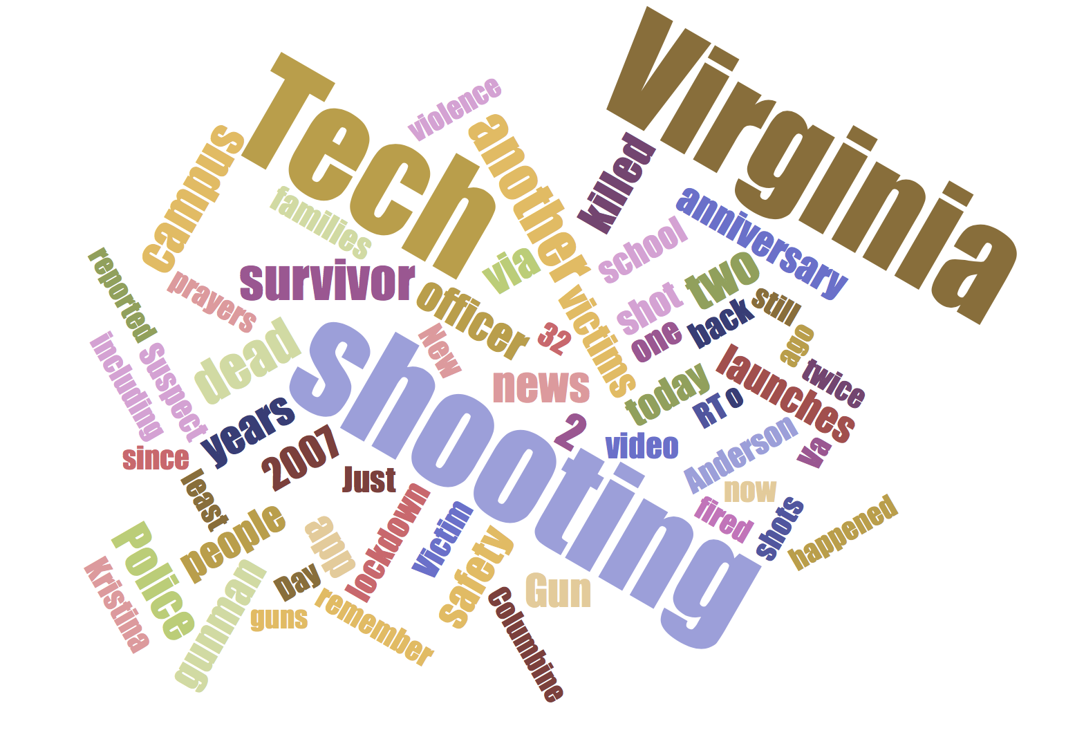
VT Visuals - Tweet Word Cloud

Slide 16
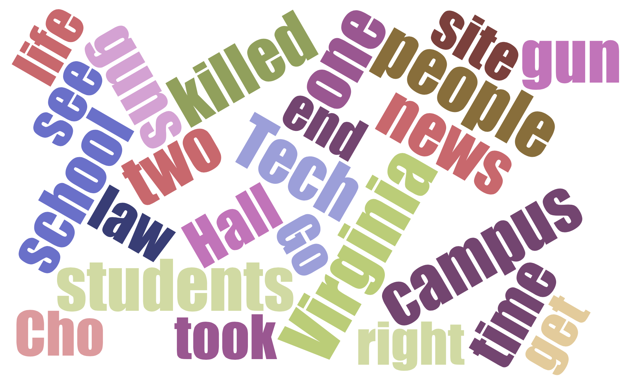
VT Visuals - URL Word Cloud

Slide 17
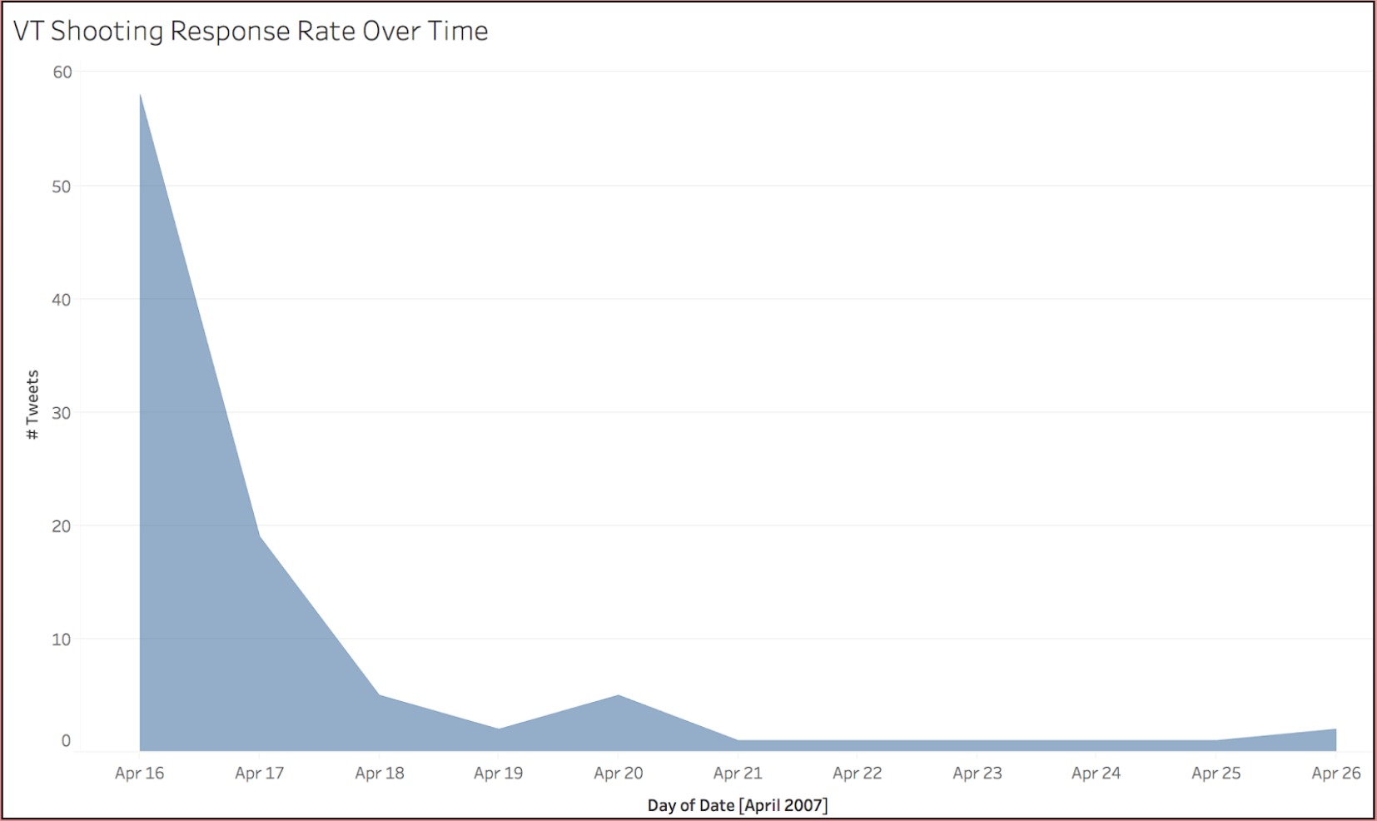
VT Visuals - Tweets Over Time

Slide 18
Lessons Learned
Data validation and cleaning
Managing large sums of data
Creating meaningful visuals

Slide 19
Acknowledgements
Dr. Shoemaker
Jason Callahan
Ziqian Song
GETAR
The NSF for funding GETAR through grant IIS-1619028
Dr. Fox

