Slide 1

WELCOME!
Pre-Conference on OER & Open Education
Anita Walz, University Libraries, Virginia Tech @arwalz
June 11, 2018 ~ Association of Christian Librarians, Wilmore, KY
Notes:
Philosophy = values behind XYZ

Slide 2
PRE-CONFERENCE AGENDA
8:00 - 8:20 Survey results, introductions & review agenda for the morning (20 minutes)
8:20 - 9:20 Interactive presentation: Philosophy, Practices & Potential (60 minutes, incl Q&A)
9:20 - 9:30 Break (10 minutes)
9:30 - 9:50 Advancing Open Education on campus
Institutional goals & stakeholders (5 minutes)
Activity: Connecting with Your Community (10 minutes)
Discussion (5 minutes)
9:50 - 10:10 Hands on Practice: Finding OER (including discussion) (20 minutes)
10:10 - 10:30 Videos: Reference interviews for instructional content (20 minutes)
10:30 - 10:40 Tour of teaching materials: Teaching about OER and Creative Commons (10 min)
10:40 - 10:45 What kind of support to offer?
Being realistic & setting boundaries. Open Education alignment rubric (5 mins)
10:45 - 10:55 Reflection and planning (10 minutes)
10:55 - 11:00 Sharing “next steps” (5 minutes)
11:00 Adjourn and off to lunch!

Slide 3

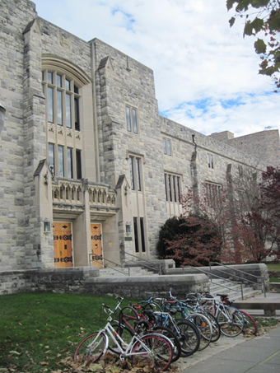
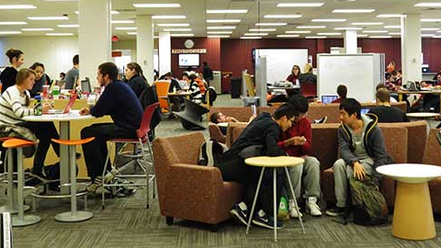
Traditional library services
Expanded focus on “making”
~34,000 (full time equivalent) students
© Anita Walz CC BY 4.0

Slide 4

Librarian since 2001 - government, international, school +
Academic libraries, since 2013
Working in Open Education, since 2013
Open Education
Copyright / Open Access
Publishing
Liaison: Economics, Math
+ legal studies
[Public domain image]

Slide 5

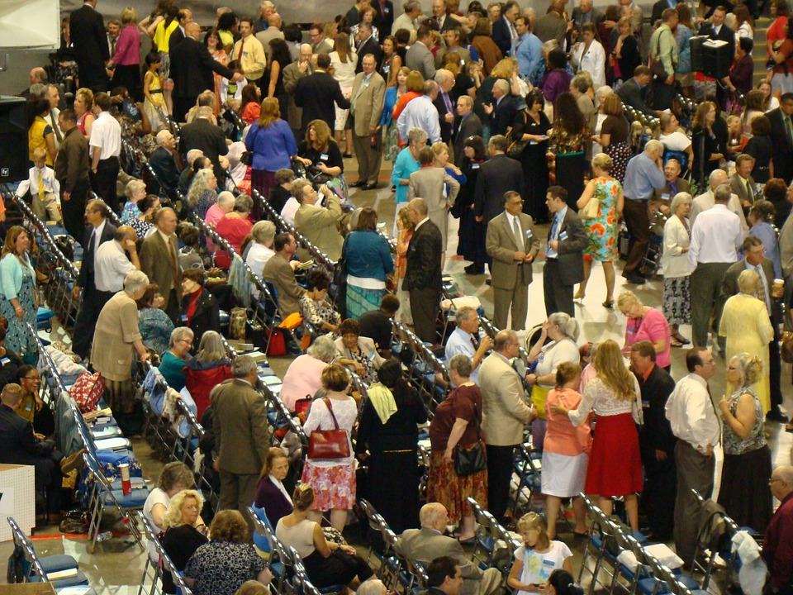
Spring 2014
[Used under Fair Use]
[Public domain image]

Slide 6

Getting to know each other
[Public domain image]

Slide 7
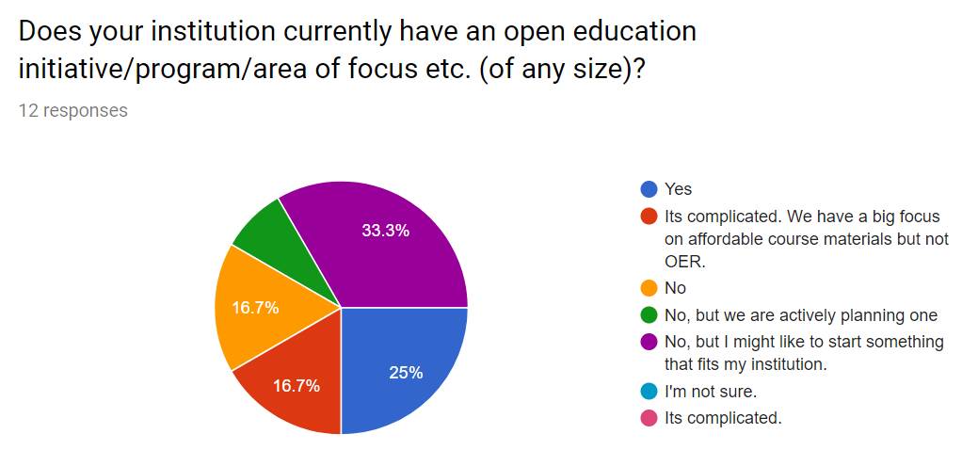
Thank you (also) for taking the survey!

Slide 8
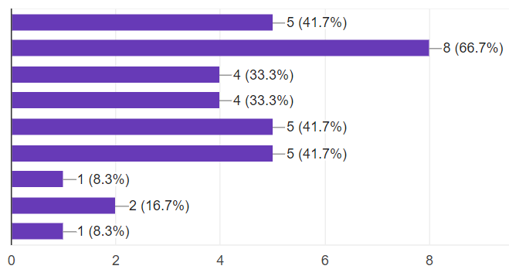
What you said: What you want to learn
#1 This is a new topic!!
#2 Be able to find useful OER
#3 How to educate faculty about OER
#4 Understand what the library’s role could be / Develop a
program at my institution
#5 Adopting, authoring, sharing, creating open textbooks and/or OER

Slide 9
LEARNING OBJECTIVES
Articulate what open education and OER are
Use several different methods to find openly licensed content
Analyze motivations of various campus actors as relevant to OER
Use a rubric to evaluate projects and conduct a reference interview for OER
Create a DRAFT plan of what to do next, investigate next, or learn next
Know where to find more information (for building expertise, about sources, documents helpful for planning, resources for adapting/publishing, and communities to join)

Slide 10
Philosophy, Practices & Potential of Open Education & OER

Slide 11
What is Open Education?

Slide 12
Open education encompasses resources, tools and practices that employ a framework of open sharing to improve educational access and effectiveness worldwide.

Slide 13
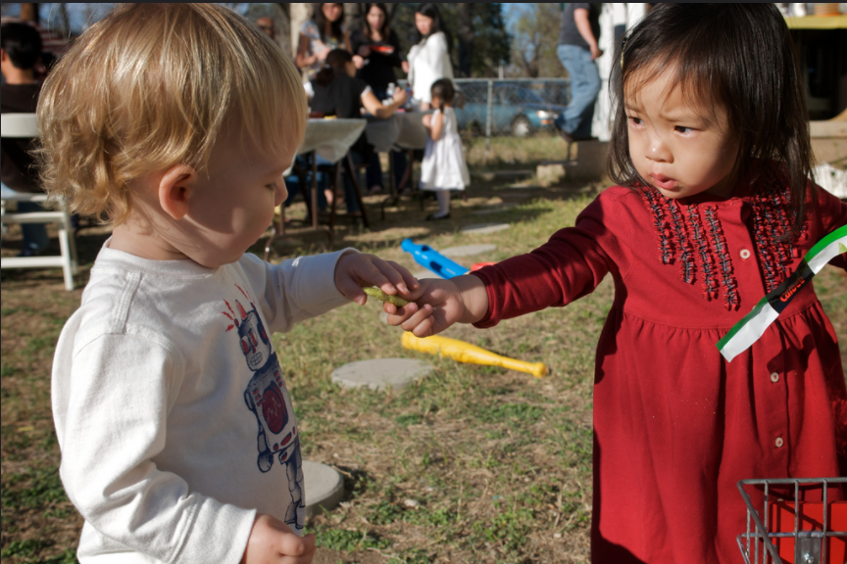
© Enoch Lai “Sharing is Caring” CC BY NC ND

Slide 14
Knowledge sharing
Technology
Collaboration
in service of learning

Slide 15

Open Educational Resources
Open Pedagogy
value framework
[Public domain image]

Slide 16
Open Educational Resources

Slide 17
OER are teaching, learning, and research resources that reside in the public domain or have been released under an intellectual property license that permits their free use and re-purposing by others.
. . . including full courses, course materials, modules, textbooks, streaming videos, tests, software, and any other tools, materials, or techniques used to support access to knowledge.
-Hewlett Foundation

Slide 18

Screenshot from “A Review of the Effectiveness & Perceptions of Open Educational Resources As Compared to Textbooks” https://youtu.be/SX0K0hb_xKE © Open Education Research Group. CC BY 4.0
Screenshot from “A Review of the Effectiveness & Perceptions of Open Educational Resources As Compared to Textbooks” https://youtu.be/SX0K0hb_xKE © Open Education Research Group. CC BY 4.0c

Slide 19
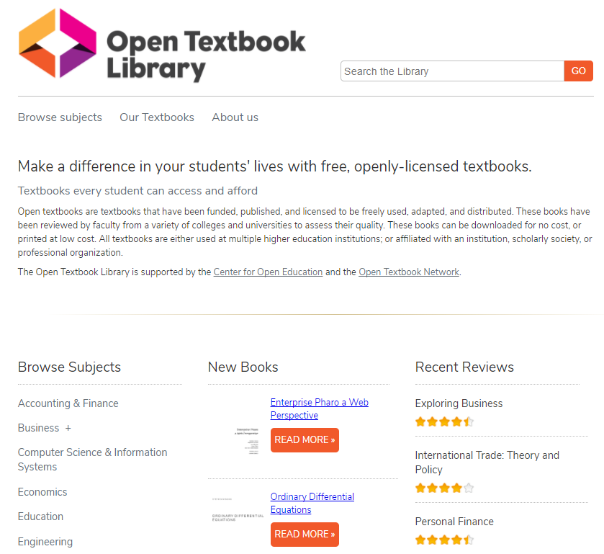

[Used under Fair Use]

Slide 20
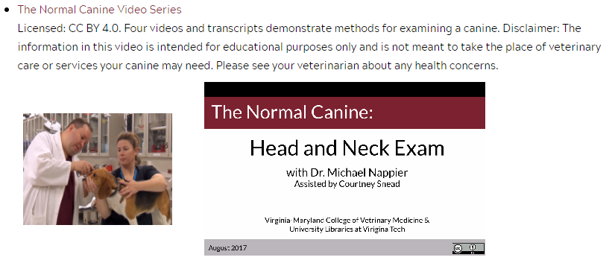

Slide 21

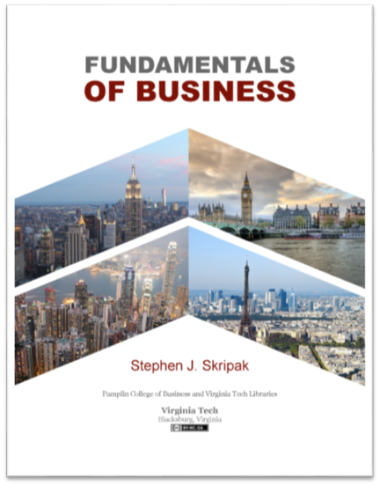
Open Textbooks at Virginia Tech
https://vtechworks.lib.vt.edu/handle/10919/70959
Cover design: Robert Browder
Cover image: (c) Michelle Yost. Total Internal Reflection (cropped by Robert Browder) is licensed with a Creative Commons Attribution-ShareAlike 2.0 license.
Cover design: Trevor Finney. “Hong Kong Skyscrapers” by Estial, cropped and modified by Trevor Finney CC BY-SA 4.0; “Paris vue d’ensemble tour Eiffel” by Taxiarchos228, cropped and modified by Poke2001 and Trevor Finney CC BY 3.0; “London Bridge” by Skitterphoto, cropped and modified by Trevor Finney, Public Domain; “New York” by Mscamilaalmeida, cropped and modified by Trevor Finney, Public Domain.

Slide 22
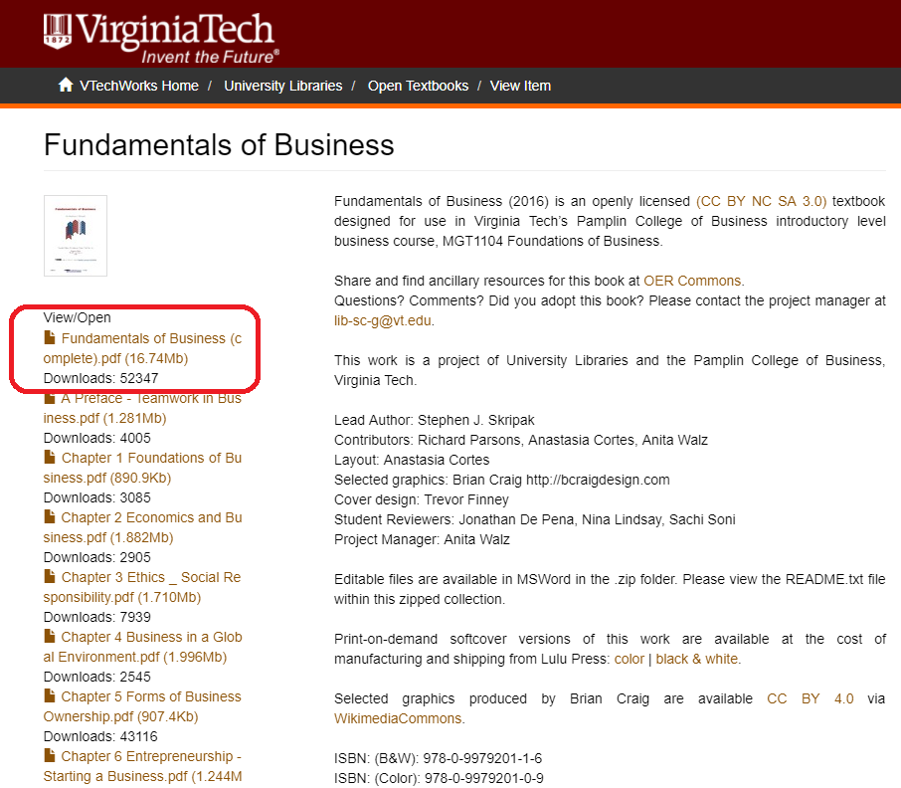
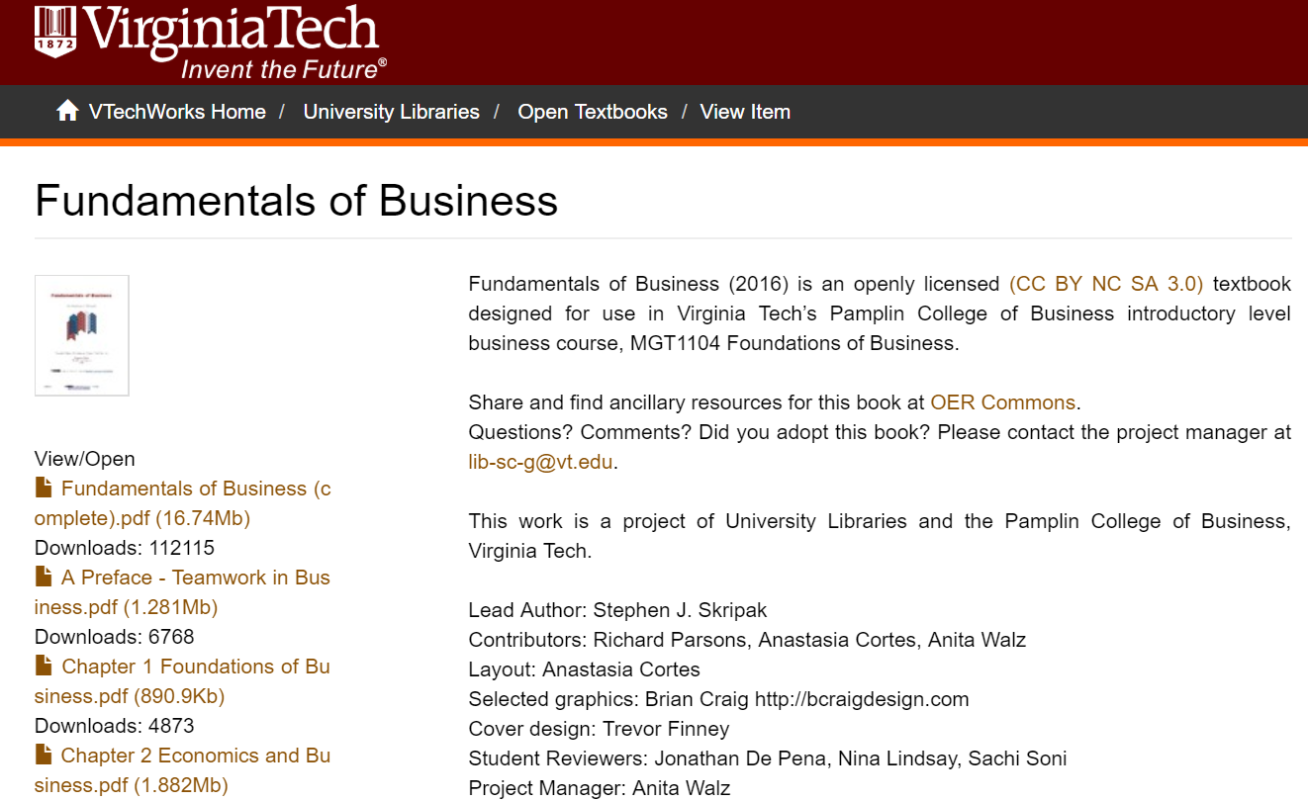
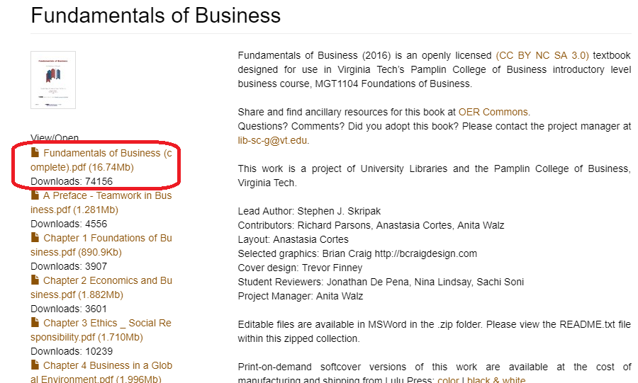

Slide 23

Creative Commons
Licenses
5 R permissions
Can anyone . . .
Retain it?
Reuse it?
Revise it?
Remix it?
Redistribute it?
http://opencontent.org/definition

Slide 24


Slide 25
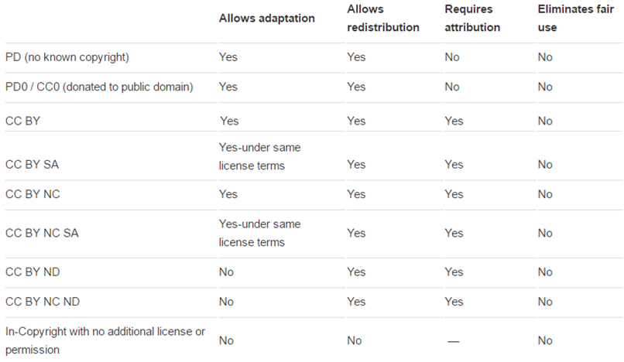

Most open
Least open

Slide 26
What’s the potential here?

Slide 27
Anyone can create, adapt & share if they:
Understand the licenses
Can extract content
Create in a format others can use
Attribute 3rd party works

Slide 28
Potential areas of growth: critical thinking, communication
Understand the licenses
-- understanding of copyright, information ethics
Can extract content
-- digital literacy / technical / software skills
Create in a format others can use
-- reflection regarding barriers others may face
Attribute 3rd party works
-- give credit
→ Leverages the power of the web
→ Enormous creative potential

Slide 29
What problems could this solve?

Slide 31
Open Educational Resources
Open Pedagogy
value framework

Slide 32
Open Pedagogy

Slide 33
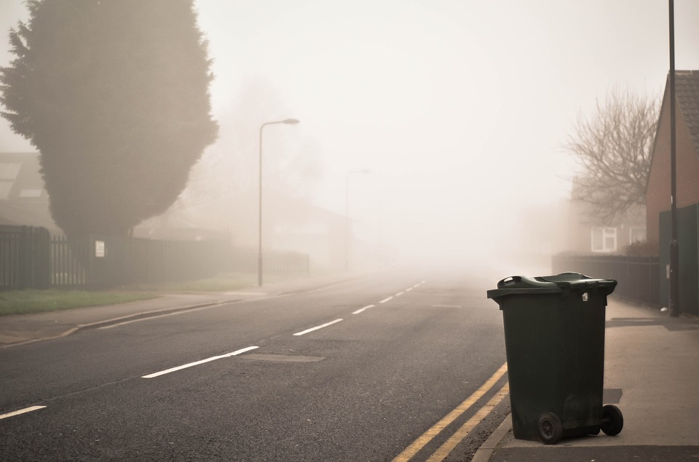
Non-disposable assignment
[Public domain image]

Slide 34

Aspects of Open Pedagogy
Create
Adapt or
Modify with the intent of sharing
Student agency / choice
Valuing access by others
Instructor as “coach”
Themes:
autonomy and interdependence; freedom and responsibility; democracy and participation
[Public domain image]

Slide 35

Student engagement & motivation
Deeper learning approaches
Real world connections
Produces value for the real world
[Public domain image]

Slide 36
Baeten, M., Kyndt, E., Struyven,. K., Dochy, F., (2010) Using student-centred learning environments to stimulate deep approaches to learning: Factors encouraging or discouraging their effectiveness. Educational Research Review, 5(3), 243-260. doi.org/10.1016/j.edurev.2010.06.001
DeRosa, R., and Jhangiani, R. (2017) Open Pedagogy. In Mays, E. (2017) A Guide to Making Open Textbooks with Students. Retrieved from https://press.rebus.community/makingopentextbookswithstudents/chapter/open-pedagogy
Hendricks, C. (2015) Non-disposable assignments in intro to philosophy [Blog post]. Retrieved from http://blogs.ubc.ca/chendricks/2015/08/18/non-disposable-assignments-intro-philosophy Morgan, T. (2016, December 21). Open pedagogy and a very brief history of the concept. [Blog post]. Retrieved from https://homonym.ca/uncategorized/open-pedagogy-and-a-very-brief-history-of-the-concept

Slide 37
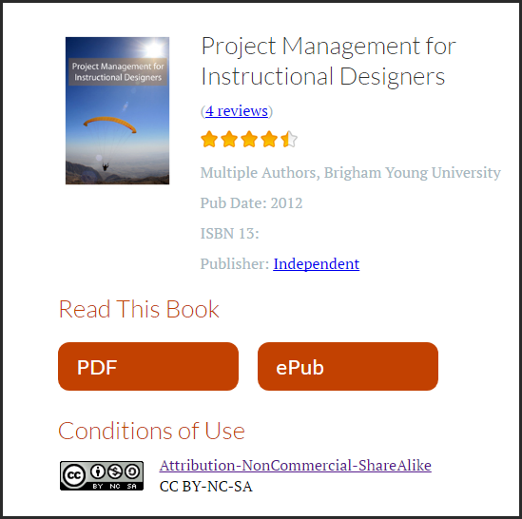

Slide 38
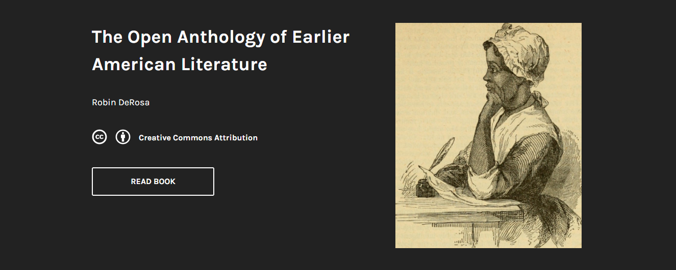
https://openamlit.pressbooks.com
http://robinderosa.net/uncategorized/my-open-textbook-pedagogy-and-practice

Slide 39
What’s the potential here?

Slide 40
Allows learners to . . . Allows instructors to . . .
Connect with people and ideas in the real world
Get feedback beyond the instructor
Explore areas of interest in a supportive context
Explore developing their digital persona
Learn, alongside students
Develop skill in coaching and authentic assessment
Include students in research programs
Obtain meaningful feedback

Slide 41
For more examples of open pedagogy see:
The Open Pedagogy Notebook
http://openpedagogy.org

Slide 42
Open Educational Resources
Open Pedagogy
value framework

Slide 43
value framework

Slide 44
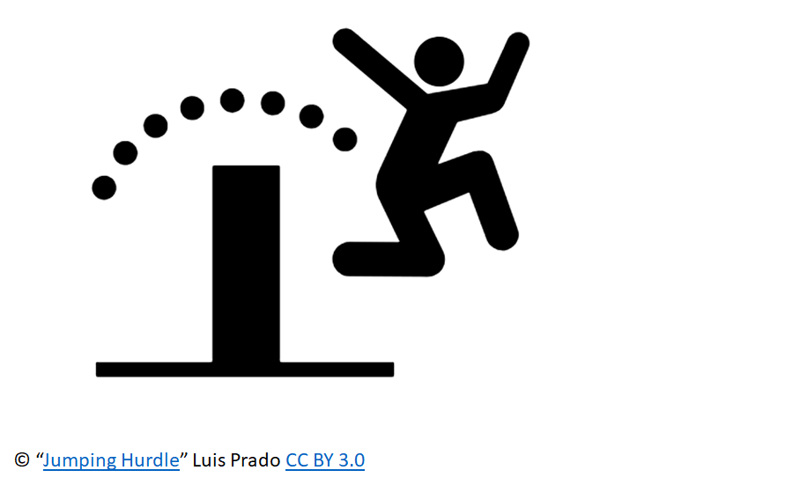
Open Education Is:
a movement
a philosophy
a broad, expanding set of value-driven practices.

Slide 45
Outward facing
Adapted from: McKernan, R., Skirko, T., & West, Q. (2015) Librarians as open education advocates: Readings on being an open advocate. Retrieved from https://openedadvocates.pressbooks.com/chapter/definition-of-open-education

Slide 46
Expand
possibilities:
Reducing all sorts of barriers and expand possibilities . . .
Adapted from: McKernan, R., Skirko, T., & West, Q. (2015) Librarians as open education advocates: Readings on being an open advocate. Retrieved from https://openedadvocates.pressbooks.com/chapter/definition-of-open-education
Notes:
What can I give rather than what can I get . . .

Slide 47
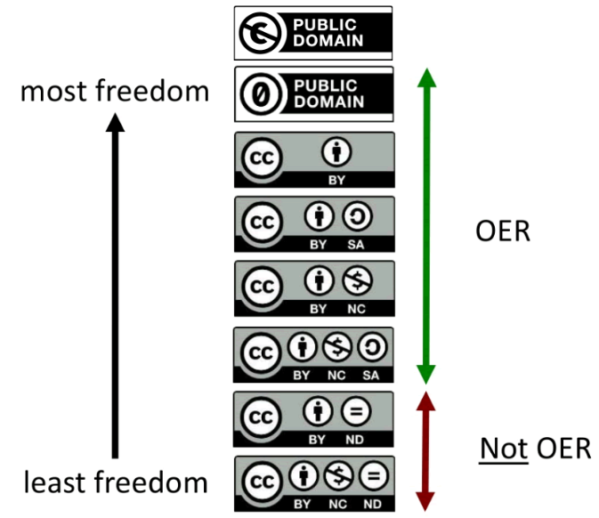
Open Licenses
Adapted from: McKernan, R., Skirko, T., & West, Q. (2015) Librarians as open education advocates: Readings on being an open advocate. Retrieved from https://openedadvocates.pressbooks.com/chapter/definition-of-open-education

Slide 48
Feedback:
& Collaboration
Adapted from: McKernan, R., Skirko, T., & West, Q. (2015) Librarians as open education advocates: Readings on being an open advocate. Retrieved from https://openedadvocates.pressbooks.com/chapter/definition-of-open-education

Slide 49
New Ideas
. . . about teaching
. . . about research
Adapted from: McKernan, R., Skirko, T., & West, Q. (2015) Librarians as open education advocates: Readings on being an open advocate. Retrieved from https://openedadvocates.pressbooks.com/chapter/definition-of-open-education

Slide 50
Giving Credit
Adapted from: McKernan, R., Skirko, T., & West, Q. (2015) Librarians as open education advocates: Readings on being an open advocate. Retrieved from https://openedadvocates.pressbooks.com/chapter/definition-of-open-education

Slide 51

Lever
Public domain. By Jakob Ukrop. https://thenounproject.com/term/lever/4927

Slide 52
What can I do
to make what I do
more OPEN?

Slide 53
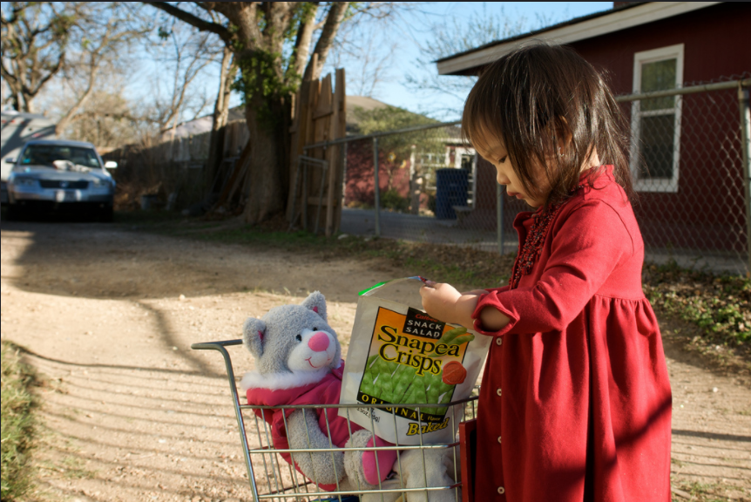
© Enoch Lai https://flic.kr/p/64rz9n CC BY NC ND

Slide 54
If I choose to,
how do I convey this
Information to others?

Slide 55
Discussion

Slide 56

Shall we take a break?
[Public domain image]

Slide 57
Advancing Open Education on Campus

Slide 58
https://guides.lib.vt.edu/oer

Slide 59
Q: What should my campus offer?
… it depends

Slide 60
MY INSTITUTION
Institutional Goals
Institution name:
My institution aims to ________________________________________________
By providing __,___,__,__&__ to [whom]________________.
Institutional Characteristics
# faculty, # students, levels & types of degrees offered,
delivery formats (online, in person etc.), # of locations, etc...

Slide 61
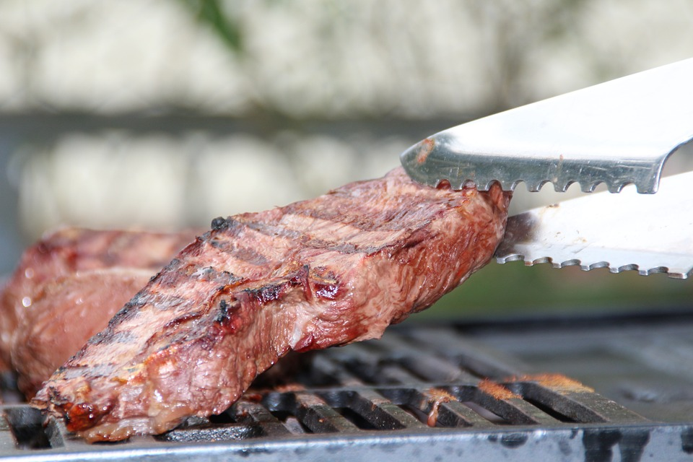

Steakholders
[Public domain images]

Slide 62

Stakeholders
Stakeholder - A person, group or organization that has interest or concern in an organization or process. Stakeholders can affect or be affected by the organization's actions, objectives and policies.
© “Group” by corpus delicti CC BY 4.0

Slide 63
Stakeholders
Stakeholders in higher education:
Instructors (of all types)
Students
Administrators
Librarians
Board members
Alumni
Parents
Student Services
Staff
Denominational regions
Accrediting bodies
IT people
Instructional designers

Slide 64
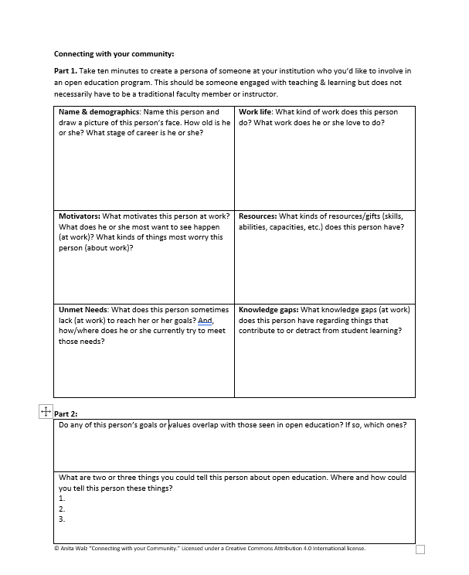
Exercise:
Connecting with your Community
Part 1 only
You do not have to share unless you want to

Slide 65
Anita’s example

Slide 66
Institutional Roles in Open Education
Functions | Which stakeholders do these things?
 | Instructors Students Administrators Librarians [add other stakeholders here]

Slide 67
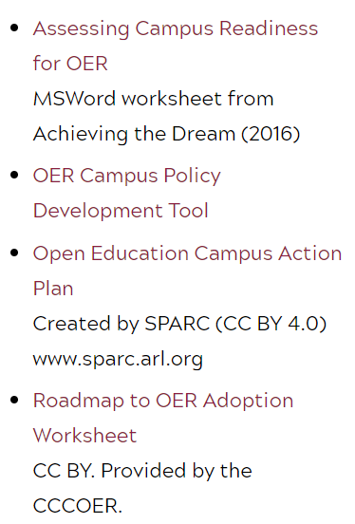
More tools for Stakeholder analysis at your Institution
https://guides.lib.vt.edu/oer/lib-toolbox (RH column)

Slide 68
Q: What services should my library offer?

Slide 69
Connect Open education & OER with what you already do.

Slide 70
Stories of “getting started”
Librarian story (Anita’s)
To Boldly Go: First-year exploration of OER Initiatives (2014)
http://hdl.handle.net/10919/50612
Faculty story
My Open Textbook: Pedagogy and Practice
https://robinderosa.net/uncategorized/my-open-textbook-pedagogy-and-practice

Slide 71
Nearly 5 years later at Virginia Tech
Hosting and making open educational resources findable
Connecting / Awareness / Education / Building collaborations
Learning opportunities
“Open Education Week” events & recordings, Open Textbook Adoption Workshop, Teaching Inquiry/Discussion Group
Consultations: Copyright, Creative Commons, Publishing (broadly defined), Technology, Collaborations
Find/locate OER LibGuide
Run Listservs OpenVT (& OpenVA)
Administer grants & provide technical support for creating (publishing) and adapting OER
And more marketing/persuasion. . .
Awareness / Crowdfunding campaign

Slide 72
Library Roles in Open Education
Core functions | Additional functions
Find OER Reference interview for OER Teach about Creative Commons Strategize ways to advance Open Ed Encourage OER adoption Assist faculty OER creators in finding information | Host / publish OER
Think: Connecting Open education & OER with what you already do.

Slide 73
Where and how to find OER
Curated lists: https://open4us.org/find-oer
Search engines (Google Advanced search - Filter by rights) example
Indexed collections (OER Commons, MERLOT, Open Textbook Library, BCOpen Campus)
Find links to ALL OF THESE and more at: http://guides.lib.vt.edu/oer

Slide 74
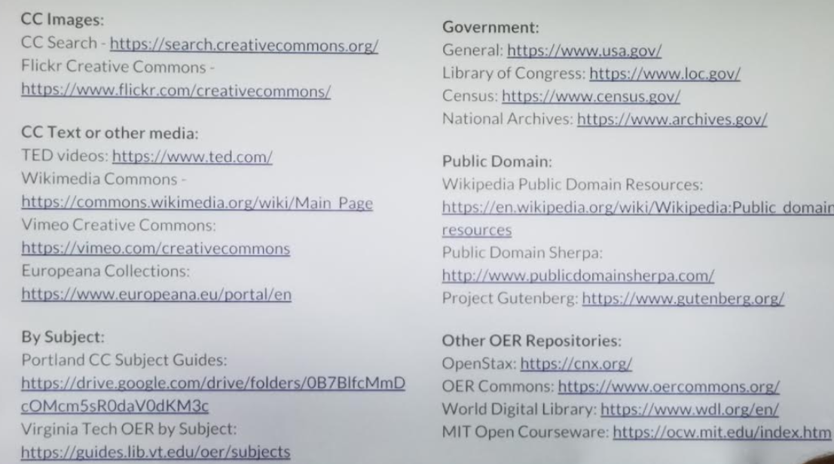
Hands on Practice (in groups)
Create a scenario,
Can you find a
relevant:
CC/PD image
CC/PD text
© text (fair use)
*Don’t forget to cite everything and to provide attribution for CC-licensed works: https://wiki.creativecommons.org/wiki/Best_practices_for_attribution

Slide 75
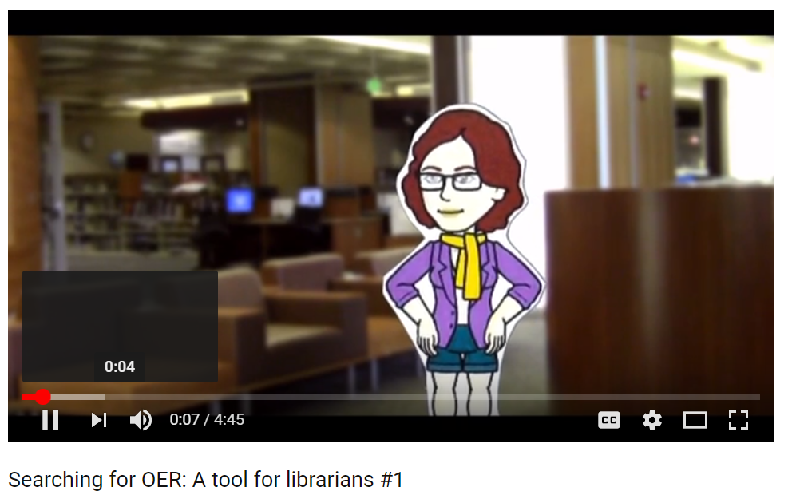
Reference interview process
for instructional content
https://libraryasleader.org/searching-for-open-materials
Three videos + templates
© Quill West CC BY 4.0

Slide 76
Teaching about Creative Commons
Article: The Beauty of Some Rights Reserved https://crln.acrl.org/index.php/crlnews/article/view/8077/8077
Slides: https://libres.uncg.edu/ir/uncg/f/B_Williams_Intro_2010.pptx
Video: https://creativecommons.org/about/videos/get-creative
_ _ _ _ _
PPT: Get Creative (and Stay Legal): Copyright Compliance with Creative Commons and Open Educational Resources http://hdl.handle.net/10919/50583

Slide 77
Open Textbook Adoption focus
Open textbook “adopt to adapt” workshop (Walz/Guimont)
https://docs.google.com/presentation/d/1UaiGuQYAYiZlN9Dg4yFbD73SS_gL8esbJWdDoStJjyw/edit?usp=sharing
Open Textbook Network ($1,500/year + first year fee) (slides are a member benefit); Video: http://hdl.handle.net/10919/51599 (2015)
BCOER Librarians group https://open.bccampus.ca/bcoer-librarians
Adopting workshop slides (with Canadian data/currency): https://docs.google.com/presentation/d/18jUn-EyuozYk_z73QOIe_XwzDXp2EHjr-f-hswCmYnY/edit?usp=sharing

Slide 78
Tools for teaching how to search for OER
Introductory presentation about OER + Creative Commons
Resource list
Exercises:
http://bit.ly/OERScenario1
http://bit.ly/OERScenario2
http://bit.ly/OERScenario3
http://bit.ly/OERScenario4
Contact: Melissa Cantrell, University of Colorado, Boulder melissa.cantrell@colorado.edu

Slide 79
And finally
Tools and resources for open textbook creation
https://guides.lib.vt.edu/oer/authors

Slide 80
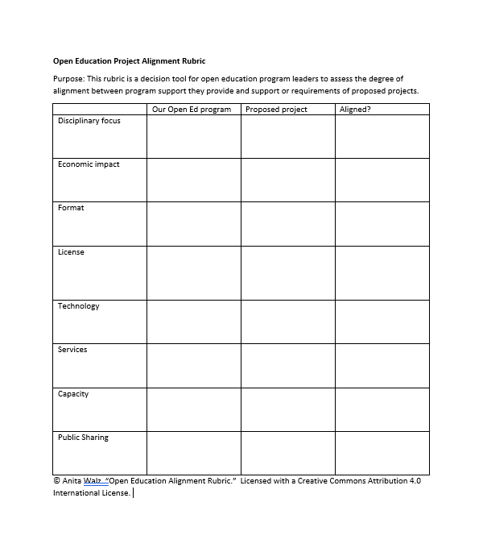
The Open Education Alignment Rubric
How do we know if a project fits our scope?
Can we say yes or should we say no to a proposed project?
How do we communicate our limits in a way that is fair to all requesters?
What evidence can we provide that we need more funding or staff in order to meet possible project needs?

Slide 81
What will you take home?
What are your next steps? (10 minutes on your own or at your table)
Sharing (if you wish) (5 minutes large group)
THANK YOU for your time and attention!
Anita Walz
arwalz@vt.edu

