Slide 1
Virginia Tech Libraries’
Next Gen Digital Libraries Platform
Yinlin Chen and James Tuttle
{ylchen, james.tuttle}@vt.edu
Virginia Tech Libraries
Notes:
Presented to the Virginia Tech IT Council Symposium on January 8, 2020.

Slide 2
Agenda
Problem Space
DLD Projects
Cloud-native
Serverless & Microservices
Virginia Tech Digital Library Platform (VTDLP)
Architecture Overview
Outcome
Next Steps

Slide 3
Problem Space
Numerous, web applications with similar stacks stretching resources
Limited in-house capacity to address performance, resilience, and scaling
Library-specific software requires training or competing for few experienced library devs
Notes:
The Libraries has developed and managed many instances of similar software stacks to run different services. The maintenance burden of all of these applications has been overwhelming. Even simple things like updating the university theme are difficult to keep up with.
We’ve had very limited capacity to target individual applications for improvements to performance, resilience, and scaling as we’re spread so thin. We also have little time for process improvement like ensuring reproducible builds and other devops concerns.
Libraries are a pretty niche market and the software we use is largely Open Source, but built on very specific and usually uncommon technologies which means that we often have to compete for developers with other libraries.

Slide 4
DLD Projects
FishTraits database
ETDplus
VTechData
GeoData
CollabVT
Fedora
VTDLP
IAWA
……
On-premises
Servers
(VMs, instances)
Cloud-native (AWS)
Serverless
Notes:
We maintain a lot of applications locally developed by Digital Libraries Development (DLD). Each of these represents a significant maintenance burden. Many of these applications are built on similar software stacks- FEDORA/Samvera and Omeka, mostly.
Refactoring these applications to share the same software stack combined with managed cloud services mean that we can reduce that maintenance burden significantly.

Slide 5
Cloud Native
Entire infrastructure is deployed in the Cloud (AWS)
Platform is composed of a suite of microservices and managed services
Focus on the business logic and workflow
Utilize the advantages provided by the Cloud
  fault-tolerant, auto-scale, update/rollback without downtime, etc.
Facilitate the development process
Optimize resource utilization
Optimize and reduce cost
Notes:
Use some technique provided by the cloud, not build everything by ourselves. Security, backup, scaling
Cloud ecosystem.
Service is hosted in the cloud, integrated in the cloud.

Slide 6
Resource Usage Optimization and Automation
Consume only the required resources for the applications
Scale up and down automatically
Service and function oriented, not server oriented
Utilize cloud services to help understand applications (CloudWatch, Auto Scaling, Trusted Advisor, etc.)
Notes:
Segment application into microservices. The left illustration demonstrates the unused resources (in blue) that are idle in a typical virtual machine deployment. The right illustration describes the dynamic resource allocation in AWS managed services that scale up and down as needed.
Pay as you go
Utilize cloud services to help you understand your application and keep evolving

Slide 7
Serverless
Does not mean “There are no servers at all”.
Does mean “Use fully managed services”.
Focus on application development,
not server maintenance
Notes:
Besides microservice, we want to be serverless (i.e., we don’t have to manage a machine or its OS or base software).
Based on our settings, it then dynamically manages the allocation of machine resources.
Not only reduces our work on maintenance, but also helps reduce human errors
Problems like server down or auto-restart, do not require user intervention

Slide 8
Microservice
Small applications that do one thing well
Messaging enabled – communicate with messages
Decentralized
  Autonomously developed
  Independently deployable
  Can change independently of each service
  Scale individually by load
Built and released with automated processes
More complex architecture
Notes:
See the Unix Philosophy to learn more about small applications that do one thing well.

Slide 9
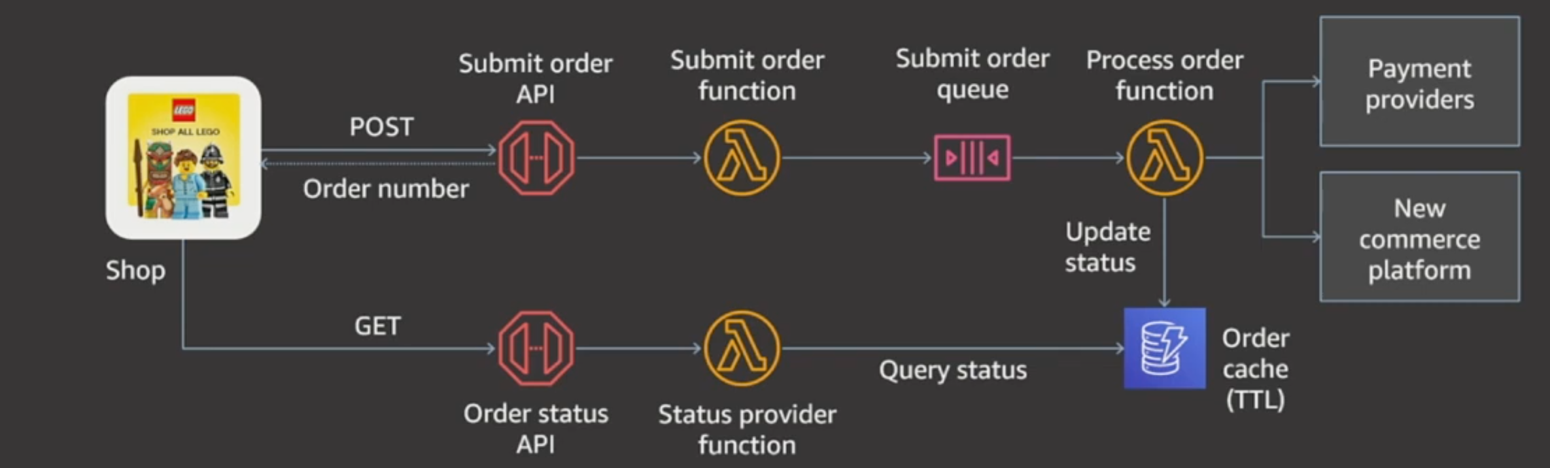
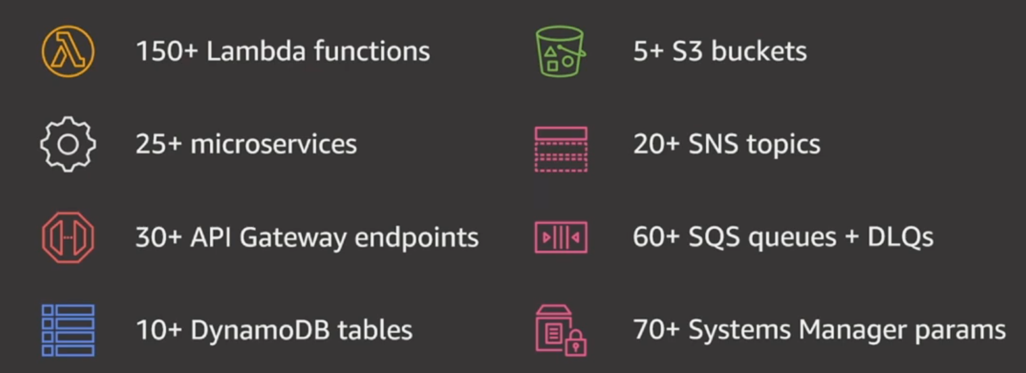
Shop.LEGO.com serverless on AWS
Images from Lego AWS:reinvent 19 presentation

Slide 10




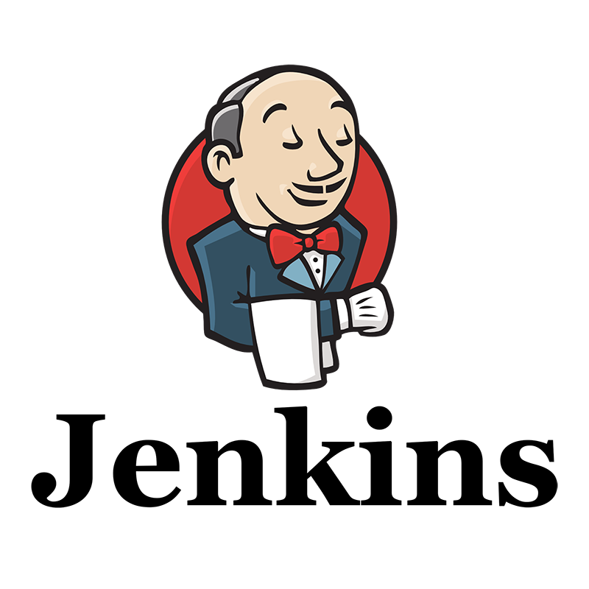
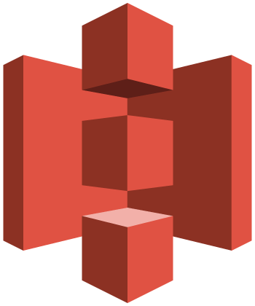
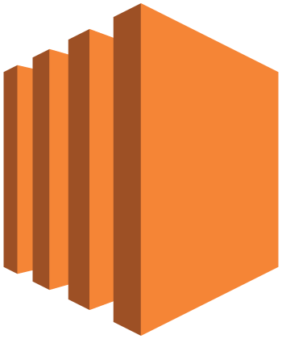
Continuous Integration and Delivery (CI / CD)
AWS
CodePipeline
Source Stage
Build Stage
Test Stage
Deploy Stage
AWS CodeBuild
AWS Elastic Beanstalk
AWS Elastic Beanstalk
Amazon S3
Amazon EC2
Amazon EC2
Notes:
https://aws.amazon.com/getting-started/projects/set-up-ci-cd-pipeline/

Slide 11
Virginia Tech Digital Library Platform (VTDLP)
Preservation
Data Modeling
Presentation
New services to Digital Library Platform
  ID Minting service, Access Service, Metadata service, …
Migrating legacy services to Digital Library Platform
  IAWA, VTechWork, …
A Multi-Tenancy Cloud-Native Digital Library Platform – OR 2019
Notes:
Form more information see A Multi-Tenancy Cloud-Native Digital Library Platform, our presentation to Open Repositories 2019.

Slide 12














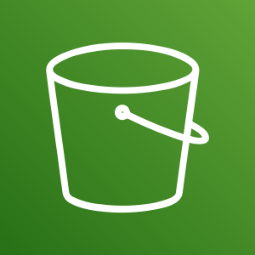
VTDLP Overview
Preservation staging
Presentation
VtechWork ETDs
Serialization Service
Resolution Service
IAWA
IAWA Images
BeyondVT
ID Minting Service
Metadata Service
.
.
.
SW Virginia
Others
Batch Metadata Service
Others
Other Services
Storage
Amazon S3
APTrust
Notes:
Iawa – 2016
Iawa v2 - oct

Slide 13


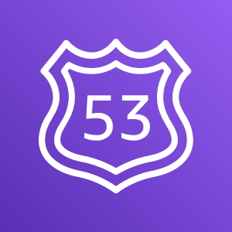



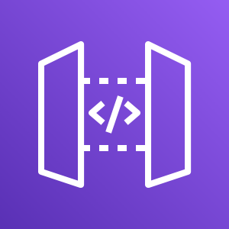
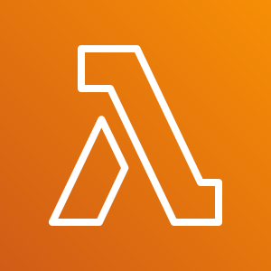

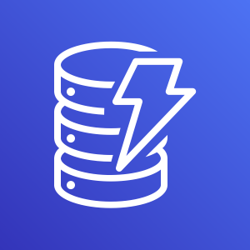

AWS Cloud
Amazon S3
Amazon
Elasticsearch
Service
Web App
Amazon Route 53
Amazon
CloudFront
Amazon API
Gateway
AWS Lambda
AWS
Certificate Manager
Amazon
DynamoDB
Amazon Cognito

Slide 14
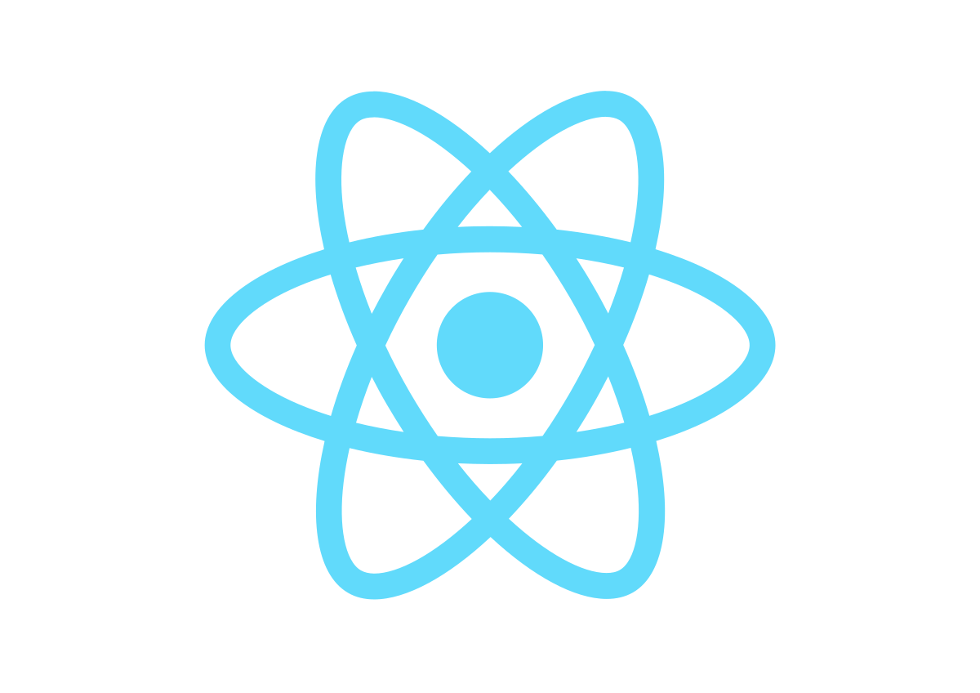
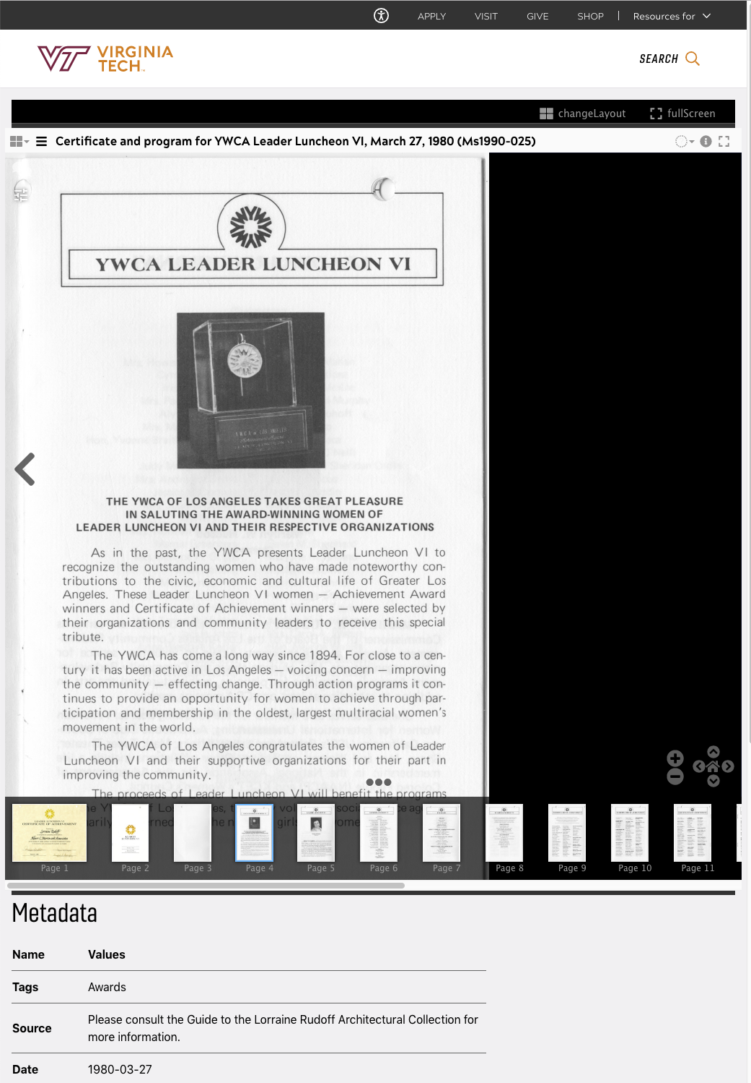
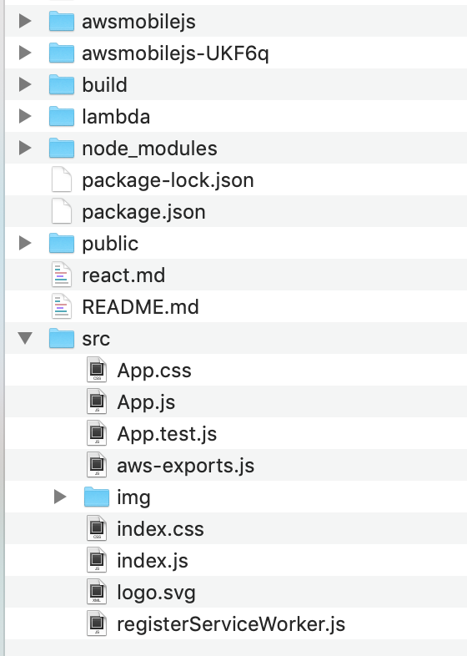
Presentation - Multi-Tenant Architecture
App1
App2
AppN
Application Hub
DB
Search
Notes:
Multi-tenant application, not multiple instances. More shared infrastructure means:
Less infrastructure to maintain, patch, update, etc.
Features added for one application are instantly available to the others
Cross-site work, like modifying the shared theme, is a simple process
Add a react package

Slide 15
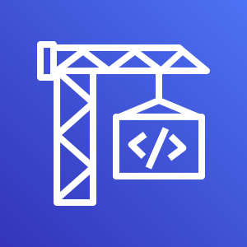

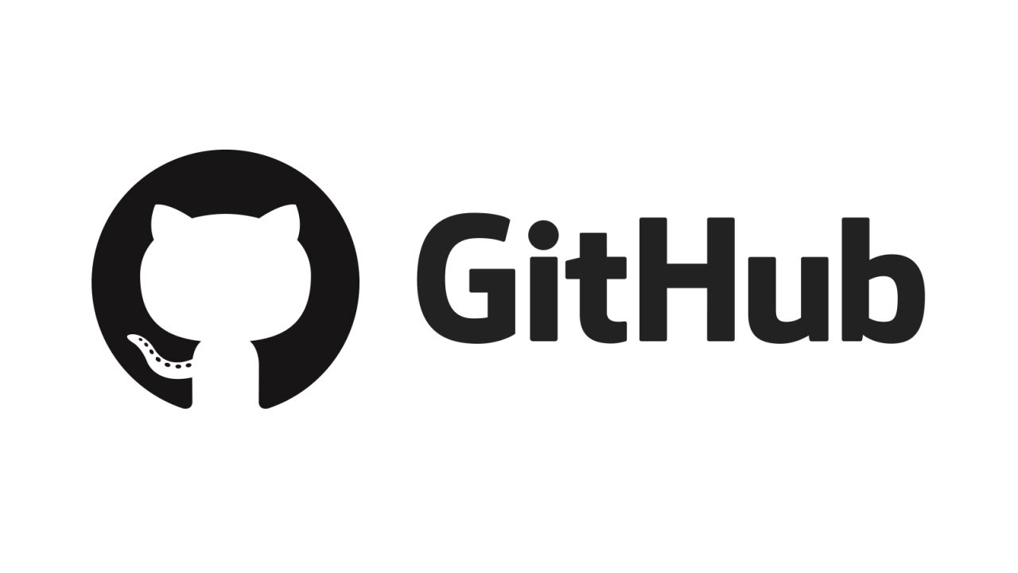

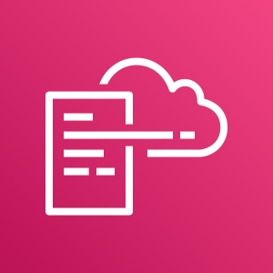
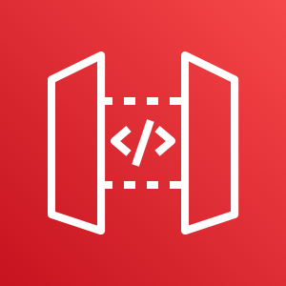
CI/CD with AWS
(4)
(3)
AWS CodeBuild
Amazon S3
(1)
(2)
(6)
Developers
AWS Amplify
(5)
AWS Lambda
(7)
AWS CloudFormation
Amazon API Gateway

Slide 16
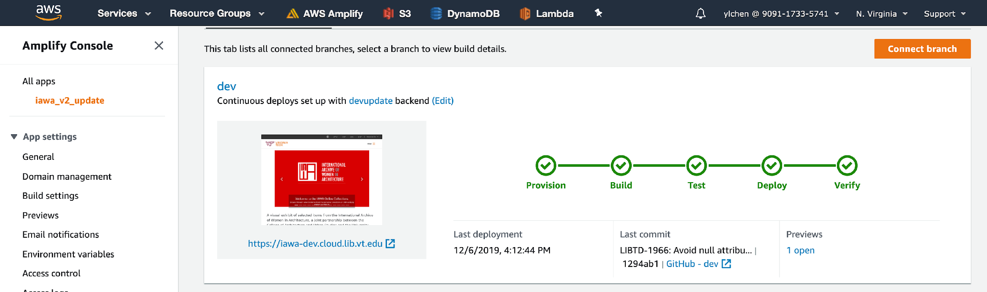
Automatic CI/CD Pipeline

Slide 17
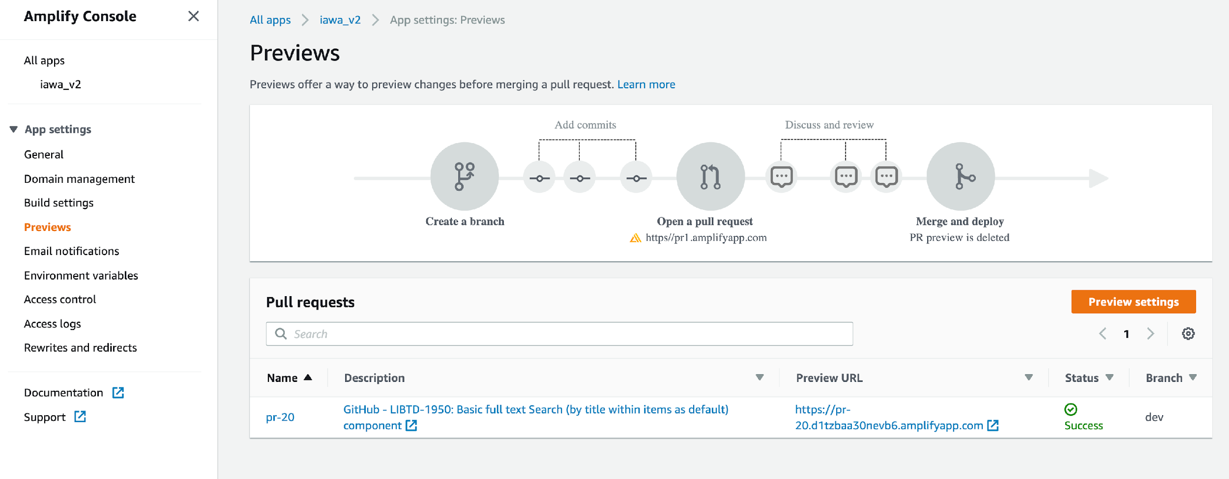
A New Version for each Pull Request

Slide 18

The International Archive of Women in Architecture
A level 0 compliant image server using Amazon S3 and Amazon CloudFront
Tiles images, manifest JSON files, and etc.
Terabytes of scan images to be processed
Scaling IIIF image tiling in the cloud – Code4Lib Journal (To be published)

Slide 19






Image processing workflow
AWS Batch
Raw
images
Amazon S3
Batch Job – image set 1
Batch Job – image set 2
Amazon EC2
Amazon
CloudWatch
AWS Lambda
Amazon S3
Batch Job – image set 3
Rule
Tiles &
Manifest
Amazon Elastic
File System
Batch Job – image set N

Slide 20
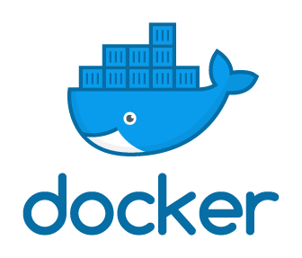

Batch job - IIIF_S3 Docker
AWS Batch
Command
Parameters
Environment variables
vCPUs
Memory
Amazon S3
IIIF
Tiles &
Manifest
Amazon Elastic
File System

Slide 21
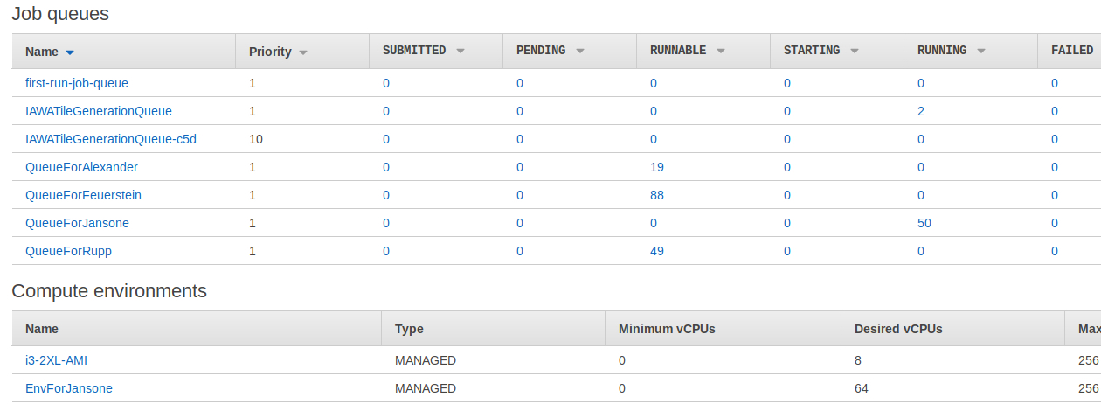
Automatic Data Process Pipeline
Notes:
Using AWS Batch.

Slide 22
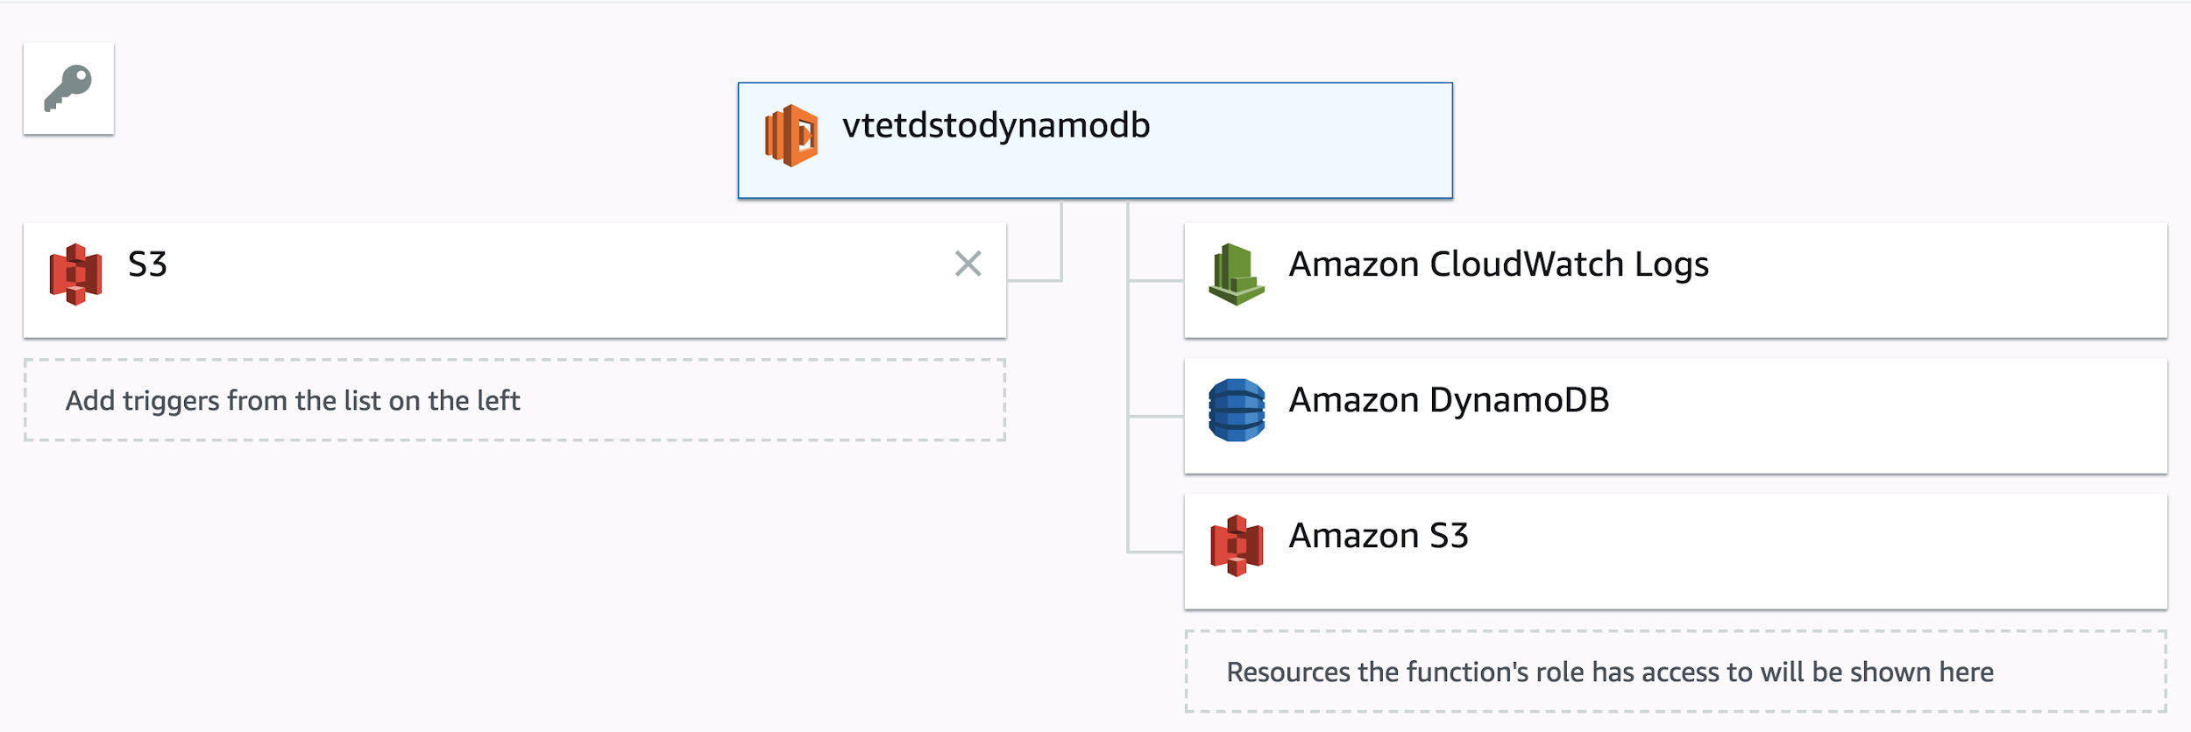
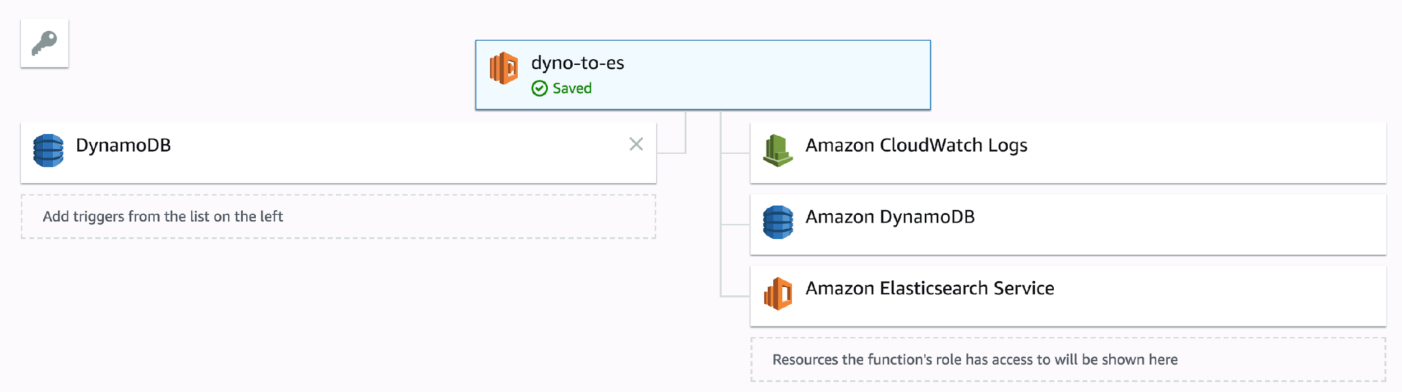
Microservice – Using AWS Lambda
Notes:
Dr. Chen wrote these two. First moves our data to the DB. Second moves data to ElasticSearch. They use Lambda to apply these functions.

Slide 23
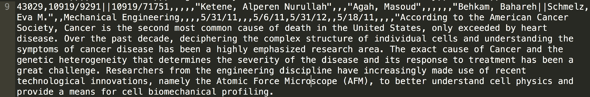
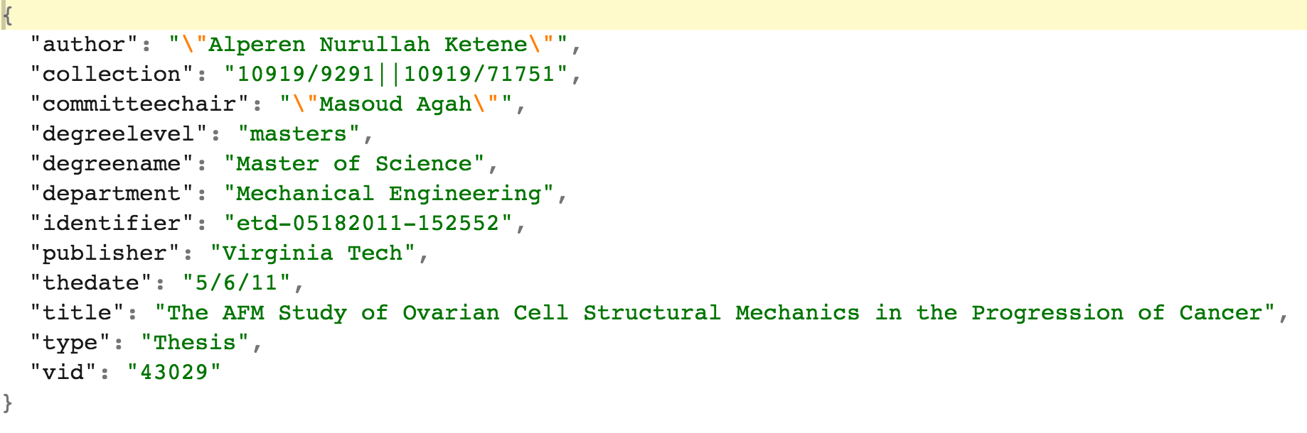
Metadata Transformation Using AWS Lambda
Notes:
We convert delimited text-based metadata into JSON for storage in AWS DynamoDB and indexing with ElasticSearch.

Slide 24
Outcomes
Developer/DevOps candidate pool much larger
Automated compliance with Digital Preservation Best Practices
Benefits of tiered storage for long-term data archiving
Performance improvements even without optimization
Notes:
Hiring- we’ve been able to hire 1 developer and are working up position descriptions for another developer and a devOps position. The skills and experience we’re advertising for are much more common than our previous positions. We can also offer more desirable experience and training to candidates like AWS Certifications and training in React and Amplify rather than Rails and Java used in the legacy stack.
This infrastructure makes it much easier for us to automate Digital Preservation Best Practices like keeping three copies of data in 3 seperate locations in geographically distributed locations.
We’re excited to be able to take advantage of tiered storage since libraries keep everything forever so Glacier is quite useful to us.

Slide 25
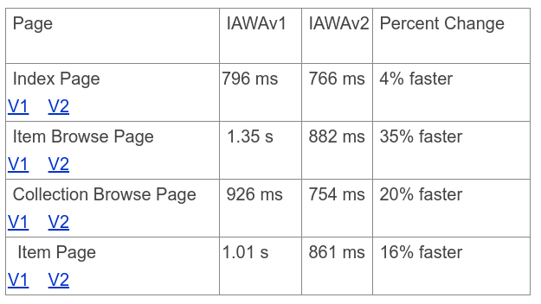
Performance improvement before optimization
Notes:
This is an apples-to-apples comparison of our first production application where v1 is our legacy application stack at VTUL and v2 is the same application refactored in AWS. The performance improvements are actually much more dramatic than this table indicates as the v1 legacy application was necessarily refactored to use AWS S3 and Lambda, which was done to address 20 minute page load times.

Slide 26
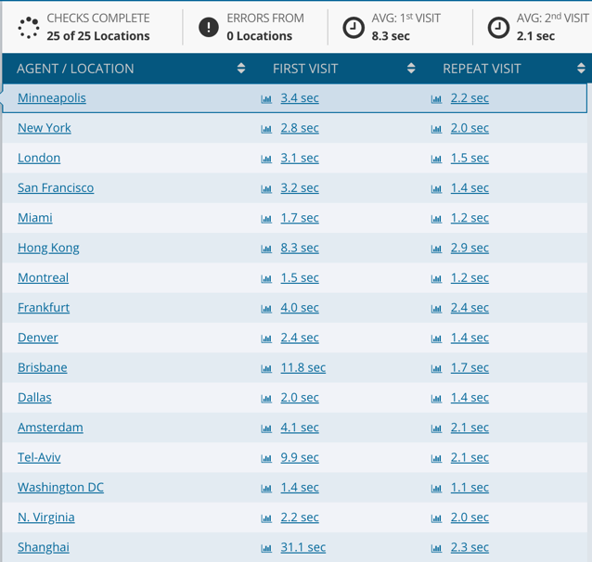
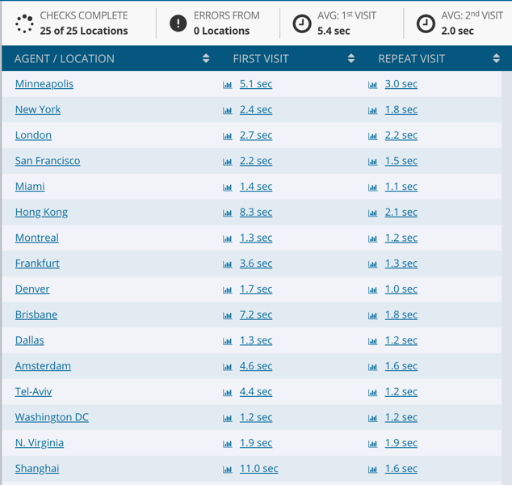
Site performance
Collection page
Search page
Notes:
The new site is probably ~40% faster across the board without any optimization in AWS and significant optimization in the local stack.

Slide 27
Demo
https://iawa-dev.cloud.lib.vt.edu/
Notes:
The development site is only accessible from the Virginia Tech network.

Slide 28
Next Steps
Docker and kubernetes for reproducible builds and orchestration between cloud and local
Exploring local infrastructure changes e.g. Ceph storage
Benchmarking and cost optimization of cloud services
Refactoring of legacy applications to AWS
CloudFormation or Terraform for everything
Notes:
We want to work on containerization to allow us to make more reproducible builds that we can fail over and migrate between cloud and local.
We’re at a decision point in our local infrastructure planning and would like to be able to take advantage of ETF while still enjoying the benefits of the cloud.
We’ve been working on benchmarking processes to determine the most cost-efficient way to accomplish tasks and have published results for the benefit of other libraries who might be interested in this approach.
Our plans are to migrate as many of our legacy applications to AWS as possible to create resource deployment templates for each application.

Slide 29
Thank You!
Q & A

