Slide 1
Clustering tweets and webpages
Saket vishwasrao
Swapna thorve
Social network
Lijie tang
May 3, 2016
Spring 2016
CS 5604 Information storage and retrieval
Instructor : Dr. Edward Fox
Virginia Polytechnic Institute and State University, Blacksburg, VA 24061

Slide 2
clustering

Slide 3
Clustering overview
Feature Extraction
TF-IDF
word2vec
K-means
WSSE evaluation
HBase Schema
Clustering and LDA result evaluation
Future Work

Slide 4
Feature extraction
TF-IDF
Represent documents as a bag of words model
Vector dimension = Vocabulary size
Word score = TF-IDF
Word2vec
Combine all tweets to a single document
Train a neural network and extract vector representation of each word
Document vector = Sum all vectors (for each word) in a document

Slide 5
Clustering with k-means
Normalize data using ||L₂|| norm
Write to HDFS as part files.
Compute
Within Set Sum of Squares (WSSE) scores
Tweet distribution

Slide 6
Comparison of TF-IDF vs. word2vec

Slide 7
WSSE Based evaluation

Slide 8
Running over different TwEET collections
Collection Clusters | 541 #NAACPBombing | 602 #Germanwings | 668 #houstonflood | 686 #Obamacare | 694 #4thofjuly
0 | 1374 | 31189 | 283 | 5333 | 6627
1 | 7504 | 26297 | 899 | 36070 | 5529
2 | 18375 | 5785 | 2605 | 16899 | 762
3 | 3166 | 11979 | 3672 | 69555 | 13663
4 | 1009 | 8328 | 1488 | 36383 | 1427
5 | 2437 | 6459 | 5884 | 19302 | 3961
Notes:
Total sizes
Put pie charts
Collection names
Right align the data

Slide 9
Running over different TwEET collections

Slide 10
Hbase schema design
Document ID | Cluster no. | Cluster label | Probability
String (Tweet-id/URL) | Integer | String | Float

Slide 11
Collections evaluated
Tweets
- 602, 668, 694, 541
Webpages
- 686 (TODO)

Slide 12
Clustering evaluation using topic analysis data
Combine document matrices
Create topic frequency matrix per cluster
1. Cluster labels
2. Hierarchy of mixed topics and clusters
3. Probability of a document belonging to the cluster
Extract relevant topics per cluster using mean, frequency, deviation
Outcome
Notes:
Picture of matrix circle 2, sketches n stuff

Slide 13
Explanation
Combine document matrices
Create topic frequency matrix per cluster
Extract relevant topics per cluster using mean, frequency, deviation
Doc id | Cluster no
Doc id | Topics Probability
+
How many times a topic occurs in a cluster ?
Cluster no | Topics per cluster
1 | T3, T2
2 | T1, T2
Cluster no | Topic frequency
1 | T1=2, T5=2, T2=1, T3=1
2 | T1=3, T3=3, T5=1, T2=5

Slide 14
results
Collection 602 - tweets
Cluster no (wordToVec) | Topics | Topic words | Cluster labels
0 | Topic 3, Topic 4 | crash,germanwings,pilot,victims,plane,Lufthansa germanwings,lubitz,copilot,flight,playing | Germanwings crash and pilot Lubitz
1 | Topic 1, Topic 5 | germanwings,ripley,believe,click,bigareveal germanwings,world,charliehebdo,lives,garissa | Germanwings news
2 | Topic 4, Topic 5 | germanwings,lubitz,copilot,flight,playing germanwings,world,charliehebdo,lives,garissa | Germanwings crash news
3 | Topic 1, Topic 4 | germanwings,ripley,believe,click,bigareveal germanwings,lubitz,copilot,flight,playing | Pilot Lubitz of Germanwings
4 | Topic 1, Topic 2 | germanwings,ripley,believe,click,bigareveal germanwings,copiloto,vctimas,accidente,vuelo | Happenings and accidents
5 | Topic 1, Topic 4 | germanwings,ripley,believe,click,bigareveal germanwings,lubitz,copilot,flight,playing | Pilot Lubitz of Germanwings

Slide 15
Hierarchy of mixed topics and clusters
Collection 602 - tweets
Pilot Lubitz of Germanwings
Cluster 5
Topic 2
Topic 3
Cluster 4
Cluster 3
Cluster 0
Topic 1
Topic 4
Happenings and accidents
Pilot Lubitz of Germanwings
Germanwings crash and pilot Lubitz
Cluster 1
Cluster 2
Topic 5
Germanwings news
Germanwings crash news
Notes:
Change the figure

Slide 16
Hierarchy of mixed topics and clusters
Cluster 0
Collection 602 - tweets
Topic 1
Topic 5
Topic 2
Cluster 2
Cluster 0
Cluster 4
Topic 3
Cluster 3,
Cluster 5
Topic 4
Notes:
Change the figure

Slide 17
Future work
Use probabilistic models for clustering
Clustering evaluation
- Evaluate clusters with internal and external criteria
- Implement Silhouette scoring in Spark-Scala
- Establish ground truth for comparison of evaluation results (probabilities)
Labeling of clusters
- Label extraction from clusters words
- Compare cluster labeling methods
Clustering as a start point
- Feed clustering results to LDA/classification/collaborative filtering for more accurate results.
Notes:
Reverse the approach
Labelling clusters

Slide 18
Social network

Slide 19





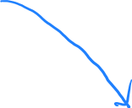


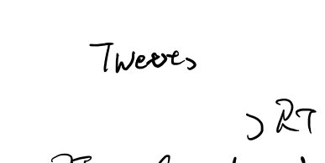






objective
To find the most relevant content given an User Query
Clusters/Classification/Topic Modeling are content driven
Social Network are User driven
Query is user generated
Notes:
Use figures from your work rather than this one

Slide 20



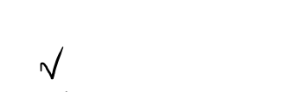

assumptions
1. More RT = important tweets
2. More RT = important accounts
3. More follower = important accounts
4. Generated/Distributed by important accounts = important tweets
5. Higher RT ratio inside cluster = important tweets/accounts in the cluster
6. More follower inside cluster = important accounts in cluster
Clusters could be content cluster or SN cluster

Slide 21
Importance factors (general)
1. Start from follower counts:
IF_{account} = Number of followers/Maximum follower count in SN
2. Tweet IF:
IF_{tweet} = SUM ( RT * IF_{account}) for each RT
3. Account IF:
IF_{account} = SUM (IF_{tweet} )/Tweet count
Repeat 2, 3 until converge

Slide 22
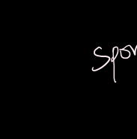
Importance factors (cluster)
? Should we consider outside influence ?
Two tweet with same RT network inside a cluster
Are they the same important?
In our approach
Inside IF is calculated as the general approach
Inside IF is more important than general IF
Inside IF first
General IF second
Notes:
Simplify and give example: thought experiment or really done. If really done give examples else drop this slide

Slide 23
Work Flow
Work
Data Collection
Social Network Building
Social Network Clustering
Important Factor Calculation
Key Activities
Twitter Crawling: build a crawler to scrapy the twitter account information.
Twitter connections summarization: find the RT and Mention (@) between accounts.
Calculation of the nodes-edge networks: nodes – accounts; edge – follow, RT, mention.
Social Network Drawling.
Clustering Based on Social Network Structure:
Graph Clustering Given Nodes and Edges.
Nodes Grouping Using Clustering result.
Importance factor calculation based position in the social network (centroid or border of a cluster)
Milestones
Twitter Crawler: 1. User Information; 2. RT counts of each tweets.
Social Network Visualization.
Clustering algorithm and programming.
Program the RT, Mention Network Builder.

Slide 24
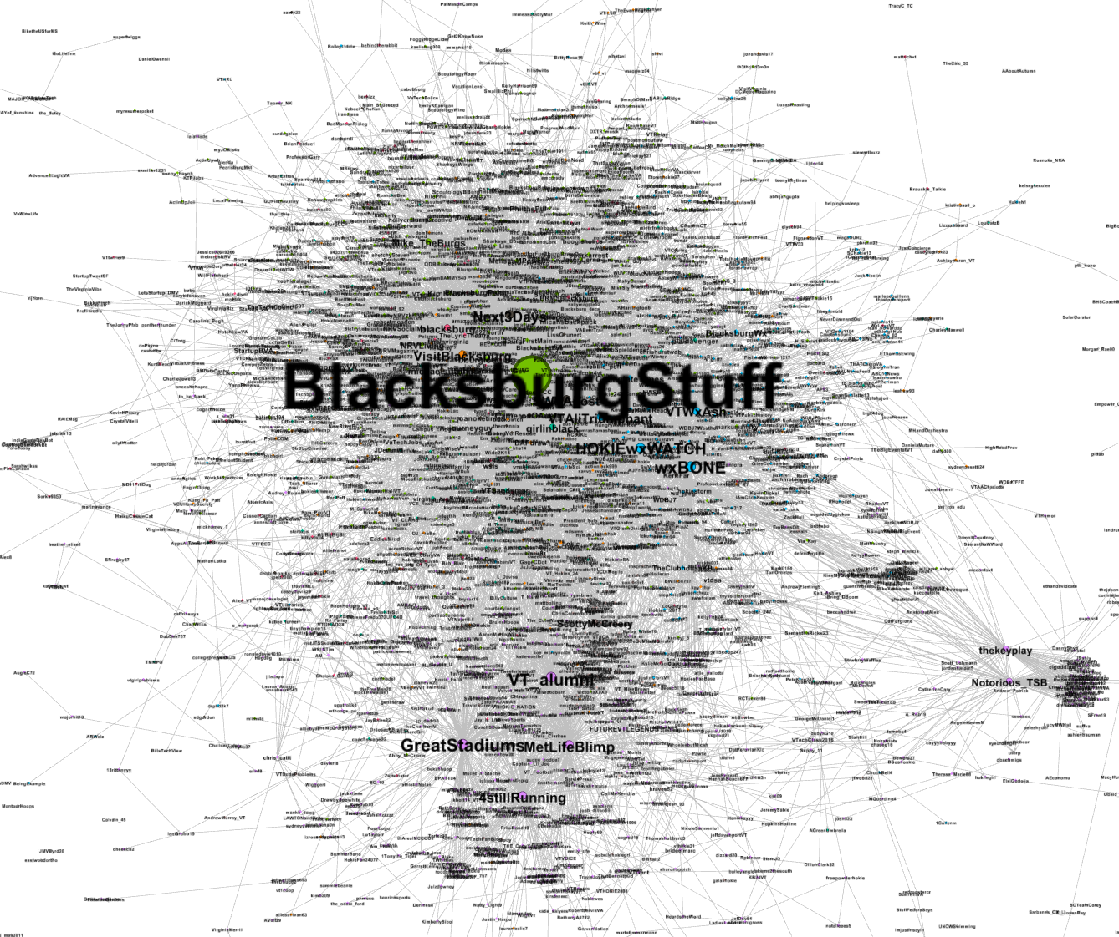
Tool used
Crawl: Python -> tweepy
Streaming tweets in real time
SN build: Python
Simple Visualization: Gephi.
Could expand to D3.
Notes:
Make this slide clearer. Nice to know what is the dataset. Histogram of importance factors/scores. Pick up a few points from the graphs and explain them or show their scores. Supporting data for the graph shown here.
Make a workflow diagram, because the slide is not clear.

Slide 25
acknowledgments
Dr. Fox
NSF for grant IIS – 1319578
IDEAL project
GRAs – Sunshin Lee and Mohamed Magdy Farag
Teams – Collection management, Solr, Front end, Topic Analysis
Class – Discussions, suggestions

Slide 26
Questions?
Thank you

