Slide 1
Port Video
Students: Joshua Rush, Stuart Whitehead
Client: Purdom Lindblad
Virginia Tech, Blacksburg VA
May 8th, 2013
CS 4624

Slide 2
Goals
Promote the Digital Humanities Research Space: Port
Design a logo
Create a 3-5 minute video

Slide 3
Roles
Josh
Principal Cameraman
Video Editing
Stuart
Assistant Cameraman
Logo Design
Video Narration

Slide 4
Schedule
February – Preliminary research, begin filming and logo design
March – Get feedback on logo, begin editing
April – Continue filming, finalize logo
May – Finish editing, archive

Slide 5
Logo
Provide several logo variations
Provide icon version of logo

Slide 6



Logo

Slide 7
Video
Title screen
Narration
Screen Casts
Interview
B-roll
Credits

Slide 8
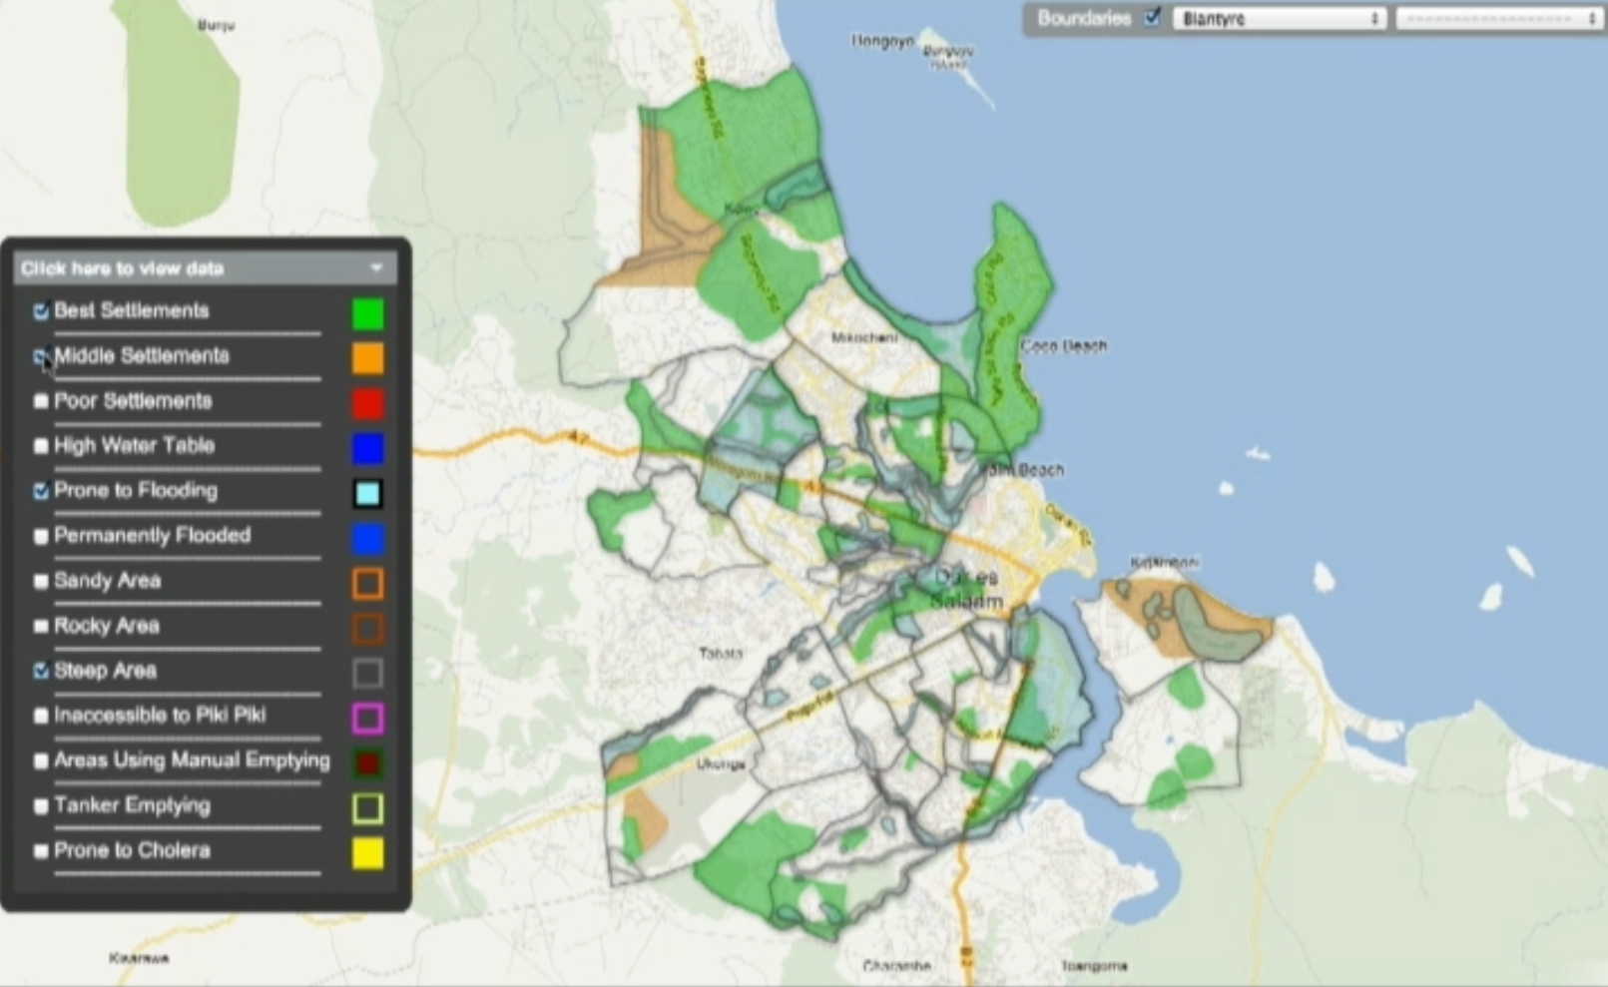
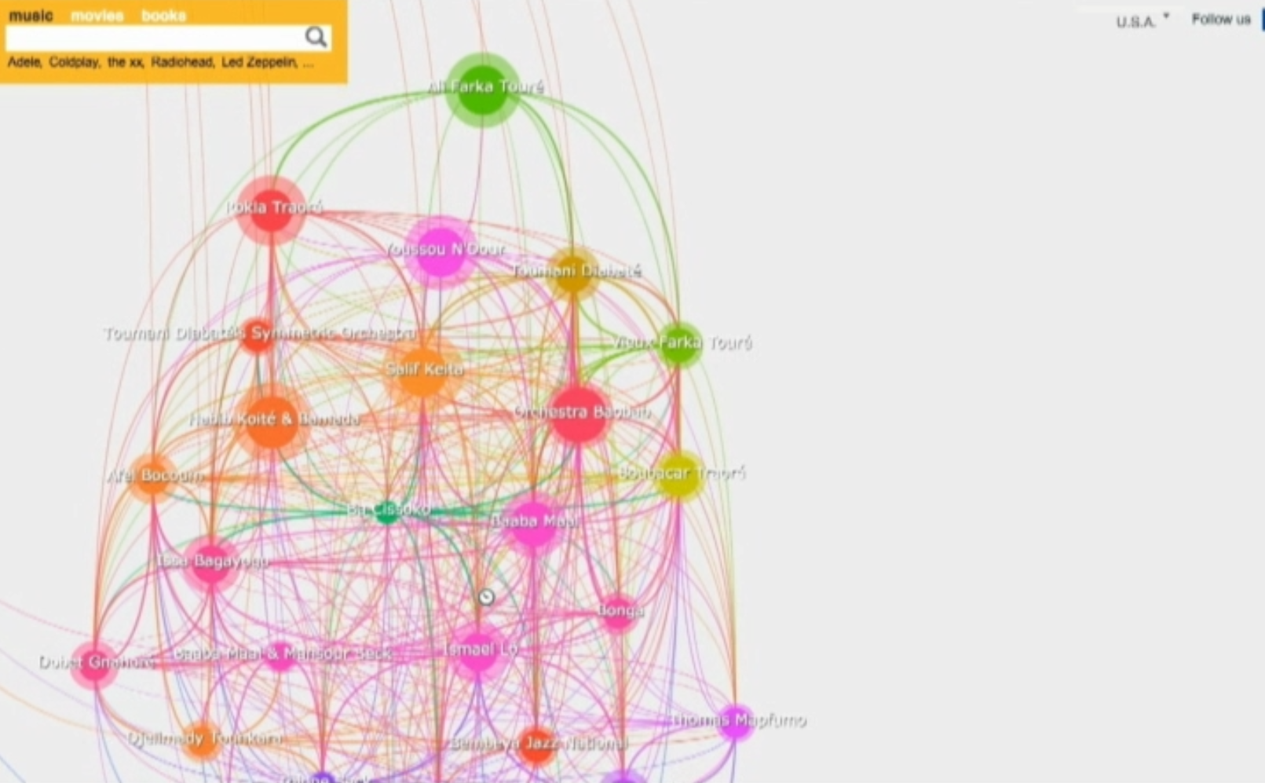
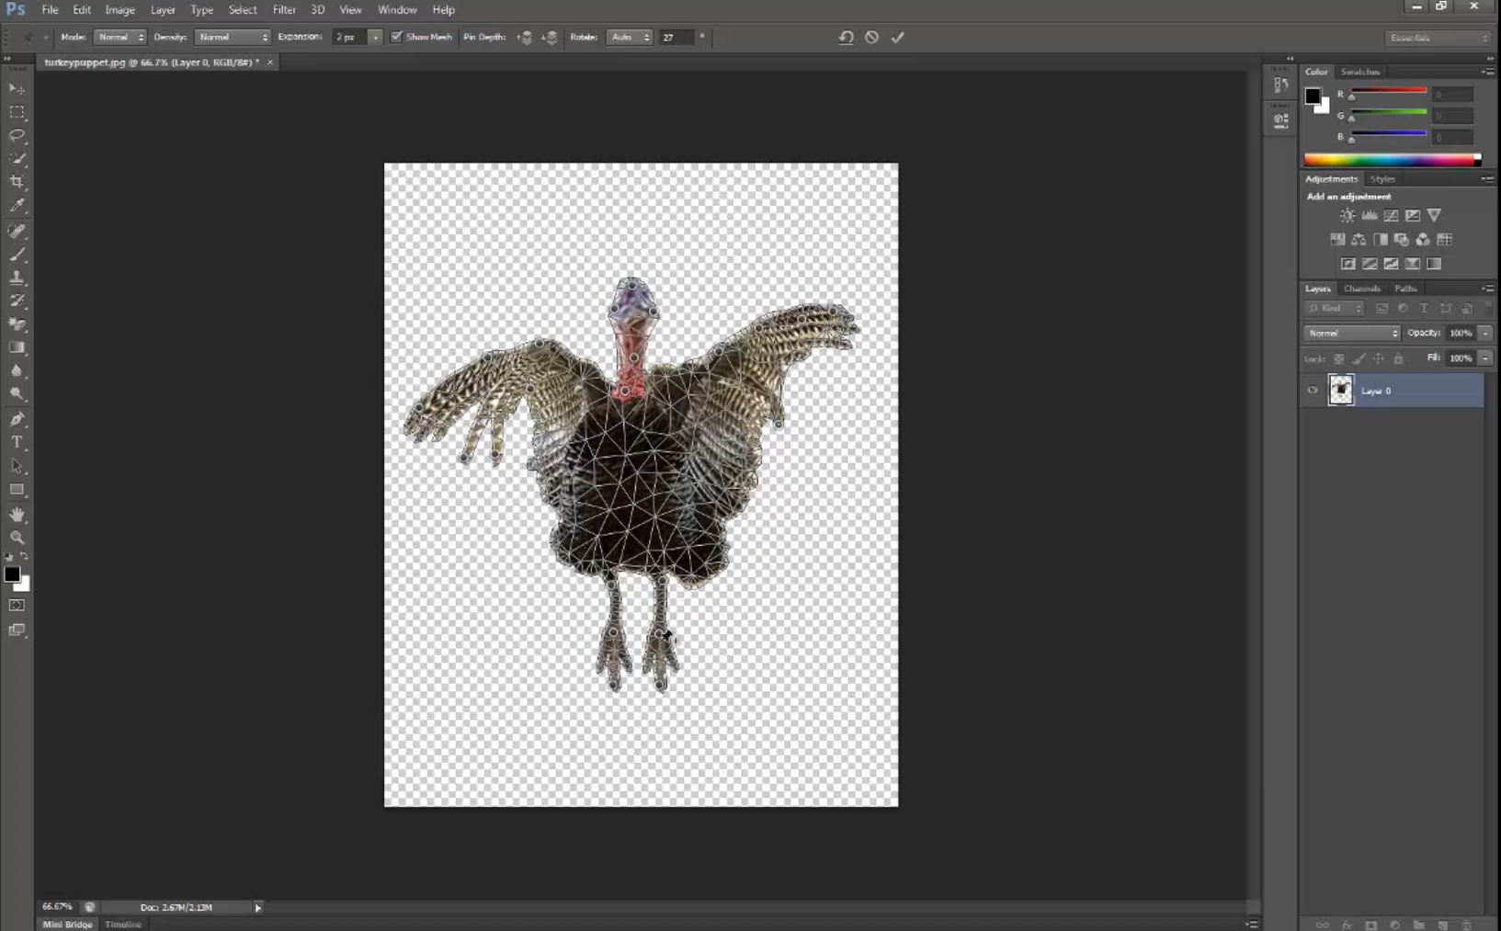
Screen Casts
Adobe Photoshop
Puppet feature
Google Fusion Tables
LivePlasma

Slide 9
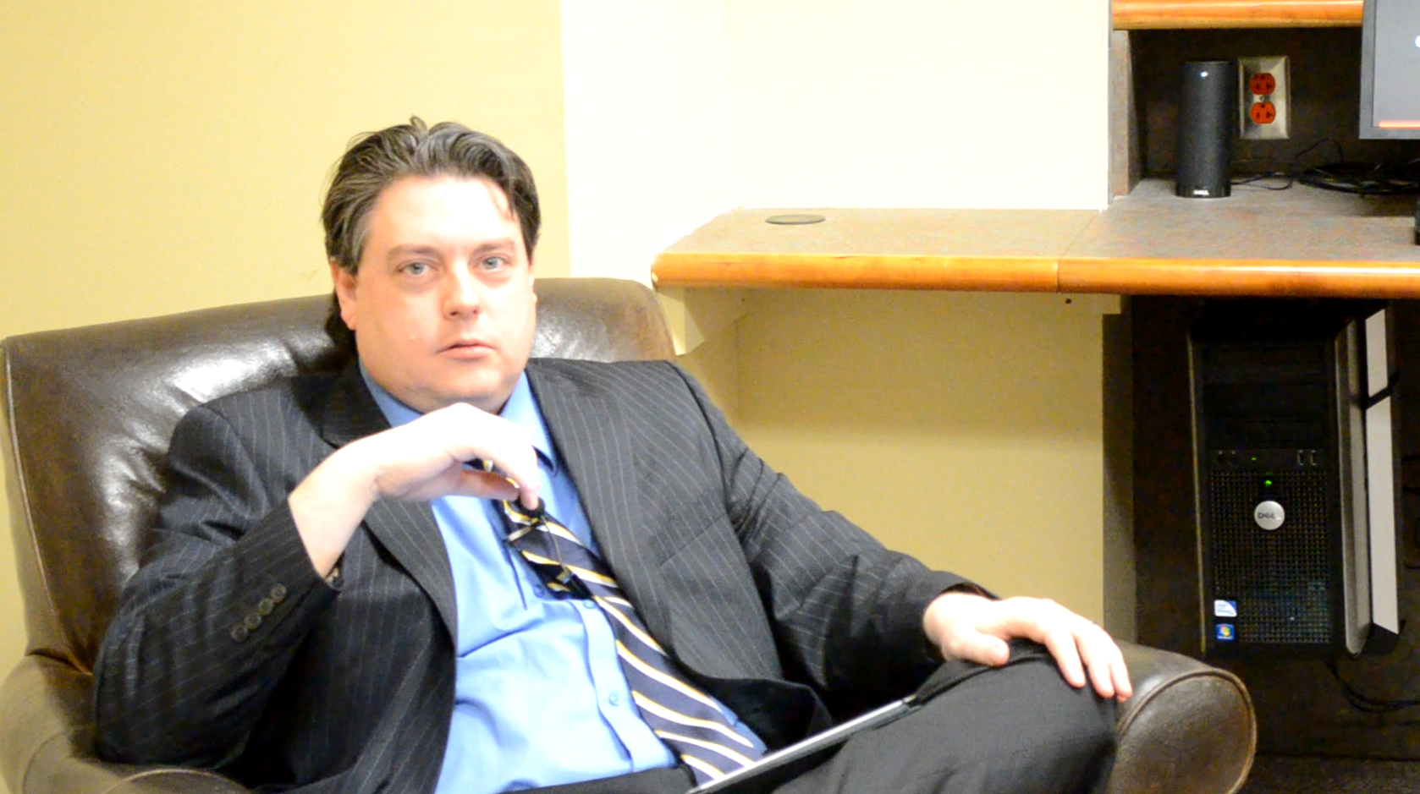
Interview
Brian Matthews
Associate Dean for Learning and Outreach

Slide 10
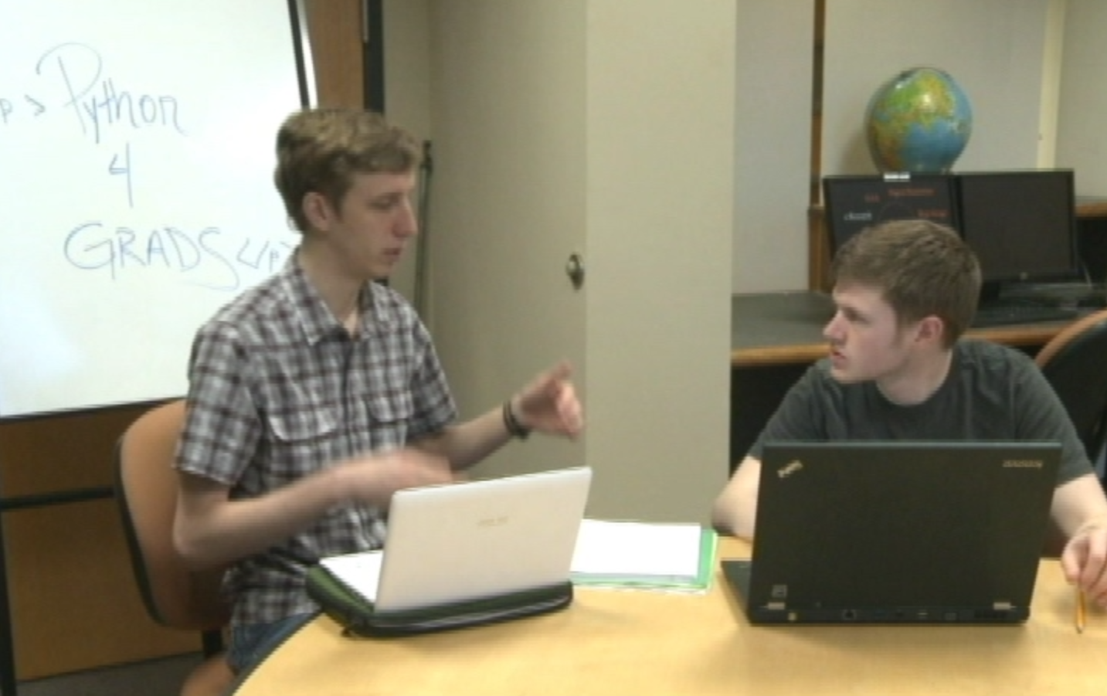
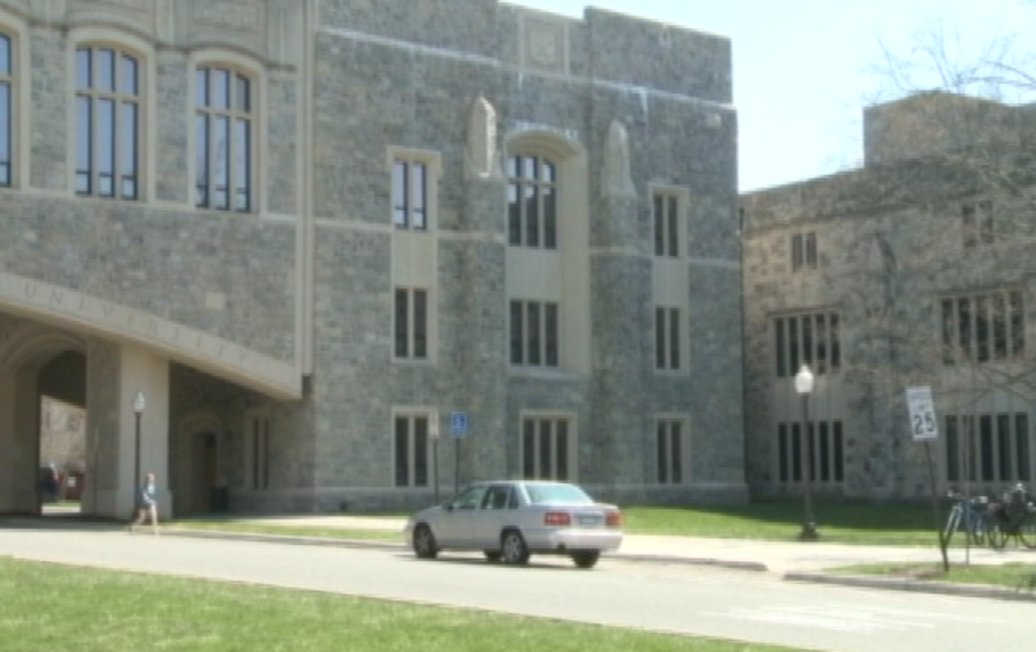
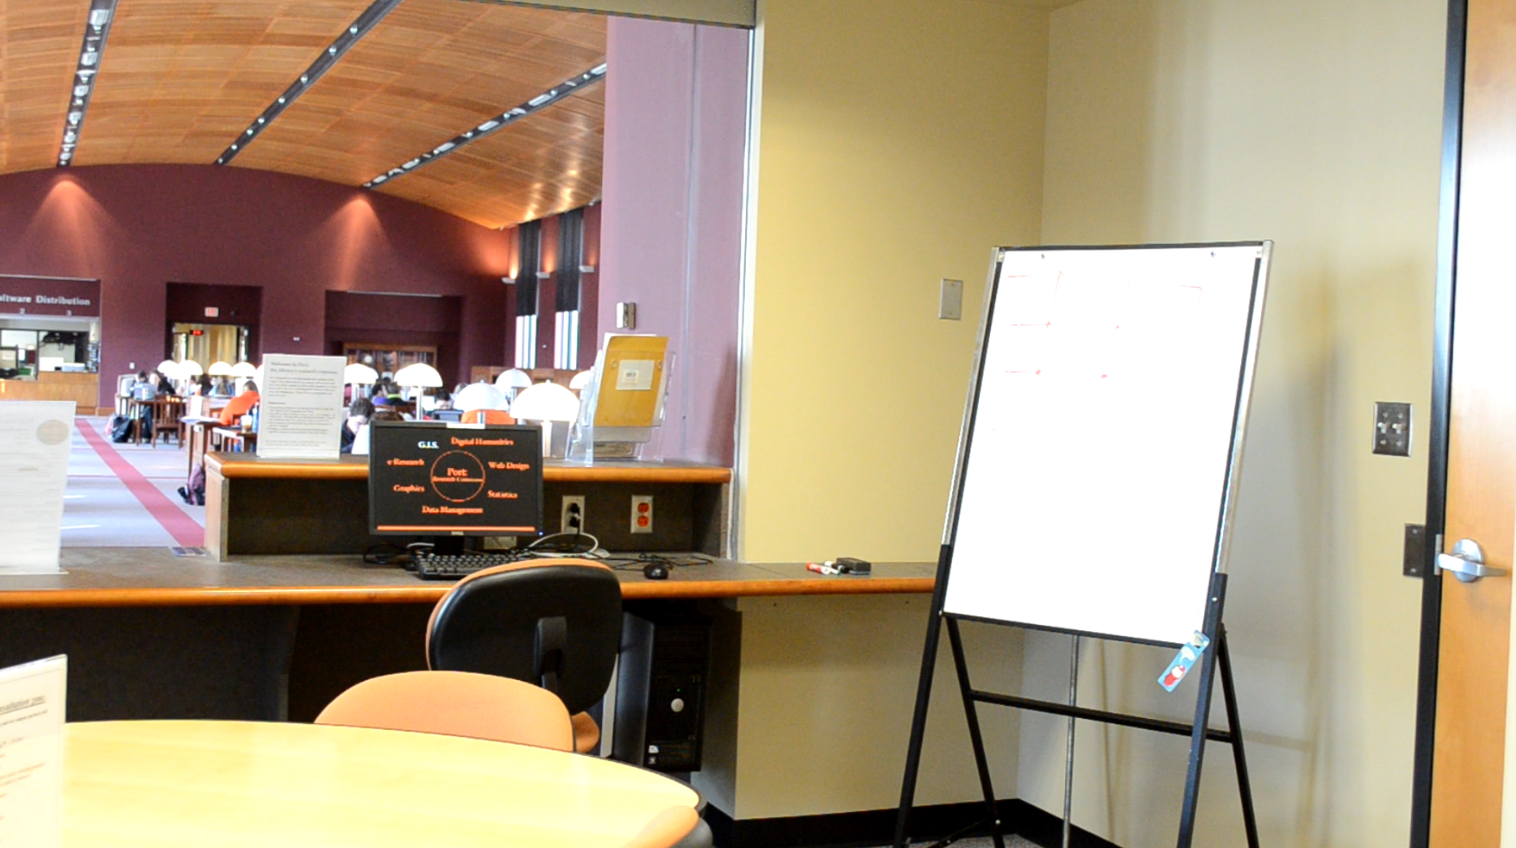
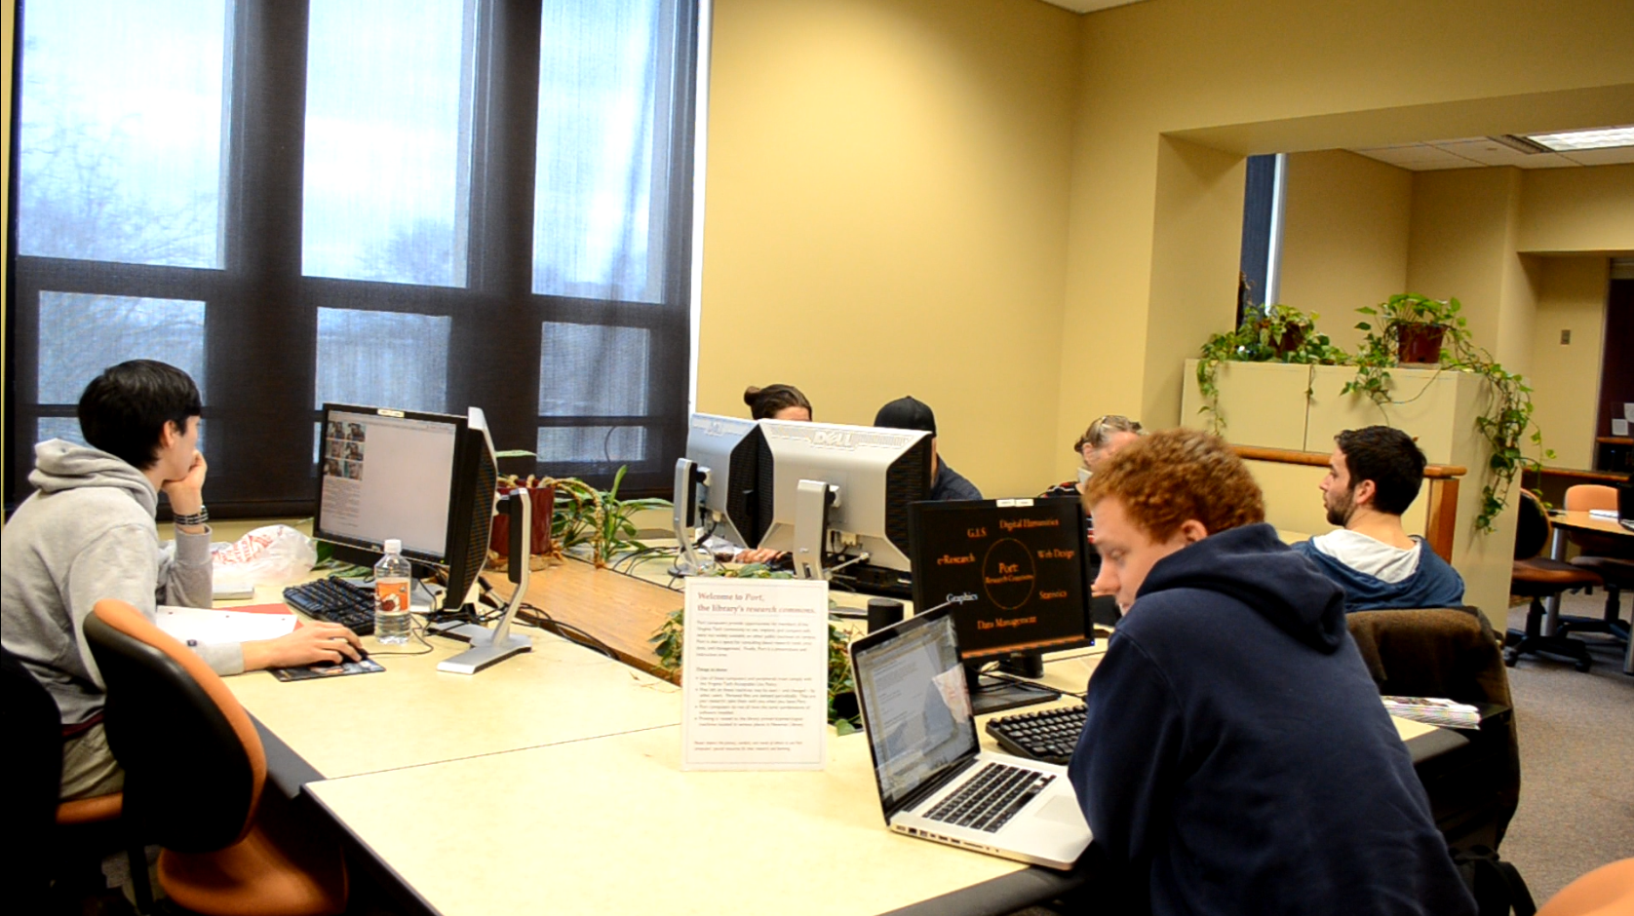
B-roll

Slide 11
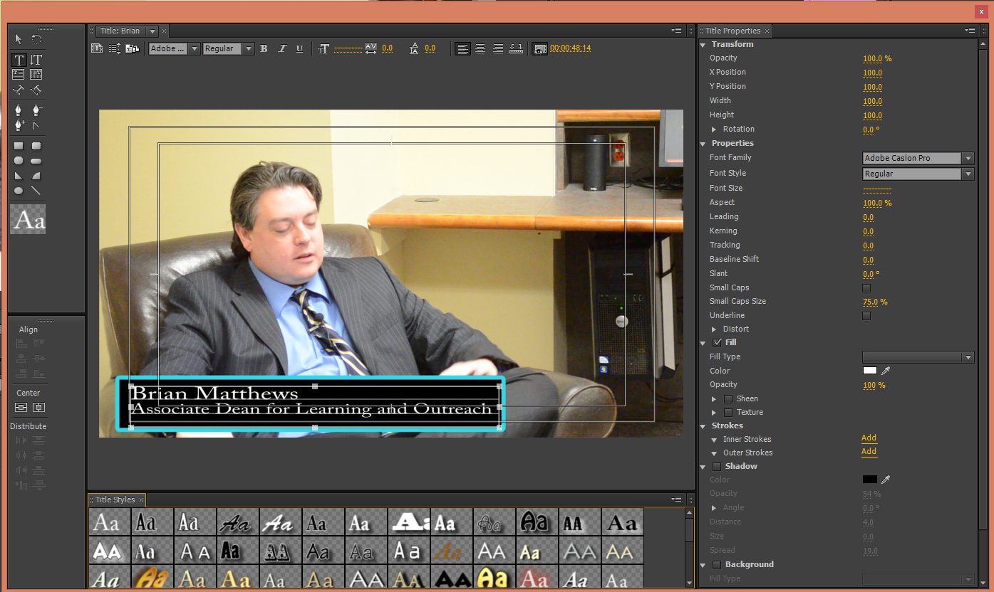
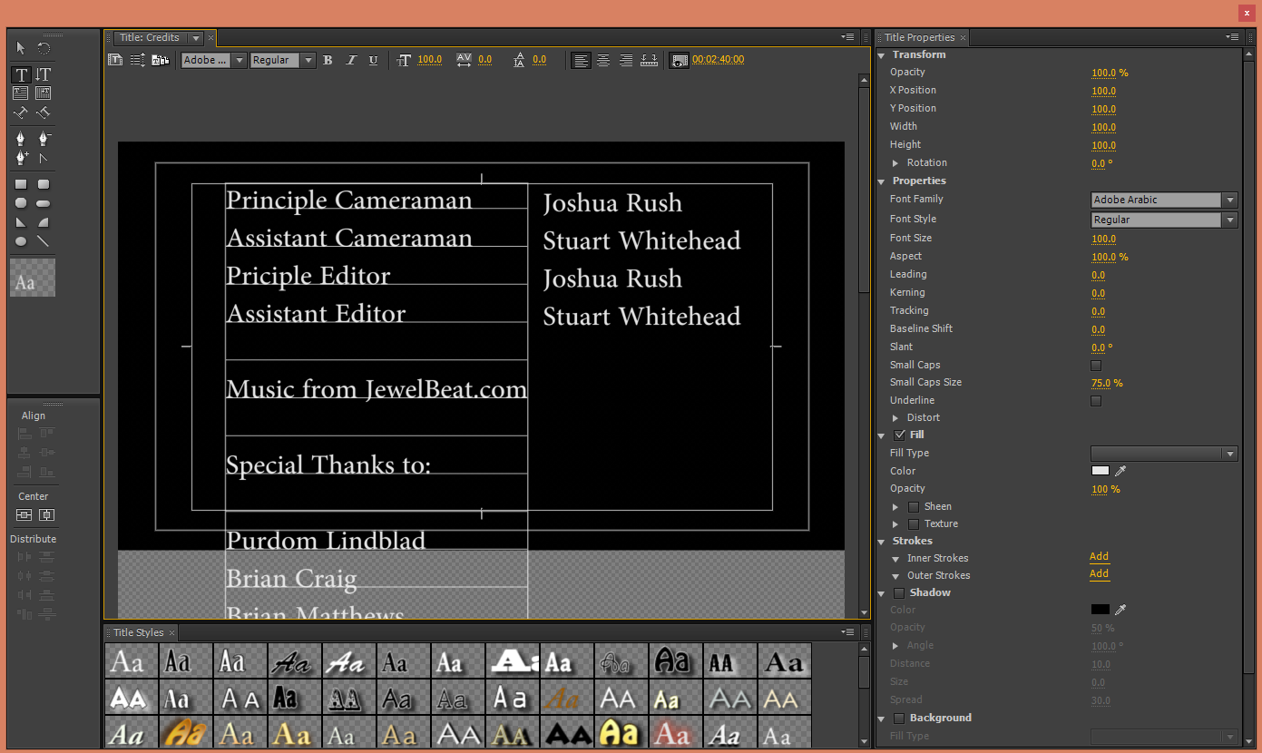
Editing
Adobe Premiere CS6
Narration
Music
Transitions
Titles
Credits
~4 minute video completed

Slide 12
Challenges
Inconsistent lighting
Multiple file types
Quality of exports
VirtualDub

