Slide 1

Curating Your
Digitizing Collections of SWVA Community History
Alex Kinnaman, Virginia Tech University Libraries
Jenny Nehrt, Christiansburg Institute, Inc.
Ann-Margaret Shortt, Montgomery-Floyd Regional Library
Sherri Huffman, Danville Community College (Ret.)
Image source: Julia Westblade, Digital Imaging Coordinator, VTUL
Notes:
Good morning everyone. Thank you for joining us for this roundtable “Curating Your Box of Chaos: Digitizing Collections of SWVA Community History, and thank you to VAM for giving us this opportunity to share at this conference. My name is Alex Kinnaman and I’m the Assistant Director of Digital Libraries & Preservation at Virginia Tech University Libraries.
We want this session to be more focused on the panelists that I will introduce shortly and on conversations with you, but I will start with a quick history and context of what brought us here today before spending the majority of time in discussion.

Slide 2





Panelists
Alex Kinnaman (moderator)
Jenny Nehrt
Ann-Margaret Shortt
Sherri Huffman (Ret.)
Notes:
Our panelists today are some of my favorite colleagues, all from the Greater Southwest Virginia Digital Collective Advisory Board: Jenny Nehrt, Curator at the Christiansburg Institute, Inc.; Ann-Margaret Shortt, Library Assistant at the Montgomery-Floyd Regional Library; and Sherri Huffman, formerly of the Danville Community College and Blue Ridge Heritage.

Slide 3


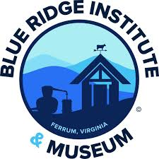

Greater Southwest Virginia Digital Collective (GSDC)
Goal to build relationships with the cultural heritage communities from within the community and offer resources to curate their collections
Advisory Board composed of community members and Virginia Tech University Library (VTUL)
3
3
Notes:
The Greater Southwest Virginia Digital Collective, or GSDC, is a community built around relationship development among cultural heritage organizations and individual collectors to provide and facilitate access to resources to curate their collections. The leadership is composed of an Advisory Board with both community members and VT University Library faculty. The problem we’re hoping to solve is tackling that gap between larger organizations with resources taking ownership of material, and smaller organizations with collection but fewer resources to curate, and finding that middle ground.

Slide 4
History of GSDC
2016
2019
2022
2023
Virginia Tech University Libraries began conversations with community to digitize and preserve Southwest Virginia’s cultural heritage
IMLS Community Catalyst Grant (2019-2022) supported collaboration with over a dozen community organizations.
Transitioned to a community-governed entity in 2022, shifting decision-making to local stakeholders.
Formation of GSDC: Eight institutions collaborated to establish an advisory board.
Notes:
This didn’t happen quickly. Discussions around community collections facilitated by VTUL began by 2016, possibly earlier but that was before my time, with my former supervisor building relationships with community organizations to digitize and preserve regional cultural heritage. By 2019, VTUL received an IMLS Community Catalyst to support collaborative forums with over a dozen organizations, all compensated for their time to participate and all providing valuable insight into the functional requirements for a cultural heritage organization.
When the grant concluded, we transitioned to planning an Advisory Board to guide the mission in 2022 and launched GSDC formally in 2023.

Slide 5

Mission
Values
Empowering partners to share primary source materials in a sustainable program that provides access to the region’s unique archival resources. We connect communities and facilitate online access to significant collections within greater Southwest Virginia.
Community, inclusion, and diversity
Ownership and engagement
Trust, transparency, and accountability
Sustainability
Accessibility
Notes:
I want to set the tone by highlighting our values, which were all very carefully curated around those functional requirements identified during the grant, including community, ownership, trust, sustainability, and accessibility.

Slide 6


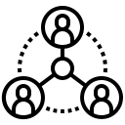
Purpose
Collection scope & governance
Promote open access to collections while respecting community control over representation.
Ensure that materials remain accessible and properly maintained over time.
Community Collaboration
Maintain an inclusive, participatory decision-making process for partners.
Advocate for underrepresented histories and organizations in digital archiving.
Connect with experts on processing, metadata, digitization, and digital preservation
Notes:
So we’re here, we’re real, now what, what are we doing? We first, and most importantly, are the guide to setting the community collection scope and maintaining the governance of the overall process, like paperwork (gross but important), promoting open access while ensuring that material owners have autonomy in how those materials are represented and used, and access. Second, community engagement and collaboration, ensuring anyone may participate and especially advocating for underrepresented and under-resourced organizations. Finally, connecting people, both peer-to-peer and with experts and resources at VTUL.

Slide 7
1
GSDC
2
VTUL
3
Partners
Outreach & connection
Review projects for aligned scope
Champion projects
Paperwork & documentation
Digitization (if needed)
Metadata support
Ingest to Digital Library
Proposal form (structured, 2 pages)
Collection processing
Provide metadata
Provide access to materials
Roles & Responsibilities
Notes:
We also promote a shared responsibility model. GSDC is at the forefront of outreach and connection, meeting with folks, and championing projects in scope.
VTUL handles the documentation and the technical components (as much or little as needed) for digitization, metadata, and ingest to the VT Digital Library.
And the Partners create their proposal and make their case, and then manage their own collections processing, metadata creation, and provide materials for ingest, as well as have final say in quality control and approval.

Slide 8
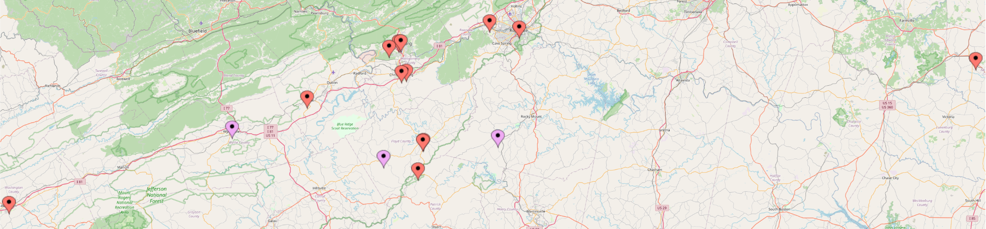


Current & Potential Partners
12 - Current partners in GSDC Advisory Board and/or with collections in or in progress
3 - Potential partners in beginning discussions
Notes:
So far, both through GSDC and through previous efforts at VTUL, we have 12 partners (with two more not listed here on the way!) that are either on the Advisory Board, or with collections in or in progress, or both; and another 3 that we’re working to bring collections in with.
This is a good time to highlight why we are the “Greater” SWVA Digital Collective – the Town of Crewe, for example, is beyond the formal margins for southwest Virginia, and we plan to extend reach into other areas and bordering states as we grow. We want to be as flexible as possible for partners that need the resources and community we have.

Slide 9
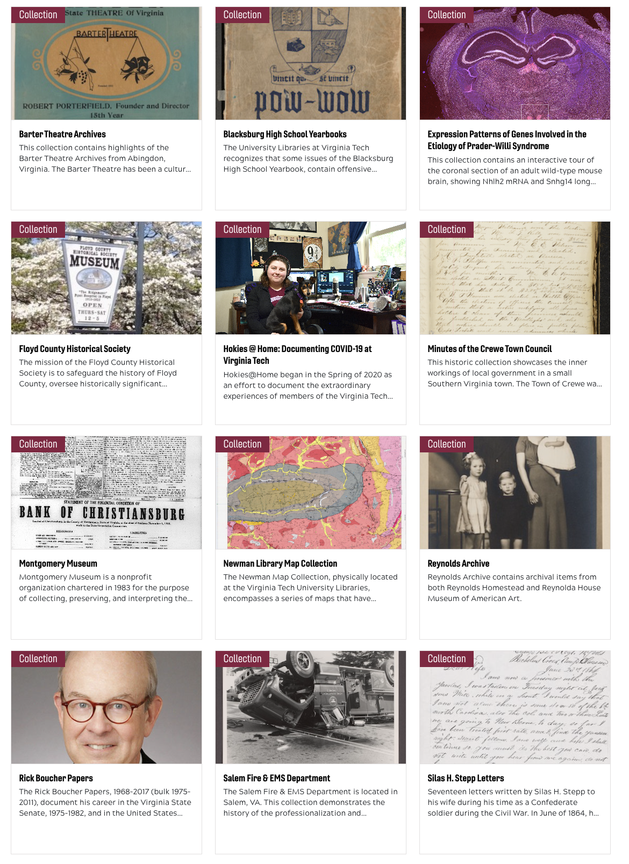
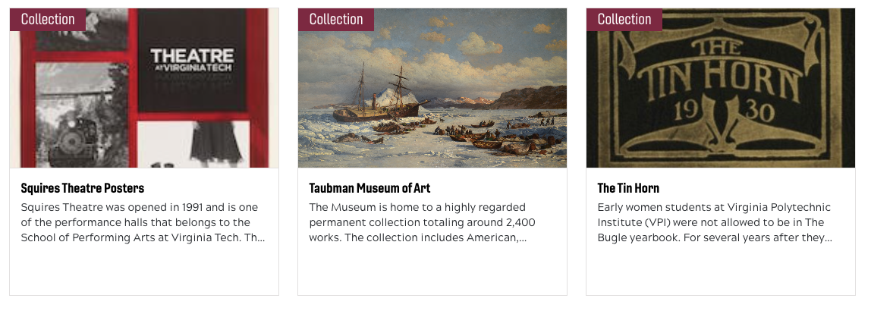
VT Digital Library:
Community Collections
8 live collections
Small museums, large museums, historical societies, municipal offices
2 on deck
1+ in Special Collections & University Archives
Notes:
As for the VT Digital Library, I’m so excited to show that of our 15 live collections, 8 of those are community collections, and include small and large museums, historical societies, and municipal offices. We also have 2 on deck, and at least 1 or more in our Special Collections and University Archives *from this initiative specifically,* SCUA has many community collections in the archive already.

Slide 10
How GSDC Can Help
Supporting and facilitating your digital curation needs
without changing ownership or rights of materials
and from within the community
Setting expectations
Outreach
Connection & advocacy
Consultation
Notes:
Hopefully we’re making the case that a community-governed model for community collections is key for sustainability, but just to hit it home, the way we want to help with turning those boxes of chaos into discoverable, accessible, and preserved collections is by supporting and facilitating your digital curation needs, without changing ownership or rights of materials, and from within the community, and I want to get into the 4 main ways we do this.

Slide 11
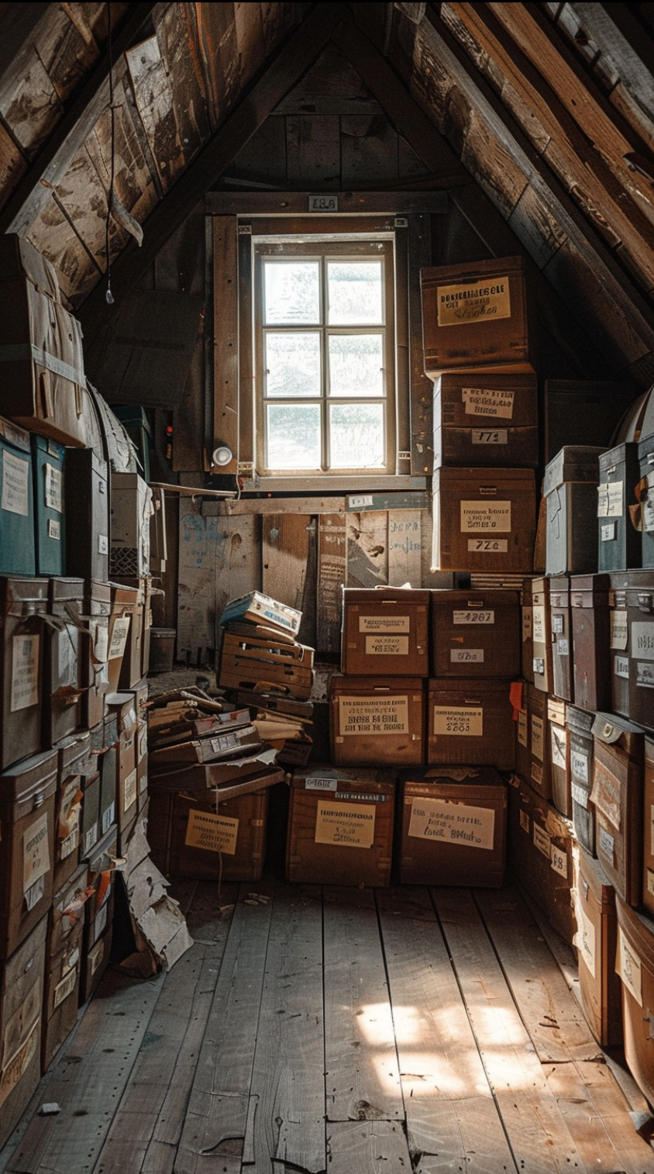
How GSDC Can Help:
Setting Expectations
Knowing your rights → copyright, rights statements, memorandums of agreement
Knowing your capacity → resources like time, personnel, funding, equipment/tech
Values alignment → what requirements do you have?
https://stockcake.com/i/attic-storage-space_765058_784251
Notes:
First, setting expectations. This process is, as we all know, not a quick one. It takes a lot of time to determine what will be the best fit for everyone. We like to have a consultation or conversation that covers what you know about your rights and what autonomy you have to make decisions in your org – a lot of folks are told to find a solution but still need the powers-that-be to approve it, requiring additional advocacy; understanding your capacity and resources available to dedicate to a project; and ensuring values are aligned and your requirements can be met.

Slide 12

How GSDC Can Help:
Outreach
Internally in the community
Externally with VTUL
  VTUL highlights and exhibits collections
Support for pursuing funding
https://stockcake.com/i/cluttered-storage-room_1207487_984947
Notes:
Second, outreach. This might be connecting you with other organizations similar to you or with similar situations, bottlenecks, needs, etc. It’s also outreach with and through VTUL. The Library loves to highlight collections and sometimes host physical exhibits of collections that really get students and campus folks engaged. We are also, in some cases, able to support pursuing funding through joining a grant, helping write or providing information and language.

Slide 13

How GSDC Can Help:
Connection & Advocacy
Peer-to-peer support
Knowledge sharing
Advocacy of organizations
Advocacy within organizations to administration/governing boards
Feedback loops
https://stockcake.com/i/cluttered-storage-room_1207487_984947
Notes:
Third, connection and advocacy. This might be as simple as facilitating peer-to-peer support where knowledge sharing and collective problem solving is the goal. We also advocate for smaller organizations to get resources, and maybe what’s even more difficult, helping representatives advocate within their own organizations to use resources for digital curation. We also want feedback on what works within this community model and where we still have gaps.

Slide 14
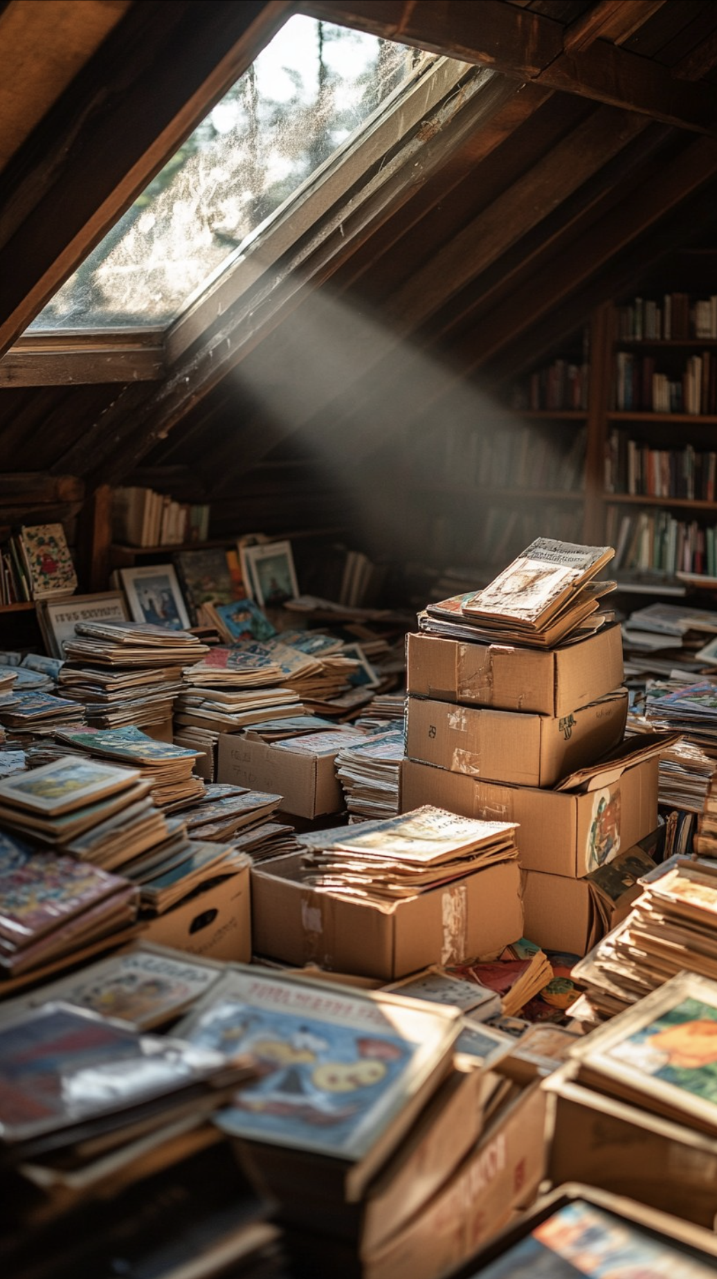
How GSDC Can Help:
Consultation
In-house digitization best practices guidance
  Example: Technical assistance to CI,Inc. during the CLIR grant
Metadata development
Project management assistance
Collection processing guidance
https://stockcake.com/i/sunlit-attic-library_1390963_191713
Notes:
Finally, and this one is more on the VTUL side, but we want to ensure that even if you don’t have a project ready or don’t know if you even want to get one going, that you have resources just for consultation, particularly on the technical side with digitization, metadata, project management, and collection processing. We had one crazily successful collaboration with CII and were able to support them in getting some funding and offering technical assistance for that grant with VTUL staying mostly hands-off until invited.

Slide 15
What Does That Look Like?
Outreach / Referral
Paperwork
& Revisions
Curation
Defined in MOA
Quality Control
Yes
No
Yes
No
In Scope?
VTUL
Proposal
Content Transfer
Materials, metadata
No
Yes
To and from VTUL
Refer Elsewhere
Consultation
with GSDC
Yes
No
Yes
No
Ingest
Access Platform
Tiling
Preservation
Partner
MOA
No
Partner Agreement
Yes
Publish
15
Notes:
Very quickly, and not to scare you with a giant workflow diagram, but this is about what we would follow if approached about a project. We determine scope and have a consultation about the project, move into paperwork that starts with a short, structured proposal form and ends with a Memorandum of Agreement to outline the scope of work; then it moves to VTUL, QC, and is ingested.

Slide 16
Benefits & Bottlenecks
We’re growing!
Ownership
Networking and sharing resources Advocacy for collections
Direct line to VTUL
Translations/resources of library and developer jargon
No fees, dues, or other financial compensation paid to anyone at VTUL
Staffing, labor, time → processing, metadata, meetings, generating buy-in
Willingness to engage and participate → metadata requirements, documentation
Patience → the VT Digital Library is new and many features are still in development or beta form
Trust → Larger institutions traditionally take ownership; MOAs are daunting
Notes:
This process is not without both its own unique benefits and bottlenecks. Again, I won’t read the whole slide to you, but the good news is, we’re growing, we have more organizations interested in involvement and projects in development. We ensure you maintain ownership and have networking and advocacy support, as well as a direct line to VTUL and translation for all the jargon of this business, and of course, there are no financial costs.
The bottlenecks we encounter are similar across the board. There may not be a financial cost, but there certainly is a cost in staffing, time and labor and a lot of it is invisible labor. Some folks don’t even have the capacity to engage and participate in the GSDC, let alone to meet other requirements for organizing chaos boxes. As I mentioned, this is a slow and steady process and it takes time and patience as both GSDC grows and as VT Digital Library grows. And finally, I want to acknowledge that trust is key and is scary. Larger institutions traditionally take (or try to take) ownership of materials they curate. There are good reasons for why this may happen, but it leaves those who want to keep their materials out to dry. And MOAs are daunting and feel like a legal trap – they’re more like written handshakes, but it’s still a formal commitment.
So next up, we wanted to share 3 quick experiences on the process so far.

Slide 17
Christiansburg Institute, Inc.’s Experience
Collaboration with VT strengthens grant applications
Allows CI,Inc. access to a network of highly specialized digital humanities professionals
Inclusion in Southwest Virginia Digital Archives increases access to Christiansburg Institute Digital Archives

Slide 18
Montgomery-Floyd Regional Library
Want to participate and have representation
Working with genealogical materials that are of community interest
Main bottleneck: copyright and permissions
Potential projects are in limbo until copyright can be determined

Slide 19


Unsuccessful Project A
Project began before we had formal documentation
Completed digitization at VTUL, partner completed all metadata
Items were ingested into pre-production for review
Not comfortable signing a Memorandum of Agreement
Result: Project was abandoned, no consequences for either party, all content was returned to the organization
Notes:
I wanted to also share a project that was unsuccessful, which I’m keeping anonymous because the circumstances were outside of their control. We had a good relationship with these folks, they were willing and able and trusting, we had the digitization complete, they provided beautiful metadata complete, BUT, we didn’t have our MOA developed at the beginning of the project and they were too uncomfortable to sign it and continue. We did end up stopping the project, no real harm done, and all materials (including the digital copies) were returned to them.

Slide 20
Takeaways
It doesn’t hurt to ask about a potential project
You can bypass directly going to the Library and work with people you know
Projects can end without consequence
All content will always be returned to you
Opportunities to contribute to a central, open access hub of greater Southwest Virginia cultural heritage collections that has oversight by the community itself
Notes:
So, to wrap up, it never hurts to ask about a project, to ask for resourcing and support (plus we hate saying no). You can go through GSDC individuals rather than to the Library, and either way, there are no consequences to ending a project because everything will always be returned. And this community is awesome, it’s based in ensuring the unique and valuable Southwest Virginia cultural heritage is sustainable and discoverable and in a central place governed by the community.

Slide 21
Panelist Q&A
What got you interested in participating in this community?
What motivated you to stay involved and invested?
What benefits or bottlenecks have you/your organization experienced?

Slide 22
Audience Q&A
Do you have a box of chaos?
What kind of organization are you a part of?
What type of material do you collect?
Have you ever worked with a smaller/larger organization to meet your curation goals? (e.g. digitization, metadata/description, storage/access)
If you were to collaborate with another organization, what support would you need the most?

Slide 23
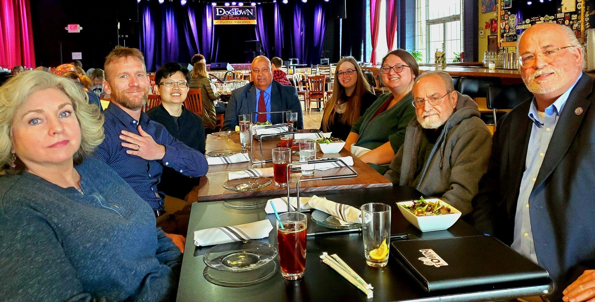
Acknowledgements
GSDC Advisory Board Members
Ann-Margaret Shortt (MFRL)
Mickey Hickman (CC&CC)
Jenny Nehrt (CII)
Sherri Huffman (Ret.)
David Rotenizer (BRIM)
Wen Nie Ng (VTUL)
Anthony Wright de Hernandez (VTUL)
Previous Leaders & Consultants
Nathan Hall, PhD (Penn State)
Ralph Lutts (ret. BRH)
Katherine Skinner (IOI)
Additional Support
Rob Barrowclift - website & logo
Scott Fralin - exhibits & printing
Grant Support
IMLS Community Catalyst LG-15-19-0137-19

Slide 24
Thank You!
GSDC website: https://gswvadc.org/
Advisory Board email: gsdc-advisory@googlegroups.com
Virginia Tech Digital Library: https://digital.lib.vt.edu/
Speakers:
Alex Kinnaman
alexk93@vt.edu
Jenny Nehrt
curator@christiansburginstitute.com
Ann-Margaret Shortt
ashortt@mfrl.org
Sherri Huffman
sherrihhuffman@gmail.com

