Slide 1
Knowledge Graph Building
Qianxiang Hao, Haoran Xing
CS4624 Multimedia, Hypertext and Information Access
Instructor: Professor Edward A. Fox
Virginia Tech, Blacksburg VA 24061
May 9, 2024

Slide 2

Outline
Project Overview
Problem & Motivation
Design
Implementation
Testing
Progress Updates
Acknowledgements
References

Slide 3

Project Overview
Our team aims to grow the Virtuoso database by adding enhanced Electronic Theses and Dissertations (ETDs), building on the initial 200 ETD records. This expansion will allow for more thorough testing and analysis of the Knowledge Graph database.

Slide 4

Problem & Motivation
Problem: There are a lot of online school papers (ETDs), yet the current Knowledge Graph database houses only 200 ETDs. It is still too small, which limits testing and makes it tough for developers to use it fully.
Motivation: We aim to enhance the Knowledge Graph by adding 500,000 ETDs. The expansion of ETDs within the Knowledge Graph amplifies its effectiveness as a tool for academic research, innovation, and knowledge dissemination.

Slide 5
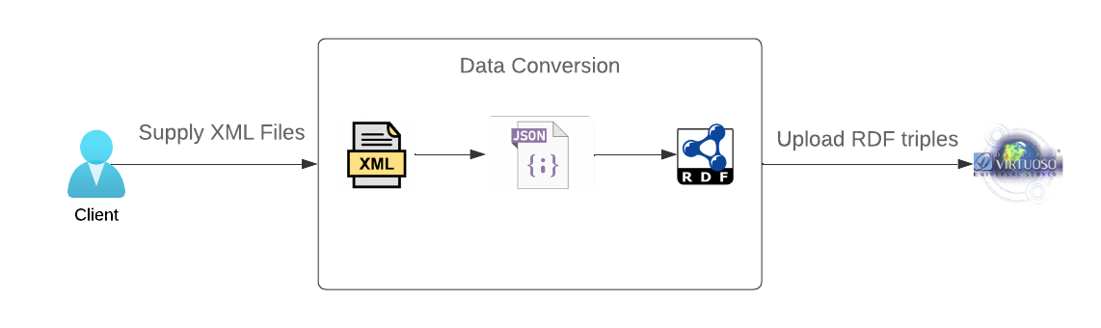
Design
Data Conversion & Upload

Slide 6
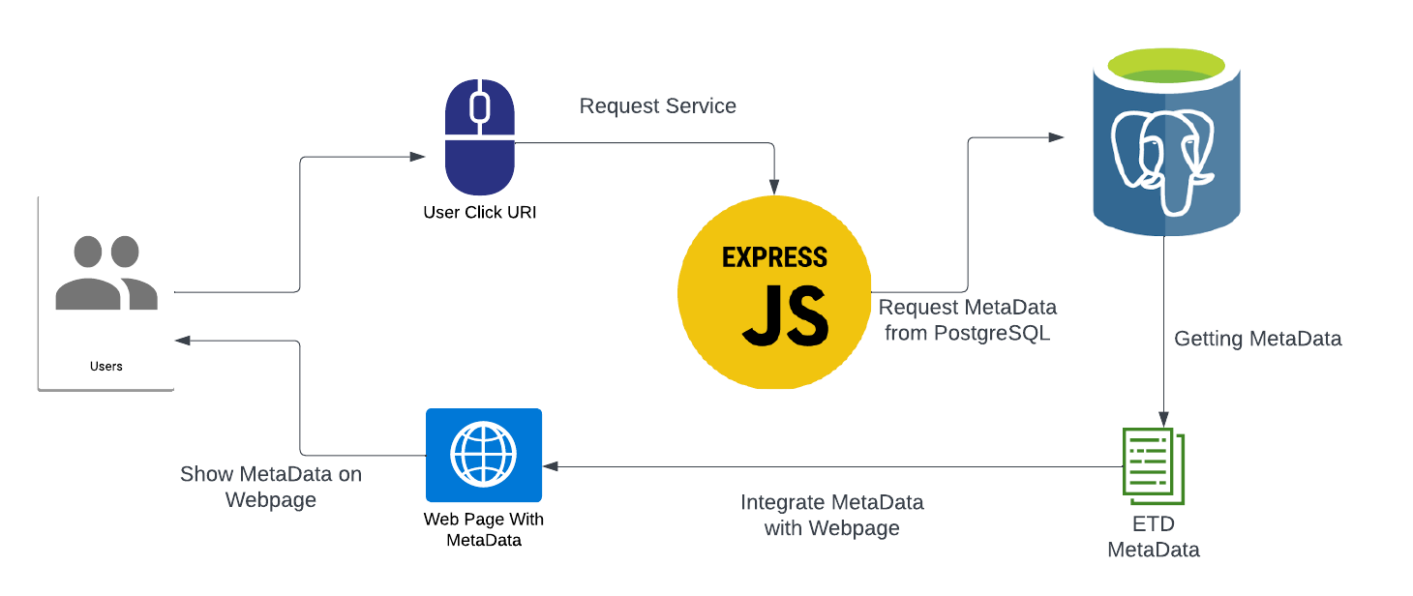
Design
URI Resolution

Slide 7
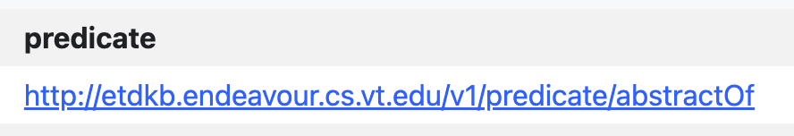

URI Resolution Example

Slide 8

Implementation
Data Conversion
xmltodict
JSON
rdflib
XML
Python Dictionary
JSON
RDF triples
Triple URI

Slide 9
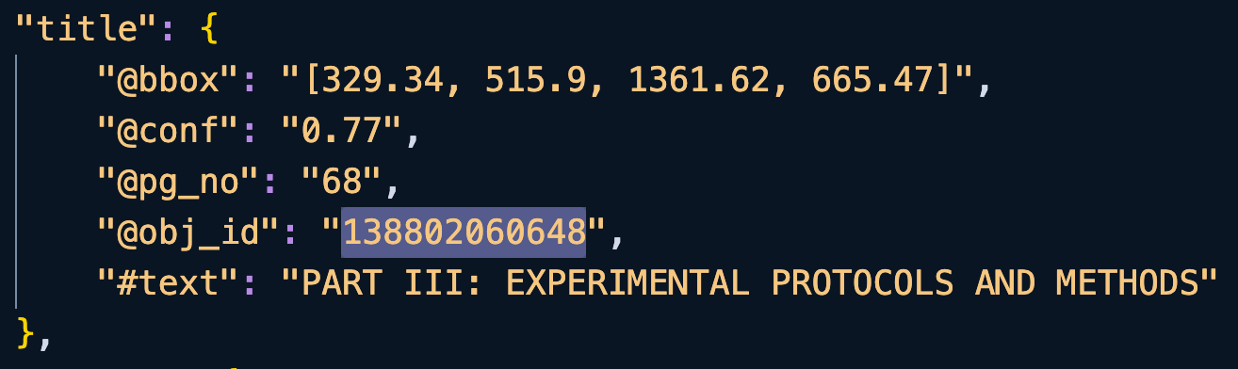
Implementation
Data Conversion
XML to JSON
JSON to RDF triple

Slide 10
Implementation
Data Uploading
requests
SPARQL Wrapper
RDF triples
Virtuoso Database
HTTP Request

Slide 11
Implementation
Data Uploading
Upload
Small RDF chunks
Large RDF files
Split
Upload
Chunking RDF Data:
Small RDF chunks
Small RDF chunks
Upload
Avoid SPARQL endpoint upload limit
Upload process more manageable and reliable

Slide 12
Implementation
GUI Application Development
Data Conversion
Data Uploading
Standardize Workflow
Simplifying Process
tkinter
GUI Tool

Slide 13
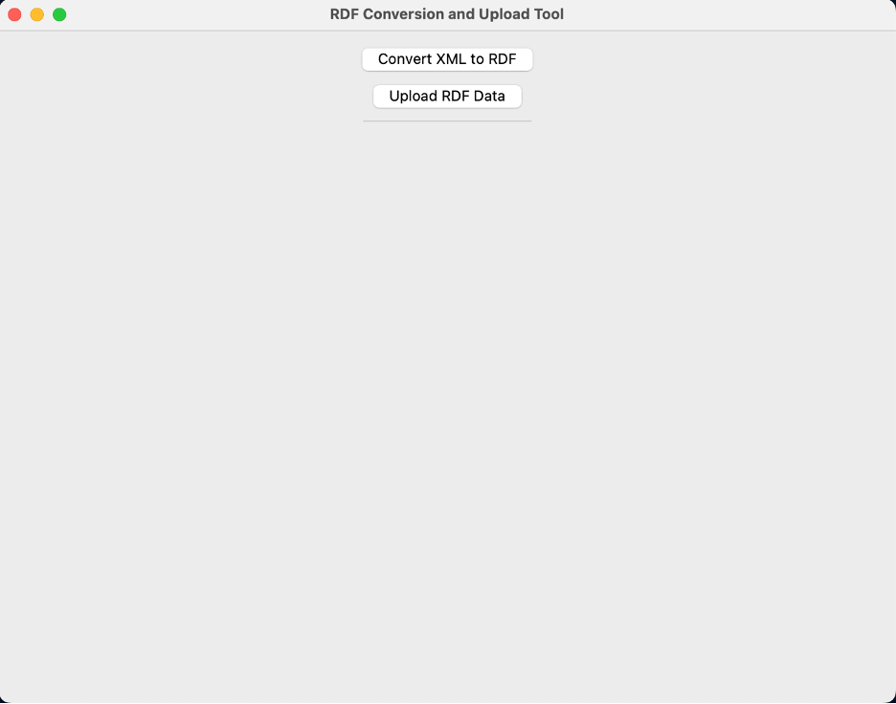
GUI Application Screenshots

Slide 14
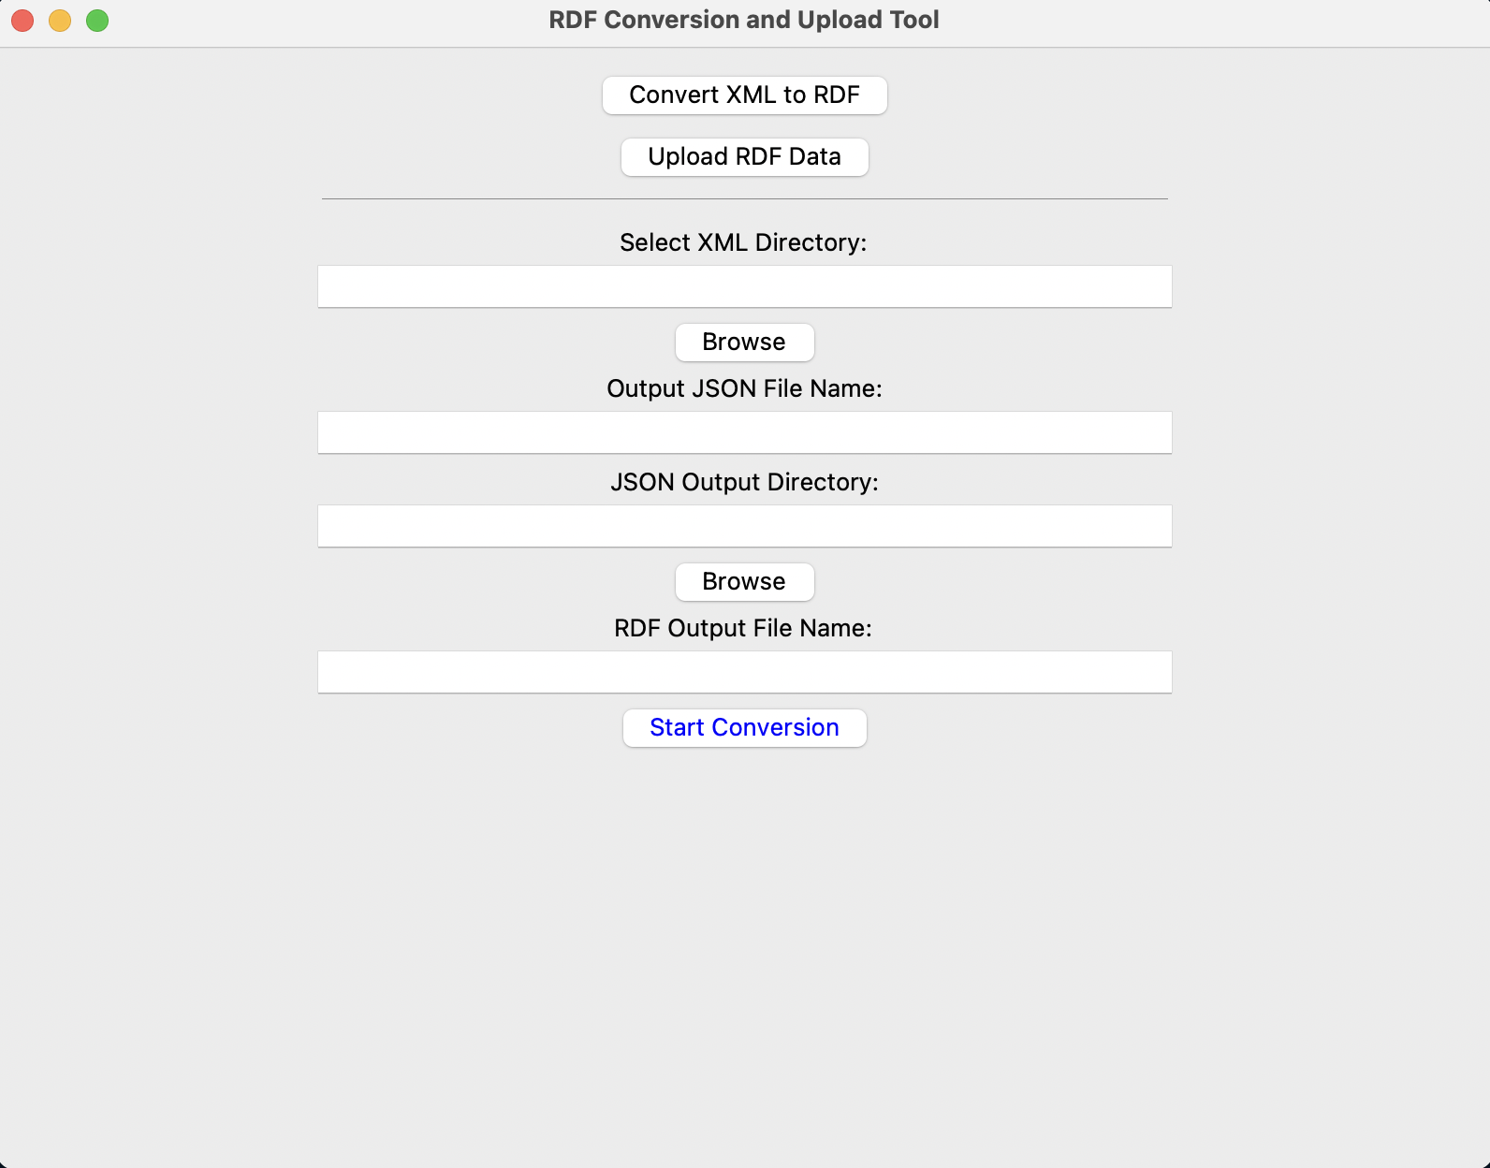
GUI Application Screenshots

Slide 15
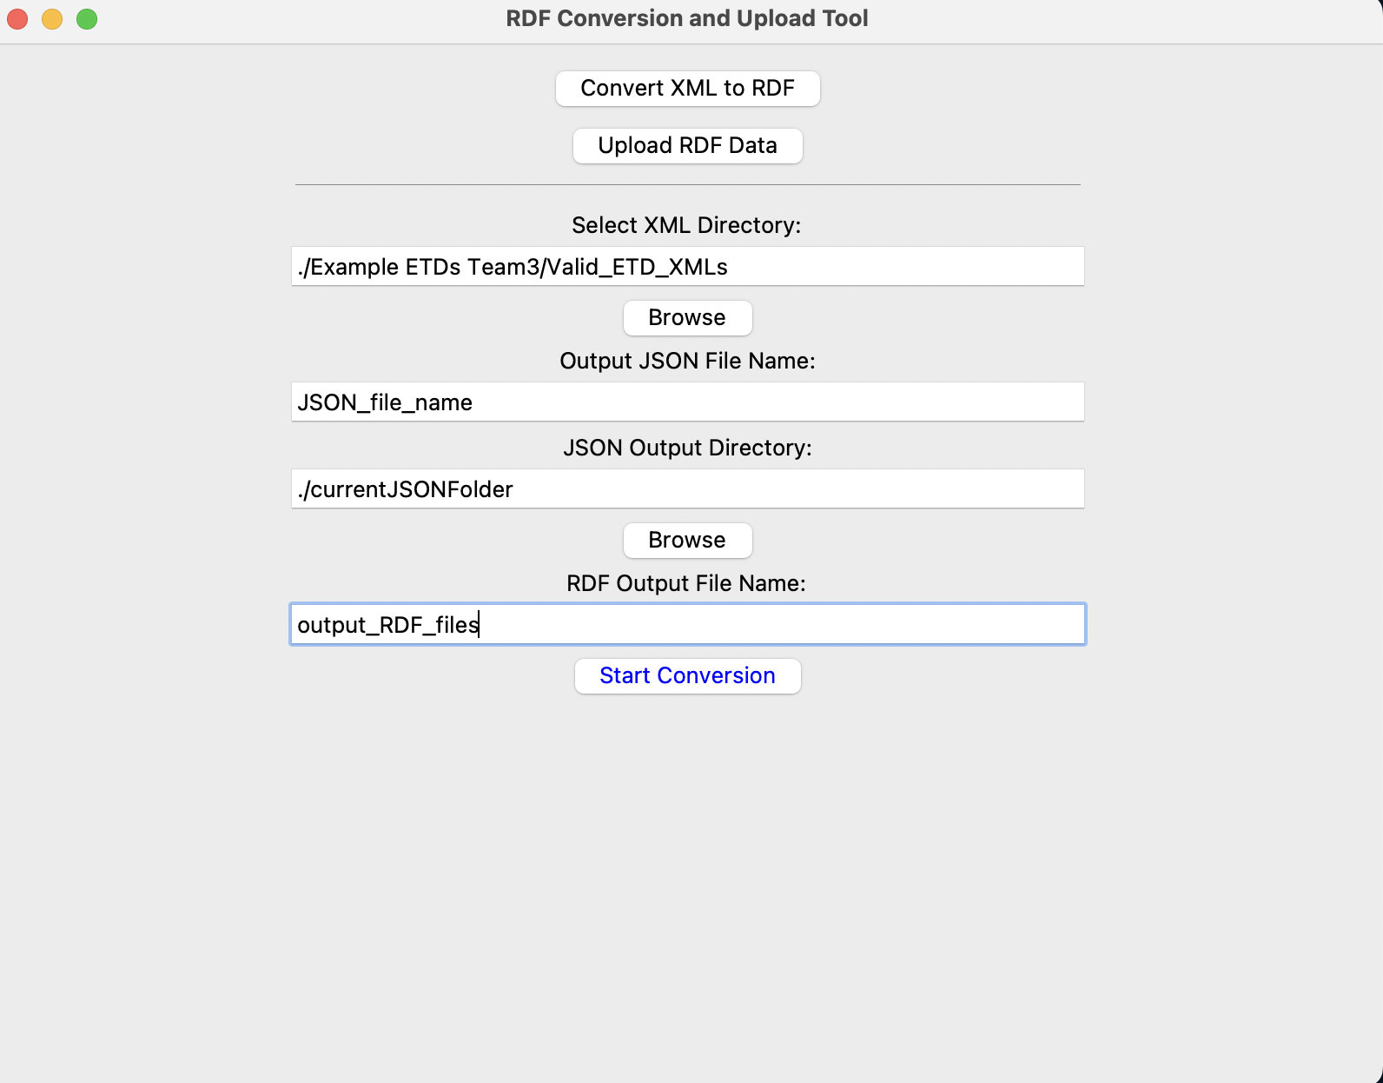
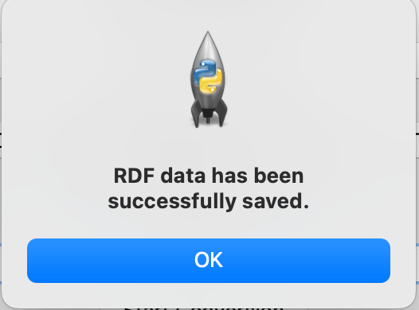
GUI Application Screenshots

Slide 16
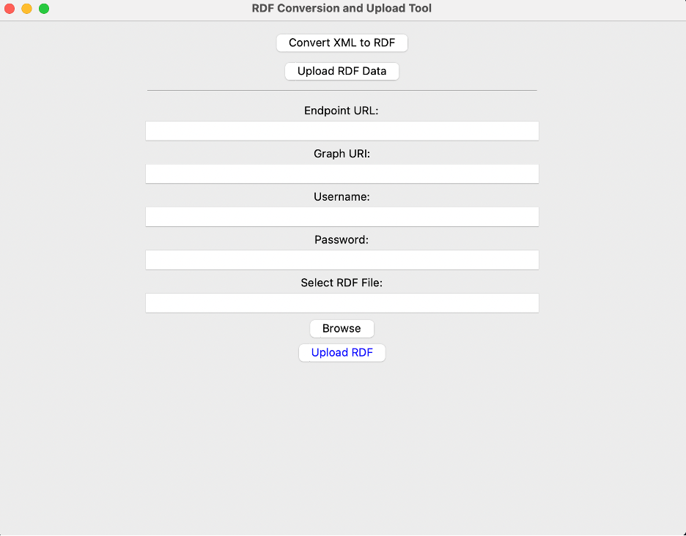
GUI Application Screenshots

Slide 17
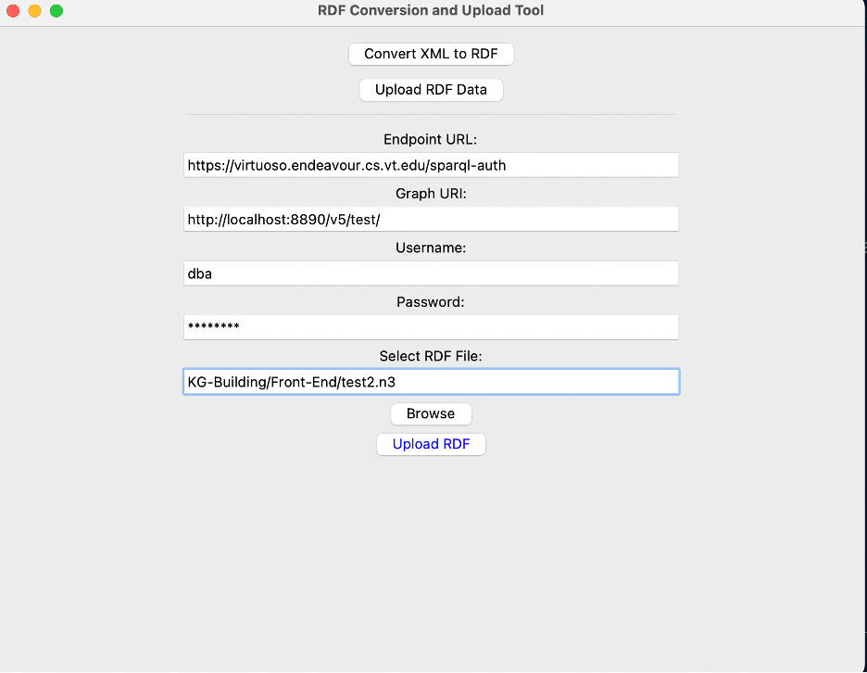
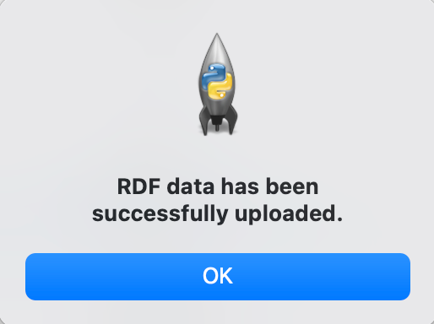
GUI Application Screenshots

Slide 18
Testing
Counting triples
Query objects in SPARQL interface
Comparing data manually

Slide 19
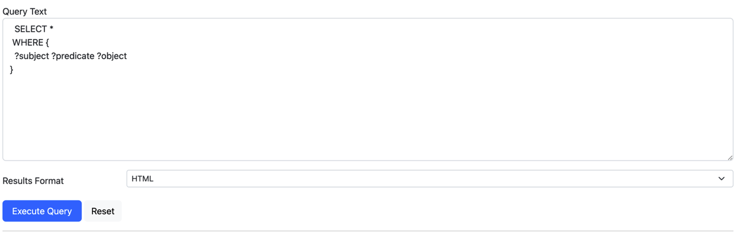
Testing
Showing all data in a Graph

Slide 20
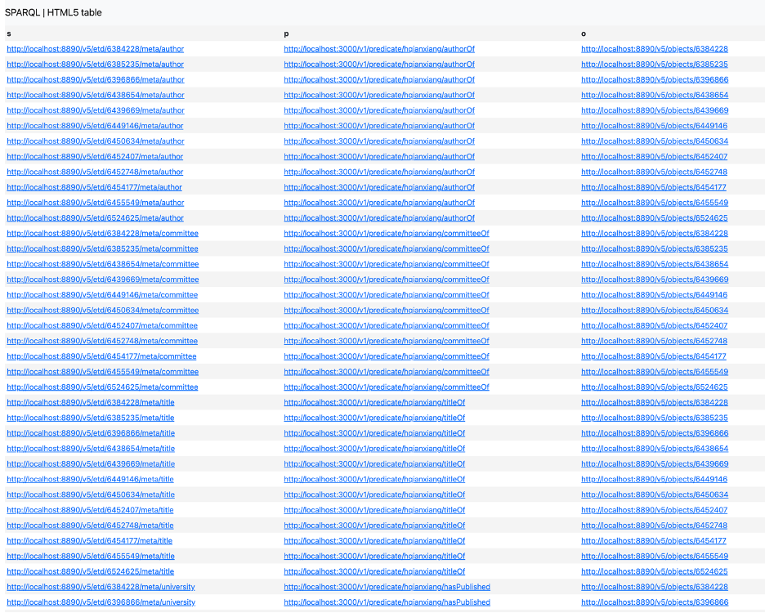
Testing

Slide 21
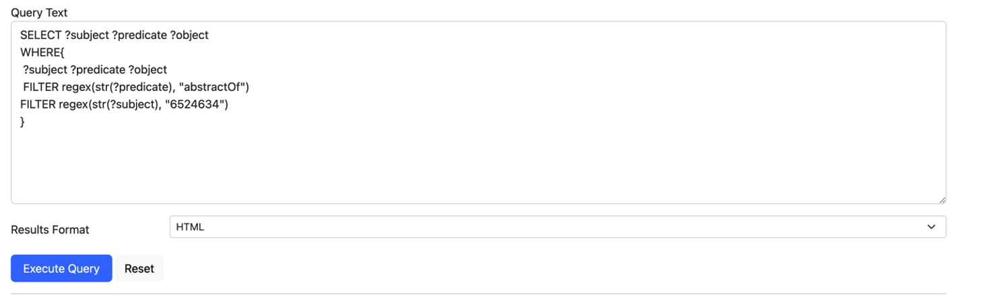
Testing
Querying predicate contain “abstractOf”, subject and object with certain Object ID

Slide 22
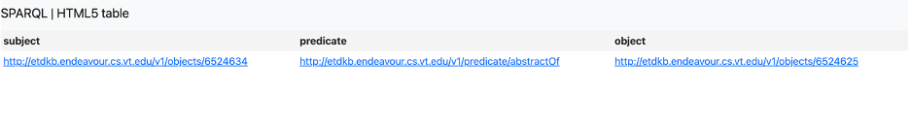
Testing
Querying results contain “abstractOf”, RDF with certain Object ID

Slide 23
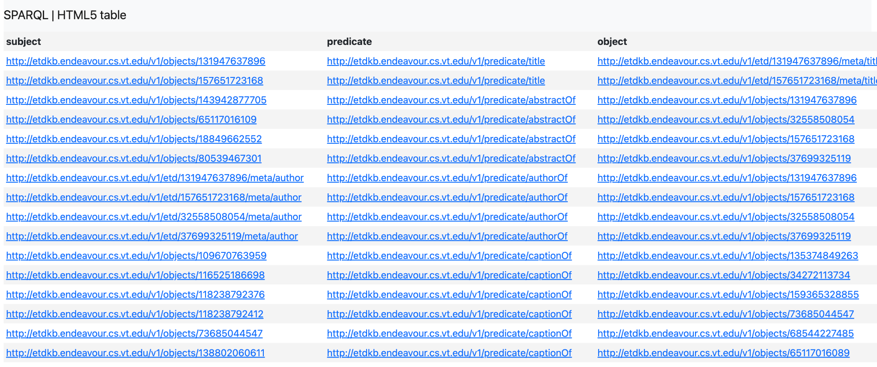
Progress Update
Uploaded 60 ETDs under graph “http://localhost:8890/v6/”

Slide 24

Progress Update
Difficulties
URI Resolution
  Object ID
  PostgreSQL Database
XML file shortage
Error message for URI Webpage

Slide 25

Future Works
PostgreSQL access issue
Object ID consistency
Expanding 332 or more ETDs for Knowledge Graph

Slide 26

Acknowledgements
We want to thank Dr. Edward A. Fox for his valuable guidance, Satvik Chekuri for his technical support and insights, and Amr Aboelnaga and Bipasha Banerjee for providing the essential XML files for our project.

Slide 27
References
[1] Group, PostgreSQL Global Development. PostgreSQL, 28 Apr. 2024, www.postgresql.org/. Accessed 1 May 2024.
[2] Fundamentals, Ontotext. “What Is SPARQL?” Ontotext, Ontotext AD, 18 Mar. 2021, www.ontotext.com/knowledgehub/fundamentals/what-is-sparql/. Accessed 7 May 2024.
[3] Li, Yike, et al. “Construction of satellite spectrum knowledge graph: Ontology design and knowledge application.” 2023 International Conference on Ubiquitous Communication (Ucom), 7 July 2023, https://doi.org/10.1109/ucom59132.2023.10257575.
[4] Gaugler, Daniel, and Ashish Aggarwal. Information Storage and Retrieval - CS5604 Final Report Team 1 (Knowledge Graphs), in: Virginia Tech, Blacksburg, VA, 4 Dec. 2023, pp. 1–32, https://hdl.handle.net/10919/118698.
[5] Aina, Adeyemi, et al. Team 5 - Infrastructure and DevOps Fall 2023, In CS 5604: Information Storage and Retrieval, Virginia Tech, Blacksburg, VA, 17 Jan. 2024, pp. 1–90, https://hdl.handle.net/10919/118666.
[6] StrongLoop, IBM, and other expressjs.com contributors. “Node.Js Web Application Framework.” Translated by StrongLoop/IBM, Express, StrongLoop, IBM, 2017, expressjs.com/. Accessed 7 May 2024.

Slide 28


