Slide 1
Moving Beyond Boundaries to Optimize Impacts
Susan G. Magliaro & Liesl M. Baum
Center for Research in SEAD Education

Slide 2
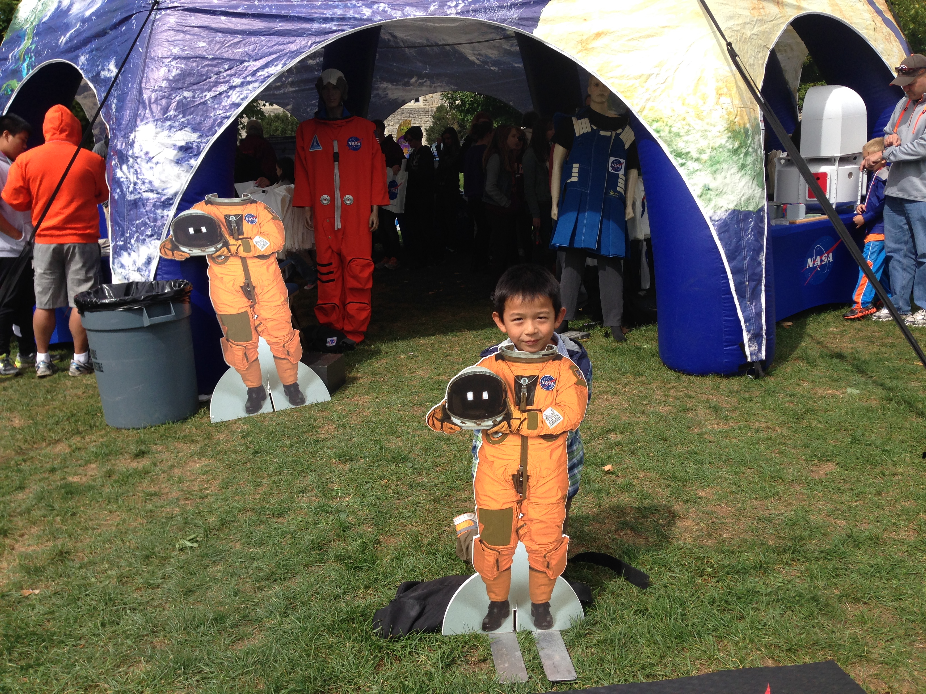
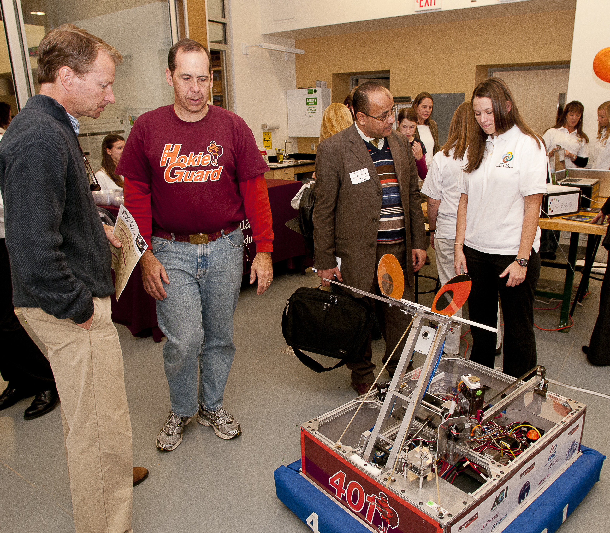
^{Objectives:}
Explain the vision, mission, activities, and plan for the new CRSE
Engage you in an ideation to demonstrate our process
Lead an open forum on participants’ related activities, problems, and solutions
Solicit your input into a national study of STEM education networks
Open the discussion for networking among the participants

Slide 3
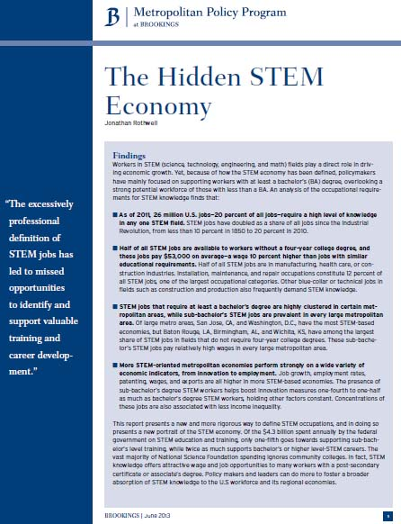
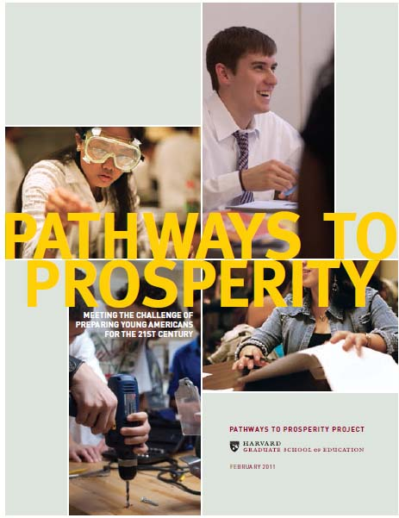
Why STEM?
Economy
Innovation
Opportunity
Engagement
Informed Citizenry
Notes:
But first, why this emphasis on STEM?
For the past 25 years, report after report has identified the promotion of high quality education related to science, technology, engineering and math (STEM) as central to:
Workforce and economic development
Maintaining the US position in the global economy through innovation
Affording all learners the opportunity to contribute to the nation’s needs and greater good
Reducing the loss of potential as we see students drop out of high school or received sub-standard education – especially in the STEM areas with the types of hands-on, minds-on learning that is basic to problem-based instructional approaches -- letting no talent go to waste
Ensuring an informed citizenry who can better understand ideas, concepts and directions related to issues of national security, medical decision-making, national and state policy, childhood vaccinations, and so forth
The President’s Council of Advisors on Science and Technology
the Metropolitan study on the Hidden STEM Economy
the Harvard Graduate School of Education
The National Academies on Science, Engineering, and Medicine reports
NASA
Innovation: Always has been America’s strength, key to global competitiveness; Entrepreneurship
Opportunity: Ensuring all talent has access to high quality learning experiences
Problem-based approaches give rise to engagement
Engagement
STEM opens the door to interdisciplinary/transdisciplinary problem-based learning
Attacking real-world projects or addressing real-world problems
Learning by doing, hands-on/minds-on
Letting no talent go to waste
Informed Citizenry
By promoting STEM literacy – making meaning of what one hears, sees, experiences in today’s world
Build awareness to appreciation to support to participation
Enabling our institutions and communities to thrive

Slide 4
History of CRSE
2002: Launched as VT-STEM by the College of Human Resources and Education and the Office for Outreach and International Affairs
  Mission: Visibility, Partnerships, Faculty Support
  School-University focused
2010: Shifted to a regional initiative
2012: Engaged economic development sector
2015: Shifted to a university center, based in an institute
  Catalyst for expanded research on impacts on P-20 education
  Engaged in national networks to advance STEM ecosystems
  Serving as the university’s “go-to” office for organizing P-12 activities for maximize impact on STEM education
Notes:
Originally designed as a mechanism for the university to publicize its research advancements through the development of stronger partnerships with Pk-12. Also, at the same time, granting agencies such as the National Science Foundation, began requiring proposals to explain how the research project would contribute to society, commonly known as demonstrating “Broader Impacts” – and had key requirements such as some teaching/education experience, broadening participation of underrepresented groups, enhancing infrastructure, public dissemination, or other significant benefit.
For the first 6-8 years of this initiative, the work of VT-STEM focused on providing a website/portal so that our P-12 partners could see what was happening across the university, tried to connect university faculty with school divisions who might welcome a project, workshop, or some intervention related to the grant, and held workshop meetings for faculty related to creating evaluation tools to assess the outcome of any BI intervention.
As time went on, the needs of faculty changed, our university evolved, and the national landscaped also evolved and became more complex, global, and interconnected. We also realized that while there was a lot going on in the schools, there was no way to evaluate the overall impact of VT resources on PK-12 learning. At the same time, VT-STEM realized that just promoting these brief, narrowing defined activities in schools was not helpful either. The economy was in recession. Schools could not sustain innovations with reduced budgets. Accountability was an essential element of any engagement with schools – especially those activities that did not directly align with Standards of Learning. We needed to broaden the group of stakeholders to get communities involved, we needed to promote evaluations to demonstrate impact and student learning.
At the same time, ICAT came along and offered a natural partner for VT-STEM with a shared focus on content and mission with P-12. Also, at the same time, VT-STEM joined national organizations who were all wrestling with the concern about high quality STEM education for all learners, a more cohesive and coherent approach to broader impacts, and collective ways to better evaluate the impact that all of our STEM-y activities have on P-12 learners. And, of course, the national need for well-qualified STEM-trained employees grew, but now with the increasing recognition that we needed to promote innovation and entrepreneurship – creativity – to really reach our national goals.

Slide 5
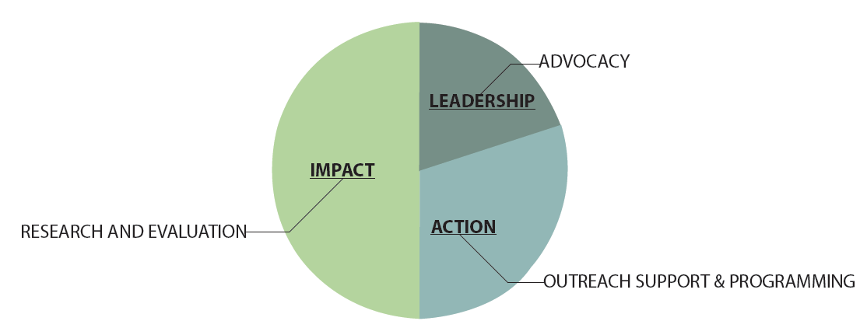
Vision
The university’s mechanism for research of formal and informal PK-12 STEM education.
Notes:
So, as we look at our vision, you will see that the key focus is on providing the university with the support for a central mechanism to evaluate, collectively, our impact on P-12 STEM learning across our research efforts.
General scope of work to better match the mission of an institute at VT
To also examine the significance of what we do
Trying to better coordinate projects
Identify key partners and stay with for the time it takes to determine impact
Better evaluate approaches to school-university partnerships
Better support faculty, graduate students, staff – all resources

Slide 6
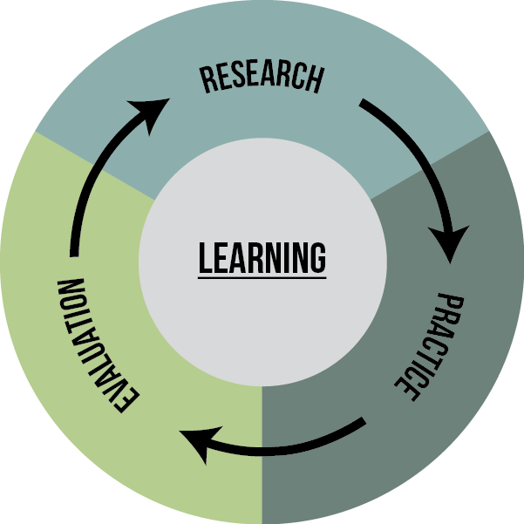
Impact
To produce evidence-based contributions through a cycle of research, practice and evaluation.
Notes:
Centered on learning
Streamline what faculty need to do by providing research and evaluation tools and expertise
Ensuring that best practices are integral to our partnership work
ROI
Engage in a cycle of work that best represents a strategic approach to learning in real-world environments
Respecting what can be learned from practice (Practice-based theory), as well as from research Research-based practice
Iterative/recursive cycle
Allows for longitudinal approach

Slide 7
Action
Research and evaluation support, coordination, and dissemination
Broker partnerships among stakeholders to advance broader impacts
Bring visibility and access to high quality STEM PK-12 learning experiences, innovations, and opportunities across the Commonwealth
STEM-network leadership for policies, practices, programs, and people.
Outreach programs (i.e., Virginia Tech Week of Science, Kindergarten-to-College, ICAT Day)
Notes:
Actual activity that will allow outcomes-based evaluation

Slide 8
Advocacy
National
  National Alliance for Broader Impacts (NSF)
  STEM Centers Network (APLU)
  Statewide STEM Networks Inventory (NSEC)
  FabLab for Early Childhood Learning
State
  Secretary of Education
  VA DOE Strategic Review of CTE Programming
  Governor’s Standards of Learning Innovation Committee
Notes:
Have been building for the past five years: VT-STEM has emerged as the model center/hub for advancing STEM education opportunities for PK-12…. JMU story
Work with the Secretary of Education: STEM strategic plan
Leadership…

Slide 9
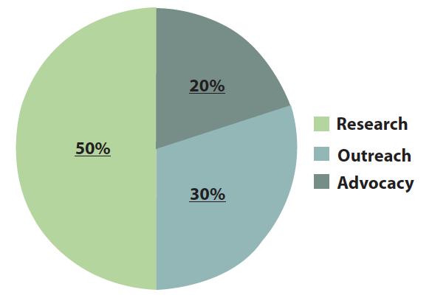
Staff/Funding
Staff
  Director
  Research team
  Outreach coordinator
  Evaluation coordinator
  Students
  Teacher in residence, MCPS
Funding sources
  Base operating – univ.
  Contracts
  Grants
Notes:
Contrast past, present to future

Slide 10
Stakeholders
Institute for Creativity, Arts, and Technology
VT colleges and institutes
Virginia’s PK-12 schools
Community colleges
Roanoke-Blacksburg Technology Council
Chambers of Commerce
Governmental agencies
Community organizations
Notes:
This network supports the university’s 3 missions
Internal:
Innovate Ecosystem: Innovate was created to fill this gap, an experimental program that provides opportunities for high-performing students to gain insights into the entrepreneurial process, interact with successful entrepreneurs, and learn from faculty and community partners with expertise in areas related to developing an entrepreneurial mindset.
External:
Our partners/collaborators
Learning more and more how to engage these various publics with different goals, language, skill sets, etc.

Slide 11
5-Year Strategic Plan
Key features of first 3 years…
  Create an inventory of past 5 years of VT P-12 STEM programs
  Create messaging and marketing plans
  Meet face-to-face with all key stakeholders
  Create the beta version of the data base (impact)
  Formalize P-12 and industry/agency partnerships
  Create a plan to attract affiliates
  Diversify revenue streams
  Develop an advancement plan
  Continue engagement with government offices, etc.
Notes:
This network supports the university’s 3 missions
Internal:
Innovate Ecosystem: Innovate was created to fill this gap, an experimental program that provides opportunities for high-performing students to gain insights into the entrepreneurial process, interact with successful entrepreneurs, and learn from faculty and community partners with expertise in areas related to developing an entrepreneurial mindset.
External:
Our partners/collaborators
Learning more and more how to engage these various publics with different goals, language, skill sets, etc.

Slide 12
By the 5th Year…
Develop the infrastructure and capacity (personnel and budget) to function up to 50% on earned income
Finalize data system
Conduct longitudinal analyses
Emerge as national leader
Maintain partnerships
Notes:
This network supports the university’s 3 missions
Internal:
Innovate Ecosystem: Innovate was created to fill this gap, an experimental program that provides opportunities for high-performing students to gain insights into the entrepreneurial process, interact with successful entrepreneurs, and learn from faculty and community partners with expertise in areas related to developing an entrepreneurial mindset.
External:
Our partners/collaborators
Learning more and more how to engage these various publics with different goals, language, skill sets, etc.

Slide 13

Critical and Creative Thinking by Design
Courtesy of IDEA Studio, Institute for Creativity, Arts, and Design
Notes:
Conclusion:
Excited about the future. ICAT will serve as a great host and we’ll be able to enhance its mission
Already have small projects that are helping us to establish a foundation: Office of Economic Development, Institute for Advanced Learning and Research
Tobacco Region Revitalization Commission funding: Southside and Southwest
Questions?

Slide 14
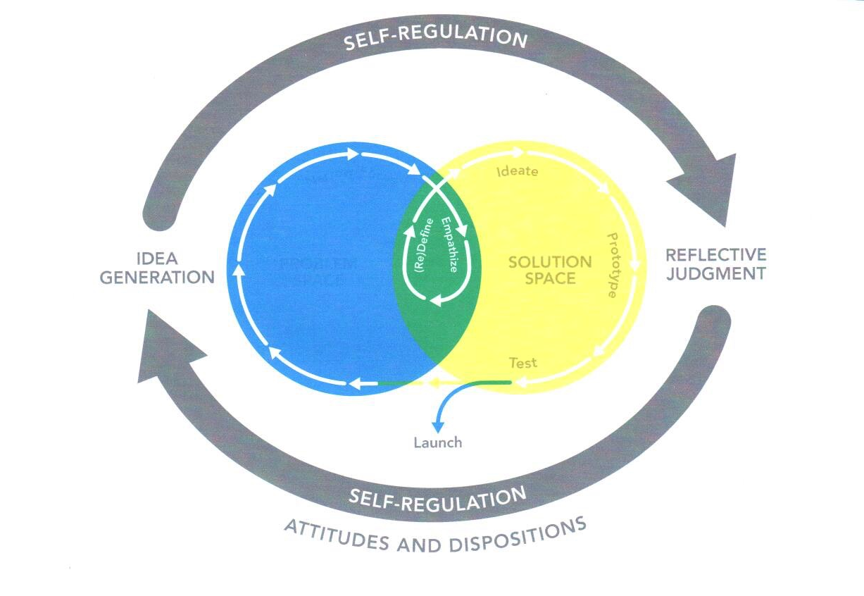
The Relationship between Critical and Creative Thinking

Slide 15
Process Elements
Idea Generation
Reflective Judgment
Self-Regulation
Attitudes and Dispositions
Problem Space
Solution Space
Notes:
This network supports the university’s 3 missions
Internal:
Innovate Ecosystem: Innovate was created to fill this gap, an experimental program that provides opportunities for high-performing students to gain insights into the entrepreneurial process, interact with successful entrepreneurs, and learn from faculty and community partners with expertise in areas related to developing an entrepreneurial mindset.
External:
Our partners/collaborators
Learning more and more how to engage these various publics with different goals, language, skill sets, etc.

Slide 16
Design Thinking
Narrow the focus: Conceptualize, analyze, hypothesize, recognize challenge and relevance
Empathize: Examine new ways, question, judge value/worth; embrace multiple viewpoints
Define: analogical and metaphorical thinking, elaborate, summarize, just resources and logic
Ideate: brainstorm, understand ability and consequences; tolerate ambiguity
Prototype and test: Explore, allocate resources, revise, take risks, exhibit courage
Launch: Evaluate process and product, judge value/worth, take risks
Notes:
This network supports the university’s 3 missions
Internal:
Innovate Ecosystem: Innovate was created to fill this gap, an experimental program that provides opportunities for high-performing students to gain insights into the entrepreneurial process, interact with successful entrepreneurs, and learn from faculty and community partners with expertise in areas related to developing an entrepreneurial mindset.
External:
Our partners/collaborators
Learning more and more how to engage these various publics with different goals, language, skill sets, etc.

Slide 17
Sample Activity
Design a STEM Education network for your region; goal to promote access to high quality STEM education for all citizens
  Narrow the focus
  Examine new ways
  Define what it would look like (optimally)
  Ideate: play out how it would work, who would be a part of it, what folks would do, how it would be sustainable, etc.
  Develop a draft plan; share it with stakeholders; revise, etc.
  Launch with a STEM summit/conference
Notes:
This network supports the university’s 3 missions
Internal:
Innovate Ecosystem: Innovate was created to fill this gap, an experimental program that provides opportunities for high-performing students to gain insights into the entrepreneurial process, interact with successful entrepreneurs, and learn from faculty and community partners with expertise in areas related to developing an entrepreneurial mindset.
External:
Our partners/collaborators
Learning more and more how to engage these various publics with different goals, language, skill sets, etc.

Slide 18
Data System
Purpose: To assess impact of VT P-12 education/outreach programs
Input from VT and partner offices to determine baseline
Input from VT and partner offices to determine their data and reporting needs
Meeting with VT IT personnel to determine capacity and security needs
Identifying first set of elements/variables to assess
Notes:
This network supports the university’s 3 missions
Internal:
Innovate Ecosystem: Innovate was created to fill this gap, an experimental program that provides opportunities for high-performing students to gain insights into the entrepreneurial process, interact with successful entrepreneurs, and learn from faculty and community partners with expertise in areas related to developing an entrepreneurial mindset.
External:
Our partners/collaborators
Learning more and more how to engage these various publics with different goals, language, skill sets, etc.

Slide 19
Partnership Development
Identification: Inclusive, open events, self-selection
Needs assessment
Determination of mutual benefits
Determination of commitment/capacity
Identification of key individuals in organization
Development of communication system
Development of short- and long-term plan
Celebrate small victories
Notes:
This network supports the university’s 3 missions
Internal:
Innovate Ecosystem: Innovate was created to fill this gap, an experimental program that provides opportunities for high-performing students to gain insights into the entrepreneurial process, interact with successful entrepreneurs, and learn from faculty and community partners with expertise in areas related to developing an entrepreneurial mindset.
External:
Our partners/collaborators
Learning more and more how to engage these various publics with different goals, language, skill sets, etc.

Slide 20
MOU Development
Need for memoranda of understanding
Who
What
Where
How
When
Who pays
Who supplies what data, how, etc.
Who accesses the data, when, etc.
Notes:
This network supports the university’s 3 missions
Internal:
Innovate Ecosystem: Innovate was created to fill this gap, an experimental program that provides opportunities for high-performing students to gain insights into the entrepreneurial process, interact with successful entrepreneurs, and learn from faculty and community partners with expertise in areas related to developing an entrepreneurial mindset.
External:
Our partners/collaborators
Learning more and more how to engage these various publics with different goals, language, skill sets, etc.

Slide 21
Evaluation Plans
Purpose/Goals of event
Creation of logic model: details capacity and outcome/expectations
Share with stakeholders
Agree on how results are shared and with whom
Develop evaluation tools
Conduct event or program
Collect information
Analyze/evaluate results
Notes:
This network supports the university’s 3 missions
Internal:
Innovate Ecosystem: Innovate was created to fill this gap, an experimental program that provides opportunities for high-performing students to gain insights into the entrepreneurial process, interact with successful entrepreneurs, and learn from faculty and community partners with expertise in areas related to developing an entrepreneurial mindset.
External:
Our partners/collaborators
Learning more and more how to engage these various publics with different goals, language, skill sets, etc.

Slide 22
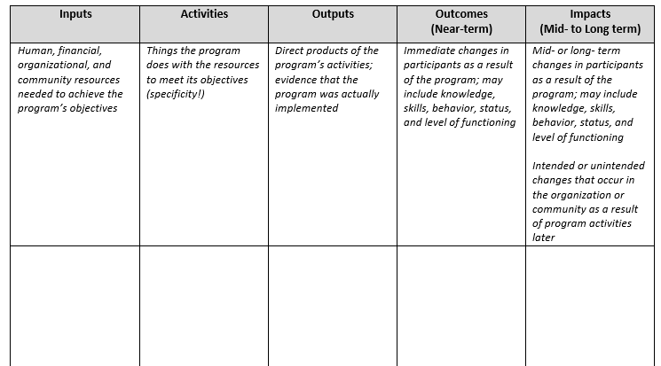
Logic Model

Slide 23
Outreach Programs
Week of Science:
  School Preview Day
  Maker Festival
  Art Venture Day
  STEM Summit
  VT Science Festival
ICAT Day
Maker Camp
Partnership with Science Museum of Western VA
Others based on grant partnerships
Notes:
This network supports the university’s 3 missions
Internal:
Innovate Ecosystem: Innovate was created to fill this gap, an experimental program that provides opportunities for high-performing students to gain insights into the entrepreneurial process, interact with successful entrepreneurs, and learn from faculty and community partners with expertise in areas related to developing an entrepreneurial mindset.
External:
Our partners/collaborators
Learning more and more how to engage these various publics with different goals, language, skill sets, etc.

Slide 24
Time to Reflect
Take a moment to identify questions, comments, suggestions, concerns, etc.
Open discussion
Problem solve with session participants
Next steps?
Notes:
This network supports the university’s 3 missions
Internal:
Innovate Ecosystem: Innovate was created to fill this gap, an experimental program that provides opportunities for high-performing students to gain insights into the entrepreneurial process, interact with successful entrepreneurs, and learn from faculty and community partners with expertise in areas related to developing an entrepreneurial mindset.
External:
Our partners/collaborators
Learning more and more how to engage these various publics with different goals, language, skill sets, etc.

Slide 25
Statewide STEM Networks
Shine a light on your networks
Please write down any networks in which you engage
  Nature of your engagement/role
  Nature of the outcomes, successes, challenges
  Your next steps
Notes:
This network supports the university’s 3 missions
Internal:
Innovate Ecosystem: Innovate was created to fill this gap, an experimental program that provides opportunities for high-performing students to gain insights into the entrepreneurial process, interact with successful entrepreneurs, and learn from faculty and community partners with expertise in areas related to developing an entrepreneurial mindset.
External:
Our partners/collaborators
Learning more and more how to engage these various publics with different goals, language, skill sets, etc.

Slide 26
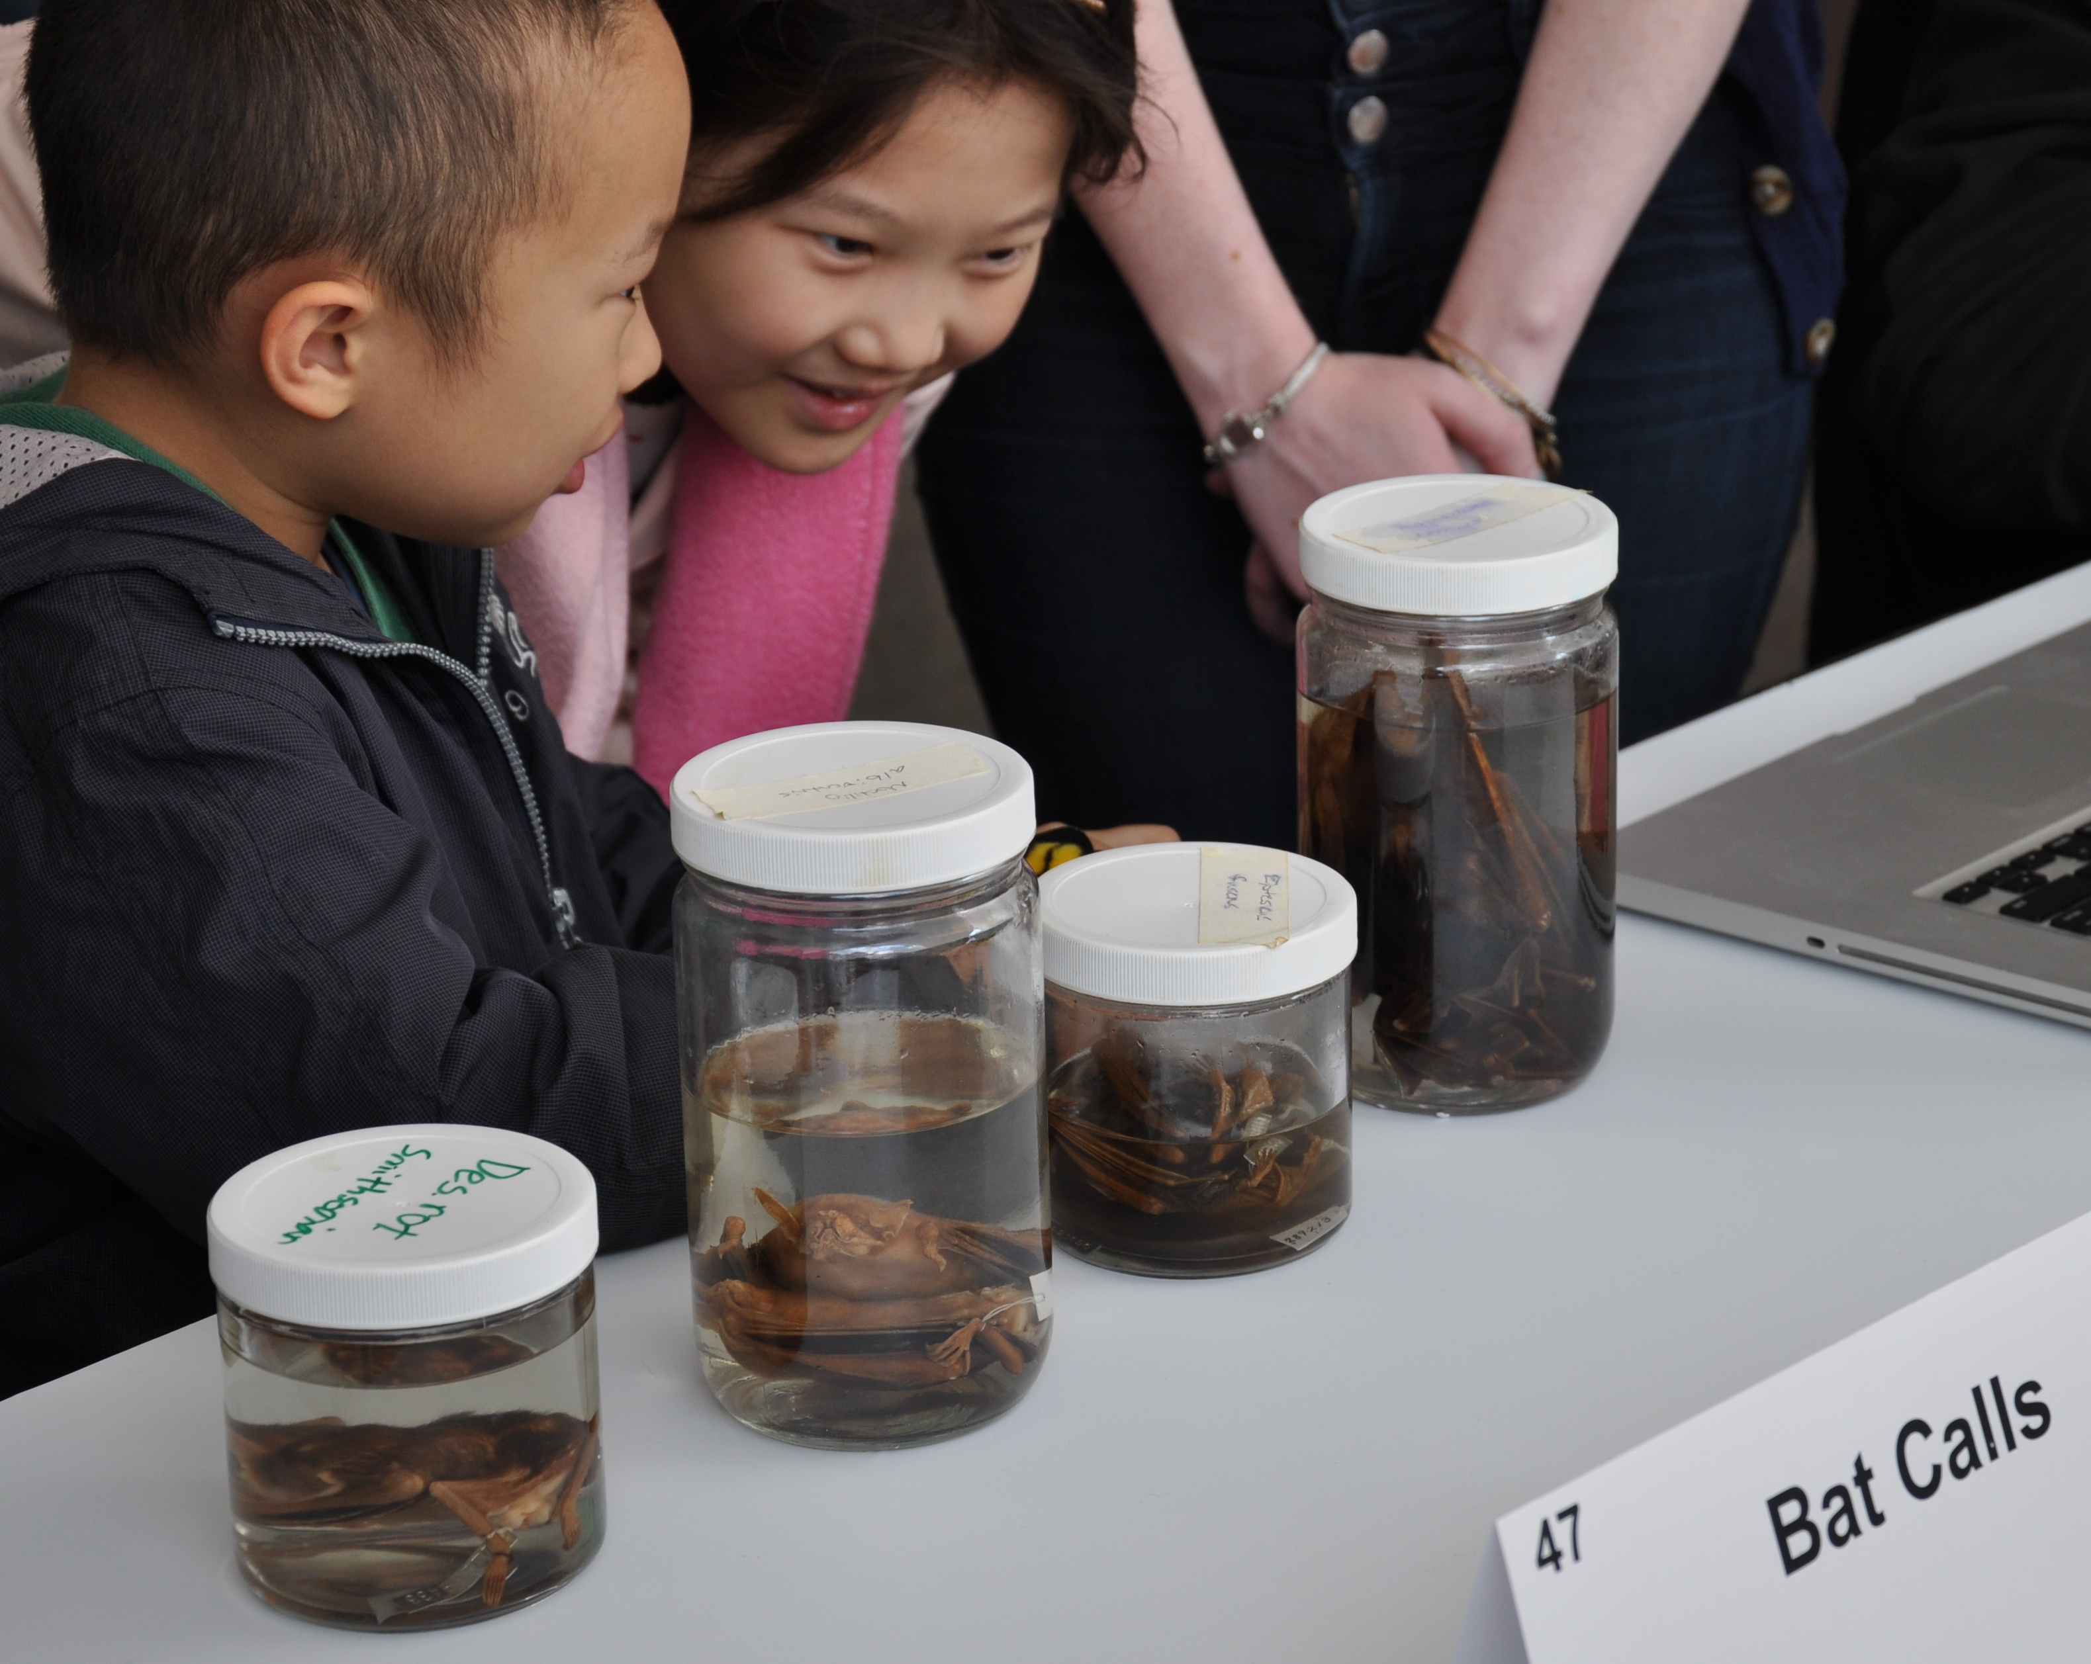
^{Final Thoughts?}
^{Questions?}
^{Comments?}
^{Suggestions?}
^{Next Steps?}

Slide 27
Thank you!
Enjoy the Conference!

