Slide 1

Chapter 2
The Three Spheres of Sustainable Property Management
Unless otherwise noted, this slide deck is (c) Erin A. Hopkins.
It is released under a Creative Commons Attribution NonCommercial ShareAlike 3.0 license (CC BY NC-SA 3.0).

Slide 2
Chapter Sections
2.1 Introduction
2.2 The Environmental Sphere
2.3 The Social Sphere
2.4 The Economic Sphere
2.5 The Interdependence of Sustainable Property Management Spheres
2.6 A Broader and Measurable Perspective
2.7 Conclusion

Slide 3
Learning Objectives
Explain why the environmental sphere is important in sustainable property management
Explain why the social sphere is important in sustainable property management
Explain why the economic sphere is important in sustainable property management
Recognize the interdependence of sustainable property management spheres
Describe why a broader and measurable perspective is important to sustainable property
management
Describe the ESG framework for property management

Slide 4
2.1 Introduction
Human-centered approach to green real estate management

Slide 5
2.2 The Environmental Sphere
Planet does not have an active voice other than exemplifying ecological degradation

Slide 6
Strategies
Carbon footprint calculation
The Paris Agreement
Greenhouse Gas Protocol
Benchmarking
LOCATION, LOCATION, LOCATION

Slide 7
2.3 The Social Sphere
Environmental privilege
Maslow’s Hierarchy of Needs
Universal design

Slide 8
2.4 The Economic Sphere
a necessity to stay in business

Slide 9
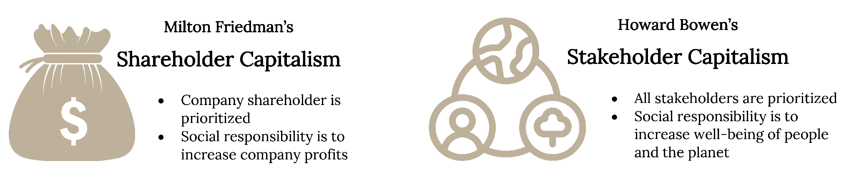
Shareholder versus stakeholder capitalism
Figure 2.3: Shareholder versus stakeholder capitalism. Kindred Grey. 2023. CC BY 4.0. Includes Money Bag by leo-graph.com from Noun Project (Noun Project license) and Csr by Hilmy Abiyyu Asad from Noun Project (Noun Project license).
Notes:
The text box above the slide is for accessibility purposes. If you edit this PPT, please leave it there. It doesn’t show up in preview mode.

Slide 10
2.5 The Interdependence of Sustainable Property Management Spheres
Systems theory

Slide 11
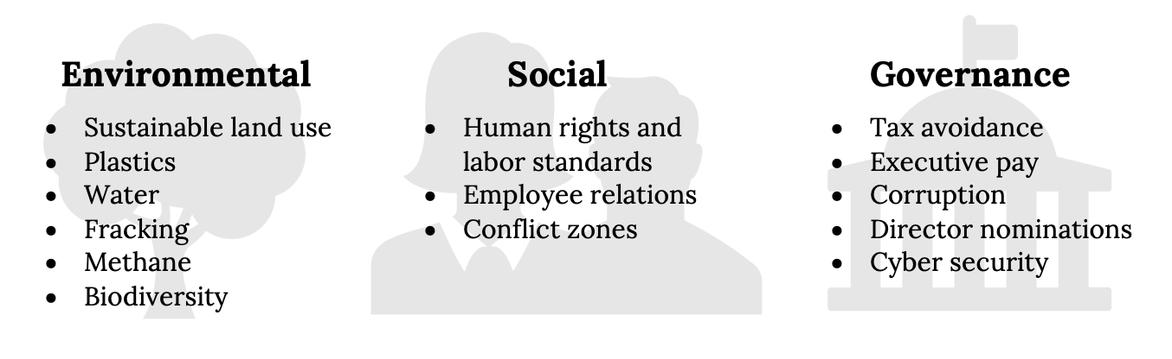
2.6 A Broader and Measurable Perspective - ESG Reporting
Figure 2.4: A sampling of key ESG issues. Kindred Grey. 2023. CC BY 4.0. Adapted from https://www.unpri.org/sustainability-issues/environmental-social-and-governance-issues. Includes Government by Adrien Coquet from Noun Project (Noun Project license), group by Gregor Cresnar from Noun Project (Noun Project license), and Tree by Guilherme Furtado from Noun Project (Noun Project license).

Slide 12
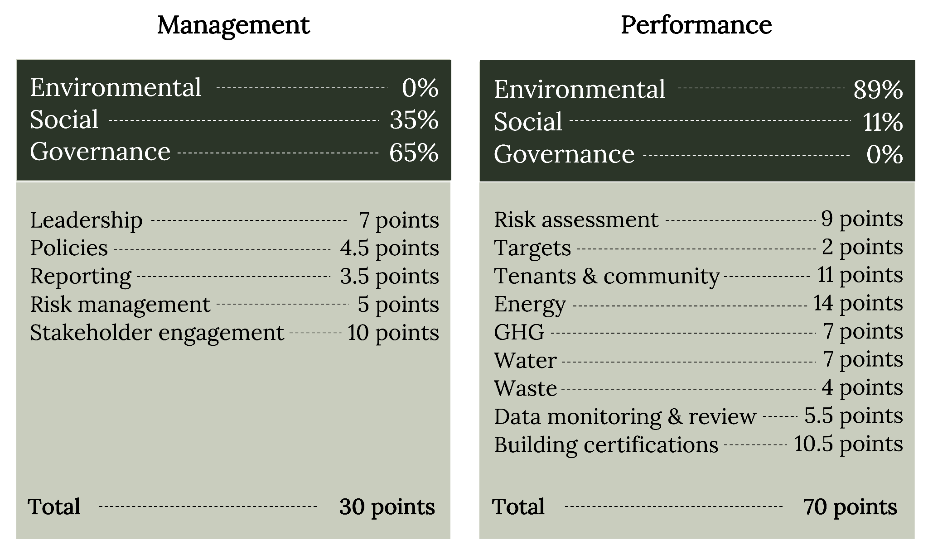
GRESB ESG Components and Associated Aspects for Building Operators
Figure 2.6: GRESB ESG components and associated aspects for building operators. Kindred Grey. 2023. CC BY 4.0. Data from GRESB Real Estate Assessment Reference Guide, 2021 (https://documents.gresb.com/generated_files/real_estate/2021/real_estate/reference_guide/complete.html).

Slide 13
2.7 Conclusion
Sustainable property management is a critical component of:
Modern environmental progress
The health and well-being of society
Corporate profitability
The importance of the decisions of property managers in sustainable building operations cannot be overstated
ESG reporting fosters inclusion of environmental, social, and economic spheres and provides a broader perspective

