Slide 1

Open Textbooks and Beyond
Access, Affordability, and Academic Success
Anita Walz
Assessment, Open Education & Online Learning Environments Librarian
University Libraries, Virginia Tech
arwalz@vt.edu Newman Library #207B @arwalz
April 8, 2015

Slide 2
“…higher education shall be
equally accessible to all…”
-United Nations Universal Declaration of
Human Rights

Slide 3
The cost barrier kept
2.4 million
low and moderate-income college-qualified high school graduates from completing college in the previous decade.
The Advisory Committee on Student Financial Assistance http://files.eric.ed.gov/fulltext/ED529499.pdf

Slide 4
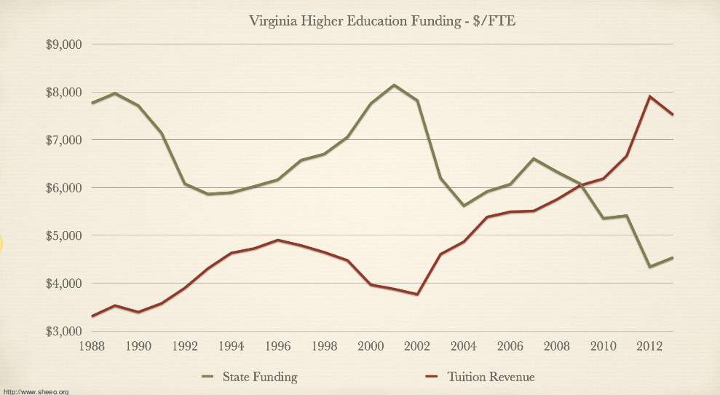

Slide 5
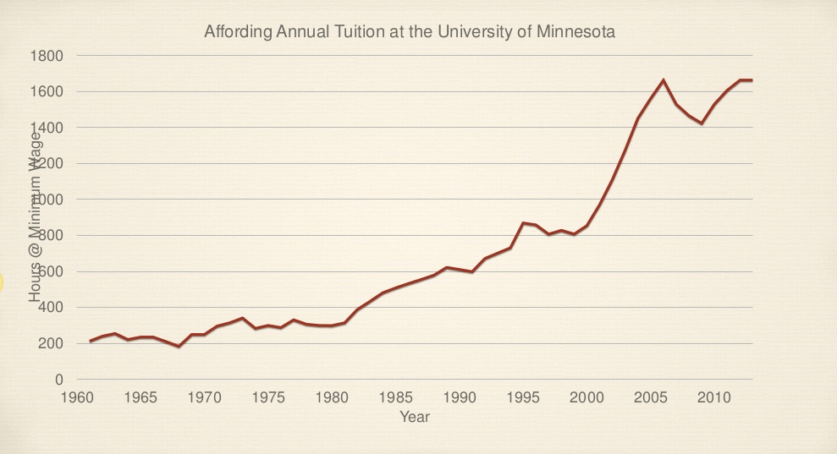
© Dave Ernst CC BY http://www.slideshare.net/djernst/virginia-tech-master-sans-video

Slide 6
© Dave Ernst CC BY http://www.slideshare.net/djernst/virginia-tech-master-sans-video

Slide 7
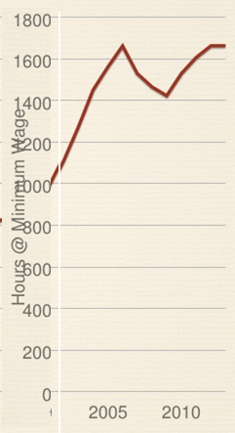
# work hours at minimum wage (2004-2014)
VT Tuition + fees (annual)
UMN Tuition (annual)
© Dave Ernst CC BY http://www.slideshare.net/djernst/virginia-tech-master-sans-video

Slide 8
The average borrower owes more than
$29,400
in student loans (class of 2012)
Institute for College Access and Success http://projectonstudentdebt.org/files/pub/Student_Debt_the_Class_of_2012_NR.pdf

Slide 9
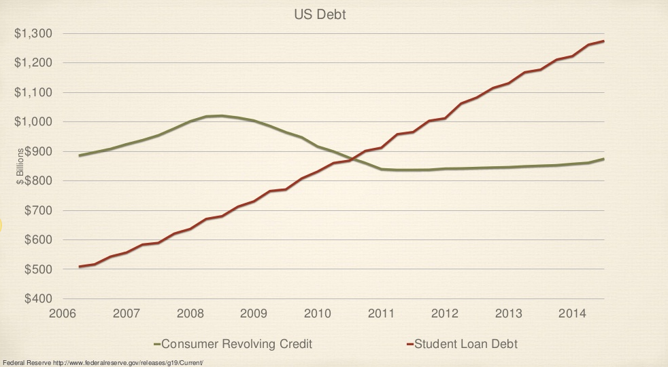
© Dave Ernst CC BY http://www.slideshare.net/djernst/virginia-tech-master-sans-video

Slide 10
What can we do?
Tuition and Fees
Room and Board
Books and Supplies
Personal Expenses
Transportation
© Dave Ernst CC BY http://www.slideshare.net/djernst/virginia-tech-master-sans-video

Slide 11
What can we do?
Tuition and Fees
Room and Board
Books and Supplies
Personal Expenses
Transportation
© Dave Ernst CC BY http://www.slideshare.net/djernst/virginia-tech-master-sans-video

Slide 12
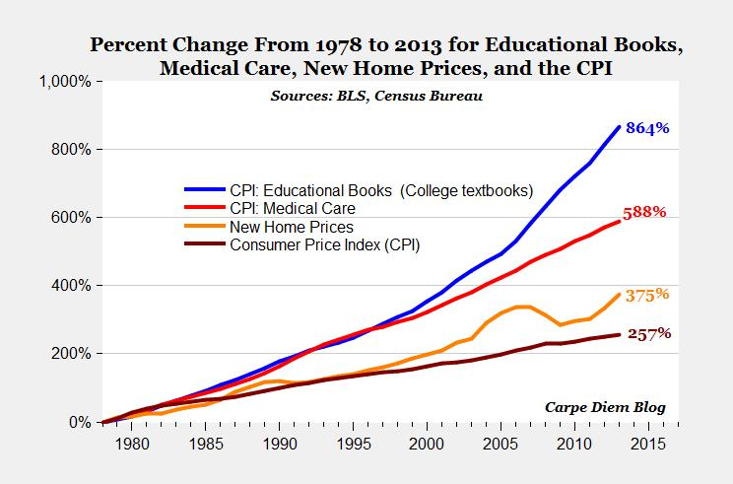
Increase in Textbook Prices
© 2014, Mark Perry, Scholar at American Enterprise Institute for Public Policy Research. All Rights Reserved. Used with permission. https://twitter.com/Mark_J_Perry/status/459395162032988160/photo/1
http://www.aei-ideas.org/2012/12/the-college-textbook-bubble-and-how-the-open-educational-resources-movement-is-going-up-against-the-textbook-cartel

Slide 13
The average student can expect to pay
$1,200
on textbook and course materials in 2014-15.
Virginia Tech = $1,130 (2014-15)
$1,280 for VetMed
https://bigfuture.collegeboard.org/pay-for-college/college-costs/quick-guide-college-costs
http://www.finaid.vt.edu/coa/cost-of-attendance14-15.html
© Dave Ernst CC BY http://www.slideshare.net/djernst/virginia-tech-master-sans-video

Slide 14
What are VT Students spending?
Notes:
https://twitter.com/AAffairs_VTSGA

Slide 15
Academic Impact
Purchase an older edition of the textbook
“I figured that French hadn’t changed that much”
Delay purchasing the textbook
Never purchase the textbook
© Dave Ernst CC BY http://www.slideshare.net/djernst/virginia-tech-master-sans-video

Slide 16
59%
of students report that they have had to wait
for their financial aid check to purchase textbooks.
© Dave Ernst CC BY http://www.slideshare.net/djernst/virginia-tech-master-sans-video
Unpublished Minnesota State University Student Association survey

Slide 17
7/10
students surveyed hadn’t bought a required textbook due to cost.
http://www.slideshare/net/txtbks/open-education-and-solving-the-textbook-cost-crisis

Slide 18
In your academic career, has the cost of
required textbooks caused you to:
63.6% Not purchase the required textbook
49.2% Take fewer courses
45.1% Not register for a specific course
33.9% Earn a poor grade
26.7% Drop a course
17.0% Fail a course
http://www.openaccesstextbooks.org/pdf/2012_Florida_Student_Textbook_Survey.pdf

Slide 19
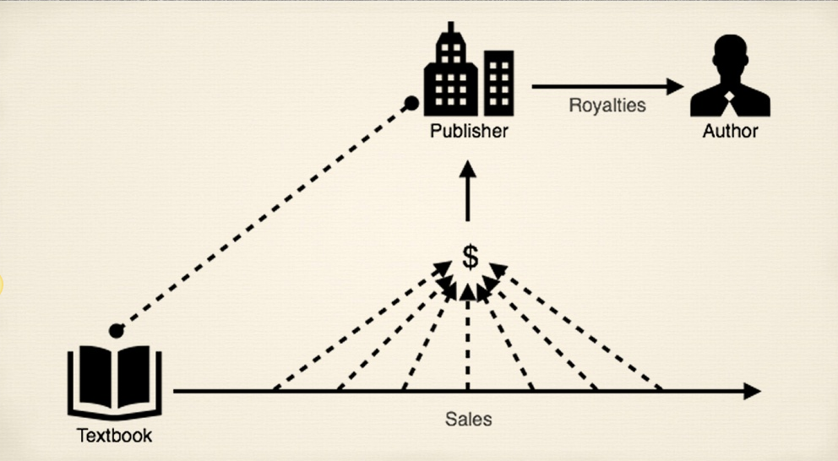
Current model
© Dave Ernst CC BY http://www.slideshare.net/djernst/virginia-tech-master-sans-video

Slide 20
How can we improve on this?

Slide 21
What if publishers and authors were funded
to give works away freely?

Slide 22
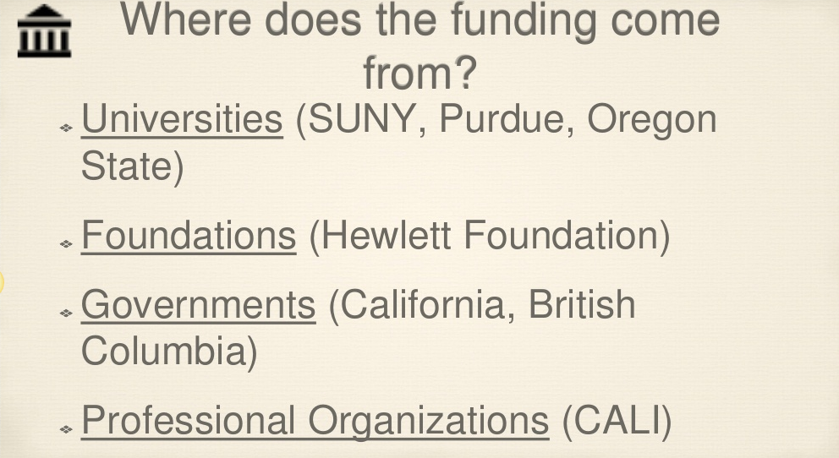
© Dave Ernst CC BY http://www.slideshare.net/djernst/virginia-tech-master-sans-video

Slide 23
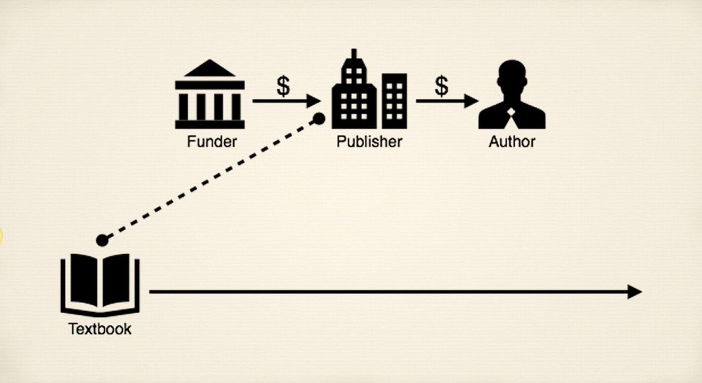
© Dave Ernst CC BY http://www.slideshare.net/djernst/virginia-tech-master-sans-video

Slide 24
©

Slide 25


Slide 26

©
All Rights Some Rights
Reserved Reserved

Slide 27
With Creative Commons licenses,
you are free to:
Copy Mix
Share Keep
Edit Use

Slide 28
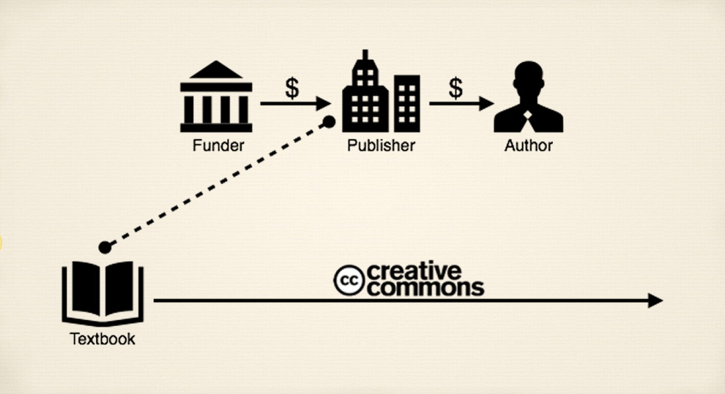
© Dave Ernst CC BY http://www.slideshare.net/djernst/virginia-tech-master-sans-video

Slide 29
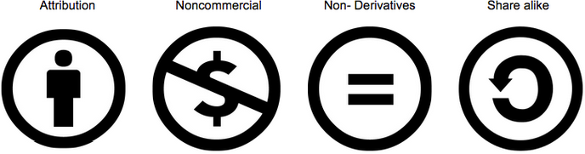

Slide 30


Slide 31
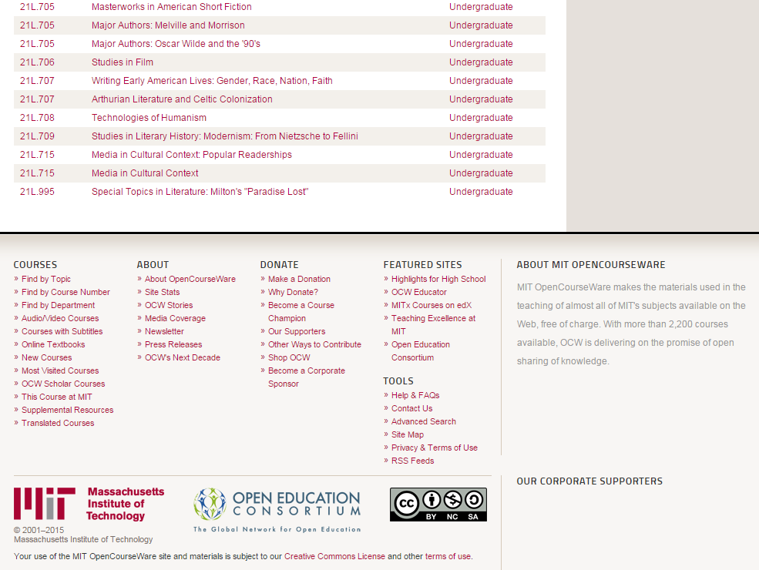
http://ocw.mit.edu/courses/literature

Slide 32


Slide 33
Many options

Slide 34
Open Textbooks
Openly licensed everything else
(video, images, games, simulations)
Public domain works
(U.S. works published pre-1923) https://copyright.cornell.edu/resources/publicdomain.cfm

Slide 35
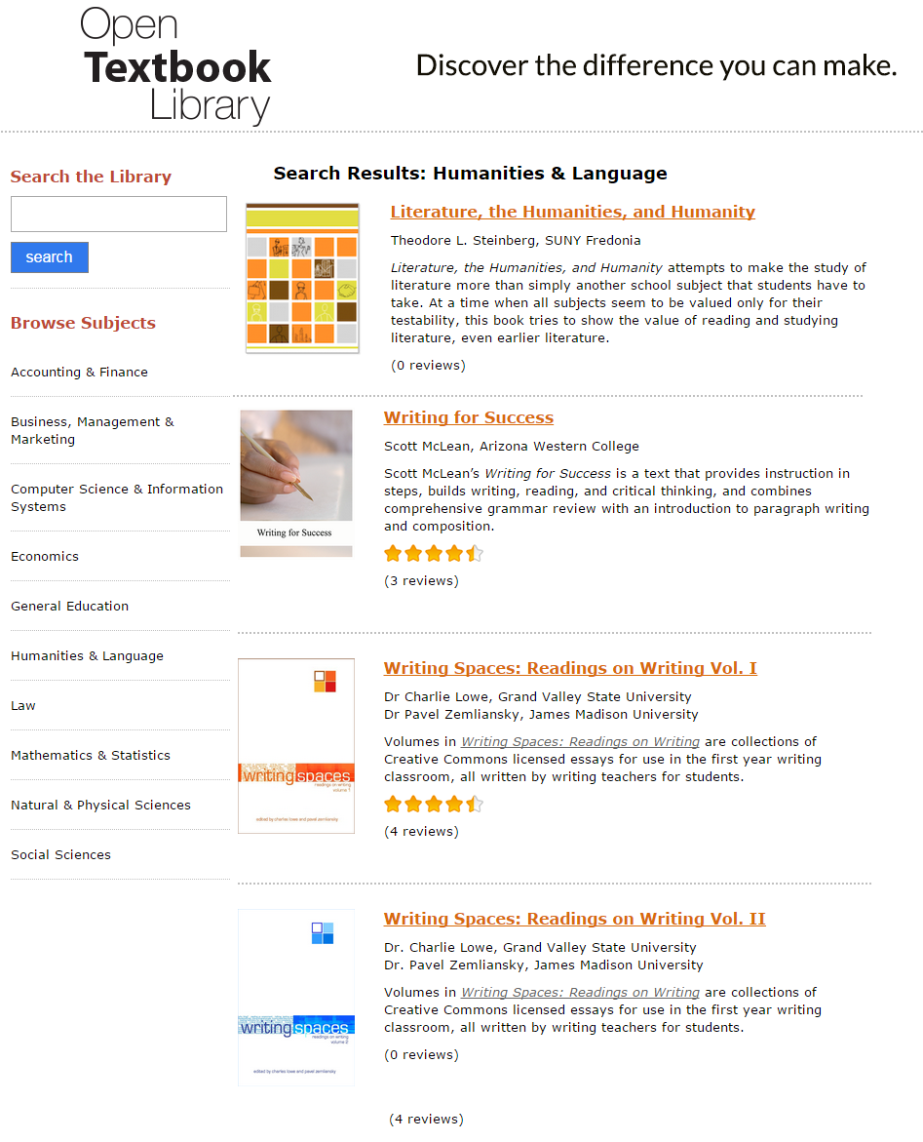

Slide 36
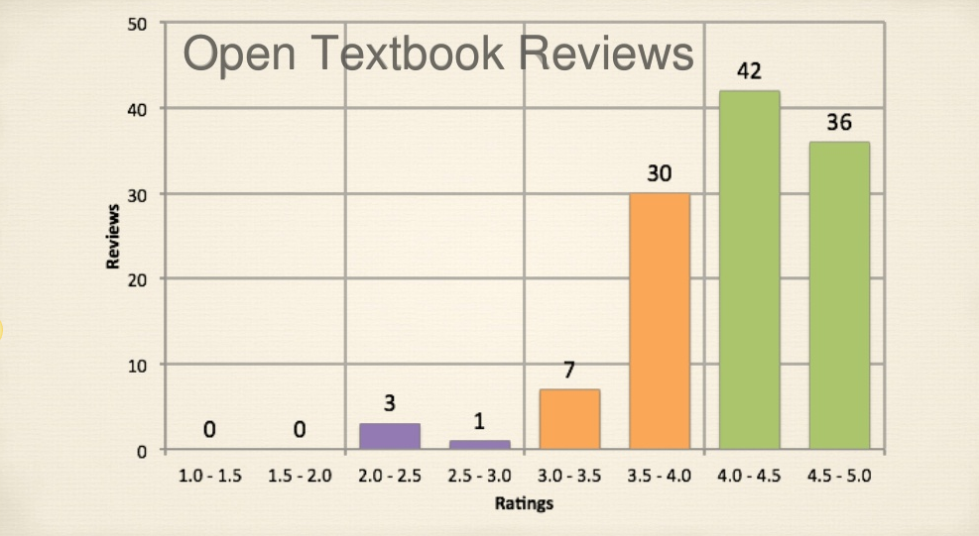
© Dave Ernst CC BY http://www.slideshare.net/djernst/virginia-tech-master-sans-video

Slide 37
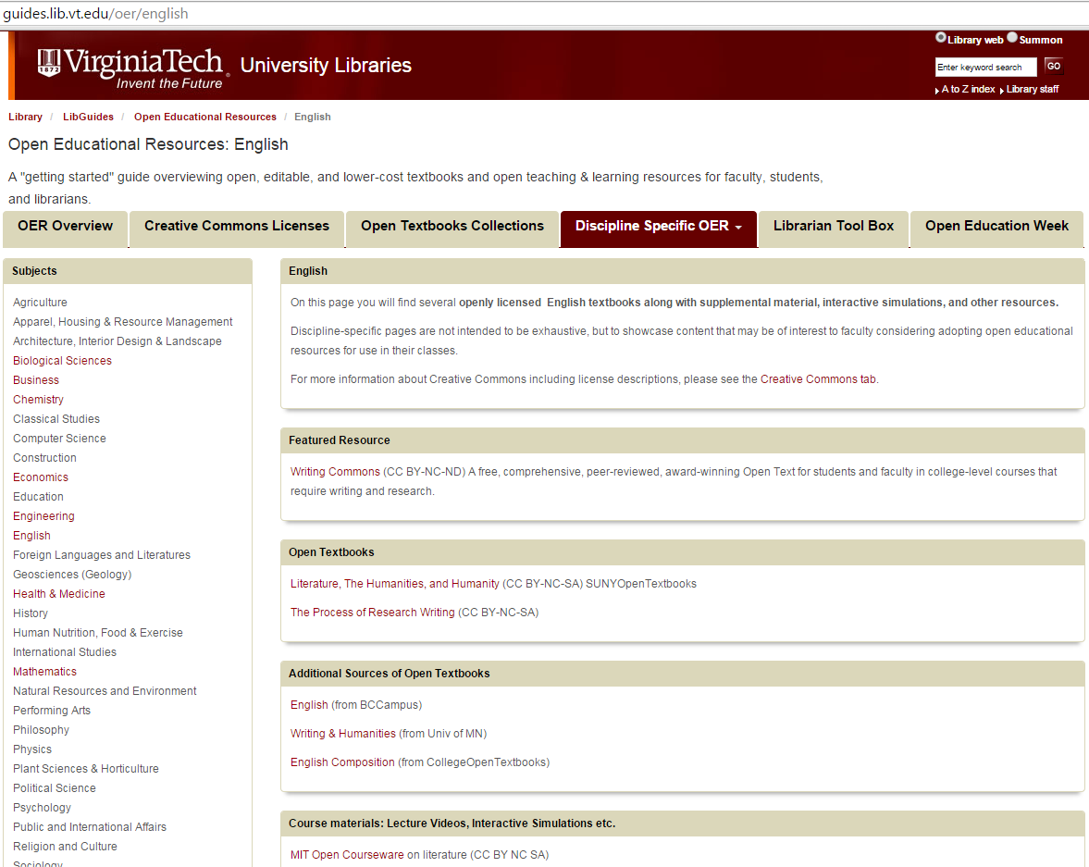
Notes:
Public domain and openly licensed “everything else” http://ocw.mit.edu/courses/literature

Slide 38
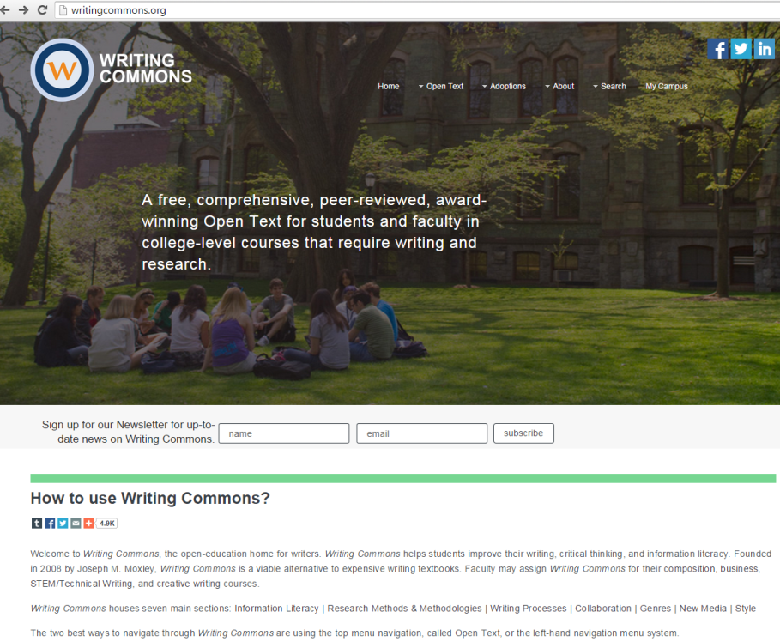
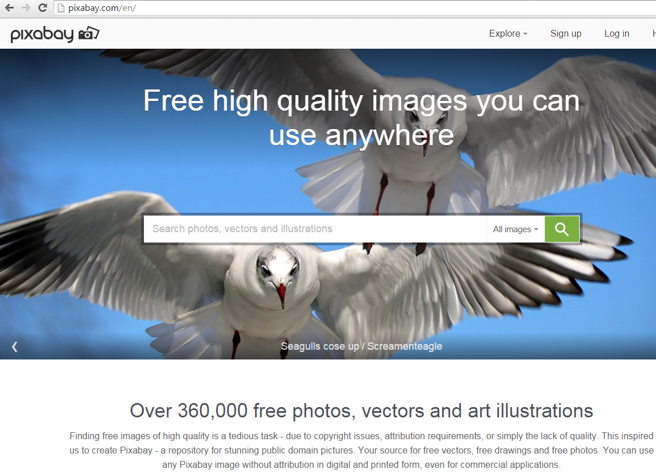
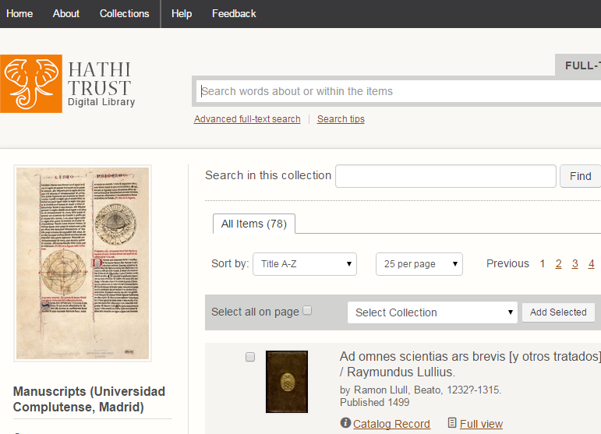
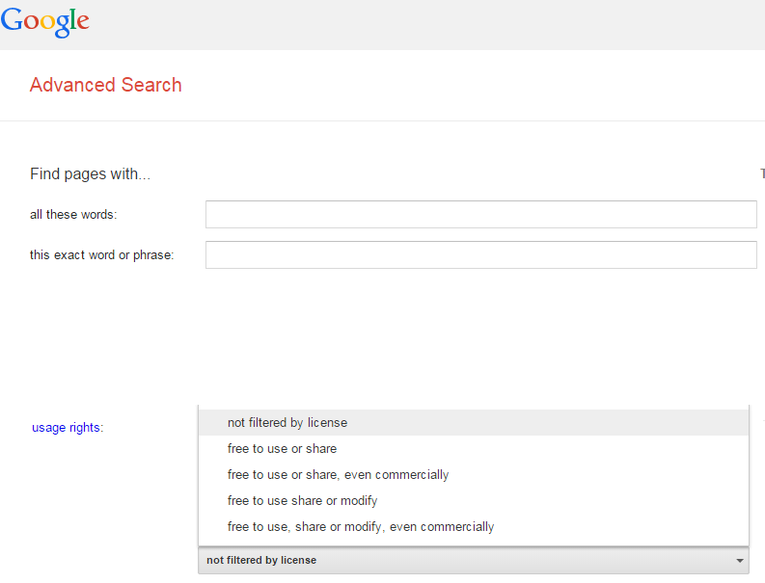
Merlot.org
OERCommons.org

Slide 39
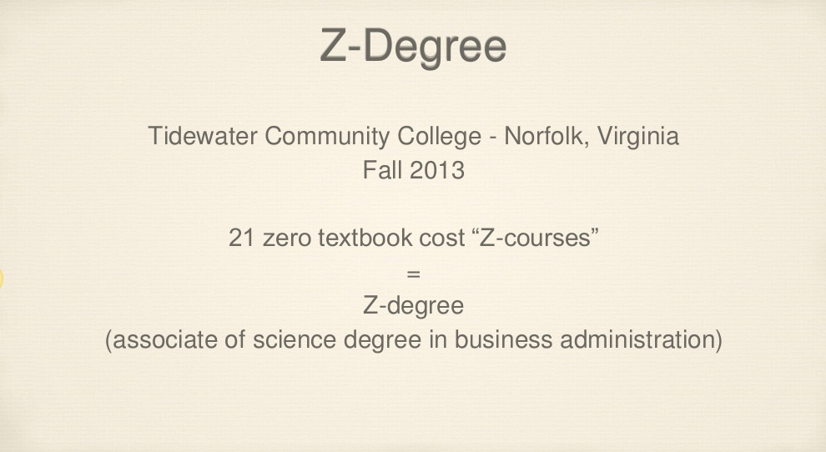
© Dave Ernst CC BY http://www.slideshare.net/djernst/virginia-tech-master-sans-video

Slide 40
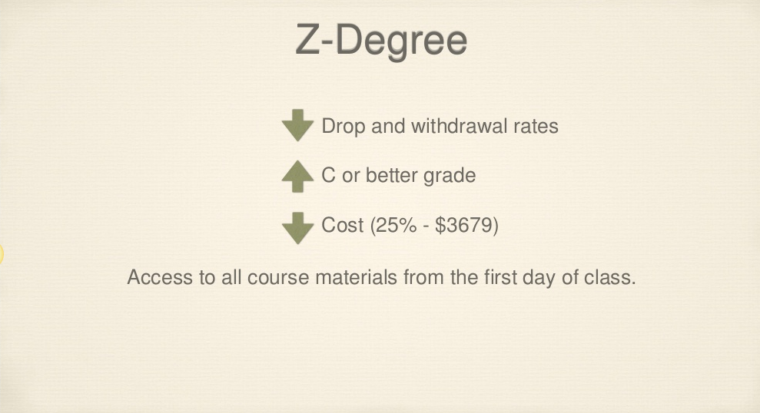
© Dave Ernst CC BY http://www.slideshare.net/djernst/virginia-tech-master-sans-video

Slide 41
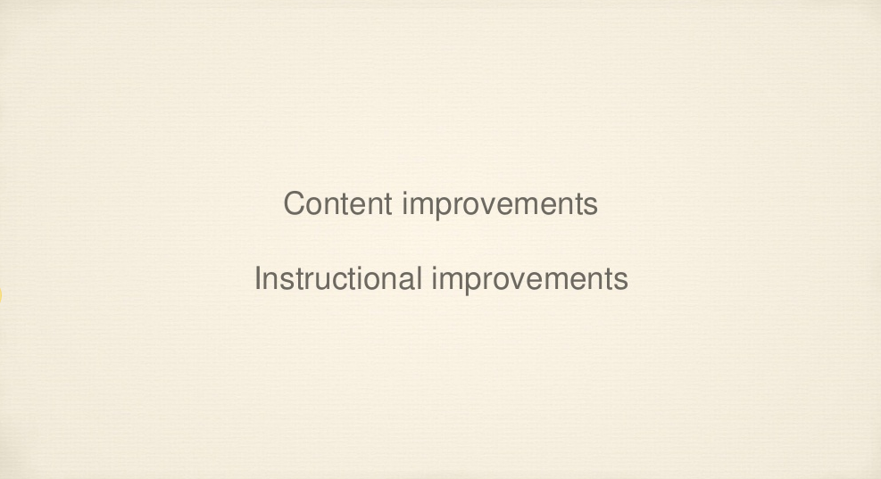
© Dave Ernst CC BY http://www.slideshare.net/djernst/virginia-tech-master-sans-video

Slide 42
Library-subscribed resources (point to)
Copyrighted works freely accessible online – but not openly licensed (point to)
Works used under copyright exemptions or Fair Use
Works you have authored and shared via VTechWorks

Slide 43
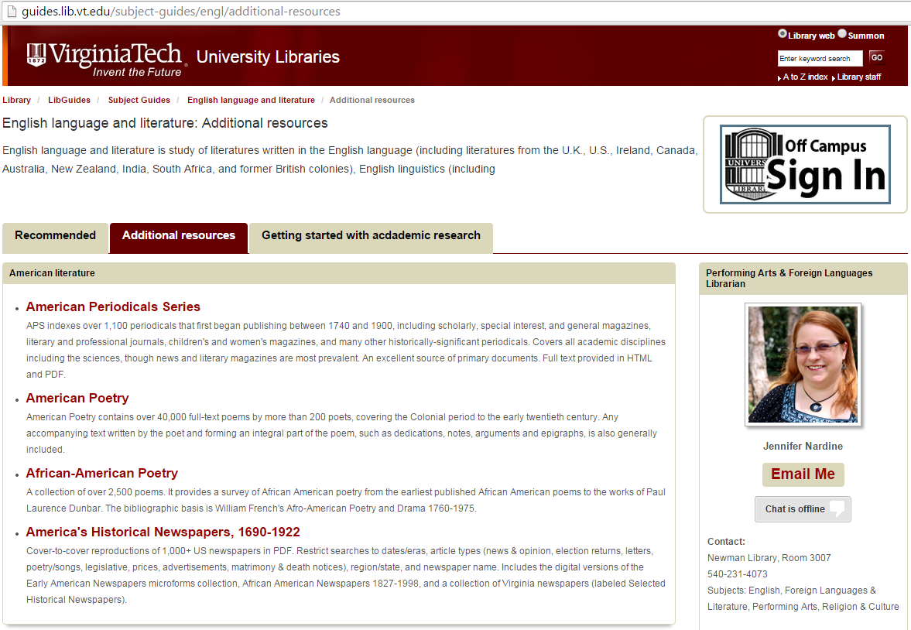
Guidance on creating persistent links for off campus users: http://www.lib.vt.edu/help/scholar/persistentlinks.html

Slide 44



Slide 45
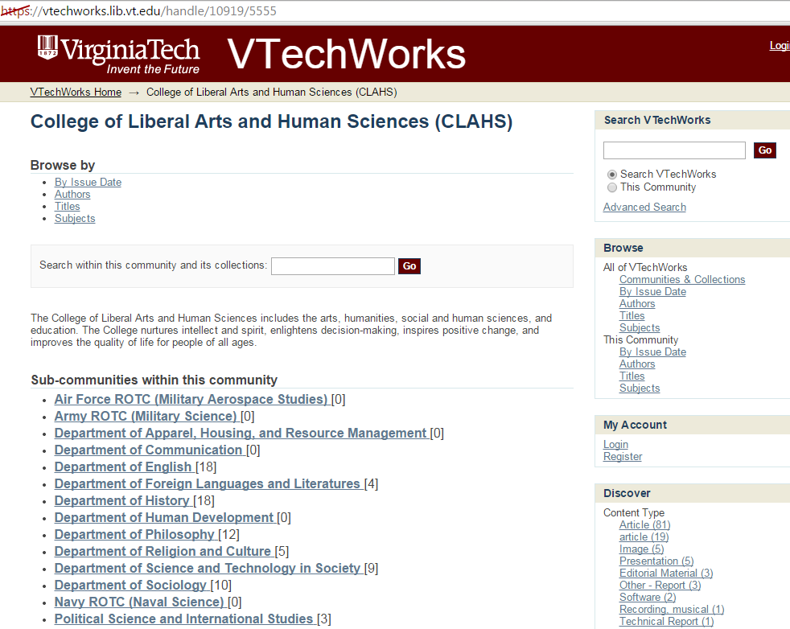

Slide 46

Linking
+ Library-subscribed resources (via persistent links)

Slide 47
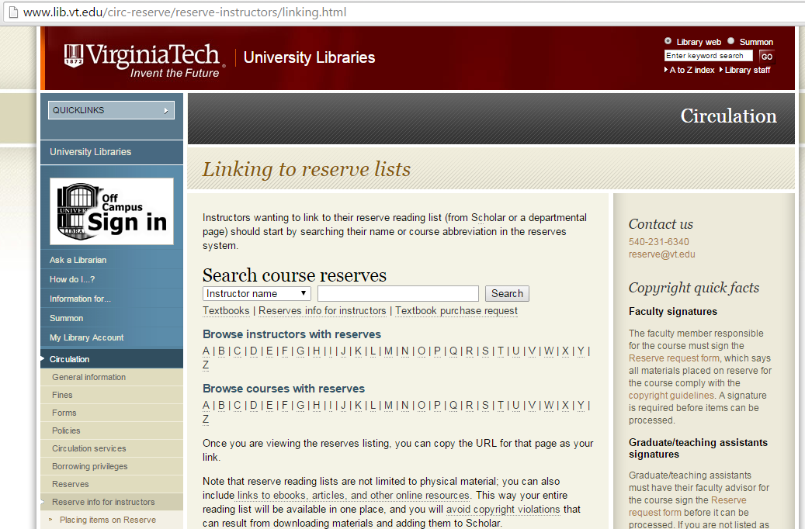
Course Reserves (reserve@vt.edu)
- Textbooks
- Other materials

Slide 48
X
In your academic career, has the cost of
required textbooks caused you to:
63.6% Not purchase the required textbook
49.2% Take fewer courses
45.1% Not register for a specific course
33.9% Earn a poor grade
26.7% Drop a course
17.0% Fail a course
http://www.openaccesstextbooks.org/pdf/2012_Florida_Student_Textbook_Survey.pdf

Slide 49
What can we do?
Take a look! Is there a book for you?
Write a review of an open textbook from http://open.umn.edu/opentextbooks ! ($200 stipend)
Adopt a book if it meets the needs of you and your students
Raise awareness – talk with colleagues in your program and department

Slide 50
Additional opportunities
Need help finding something, or need instructional design assistance?
  Libraries can help! (Or we will connect you to someone who can)
Interested in publishing?
  Explore library publishing with us!
  Understand author rights before signing agreements – ask a librarian!
Want to share?
- Contribute your work to VTechWorks, Merlot, OER Commons
Want more information?
- Inside Higher Ed Webinar 4/28 2pm
- Explore the OER LibGuide guides.lib.vt.edu/oer
- Follow “Open@VT” blog blogs.lt.vt.edu/openvt
- Join the OpenVT email listserv (events & grants)
- Contact Anita at arwalz@vt.edu
Notes:
http://go.pardot.com/webmail/27982/928210437/8da762fad53f73981777d9383084ac87

Slide 51
Thanks for your time!
Anita Walz, University Libraries
arwalz@vt.edu

